Slide 1

Testing 101
Setting up and automating your test environment
Jim Priest
University of North Carolina
Office of Research Information Systems
August 18, 2011

Slide 2

Introduction
What Is Testing? (from Wikipedia)
Software testing can be stated as the process of validating
and verifying that a software program/application/product:
Meets the requirements that guided its design and development;
Works as expected; and
Can be implemented with the same characteristics
Selenium - Jim Priest

Slide 3
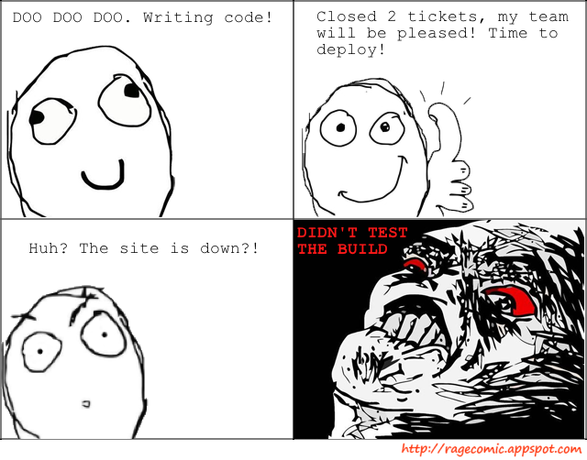
Why Test?
Selenium - Jim Priest

Slide 4

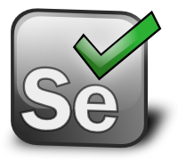

Our Agenda
What Are We Going To Cover?.
MXUnit
Selenium
Jenkins
MXUnit is a proven and robust test framework and Eclipse plugin used by the some of the best ColdFusion developers around the world.
Selenium automates browsers. That's it.
An extendable open source continuous integration server.
Selenium - Jim Priest

Slide 5
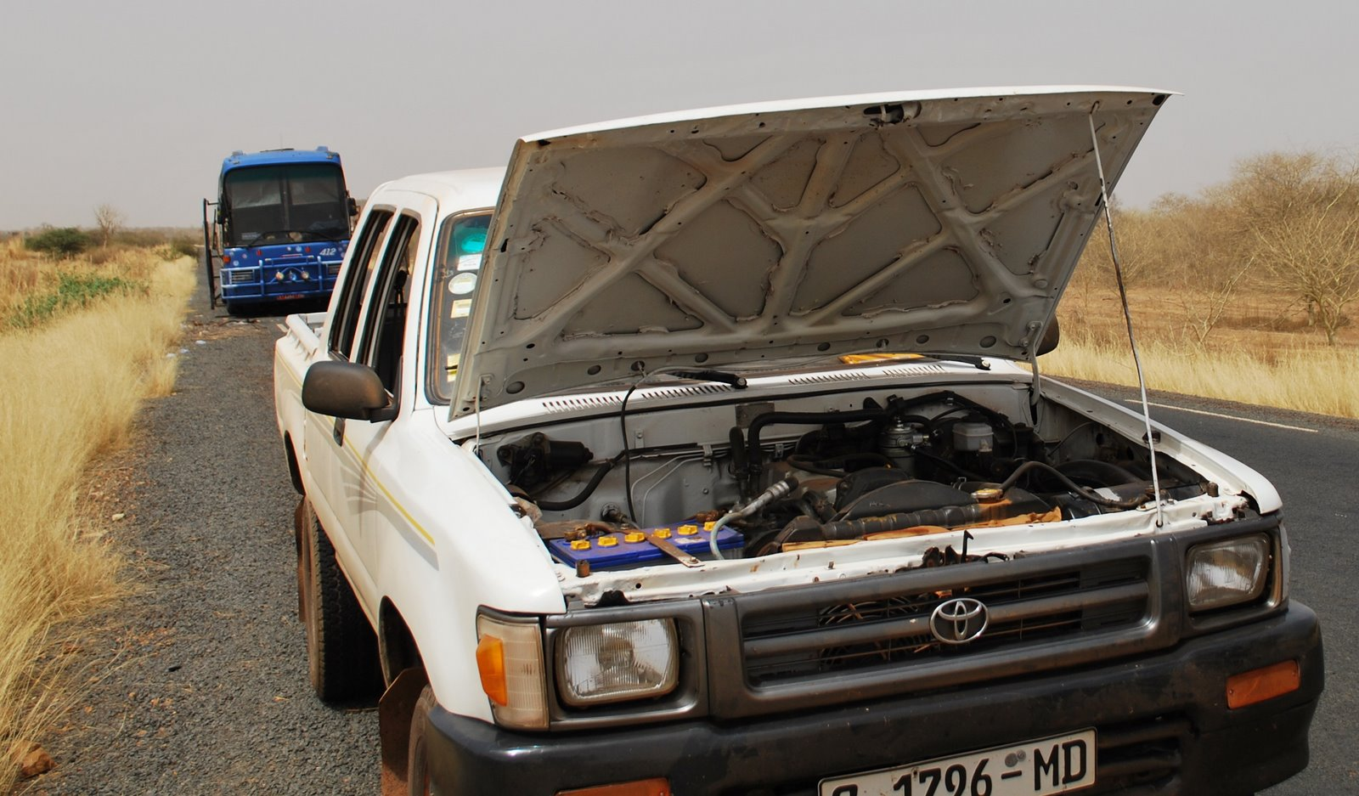
What To Test
Selenium - Jim Priest

Slide 6
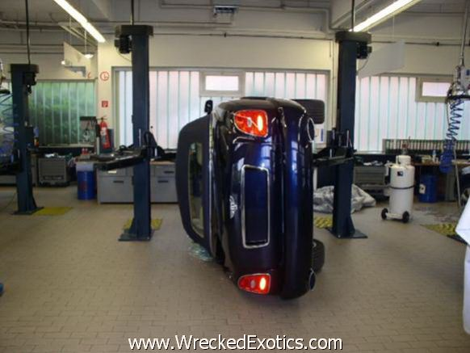
What To Test
Selenium - Jim Priest

Slide 7

MXUnit
Selenium - Jim Priest

Slide 8
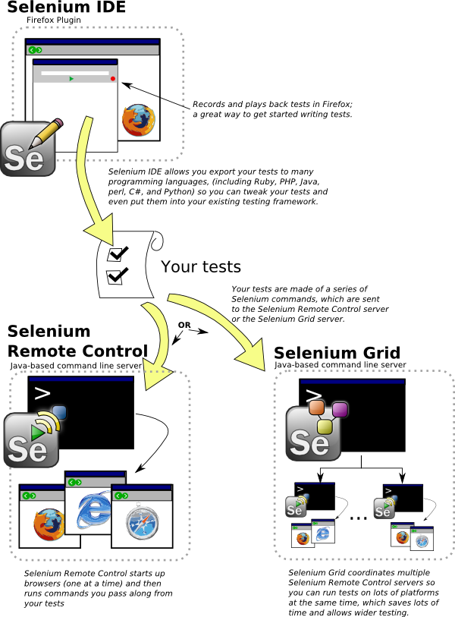
Selenium
Selenium - Jim Priest

Slide 9


Jenkins
Selenium - Jim Priest

Slide 10
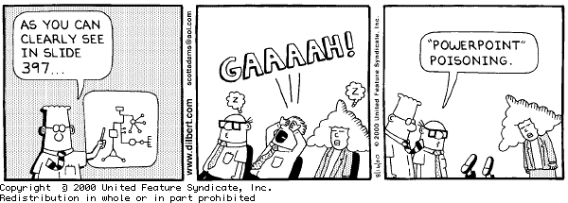
Examples
Powerpoint sucks
Let’s look at some examples!!!!
Selenium - Jim Priest

Slide 11
Resources
MXUnit - http://mxunit.org/
Selenium - http://seleniumhq.org/
Jenkins - http://jenkins-ci.org
CFSelenium
  Download- https://github.com/bobsilverberg/CFSelenium
  Blog - http://www.silverwareconsulting.com/index.cfm/CFSelenium
Selenium - Jim Priest

Slide 12
The End
Questions?
Selenium - Jim Priest

