Slide 1

Testing 101
Setting up and automating your test environment
Jim Priest

Slide 2

Introduction
What Is Testing? (from Wikipedia)
Software testing can be stated as the process of validating
and verifying that a software program/application/product:
Meets the requirements that guided its design and development;
Works as expected; and
Can be implemented with the same characteristics
Selenium - Jim Priest

Slide 3
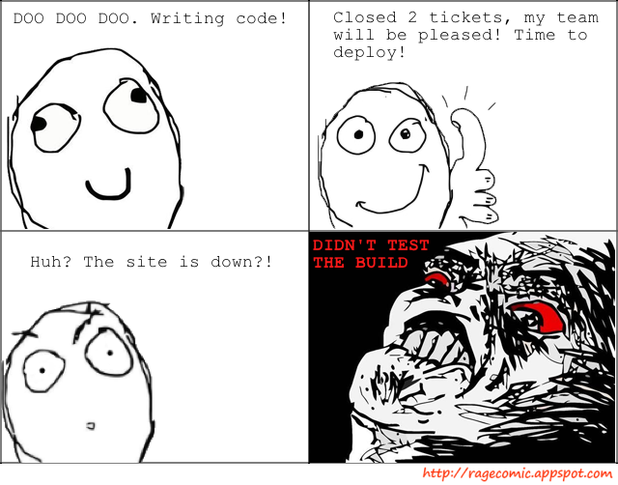
Why Test?
Selenium - Jim Priest

Slide 4
Goal
“Imperfect tests run frequently are better than perfects tests that are never run.”
-Kent Beck
Test Driven Development By Example
-Martin Fowler
Continuous Integration
Selenium - Jim Priest
Notes:
Not looking for 100% code coverage. Just want to start writing tests!!

Slide 5
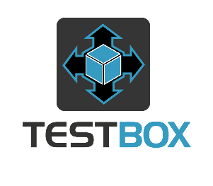
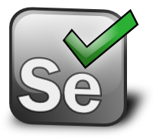

Our Agenda
What Are We Going To Cover?.
TestBox
Selenium
Jenkins
TestBox is a next generation testing framework for ColdFusion (CFML).
Selenium automates browsers. That's it.
An extendable open source continuous integration server.
Selenium - Jim Priest

Slide 6
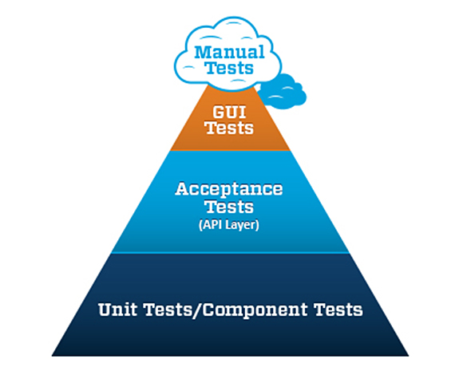
Test Pyramid
Selenium - Jim Priest
Notes:
Much easier to write tests either BEFORE code or during.
More difficult to write afterwards

Slide 7
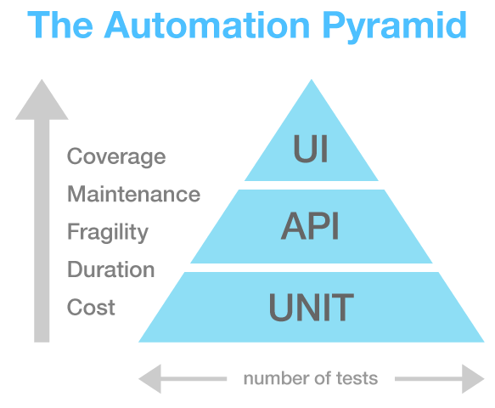
Test Pyramid
Selenium - Jim Priest
Notes:
Much easier to write tests either BEFORE code or during.
More difficult to write afterwards

Slide 8
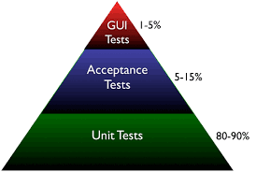
Test Pyramid
Selenium - Jim Priest
Notes:
Much easier to write tests either BEFORE code or during.
More difficult to write afterwards

Slide 9
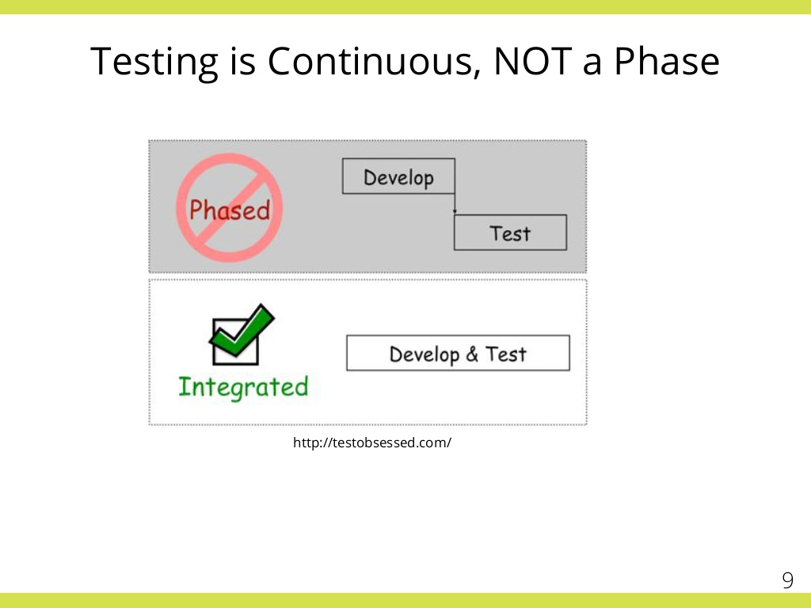
When To Test
Selenium - Jim Priest
Notes:
Much easier to write tests either BEFORE code or during.
More difficult to write afterwards

Slide 10
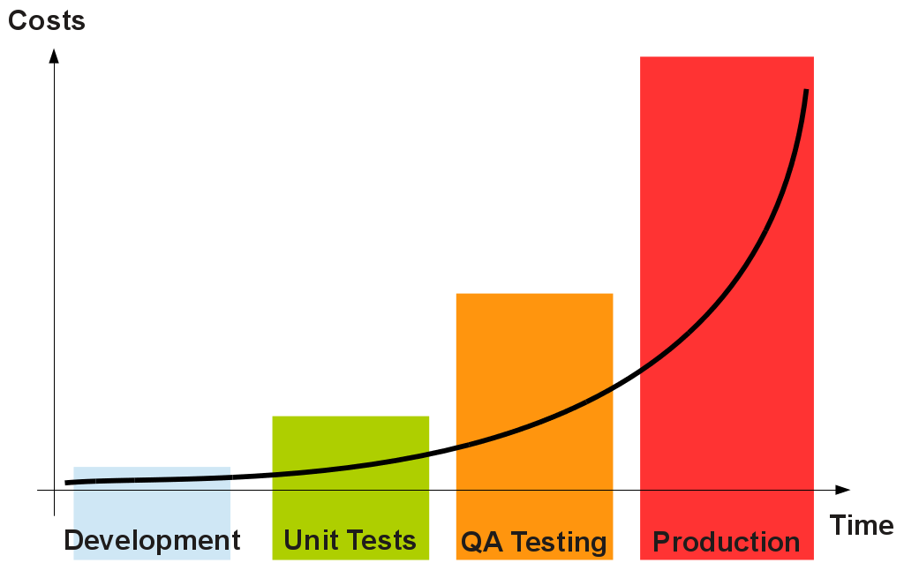
Regression Testing
Fix bugs as soon as they are found. Write a test for every bug so it is not reproduced later.
The sooner you find a defect the cheaper it is to fix.
Selenium - Jim Priest
Notes:
Much easier to write tests either BEFORE code or during.
More difficult to write afterwards

Slide 11
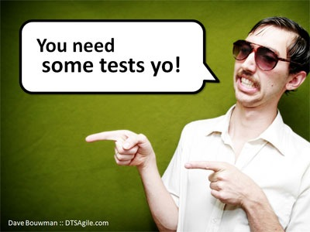
TestBox
Selenium - Jim Priest

Slide 12
Unit Tests
Testable code is usually better code
  Methods get smaller and do less work
  Less spaghetti coding – harder-to-test chunks get pulled into separate methods for easier “mocking” in tests (“extract method” pattern will demonstrate this)
  Code becomes more reusable as you genericize
Unit testing is not meant to test external dependencies; e.g., database connections, email servers, file systems, etc.. Unit tests are frequently done in isolation
Unit testing is not a silver bullet and will not find all bugs
As you get better at thinking about testability, you will become a better programmer
Selenium - Jim Priest
Notes:
Much easier to write tests either BEFORE code or during.
More difficult to write afterwards

Slide 13
Unit Tests
Warning Signs
Be wary of long methods. Can you extract them into smaller ones?
  Smaller, single-responsibility methods can be spoofed in a test!
Get familiar with cf_querysim for query spoofing.
If you find yourself writing code that touches a file system, sends emails, depends on system time, etc, Abstract it!
Selenium - Jim Priest
Notes:
Much easier to write tests either BEFORE code or during.
More difficult to write afterwards

Slide 14


Unit Tests
Behaviour Verification
Two schools of thought
  State verification
    Ask object to return data
    This data aggregation is the object’s state
  Behavior verification
    Ask object to perform a task
    We are not concerned with state – we trust the object will do as we tell it
Selenium - Jim Priest
Notes:
Much easier to write tests either BEFORE code or during.
More difficult to write afterwards

Slide 15
Unit Tests
Database
Transaction rollback
Sample data (insert)
Mock objects (query sim)
Selenium - Jim Priest
Notes:
Much easier to write tests either BEFORE code or during.
More difficult to write afterwards

Slide 16
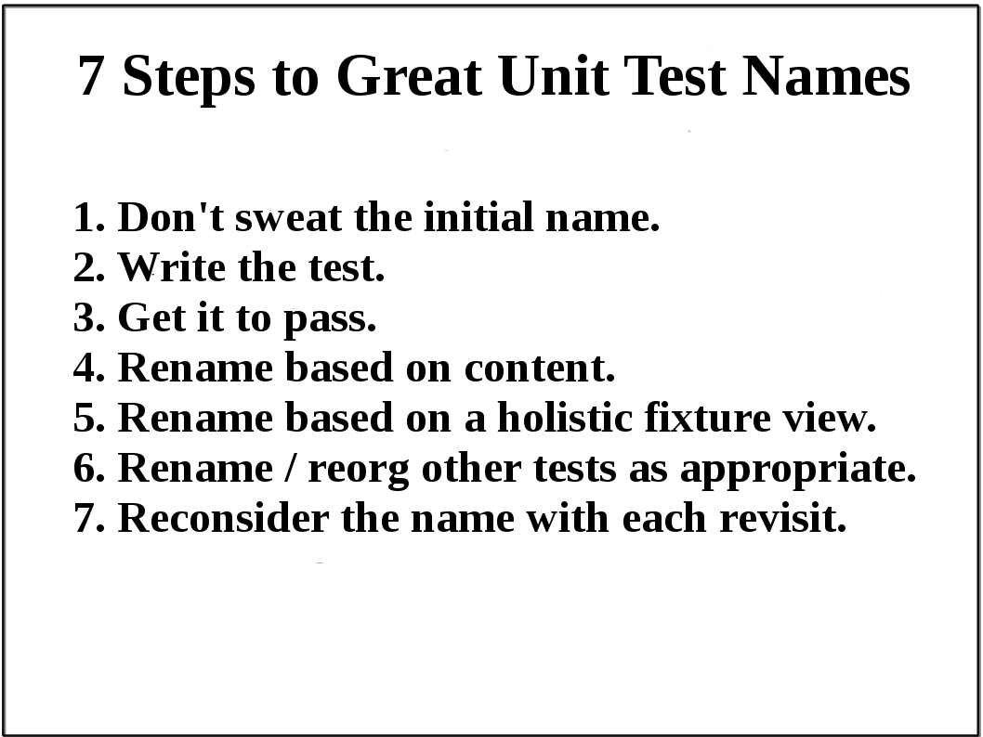
Unit Tests
Selenium - Jim Priest
Notes:
Much easier to write tests either BEFORE code or during.
More difficult to write afterwards

Slide 17
Assertions
Usually one assertion per test.
Once there is a failure the test ends.
TestBox provides a lot of built in assertions and you can write your own: http://wiki.coldbox.org/wiki/TestBox-Unit-Primer.cfm#Assertions
Selenium - Jim Priest
Notes:
Much easier to write tests either BEFORE code or during.
More difficult to write afterwards

Slide 18
KISS
Mocking
Stubs
TDD / BDD
Private methods
Asynchronous Testing
Selenium - Jim Priest
Notes:
Much easier to write tests either BEFORE code or during.
More difficult to write afterwards

Slide 19
Test Pyramid
Selenium - Jim Priest
Notes:
Much easier to write tests either BEFORE code or during.
More difficult to write afterwards

Slide 20
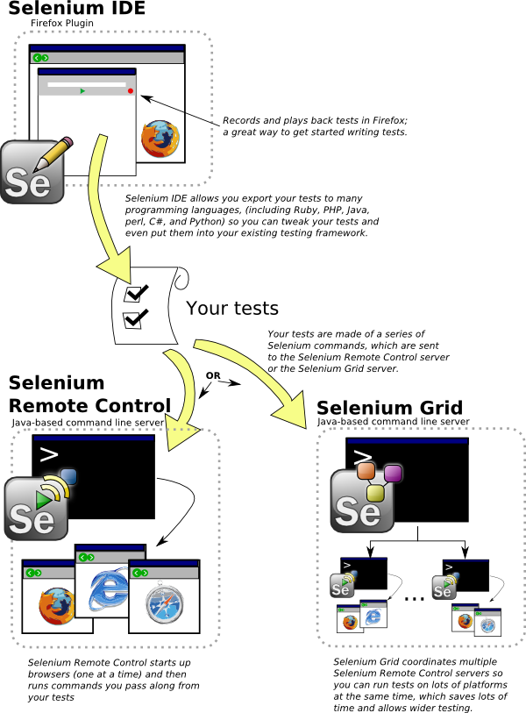
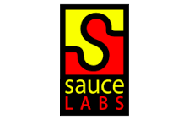
Selenium
Selenium - Jim Priest

Slide 21
Selenium
Testing expected content
Test Links
Functions (login, form submission)
Test dynamic elements (show / hide)
Finding stuff:
Using an element ID or name locator is the most efficient in terms of test performance, and also makes your test code more readable, assuming the ID or name within the page source is well-named.
Selenium - Jim Priest

Slide 22
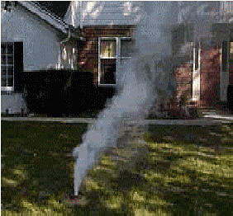
Smoke Tests
Selenium - Jim Priest
Notes:
Much easier to write tests either BEFORE code or during.
More difficult to write afterwards

Slide 23
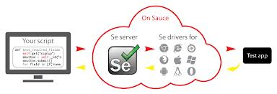
Selenium
Google Chrome
Internet Explorer 6, 7, 8, 9, 10
Firefox
Safari
Opera
HtmlUnit
Phantomjs (headless = fast)
Android (with Selendroid or appium)
iOS (with ios-driver or appium)
Selenium - Jim Priest

Slide 24
Selenium
Selenium IDE (Leanne)
>>
WebDriver (Developer / Python)
>>
Jenkins
Selenium - Jim Priest

Slide 25
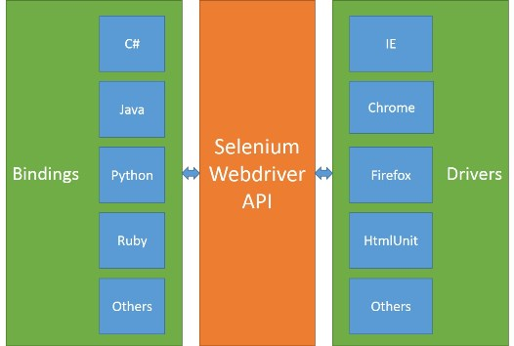
Selenium
Selenium - Jim Priest

Slide 26
KISS
Page Object
Data Driven Testing
Grid
Selenium - Jim Priest

Slide 27
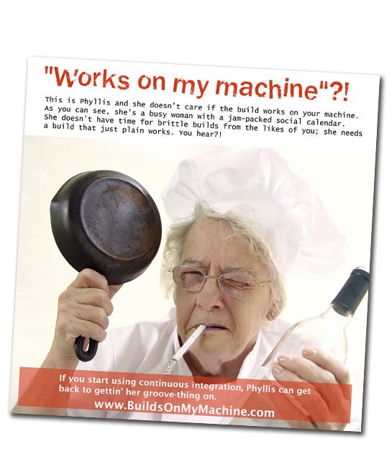
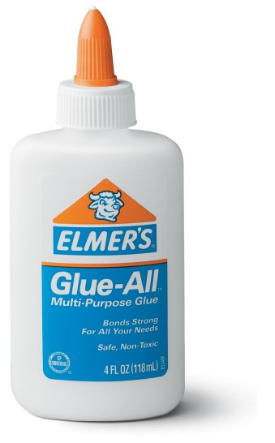
Jenkins
Selenium - Jim Priest

Slide 28
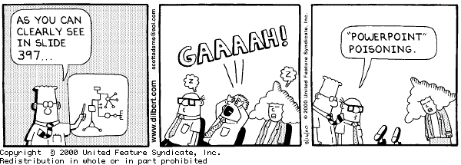
Examples
Code
Selenium - Jim Priest

Slide 29
The End
Questions?
Selenium - Jim Priest

Slide 30
Resources
TestBox - http://wiki.coldbox.org/wiki/TestBox.cfm
Selenium - http://seleniumhq.org/
Jenkins - http://jenkins-ci.org
Resources
http://www.slideshare.net/RajIndugula/agile-testing-practices-38015016
http://wiki.mxunit.org/display/default/Presentations%2C+Talks%2C+and+Meetups
Selenium - Jim Priest

