Slide 1

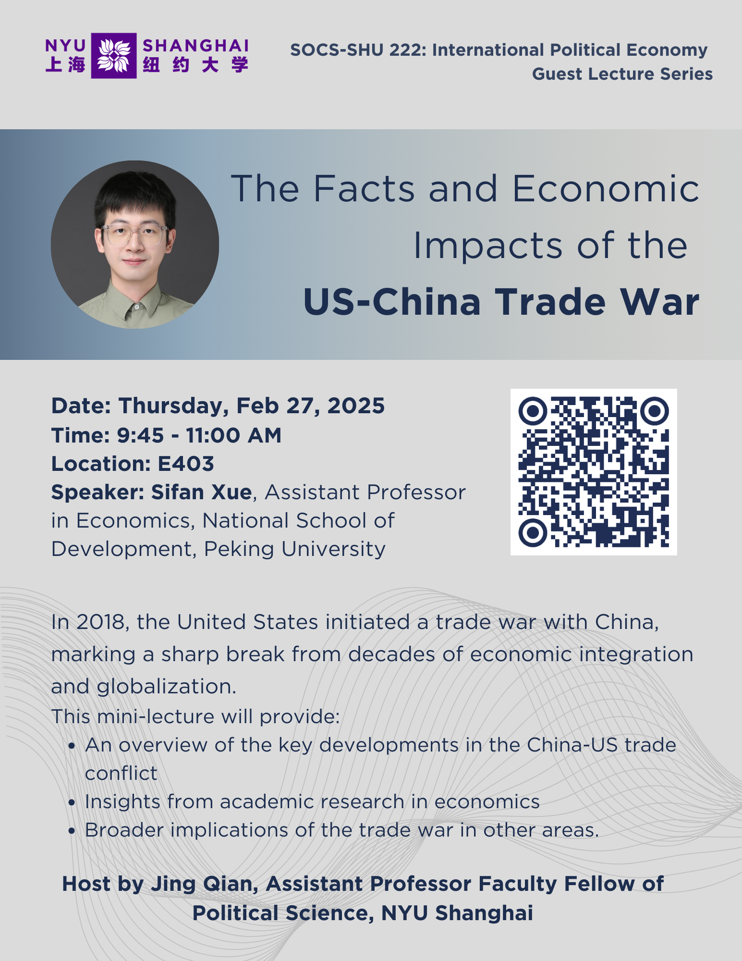

International Political Economy
(SOCS-SHU 222)
Instructor: JING QIAN

Slide 2
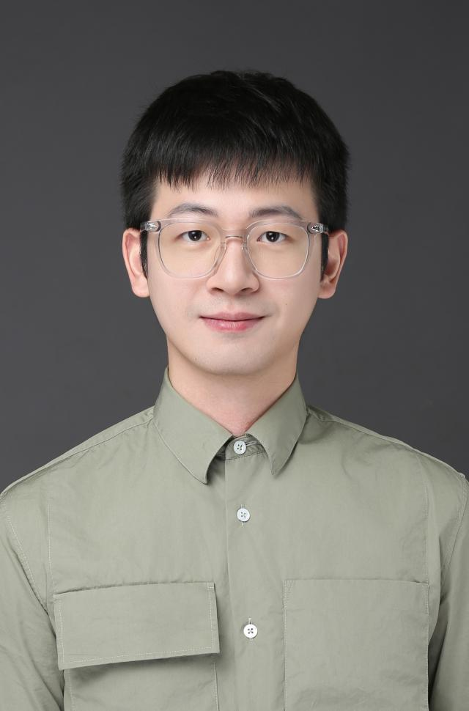
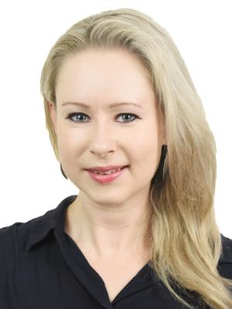
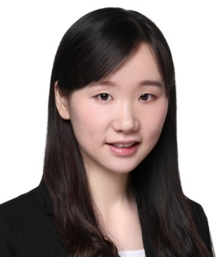
International Political Economy (SOCS-SHU 222)
Guest Lecture Series
February 27
Sifan Xue
National School of Development,
Peking University
March 13
Pippa Morgan
Duke Kunshan University
April 17
Yijiang Zhou
Tongji University

Slide 3


