Slide 1
Thanks

Slide 2

Jens
Credit: Joakim

Slide 3
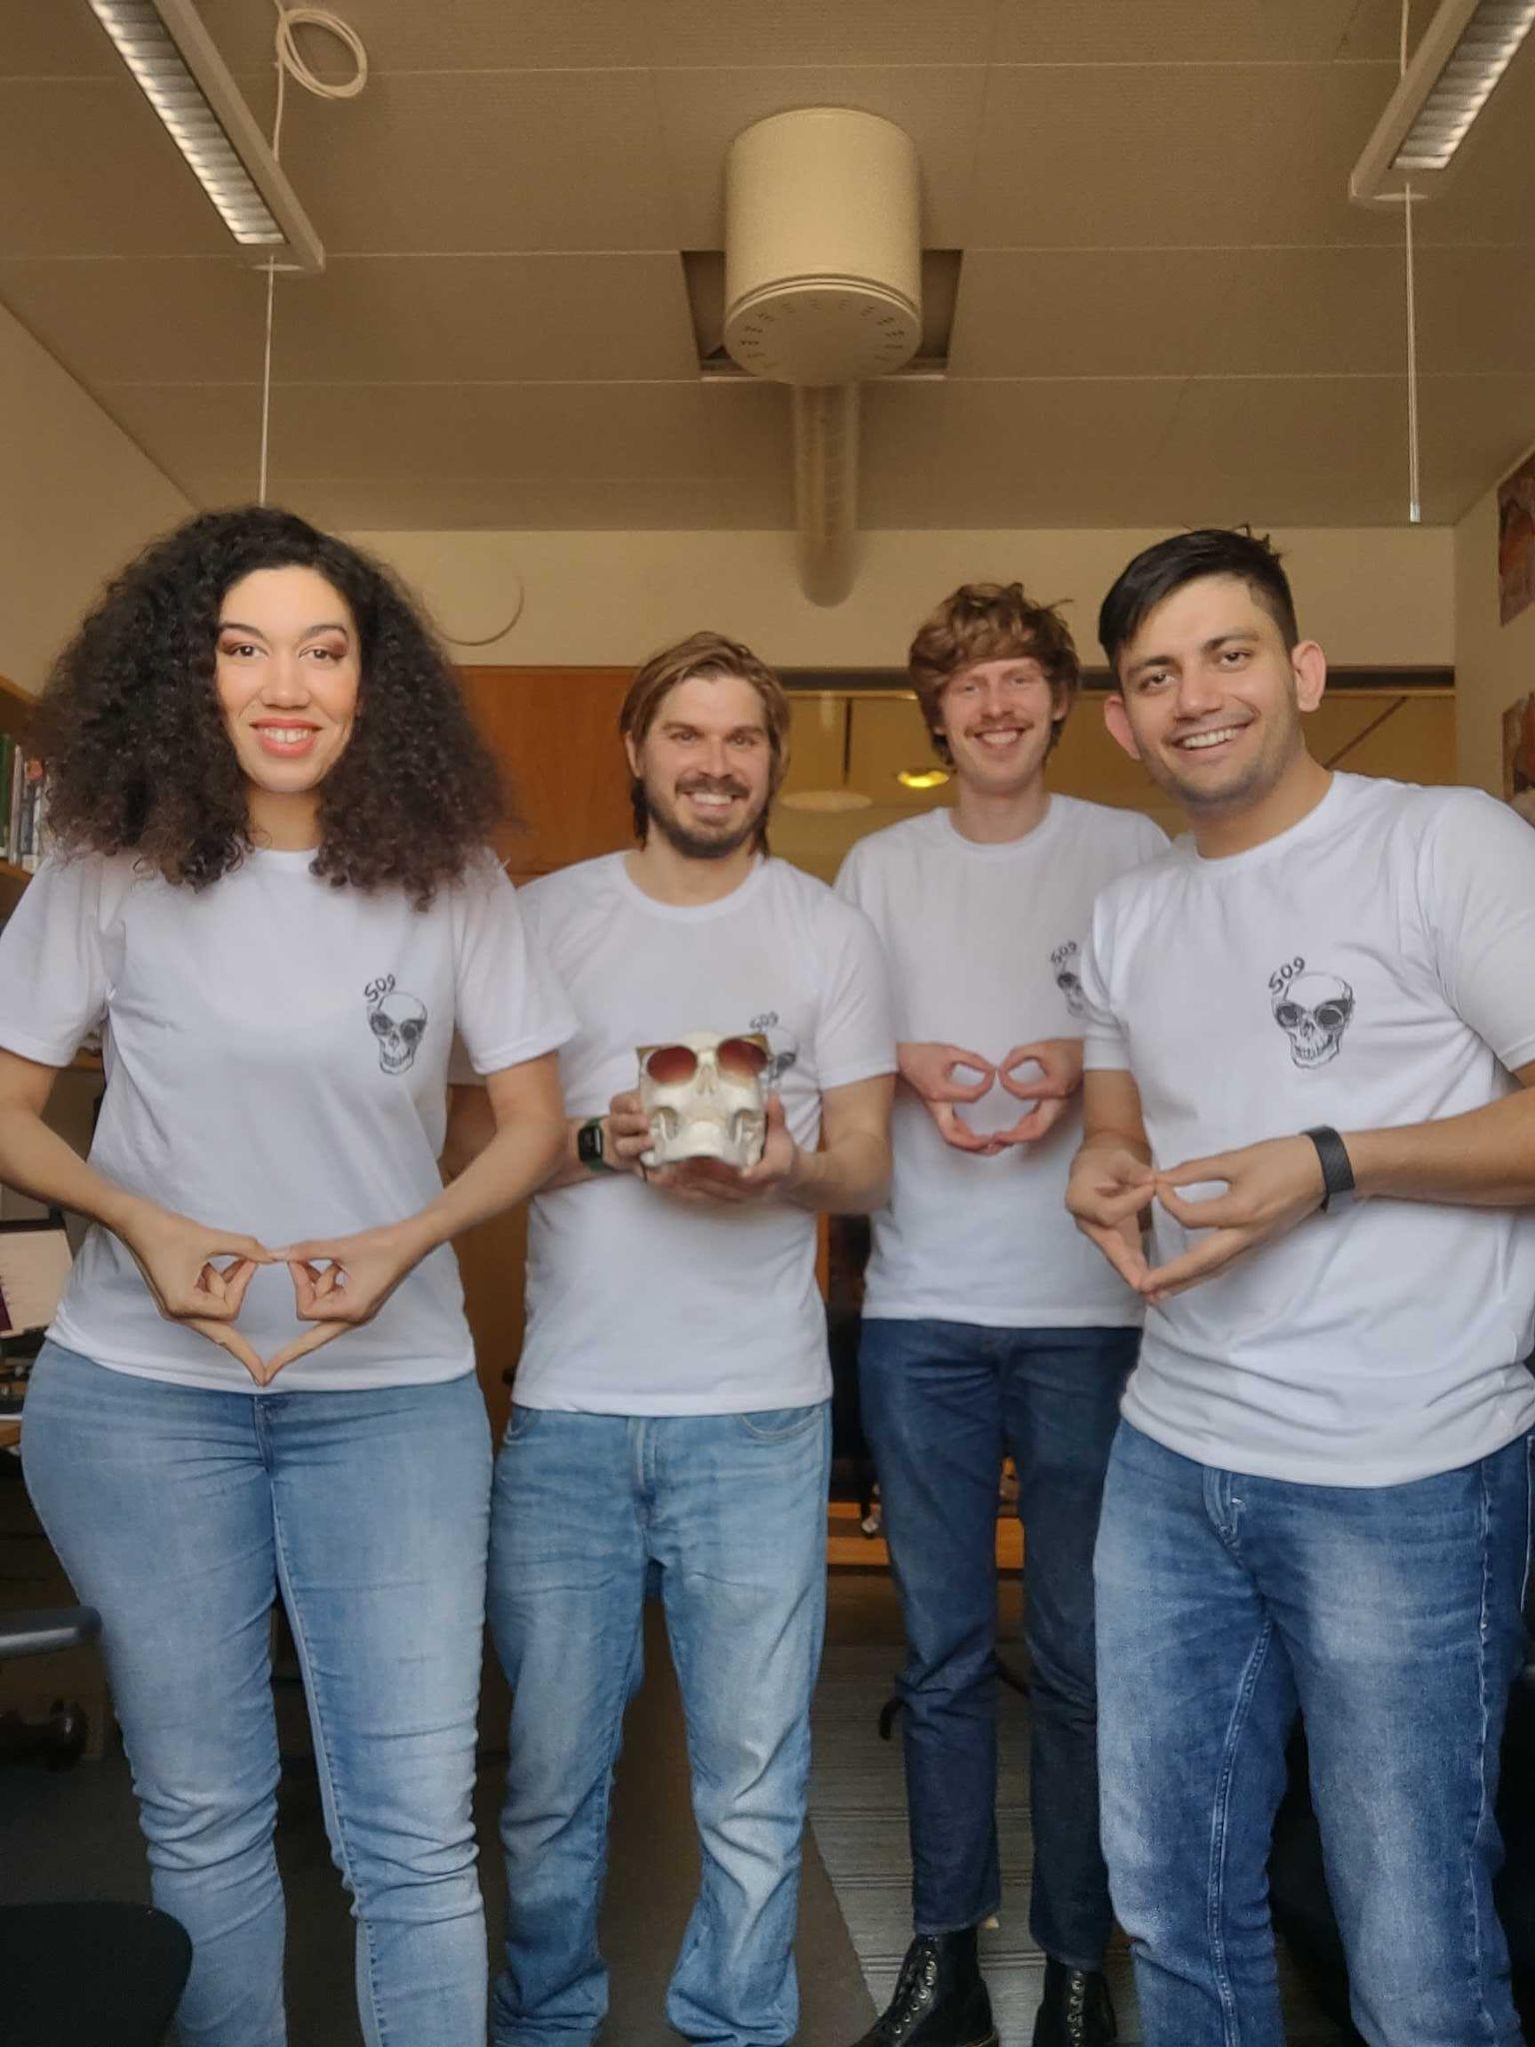
509
Credit: Ambika

Slide 4
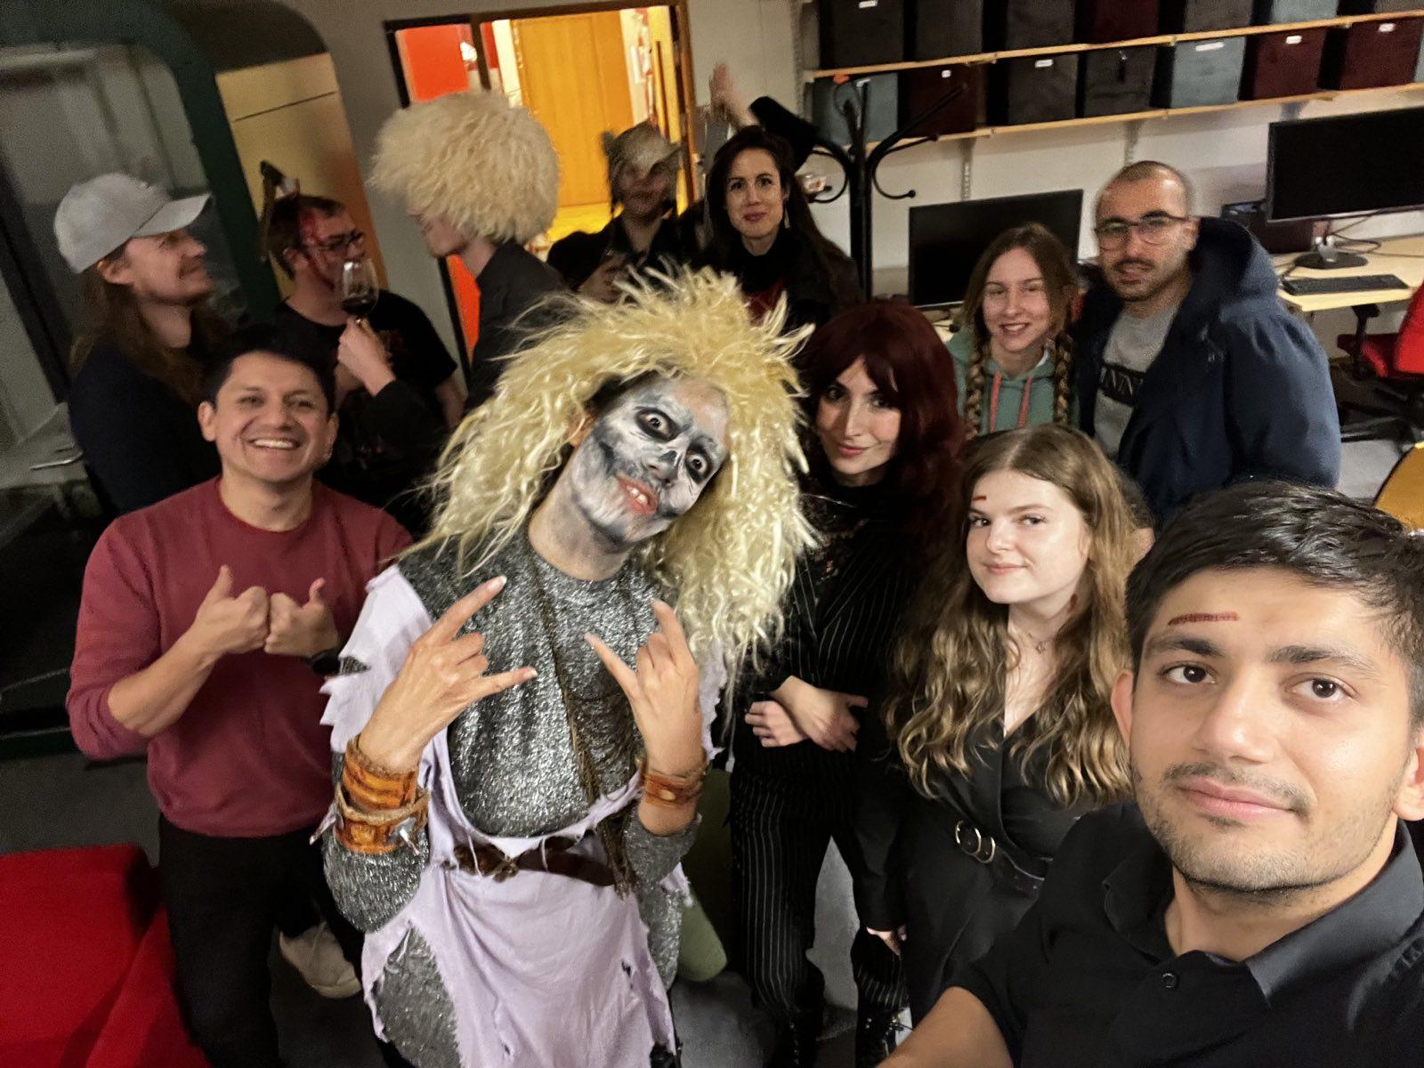
509+
Credit: Shivam

Slide 5
509+ ✅
Credit: Shivam

Slide 6
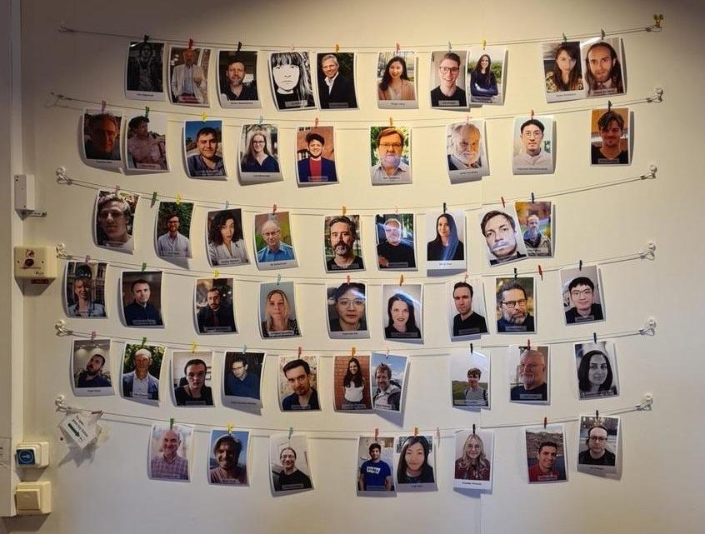
509++ (TMH)
Credit: Charlotte

