Slide 1
Verifying PCR Extension
Jessica Ims
Undergraduate Honors Research with Professor P. Alexander
KU - EECS 498 Spring 2014
Notes:
I’m Jessica Ims. Welcome to my presentation on the verification of PCR extension.
[NOTE: This presentation contains animations. To fully view the content, use Slide Show View.]

Slide 2
Overview
The Research
Working with Professor Alexander to verify PCR extension in the TPM
First
Background -The TPM and PCRs
Notes:
Over the last term, I have been working with Professor Alexander in order to model and verify the PCR extend operation. But before I get into the actual work <CLICK>, I will first cover some background. Namely, what are TPMs and PCRs and why do we care.

Slide 3
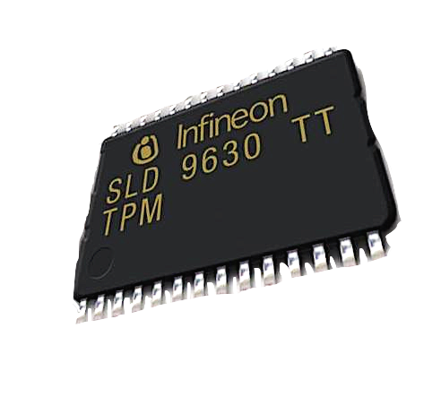
The Trusted Platform Module (TPM)
Secure cryptoprocessor
Functionality
Secure storage
Platform measurement and reporting
Platform authentication
Notes:
The Trusted Platform Module, or TPM, is a special microprocessor designed by the Trusted Computing Group. The TPM is used to verify the continued trustworthiness of the platform on which it is installed, and also that of any connected remote platforms. The TPM provides root of trusts for our computer platform – but how to know that the TPM is itself trustworthy?

Slide 4

Verifying the TPM
Is it trustworthy?
PVS
Specification and verification language
Automated theorem prover
Use theorems to verify TPM operations.
Logically prove everything works like it’s supposed to work.
My job: Verify PCR extension.
Notes:
In order to ensure the trustworthiness of the TPM, it is necessary to specify and verify the TPM’s operations. <Click> We use the PVS Specification and Verification System to model TPM operations and verify them with theorems. Or in other words, <Click> we logically prove that everything works like it’s suppose to. My job, <click> was to verify the PCR extend operation.

Slide 5
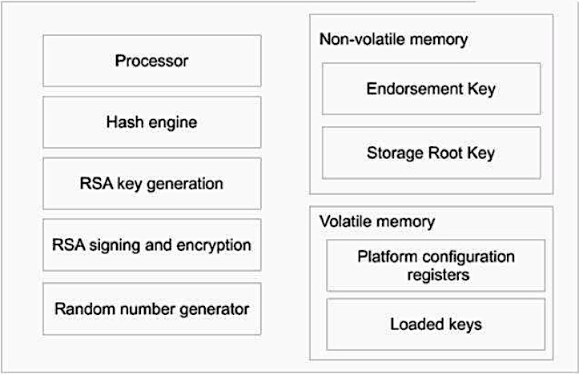
Platform Configuration Registers (PCRs)
160-bit storage registers
Record measurements of a platform’s configuration (hash values)
TPM
Notes:
PCRs, or Platform Configuration Registers, <click> are 160-bit registers. They are used to monitor and record measurements, or hashes, of the the state of the platform’s hardware and software.

Slide 6
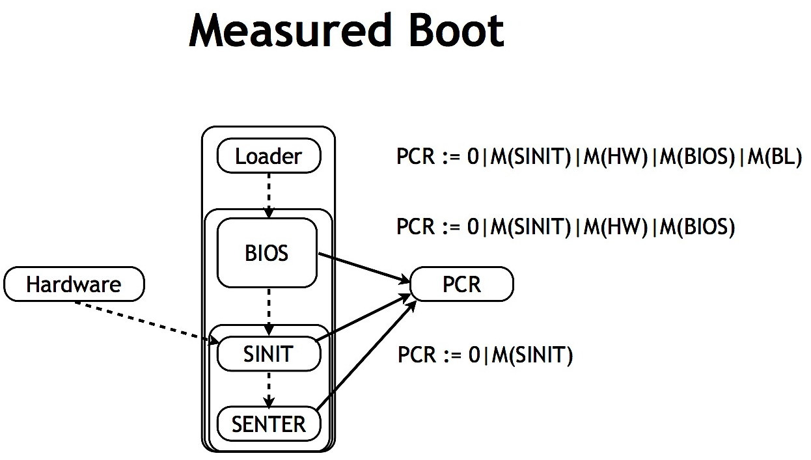
Platform Configuration Registers
Only one update operation: extend
Current PCR value is the extension of previous PCR value and a hash value
pcr
PCRs : -1 at power on
PCRs reset to 0 at SENTER
Problem with boot ->
SENTER doesn’t run ->
Incorrect PCR
extend( , hash2 )
extend( , hash3 )
extend( , hash1 )
Notes:
PCRs can be used to create a chain of trust because instead of being set when they receive new hashes, the PCRs are extended <click>. The updated PCR is the concatenation or extension of the old PCR and new hash. In this way, <click> no information is lost. <Click> When the platform on which the TPM is installed is powered on, the PCRs have value -1. The secure operation SENTER then runs, which resets the PCRS to 0. <Click> if there is a problem with the boot process, SENTER doesn’t run, and the PCRs remain at the now incorrect -1. This means that every update to the PCR will also be incorrect, because the extend operation allows the retention of all previous PCR values. The extend operation ensures that the error or attack, whatever when wrong, can’t get lost.

Slide 7
PCRs in PVS
pcr.pvs : pcr[PCRVAL:TYPE+] : THEORY
PCR : datatype
begin
reset : reset?
resetOne : resetOne?
extend(pcr:PCR,hash:PCRVAL) : extend?
end PCR;
SENTER constructor
Power On constructor
Extend constructor
Notes:
Now we come to my work. To verify PCR extension, what is first needed is a model of a PCR in PVS. <Click> This model, a PCR datatype, was already created, and was supplied to me by Professor Alexander. This datatype gives three constructors for a PCR. The constructors correspond to the three methods of creating a PCR value <click>. The first constructor RESET corresponds to the PCR 0, which as you recall from the previous slide results from running SENTER. The second constructor RESETONE corresponds to -1, at power-on of the platform. The third constructor models the EXTEND operation. Hash values are modeled by the abstract type PCRVAL.

Slide 8


Extend
Extend
extend(pcr:PCR, hash:PCRVAL) = new_pcr
PCR
New PCR
Hash
Notes:
In the PVS model of PCR extension,<click> extend takes as input a PCR and a PCRVAL and returns a new PCR.

Slide 9
Basic Extension Theorems
differentHashesExtend : THEOREM
(FORALL (p:PCR, h0,h1:PCRVAL) :
( (h0 /= h1) => (extend(p,h0) /= extend(p,h1)) ))
extendDifferentHashes : THEOREM
(FORALL (p:PCR, h0,h1:PCRVAL) :
( (extend(p,h0) = extend(p,h1)) => (h0 = h1) ))
differentPcrsExtend : THEOREM
(FORALL (p0,p1:PCR, h:PCRVAL) :
( (p0 /= p1) => (extend(p0,h) /= extend(p1,h)) ))
extendSameInputs : THEOREM
(FORALL (p0,p1:PCR, h0,h1:PCRVAL) :
( (extend(p0,h0) = extend(p1,h1)) IFF ((h0 = h1) AND (p0 = p1)) ))
Notes:
Given the PCR datatype, I began to construct - and prove - theorems concerning PCR extension <click>. The first theorem shows that if any two hash values are not the same, then the extensions of each hash with the same PCR are not the same. The second theorem <click> is the contrapositive of the first; it states that if any two extensions with the same PCR are identical, then the two hashes used must be identical as well. The third theorem <click> shows that if any two PCRs are not the same, then the extensions of each PCR with the same hash are not the same either. The forth theorem <click> verifies that the extend of any PCR with any hash is identical to another extend of any PCR and any hash IF AND ONLY IF the two hashes are identical and the two PCRs are identical. From this, we conclude that for a given hash and PCR, the extend operation returns a new, unique PCR. You will notice that all of these theorems explicitly refer to only one PCR extension. Theoretically, they could involve more, as these Ps can be any PCR; they could themselves be the result of an extend. However.

Slide 10
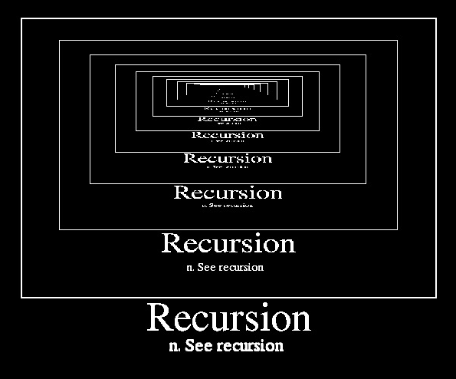
Extension
Recursive E
Prove for any number of extends
Prove for any number of hashes
HASHES : TYPE = list[PCRVAL];
Q(p:PCR, hs:HASHES) : RECURSIVE PCR =
(IF null?(hs)
THEN p
ELSE Q( extend(p, car(hs)), cdr(hs) ) ENDIF)
MEASURE length(hs)
Q(pcr, [h0, h1, h2]) = extend(extend(extend(p, h0), h1), h2)
Notes:
What if we want to explicitly verify that the theorems hold for a series of extend calls? Well, it seemed to me that modeling any number of extends is the same as modeling with any number of hashes <click>, as each extend call requires a hash value. Each extend call also requires a PCR, of course, but that is the output from the previous extend. I used the PVS list structure <click> to model an unspecified number of hash values. I then created <click> the recursive function Q. Given a PCR and a list of hash values, Q checks the length of the list. If the list is empty of hashes, no extends can be performed and the PCR is returned unchanged. If the list is not empty, Q calls itself with inputs extend(p, first of hash list) and rest of hash list. So, <click> calling Q with a list of three hashes would result in this way, with three extends.

Slide 11
Recursive Extension Theorems
differentPcrsExtendMulti : THEOREM
(FORALL (p0,p1:PCR, hs:HASHES) :
( (p0 /= p1) => (Q(p0,hs) /= Q(p1,hs)) ))
diffPcrsQ : THEOREM
(FORALL (p0,p1:PCR, hs:HASHES) :
( (p0 = p1) => (Q(p0,hs) = Q(p1,hs)) ))
qDiffPcrs : THEOREM
(FORALL (p0,p1:PCR, hs:HASHES) :
( (Q(p0,hs) = Q(p1,hs)) => (p0 = p1) ))
diffHashListQ : THEOREM
(FORALL (p:PCR, hs0,hs1:HASHES) :
( (hs0 = hs1) => (Q(p,hs0) = Q(p,hs1)) ))
Notes:
I then began to prove theorems with Q. <Click> The first theorem states that if any two PCRs are not the same, then the extension of one PCR any number of times with some hashes is not the same as the extension of the other PCR with the same list of hashes. The second theorem <click> is the inverse of the first; it states that if any two PCRs are the same, then the extension of one PCR any number of times with some hashes is the same as the extension of the other PCR with the same list of hashes. The third theorem <click> is the contrapositive of the first and the converse of the second; it states that if the recursive extension of one PCR any number of times with some hashes is the same as the extension of the other PCR with the same list of hashes, then the original PCRs are also the same. The last theorem <click> states that if any two lists of hashes are identical, then the extensions of each list with the same PCR are also identical.

Slide 12
Recursive Extension Theorems
qDiffHashList : THEOREM
(FORALL (p:PCR, hs0,hs1:HASHES) :
( (Q(p,hs0) = Q(p,hs1)) => (hs0 = hs1) ))
diffHashList_diffPcrs_Q : THEOREM
(FORALL (p0,p1:PCR, hs0,hs1:HASHES) :
( ((p0 = p1) AND (hs0 = hs1)) IFF (Q(p0,hs0) = Q(p1,hs1)) )
diffHashList_diffPcrs_Q : THEOREM
(FORALL (p0,p1:PCR, hs0,hs1:HASHES) :
( ((p0 = p1) AND (hs0 = hs1)) => (Q(p0,hs0) = Q(p1,hs1)) ))
diffPcrsQ_iff : THEOREM
(FORALL (p0,p1:PCR, hs:HASHES) :
( (p0 = p1) IFF (Q(p0,hs) = Q(p1,hs)) ))
Q(extend(p,first0), rest0) Q(extend(p, first1), rest1)
Q(p, first0+rest0) Q(p, first1+rest1)
Q(p, hs0) Q(p, hs1)
Q(pcr, [h0, h1, h2]) = extend(extend(extend(p, h0), h1), h2)
Notes:
I intended to ultimately prove that any two PCRs were identical and any two hash lists were identical IF AND ONLY IF the recursive extension of one PCR and hash list was identical to the recursive extension of the other PCR and hash list. However, I ran into trouble with a preliminary proof. <Click> I tried for quite a while to prove that two identical recursive extensions with the same PCR meant that the hash lists were identical, but I kept running into this problem: <click> I have two hash lists (hs0 and hs1) that I want to show are the same. They are not empty, <click> meaning that there is a first item in the list and a rest of the list. By the implementation of Q, I can change this <click> to this. It can easily be checked that the first two hashes are equal, because they are now part of extend. But now we have the rest of the list. Oh no, <click> we are back to the original problem, proving that two abstract lists of hashes are the same. I believe the problem lies with the fact that the list has no definite ending; following this pattern in PVS, with this abstract list, I could continue forever. If I had a concrete list, <click> I could check the final result. But hs0 and hs1 are abstract. It looks like this proof would work for a given list, but for an abstract list …more research is needed. <click> We finally decided to move on, leaving these two theorems not disproven, but unproven. <Click> I did successfully prove two other theorems using Q. The first here states that if any two PCRs are identical and any two lists of hashes are identical, then the extension of one list with one PCR is identical to the extension of the other list with the other PCR. The second theorem states that any two PCRs are the same IF AND ONLY IF the extension of one PCR any number of times with some hashes is the same as the extension of the other PCR with the same list of hashes.

Slide 13







The Sequencing Problem
Q is a recursive function.
TPM executes commands in sequence
Need to verify that EXTEND works sequentially
Use a state monad to represent sequential operations
Notes:
But why could we leave those two theorems behind? Because there was a problem with using Q in the first place. <Click> Q is a recursive function. This makes it a poor model of TPM execution because <click> the TPM executes commands in sequence. If we can model sequential extension, which is what we really want, we can ignore the recursive problems. So now we go a new direction <click>. In order to model sequential extension calls, <click> we use a state monad.

Slide 14
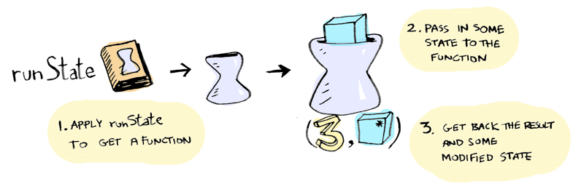
The State Monad
Wrapper for a function that takes a state and returns an output and a state.
StateMonad( runState function: (state -> [output, new_state]) )
Notes:
The state monad provides us with a wrapper for a function and allows us to thread state through a sequence of operations. Passing state to the wrapped function produces a an output paired with a new state.

Slide 15
The State Monad in PVS
StateMonad.pvs : StateMonad[A,S:TYPE+] : THEORY
State : DATATYPE
BEGIN
state(runState:[S->[A,S]]):state?
END State
“State” is actually a state monad -- given an abstract state s will generate an output - state pair.
return(x:A):State = state(LAMBDA (s:S) : (x,s)
>>= (m:State,f:[A->State]):State =
state(LAMBDA(s0:S):
LET (a,s1) = runState(m)(s0) IN
runState(f(a))(s1));
Notes:
I was provided with a state monad model by Professor Alexander. As you can see, the state monad datatype, called State, encapsulates an abstract function runState that when given an input of abstract type S, gives back a pair with abstract types A and S. It’s important to note that the State datatype, despite its name does not represent a single state. <Click> The datatype State is a state monad. It is the abstract type S that represents a single state. A is the output type, S is the state type, and State the state monad type. As State is a monad, <click> we also, of course, have an implementation for the all-important return and bind functions.

Slide 16


return
return(x:A):State = state(LAMBDA (s:S) : (x,s));
runState( return(a) )(State0)
return
a
s -> (a,s)
a ,
Notes:
This is the implementation for return, using abstract types. <Click> The return function, given an input of type A, gives us a state monad encapsulating a runState function. When given a input of type S (which as you recall from the previous slide represents abstract single state), this encapsulated function produces a pair consisting of the two inputs, unchanged. To run this wrapped runState function, we pull it out and give it a single state. As shown here, we get back the paired inputs. No change, just put through the monad.

Slide 17
bind
>>= (m:State,f:[A->State]):State =
state(LAMBDA(s0:S):
LET (a,s1) = runState(m)(s0) IN
runState(f(a))(s1));
Notes:
This is the implementation for bind with abstract types. This is a bit more complicated looking than return, but what’s happening is that bind takes as input a state monad m and a function f. F produces a state monad when given an input of type A. The function inside of m is run with the starting state applied to the bind, producing the result (a, s1). a is given to f, creating a state monad, whose wrapped function is then run with s1. The result of this run is the result of bind.

Slide 18




runState( m >>= f )(state0)
bind
m : stateMonad [foo]
f : output_var -> stateMonad [bar]
m
output1 ,
output1
output2 ,
>>= (m:State,f:[A->State]):State =
state(LAMBDA(s0:S):
LET (a,s1) = runState(m)(s0) IN
runState(f(a))(s1));
Notes:
To be a little clearer. We have bind with inputs m and f, run with state0. Bind takes the function in m, foo, and gives it state0, which produces the pair (output1, state1). Output1 is given to function f, which –poof- makes a state monad encapsulating a function bar. Bar is unwrapped and run with state1, which produces the ultimate result (output2, state2).

Slide 19

m >>= f
f >>= f
m
output1 ,
output1
output2 ,
output2
output3 ,
Notes:
We have here used bind to sequence two operations, passing and modifying state as we went. We could use bind to continue the sequence <click>.

Slide 20
m >>= f >>= f
f >>= f
f >>= f
output2
output3 ,
output2
output3 ,
output2
output3 ,
Notes:
<click> <click>

Slide 21
pcrMonad.pvs
pcrMonad[A,S,PCRVAL:TYPE+] : THEORY
importing pcr[PCRVAL];
importing StateMonad[A,S];
StateMonad[A,S:TYPE+];
return(x:A):State = state(LAMBDA (s:S) : (x, s));
importing StateMonad[PCR,S];
Which is PCR?
Notes:
To to use the PCR datatype from pcr theory and the State datatype form state monad theory, I created a new theory: pcr monad. Into this, I imported the types and theorems from pcr theory and from state monad theory. In importing from pcr theory, I continued to represent hash values with the abstract type PCRVAL. Now to import state monad theory, with its two abstract types A and S. Well, to use the state monad with PCRs, obviously I have to replace an abstract type with the PCR datatype. <Click> But which one? Which is the important one? <Click> At first I thought it was the A type – the A type gets passed into the monad here, and the A type is the the output of the wrapped functions. So, going with that thought, <click> I replaced abstract type A with datatype PCR, leaving S abstract.

Slide 22
pcrMonad.pvs --- First Theorems
importing StateMonad[PCR,S];
sameReturn_sameRun : THEOREM
(FORALL (s:S, p0,p1:PCR) :
( (return(p0) = return(p1)) =>
(runState(return(p0))(s) = runState(return(p1))(s)) ))
returnPcr : THEOREM
(FORALL (p0,p1:PCR) : ( (p0 = p1) IFF (return(p0) = return(p1)) ))
Notes:
I proceeded to prove some theorems. The first here states that if state monad return(any pcr) is identical to return(any other pcr), then running the returns will produce the same result. The second theorem <click> states that two PCRs are the same IFF they produce the same state monad when applied to return.

Slide 23
What about S?
StateMonad[A,S:TYPE+];
return(x:A):State = state(LAMBDA (s:S) : (x, s));
importing StateMonad[PCR,S];
return(pcr:PCR):State = state(LAMBDA (s:S) : (pcr, s));
importing StateMonad[A,PCR];
return(x:A):State = state(LAMBDA (pcr:PCR) : (x, pcr));
importing StateMonad[PCR,PCR];
return(output_pcr:PCR) : State =
state(LAMBDA (state_pcr:PCR) : (output_pcr, state_pcr));
Notes:
But hold on a minute, what about S? I was using the PCR datatype to replace abstract type A, but S has to be important because otherwise why use a state monad? S is the abstract state type. Well, I talked with Professor Alexander and it turns out I got things a bit mixed up <click>. The PCR datatype should replace the abstract S type. The PCR is the state, lifted into the monad with return and passed through sequences of extend calls using bind. <Click> The output A type actually pretty unimportant for my purposes, but in order to keep the the previous two theorems working, I kept the replacement of the A type with PCR. So, now I import state monad theory with the PCR datatype replacing both the abstract output type A and the abstract single state type S. <Click> It is the state PCR, however, that we focus on.

Slide 24
Return Theorems
sameStatePcr : THEOREM
(FORALL (outPcr,statePcr0,statePcr1:PCR) :
( (statePcr0 = statePcr1) =>
(runState(return(outPcr))(statePcr0) =
runState(return(outPcr))(statePcr1)) ))
sameReturnRun : THEOREM
(FORALL (outPcr,statePcr0,statePcr1:PCR) :
( (runState(return(outPcr))(statePcr0) =
runState(return(outPcr))(statePcr1)) =>
(statePcr0 = statePcr1) ))
sameStatePcr_sameReturnRun : THEOREM
(FORALL (outPcr,statePcr0,statePcr1:PCR) :
( (statePcr0 = statePcr1) IFF
(runState(return(outPcr))(statePcr0) =
runState(return(outPcr))(statePcr1)) ))
Notes:
I proved two theorems. If two state PCRs are the same, then the results of running return with those states are the same. Also, if the results of running return with two state PCRs are the same, then those two state PCRs are themselves the same. <Click> From these, I then proved that two state PCRs are the same IFF the results of running return with those states are the same.

Slide 25
pcrMonad.pvs --- bind
importing StateMonad[PCR,PCR];
>>= (m:State,f:[A->State]):State =
state(LAMBDA(s0:S):
LET (a,s1) = runState(m)(s0) IN
runState(f(a))(s1));
runState( return(output) )(state_pcr) = (output, state_pcr)
runState( m >>= f )(state_pcr) = (output, extend(state_pcr, hash))
M : return(output_pcr)
F : ???
>>= (m:State,f:[PCR->State]):State =
state(LAMBDA(state_pcr0:PCR):
LET (output_pcr, state_pcr1) = runState(m)(state_pcr0) IN
runState(f(output_pcr))(state_pcr1));
Notes:
So much for return. What about bind? <Click> This is bind with the PCR datatype replacing abstract types A and S. M is a state monad and f is a function that, given an output type PCR, produces a state monad. But what are m and f, for our purposes? <Click> Well, running return with a state PCR just gives back the state PCR. What we want for bind <click> is to give back the extension of the state PCR. How to model extend? Recalling that bind puts the state through two function calls, and seeing here that we only want to call extend once, it is clear that the first operation shouldn’t alter the state PCR. We have that: <click> given an output PCR, return becomes a state monad. When run with a state, we will get the state back unchanged. So, our m is return. <Click> What about f?

Slide 26
Creating bind for PCRs --- F
runState( m >>= f )(state_pcr)
F : [PCR->State] =
Extend : [PCR, PCRVAL -> PCR]
(LAMBDA (output_pcr:PCR) : State =
state(LAMBDA (state_pcr:PCR) : (output_pcr, runExtend(state_pcr))) )
(LAMBDA (output_pcr:PCR) : modify(output_pcr, g(state_pcr)))
modify(a:A, g:[S->S]) : State = state(LAMBDA(s0:S):(a, g(s0)))
extendWithStatePcr
???
modify(output_pcr:PCR, g:[PCR->PCR]) : State =
state(LAMBDA(state_pcr:PCR):(output_pcr, g(state_pcr)))
G : [PCR->PCR]
extendCurry (h:PCRVAL) : [PCR -> PCR] = (LAMBDA (p:PCR) : extend(p, h))
F : extendWithStatePcr (h:PCRVAL) : [PCR -> State] =
(LAMBDA (output_pcr:PCR) : modify(output_pcr, extendCurry(h)))
Notes:
What do we know about f? We know it has to involve extend, somehow, but that it is not the extend function itself; F takes an output PCR and gives a State monad, while extend takes a PCR and a hash and gives a PCR. F is not extend, so it must call extend – in its encapsulated function. <Click> The encapsulated function, given a state PCR, produces an output–state pair. The output side is unimportant, but the state side has to be the extension of the input state PCR. As it so happens there is a function in State Monad theory can help here. <Click> This function modify takes as input an output type and function and produces a state monad encapsulating a function giving the the result (output, function(state)). Replacing the abstract types with the PCR datatype <click>, this is what we have. This looks like part of what we want for f <click>. So now we have to determine what g is. We want it to be extend, but there’s a problem: <click> G takes a PCR and gives a PCR; extend needs a hash value as well. So, we do this <click>. The function extendCurry takes a hash value and produces a PCR to PCR function – G – that runs extend. We must do a similar adjustment to F <click>. Given a hash value, extendWithStatePcr produces a PCR to state monad function – f – that calls modify.

Slide 27
Creating bind for PCRs
runState( m >>= f )(state_pcr)
M :
return(output_pcr)
F :
extendWithStatePcr (h:PCRVAL) : [PCR -> State] =
(LAMBDA (output_pcr:PCR) : modify(output_pcr, extendCurry(h)))
Bind :
return(output_pcr) >>= extendWithStatePcr(hashVal)
Notes:
To summarize. For our bind-extend, m is return, f is extendWithStatePcr(hash). Give it a hash, get a function, give IT an output PCR, get a state monad eventually encapsulating extend. Thus, we have our implementation of extend, using bind.

Slide 28
Testing Bind
hashVal : PCRVAL
outputPcr : PCR
bindTest1 : THEOREM
runState( return(output_pcr) >>= extendWithStatePcr(hashVal) )(reset) =
(output_pcr, extend(reset, hashVal))
bindTest2 : THEOREM
runState( return(output_pcr) >>= extendWithStatePcr(hashVal) )(reset) =
runState( return(output_pcr) )(extend(reset, hashVal))
Notes:
Now that we hope we have correctly implemented extend with bind, we test what we have done. I created two tests. The first checks that running bind with state PCR RESET produces the extension of RESET. The second checks that running bind with state PCR RESET produces the same result as running return with state PCR extend(RESET). <Click> Both tests were successfully proved. The implementation of extend in the monad - sequential extension - works.

Slide 29
Bind Theorems
bindPcr_differentState : THEOREM
(FORALL (outPcr:PCR, h:PCRVAL) :
( runState( return(outPcr) >>= extendWithStatePcr(h) )(reset) /=
runState( return(outPcr) >>= extendWithStatePcr(h) )(resetOne) ))
bindPcr_differentStateGeneral : THEOREM
(FORALL (outPcr,statePcr0,statePcr1:PCR, h:PCRVAL) :
( (statePcr0 /= statePcr1) =>
(runState( return(outPcr) >>= extendWithStatePcr(h) )(statePcr0) /=
runState( return(outPcr) >>= extendWithStatePcr(h) )(statePcr1)) ))
It will be noticed if SENTER doesn’t run.
Notes:
Now I could prove more in-depth theorems. First, I showed that sequential extension with state PCR RESET did not produce the same result as sequential extension with state PCR RESETONE, with hash value and output PCR remaining the same. This is important because it shows that the difference between reset and resetOne can be detected after the register has been updated. In other words, <click> it will be noticed is SENTER doesn’t run. Then <click>, I proved a more general version of the theorem; If any two state PCRs are not the same, then the results of extending them sequentially won’t be the same either.

Slide 30
Bind Theorems
sameStatePcr_sameBindRun : THEOREM
(FORALL (outPcr,statePcr0,statePcr1:PCR, h:PCRVAL) :
( (statePcr0 = statePcr1) IFF
(runState( return(outPcr) >>= extendWithStatePcr(h) )(statePcr0) =
runState( return(outPcr) >>= extendWithStatePcr(h) )(statePcr1)) ))
sameHash_sameBindRun : THEOREM
(FORALL (outPcr,statePcr:PCR, h0,h1:PCRVAL) :
( (h0 = h1) IFF
(runState( return(outPcr) >>= extendWithStatePcr(h0) )(statePcr) =
runState( return(outPcr) >>= extendWithStatePcr(h1) )(statePcr)) ))
Notes:
Furthermore, I proved that two state PCRs are the identical IFF the results of sequential extension with each state PCR are the identical, using the same output PCR and hash value. <Click> Also, two hash values are the identical IFF the results of sequential extension with each hash are the identical, using the same output PCR and state PCR.

Slide 31
Bind Theorems
sameBind : THEOREM
(FORALL (outPcr,statePcr0,statePcr1:PCR, h0,h1:PCRVAL) :
( ((statePcr0 = statePcr1) AND (h0 = h1)) IFF
(runState( return(outPcr) >>= extendWithStatePcr(h0) )(statePcr0) =
runState( return(outPcr) >>= extendWithStatePcr(h1) )(statePcr1)) ))
sameBindTotal : THEOREM
(FORALL (outPcr0,outPcr1,statePcr0,statePcr1:PCR, h0,h1:PCRVAL) :
( ((statePcr0 = statePcr1) AND (h0 = h1) AND (outPcr0 = outPcr1)) IFF
(runState( return(outPcr0) >>= extendWithStatePcr(h0) )(statePcr0) =
runState( return(outPcr1) >>= extendWithStatePcr(h1) )(statePcr1)) ))
Notes:
Putting these together, we have: Two state PCRs identical and two hash values are identical IFF sequential extension with one state PCR and hash is identical to sequential extension with the other state PCR and hash, using the same output PCR. And to be complete: <click> Two state PCRs are identical, two hash values are identical, and two output PCRs are identical IFF sequential extension with one state PCR, hash value, and output PCR is identical to sequential extension with the other state PCR, hash value, and output PCR.

Slide 32
Sequential Extension
sequentialExtend : THEOREM
( FORALL (outPcr,statePcr:PCR, h0,h1:PCRVAL) :
(runState( return(outPcr) >>=
extendWithStatePcr(h0) >>=
extendWithStatePcr(h1) )(statePcr))
= (outPcr, extend(extend(statePcr, h0), h1))
)
Notes:
Once again, though, these theorems only explicitly refer to one extend call. However, using the sequential implementation for bind, it’s easy to show conclusively that sequential extension is the same as logically calling extend on the result of extend. <Click> Here, I sequence together two extends and prove that the result is, as it should be, the extension of an extension.

Slide 33

Important Conclusions
Extending a pcr with a hash produces a unique new pcr
(extend(p0,h0) = extend(p1,h1)) IFF ((h0 = h1) AND (p0 = p1)) ))
It will be noticed if SENTER doesn’t run
runState( return(outPcr) >>= extendWithStatePcr(h) )(reset) /=
runState( return(outPcr) >>= extendWithStatePcr(h) )(resetOne)
(statePcr0 = statePcr1) IFF
(runState(return(outPcr))(statePcr0) = runState(return(outPcr))(statePcr1)) ))
Verified: Running extend sequentially (as in the TPM) is the same as logically calling extend on the results of extend.
runState( return(outPcr) >>= extendWithStatePcr(h0) >>= extendWithStatePcr(h1) )(statePcr)) = (outPcr, extend(extend(statePcr, h0), h1)) )
Notes:
In conclusion! …Since I have proved – and discussed – a good many theorems, I will conclude this presentation with a recap of only the most important points. We have shown: <click> Given a hash and PCR, extension produces new, unique PCR. We have shown: <click> Errors won’t get lost with extension. You can’t extend reset and have the result be the same as extending resetOne. Finally, we have shown <click> that sequential PCR extension works as it should, logically.

Slide 34

References
Ryan, M.; Introduction to the TPM 1.2 (draft 2009); https://github.com/ku-sldg/verified-tpm12/blob/master/refs/Introduction%20to%20the%20TPM%201.2%202009.pdf
Alexander, P.; Verifying the TPM: How I Learned to Love the Monad; verifying-tpm-20120215.pdf; https://github.com/ku-sldg/verified-tpm12/tree/verified-tpm12/docs/verifying-tpm
Dinh, T., Ryan, M.; Trusted Computing – TCG Proposals (2006);https://www.cs.bham.ac.uk/~mdr/teaching/modules/security/lectures/TrustedComputingTCG.html
TCG: Trusted Computing Group; 08-TCG.ppt (2008); http://www.google.com/url?sa=t&rct=j&q=platform%20configuration%20registers%20senter&source=web&cd=1&ved=0CCYQFjAA&url=http%3A%2F%2Fcrypto.stanford.edu%2Fcs155old%2Fcs155-spring08%2Flectures%2F08-TCG.ppt&ei=pltgU8zrEIussASR14CACQ&usg=AFQjCNFtwtXtzYcxcx9Zd597yeKe8L1ljw&bvm=bv.65636070,d.cWc
Adit; Functors, Applicatives, and Monads In Pictures – adit.io (2013); http://adit.io/posts/2013-04-17-functors,_applicatives,_and_monads_in_pictures.html#monads
Adit; Three Useful Monads – adit.io (2013); http://adit.io/posts/2013-06-10-three-useful-monads.html#the-state-monad
Simmons, B.; The State Monad: A Tutorial for the Confused (2009); http://brandon.si/code/the-state-monad-a-tutorial-for-the-confused/
Trusted Computing Platforms: TCPA Technology in Context (2003); http://books.google.com/books?id=EWk2pLY7atgC&pg=PA138&lpg=PA138&dq=Platform+Configuration+Registers&source=bl&ots=HiBzrsFSfZ&sig=m213jguU-s9TiqIz7oRSZEyfclM&hl=en&sa=X&ei=m1VgU8rXKNSvsAT40YDoAw&ved=0CFIQ6AEwBQ#v=onepage&q=Platform%20Configuration%20Registers&f=false
http://www.dreamstime.com/stock-photo-sherlock-holmes-cartoon-vector-image14725610
Halling, B., Alexander, P.; Verifying TPM Protocols Using a State Monad (2013-2014); http://ku-sldg.github.io/verified-tpm12///resources/fm14.pdf
Notes:
Thank you for coming. Drive safely.

