Slide 1
AI-Powered Technical Proposal and Cost Estimation System
Case Study: Jimstech Innovations Nigeria Limited AJIBEWA Johnson Irekanmi | Student ID: 25626 | June 2026
- Final Year Project Defense - B.Sc. Information Technology - Software Engineering - Adventist University of Central Africa
Defense Presentation
Notes:
Introduce the project title, case study organization, your name, department, and the purpose of the defense.

Slide 2
Abstract
- Software firms struggle with slow proposal writing, inconsistent estimates, and weak timeline prediction. - This project automates requirement analysis, proposal generation, cost estimation, timeline prediction, and technology recommendation. - The system uses LLM-assisted intelligence through NVIDIA NIM with local fallbacks and stores project records in Supabase. - Result: faster, more structured, and more defensible pre-project planning for software development firms.
AI-Powered Technical Proposal and Cost Estimation System
2
Notes:
Summarize the entire research in one minute: the problem, the solution, the AI approach, and the expected impact.

Slide 3
Introduction
- Technical proposals are critical in converting client ideas into approved software projects. - Manual proposal preparation depends heavily on senior staff experience and takes significant time. - Poor early estimates can lead to budget overruns, missed deadlines, and reduced client trust. - The study focuses on using intelligent automation to improve this workflow.
AI-Powered Technical Proposal and Cost Estimation System
3
Notes:
Explain why proposal preparation and estimation matter before a project starts.

Slide 4
Background of the Study
- Jimstech Innovations Nigeria Limited builds software, digital solutions, AI/data products, e-commerce systems, and education technology. - As the company grows, client requests and project complexity also increase. - Existing proposal and estimation processes rely on generic templates, informal consultation, and manual calculations. - AI-assisted tools can analyze requirements and generate structured decision-support outputs.
AI-Powered Technical Proposal and Cost Estimation System
4
Notes:
Connect the study to the real operational environment of Jimstech Innovations Nigeria Limited.

Slide 5
Statement of the Problem
- No centralized digital process for capturing and analyzing client requirements. - Proposal quality varies across staff, templates, and project types. - Cost and timeline estimates are mostly experience-based and difficult to justify. - Technology stack decisions are often ad hoc rather than requirement-driven. - Historical project data is not fully reused for future planning.
AI-Powered Technical Proposal and Cost Estimation System
5
Notes:
Present the core gap: the organization needs a repeatable and data-backed proposal and estimation workflow.

Slide 6
Motivation of the Study
- Academic: contribute a practical AI application in software engineering project planning. - Organizational: help Jimstech respond faster and more professionally to clients. - Operational: reduce repeated manual work and improve consistency in documentation. - Personal: apply software engineering, database, AI integration, and system design knowledge to a real problem.
AI-Powered Technical Proposal and Cost Estimation System
6
Notes:
Explain the academic, company, operational, and personal reasons for selecting this project.

Slide 7
Objectives of the Study
- General objective: design and implement an AI-powered proposal and cost estimation system for software projects. - Analyze the existing manual proposal and estimation process. - Design structured requirement analysis and proposal generation modules. - Implement cost, timeline, and technology recommendation features. - Provide role-based access, auditability, and a project repository for learning from past work.
AI-Powered Technical Proposal and Cost Estimation System
7
Notes:
State the general objective first, then the specific objectives as measurable deliverables.

Slide 8
Scope of the Study
- Requirement analysis and categorization of client project needs. - AI-assisted technical proposal generation with editable sections. - Cost estimation in NGN with development, infrastructure, third-party, and contingency values. - Timeline prediction with phases, milestones, risk level, and confidence score. - Technology recommendation, project repository, reports, templates, clients, security, and role management.
AI-Powered Technical Proposal and Cost Estimation System
8
Notes:
Clarify what the system covers and keep the scope tied to implemented modules.

Slide 9
Methodology and Interviews
- Research methods: observation, documentation review, and stakeholder interviews. - Interviewed management, project managers, and software engineers at Jimstech. - Key finding: proposals are prepared manually using experience, informal consultation, and generic templates. - Development method: Incremental Software Development Model for building and improving modules step by step.
AI-Powered Technical Proposal and Cost Estimation System
9
Notes:
Explain how data was collected and how the system was developed incrementally.

Slide 10
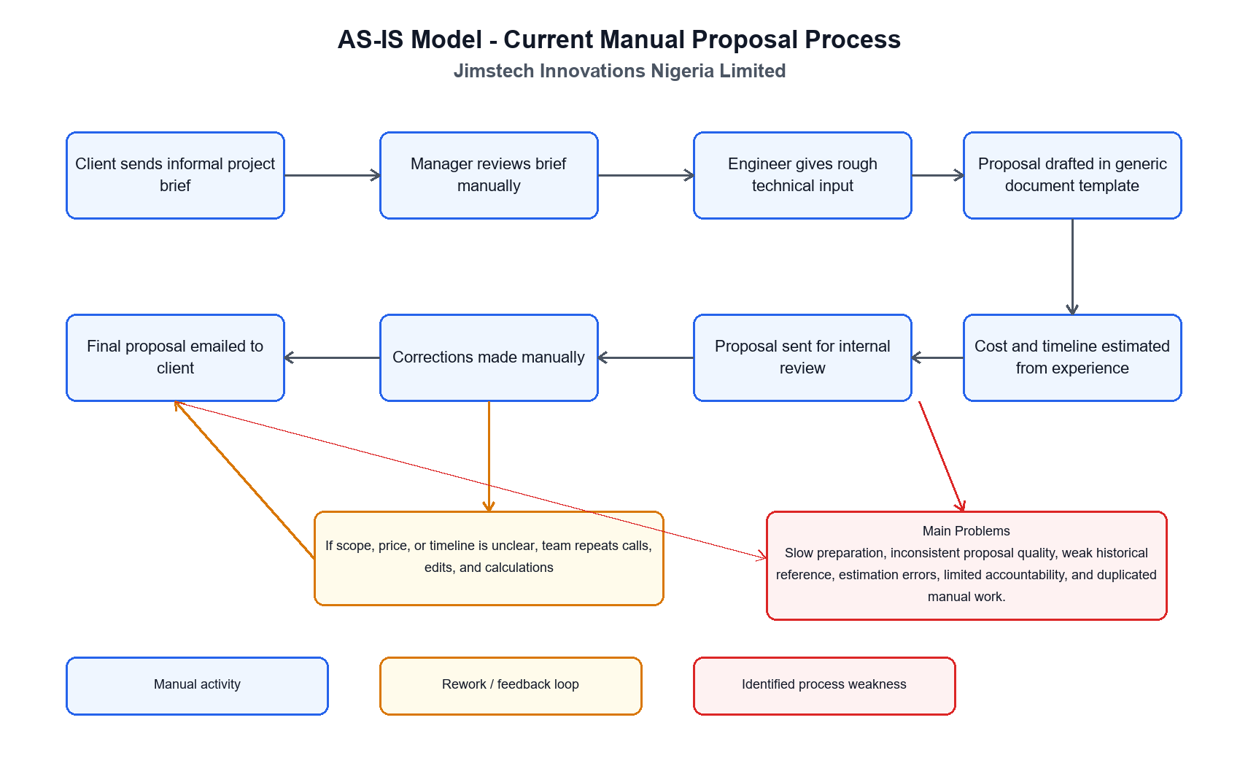
Current System Analysis
- Client briefs arrive through emails, chats, calls, and informal documents. - Requirements are scattered and may be incomplete or ambiguous. - Senior staff manually prepare proposals and estimate cost/timeline. - There is limited reuse of past project records and no automated review workflow. - Main effect: slow response time, inconsistent output, and reduced scalability.
AI-Powered Technical Proposal and Cost Estimation System
10
Notes:
Use this slide to describe how the current manual process works and why it creates delays.

Slide 11
Proposed Solution
- A web-based AI-assisted system for end-to-end proposal and estimation workflow. - Structured requirement capture feeds proposal, cost, timeline, and technology modules. - LLM API generates decision-support content; local fallbacks keep the workflow usable when API is unavailable. - Supabase stores users, clients, projects, proposals, reviews, estimates, timelines, recommendations, reports, and audit logs. - Role-based access protects sensitive proposal and financial data.
AI-Powered Technical Proposal and Cost Estimation System
11
Notes:
Present the proposed system as an integrated workflow, not just separate pages.

Slide 12
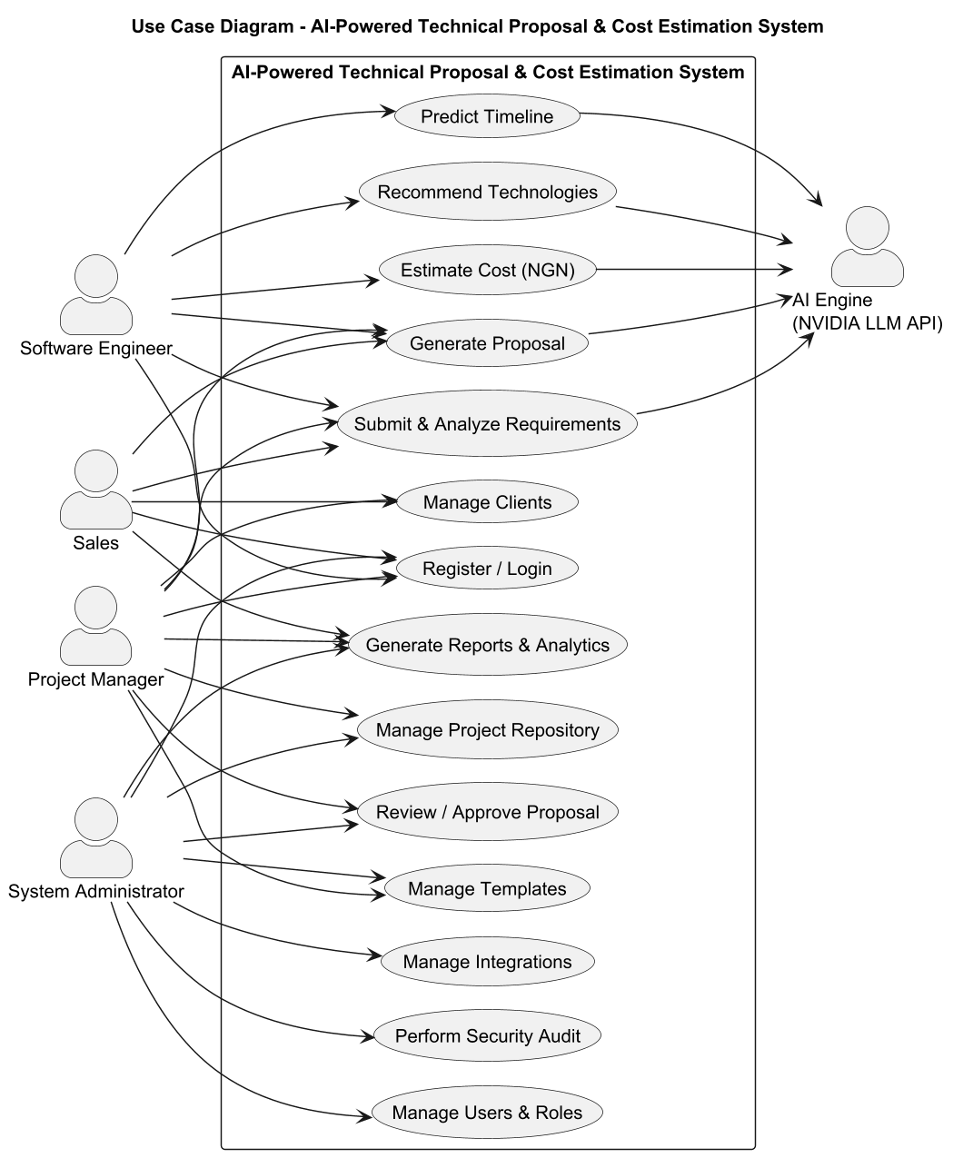
Use Cases
- Software Engineer: capture requirements, generate planning outputs, and create proposal drafts. - Project Manager: review, approve, manage templates, and oversee project repository records. - Sales: manage clients, requirements, proposals, and reports for client engagement. - Admin: manage users, integrations, security audit, and system settings.
AI-Powered Technical Proposal and Cost Estimation System
12
Notes:
Explain the main actors and what each role can do in the system.

Slide 13
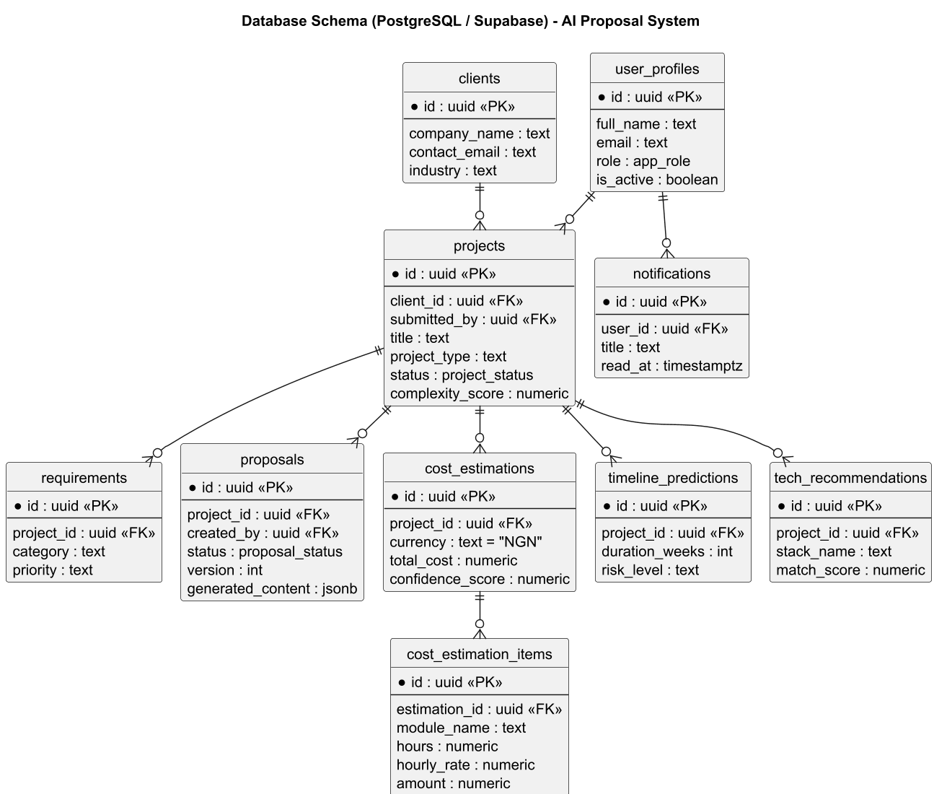
System Design and Architecture
- Frontend: React 18, TypeScript, Vite, Tailwind CSS, Radix UI, Lucide icons, and Recharts. - Backend/data: Supabase PostgreSQL, authentication, Row-Level Security, triggers, and audit logs. - AI layer: NVIDIA NIM LLM API for analysis and generation, with deterministic local fallbacks. - Architecture supports maintainability, security, scalability, and modular development.
AI-Powered Technical Proposal and Cost Estimation System
13
Notes:
Briefly describe the layers of the system and the technologies used.

Slide 14
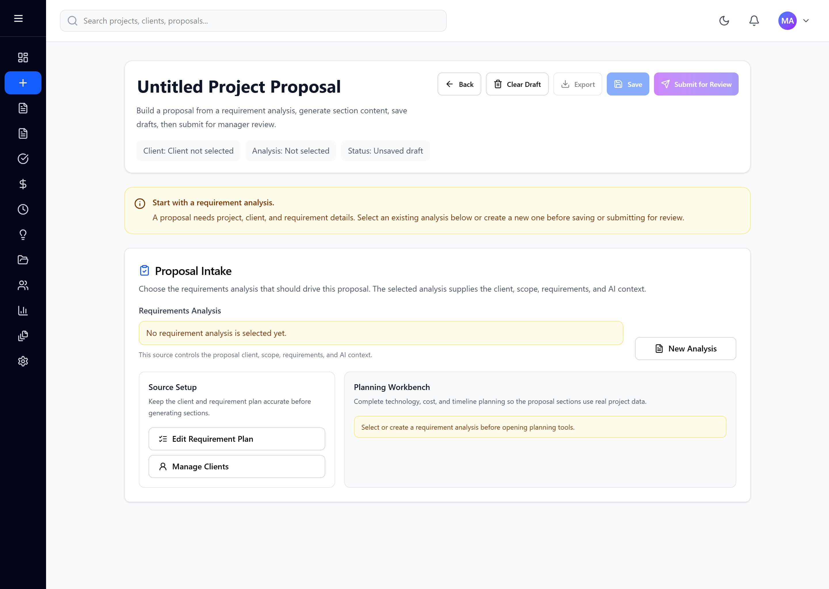
Implementation Highlights
- Requirement analysis converts client needs into structured project records. - Proposal module generates editable sections and supports review/approval. - Cost, timeline, and technology modules provide real planning values for proposals and reviews. - Exports support Markdown, PDF print flow, and DOC format for reports and proposals. - Client email action opens Gmail compose from jimstech4u@gmail.com without API integration.
AI-Powered Technical Proposal and Cost Estimation System
14
Notes:
Highlight the actual implemented features that are most important for demonstration.

Slide 15
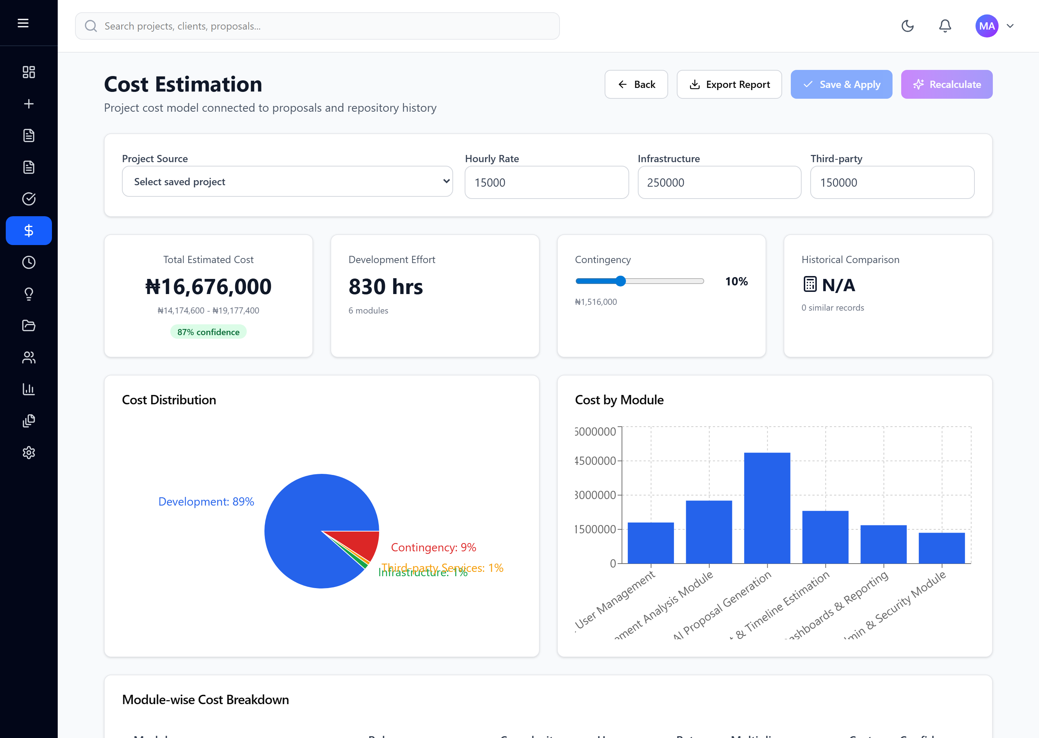
Expected Results
- Reduced time required to prepare technical proposals. - More consistent proposal structure and documentation quality. - Improved cost and timeline projections using requirement and historical project context. - Better technology decisions aligned with project needs. - Faster client onboarding and stronger organizational learning through project repository records.
AI-Powered Technical Proposal and Cost Estimation System
15
Notes:
State the expected benefits in business and technical terms.

Slide 16
Recommendations and Conclusion
- Deploy the system for real proposal workflows at Jimstech Innovations Nigeria Limited. - Train engineers, project managers, sales staff, and administrators before full adoption. - Keep historical project data accurate so future estimates become more reliable. - Extend future versions with CRM, email/calendar automation, and richer analytics. - Conclusion: the system provides a practical AI-assisted platform for improving proposal quality, estimation accuracy, and client response speed.
AI-Powered Technical Proposal and Cost Estimation System
16
Notes:
Close by emphasizing practical value, adoption steps, future improvement, and final contribution.

