Slide 1
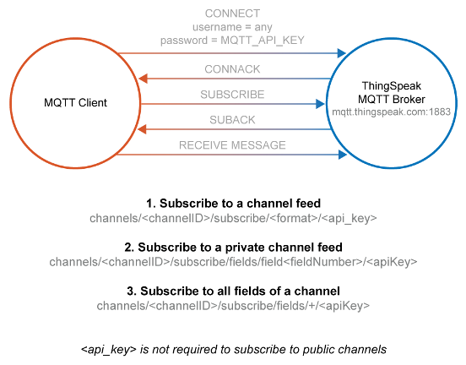
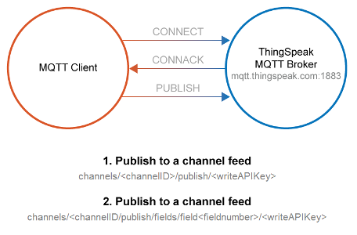
Project Graphics & Benchmarks •Pictorial (block level) representation of project
•Flow chart of potential algorithm/logic
•Informational flow diagram •Deliverable: Slides addressing the above
Externalise API keys from code for security on public repositories

Slide 2
