Slide 1
Kaggle: Otto Group Product Classification Challenge

Slide 2
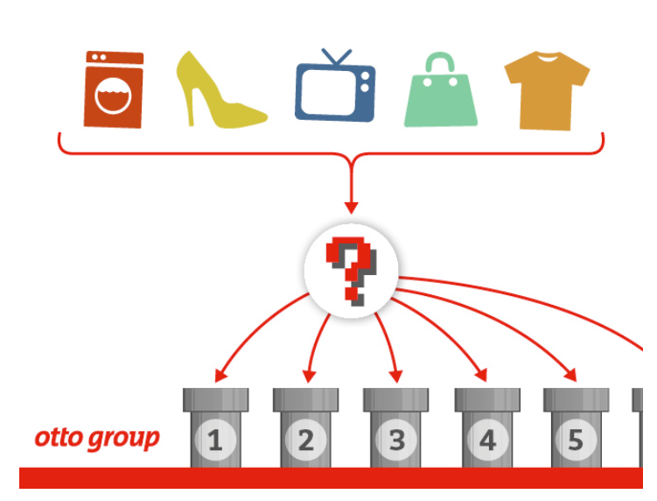
Challenge Overview
The Otto Group is one of the world’s biggest e-commerce companies, with subsidiaries in more than 20 countries, including Crate & Barrel (USA), Otto.de (Germany) and 3 Suisses (France). They sell millions of products worldwide every day, with several thousand products being added to the product line.
A consistent analysis of the performance of our products is crucial. However, due to our diverse global infrastructure, many identical products are classified differently. Therefore, the quality of our product analysis depends heavily on the ability to accurately cluster similar products.
The objective is to build a predictive model which is able to distinguish between our main product categories. The winning models will be open sourced.

Slide 3
Challenge Data
Kaggle Training Data Set
61,878 observations
1 identifier attribute
93 explanatory attributes (feat_1, …, feat_93), numeric counts
Response attribute designating the product category (Class_1, …, Class_9)
Input to predictive modeling work
Kaggle Test
Data Set
144,368 observations
1 identifier attribute
93 explanatory attributes
Used to make predictions from developed models

Slide 4
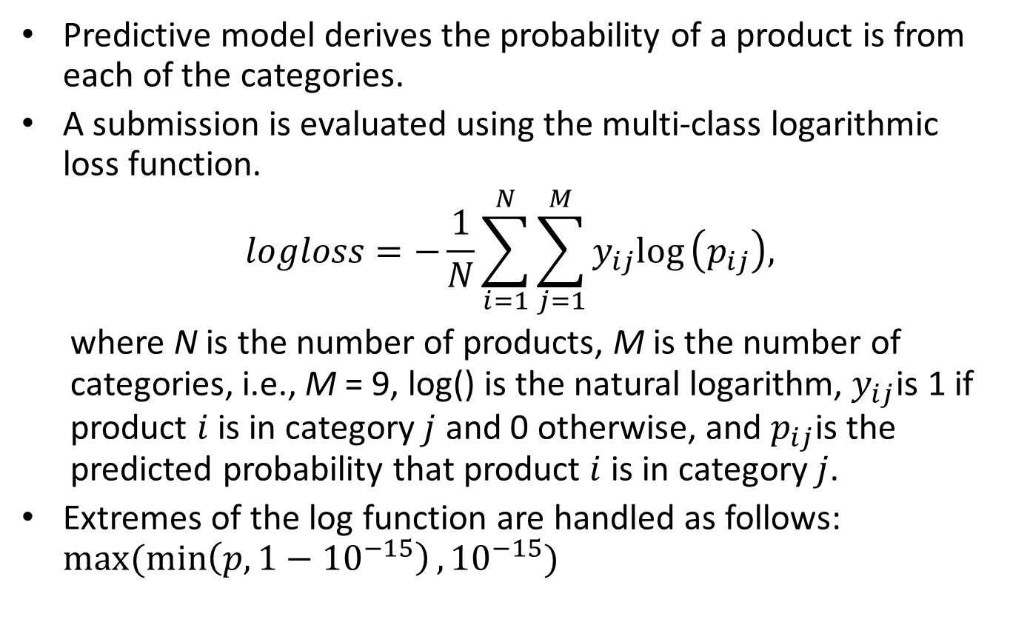
Predictive model derives the probability of a product is from each of the categories.
A submission is evaluated using the multi-class logarithmic loss function.
$$logloss=−\frac{1}{N}\sum_{i=1}^{N}{\sum_{j=1}^{M}{y_{ij}\text{log}}}\left(p_{ij}\right),$$
where N is the number of products, M is the number of categories, i.e., M = 9, log() is the natural logarithm, $y_{ij}$is 1 if product $i$ is in category $j$ and 0 otherwise, and $p_{ij}$is the predicted probability that product $i$ is in category $j$.
Extremes of the log function are handled as follows: $max⁡(\min\left(p,1−{10}^{−15}\right),{10}^{−15})$

Slide 5
Modeling Data Set up
Partition Kaggle Training Data set into three mutually exclusive subsets.
Kaggle Training Data Set
train.raw
60% random sample of Kaggle Training Data
Used to train model
calib.raw
20% random sample of Kaggle Training Data
Used to derive blending weights
test.raw
20% random sample of Kaggle Training Data
Estimate submission score

Slide 6
Modeling Cycle
Feature Analysis
Feature Engineering
Feature Selection
Model Training
Model Performance Assessment

Slide 7
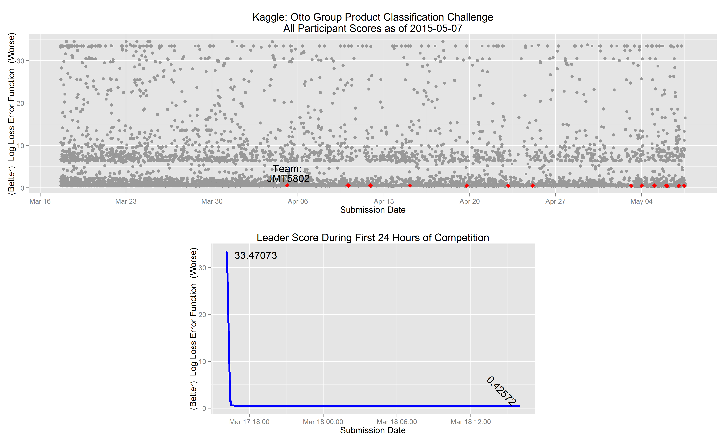

Slide 8
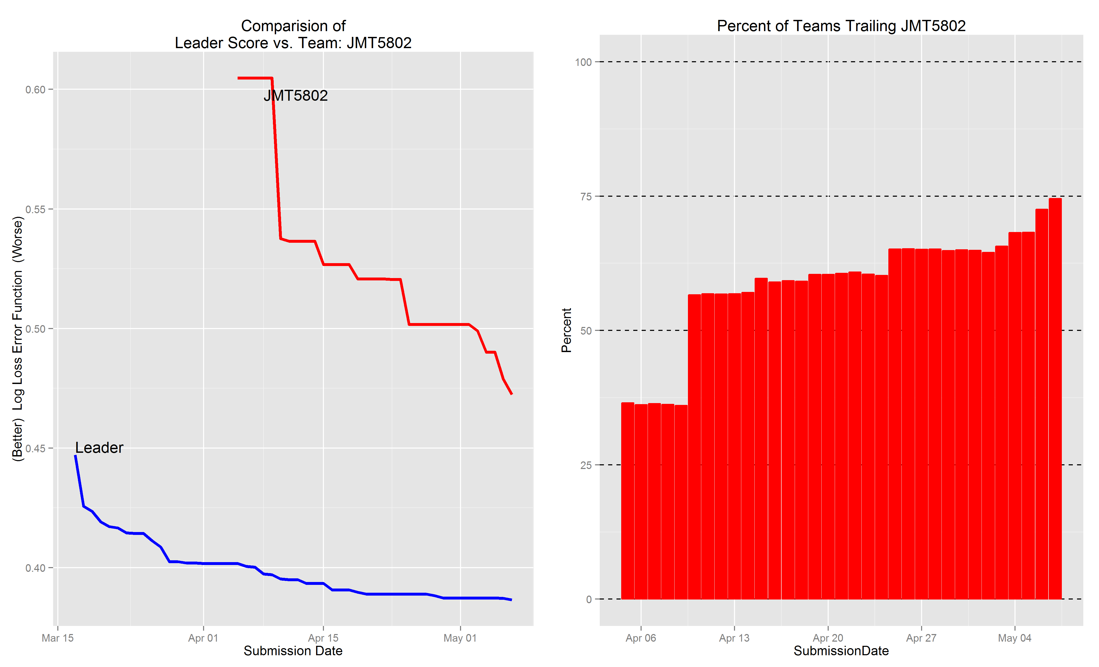
Phase 3
Phase 2
Phase 1

Slide 9
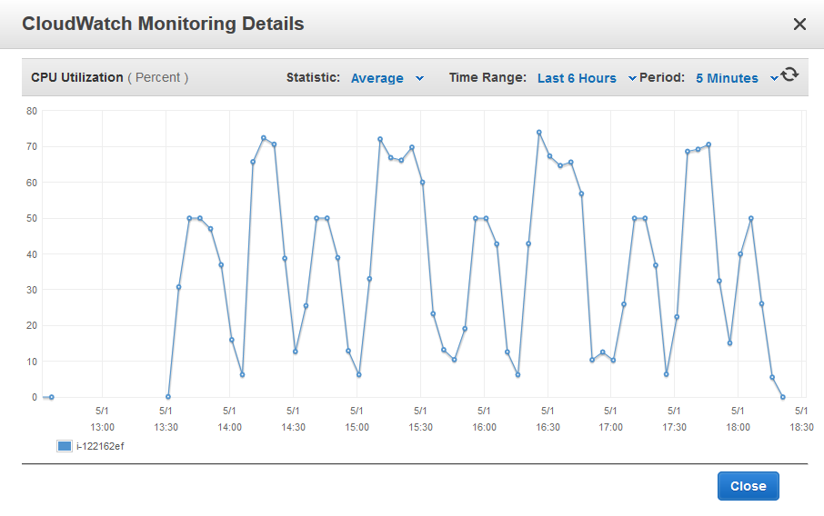

Slide 10
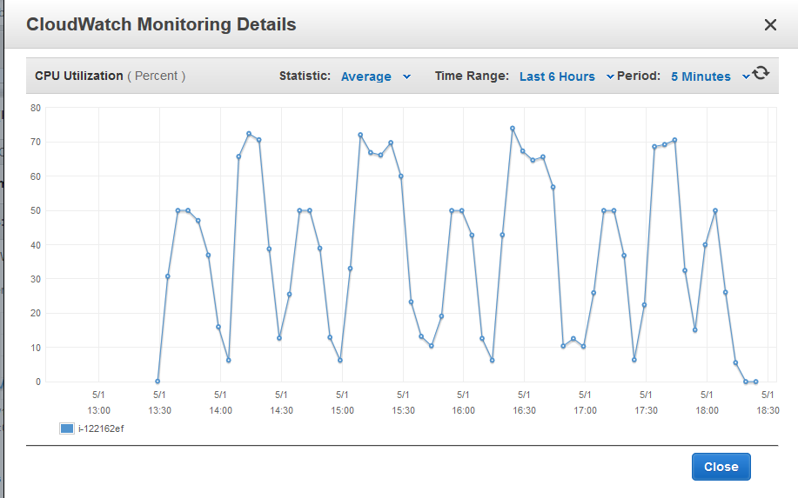

Slide 11
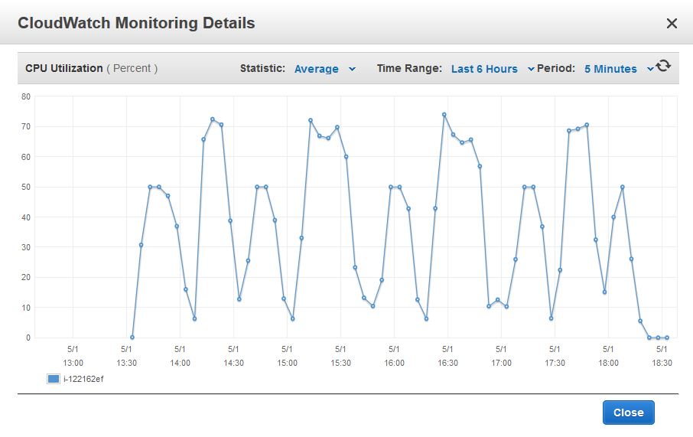

Slide 12
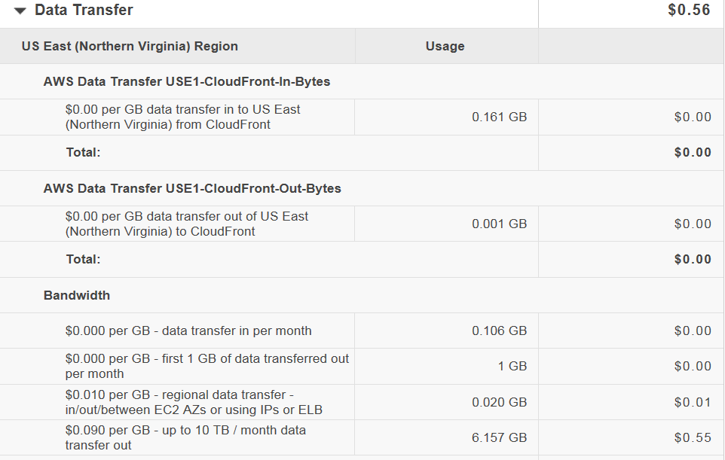

Slide 13
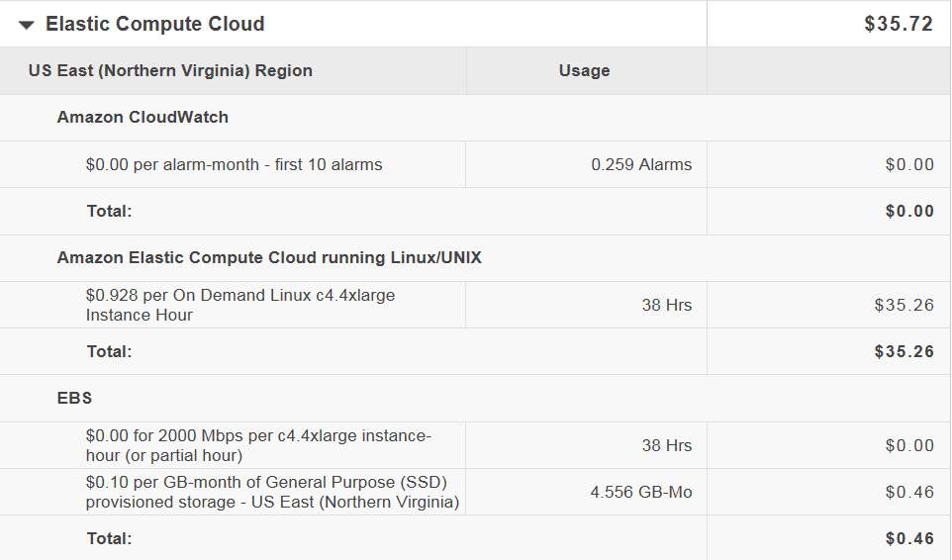

Slide 14
