Slide 1
Research meeting
21-11-2023
Jim van Veenhuyzen

Slide 2
Current short term goals:
Make a selection of galaxies from all subhalos
Here currently, almost finished?
Create our own galaxy catalogue
Use galaxy catalogue to create power spectra using NBODYKIT
Longer term: apply the RSD effect…

Slide 3
What I did this week…
Wrote code that finds the stellar positions, masses and velocities per sub-halo
Makes a selection within 50kpc from Centre of Potential
Calculates total stellar mass of all particles in this region
If large enough, accept as a galaxy, else reject
For galaxies we save the…
Positions of all particles
Average position
Average velocity
Velocity dispersion
Galaxy mass

Slide 4
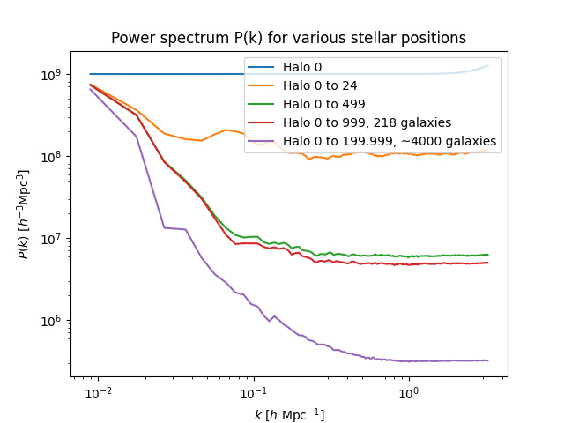
Ran the code for 200.000 subhalos
Not using np.intersect1d over all particles is significantly faster
Rate of about 4 subhalos/s
Power spectra in line with expectations
We did not use foldings yet
Sharp edges at low k?

Slide 5
2 remaining issues and my solution attempts:
Rate of 4 subhalos/seconds still too slow
13.2 mil SH would take 5.5 weeks to run
Let’s inspect my code? My efficiency solutions (thanks to NUR):
Use float32/int32 to save memory
Use numpy masking (np.where): only define the mask once
Ofcourse, use r^2 instead of sqrt(r^2)
Brought the code down from 9 seconds / SH to 4 SH / second (36x faster)
The stellar mass I calculate is way off compared to the InclusiveSphere Stellarmass from the data!
My guess: problem is VR/CentreOfPotential uses all particles instead of just stellar
Underestimates the mass because it cannot find enough particles within 50kpc
I tried ExclusiveSphere & FOFshproperty stellar mass and manually computing the stellar centre of mass & InclusiveSphere (regular) centre of mass, nothing matches

