Slide 1
Research meeting
28-11-2023
Jim van Veenhuyzen

Slide 2
What am I currently working on?
Creating a galaxy catalogue so that we can create our own power spectra
Using catalogue, create power spectra while applying RSD effect: using a velocity offset along some line of sight axis (e.g. [0,0,1])

Slide 3
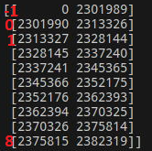
How to create this galaxy catalogue?
GroupNr_all from the membership files links snapshot data to VR
Contains array index of VR group that some particle belongs to (-1 = ungrouped)
Create ‘lookup-table’ using GroupNr_all that allows us to find particle indices per VR group
Apply same sorting on the snapshot data (positions,velocities,masses)

Slide 4
Past problems
Stellar mass I calculated and the stellar mass from the Inclusive Sphere did not match
Fixed easily as I used the wrong particle mass
Reading in the halos was too slow
Fixed by using the aforementioned sorting

Slide 5
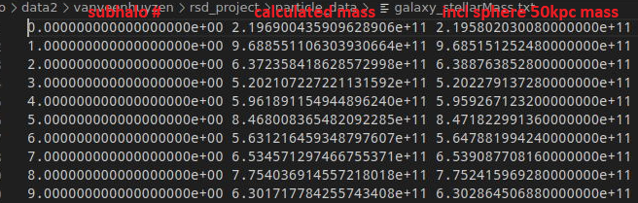
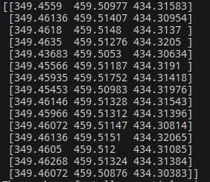
Current problem (that I have spend too much time on…)
My code works perfectly for the first amount of halos
For some reason still unknown to me, a de-sync occurs between my lookup-table and the VR group
Appears to happen at around subhalo 10.000
Example for subhalo 1 million:

Slide 6
What I think might be possible culprits
The ungrouped particles somehow disrupt the order
Unlikely, since the first few thousand halos match up perfectly
The de-sync happens when switching from the first snapshot file to the second
Unlikely, since that would mean it happens at around SH 200.000, but it happens some time earlier
The subhalos that contain no stellar particles (and thus have stellar mass 0) disrupt the order of the lookup-table.
Strange, since only 22 positions in the array of 5.4 billion Stellar particles contain the position 0
Not sure how else they would represent a ‘missing’ Stellar particle, so there should be 5.4 billion stellar particles

