Slide 1
How feedback influences galaxy redshift-space distortions
Jim van Veenhuyzen, 11-6-2024
Project Supervisor: Dr. Marcel van Daalen

Slide 2
Contents
Introduction
Methodology
Galaxy catalogue
Redshift-space positions
Power spectra
Modelling of the RSD
Feedback-mechanism variations
Results
Discussion & Conclusion

Slide 3
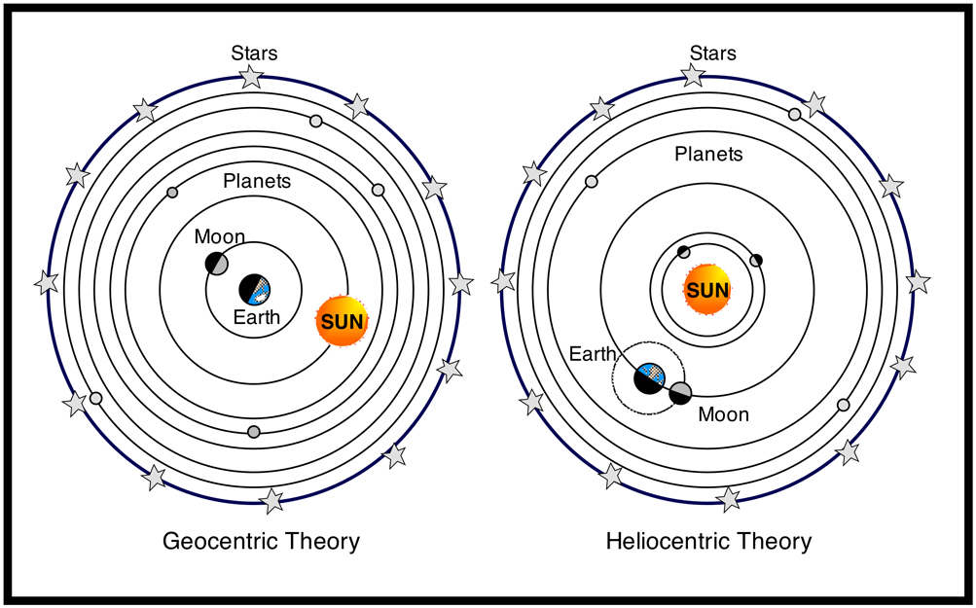
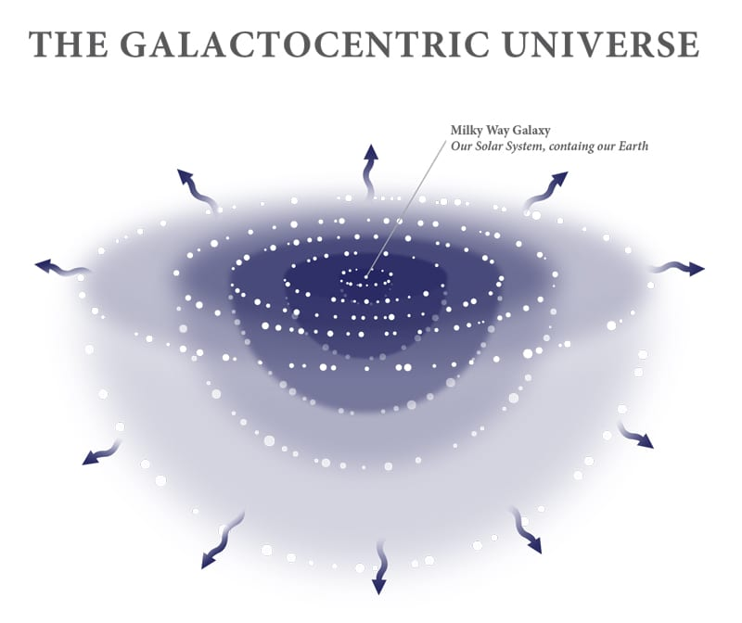
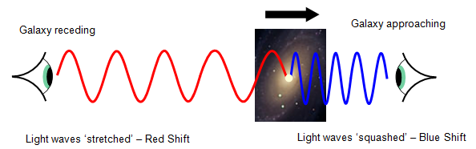
Introduction: Historical context
History:
~150: Geocentrism by Ptolemy
1543: Heliocentrism by Copernicus
1926: Galactrocentrism by Hubble
1975: Acentrism: shift due to Hubble’s observations of distant galaxies*
*Doppler effect: observed light from far-away galaxies is redshifted

Slide 4
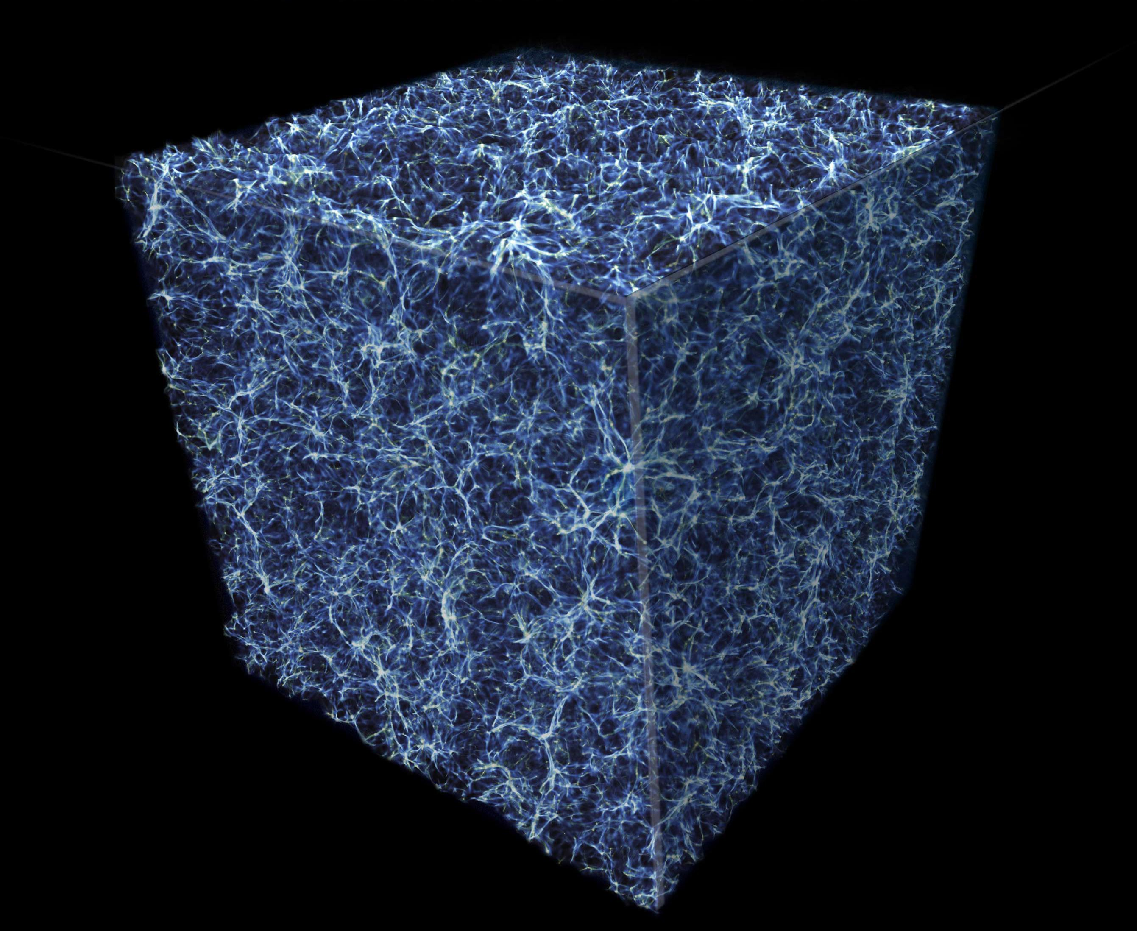

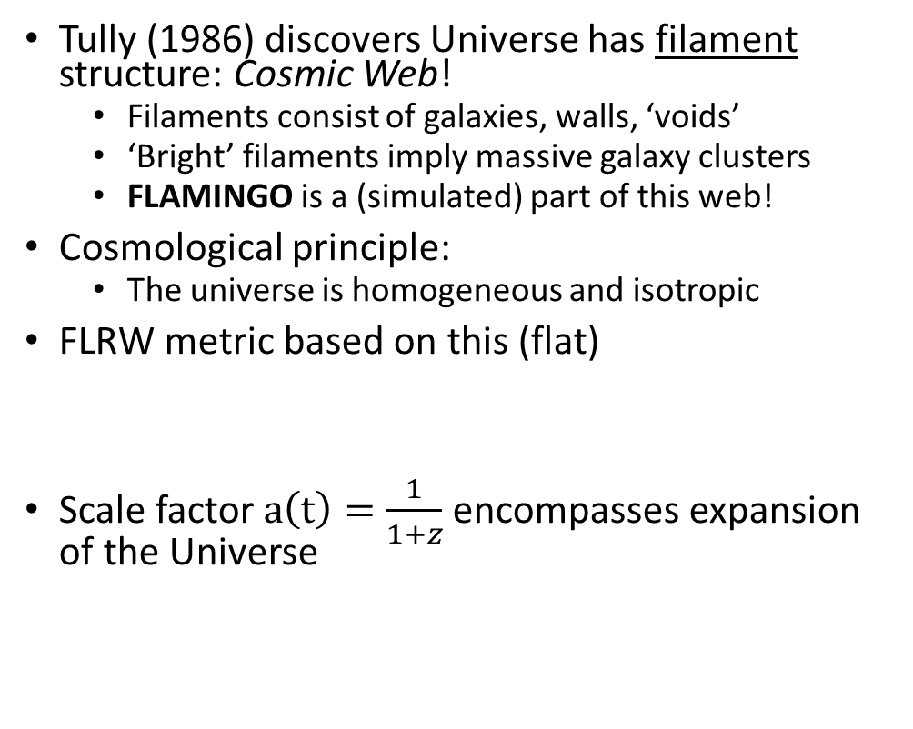
Introduction: The universe at the largest scale
Tully (1986) discovers Universe has filament structure: Cosmic Web!
Filaments consist of galaxies, walls, ‘voids’
‘Bright’ filaments imply massive galaxy clusters
FLAMINGO is a (simulated) part of this web!
Cosmological principle:
The universe is homogeneous and isotropic
FLRW metric based on this (flat)
Scale factor $a\left(t\right)=\frac{1}{1+z}$encompasses expansion of the Universe
Notes:
We recover the metric tensor if we take a(t)=1 (steady state cosmology)

Slide 5
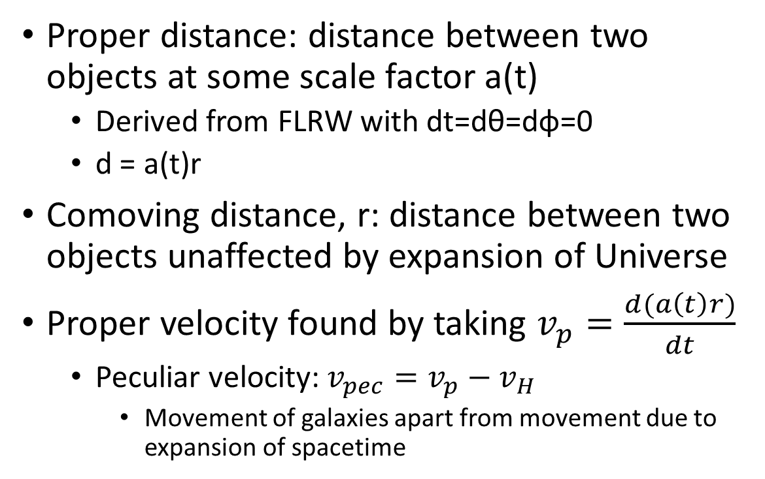
Introduction: Proper and comoving
Proper distance: distance between two objects at some scale factor a(t)
Derived from FLRW with dt=dθ=dφ=0
d = a(t)r
Comoving distance, r: distance between two objects unaffected by expansion of Universe
Proper velocity found by taking $v_{p}=\frac{d(a\left(t\right)r)}{dt}$
Peculiar velocity: $v_{pec}=v_{p}−v_{H}$
Movement of galaxies apart from movement due to expansion of spacetime

Slide 6
Introduction: Redshift-Space Distortions
With the background ,

Slide 7
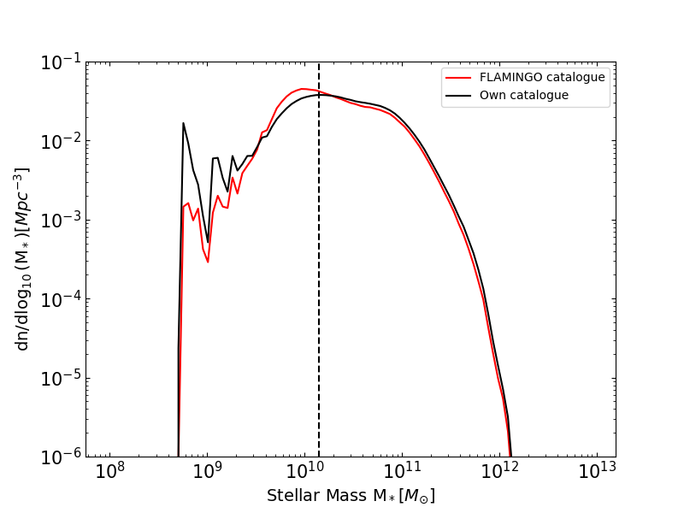
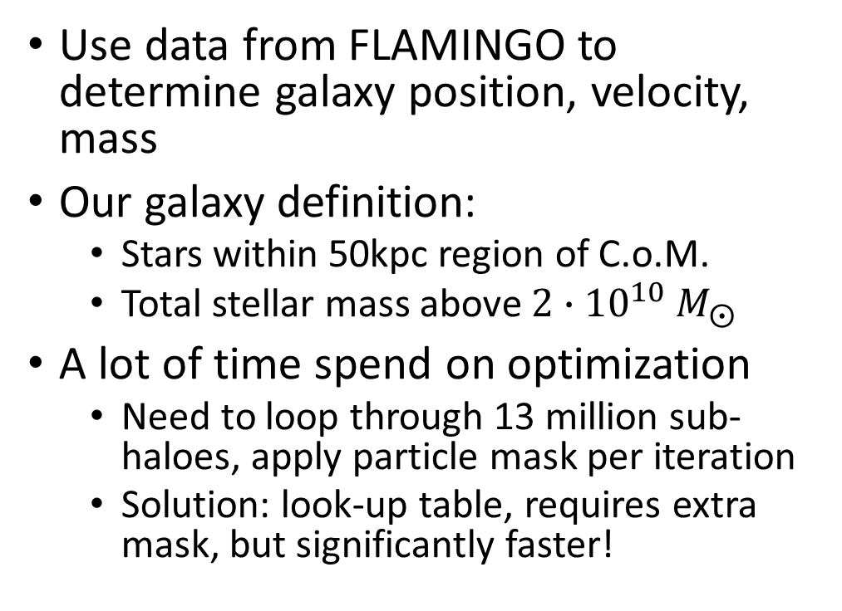
Methods: creating a galaxy catalogue
Use data from FLAMINGO to determine galaxy position, velocity, mass
Our galaxy definition:
Stars within 50kpc region of C.o.M.
Total stellar mass above ${2∙10}^{10} M_{⨀}$
A lot of time spend on optimization
Need to loop through 13 million sub-haloes, apply particle mask per iteration
Solution: look-up table, requires extra mask, but significantly faster!

Slide 8
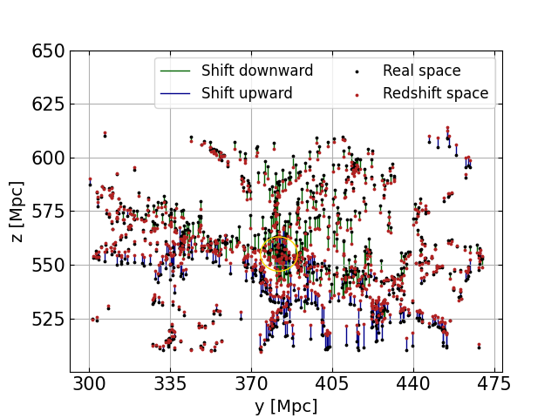
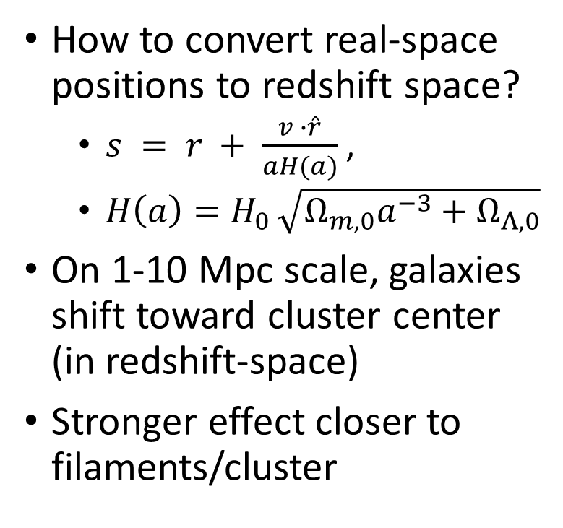
Methods: redshift-space positions
How to convert real-space positions to redshift space?
$s = r + \frac{v ∙\hat{r}}{aH(a)}$,
$H\left(a\right)=H_{0 }\sqrt{Ω_{m,0}a^{−3}+Ω_{Λ,0}}$
On 1-10 Mpc scale, galaxies shift toward cluster center (in redshift-space)
Stronger effect closer to filaments/cluster

Slide 9
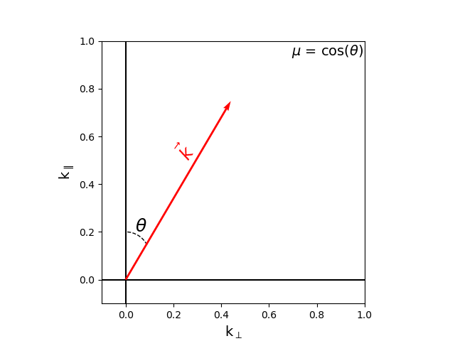
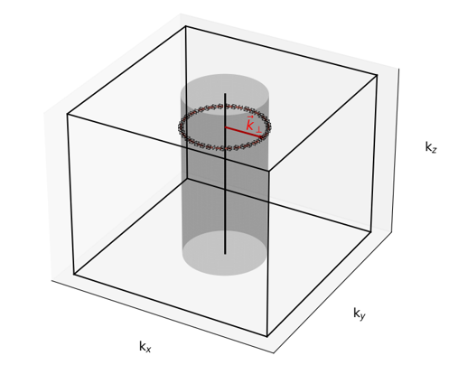
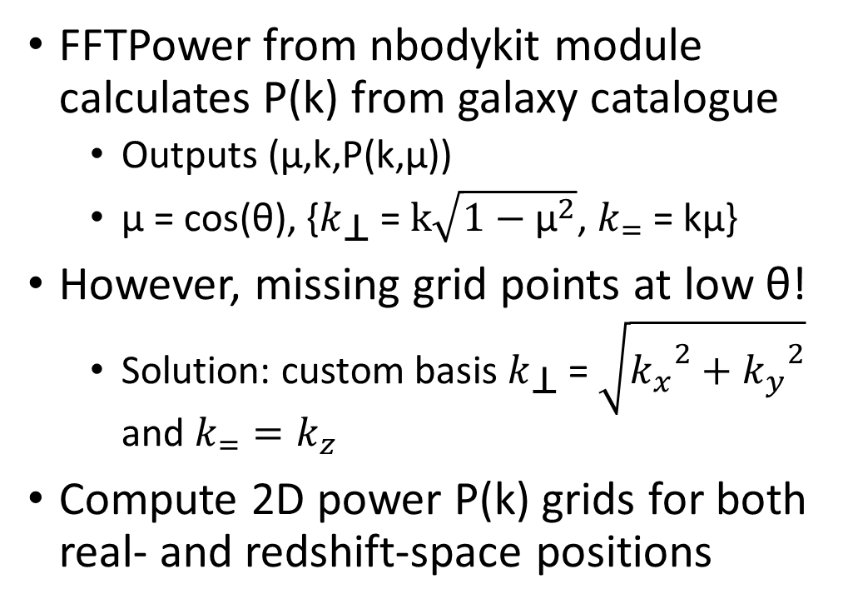
Methods: 2D power-spectrum grid
FFTPower from nbodykit module calculates P(k) from galaxy catalogue
Outputs (μ,k,P(k,μ))
μ = cos(θ), {$k_{\text{⊥}}$ = $k\sqrt{1−{\text{μ}}^{2}}$, $k_{=}$ = kμ}
However, missing grid points at low θ!
Solution: custom basis $k_{\text{⊥}}$ = $\sqrt{{k_{x}}^{2}+{k_{y}}^{2}}$ and $k_{=}=k_{z}$
Compute 2D power P(k) grids for both real- and redshift-space positions

Slide 10
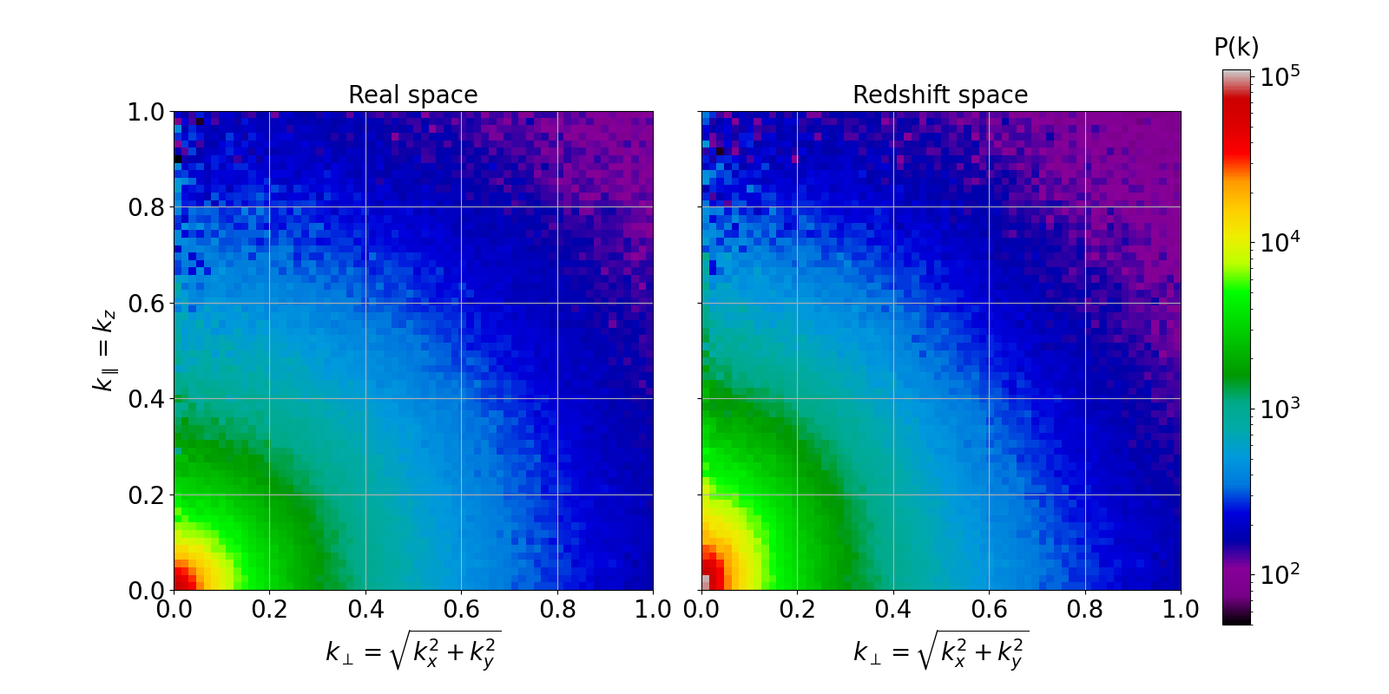

The real- and redshift position grids before (left) and after (right) re-binning
Next step: modelling the $\frac{P_{RSD}}{P_{Real}}$ grid! But first…

Slide 11
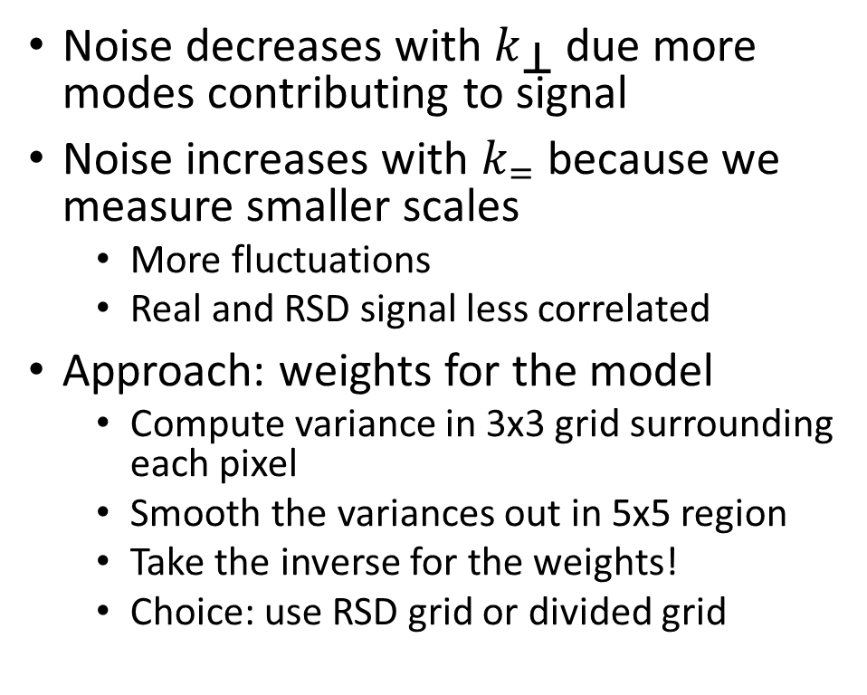
Methods: Weights
Noise decreases with $k_{\text{⊥}}$ due more modes contributing to signal
Noise increases with $k_{=}$ because we measure smaller scales
More fluctuations
Real and RSD signal less correlated
Approach: weights for the model
Compute variance in 3x3 grid surrounding each pixel
Smooth the variances out in 5x5 region
Take the inverse for the weights!
Choice: use RSD grid or divided grid

Slide 12
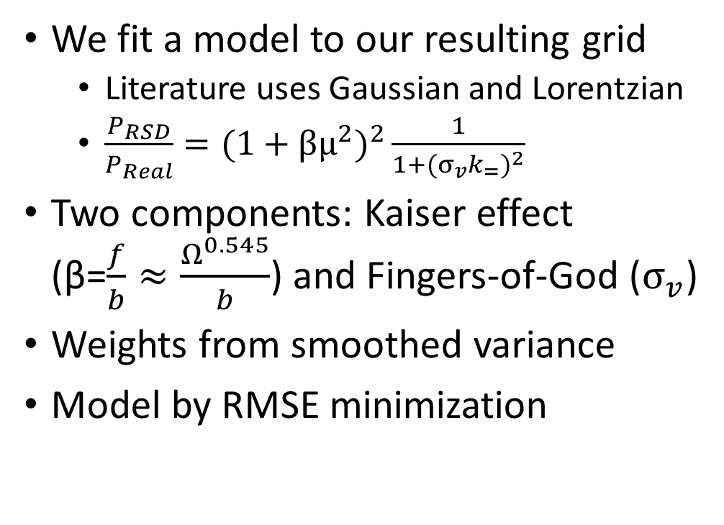
Methods: Redshift-Space Distortion model
We fit a model to our resulting grid
Literature uses Gaussian and Lorentzian
$\frac{P_{RSD}}{P_{Real}}=(1+βμ^{2})^{2}\frac{1}{1+({σ_{v}k_{=})}^{2}}$
Two components: Kaiser effect (β=$\frac{f}{b}≈\frac{Ω^{0.545}}{b}$) and Fingers-of-God ($σ_{v}$)
Weights from smoothed variance
Model by RMSE minimization

Slide 13
Methods: different simulations
Logaritmic mass bins
Higher redshifts
Vary AGN feedback strength

Slide 14
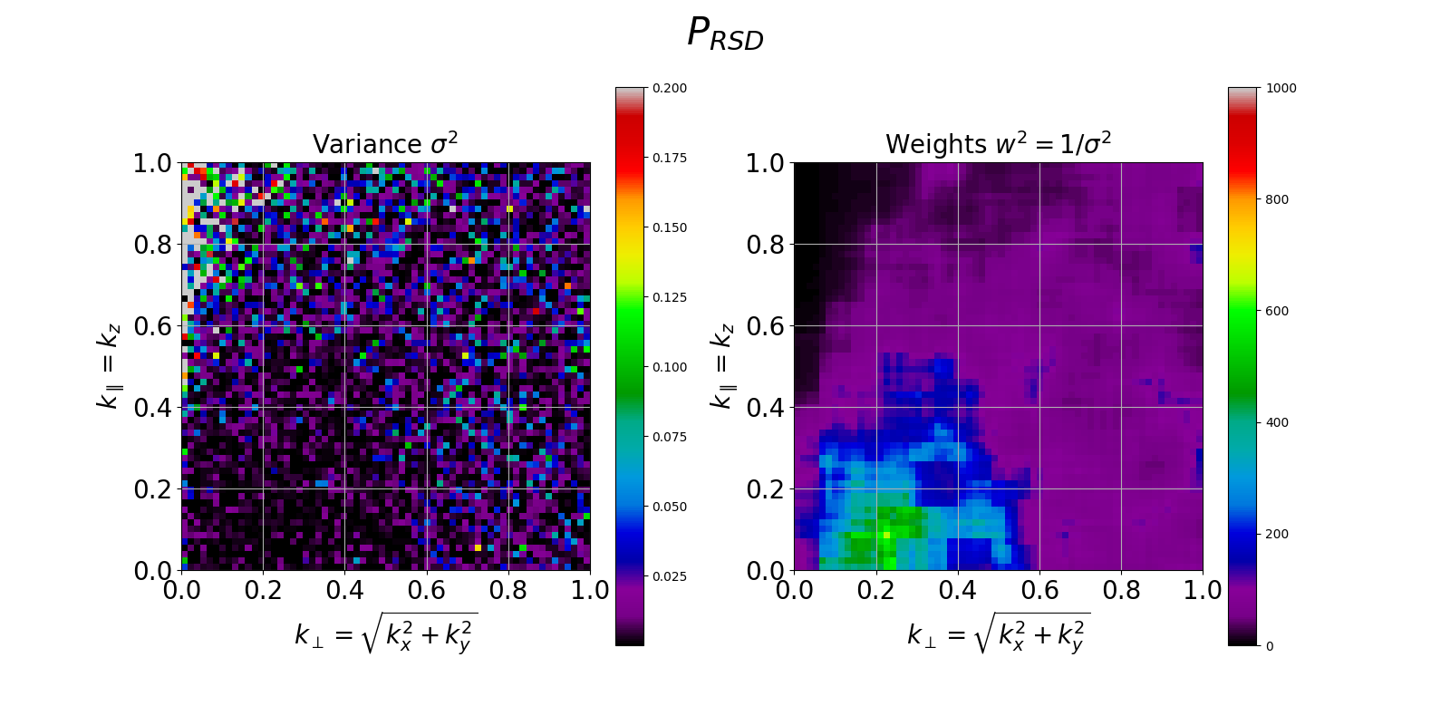
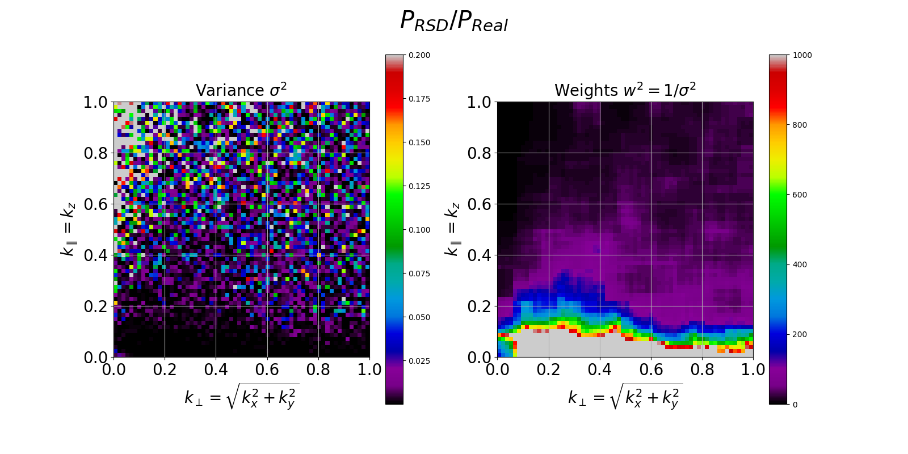
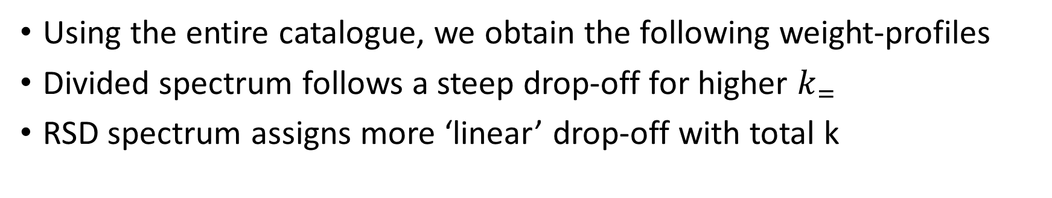
Results: Weight-grids
Using the entire catalogue, we obtain the following weight-profiles
Divided spectrum follows a steep drop-off for higher $k_{=}$
RSD spectrum assigns more ‘linear’ drop-off with total k

Slide 15
Results

Slide 16
Results:

Slide 17
Discussion

