Slide 1
Personal Website
Ethan Shin

Slide 2
Languages & framework
HTML
CSS
Java Script
Bootstrap(version 5)

Slide 3
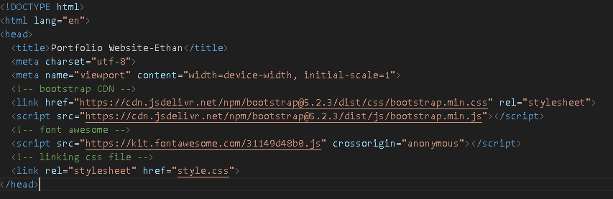
Bootstrap

Slide 4
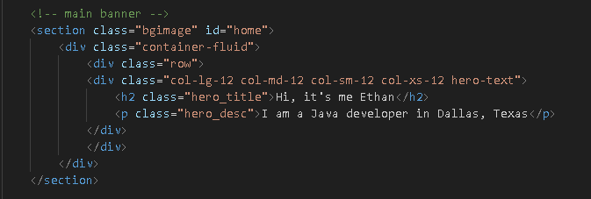
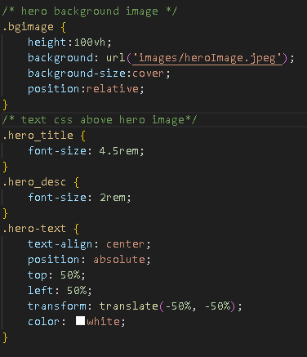
Main banner

Slide 5
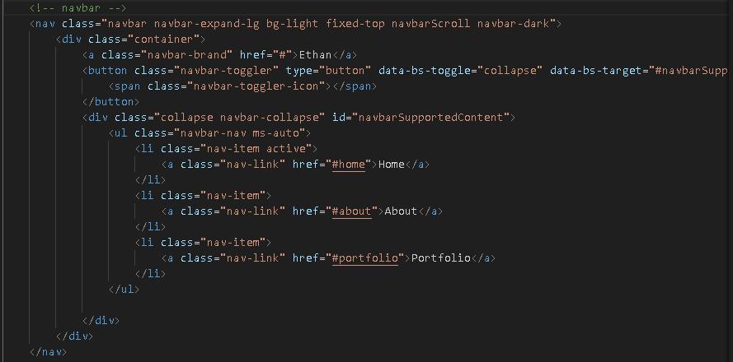

Navigation bar

Slide 6
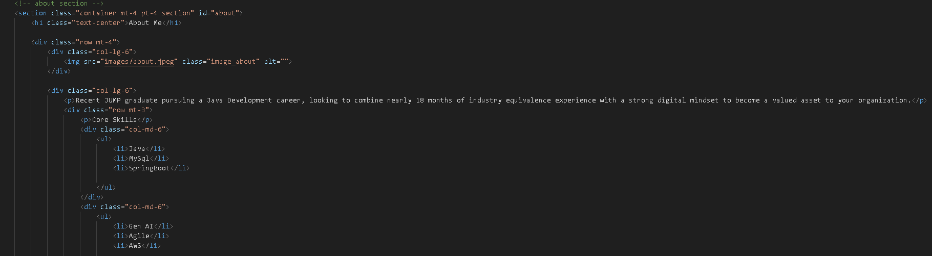

About me section

Slide 7
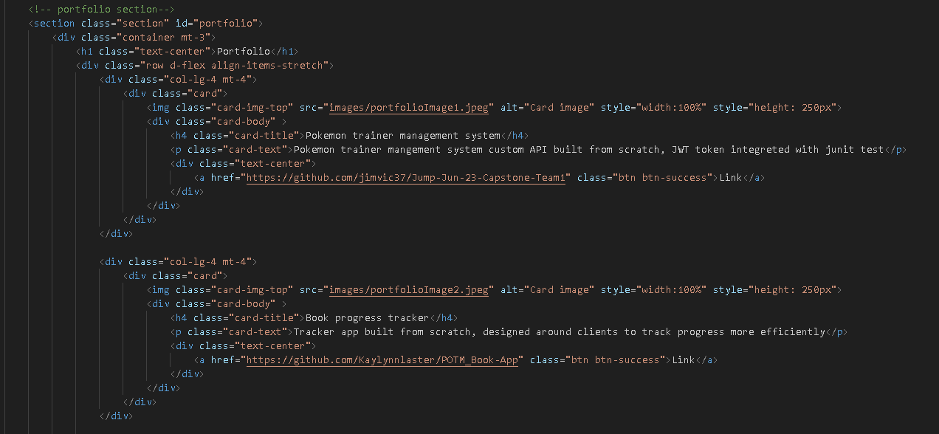
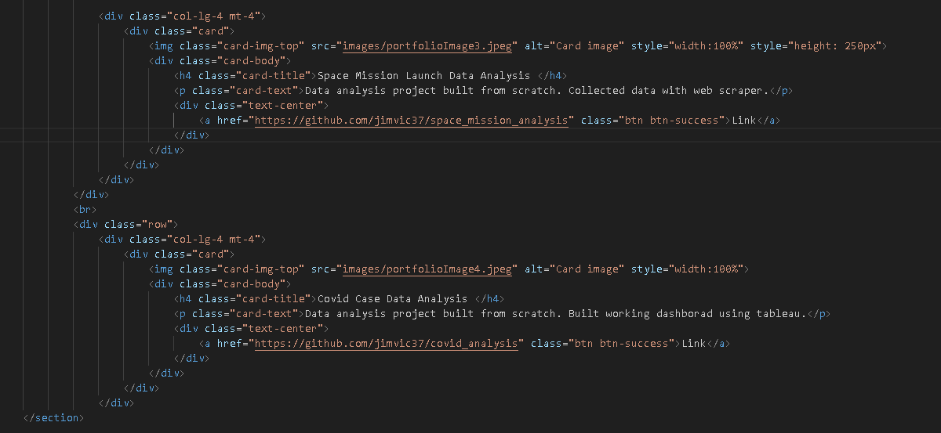
Portfolio section

Slide 8
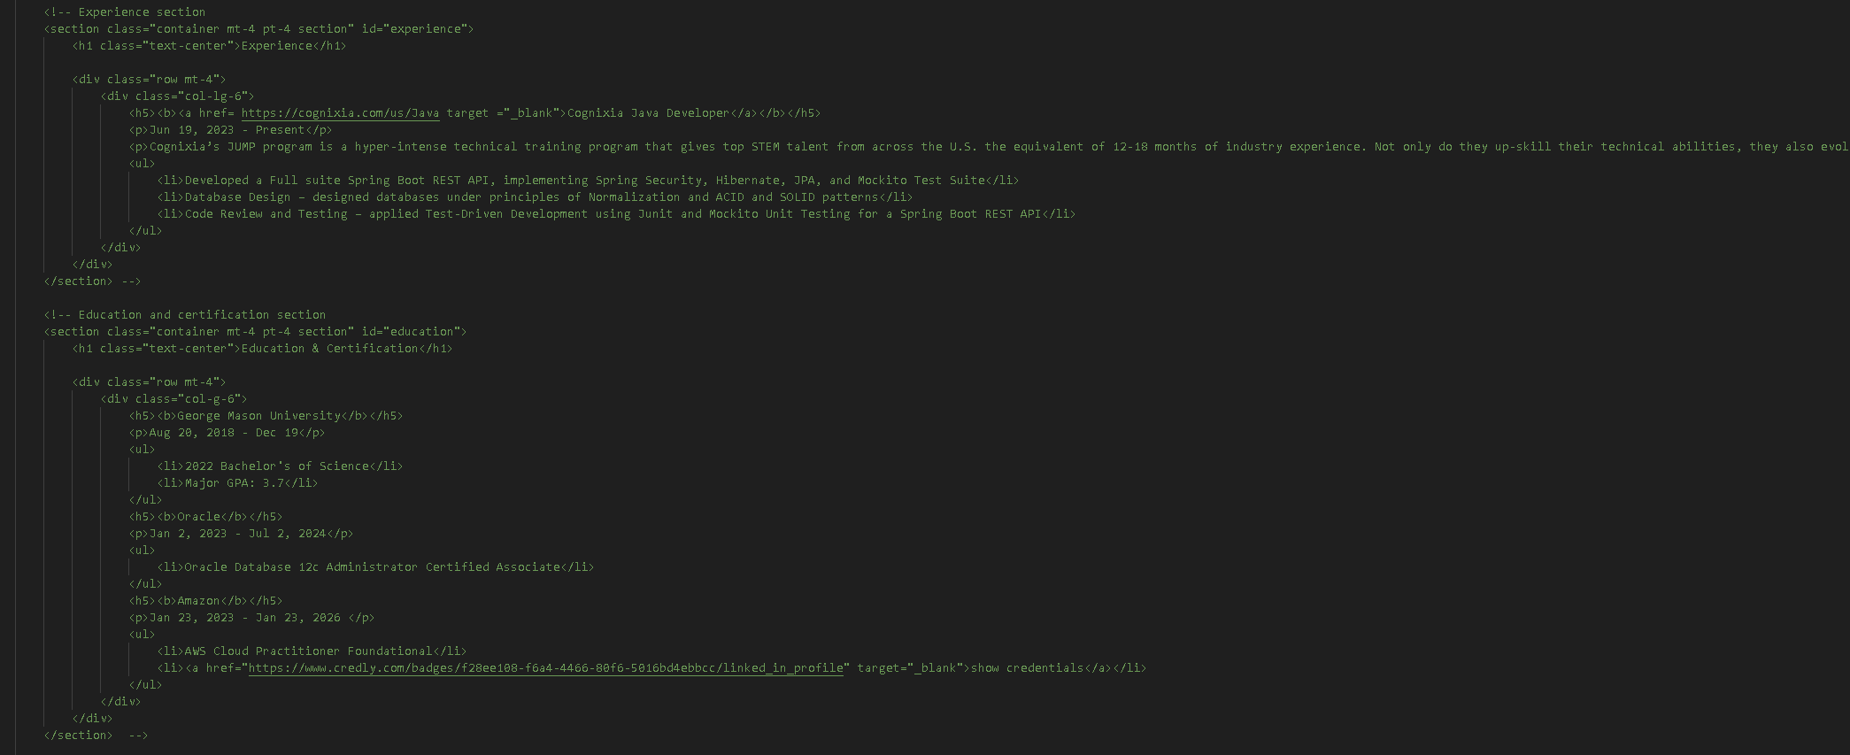
Experience & Education

Slide 9
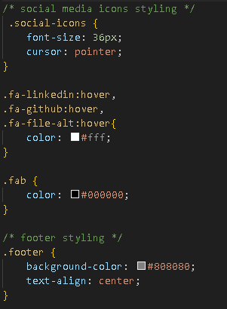
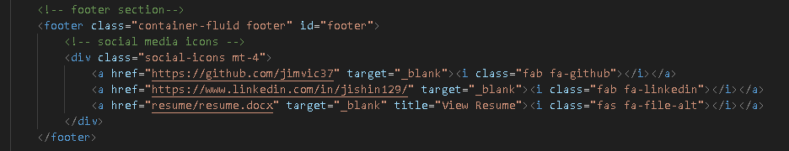
Social media link

Slide 10
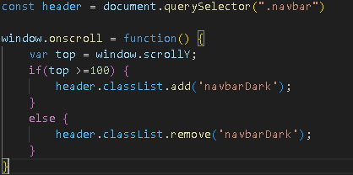
Java script
Notes:
If over 100 pixels display navbar dark if not remove it

Slide 11
Live Demo
Personal portfolio website

Slide 12
Reference
Chapagain, S. (2023a, May 18). How to create a portfolio website using HTML, CSS, JavaScript, and bootstrap 5. freeCodeCamp.org. https://www.freecodecamp.org/news/how-to-create-a-portfolio-website-using-html-css-javascript-and-bootstrap/#what-is-bootstrap
Mark Otto, J. T. (n.d.). Introduction. · Bootstrap v5.0. https://getbootstrap.com/docs/5.0/getting-started/introduction/

