Slide 1
DIP Final Project
資工二 王俊翔
資工三 陳建丞

Slide 2
Hawkeyes
Basketball Tracking

Slide 3
Problem Definition
Track the basketball movement in the video.
Detect whether shot from a player is a hit or a miss.

Slide 4
Motivation
There is a hawk-eye system in tennis field. It’s interesting to try it on basketball.
Provide great accuracy to the decsision making in game.

Slide 5
1.
Video segmentation

Slide 6
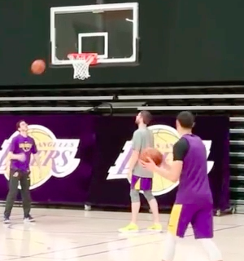
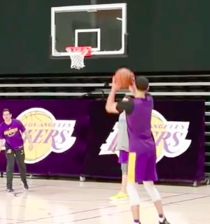
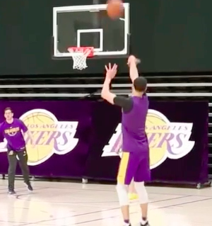
Video segmentation
Split the videos into many disjoint frames (about 35~40 fps)
Each frame can be considered as a colored picture
We will perform operations on each frame and compare the relation among different frames.

Slide 7
2.
Object Detection
Shape
detection
Color
detection

Slide 8
Color detection

Slide 9
Color detection
Convert
HSV
space
Opening
Find
contours

Slide 10
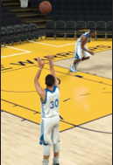
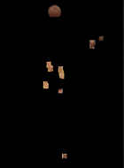
Color detection
Change the frame photo into HSV color space.
Apply a color mask on the frame, filter out the color unneeded.

Slide 11
Color detection
Perform opening operation to smoothen the shapes in the photo.
Find the contours with same color intensity.
Select suitable contours according to their average y-coordinate and contour area.
Calculate the minimum enclosing circle of the contour.

Slide 12
Shape detection

Slide 13
Shape detection
Convert
HSV
space
Remove
back
ground
Apply
filters
Find
contours
Edge
detection
Opening

Slide 14
Shape detection
Change the frame photo into HSV color space.
Apply a color mask on the frame, filter out the color unneeded.

Slide 15
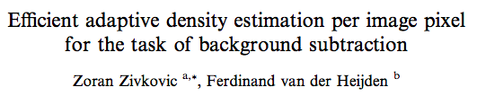
Shape detection
Perform background subtraction to detect moving objects.
Apply bilateral filter & Gaussian filter to remove noise.
Perform opening operation to smoothen the shapes in the photo.

Slide 16
Shape detection
Perform Canny edge detection.
Find the contours with same color intensity.
Use circle Hough transform to detect circles.

Slide 17
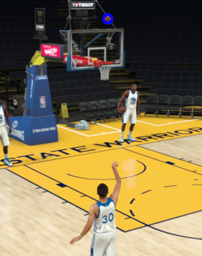
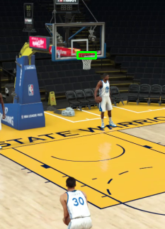
Object detection
Combine the results of shape detection and color detection.

Slide 18
3.
Movement tracking
Lagrange
Interpolation
Polynomials
method
Kalman
filter

Slide 19
Lagrange method

Slide 20
Lagrange method
Use three previously detected points to construct a quadratic polynomial.
Compute time interval to get x-coordinate and use it to derive y-coordinate.
Predict next possible position.

Slide 21
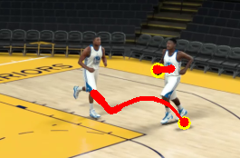
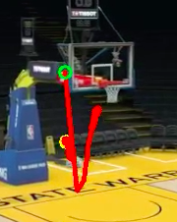
Lagrange method
Do not provide great accuracy in some situations.

Slide 22
Kalman filter

Slide 23
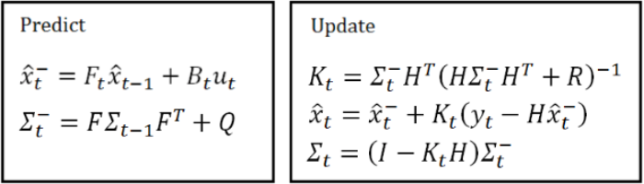
Kalman filter
Feed the coordinates of the ball to Kalman filter.
Update and predict the movement of the ball.

Slide 24
4.
Hit / miss detection

Slide 25
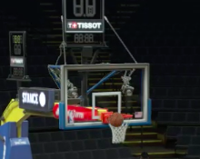
Hit/miss detection
Use the rim coordinates and the ball coordinates to detect whether the shot is a hit or a miss.
If the coordinates of ball cross the rim from up to down, chances are that it’s a hit.
Unfortunately, sometimes ball crosses the rim, but it’s actually outside the rim.

Slide 26
Hit/miss detection
If the ball crosses the rim from the outside, the ball will cover the rim and the net.
We can calculate the contour area of the rim and the net, if the area decreases largely, then the ball must have gone from the outside.

Slide 27
Obstacles
Not every frame of the video has great quality, some of it might be blurred.
If the scene becomes complex, the detection will be very bad.
The detection method is not generalized.

Slide 28
Reference
Shiuh-KuWeng, Chung-MingKuo, Shu-KangTu. Video object tracking using adaptive Kalman filter. Journal of Visual Communication and Image Representation, 2006.
Zoran Zivkovic, Ferdinand van der Heijden. Efficient adaptive density estimation per image pixel for the task of background subtraction. 2006.
Bodhisattwa Chakraborty, Sukadev Meher. Real-Time Position Estimation and Tracking of a Basketball. 2012 IEEE International Conference on Signal Processing, Computing and Control .

Slide 29
Result Demo

Slide 30

Thanks for listening

