Slide 1
Text Analytics and processing series session 1 –intro and foundation
Azure Machine Learning Meetup
January 25, 2018

Slide 2
motivation
Predicting Abnormal Bank Stock Returns
Using Textual Analysis of Annual Reports – a Neural Network Approach
©Springer International Publishing Switzerland 2016
C. Jayne and L. Iliadis (Eds.): EANN 2016, CCIS 629, pp. 67
–
78, 2016.
DOI: 10.1007/978-3-319-44188-7_5

Slide 3
A series on text and language analytics
There is an extensive portfolio of text and language analytic and processing capabilities
In various consumption models (Saas,Paas, Iaas) and integrated into other services and products
With a range of customization, extensibility, security and architecture options
There are many options – we will cover a generally popular subset
OSS libraries and frameworks included

Slide 4
What we’ll Cover & skip
cover
skip
Intent
Extraction
Topic
Semantic
Relations
Search
Translation
Voice
OCR
IVR
Video
Voice or Photo Authentication

Slide 5
Provide a basis for understanding and evaluating the offerings
Takes a systematic look at each option
With a demo
Discussions tradeoffs, constraints, and architecture
Provide supporting theory as appropriate
Help to think about ‘when to use what’

Slide 6
First session – introducing the portfolio
Scope of the effort
How we’ll proceed (from SaaS to totally custom)
Criteria and validation of an option
Just enough theory

Slide 7
The Saas offerings – a tour
Language
LUIS
Translator (text)
Analytics
Spell
Linguistics

Slide 8
Paas offerings tour
Azure Machine Learning (Azure ML)
Azure Machine Learning Workbench (Azure WB)
Azure Data Lake Analytics Text Components

Slide 9
Iaas tour
SQL Server 2017 with R and Python
MML Server (Microsoft Machine Learning)

Slide 10
Library/framework tour
R for Text Mining
Python NLTK
Python spaCy

Slide 11
Deep learning tour
Building blocks
Encodings
algorithms
Implementation
CNTK
Keras?

Slide 12
Session1: Basic Text Processing
http://web.stanford.edu/class/cs224n/

Slide 13
Text Preprocessing
Normalization
Convert words into a normalized forms
Down-case: e.g, The → the
Lemmatization: e.g, plays → play
Stemming: e.g, cat/cats, mouse/mice and run/runs/running/ran
Language Detection
Stop-words Removal
ignore predefined common words, e.g., the, a, to, with, that …
Special Characters Removal
ignore Non-Alphanumeric
Ignore numbers, emails, URLs

Slide 14
Text Normalization
Every NLP task needs to do text normalization:
Segmenting/tokenizing words in running text
Normalizing word formats
Segmenting sentences in running text

Slide 15
How many words?
I do uh main- mainly business data processing
Fragments, filled pauses
Seuss’s cat in the hat is different from other cats!
Lemma: same stem, part of speech, rough word sense
cat and cats = same lemma
Wordform: the full inflected surface form
cat and cats = different wordforms

Slide 16
How many words?
they lay back on the San Francisco grass and looked at the stars and their
Type: an element of the vocabulary.
Token: an instance of that type in running text.
How many?
15 tokens (or 14)
13 types (or 12) (or 11?)

Slide 17
How many words?
N = number of tokens
V = vocabulary = set of types
|V| is the size of the vocabulary
Church and Gale (1990): |V| > O(N^{½})
 | Tokens = N | Types = |V|
Switchboard phone conversations | 2.4 million | 20 thousand
Shakespeare | 884,000 | 31 thousand
Google N-grams | 1 trillion | 13 million

Slide 18
Simple Tokenization in UNIX
(Inspired by Ken Church’s UNIX for Poets.)
Given a text file, output the word tokens and their frequencies
tr -sc ’A-Za-z’ ’\n’ < shakes.txt
| sort
| uniq –c
1945 A
72 AARON
19 ABBESS
5 ABBOT
... ...
Change all non-alpha to newlines
Sort in alphabetical order
Merge and count each type
25 Aaron
6 Abate
1 Abates
5 Abbess
6 Abbey
3 Abbot
.... …

Slide 19
The first step: tokenizing
tr -sc ’A-Za-z’ ’\n’ < shakes.txt | head
THE
SONNETS
by
William
Shakespeare
From
fairest
creatures
We
...

Slide 20
The second step: sorting
tr -sc ’A-Za-z’ ’\n’ < shakes.txt | sort | head
A
A
A
A
A
A
A
A
A
...

Slide 21
More counting
Merging upper and lower case
tr ‘A-Z’ ‘a-z’ < shakes.txt | tr –sc ‘A-Za-z’ ‘\n’ | sort | uniq –c
Sorting the counts
tr ‘A-Z’ ‘a-z’ < shakes.txt | tr –sc ‘A-Za-z’ ‘\n’ | sort | uniq –c | sort –n –r
23243 the
22225 i
18618 and
16339 to
15687 of
12780 a
12163 you
10839 my
10005 in
8954 d
What happened here?

Slide 22
Issues in Tokenization
Finland’s capital → Finland Finlands Finland’s ?
what’re, I’m, isn’t → What are, I am, is not
Hewlett-Packard → Hewlett Packard ?
state-of-the-art → state of the art ?
Lowercase → lower-case lowercase lower case ?
San Francisco → one token or two?
m.p.h., PhD. → ??

Slide 23
Tokenization: language issues
French
L'ensemble → one token or two?
L ? L’ ? Le ?
Want l’ensemble to match with un ensemble
German noun compounds are not segmented
Lebensversicherungsgesellschaftsangestellter
‘life insurance company employee’
German information retrieval needs compound splitter

Slide 24
Tokenization: language issues
Chinese and Japanese no spaces between words:
莎拉波娃现在居住在美国东南部的佛罗里达。
莎拉波娃 现在 居住 在 美国 东南部 的 佛罗里达
Sharapova now lives in US southeastern Florida
Further complicated in Japanese, with multiple alphabets intermingled
Dates/amounts in multiple formats
フォーチュン500社は情報不足のため時間あた$500K(約6,000万円)
Katakana
Hiragana
Kanji
Romaji
End-user can express query entirely in hiragana!

Slide 25
Word Tokenization in Chinese
Also called Word Segmentation
Chinese words are composed of characters
Characters are generally 1 syllable and 1 morpheme.
Average word is 2.4 characters long.
Standard baseline segmentation algorithm:
Maximum Matching (also called Greedy)

Slide 26
Maximum Matching Word Segmentation Algorithm
Given a wordlist of Chinese, and a string.
Start a pointer at the beginning of the string
Find the longest word in dictionary that matches the string starting at pointer
Move the pointer over the word in string
Go to 2

Slide 27
Max-match segmentation illustration
Thecatinthehat
Thetabledownthere
Doesn’t generally work in English!
But works astonishingly well in Chinese
莎拉波娃现在居住在美国东南部的佛罗里达。
莎拉波娃 现在 居住 在 美国 东南部 的 佛罗里达
Modern probabilistic segmentation algorithms even better
the cat in the hat
the table down there
theta bled own there

Slide 28
Basic Text Processing
Word Normalization and Stemming

Slide 29
Normalization
Need to “normalize” terms
Information Retrieval: indexed text & query terms must have same form.
We want to match U.S.A. and USA
We implicitly define equivalence classes of terms
e.g., deleting periods in a term
Alternative: asymmetric expansion:
Enter: window Search: window, windows
Enter: windows Search: Windows, windows, window
Enter: Windows Search: Windows
Potentially more powerful, but less efficient

Slide 30
Case folding
Applications like IR: reduce all letters to lower case
Since users tend to use lower case
Possible exception: upper case in mid-sentence?
e.g., General Motors
Fed vs. fed
SAIL vs. sail
For sentiment analysis, MT, Information extraction
Case is helpful (US versus us is important)

Slide 31
Lemmatization
Reduce inflections or variant forms to base form
am, are, is → be
car, cars, car's, cars' → car
the boy's cars are different colors → the boy car be different color
Lemmatization: have to find correct dictionary headword form
Machine translation
Spanish quiero (‘I want’), quieres (‘you want’) same lemma as querer ‘want’

Slide 32
Morphology
Morphemes:
The small meaningful units that make up words
Stems: The core meaning-bearing units
Affixes: Bits and pieces that adhere to stems
Often with grammatical functions

Slide 33
Stemming
Reduce terms to their stems in information retrieval
Stemming is crude chopping of affixes
language dependent
e.g., automate(s), automatic, automation all reduced to automat.
for example compressed
and compression are both
accepted as equivalent to
compress.
for exampl compress and
compress ar both accept
as equival to compress

Slide 34
Porter’s algorithm The most common English stemmer
Step 1a
sses → ss caresses → caress
ies → i ponies → poni
ss → ss caress → caress
s → ø cats → cat
Step 1b
(*v*)ing → ø walking → walk
sing → sing
(*v*)ed → ø plastered → plaster
…
Step 2 (for long stems)
ational→ ate relational→ relate
izer→ ize digitizer → digitize
ator→ ate operator → operate
…
Step 3 (for longer stems)
al → ø revival → reviv
able → ø adjustable → adjust
ate → ø activate → activ
…

Slide 35
Viewing morphology in a corpus Why only strip –ing if there is a vowel?
(*v*)ing → ø walking → walk
sing → sing

Slide 36
Viewing morphology in a corpus Why only strip –ing if there is a vowel?
(*v*)ing → ø walking → walk
sing → sing
tr -sc 'A-Za-z' '\n' < shakes.txt | grep ’ing$' | sort | uniq -c | sort –nr
tr -sc 'A-Za-z' '\n' < shakes.txt | grep '[aeiou].*ing$' | sort | uniq -c | sort –nr
1312 King
548 being
541 nothing
388 king
375 bring
358 thing
307 ring
152 something
145 coming
130 morning
548 being
541 nothing
152 something
145 coming
130 morning
122 having
120 living
117 loving
116 Being
102 going

Slide 37
Dealing with complex morphology is sometimes necessary
Some languages requires complex morpheme segmentation
Turkish
Uygarlastiramadiklarimizdanmissinizcasina
`(behaving) as if you are among those whom we could not civilize’
Uygar `civilized’ + las `become’
+ tir `cause’ + ama `not able’
+ dik `past’ + lar ‘plural’
+ imiz ‘p1pl’ + dan ‘abl’
+ mis ‘past’ + siniz ‘2pl’ + casina ‘as if’

Slide 38
Basic Text Processing
Word Normalization and Stemming

Slide 39
Basic Text Processing
Sentence Segmentation and Decision Trees

Slide 40
Sentence Segmentation
!, ? are relatively unambiguous
Period “.” is quite ambiguous
Sentence boundary
Abbreviations like Inc. or Dr.
Numbers like .02% or 4.3
Build a binary classifier
Looks at a “.”
Decides EndOfSentence/NotEndOfSentence
Classifiers: hand-written rules, regular expressions, or machine-learning

Slide 41
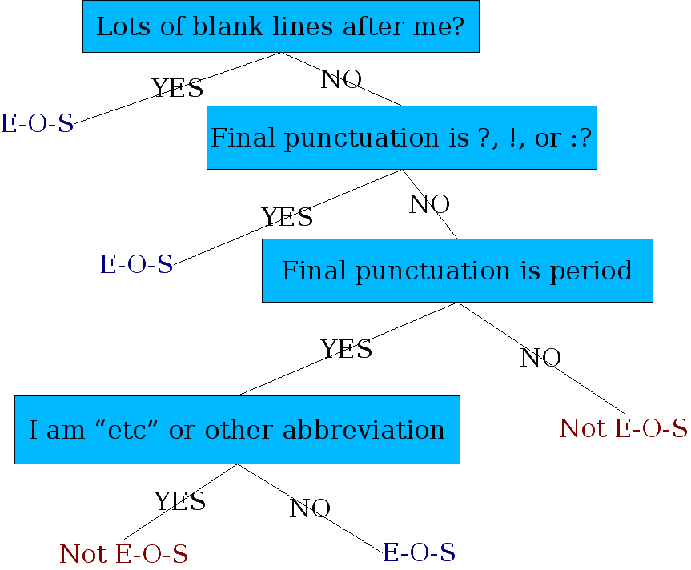
Determining if a word is end-of-sentence: a Decision Tree

Slide 42
More sophisticated decision tree features
Case of word with “.”: Upper, Lower, Cap, Number
Case of word after “.”: Upper, Lower, Cap, Number
Numeric features
Length of word with “.”
Probability(word with “.” occurs at end-of-s)
Probability(word after “.” occurs at beginning-of-s)

Slide 43
Implementing Decision Trees
A decision tree is just an if-then-else statement
The interesting research is choosing the features
Setting up the structure is often too hard to do by hand
Hand-building only possible for very simple features, domains
For numeric features, it’s too hard to pick each threshold
Instead, structure usually learned by machine learning from a training corpus

Slide 44
Decision Trees and other classifiers
We can think of the questions in a decision tree
As features that could be exploited by any kind of classifier
Logistic regression
SVM
Neural Nets
etc.

Slide 45
Basic Text Processing
Now ready for some analysis

Slide 46
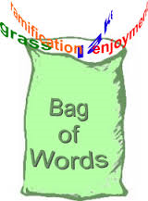
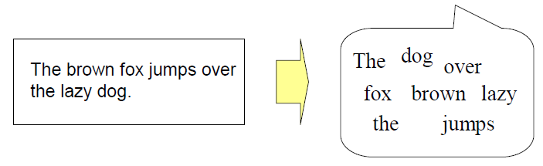
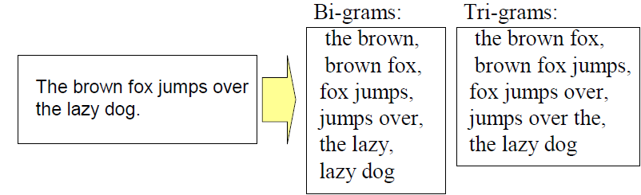
Feature Extraction
Bag-of-Word approach
a document is regarded as a set of words regardless of the word
order and grammar
Bi-grams, tri-grams, n-grams

Slide 47
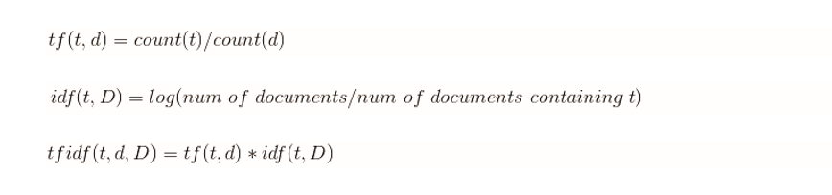
From Symbolic to Numeric
Term occurrence
Term Frequency (TF)
the number of times where word/n-gram appears in a document
Inverse Document Frequency (IDF)
the inverted rate of documents that contain word/ngram against the whole training data set of documents
TF-IDF
frequent words that appear only in a small number of documents achieve high value

Slide 48
Dimensionality Reduction
Vocabulary size may be very large.
Curse of Dimensionality
Methods
Filter-based Feature Selection
Wrapper-based Feature Selection
Feature Hashing: VW 32-bit murmurhash v3 hashing
Topic Modeling: VW LDA and other implementations

Slide 49
Session 2: (most likely late February)
Doing pre-processing and basic analytics with some different tools and techniques:
Finish fundamental theory
Python NLTK with jupyter notebooks – build our first sample
Cognitive Service Text API (time permitting or move to session #3)
Prerequisites will be posted when session is scheduled

Slide 50
All content at:
https://github.com/jimwill3/NY-AZML-Meetup
Recommended texts:
Natural_Language_Processing_in_Action_v4 by Lane and Howard
Text Analytics with Python by Dipanjan Sarkar

Slide 51

Appendix (code snippet)
We are pleased to announce preview availability of SDKs for the Cognitive Serivces - Bing Search APIs. Currently available as REST APIs, the Bing APIs v7 now have SDKs in four languages: C#, Java, Node.js, and Python.
g = feedparser.parse('https://azure.microsoft.com/en-us/blog/feed/')
print(g.feed.title)
sourceblog = 'azureblogfeed'
for n in g.entries:
tokens = nltk.word_tokenize(n.description)
cleanup = [token.lower() for token in tokens if token not in stopset and len(token)>2]
wc2=Counter(''.join(str(e)) for e in cleanup)
print("WC2:",wc2)
Counter({'apis': 3, 'bing': 2, 'sdks': 2, 'cognitive': 1, 'pleased': 1, 'preview': 1, 'serivces': 1, 'availability': 1, 'available': 1, 'languages': 1, 'java': 1, 'announce': 1, 'search': 1, 'python': 1, 'four': 1, 'node.js': 1, 'currently': 1, 'rest': 1})

