Slide 1
Text Analytics and processing series session 3 – Topic analysis
Azure Machine Learning Meetup
April 26 (postponed from March 22) , 2018

Slide 2
Recap – session 2
We summarized session 1
Expand on text normalization, stopwords etc.
Write a first sample that does bag of words and a basic TFIDF calculation using active blogs as a source
Some gaps in the code that we can close up but will do so in fresh code

Slide 3
Text Preprocessing(recap)
Normalization
Convert words into a normalized forms
Down-case: e.g, The → the
Lemmatization: e.g, plays → play
Stemming: e.g, cat/cats, mouse/mice and run/runs/running/ran
Language Detection
Stop-words Removal
ignore predefined common words, e.g., the, a, to, with, that …
Special Characters Removal
ignore Non-Alphanumeric (this can be detrimental when it comes to specialized content, C#)
Ignore numbers, emails, URLs

Slide 4
Text Normalization (RECAP)
Every NLP task needs to do text normalization:
Segmenting/tokenizing words in running text
Normalizing word formats
Segmenting sentences in running text

Slide 5
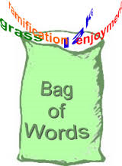
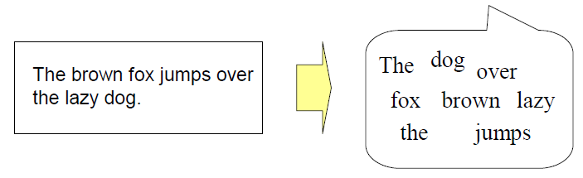
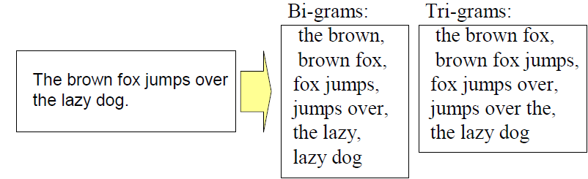
Feature Extraction (RECAP)
Bag-of-Word approach
a document is regarded as a set of words regardless of the word
order and grammar
Bi-grams, tri-grams, n-grams

Slide 6
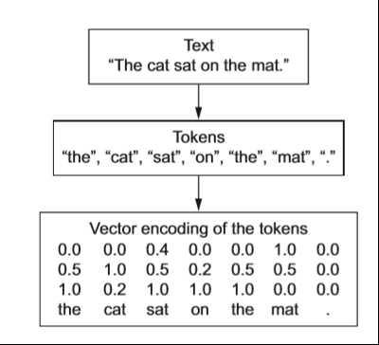
Recap Session2: Basic Text Processing

Slide 7
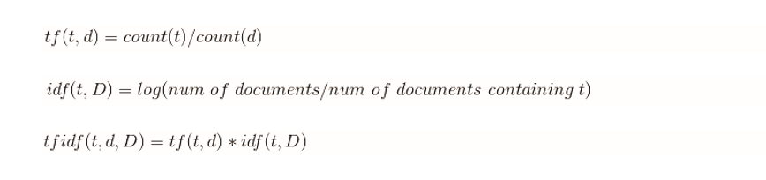
From Symbolic to Numeric
Term occurrence
Term Frequency (TF)
the number of times where word/n-gram appears in a document
Inverse Document Frequency (IDF)
the inverted rate of documents that contain word/ngram against the whole training data set of documents
TF-IDF
frequent words that appear only in a small number of documents achieve high value

Slide 8
Prior Lab time
Jupyter notebook, or similar, with python 3.5 or later
You’ll need (nice if already on a local system):
import nltk #all environments
import feedparser #parsing rss feeds
!python -m nltk.downloader punkt #jupyter notebook
!python -m nltk.downloader stopwords #jupyter notebook
!python -m nltk.downloader treebank #jupyter notebook
Code snippets at:
https://github.com/jimwill3/NY-AZML-Meetup/snip1.txt snip2.txt...

Slide 9
TFIDF Code snippets (also on github) featurizing text
sklearn_tfidf = TfidfVectorizer(norm='l2',min_df=1, use_idf=True, smooth_idf=False, sublinear_tf=True)
sklearn_representation = sklearn_tfidf.fit_transform(docs)
#norm = ‘l2’ L2 is the Euclidian distance between vectors
#min_df = minimal doc frequency (1 or more) – see what happens if you make this 2 or 3…
#docs is our existing corpus created earlier
#try ngram_range = (min_n, max_n)
The lower and upper boundary of the range of n-values for different n-grams to be extracted. All values of n such that min_n <= n <= max_n will be used

Slide 10
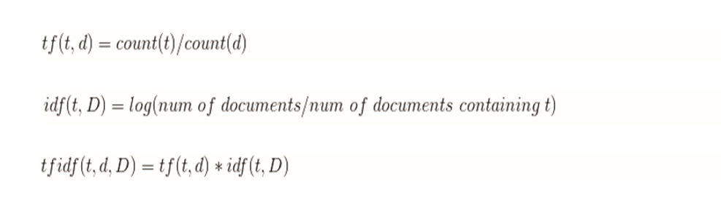
Review TFIDF
Bring math to help us
Calculate similarities
Determine likely topics
Note:
As (d) increases the tf decreases (word is spread wider)
As count of word (t) increases – the tf increases

Slide 11
What does TFIDF tell us?
Relative frequency of words in a corpus normalized by the number of documents containing that word
In other words – the higher the frequency the more important the word is to a document and
Presumably, helps to separate documents that have little in common.
For example, ‘performance’ may surface in many technology blog documents so its TFIDF is not that high
But, ‘optimizer’ may only tend to surface in technology blogs discussing databases. The TFIDF for ‘optimizer’ may be a stronger signal
What this let’s us do is compare documents by comparing their TFIDF entries, and as we have seen, many entries are empty (0.0).
Intuition:
Documents with any value > 0.0 in the same TFIDF location are more likely to be about the same thing than where one or both are 0.0

Slide 12
Tonight - Session 3 – April 26
Cleaner and simpler code to make our BOW and TFIDF
Start doing some basic operations now that we have moved from words to features where the features are expressed as numerical values
Tooling: (no real changes – we may add some packages)
You can run python locally on your laptop of choice (3.5 or 3.6 is what I use)
We can use free Azure notebooks (I will be using those) and it takes about 5 minutes to set one up for yourself (Microsoft or Google mail account needed)
Build topic models over a small sample corpus
https://github.com/jimwill3/NY-AZML-Meetup
All files start with 426….

Slide 13
If you need a free python notebook environment
https://notebooks.azure.com is a free service for small scale work
All you need is a Hotmail (liveID) or Gmail account – no credit card
You can create libraries and within each library create jupyter notebooks
You can also store small amount of data
You can access the command line (linux) with non su rights
There is support for other languages but we’ll stick to Python – the default is 3.6
One thing we need to do is walk through how to download the python NLTK corpus for stopwords and other processing. It’s not quite obvious and not automatic in the notebooks site.

Slide 14
A leaner approach to BOW/TFIDF
We’ll use some static in-line data for reproducibility and easier visualization
All the mechanics and routines are the same
Add a convenience function for better labeling of the output matrix
Use this small model to test a new document against our existing small corpus
Resources:
Small text file to represent our starting corpus
Let’s code and test that up – the snippets have sample data
https://github.com/jimwill3/NY-AZML-Meetup
All files start with 426….

Slide 15
Topic models
TFIDF and BOW give us data and basic feature extraction
But – we are limited to tokens and the ability to match and weight the appearance of tokens throughout a corpus
If other authors used slightly different wording to describe the same content and material it might be difficult to detect the similarity
How can we move towards representing topics as a way to determine if documents express similar things
There are multiple approaches – we’ll try 2:
Latent Semantic Indexing (LSI)
Latent Dirichlet Allocation (LDA)

Slide 16
What doesn’t TFIDF or BOW do?
The focus is often on single words or phrases but that’s pretty much the scope of any context
Synonyms are pretty much ignored and unaccounted for
It helps identify and separate documents but only by feature counts and ratios
It cannot factor that some words or phrases can and do contribute to documents that are quite different from each other
Topic Analysis attempts to address the situation

Slide 17
Co-occurrences help identify topics
You shall know a word by the company it keeps.
-- J. R. Firth 1957
Latent Dirichlet Allocation (abbreviated to distinguish it from LDA, below) LDiA
Latent Semantic Analysis/Indexing (LSA or LSI)
Principal Component Analysis (PCA)
Linear Discriminant Analysis (LDA)
Quadratic Discriminant Analysis (QDA)
Random Projection (RP) Nonnegative Matrix Factorization

Slide 18
What can we do with these features?
Classification
Regression (SVM)
Principal Component Analysis variations
The first 2 require some labelled data
PCA is handled a bit differently

Slide 19
Foundation for topic analysis LSI
*SVD is an algorithm for decomposing a matrix into three "factors", three matrices that can be multiplied together to recreate the original matrix. This is analogous to finding the integer factors that can be multiplied to "recreate" the integer that you factored
*SVD will group those terms together that have high correlation (because they occur in the same documents together a lot). And we can then think of these collections of words as "topics" and this will help us turn our bags of words (or TFIDF vectors) into topic vectors that tell us the topics a document is about. A topic vector is kind-of like a summary, or generalization, of what the document is about, or at least what the Bag of Words is about.
Simple example in numbers: 25 47 94
Factors 25 = 5*5 47= 47*1 94=2*47 hence 47 and 94 both have 47 in common while 25 does not. One could claim that 47 and 94 are more correlated with each other than either one is with 25
*From: Natural_Language_Processing_in_Action by Lane,Howard,Hapke

Slide 20
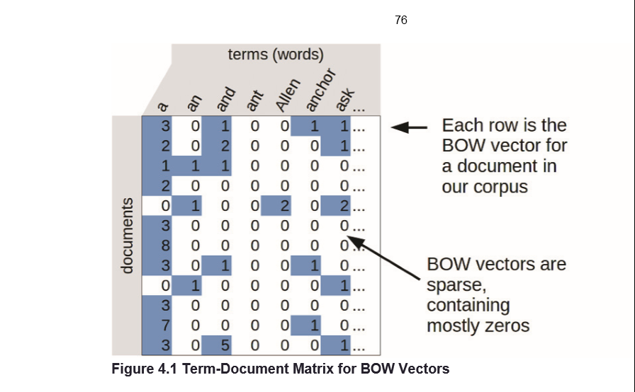
Concepts for topic analysis
We have a term and document matrix already in our sample code

Slide 21
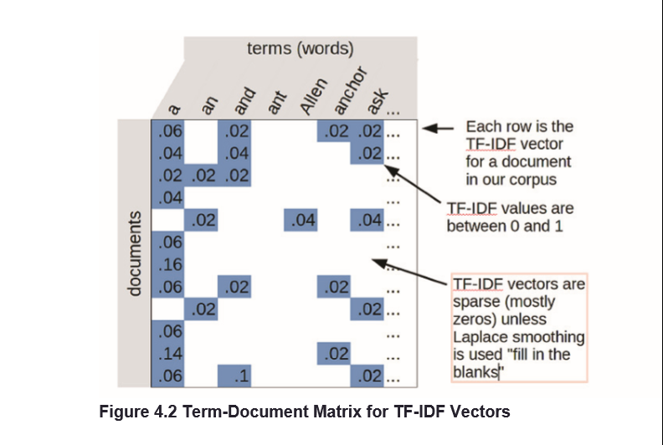
Document/Term matrix
We also have a TFIDF matrix in our sample code

Slide 22
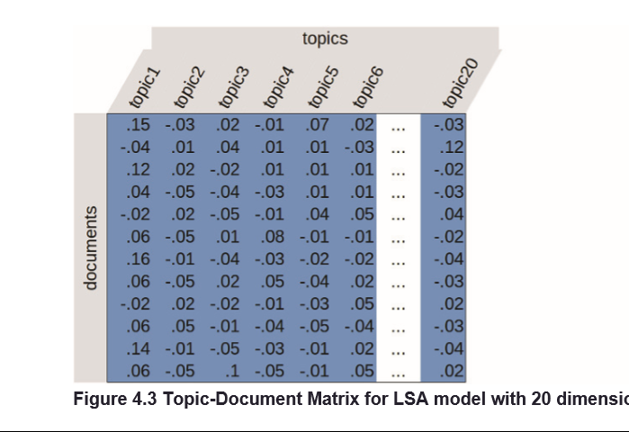
Goal: Topic/Document Matrix
We need to generate a matrix based on this kind of mapping

Slide 23
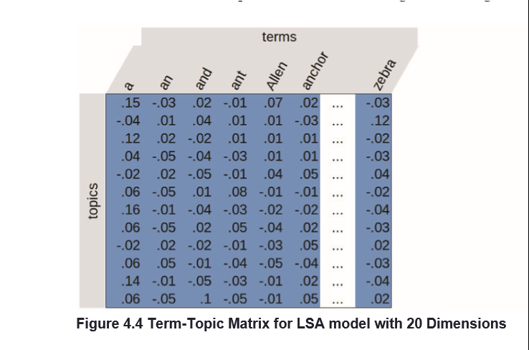
This is close but…not quite (need to collapse terms back to documents)
Can we convert terms/topic matrix to a topics/document matrix
Yes – by shifting from terms to documents using the co-occurrence of words by documents (which we can calculate from earlier matrices
The technique is called SVD or single value decomposition
Illustrations from: Natural_Language_Processing_in_Action_v5_MEAP manning.com

Slide 24
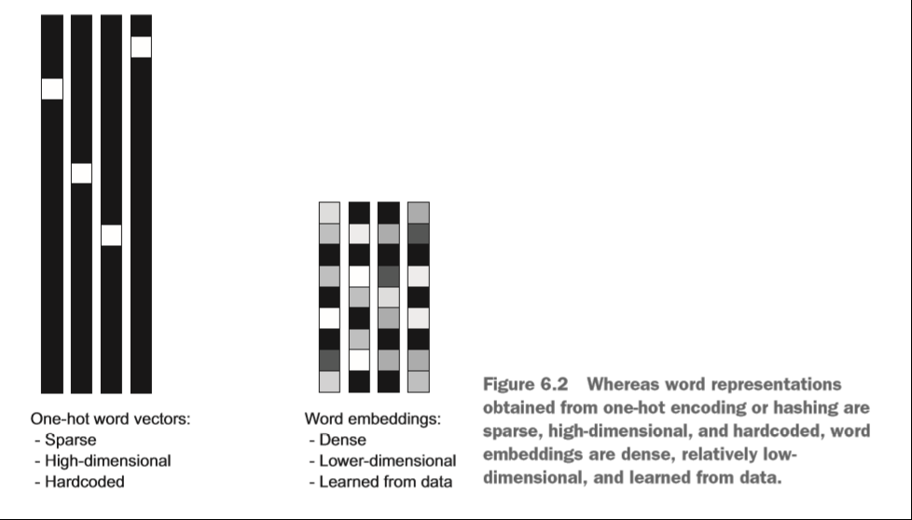
Word embedding

Slide 25
Introducing LDA
Latent Dirichlet Allocation
*Summary:
LDA represents documents as mixtures of topics emitting words with certain probabilities. It assumes that documents are produced in a probabilistic fashion
Document ->(Topic Mix); Topic -> (Word Mix)
Note – this supports words and topics contributing to documents in varying proportions. No hard cutoffs needed.
Per doc/topic probability called ‘gamma’ γ
Per doc/word probability called ‘beta’ β
*blog.echen.me/2011/08/22/introduction-to-latent-dirichlet-allocation/

Slide 26
LDA concepts
*Every document is a mixture of topics:
We imagine that each document may contain words from several topics in particular proportions. For example, in a two-topic model we could say “Document 1 is 90% topic A and 10% topic B, while Document 2 is 30% topic A and 70% topic B.”
*Every topic is a mixture of words:
For example, we could imagine a two-topic model of American news, with one topic for “politics” and one for “entertainment.” The most common words in the politics topic might be “President,” “Congress,” and “government,” while the entertainment topic may be made up of words such as “movies,” “television,” and “actor.” Importantly, words can be shared between topics; a word like “budget” might appear in both equally.
*Text Mining with R - A Tidy Approach by Robinson and Silge. Pub: O’Reilly
http://shop.oreilly.com/product/0636920067153.do

Slide 27
Scenario
Suppose you have the following set of sentences:
I like to eat broccoli and bananas.
I ate a banana and spinach smoothie for breakfast.
Chinchillas and kittens are cute.
My sister adopted a kitten yesterday.
Look at this cute hamster munching on a piece of broccoli.

Slide 28
LDA might produce something like
Sentences 1 and 2: 100% Topic A
Sentences 3 and 4: 100% Topic B
Sentence 5: 60% Topic A, 40% Topic B
Topic A: 30% broccoli, 15% bananas, 10% breakfast, 10% munching, … (at which point, you could interpret topic A to be about food)
Topic B: 20% chinchillas, 20% kittens, 20% cute, 15% hamster, … (at which point, you could interpret topic B to be about cute animals)

Slide 29
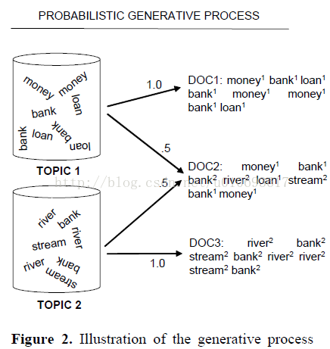
LDA is a process (generative) model Topics “generate” words and words are aggregated into Documents

Slide 30
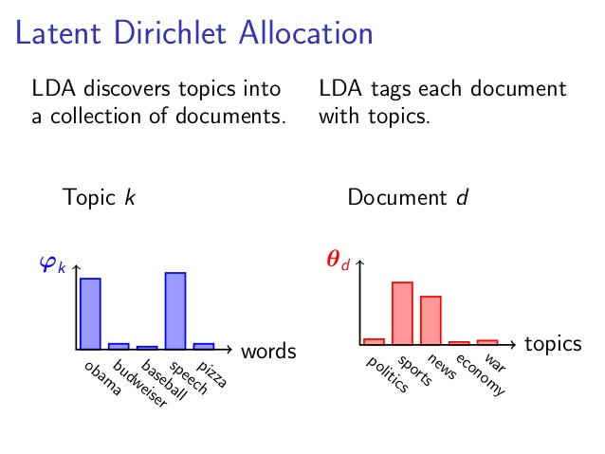
Probabalistic distribution for topic(k) and Document(d)

Slide 31
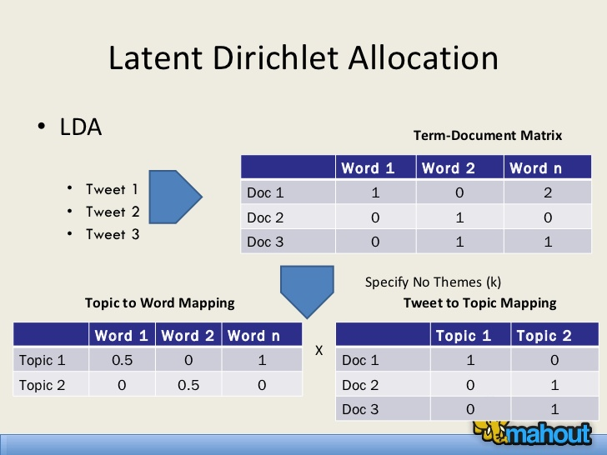
LDA as a relationship

Slide 32
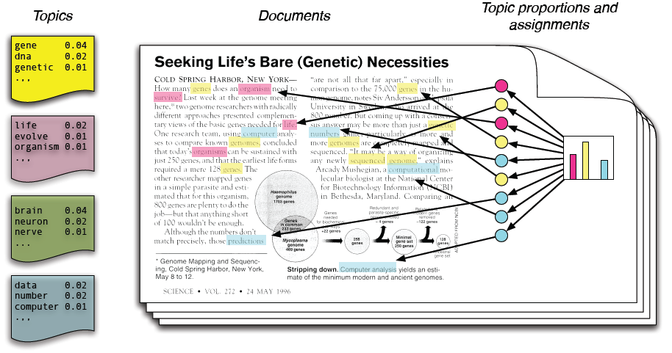
LDA
Each topic is a mix (distribution) over words
Each Document is a mix (distribution) over Topics
Each word is drawn
from one of the
topics

Slide 33
All content at:
https://github.com/jimwill3/NY-AZML-Meetup
Recommended texts:
Natural Language Processing in Action: Lane and Howard - Manning
Text Analytics with Python : Dipanjan Sarkar - Apress
Text Mining with R – A Tidy Approach: Robinson and Silge - O’Reilly press

Slide 34
Next time (early June most likely)
Word2vec and similar embedded word techniques
And then further out:
Using Deep Learning techniques

Slide 35

Appendix (code snippet)
We are pleased to announce preview availability of SDKs for the Cognitive Serivces - Bing Search APIs. Currently available as REST APIs, the Bing APIs v7 now have SDKs in four languages: C#, Java, Node.js, and Python.
g = feedparser.parse('https://azure.microsoft.com/en-us/blog/feed/')
print(g.feed.title)
sourceblog = 'azureblogfeed'
for n in g.entries:
tokens = nltk.word_tokenize(n.description)
cleanup = [token.lower() for token in tokens if token not in stopset and len(token)>2]
wc2=Counter(''.join(str(e)) for e in cleanup)
print("WC2:",wc2)
Counter({'apis': 3, 'bing': 2, 'sdks': 2, 'cognitive': 1, 'pleased': 1, 'preview': 1, 'serivces': 1, 'availability': 1, 'available': 1, 'languages': 1, 'java': 1, 'announce': 1, 'search': 1, 'python': 1, 'four': 1, 'node.js': 1, 'currently': 1, 'rest': 1})

