Slide 1
Reinforcement Learning with pytorch
Azure Machine Learning Meetup – April 25, 2019
Session 2 on RL

Slide 2
Agenda for this session
Recap first session from March
Quick summary of deep neural networking
Quick intro to PYTORCH (for TensorFlow, CNTK, Keras this may be redundant)
A similar sample to our first session but one using DNN and PYTORCH (40 min)
We’ll used notebooks.azure.com again as it already has these tools pre-installed and configured and a nice price point – no charge.
Note: next meetup will be May 23 – Markov Decision Processes and Reinforcement Learning

Slide 3
Recap from first session
Introduced reinforcement learning concepts
“ a software agent observes and decides to take actions in order to optimize a reward”
“the agent learns by implementing a policy* that samples the environment and assesses the long-term rewards”
Used a small sample written just using python and numpy to mimic 10 slot machines
Illustrated expected rewards, basic policy, value functions
Code and PPTX posted to https://github.com/jimwill3/NY-AZML-Meetup/tree/CNTK/RL
*policy can be a simple function, rule, neural net. It can be deterministic or stochastic. Our first sample used a simple stochastic policy called epsilon greedy

Slide 4
Policy from first session is an explore vs exploit tradeoff
epsilon_random = np.random.uniform(0, 1)
if epsilon_random > epsilon :
# exploit
slot2pull = np.argmax(expectedvalue)
print('exploiting: ',slot2pull)
else :
# explore
slot2pull = np.random.choice(np.arange(arms))
switches += 1
if (lastpull == slot2pull):
print('\texplore but no real change: ',slot2pull)
else:
print('\texplore with a change: ',lastpull, ' : ', slot2pull)

Slide 5
Quick check for DNN
Softmax
Onehot encoding

Slide 6
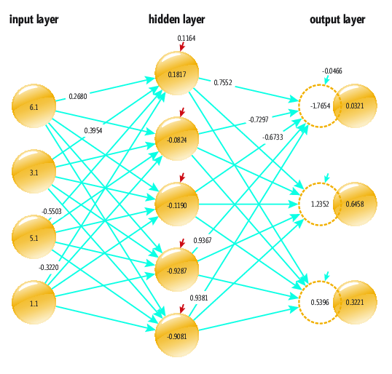
Fastest intro/summary of DNN
hidden[0] = tanh((6.1 * 0.2680) + (3.1 * 0.3954) + (5.1 * -0.5503) + (1.1 * -0.3220) + 0.1164)
= tanh(-0.1838)
= -0.1817
Repeats for all hidden layer nodes and then pushes forward from the hidden layer to the output layer
Output layer is evaluated based on the problem (classifier etc – softmax and so on)

Slide 7
Prior slide was the core – you also have
Learners (detecting progress towards better results)
Thresholds (cutoff criteria based on accuracy / number of sample runs / compute time…)
Optimizers (how to alter weights while attempting to improve learning )
This entire process is usually referred to a the Training step
Once trained the model can be sent new, unseen data and asked to evaluate it – make a classification or prediction etc.
Training can take seconds to minutes to days based on network size, algorithm, number of samples, accuracy needed.
You shape the data (map to tensors) to fit the problem and network design

Slide 8
Pytorch in context of RL
Motivation: our initial problem was interesting but simple, 10 options each with a probability of returning a reward and fairly simple challenge:
Find the optimal strategy (option to select) that maximizes reward
Decisions were pretty simple – select or don’t select an option
The only history needed was that used to calculate the expected reward for each of the 10 options
The strategy (stick with current best reward OR see if there might be a better one) was also pretty simple (a ratio of exploit/explore of about 9 to 1
There are many problems more complex where a richer toolkit – deep neural networks – can identify the most rewarding pattern (strategy)

Slide 9
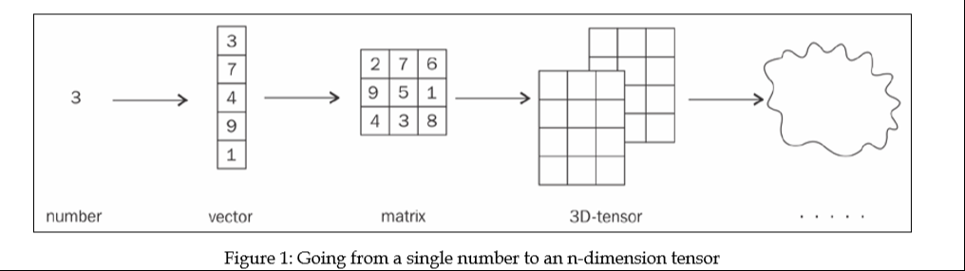
Tensors – the data format for deep learning

Slide 10
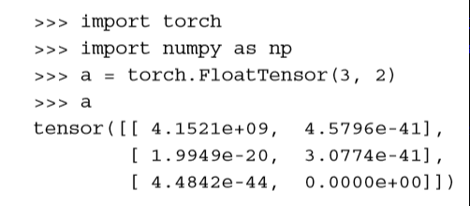
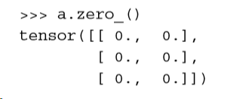
Try this

Slide 11
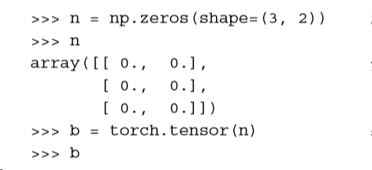
Easy to convert from numpy to tensors

Slide 12
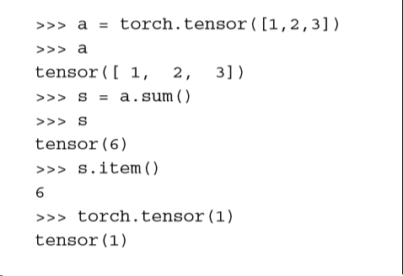
One final tensor operation to remember fetching a single item from a single dimension (scalar)

Slide 13
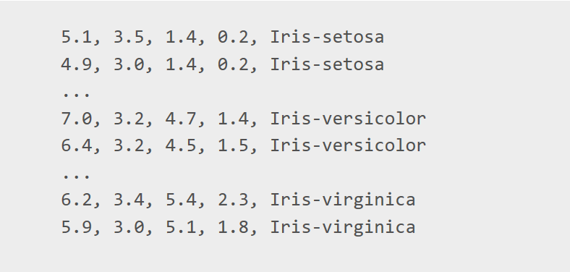
Let’s do a small sample using a DNN in Pytorch to classify iris data
sepal length, sepal width, petal length petal width, Type

Slide 14
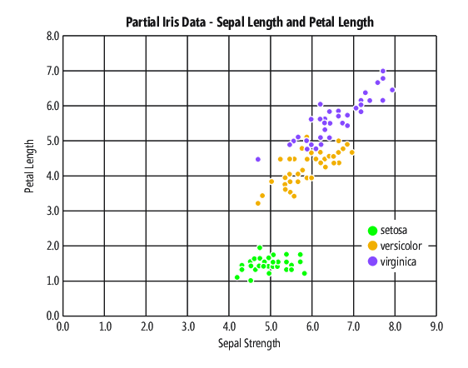
Visualizing the data
https://msdn.microsoft.com/en-us/magazine/mt848704.aspx

Slide 15
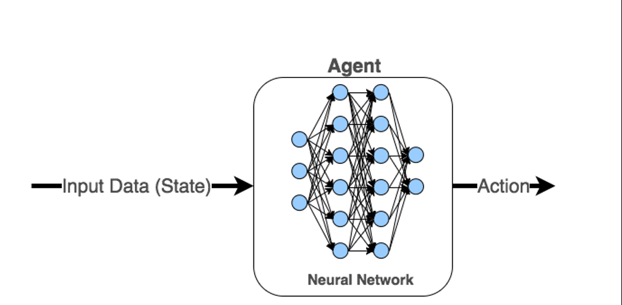
Defining a dNN in pytorch in a few lines of python
model = torch.nn.Sequential( torchh.nn.Linear(3, 6), torch.nn.ReLU(), torch.nn.Linear(6,2), torch.nn.ReLU(), )

Slide 16
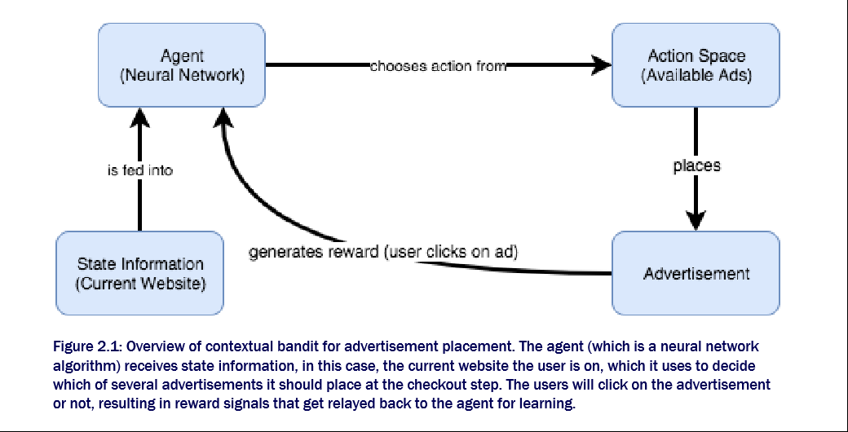
Visual model of ads/sites problem also known and contextual bandits
From Deep Reinforcement Learning in Action: Manning(p) by Zai and Brown

Slide 17
Demo – the pytorch code (notebooks.azure.com)
notebooks.azure.com – or a local python environment if you want to try
A zip file of a python version is at:
http://download.microsoft.com/download/0/9/6/0960579F-2D37-4F55-B195-82C5D2CBFFC8/Code_McCaffreyPyTorch0119.zip
And at:
https://github.com/jimwill3/NY-AZML-Meetup/tree/CNTK/RL (iris*.* files)

Slide 18
training recipe for the notebook
Initialize sites and ads to random values
Define the agent (neural net) its layers, learning rate, loss function, and optimizer
Enter a training loop:
NN model Predicts reward for current site – this returns a predrew vector
Calculate softmax of the reward vector and also normalize it so that probabilities sum to 1
Choose an ad to show based on a probability distribution (the softmax) and estimate the reward for that choice – this is current observed reward
Pass reward predicted & reward observed to loss function
NN Optimizer updates the neural net weights
Reset our site again as input to the next training cycle
Repeat until loop count reached (other termination rules are available)
Plot the results which have been stored at snapshots within the training loop

Slide 19
similar problem to last time one-armed bandit but a contextual bandit environment
What’s different about this simulation compared to our basic multi-armed bandit from march?
Assume arms (choices) represent ads to display on a web site which has 10 sections to visit
Instead of placing random ads as people navigate – we want to place ads based on their context (current section) - and assume we have 10 possible ads to display
So – there are 10 choices and 10 ads for 100 combinations – what is the best way to optimize ads to show? (for example, random ad displays may choose to show ads for laptops when someone lands on the nutrition section)
This problem has a state space - current web section, which is called the “contextual state”, leading to the phrase Contextual Bandits
We use a DNN to predict rewards based on current state and a probability function.
The original multi-armed bandit had no state space – there was no representation for the current state, only a calculation of reward and reward history
Code walkthrough
Will be published to github early next week

Slide 20
Note: next meetup will be May 23 – Markov Decision Processes and Reinforcement Learning
Content posted to https://github.com/jimwill3/NY-AZML-Meetup/tree/CNTK/RL

