Slide 1
Text Analytics and processing SEC Filings
Azure Machine Learning Meetup
December 2018
Andrew & Jim

Slide 2
Analyzing and extracting SEC Reports
Goals
Learn what we can learn by extracting and analyzing text based information from sections of company SEC filings – EDGAR reports
Search and identify any trends or patterns that can emerge based on the appearance, propensity, disappearance of “interesting” words, phrases, or entities.
To to reduce the effort to capture details that can be embedded into management commentaries on risk and finance.
Not focusing on numerical and financial data
Attempt to determine shifts in subjectivity within the documents

Slide 3
tools
Redgar to extract relevant sections of the filings
Text and NLP routines in both R and Python
Small enough to run in a notebook on a desktop, cloud service, cloud VM
Use an entity recognition service from Azure to ease the effort in detecting entities in the text (person, location, perhaps a brand)
(first 5000 invocations are free per month – after that – billing occurs).

Slide 4
Scope
Keep the number of companies < 10
Keep the subsections used at 4 (1, 1A, 7, 7A)
Select companies in not terribly dissimilar domains
Microsoft, Amazon, Google, IBM, Facebook
Anywhere from 3 to 6 years of text

Slide 5
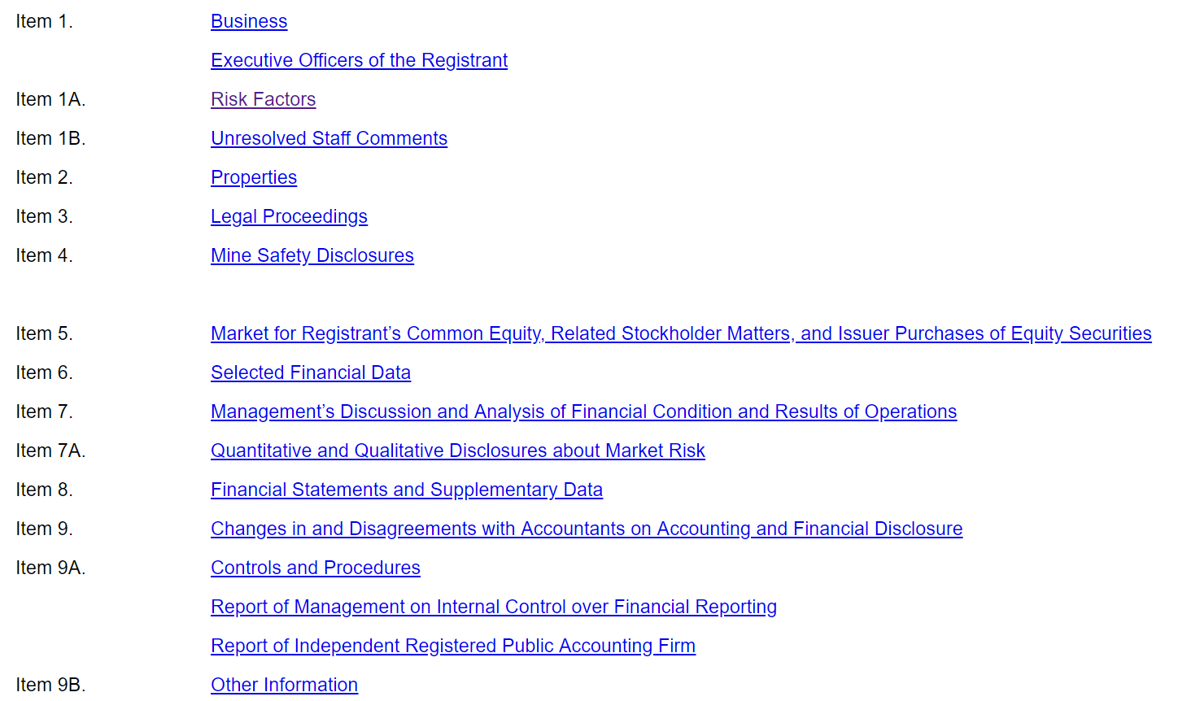
Sample table of contents

Slide 6
Sample snippet from Risk 1a (Microsoft June 2018)

Slide 7
Andrew on “R”

Slide 8
edgarWeb R
company_filings()
Fetch a bunch of 10-K and 10-Q filings for our given company using
parse_submission()
Processes a raw SGML filing into component documents
parse_filing()
Processes a narrative filing (e.g. 10-K, 10-Q) into paragraphs annotated with part and item numbers

Slide 9
Fun with R
Pipelines (which is easier to read?)
A <- c(1,2,3,4,5,6) # how to get 3,4 out?
O-O Code -> tail(head(A, 4), 2)
Functional Code -> A %>% head(4) %>% tail(2)
lapply(X, FUN) – apply a function to each element in the list
lapply(A, fun(x) x * 2)
Output: c(2,4,6,8,10,12)

Slide 10
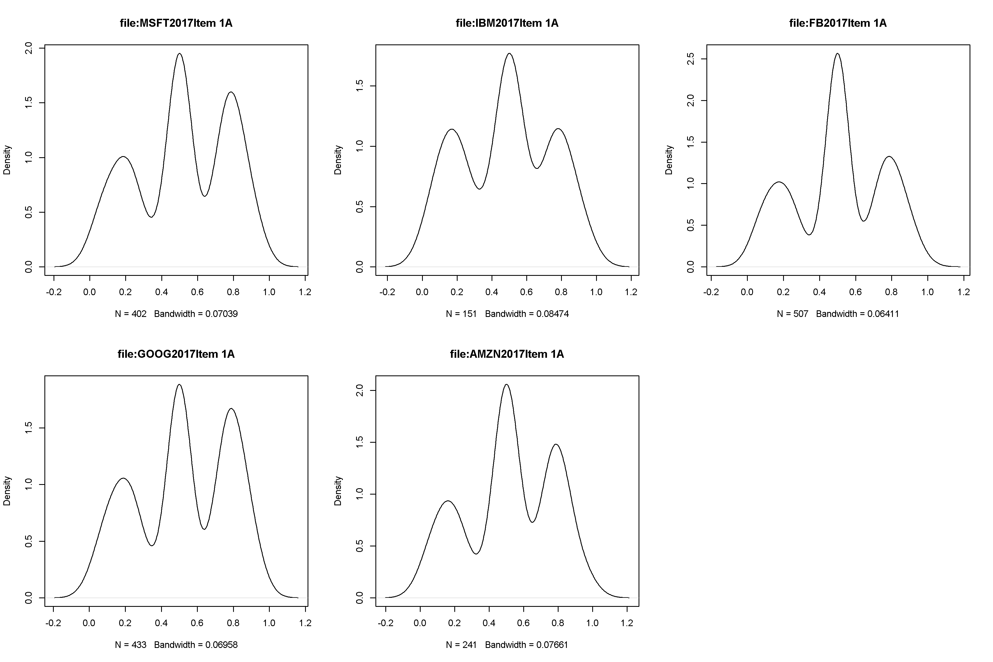
Sentiment Analyses - Item 1A – 2017 Risk Factors

Slide 11
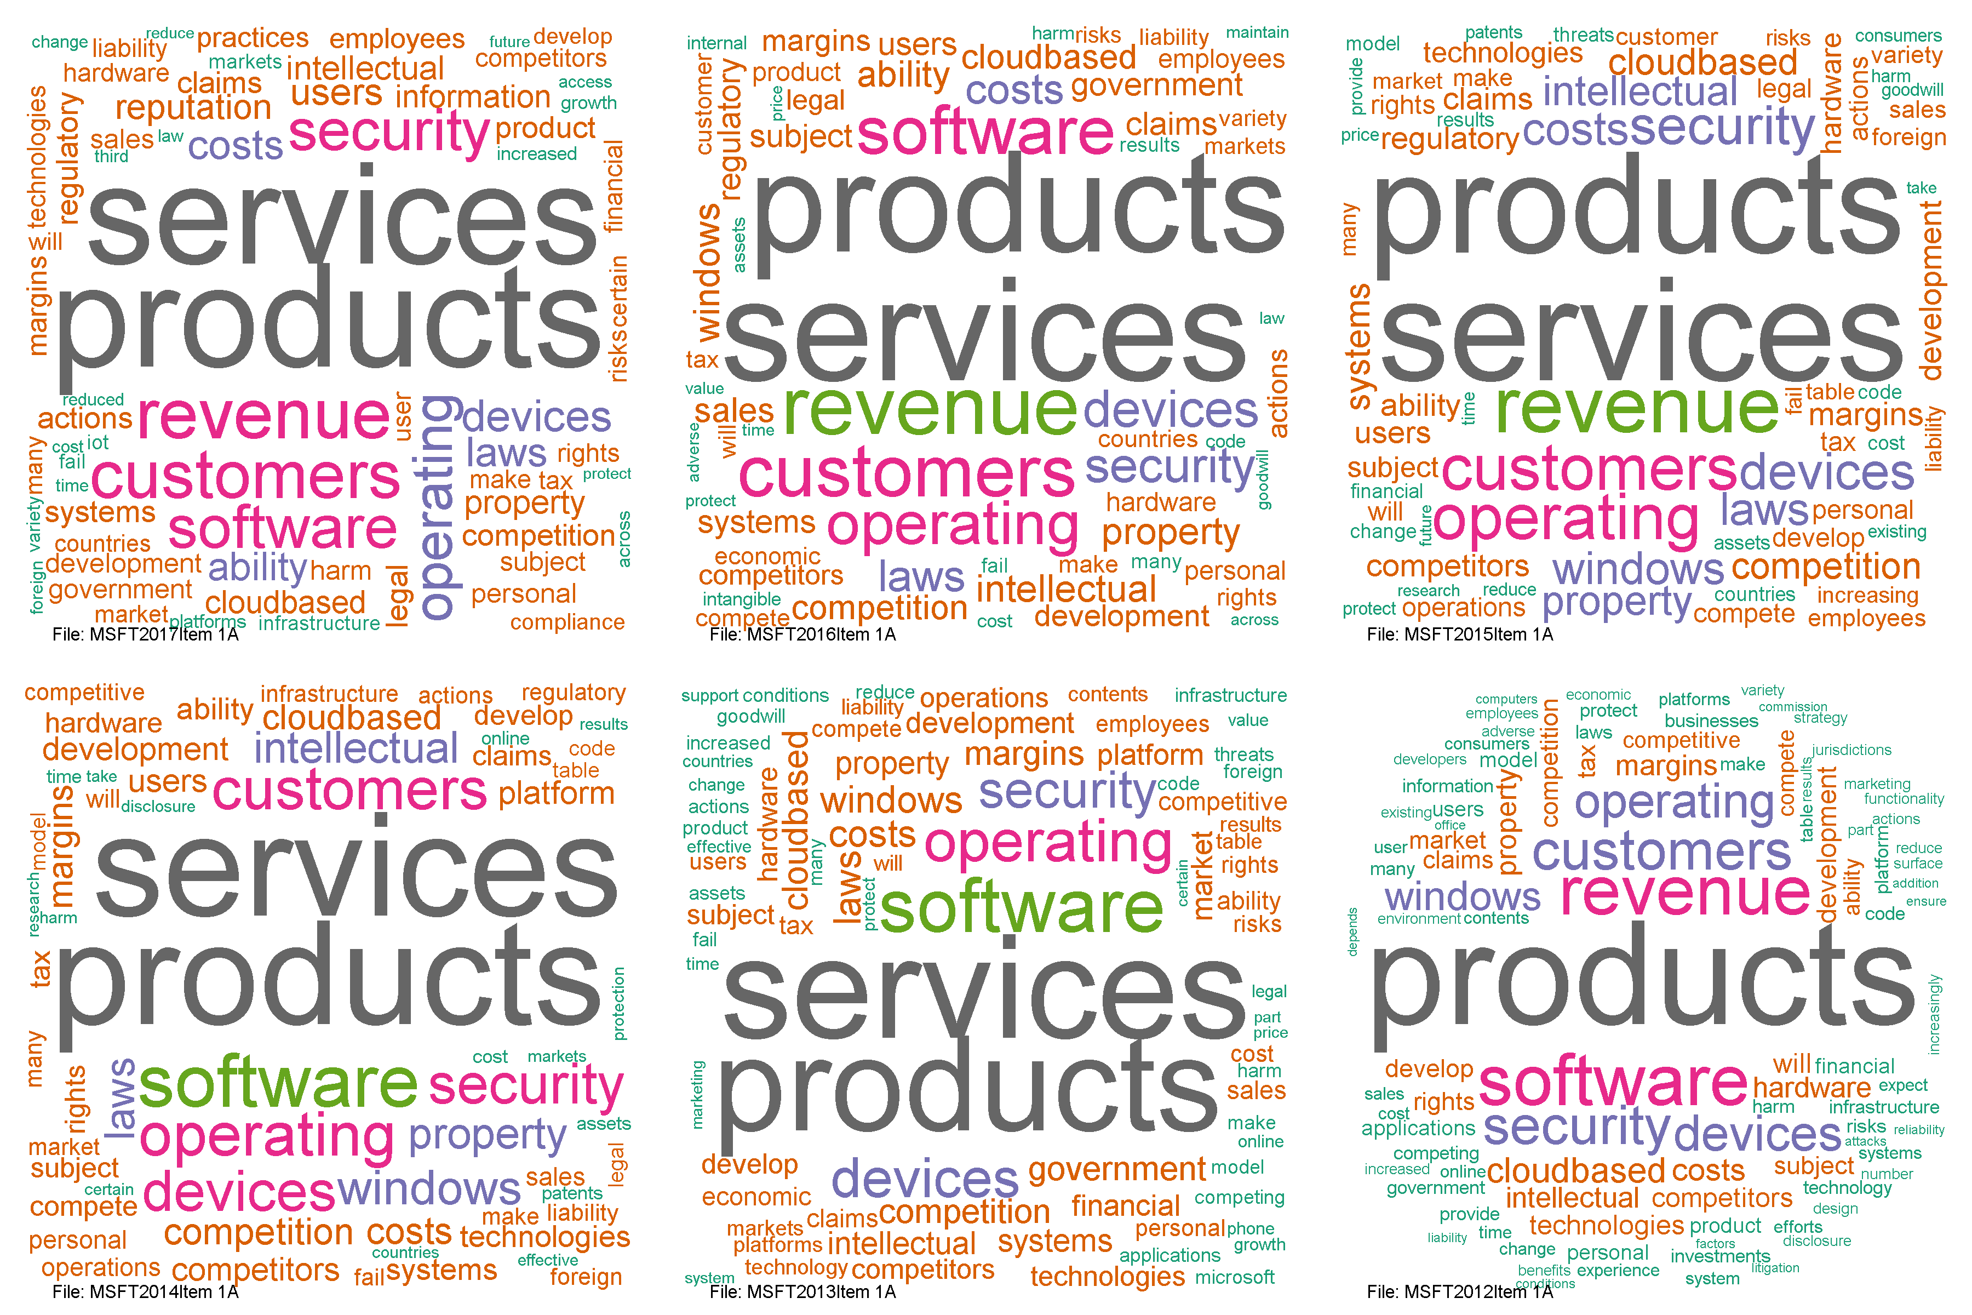
Word Clouds- MSFT Item 1A – 2017 Risk Factors
No Services

Slide 12
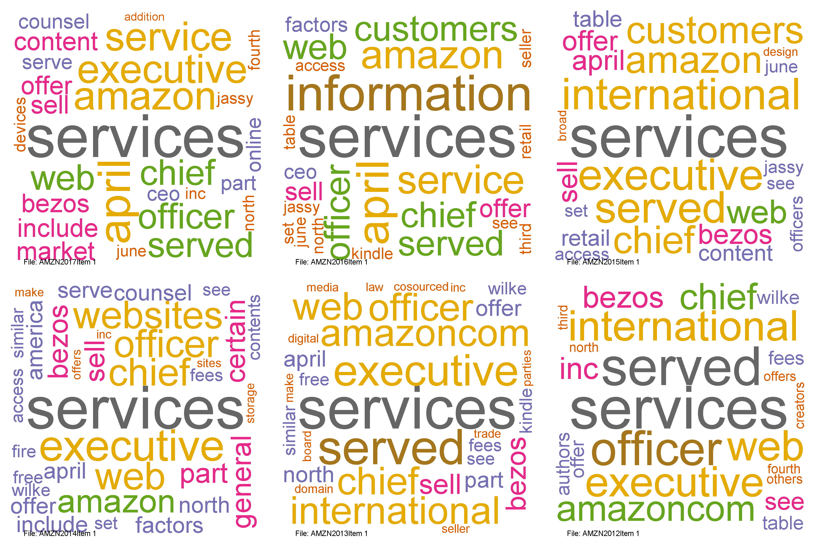
Word Clouds- Amazon Item 1 – Business

Slide 13
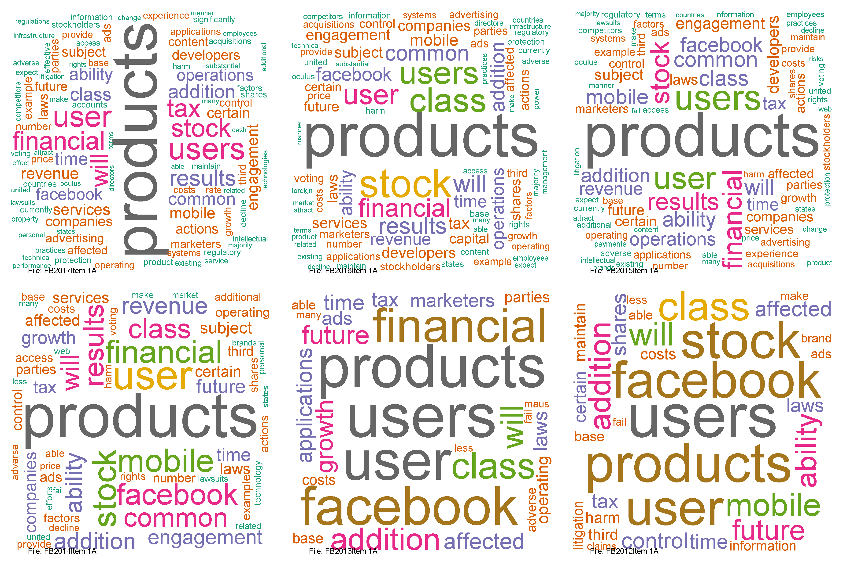
Word Clouds- FB Item 1A –Risk Factors

Slide 14
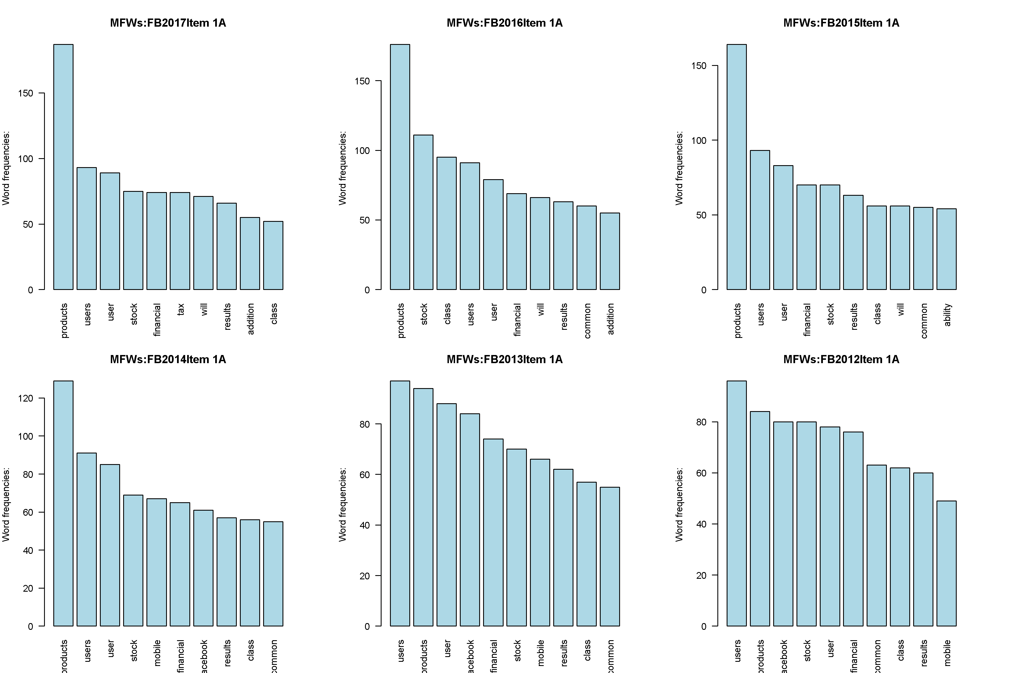
Word Clouds- FB Item 1A –Risk Factors

Slide 15
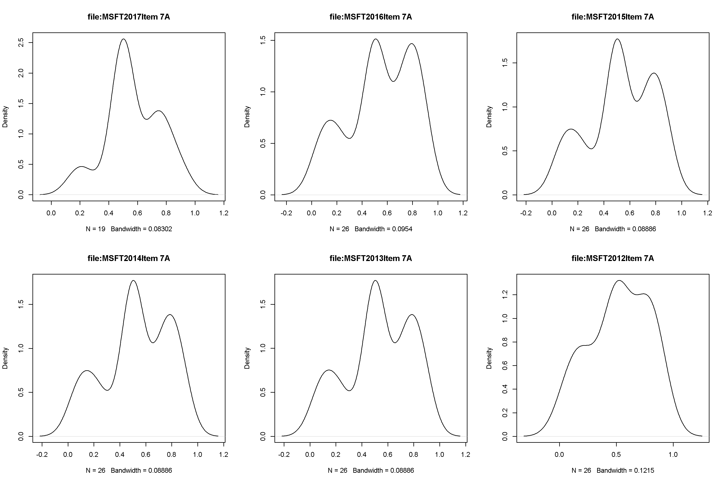
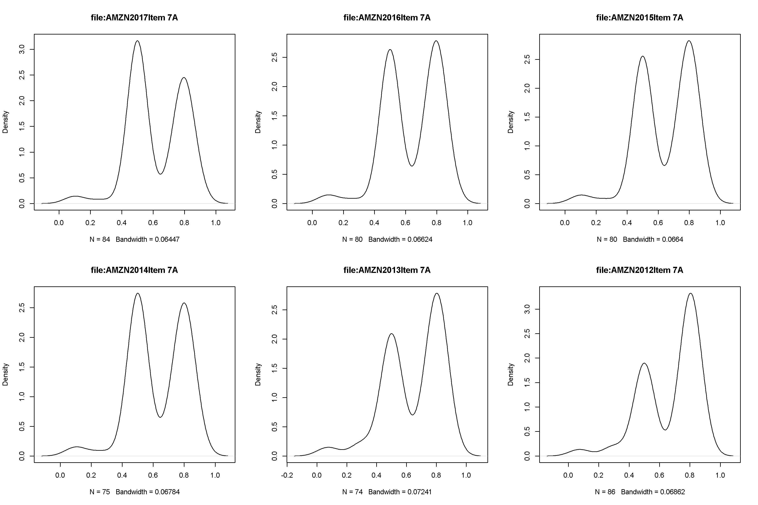
MSFT vs AMZN - Item 7A – Quantitative and Qualitative Disclosures about Market Risks
MSFT
Amazon

Slide 16
General approach and some observations
Ingest
Clean
Extract a variety of metrics
Search for patterns
Compare results within a company over time
Compare results across companies
Note:
Many acronyms to handle (AI) and entities with unusual meaning (Alexa, Siri, Watson)
About 50% of the words analyzed were stopwords (we, the, it, that…)
Lemmatization drops another 10 to 20% so use it
SEC filings tend to have a heavy dose of cautionary phrasing even when facts are generally positive So , sentiment analysis was mostly unexciting,

Slide 17
Jim python approach
Gather some basic statistics and visuals
Take advantage of the TexTBlob package as it also offers subjectivity measures
Use a separate entity recognition service instead of keyphrases (could have done both)
Use bigrams and trigrams
Customize stopwords (as did Andrew)
Also – try some topic analysis and simple document comparisons using linear algebra
Crammed into one Jupyter notebook

Slide 18
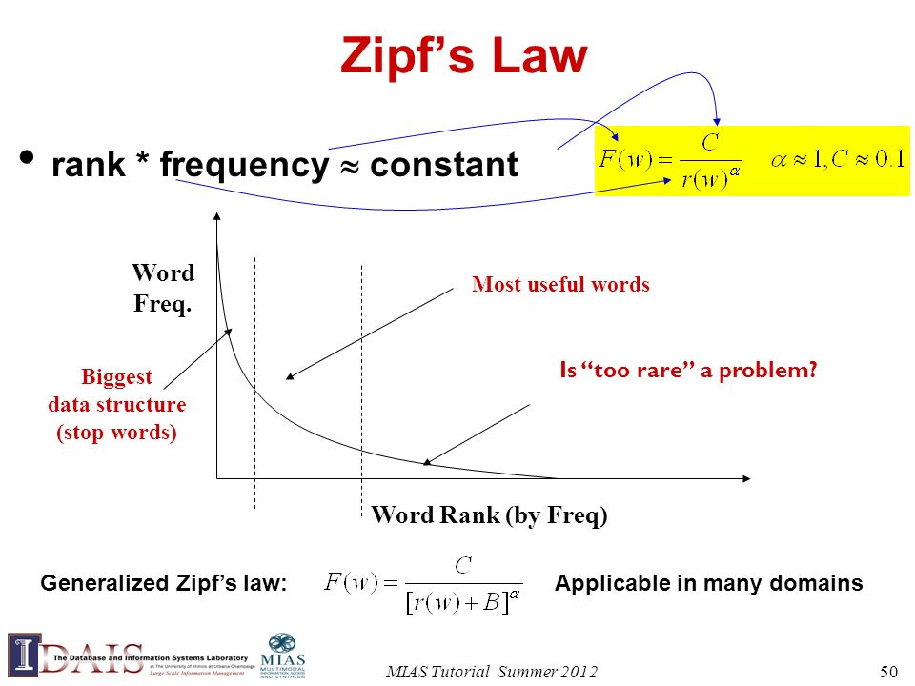
Do the docs follow zipf’s law

Slide 19
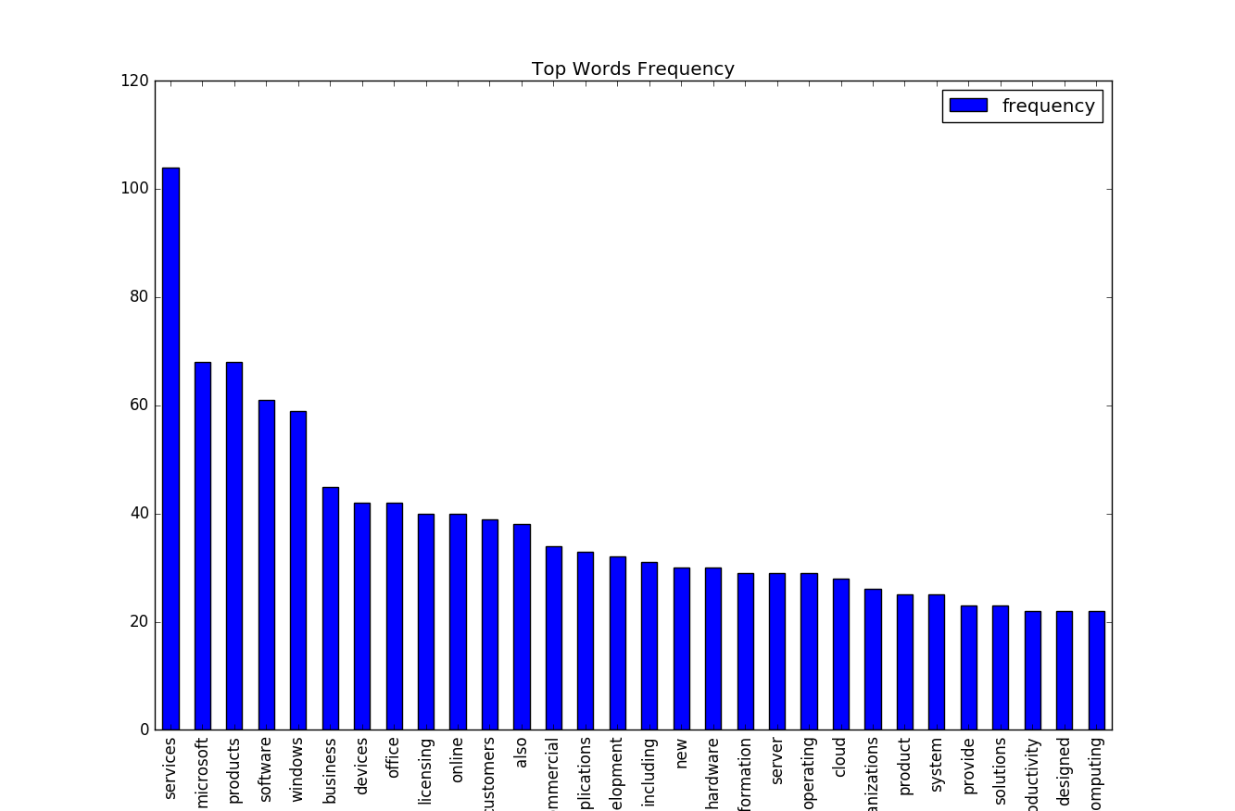
Top 30 distribution

Slide 20
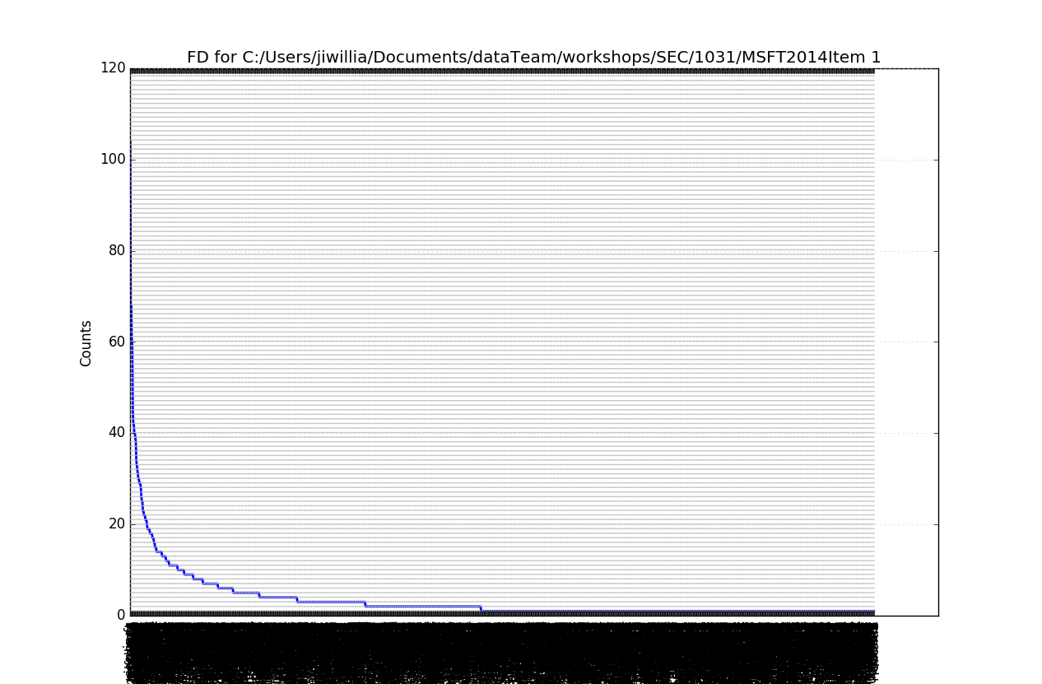
Full distribution (stop words removed)

Slide 21
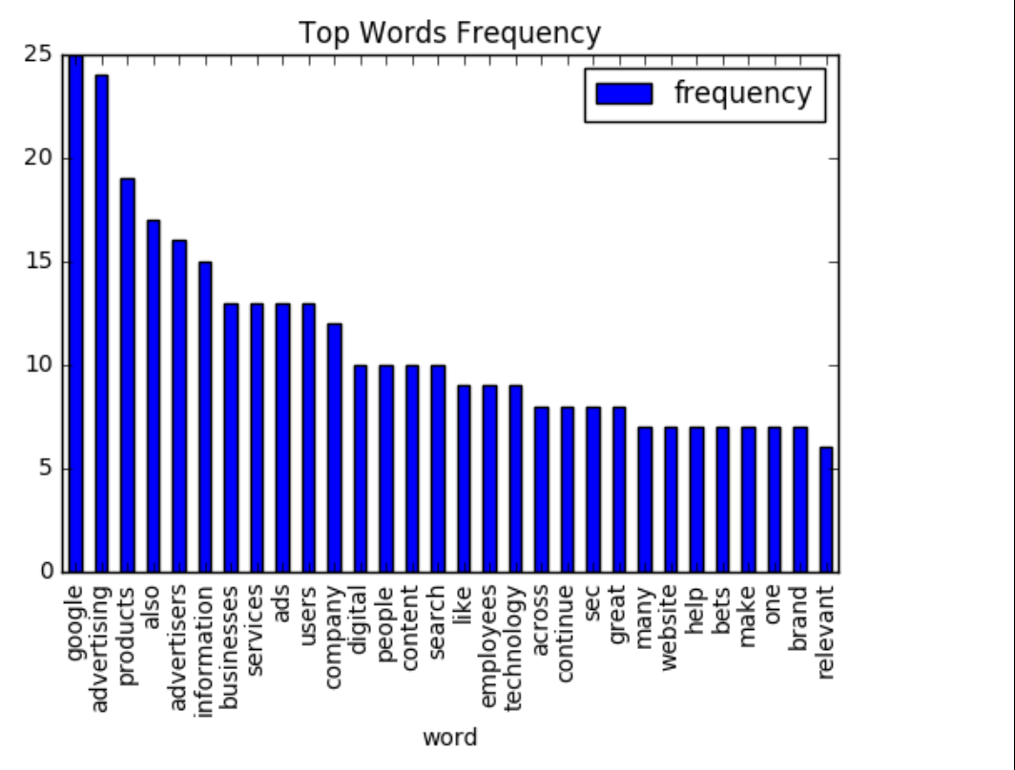
Google 2016 1

Slide 22
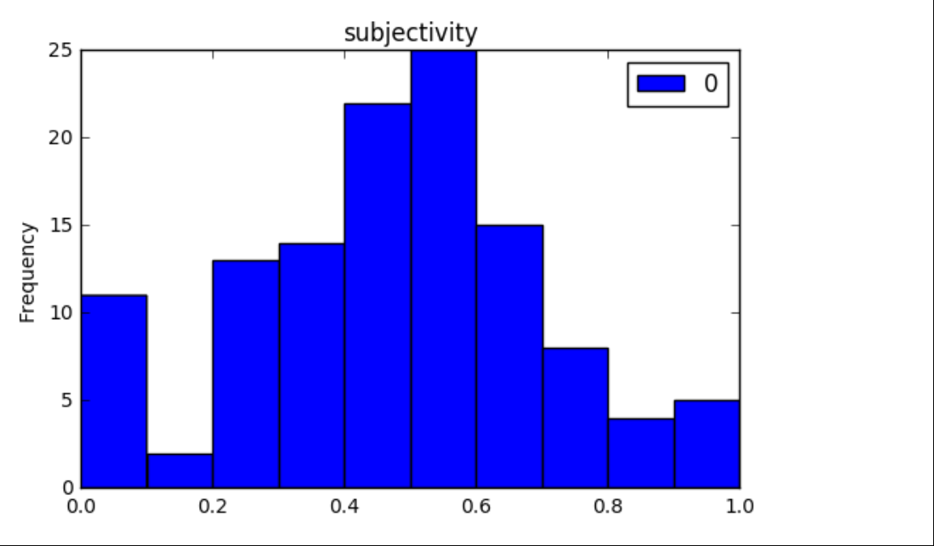
Google 2016 1 Subjectivity index
Per sentence scores on a scale from 0 (objective) to 1.0 (more subjective)
Based on words associated with opinion and/or judgement
Compare these to investor Q&A transcripts as an exercise

Slide 23
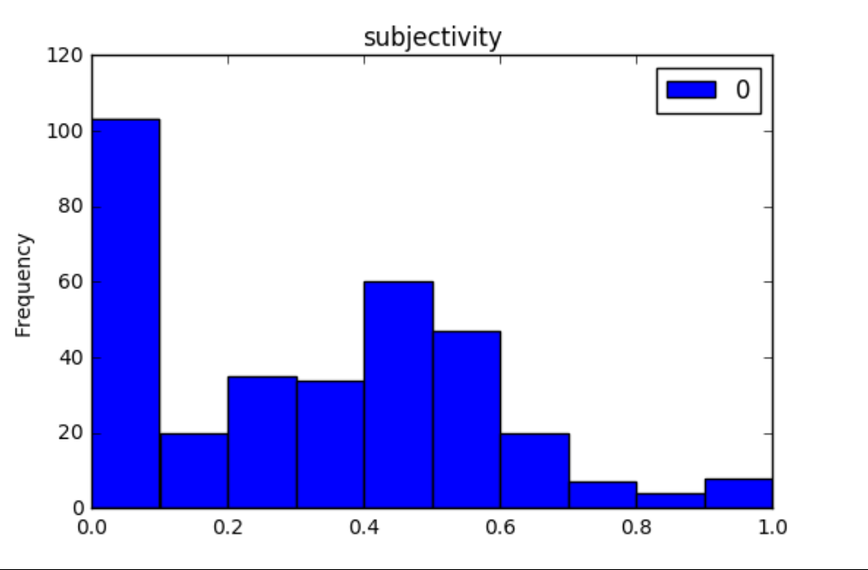
Microsoft 2016 Item 1 subjectivity

Slide 24
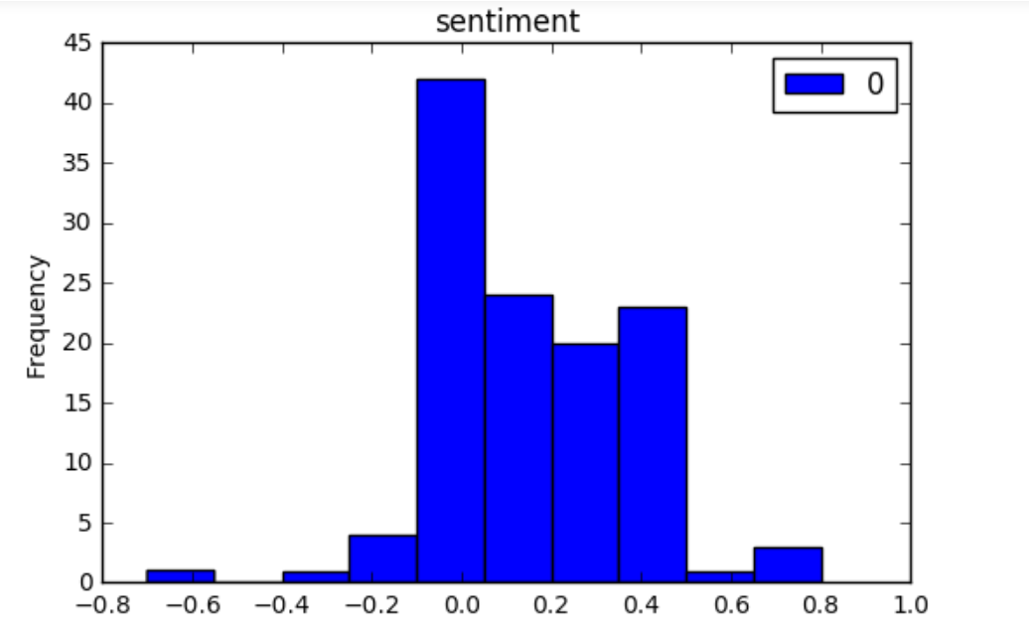
Google 2016 I sentiment by sentence

Slide 25
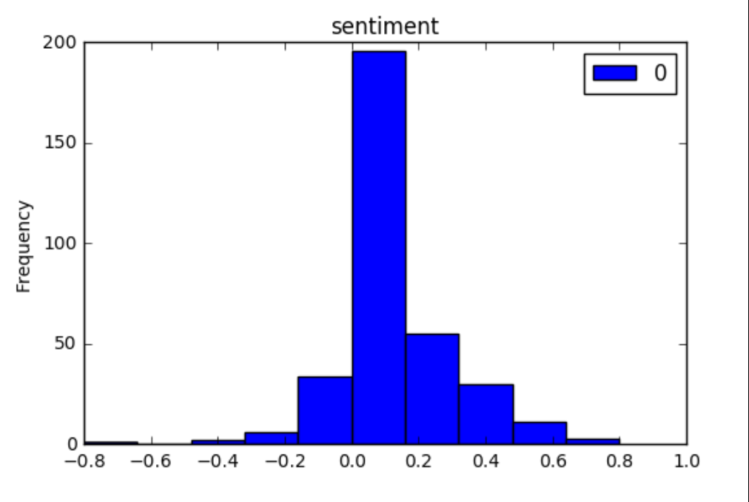
Microsoft 2016 item 1 sentiment

Slide 26
Concordance (google snippet)
servconc = ntext.concordance('competition’,width=120)
Our business is characterized by rapid change as well new and disruptive technologies . We face formidable competition in every aspect of our business , particularly from companies that are in information and provide them with relevant advertising .
our U.S. employees are not represented by a labor union
Competition for qualified personnel in our industry is intense ,

Slide 27
Google colocations top 10
ntext.collocations(num=10)
investor relations;
elations website;
machine learning;
generate revenues;
Network Members;
Annual Report;
across screens;
ContentsAlphabet Inc.;
relevant ads;
search engines

Slide 28
Google 2015 to 2017 top 10 bigrams Item 1
0 (products, services) 8
1 (relations, website) 5
2 (contentsalphabet, google) 4
3 (generate, revenues) 4
4 (relevant, ads) 4
5 (deliver, relevant) 4
6 (internet, connection) 3
7 (research, development) 3
8 (google, network) 3
9 (brand, advertising) 3
0 (machine, learning) 6
1 (products, services) 6
2 (relations, website) 5
3 (digital, content) 4
4 (generate, revenues) 4
5 (continue, invest) 4
6 (brand, advertising) 3
7 (google, maps) 3
8 (search, engines) 3
9 (make, sure) 3

Slide 29
MSFT top 10 Item 1
2012
2016
0 (products, services) 27
1 (online, services) 14
2 (xbox, 360) 14
3 (operating, system) 12
4 (microsoft, dynamics) 11
5 (research, development) 11
6 (contents, part) 10
7 (server, tools) 10
8 (part, 1) 10
9 (microsoft, office) 10
0 (products, services) 28
1 (cloud, services) 17
2 (part, 1) 13
3 (operating, system) 13
4 (research, development) 12
5 (server, products) 10
6 (volume, licensing) 10
7 (software, assurance) 10
8 (office, 365) 9
9 (personal, computing) 8

Slide 30
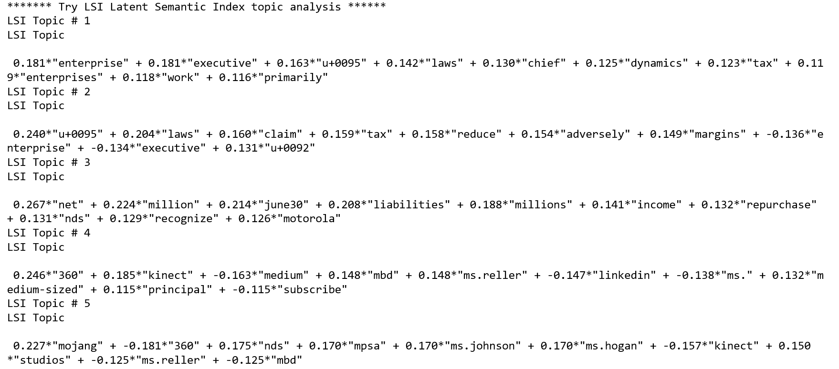
Sample topic analysis output Microsoft content

Slide 31
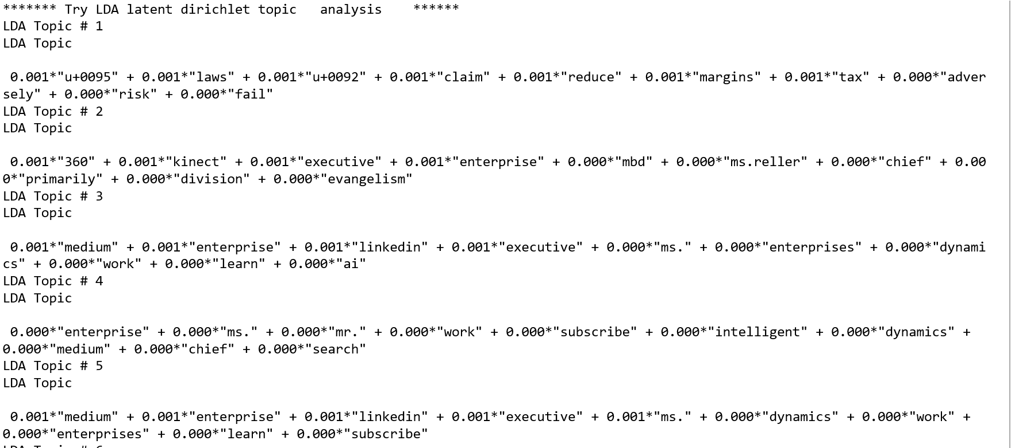
LDA for topic

Slide 32
Entity service used
Give it text (can be up to 5000 characters – multiple sentences is fine)
segment=‘ a string of text - representing a coherent chunk of a document’
Returns json that can be parsed into:
Entity Count
Microsoft 1
Tablet computer 1
Personal computer 1
Artificial intelligence 1
baseuri = 'https://westus2.api.cognitive.microsoft.com/text/analytics/v2.0'
entapi = baseuri + '/entities'
headers = {'Content-Type': 'application/json', 'Ocp-Apim-Subscription-Key’:key}
segtogo ={"documents": [
{
"language": "en", #language the chunk – can mix across id in the same invocation
"id": "1", #you can send multiple chunks (id) per invocation – this id is returned with the score
"text": segment # should be a groups of words or phrases
} ]
}
response = requests.post(entapi,headers=headers,json=segtogo)

Slide 33
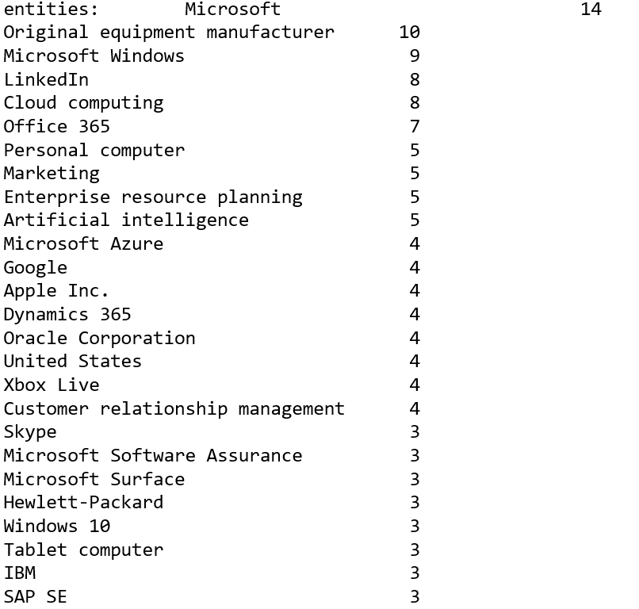
Sample entity output Microsoft
This is just from one document and only shows names – the service also returns Wikipedia entries, and will eventually support type tagging where type is ‘company’, ‘person’, ‘brand’ etc.

Slide 34
Tools and frameworks
Python
R
NLTK
TextBlob
Scikit-learn (TFID and genism)
(there is overlap – TextBlob offers a nice starting point)
Redgar package

