Slide 1
Text Analytics and processing series session 2 –Foundation and first sample code
Azure Machine Learning Meetup
Feb 22, 2018

Slide 2
Recap – session 1
Initial scoping and start on foundational concepts
Agreed that a balance of concept/practice is useful
Will focus on using python and its libraries and then use some pre-existing REST APIs for comparison
Did not finish our concepts section so…

Slide 3
Session 2
Finish some basic concepts (TFIDF in particular)
Let’s apply those concepts to a small sample program
Python with NLTK to digest some RSS feeds about blogs
Tooling:
You can run python locally on your laptop of choice (3.5 or 3.6 is what I use)
We can use free Azure notebooks (I will be using those) and it takes about 5 minutes to set one up for yourself (Microsoft or Google mail account needed)
At some point we will add using Azure Cognitive Service text analytics to compare ease of use, results, customization.

Slide 4
If you need a free python notebook environment
https://notebooks.azure.com is a free service for small scale work
All you need is a Hotmail (liveID) or Gmail account – no credit card
You can create libraries and within each library create jupyter notebooks
You can also store small amount of data
You can access the command line (linux) with non su rights
There is support for other languages but we’ll stick to Python – the default is 3.6
One thing we need to do is walk through how to download the python NLTK corpus for stopwords and other processing. It’s not quite obvious and not automatic in the notebooks site.

Slide 5
Session2: Basic Text Processing
http://web.stanford.edu/class/cs224n/

Slide 6
Text Preprocessing
Normalization
Convert words into a normalized forms
Down-case: e.g, The → the
Lemmatization: e.g, plays → play
Stemming: e.g, cat/cats, mouse/mice and run/runs/running/ran
Language Detection
Stop-words Removal
ignore predefined common words, e.g., the, a, to, with, that …
Special Characters Removal
ignore Non-Alphanumeric
Ignore numbers, emails, URLs

Slide 7
Text Normalization
Every NLP task needs to do text normalization:
Segmenting/tokenizing words in running text
Normalizing word formats
Segmenting sentences in running text

Slide 8
How many words?
I do uh main- mainly business data processing
Fragments, filled pauses
Seuss’s cat in the hat is different from other cats!
Lemma: same stem, part of speech, rough word sense
cat and cats = same lemma
Wordform: the full inflected surface form
cat and cats = different wordforms

Slide 9
How many words?
they lay back on the San Francisco grass and looked at the stars and their
Type: an element of the vocabulary.
Token: an instance of that type in running text.
How many?
15 tokens (or 14)
13 types (or 12) (or 11?)

Slide 10
How many words?
N = number of tokens
V = vocabulary = set of types
|V| is the size of the vocabulary
Church and Gale (1990): |V| > O(N^{½})
 | Tokens = N | Types = |V|
Switchboard phone conversations | 2.4 million | 20 thousand
Shakespeare | 884,000 | 31 thousand
Google N-grams | 1 trillion | 13 million

Slide 11
Simple Tokenization in UNIX
(Inspired by Ken Church’s UNIX for Poets.)
Given a text file, output the word tokens and their frequencies
tr -sc ’A-Za-z’ ’\n’ < shakes.txt
| sort
| uniq –c
1945 A
72 AARON
19 ABBESS
5 ABBOT
... ...
Change all non-alpha to newlines
Sort in alphabetical order
Merge and count each type
25 Aaron
6 Abate
1 Abates
5 Abbess
6 Abbey
3 Abbot
.... …

Slide 12
The first step: tokenizing
tr -sc ’A-Za-z’ ’\n’ < shakes.txt | head
THE
SONNETS
by
William
Shakespeare
From
fairest
creatures
We
...

Slide 13
The second step: sorting
tr -sc ’A-Za-z’ ’\n’ < shakes.txt | sort | head
A
A
A
A
A
A
A
A
A
...

Slide 14
More counting
Merging upper and lower case
tr ‘A-Z’ ‘a-z’ < shakes.txt | tr –sc ‘A-Za-z’ ‘\n’ | sort | uniq –c
Sorting the counts
tr ‘A-Z’ ‘a-z’ < shakes.txt | tr –sc ‘A-Za-z’ ‘\n’ | sort | uniq –c | sort –n –r
23243 the
22225 i
18618 and
16339 to
15687 of
12780 a
12163 you
10839 my
10005 in
8954 d
What happened here?

Slide 15
Issues in Tokenization
Finland’s capital → Finland Finlands Finland’s ?
what’re, I’m, isn’t → What are, I am, is not
Hewlett-Packard → Hewlett Packard ?
state-of-the-art → state of the art ?
Lowercase → lower-case lowercase lower case ?
San Francisco → one token or two?
m.p.h., PhD. → ??

Slide 16
Tokenization: language issues
French
L'ensemble → one token or two?
L ? L’ ? Le ?
Want l’ensemble to match with un ensemble
German noun compounds are not segmented
Lebensversicherungsgesellschaftsangestellter
‘life insurance company employee’
German information retrieval needs compound splitter

Slide 17
Tokenization: language issues
Chinese and Japanese no spaces between words:
莎拉波娃现在居住在美国东南部的佛罗里达。
莎拉波娃 现在 居住 在 美国 东南部 的 佛罗里达
Sharapova now lives in US southeastern Florida
Further complicated in Japanese, with multiple alphabets intermingled
Dates/amounts in multiple formats
フォーチュン500社は情報不足のため時間あた$500K(約6,000万円)
Katakana
Hiragana
Kanji
Romaji
End-user can express query entirely in hiragana!

Slide 18
Word Tokenization in Chinese
Also called Word Segmentation
Chinese words are composed of characters
Characters are generally 1 syllable and 1 morpheme.
Average word is 2.4 characters long.
Standard baseline segmentation algorithm:
Maximum Matching (also called Greedy)

Slide 19
Maximum Matching Word Segmentation Algorithm
Given a wordlist of Chinese, and a string.
Start a pointer at the beginning of the string
Find the longest word in dictionary that matches the string starting at pointer
Move the pointer over the word in string
Go to 2

Slide 20
Max-match segmentation illustration
Thecatinthehat
Thetabledownthere
Doesn’t generally work in English!
But works astonishingly well in Chinese
莎拉波娃现在居住在美国东南部的佛罗里达。
莎拉波娃 现在 居住 在 美国 东南部 的 佛罗里达
Modern probabilistic segmentation algorithms even better
the cat in the hat
the table down there
theta bled own there

Slide 21
Basic Text Processing
Word Normalization and Stemming

Slide 22
Normalization
Need to “normalize” terms
Information Retrieval: indexed text & query terms must have same form.
We want to match U.S.A. and USA
We implicitly define equivalence classes of terms
e.g., deleting periods in a term
Alternative: asymmetric expansion:
Enter: window Search: window, windows
Enter: windows Search: Windows, windows, window
Enter: Windows Search: Windows
Potentially more powerful, but less efficient

Slide 23
Case folding
Applications like IR: reduce all letters to lower case
Since users tend to use lower case
Possible exception: upper case in mid-sentence?
e.g., General Motors
Fed vs. fed
SAIL vs. sail
For sentiment analysis, MT, Information extraction
Case is helpful (US versus us is important)

Slide 24
Lemmatization
Reduce inflections or variant forms to base form
am, are, is → be
car, cars, car's, cars' → car
the boy's cars are different colors → the boy car be different color
Lemmatization: have to find correct dictionary headword form
Machine translation
Spanish quiero (‘I want’), quieres (‘you want’) same lemma as querer ‘want’

Slide 25
Morphology
Morphemes:
The small meaningful units that make up words
Stems: The core meaning-bearing units
Affixes: Bits and pieces that adhere to stems
Often with grammatical functions

Slide 26
Stemming
Reduce terms to their stems in information retrieval
Stemming is crude chopping of affixes
language dependent
e.g., automate(s), automatic, automation all reduced to automat.
for example compressed
and compression are both
accepted as equivalent to
compress.
for exampl compress and
compress ar both accept
as equival to compress

Slide 27
Porter’s algorithm The most common English stemmer
Step 1a
sses → ss caresses → caress
ies → i ponies → poni
ss → ss caress → caress
s → ø cats → cat
Step 1b
(*v*)ing → ø walking → walk
sing → sing
(*v*)ed → ø plastered → plaster
…
Step 2 (for long stems)
ational→ ate relational→ relate
izer→ ize digitizer → digitize
ator→ ate operator → operate
…
Step 3 (for longer stems)
al → ø revival → reviv
able → ø adjustable → adjust
ate → ø activate → activ
…

Slide 28
Viewing morphology in a corpus Why only strip –ing if there is a vowel?
(*v*)ing → ø walking → walk
sing → sing

Slide 29
Viewing morphology in a corpus Why only strip –ing if there is a vowel?
(*v*)ing → ø walking → walk
sing → sing
tr -sc 'A-Za-z' '\n' < shakes.txt | grep ’ing$' | sort | uniq -c | sort –nr
tr -sc 'A-Za-z' '\n' < shakes.txt | grep '[aeiou].*ing$' | sort | uniq -c | sort –nr
1312 King
548 being
541 nothing
388 king
375 bring
358 thing
307 ring
152 something
145 coming
130 morning
548 being
541 nothing
152 something
145 coming
130 morning
122 having
120 living
117 loving
116 Being
102 going

Slide 30
Dealing with complex morphology is sometimes necessary
Some languages requires complex morpheme segmentation
Turkish
Uygarlastiramadiklarimizdanmissinizcasina
`(behaving) as if you are among those whom we could not civilize’
Uygar `civilized’ + las `become’
+ tir `cause’ + ama `not able’
+ dik `past’ + lar ‘plural’
+ imiz ‘p1pl’ + dan ‘abl’
+ mis ‘past’ + siniz ‘2pl’ + casina ‘as if’

Slide 31
Basic Text Processing
Word Normalization and Stemming

Slide 32
Basic Text Processing
Sentence Segmentation and Decision Trees

Slide 33
Sentence Segmentation
!, ? are relatively unambiguous
Period “.” is quite ambiguous
Sentence boundary
Abbreviations like Inc. or Dr.
Numbers like .02% or 4.3
Build a binary classifier
Looks at a “.”
Decides EndOfSentence/NotEndOfSentence
Classifiers: hand-written rules, regular expressions, or machine-learning

Slide 34
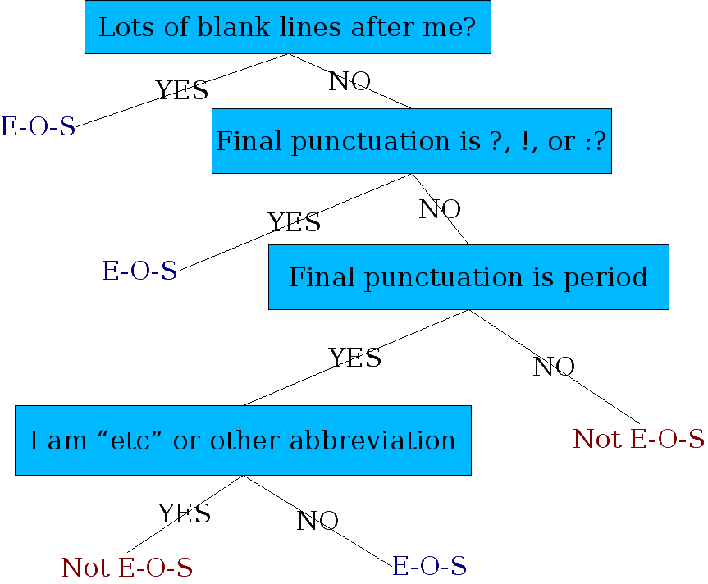
Determining if a word is end-of-sentence: a Decision Tree

Slide 35
More sophisticated decision tree features
Case of word with “.”: Upper, Lower, Cap, Number
Case of word after “.”: Upper, Lower, Cap, Number
Numeric features
Length of word with “.”
Probability(word with “.” occurs at end-of-s)
Probability(word after “.” occurs at beginning-of-s)

Slide 36
Implementing Decision Trees
A decision tree is just an if-then-else statement
The interesting research is choosing the features
Setting up the structure is often too hard to do by hand
Hand-building only possible for very simple features, domains
For numeric features, it’s too hard to pick each threshold
Instead, structure usually learned by machine learning from a training corpus

Slide 37
Decision Trees and other classifiers
We can think of the questions in a decision tree
As features that could be exploited by any kind of classifier
Logistic regression
SVM
Neural Nets
etc.

Slide 38
Basic Text Processing
Now ready for some analysis

Slide 39
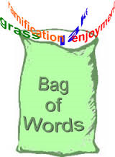
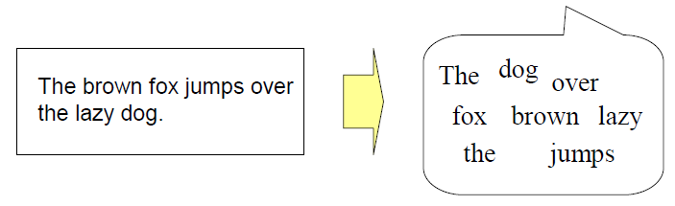
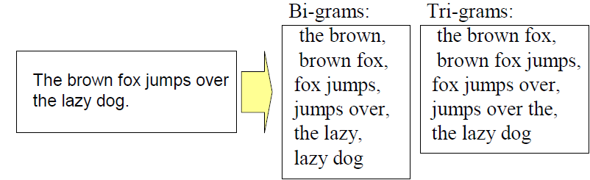
Feature Extraction
Bag-of-Word approach
a document is regarded as a set of words regardless of the word
order and grammar
Bi-grams, tri-grams, n-grams

Slide 40
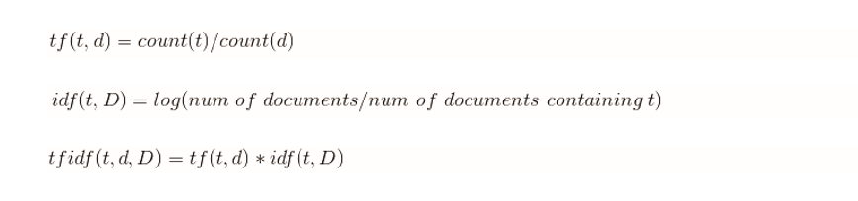
From Symbolic to Numeric
Term occurrence
Term Frequency (TF)
the number of times where word/n-gram appears in a document
Inverse Document Frequency (IDF)
the inverted rate of documents that contain word/ngram against the whole training data set of documents
TF-IDF
frequent words that appear only in a small number of documents achieve high value

Slide 41
Lab time
Jupyter notebook, or similar, with python 3.5 or later
You’ll need (nice if already on a local system):
import nltk #all environments
import feedparser #parsing rss feeds
!python -m nltk.downloader punkt #jupyter notebook
!python -m nltk.downloader stopwords #jupyter notebook
!python -m nltk.downloader treebank #jupyter notebook
Code snippets at:
https://github.com/jimwill3/NY-AZML-Meetup/snip1.txt snip2.txt...

Slide 42
Next time (targeting march 22)
Bring math to help us
Calculate similarities
Determine likely topics
Start LDA

Slide 43
All content at:
https://github.com/jimwill3/NY-AZML-Meetup
Recommended texts:
Natural_Language_Processing_in_Action_v4 by Lane and Howard
Text Analytics with Python by Dipanjan Sarkar

Slide 44

Appendix (code snippet)
We are pleased to announce preview availability of SDKs for the Cognitive Serivces - Bing Search APIs. Currently available as REST APIs, the Bing APIs v7 now have SDKs in four languages: C#, Java, Node.js, and Python.
g = feedparser.parse('https://azure.microsoft.com/en-us/blog/feed/')
print(g.feed.title)
sourceblog = 'azureblogfeed'
for n in g.entries:
tokens = nltk.word_tokenize(n.description)
cleanup = [token.lower() for token in tokens if token not in stopset and len(token)>2]
wc2=Counter(''.join(str(e)) for e in cleanup)
print("WC2:",wc2)
Counter({'apis': 3, 'bing': 2, 'sdks': 2, 'cognitive': 1, 'pleased': 1, 'preview': 1, 'serivces': 1, 'availability': 1, 'available': 1, 'languages': 1, 'java': 1, 'announce': 1, 'search': 1, 'python': 1, 'four': 1, 'node.js': 1, 'currently': 1, 'rest': 1})

