Slide 1
Getting Started with the Data Science Virtual Machine Part 1
Azure Machine Learning Meetup
March 16, 2017

Slide 2
Agenda
Part 1 (March 16)
Introduction
Tour
Setting up your own DSVM
Validate your DSVM
Using it cost effectively
Part 2 (to be scheduled)
Scenarios
Using external storage
Using a permanent disk
Working as a team or class

Slide 3
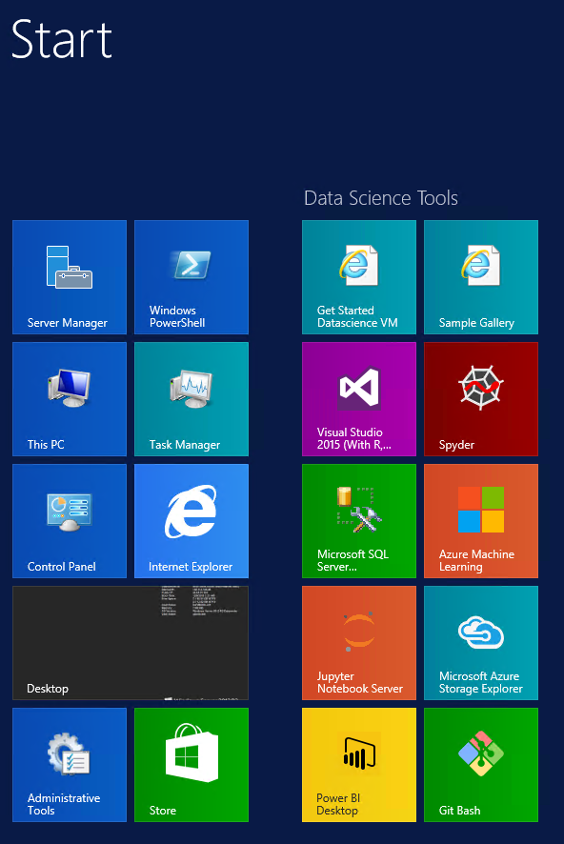
What is Data Science Virtual Machine?
Custom VM image on Azure Marketplace
Contains a set of data science, Azure tools/SDKs
All pre-configured and ready to use
Pay for cloud hardware usage only. No separate software charges!
Pointers to gallery, samples, documentation
Windows and Linux Versions
Up and running quickly

Slide 4
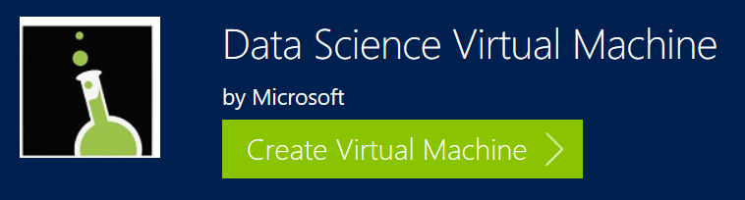
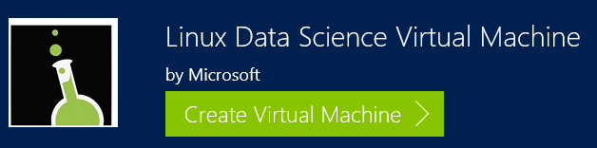
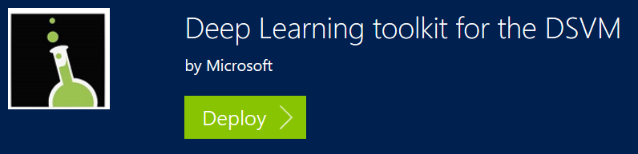
Flavors of the Data Science Virtual Machine

Slide 5
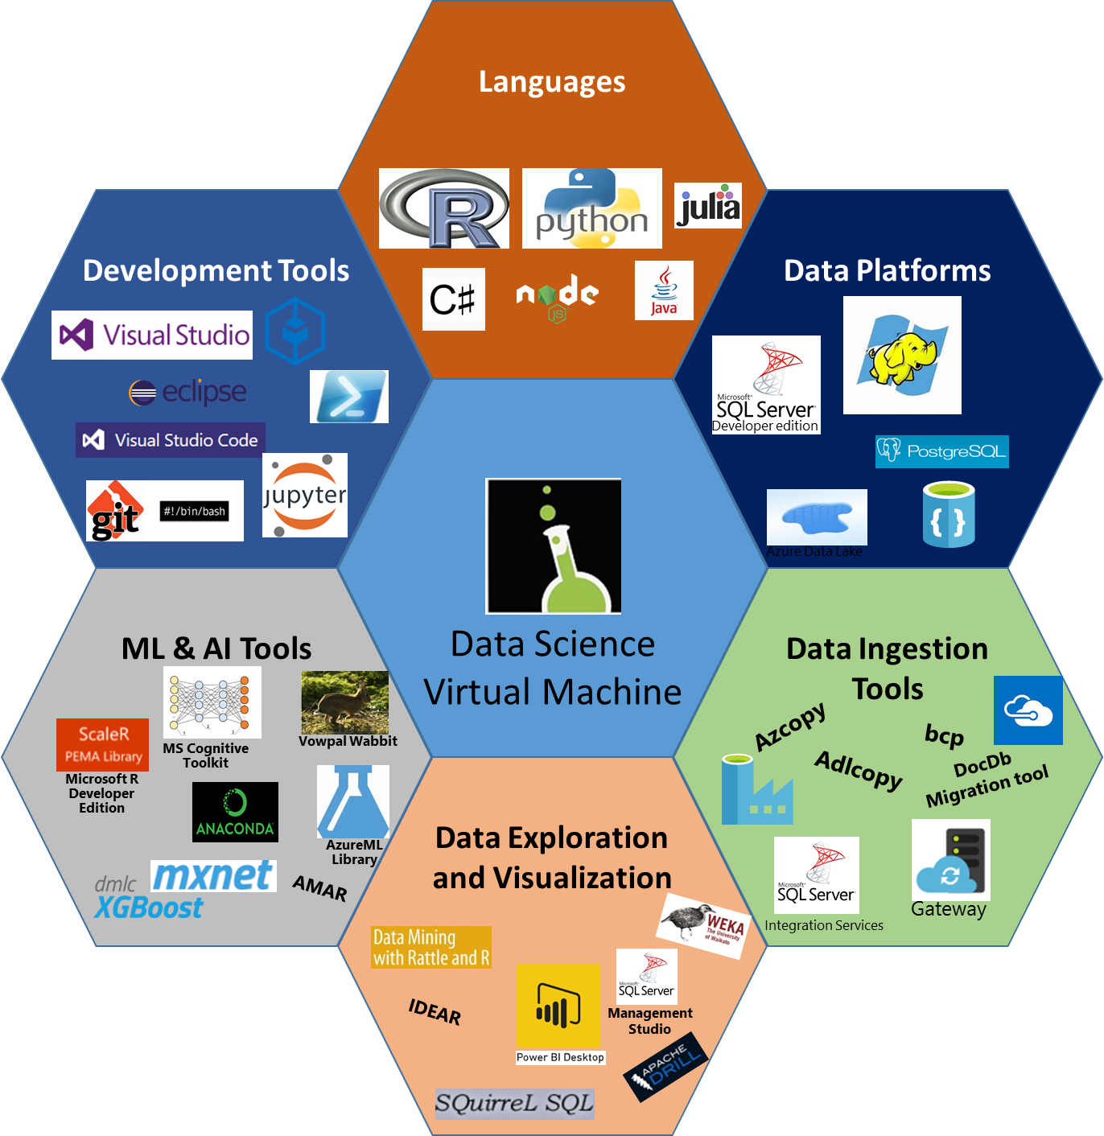


At-a-glance

Slide 6


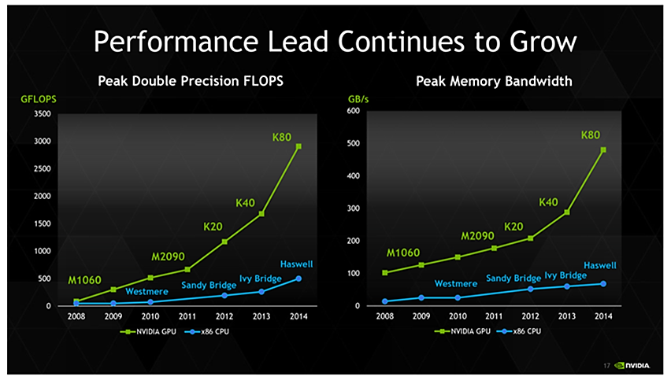
Deep Learning Toolkit
for the Data Science Virtual Machine (DSVM)
Build your first model in 30 minutes or less!
Try the DSVM for Free today…
Download the 2 page handout…
http://aka.ms/dsvm
http://aka.ms/dsvmhandout

Slide 7
Usage Scenarios
Analytics desktop in the cloud
Consistent setup across team, promote sharing and collaboration
Azure scale and management
Near-Zero Setup
Data Science Training and education
Consistent setup, ease of support
On Demand, Shared / dedicated infrastructure
Quick, Low friction startup
Short Experiments & Evaluation
Quick, Low Friction startup
Spend time evaluating instead of setup
Try before you buy
Replicate a published experiment
On-demand elastic capacity for large workloads
Ability to run analytics not feasible on desktop or on shared environment
Pay for what you use
Eg: Hackathons, Competitions
Deep Learning with Neural Networks & GPUs
Readily available GPU clusters with Deep Learning tools already pre configured

Slide 8
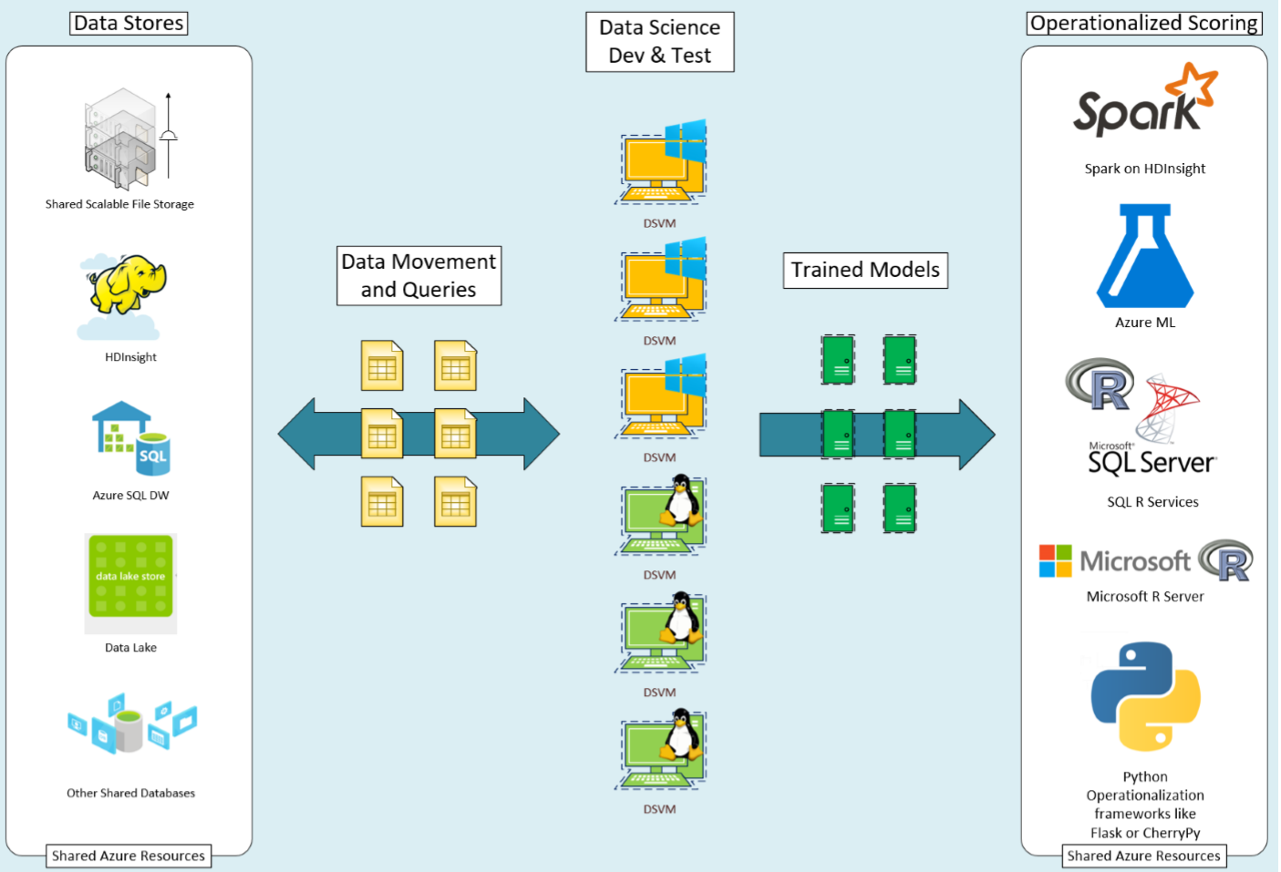
Development flow with DSVM

Slide 9
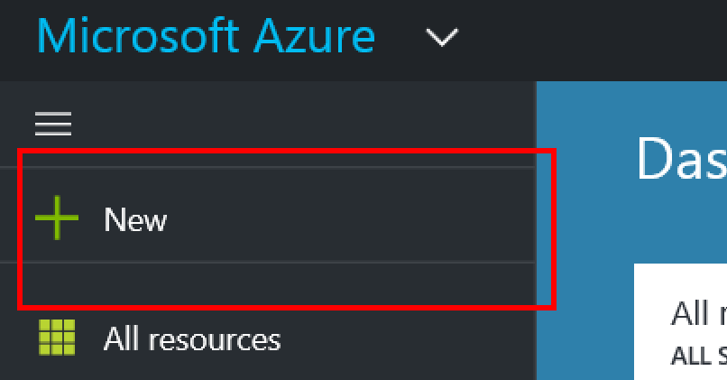
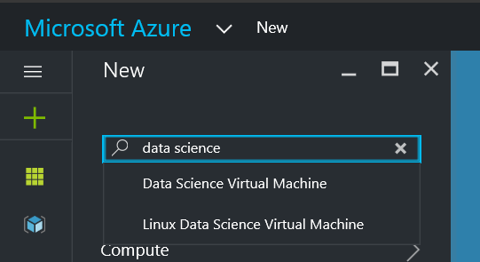
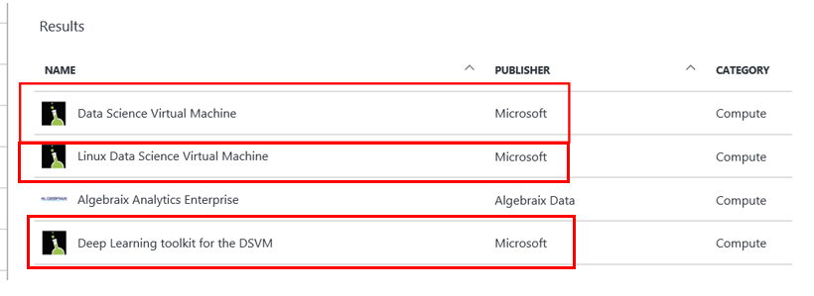
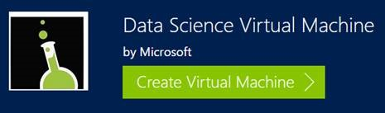
Creating a DSVM

Slide 10
Let’s create a DSVM
Start with an Azure account (if you have one)
Or get a free one: https://azure.microsoft.com/en-us/free/
And a storage account: (we suggest using the one tied to the DSVM to start)
The details (we will walk u through them) are at:
https://docs.microsoft.com/en-us/azure/machine-learning/machine-learning-data-science-linux-dsvm-intro
https://docs.microsoft.com/en-us/azure/machine-learning/machine-learning-data-science-provision-vm
Just released (March 10): standalone Spark, Hadoop, Yarn instance on Linux
https://blogs.technet.microsoft.com/machinelearning/2017/03/09/deploy-machine-learning-apps-to-big-data-platforms-with-linux-data-science-virtual-machine/

Slide 11
Validating the installation
Connecting to the DSVM
Exercising the tools (Rattle and IDEAR)
Saving your work
Shutting the VM down (save money)
Restarting the VM (pay for CPU utilization)
Make sure you shut it down again (appendix A)
Things you can try:
https://docs.microsoft.com/en-us/azure/machine-learning/machine-learning-data-science-vm-do-ten-things

Slide 12
Getting Started
Linux: SSH, Jupyter
X2Go for graphical remote desktop
Windows: RDP, Jupyter, SQL Server 2016 Developer Edition enabled by default
MS account sign in for Visual Studio Community Edition
Key tools on desktop icons or start menu
Ten things you can do on the DSVM: http://aka.ms/dsvmtenthings
There is also a test drive (free) – it lasts about 6-8 hours:
https://testdrive.azure.com/#/test-drive/microsoft-ads.linux-dsvm-testdrive/?from=azmktplc:98b67a88-f876-4389-8c9e-03c55313db95 OR
https://azuremarketplace.microsoft.com/en-us/marketplace/apps/microsoft-ads.linux-data-science-vm

Slide 13
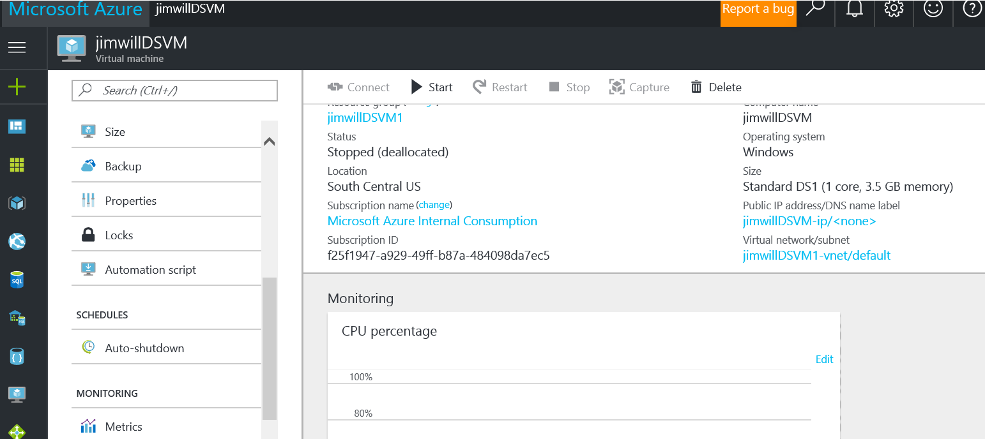
Appendix A – using auto shutdown policy
At the Azure Portal GUI for your DSVM you’ll see:

Slide 14
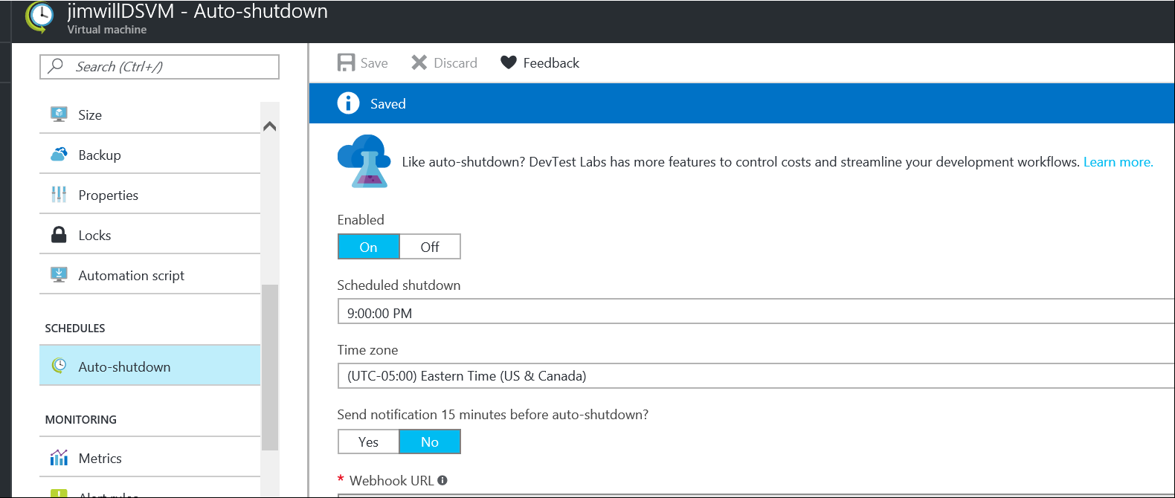
Should look like:

Slide 15
Appendix B - VM Versions comparison
Windows Edition
Microsoft R Open with popular packages pre-installed
Microsoft R Server Developer Edition
Anaconda Python 2.7, 3.5
JuliaPro with popular packages pre-installed
Jupyter Notebook Server (R, Python, Julia)
SQL Server 2016 Developer Edition: Scalable in-database analytics with R services
IDEs and Editors
Visual Studio Community Edition 2015 (IDE)
Azure HDInsight (Hadoop), Data Lake, SQL Server Data tools
Node.js, Python, and R tools for Visual Studio
RStudio Desktop
Power BI desktop - (BI Dashboard Design & Analysis)
Machine Learning Tools
Integration with Azure Machine Learning
Microsoft Cognitive toolkit (CNTK) - (deep Learning/AI)
Xgboost (popular ML tool in data science competitions)
Vowpal Wabbit (fast online learner)
Rattle (visual quick-start data and analytics tool)
Mxnet (deep learning/AI)
Tensorflow
SDKs to access Azure and Cortana Intelligence Suite of services
Tools for data movement and management of Azure and Big Data resources: Azure Storage Explorer, CLI, PowerShell, AdlCopy (Azure Data Lake), AzCopy, dtui (for DocumentDB), Microsoft Data Management Gateway
Git, Visual Studio Team Services plugin
Windows port of most popular Linux/Unix command-line utilities accessible through GitBash/command prompt
Weka
Apache Drill
Linux Edition
Microsoft R Open with popular packages pre-installed
Microsoft R Server Developer Edition
Anaconda Python 2.7, 3.5 with popular packages pre-installed
Julia with popular packages pre-installed
JupyterHub: Multi-user Jupyter notebooks (R, Python, Julia, PySpark)
PostgreSQL, SQuirreL SQL (database tool), SQL Server drivers, and command line (bcp, sqlcmd)
IDEs and editors
Eclipse with Azure toolkit plugin
Emacs (with ESS, auctex) gedit
IntelliJ IDEA
PyCharm
Atom
Visual Studio Code --
Machine Learning Tools
Integrations with Azure Machine Learning
Microsoft Cognitive toolkit (CNTK)-(deep Learning/AI)
Xgboost (popular ML tool in data science competitions)
Vowpal Wabbit (fast online learner)
Rattle (visual quick-start data and analytics tool)
Mxnet (deep learning/AI)
SDKs to access Azure and Cortana Intelligence Suite of services
Tools for data movement and management of Azure and Big Data resources: Azure Storage Explorer, CLI
Git
--
Weka
Apache Drill
Apache Spark - local instance

