Slide 1
CNTK (Deep Learning) Session 2 Azure Machine Learning Meetup
June 29, 2017
CNTK – Microsoft’s Cognition Toolkit http://cntk.ai

Slide 2
Deep Learning with CNTK - Agenda for June 29
News update
Recap CNTK Session 1 – using Python instead of Brainscript
Introduction to using Python for CNTK
Walk through of a basic Python CNTK program along with modifications and examination of using different learners, activation functions and so on.
Wrap up and feedback for session 3 CNTK topic (we have ideas but need feedback)
Suggested Prep reading:
https://github.com/Microsoft/CNTK/blob/v2.0/Tutorials/CNTK_101_LogisticRegression.ipynb

Slide 3
news
CNTK 2.0 is now in general release https://github.com/Microsoft/CNTK/releases
Keras Support
Java Bindings and Spark Support
Updated Windows DSVM
Microsoft R Server - Dev. Ed. (Scalable R)
Anaconda Python
SQL Server 2016 Dev. Ed. - With In-Database R analytics
Julia Pro + Juno Editor
Jupyter notebooks
Visual Studio Community Ed. + Python, R & node.js tools
Power BI Desktop
Deep learning tools e.g. Microsoft Cognitive Toolkit (CNTK 2.0), TensorFlow & mxnet
ML algorithm libraries e.g. xgboost, Vowpal Wabbit
https://azuremarketplace.microsoft.com/en-us/marketplace/apps/microsoft-ads.windows-data-science-vm
Free e-book for PowerBI + R
http://blog.revolutionanalytics.com/2017/06/power-bi-free-e-book.html

Slide 4
Session 1 recap
Took a small but interesting sample data set
Defined a one hidden layer NN in CNTK BrainScript engine
Trained, Tested, and Predicted using that BrainScript definition
To follow independently you can use (put wiki here)
Original article behind this at:
Observations:
BrainScript is modular and fosters composition
It works very well for first time use, testing, and experimentation
May be challenging to scale to very large definitions, traces, debugging scenarios
Is not dynamic or easy and data prep is all done separately
Material all posted to https://github.com/jimwill3/NY-AZML-Meetup/tree/CNTK

Slide 5
how to: CNTK architecture
CNTK
reader
• task-specific deserializer
• automatic randomization
network
• network definition
• CPU/GPU execution engine
learner
• SGD (momentum, AdaGrad, …)
• minibatching, packing, padding
corpus
model

Slide 6
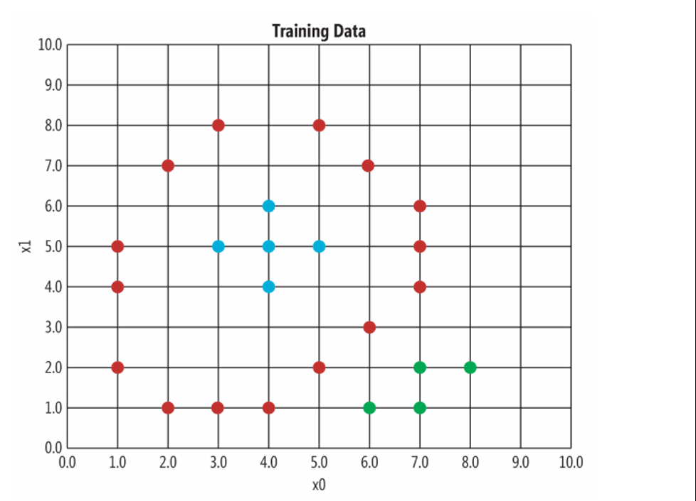
Graph of that Training Data – Colors indicate Output Label Value – exactly what we used last time…
Source: https://msdn.microsoft.com/en-us/magazine/mt791798.aspx

Slide 7
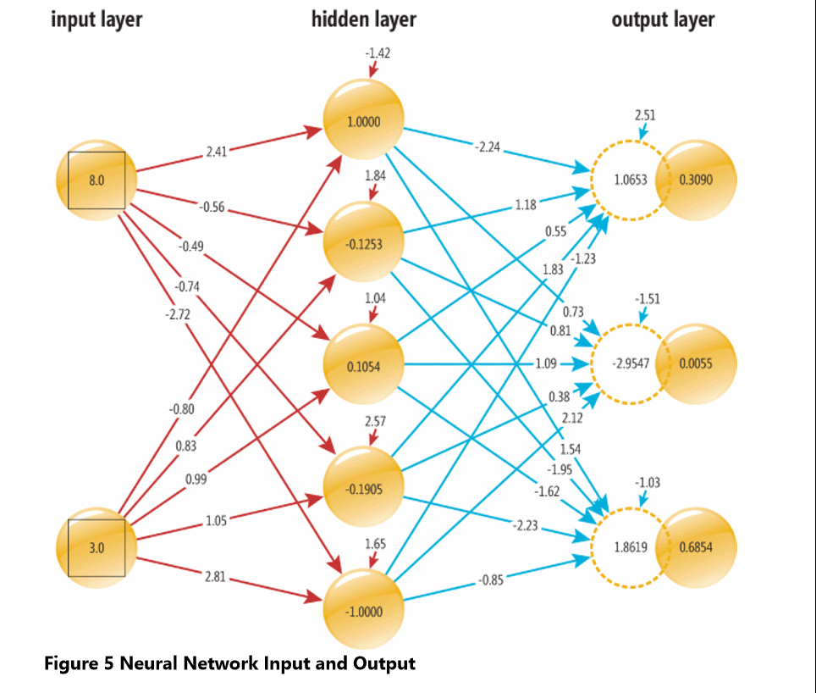
this is what we will defined with CNTK(script last time, code this tme) two input nodes that hold values (8.0, 3.0) ; three output nodes with values(probabilities) (0.3090, 0.0055, 0.6854)

Slide 8
BrainScript Key Configuration Settings
# stochastic gradient descent
SGD = [
epochSize = 0 #ignore it (see docs)
minibatchSize = 1 #input volume per adjustment
learningRatesPerSample = 0.04 #adjust weights by this factor (relatively modest)
maxEpochs = 500 #500 iterations
momentumPerMB = 0.90 #gain per minibatch (see docs)
]
readerType = "CNTKTextFormatReader"
file = "TrainData.txt"
input = [
features = [
…
format = "dense“
# define training criteria and output(s)
ce = CrossEntropyWithSoftmax (labels, myNet)
err = ErrorPrediction (labels, myNet)
pn = Softmax (myNet)

Slide 9
Reasons for Python with CNTK
Direct access and control to almost all aspects of CNTK
Can handle data from a wide variety of sources and package and data transforms within code/packages
Performs well as the CNTK team focused on efficient data transfer and marshalling
For many, more natural than BrainScript
Most interesting and complex examples and tutorials use Python!

Slide 10
Python for CNTK (based on CNTK 2.0 release)
Documented https://www.cntk.ai/pythondocs/
Embedded in Examples and Tutorials (Python Notebooks)
Layers Library Reference included (think pre-defined layers)
Let’s do an initial run demo
Feel free to code along if you have installed CNTK or are using aka.ms/DSVM or the Azure Notebook for CNTK
https://notebooks.azure.com/cntk/libraries/tutorials (same as locally installed tutorials) – they should be dated May 4, 2017 or later.
The above link should let you do some use for free – just signin/up
https://notebooks.azure.com/faq

Slide 11
Key modules/classes
trainer encapsulates the overall training process and employs one or more learners to tune the parameters of a specified model using gradients of parameters
Sequential
Layer factory function to create a composite that applies a sequence of layers (or any functions) onto an input (this is our type of network)
netout = Sequential([For(range(num_hidden_layers)….
Dense
Layer factory function to create an instance of a fully-connected linear layer of the form activation(input @ W + b) with weights W and bias b, and activation and b being optional
Dense(hidden_layers_dim, activation=sigmoid))
Trainer
trainer encapsulates the overall training process and employs one or more learners to tune the parameters of a specified model using gradients of parameters
trainer = Trainer(netout, (ce, pe), learner, progress_printer)
ce is cross entropy and pe is classification error

Slide 12
Other key syntactic elements
Epochs are 1 or more “loops” or iterations over the data
Maxepochs puts an upper limit on “work” to train a model
Epochsize = 0 (means a loop sweeps over all the sample data – think of reading the whole file)
Epochsize = ‘n’ (means a loop comprises n items from a sample)
Minibatch = ‘y’ (means take ‘y’ samples before updating parameters via SGD or similar)
Iterations consist of minbatches that fetch 1 or more items to pass thru the NN as a unit of work
One iteration is a flow through the sample or training data
One minibatch is a chunk of that iteration
Mini_batch_size defines the ‘chunk’ size per minibatch retrieval operation (next_minibatch)
At the end of each iteration/minibatch the cost optimizer function executes and updates the parameters
The parameters are updated at rates determined by:
Learning rate – defined by you – how aggressive is the parameter update estimator
Learning rate can vary (defined by you) during a model training effort
CNTK uses slightly different terminology:
Uses the SUM over gradients for a minibatch update calculation while others use average
CNTK offers the learningRatesPerMB option to achieve similar behavior

Slide 13
Enter this at your python prompt
>>>import cntk
>>>cntk.__version__
'2.0'
Run through Sample code jupyter notebook jun29.ipynb
We use the exact same training and test data files from the prior CNTK session TrainData.Txt and TestData.Txt posted to github.

Slide 14
Main elements from jun29.ipynb
from __future__ import print_function
import numpy as np
import cntk as C
from cntk.learners import sgd, learning_rate_schedule, UnitType
from cntk.logging import ProgressPrinter
from cntk.layers import Dense, Sequential
input_dim = 2 #2 features to input per sample
output_dim = 3 #3 classes/labels each sample
layers_dim = 1 #1 hidden dimension as this is just for starting
hidden2_dim = 5 #5 hidden nodes in the 1 hidden dimension
input_var = C.input(input_dim,np.float32)
label_var = C.input(output_dim,np.float32)
inputfile = "C:\\pathtotrainingdata\\TrainData.txt"

Slide 15
Jun29.ipynb – set up the reader,network etc (2 of 3)
areader = create_reader(inputfile,True,input_dim,output_dim)
#map input containers (tensors) with the text file structure
reader_map = {
input_var : areader.streams.features,
label_var : areader.streams.labels
}
#let define a network and learner - note how inputs are not included directly in the initial definition 'amodel'
#mbs, minibatch schedule, is ignored for this one as the data is so small, may be useful in other situations
amodel = Sequential ([Dense(hidden2_dim,activation=C.sigmoid),Dense(output_dim)])
zz = amodel(input_var)
mbsize = 1 #original brainscript was 1
numbatches = 18000 #same as the brainscript (500)*25 per batch
crossent = C.cross_entropy_with_softmax(zz,label_var)
classerror = C.classification_error(zz,label_var)
learn_rate = learning_rate_schedule(0.04,UnitType.minibatch) #.04 used in brainscript
prprint = ProgressPrinter(0) #0 means a geometric print schedule
mbs = minibatch_size_schedule([1,2],3000) #use 1 for the first 1000 samples and then 2 after that
Trainer2 = C.Trainer(zz,(crossent,classerror), [sgd(zz.parameters,lr=learn_rate)],[prprint])

Slide 16
Jun29.ipynb (run the trainer – see notebook for test, evaluate)
for ii in range(numbatches):
mbatch = areader.next_minibatch(mbsize,input_map=reader_map)
Trainer2.train_minibatch(mbatch)
print('training done’)
This outputs progress to the notebook (default is to output at geometric increases in examples seen)
average since average since examples
loss last metric last
------------------------------------------------------
Learning rate per minibatch: 0.04
0.699 0.699 0 0 1
0.929 1.04 0.333 0.5 3
1.07 1.18 0.429 0.5 7
1.03 1 0.4 0.375 15
0.967 0.905 0.355 0.312 31
0.93 0.894 0.349 0.344 63
0.945 0.959 0.386 0.422 127

Slide 17
General mapping Python/BrainScript
BrainScript separates features, outputs, learners, network details, and other parameters by its modular approach
Python for CNTK does the same by exposing a set of classes and utilities all from within the package “cntk”
Python does have some nice advantages:
Use memory to hold data – fetch externally ‘as needed’ etc.
Generate random data and data preparation routines
Rotate and evolve parameters and even use timing results to run a suite of models or samples
Hooks to extend CNTK
In reality – all the rich examples (today) are in Python

Slide 18
Print Progress Metrics (vary by loss function)
avg_loss_since_start
Returns: the average loss since the start of accumulation
avg_loss_since_last
Returns: the average loss since the last print
avg_metric_since_start
Returns: the average metric since the start of accumulation
avg_metric_since_last
Returns: the average metric since the last print

Slide 19
notes
https://jamesmccaffrey.wordpress.com/2017/04/14/using-the-cntk-built-in-file-reader-functions/
Python scenarios:
https://docs.microsoft.com/en-us/cognitive-toolkit/How-do-I-Express-Things-In-Python

Slide 20
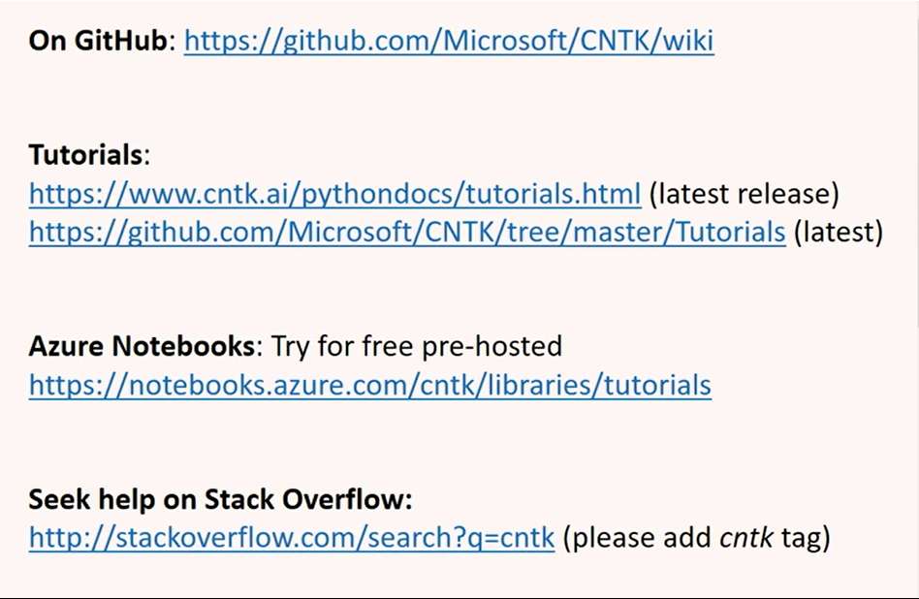
Additional content

Slide 21
Next session
MNIST digit classifier

