Slide 1
Catastrophic Forgetting in Reinforcement Learning
Azure Machine Learning Meetup
Sept 5, 2019
jw

Slide 2
agenda
Welcome and intro
Recap of prior RL sessions
Catastrophic Forgetting
The general challenge
The specific challenge in RL
One way to mitigate
Demo and sample code
Other technique
Discuss and demo
Presentation and sample code
https://github.com/jimwill3/NY-AZML-Meetup/tree/CNTK/RL

Slide 3
News Items
Pytorch 1.2 available on Azure
https://azure.microsoft.com/en-us/blog/pytorch-on-azure-full-support-for-pytorch-1-2/
Azure Machine Learning service – Azure Machine Learning streamlines the building, training, and deployment of machine learning models. Azure Machine Learning’s Python SDK has a dedicated PyTorch estimator that makes it easy to run PyTorch training scripts on any compute target you choose, whether it’s your local machine, a single virtual machine (VM) in Azure, or a GPU cluster in Azure. Learn how to train Pytorch deep learning models at scale with Azure Machine Learning.
Azure Notebooks – Azure Notebooks provides a free, cloud-hosted Jupyter notebook server with PyTorch 1.2 pre-installed. To learn more, check out the PyTorch tutorials and examples.
Data Science Virtual Machine – Data Science Virtual Machines are pre-configured with popular data science and deep learning tools, including PyTorch 1.2. You can choose a variety of machine types to host your Data Science Virtual Machine, including those with GPUs

Slide 4
recaps
Session 1: bandits and epsilon greedy to illustrate fundamental ideas (action, values, rewards, strategy, policy)
Session 2: replace simple function with a deep neural network (replace python function -> DNN)
Session 3: guest presentation by Michael Evangelista on MDP and value learning – sample code included
Session 4: Microsoft Personalizer Service – MDP as a REST based API

Slide 5
Recap from first session
Introduced reinforcement learning concepts
“ a software agent observes and decides to take actions in order to optimize a reward”
“the agent learns by implementing a policy* that samples the environment and assesses the long-term rewards”
Used a small sample written just using python and numpy to mimic 10 slot machines
Illustrated expected rewards, basic policy, value functions
Code and PPTX posted to https://github.com/jimwill3/NY-AZML-Meetup/tree/CNTK/RL
*policy can be a simple function, rule, neural net. It can be deterministic or stochastic. Our first sample used a simple stochastic policy called epsilon greedy

Slide 6
Session 2: similar problem to last time one-armed bandit but a contextual bandit environment and a DNN to estimate best action
What’s different about this simulation compared to our basic multi-armed bandit from march?
Assume arms (choices) represent ads to display on a web site which has 10 sections to visit
Instead of placing random ads as people navigate – we want to place ads based on their context (current section) - and assume we have 10 possible ads to display
So – there are 10 choices and 10 ads for 100 combinations – what is the best way to optimize ads to show? (for example, random ad displays may choose to show ads for laptops when someone lands on the nutrition section)
This problem has a state space - current web section, which is called the “contextual state”, leading to the phrase Contextual Bandits
We use a DNN to predict rewards based on current state and a probability function.
The original multi-armed bandit had no state space – there was no representation for the current state, only a calculation of reward and reward history
Code walkthrough
Will be published to github early next week

Slide 7
training recipe for the DNN notebook for contextual bandits (mock ad placements)
Initialize sites and ads to random values
Define the agent (neural net) its layers, learning rate, loss function, and optimizer
Enter a training loop:
NN model Predicts reward for current site – this returns a predrew vector
Calculate softmax of the reward vector and also normalize it so that probabilities sum to 1
Choose an ad to show based on a probability distribution (the softmax) and estimate the reward for that choice – this is current observed reward
Pass reward predicted & reward observed to loss function
NN Optimizer updates the neural net weights
Reset our site again as input to the next training cycle
Repeat until loop count reached (other termination rules are available)
Plot the results which have been stored at snapshots within the training loop

Slide 8
Markov Decision Processes & Value Iteration
Michael Evangelista (michael@powerof.to)
2019-05-23
Session 3

Slide 9
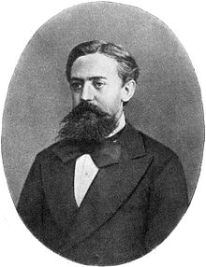
Markov Decision Process
Used to define sequential decision making problems
Defines possible states of the environment
Defines actions an agent may take
Defines the dynamics – how an action leads from one state to another and how the agent is rewarded
States have the "Markov Property"
Notes:
Andrey Markov

Slide 10
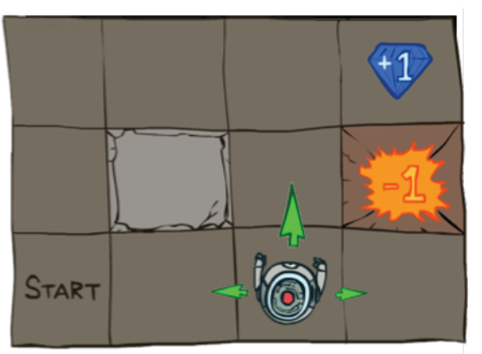
Grid World Rules
Get the diamond for a score of +1 (win the game)
Fall into fiery pit, get a score of –1 (and die)
Robot can move to any adjacent square (except on the edges and the blocked square)
Environment is stochastic (meaning, with some probability the robot may slip and go left/right instead of desired direction)
Any attempt to move to the rock or edge (whether intentionally or by slip) leaves you in current square
Game ends when the robot gets to a reward state (+1 or –1)
0
1
2
0
1
2
3
Image Credit: Abbeel, Pieter (2017). Deep Reinforcement Learning Lecture 1: Motivation + Overview + MDPs + Exact Solution Methods.
https://sites.google.com/view/deep-rl-bootcamp/lectures
Notes:
Canonical example
How do we describe this as an MDP?

Slide 11
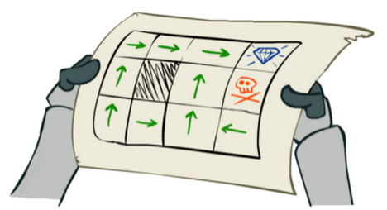
Session 3: Solving the MDP
Find a policy, π*, that yields the best return:
π* = argmax_{π} E_{π}[G_{t} | π, s₀]
= argmax_{π} E_{π}[∑_{t=0..H} γ^{t} r(s_{t}, a_{t}, s_{t+1}) | π, s₀]
Wait – what the heck does this mean?
A policy, π, defines an agent's behavior
π* is the optimal policy. When followed, π* should, in expectation (i.e., on average), produce the highest possible return starting from any state
π
Image Credit: Abbeel, 2017
Notes:
What's a policy?
Defines agent's behavior given state.
Many policies can exist (go to school, study, get a job vs. stay at home and read Facebook)
Can be stochastic or deterministic. Today we'll deal only with deterministic
What's this expectation?
Find pi s.t. it maximizes...
The average return over all possible runs through the MDP...
Weighted by their probability
REMEMBER: while the agent is deterministic, the environment is not (remember slipping into the pit?)
How do we calculate this?
Value iteration algorithm!
But first some quick notation

Slide 12
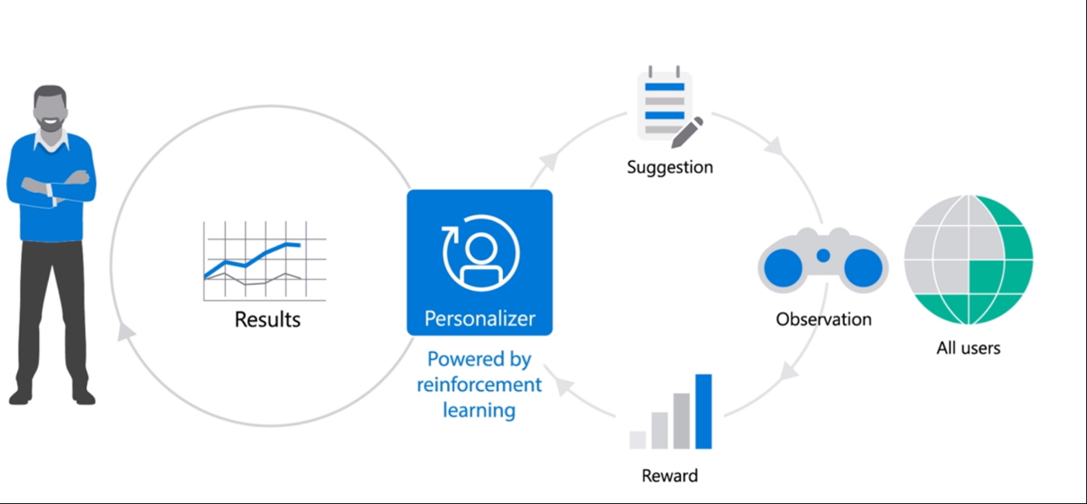
Personali Session 4 – Personalizer Service (MDP as a Service)

Slide 13
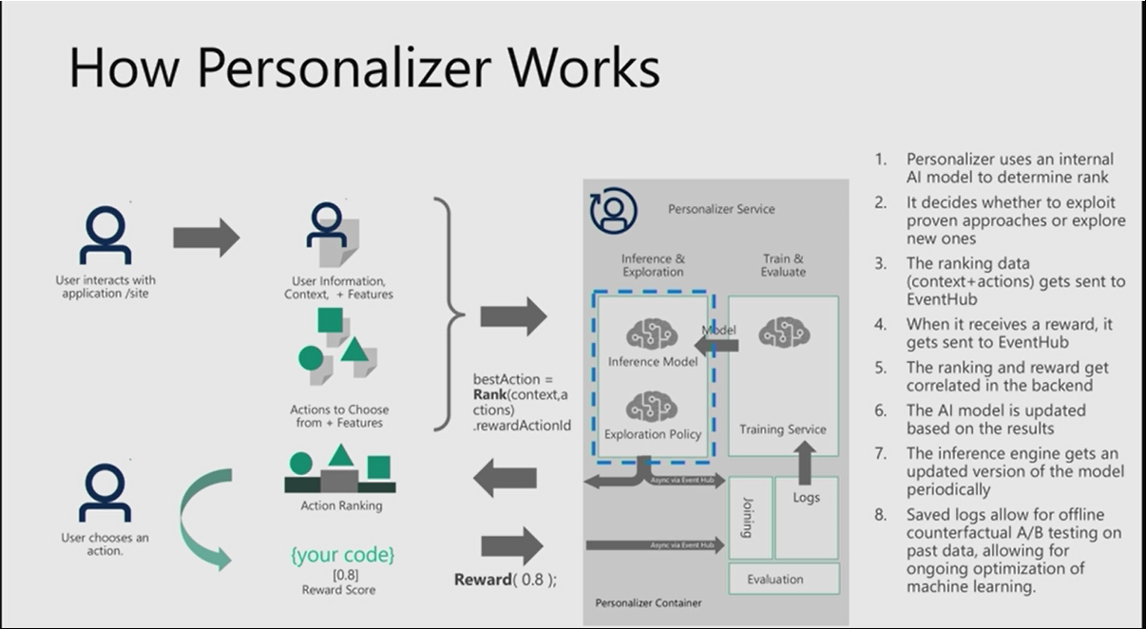
HOW IT WORKS (IMPLEMENTED IN VOWPAL WABBIT)
The current version of Personalizer uses contextual bandits, an approach to reinforcement learning that is framed around making decisions or choices between discrete actions, in a given context

Slide 14
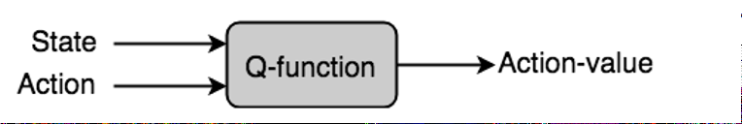
Super simple summary

Slide 15
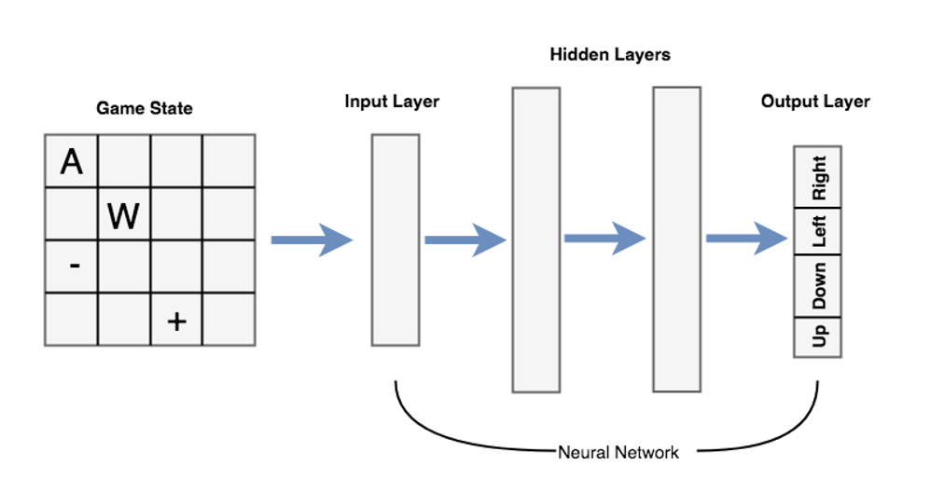
Modelling the DNN as Q-function

Slide 16
Key points …
Actions represent choices or decisions that lead to rewards
State is the information that our agent receives to make a decision on what action to take
Rewards are numerical values calculated by the application but fed back to the algorithm (feedback)
The algorithm learns to optimize rewards over time by processing samples. That optimization identifies the Action associated with the optimal long term reward (expected value)
A strategy is a way to tradeoff trying new choices or sticking with what has been working (providing rewards). Avoids missing out on a better function
policy is the strategy our agent follows when provided a state
A function takes in actions and states, returns proposed best action, and then receives feeback via the reward (or a proxy for the reward)
Functions can be simple rules or rich deep neural networks. Often referred to a Q-functions

Slide 17
Session 5: Catastrophic Forgetting
“the tendency of an artificial neural network to completely and abruptly forget previously learned information upon learning new information“
Reinforcement learning represents a worst-case scenario when it comes to precipitating catastrophic forgetting in neural networks. Meaningful training examples are acquired as the agent explores different regions of its state/action space. When the agent is in one such region, only highly correlated samples from that region are typically acquired.
Moreover, the regions that the agent is likely to visit will depend on its current policy, suggesting that an agent that has a good policy may avoid exploring particular regions. The confluence of these factors means that without some mitigation techniques, supervised neural networks as function approximation in temporal-difference learning will be restricted to the simplest test cases. https://trace.tennessee.edu/utk_graddiss/3581/
In other words – appear to make progress and learn, but suddenly degrade quickly and unexpectedly

Slide 18
Critical point about prior the RL approaches so far:
One thing really stands out in the several DNN implementation used in earlier demos
Our RL code trains per action even though many actions return 0 reward (so what do they learn?)
If the only reward (+ or -) is for the last move, how do you optimize for prior moves, and avoid losing moves?
Have you seen any signs of minibatch training?
Could this (or something like it) be happening with Catastrophic Forgetting

Slide 19
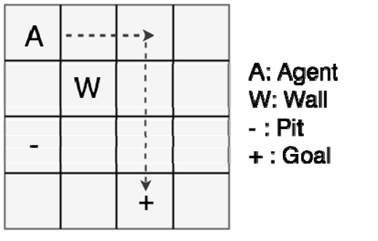
Let’s review the game we use (very similar to Michael’s grid game in session 3)

Slide 20
Gridworld rewards (in gridworld.py)
def reward(self):
if (self.board.components['Player'].pos == self.board.components['Pit'].pos): return -10
elif (self.board.components['Player'].pos == self.board.components['Goal'].pos):
return 10
else:
return -1

Slide 21
Q-function model logic
qval = model(state) #Run the Q-network forward to get predicted q-values for all actions
qval_ = qval.data.numpy() #qval as floats (tensor to array conversion)
if (random.random() < epsilon): # our greedy epsilon test
action_ = np.random.randint(0,4)
else:
action_ = (np.argmax(qval_)) #get the highest value in the array (optimal)
action = action_set[action_] # translate the numerical action into one of the actions(‘u’,’d’)
game.makeMove(action) #take the action
new_state_ = game.board.render_np().reshape(1,64) + np.random.rand(1,64)/10.0
new_state = Variable(th.from_numpy(new_state_).float()) #new state of game as number
reward = game.reward() # get reward for new state
newQ = model(new_state.reshape(1,64)).data.numpy()
maxQ = np.max(newQ) # maximum q-value predicted from the new state
y[:] = qval_[:] #make a copy of the qval_ array
if reward == -1: # update qval since we did not win or lose
update = (reward + (gamma * maxQ))
else:
update = reward
y[0][action_] = update #update element corresponding to the action taken
loss = loss_fn(qval, y) # calculate loss- how good was the prediction vs observed
– do backprop – shrink epsilon – continue…

Slide 22
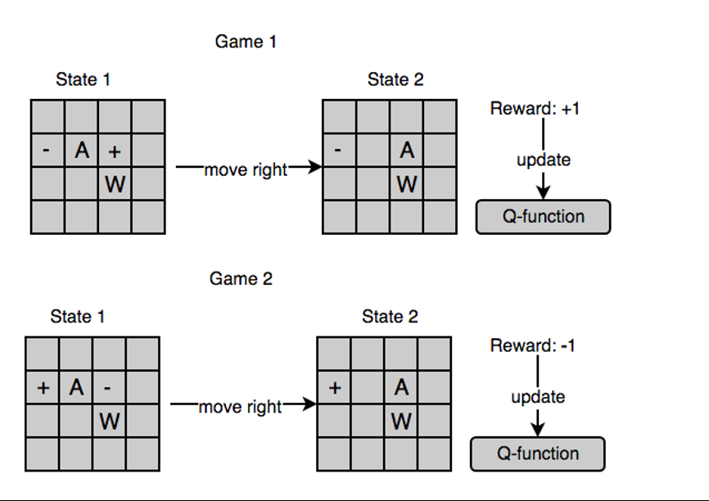
Catastrophic forgetting in one picture
No way to differentiate between a good move right and a bad move right since there are times when it is rewarding, and times when it is not.
Deep Reinforcement Learning In Action: Zai and Brown, Pub: Manning 2019

Slide 23
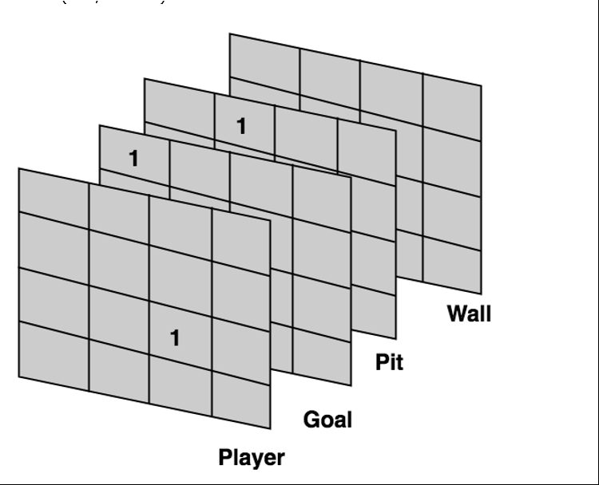
Representing the game board as a tensor
A 4x4x4 tensor has 64 total elements
This can be flattened into a 64 item array for simplicity.
(and is in the sample code)
1st dimension of this 3-tensor is divided into 4 separate grid planes, where each plane represents the position of each element. So below is an example where the player is at grid position (2,2), the goal is at (0,0), the pit is at (0,1) and the wall is at (1,1) where (row, column). All other elements are 0s.

Slide 24
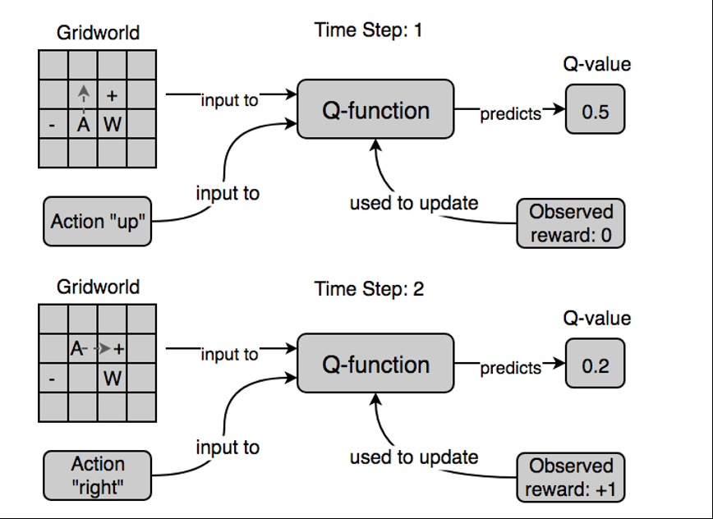
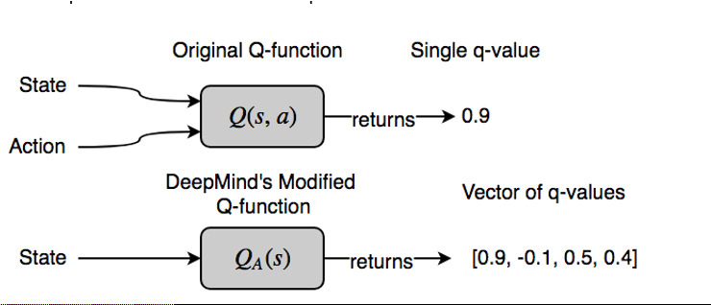
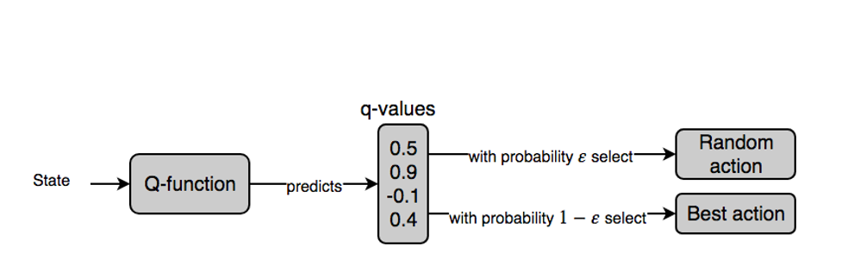
The details
Deep Reinforcement Learning in Action: Manning; active online book.

Slide 25
The learning sequence (happens in the loop)
Make a move and get an output array representing action/values
Looks like [-7.4387, -7.4534, -7.7156, -7.6931]
Take action based on max of prior array (first elem)
Observe new state and reward and update the action value with the reward we just got! (reward formula in code)
Our target vector (the one with a win included) now looks like this:
[10.0000, -7.4534, -7.7156, -7.6931] where the code set the value for the ‘u’ action to be 10 (the reward for winning the game)!
That new target vector is used to update the model (backprop etc).

Slide 26
Output sample (random test for 1 epoch)
Taken from a test run:
game done at update= 10 (winning reward)
#values before moving
qval_ [[-12.39525 -10.620232 -11.42815 -10.984893]]
newQ [[-12.614955 -10.686918 -10.6746 -10.916367]]
maxQ -10.6746 y[0][action_] is tensor(10.) #set by code
last y[0] tensor([[ 10.0000, -10.6202, -11.4282, -10.9849]])
#best – the winning action has been given the max value for this game and training has occurred

Slide 27
Experience replay
Experience replay stores a buffer (‘the replay’) of prior action/value/reward tuples as a type of memory
During training, a random subset of the buffer is fetched and used as a type of batch updating to the model
Iterate over the subset and calculate(predict) the values as if it was a regular event store in a pred_array. Compare now to the original subset (orig_array) and average the loss and then update (backprop) the model.
As you proceed just overwrite oldest values in the replay buffer

Slide 28
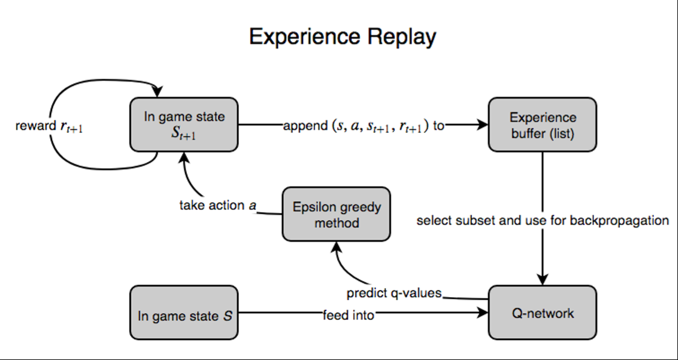
Experience replay illustration
Deep Reinforcement Learning In Action: Zai and Brown, Pub: Manning 2019

Slide 29
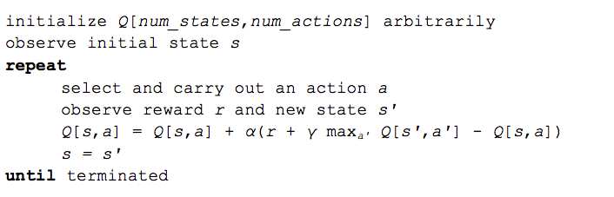
Q-learning in a nutshell (no replay)

Slide 30
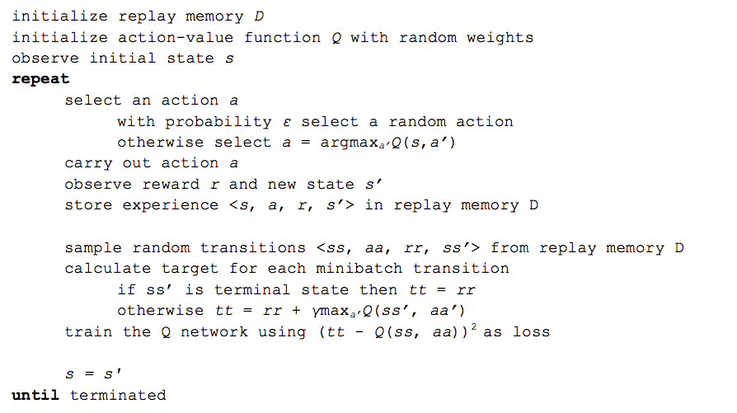
Q-learning algorithm with replay
https://www.intel.ai/demystifying-deep-reinforcement-learning/#gs.0mxq8l

Slide 31
Some sample outputs
Your results will almost certainly vary
I added nodes to layers and saw some benefits, and also more epochs but did not go beyond 5000 games in a training cycle.
Why stay below 5000 games?
16*15*4*13 is 43,680 - # of possible placements of the 4 items (player, +,-, and wall) so to prevent memorization possibiliites…

Slide 32
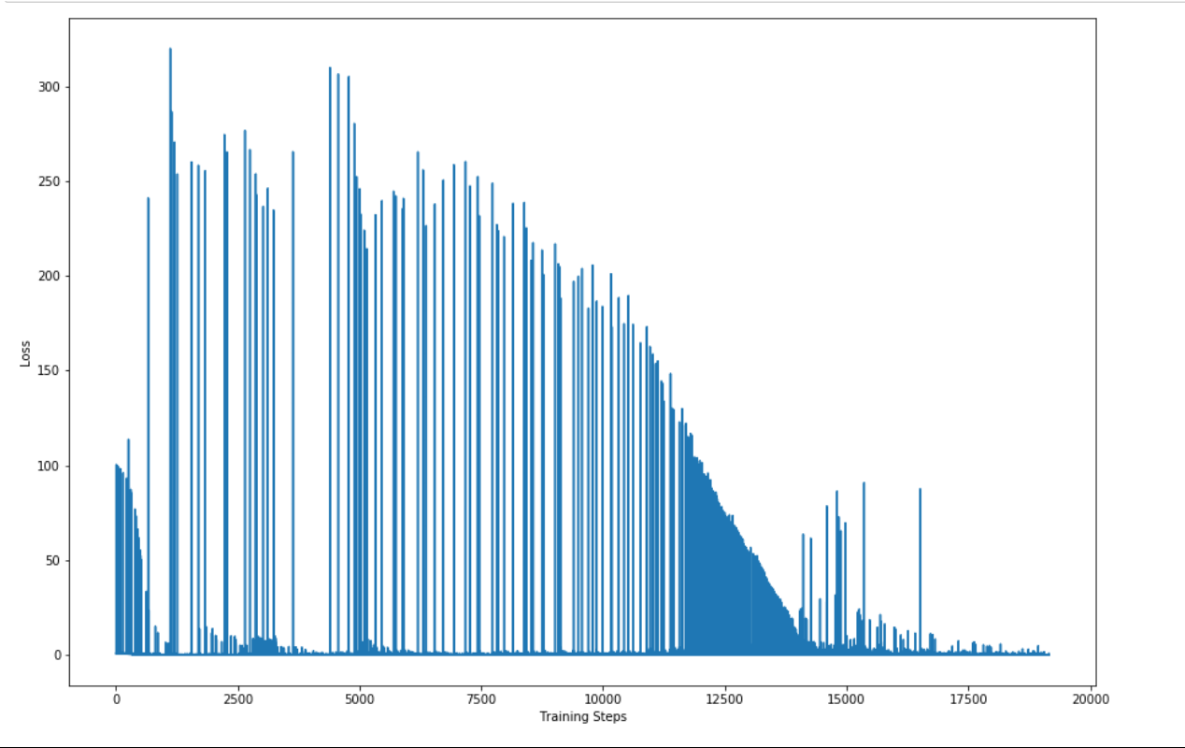
Static game – no mitigation – pretty good

Slide 33
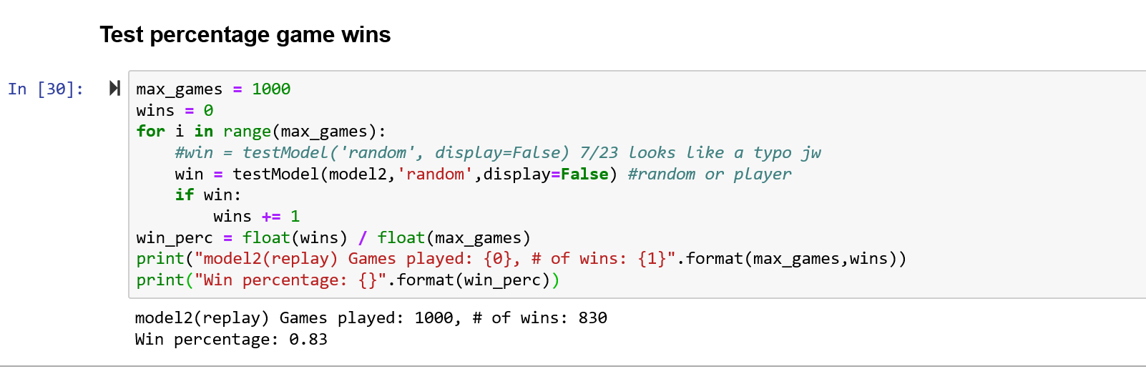
Model2 – 2000 epochs – 83% wins – with random positions… layer 3 of DNN had 250 nodes (bumped up from 150 due to poor results)

Slide 34
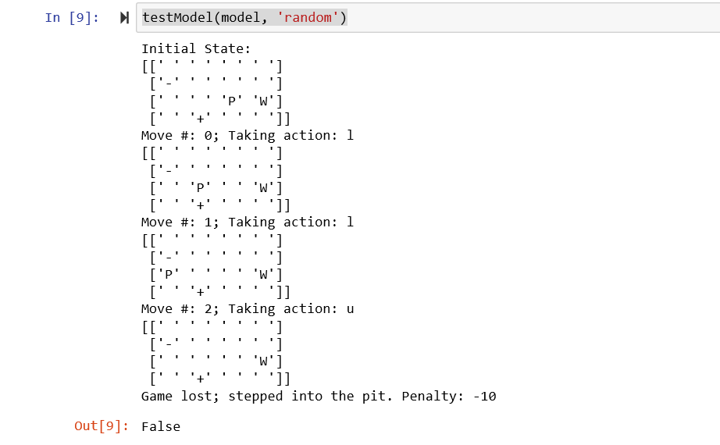
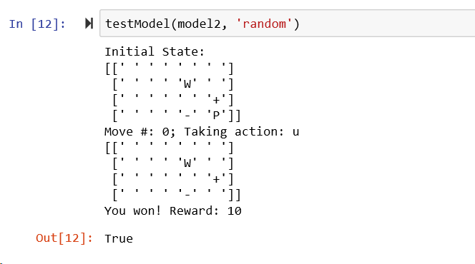
Random game – no mitigation - rapid loss, but you still win (once in a while)

Slide 35
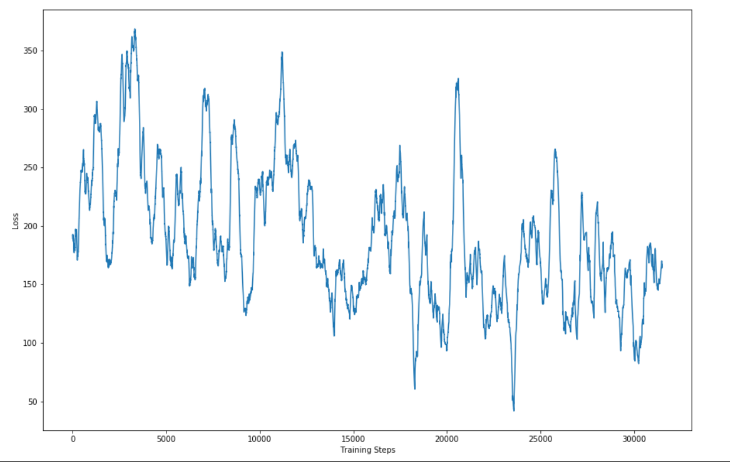
Random game – with mitigation – progress, but still hard

Slide 36
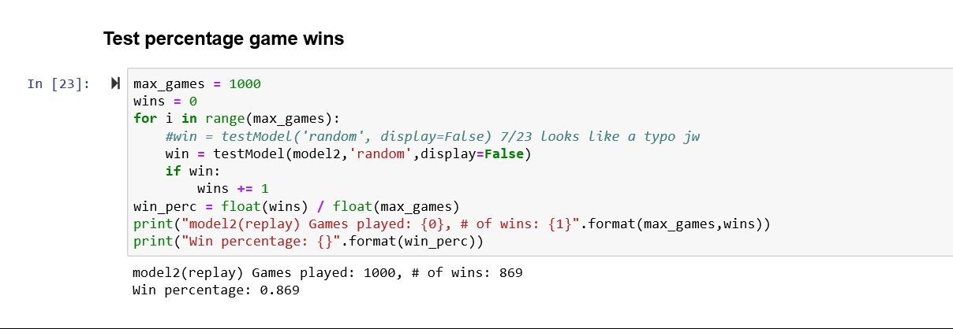
Bulk test of random with mitigation wins almost 87% of the time (on this cycle – results will vary)

Slide 37
Additional resources
https://towardsdatascience.com/reinforcement-learning-with-hindsight-experience-replay-1fee5704f2f8
https://www.intel.ai/demystifying-deep-reinforcement-learning/#gs.03lyf1
https://www.analyticsvidhya.com/blog/2019/04/introduction-deep-q-learning-python/
https://medium.com/emergent-future/simple-reinforcement-learning-with-tensorflow-part-1-5-contextual-bandits-bff01d1aad9c
https://www.coursera.org/specializations/machine-learning-reinforcement-finance
https://simoninithomas.github.io/Deep_reinforcement_learning_Course/

Slide 38
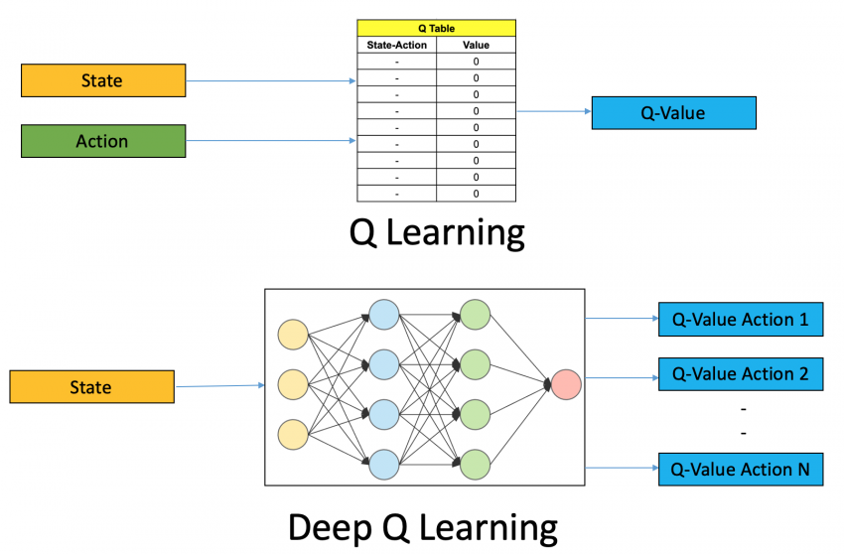
Q learning vs Deep Q learning
https://www.analyticsvidhya.com/blog/2019/04/introduction-deep-q-learning-python/

Slide 39
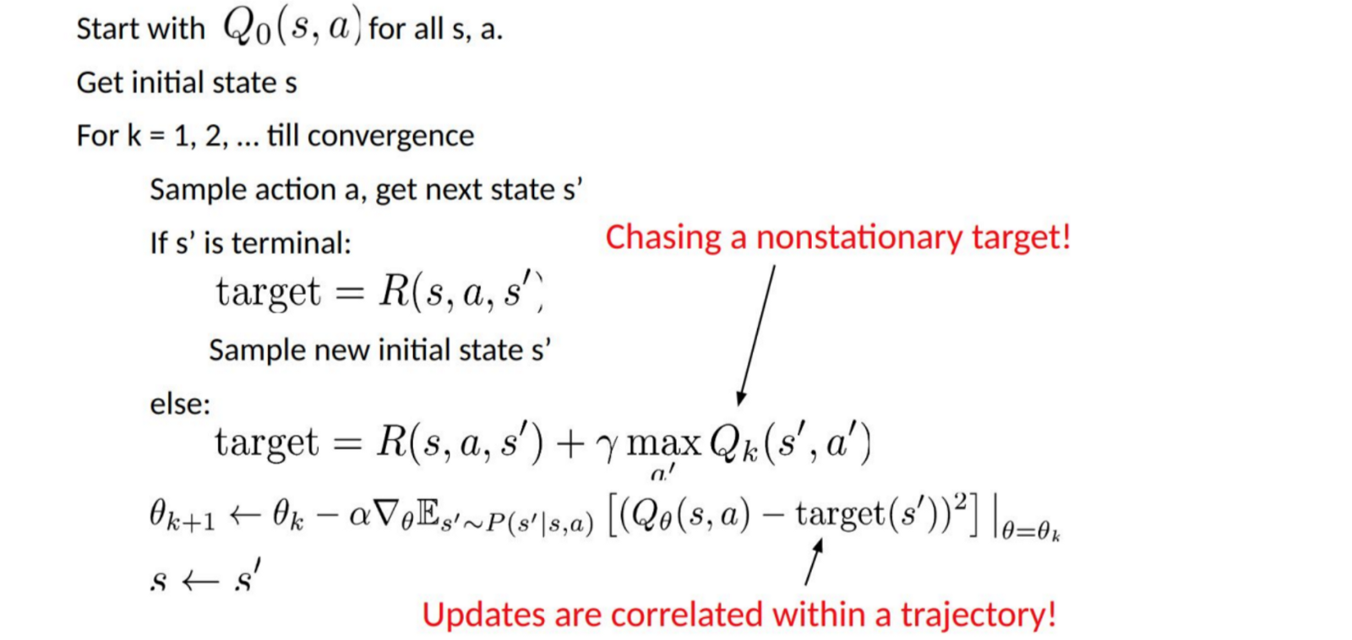
The forgetting problem –chasing a moving target

