Slide 1

DSVM Part 2
Azure Machine Learning Meetup
April 20, 2017

Slide 2
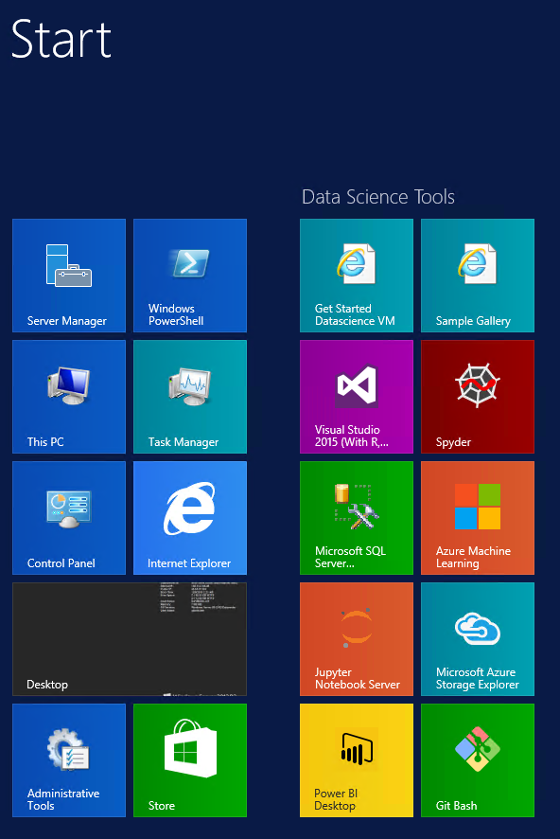
Recap:What is Data Science Virtual Machine?
Custom VM image on Azure Marketplace
Contains a set of data science, Azure tools/SDKs
All pre-configured and ready to use
Pay for cloud hardware usage only. No separate software charges!
Pointers to gallery, samples, documentation
Windows and Linux Versions
Up and running quickly

Slide 3
Usage Scenarios
Analytics desktop in the cloud
Consistent setup across team, promote sharing and collaboration
Azure scale and management
Near-Zero Setup
Data Science Training and education
Consistent setup, ease of support
On Demand, Shared / dedicated infrastructure
Quick, Low friction startup
Short Experiments & Evaluation
Quick, Low Friction startup
Spend time evaluating instead of setup
Try before you buy
Replicate a published experiment
On-demand elastic capacity for large workloads
Ability to run analytics not feasible on desktop or on shared environment
Pay for what you use
Eg: Hackathons, Competitions
Deep Learning with Neural Networks & GPUs
Readily available GPU clusters with Deep Learning tools already pre configured

Slide 4
Agenda - Build on part 1 work
Focus using the Microsoft Data Science Virtual Machine in:
Team and collaborative efforts
Jupyter notebooks tour of DVM
Using the single node Spark cluster (Linux version of DSVM)
Extending your DSVM to ‘do more’
Saving your work and data even if you delete / rebuild the DSVM
A first and short look at the Microsoft Cognitive Toolkit (CNTK)

Slide 5
Team and collaboration with DSVM
Sharing data
Sharing experiments and models
Sharing when the DVM is “offline”
Remote Access Options

Slide 6
Publishing work
You’ve built a working model – now what?
Publishing to Azure Machine Learning
Publishing RServer solutions

Slide 7
Short look at Microsoft Cognitive Toolkit
What is it
How can I use it
How can I make sure it is installed properly
Note: this is a prelude to a series focusing on deep learning with Microsoft tools and services
https://blogs.technet.microsoft.com/machinelearning/2017/04/03/microsoft-updates-its-deep-learning-toolkit/

Slide 8
Extending the DSVM
What if I have datasets in AWS I want to use
Install the AWS CLI – just like any download
Configure per AWS guidance
How can I add features and tools to DSVM
How long will the installs ‘stick around’
How can I get/use larger or smaller DSVM systems
You can create a new system with different CPU etc.
The pricing may change so check before committing
You will need to re-install anything installed on the prior instance
Best reason to keep important data in blob or file storage as it will be available when the replacement boots

Slide 9
Spark (on Linux) DSVM
Nice to have for learning, testing, small labs and so on
Scala , Java, Python, “R” preloaded
Using R and SparkR
Using Microsoft RServer

Slide 10
A possible environment
Containers and blobs are less expensive than file shares and disks
But – not every tool and framework can interact with blobs so check
Most Hadoop configurations can fetch from blobs and load to HDFS if you choose to use Spark
Tips:
Do your work in the same region (save time and latency)
Configure short lived projects in their own Azure Resource Groups
(clean up by deleting the resource group – saves time, money)
BUT – make sure you protect any valuable data first
Copy to another blob or file share outside of the temporary resource group

Slide 11
Creating a file share
Good for DSVM’s that need to share models and other work artifacts
Can handle higher IO (better latency) rates than blobs
Mount drives and use experience
Good for:
Hackathons
Classes
Tools requiring file semantics
You need to take care of:
Backups and Security
Resources:
https://docs.microsoft.com/en-us/azure/storage/storage-how-to-use-files-linux
https://docs.microsoft.com/en-us/azure/storage/storage-dotnet-how-to-use-files#mount-the-file-share
net use z: \\dsvmsharedfile.file.core.windows.net\dsvmfileshare /u:AZURE\dsvmsharedfile 3/zgyAXqYICzqmCsA/+7Giq/878qqlIXmrRxXGDF9zReT9L0PmJPzULgzz31SwyakF1Bn5BbZZIuolM8ZZWBqw==
sudo mount -t cifs //myaccountname.file.core.windows.net/mysharename /mymountpoint -o vers=3.0,username=myaccountname,password=StorageAccountKeyEndingIn==,dir_mode=0777,file_mode=0777

Slide 12
Using shared storage (blob storage)
Good for larger amounts of data that do NOT require a file system interface
Can be used to Hadoop and other tools for extraction and ingestion
Not all languages/libraries have built in support so check
Integrates well with Spark, Hadoop
Can share by sharing secure signatures
Good for teams that already have high internal trust
Can be restricted by time frame and operation (read/write etc)
Not good for very high write rates to one target (scales out well)
Has options for geo-replication
TIP:
https://social.microsoft.com/Forums/en-US/354d9b55-0ce6-4310-b2a6-01c2f3a70890/tip-connecting-to-azure-blob-from-apache-spark-on-linux-dsvm?forum=dsvm

Slide 13
Using Jupyter note books
Locally – just run jupyter (there’s an icon)
The LOCAL URL will look like:
http://localhost:8888/tree?token=edac7b0f973d7fb70ebb08662b9b1785b543295a68efdbb3
You can access remotely via:
https://yourdnsname.region.cloudapp.azure.com:8000
prompted for your local Linux machine credentials
And then you’ll get a jupyter session pointed to the samples and demos

Slide 14
spark
https://msdn.microsoft.com/en-us/microsoft-r/scaler-spark-getting-started
https://github.com/Azure/DataScienceVM/tree/master/Tutorials/WebinarDocuments-04-04-2017

Slide 15
DSVM for Deep Learning
Caffe: A deep learning framework built for speed, expressivity, and modularity
Caffe2: A cross-platform version of Caffe
Computational Network Toolkit (CNTK): A deep learning software toolkit from Microsoft Research
H2O: An open-source big data platform and graphical user interface
Keras: A high-level neural network API in Python for Theano and TensorFlow
MXNet: A flexible, efficient deep learning library with many language bindings
NVIDIA DIGITS: A graphical system that simplifies common deep learning tasks
TensorFlow: An open-source library for machine intelligence from Google
Theano: A Python library for defining, optimizing, and efficiently evaluating mathematical expressions involving multi-dimensional arrays
Torch: A scientific computing framework with wide support for machine learning algorithms
CUDA, cuDNN, and the NVIDIA driver
Many sample Jupyter notebooks

Slide 16
Using the DSVM for Deep Learning
https://docs.microsoft.com/en-us/azure/machine-learning/machine-learning-data-science-dsvm-ubuntu-intro
Can run on CPU or GPU
Cost vs Speed
CPU: Excellent for learning and smaller training (thousands to perhaps a million samples but varies greatly by the domain and problem)
GPU: probably best to use once you have prototyped a model and inputs with a CPU

Slide 17
appendix
http://aka.ms/dsvmdoc (windows)
http://aka.ms/linusdsvm (linux)
https://azuremarketplace.microsoft.com/en-us/marketplace/apps/microsoft-ads.standard-data-science-vm?tab=PlansAndPrice (windows)
https://azuremarketplace.microsoft.com/en-us/marketplace/apps/microsoft-ads.linux-data-science-vm?tab=PlansAndPrice (linux)
Walkthrough (linux) https://docs.microsoft.com/en-us/azure/machine-learning/machine-learning-data-science-linux-dsvm-walkthrough
More samples and guides:
https://github.com/Azure/DataScienceVM

