Slide 1
MS Computer Science
Computing Systems Specialization
ORIENTATION
Prof. Jun Xu
(jx@cc.gatech.edu)
Prof. Sham Navathe
(sham@cc.gatech.edu)
School of Computer Science
August 14, 2024

Slide 2
Some Basic Info
College of Computing (CoC) was established at Georgia Tech in 1990. Initially it contained only one school (department): Computer Science.
Now the college has 4 main schools involved in research and teaching:
School of Computer Science (CS)
School of Interactive Computing (IC)
School of Computational Science and Engineering (CSE)
School of Cybersecurity and Privacy (CP)
A fifth school was created in 2023 for strictly instructional purposes that handles basic undergraduate courses: School of Computing Instruction (SCI)

Slide 3
Basic Info - continued
The latest new “SCHOOL” is called SCP- School of Cybersecurity and Privacy.
Started in FALL 2022 with its program offerings. It offers an M.S. in Cybersecurity which has in-campus and online versions with their own three tracks, etc.
As M.S. students, you are NOT affected by what course is taught by faculty from which school. You have to meet the requirements of your specialization.

Slide 4
DEGREE: M.S. in Computer Science
Specialization: “Computing Systems”

Slide 5
General Degree Requirements
http://catalog.gatech.edu/programs/computer-science-ms/#requirementstext
Number of credit hours: 30, regardless of any transfer credits (limited to 6)
Non-CoC courses or courses at 4xxx level with a subject code of CS and CSE : at most 6 credit hours.
Special problems (8903): at most 3 credit hours; must be within CoC.
No maximum on Special Topics courses (8803): these are courses that do not have a regular number yet. Tend to be specialized courses in the research area of the teacher.
No course with a grade below a C will count towards graduation.

Slide 6
Specializations
Specialization Requirements:
https://www.cc.gatech.edu/academics/degree-programs/masters/computer-science/specializations
The school of Computer Science offers only “Computing Systems” as a specialization
The schools of IC and CSE have a number of specializations

Slide 7
Other Specializations
UNDER CSE (Computational Science and Engineering):
Modeling and Simulation
High Performance Computing
Visual Analytics
UNDER IC (Interactive Computing)
Computational Perception and Robotics
Computer Graphics
Human Centered Computing
Human Computer Interaction
Interactive Intelligence
Machine Learning
Scientific Computing
Social Computing

Slide 8
Expected Core Competencies
All Students are expected to have “some” Undergraduate Coursework in:
operating systems,
design and analysis of algorithms,
formal languages and automata theory,
databases,
networking and communications,
computer architecture, and
human-computer interaction.

Slide 9
MS CS – Computing Systems Specialization
Three options: project-based, course-based, and thesis-based.
For all three options: 6 required courses (18 credit hours).
Grades for the required six courses: B or better.

Slide 10
MS CS – Computing Systems Specialization
Project option
MS project work (CS6999) in one or more semesters – 9 hours
7 courses (including the six required courses)- 21 hours
Permit required (approval by the faculty advisor and program coordinator)

Slide 11
MS CS – Computing Systems Specialization
Course option
6 required courses (18 hours)
4 more courses (12 hours)
24 credit hours must come from CS and CSE

Slide 12
MS CS – Computing Systems Specialization
Thesis option
12 credit hours of thesis work (CS7000)
6 required courses (18 hours)
Permit required (approval by the thesis advisor and the program coordinator)
Personal Advice: Do the thesis option if you have any plan for going on to a Ph.D. degree

Slide 13
MS CS – Computing Systems Specialization
Program of Study
6 required courses
6515 Computability, Algorithms and Complexity
+ pick 2 Core courses
+ pick 3 from Elective or Core courses.

Slide 14
MS CS – Computing Systems Specialization
Program of Study
Core courses: (pick any 2) - All of these have projects
6210 (Operating Systems) 6241 (Compilers) 6250 (Networking) 6290 (Architecture) 6300 (Software Engineering)
6390 (Programming Language Design) 6400 (Database Systems)

Slide 15
MS CS – Computing Systems Specialization
Program of Study
Elective courses (pick 3):
NOTE: ANY OF THE ABOVE CORE COURSES CAN ALSO BE TAKEN AS AN ELECTIVE
CS 6035 Introduction to Information Security
CS 6200 Graduate Introduction to Operating Systems
CS 6220 Big Data Systems and Analytics
CS 6235 Real-Time System Concepts and Implementation
CS 6238 Secure Computer Systems
CS 6260 Applied Cryptography
CS 6262 Network Security
CS 6263 Intro to Cyberphysical Systems Security

Slide 16
MS CS – Computing Systems Specialization
Elective Courses (Contd.)
CS 6291 Embedded Software Optimization
CS 6310 Software Architecture and Design
CS 6340 Software Analysis and Testing
CS 6365 Introduction to Enterprise Computing CS 6422 Database System Implementation
CS 6550 Design and Analysis of Algorithms
CS 6675 Advanced Internet Computing Systems and Applications

Slide 17
MS CS – Computing Systems Specialization
Elective courses (Contd.)
CS 7210 Distributed Computing CS 7260 Internetworking Architectures and Protocols CS 7270 Networked Applications and Services
CS7280 Network Science CS 7290 Advanced Topics in Microarchitecture CS 7292 Reliability and Security in Computer Architecture

Slide 18
MS CS – Computing Systems Specialization
Elective Courses (Contd.)
CS 7560 Theory of Cryptography
CSE 6220 High Performance Computing
CS 8803- Special Topics: e.g., Foundations of Programming Languages, Data Management and Machine learning , Data Analytics with Deep Learning.
NOTE: Any CS8803 taught by regular faculty is admissible as an elective. If in doubt, consult the M.S. Co-Ordinator in CS:
Prof. Jun Xu (jx@cc.gatech.edu)

Slide 19
MS CS – Computing Systems Specialization
Plan your course schedule to meet the core and elective course requirements as specified.
Exceptions to the core and elective course requirements are rarely granted.
Seek assistance from MSCS advisors in the College.

Slide 20
People you will deal with
M.S. program advisors – Rebecca (Becky) Wilson is the interim advisor (to be replaced in a few weeks. She may delegate your question to her team members).
For inquiries, contact-
gradregistration@cc.gatech.edu
Director of Graduate Program Services – Becky Wilson
M.S. Program Co-ordinator – myself (limited to the “Computing Systems” specialization)- former co-Ordinator Prof. Sham Navathe is also available this Fall. Send me email (jx@cc.gatech.edu) for any exceptions or request for any special circumstances. Routine matters go to Becky.

Slide 21
Area Co-ordinators
Questions specific to courses in different areas can be channelled to area co-ordinators:
CURRENT TENTATIVE LIST:
Database Systems and Analytics: Joy Arulraj
Networking: Alberto Dainotti
Architecture: Hyesoon Kim
Progr. Languages/ Software Engg. : Qirun Zhang
Systems: Ling Liu
Theory: Dana Randall
Machine Learning Foundations: Jake Abernathy

Slide 22
Office hours
Sham Navathe and myself are planning some office hours when interested students may talk to us about matching interested MSCS students with SCS faculty research programs.
I will serve in person and Sham will serve online.
While the main purpose of the office hours is stated above, we can talk about other things such as IT job market and future of AI.
Office hours will be announced to all M.S. students.

Slide 23
Network and Big Data Algorithmics (not a typo)
Jun "Jim” Xu
Professor
School of Computer Science
jx@cc.gatech.edu

Slide 24
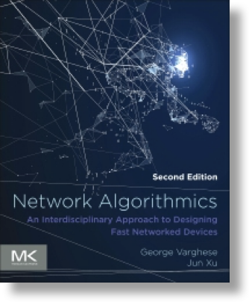
Research/Teaching on network algorithmics
Network algorithmics: data structures, algorithms, and hardware/software codesign for high-speed switches and routers.
I published a book on this subject together with George Varghese in 2022.
I teach a course (CS 7260) on this subject every year since 2007. I will teach it again this fall using this book.

Slide 25
The art of network algorithmics
This book and this course (7260) teach you, among other things, how to combine systems thinking with algorithmic thinking to build cheap, performant, and scalable network systems. More specifically, they teach you how to pay the lowest possible cost for a unit of network performance.
For new Ph.D. students, this course can count toward your breath requirement just like 6250 (but only one will count). IMHO, for most Ph.D. students, esp. systems students, they can benefit more from 7260 than from 6250, since 7260 is focused on teaching performance-boosting and cost-saving methodologies. For networking students, 7260 can count towards their major requirement on top of 6250.

Slide 26
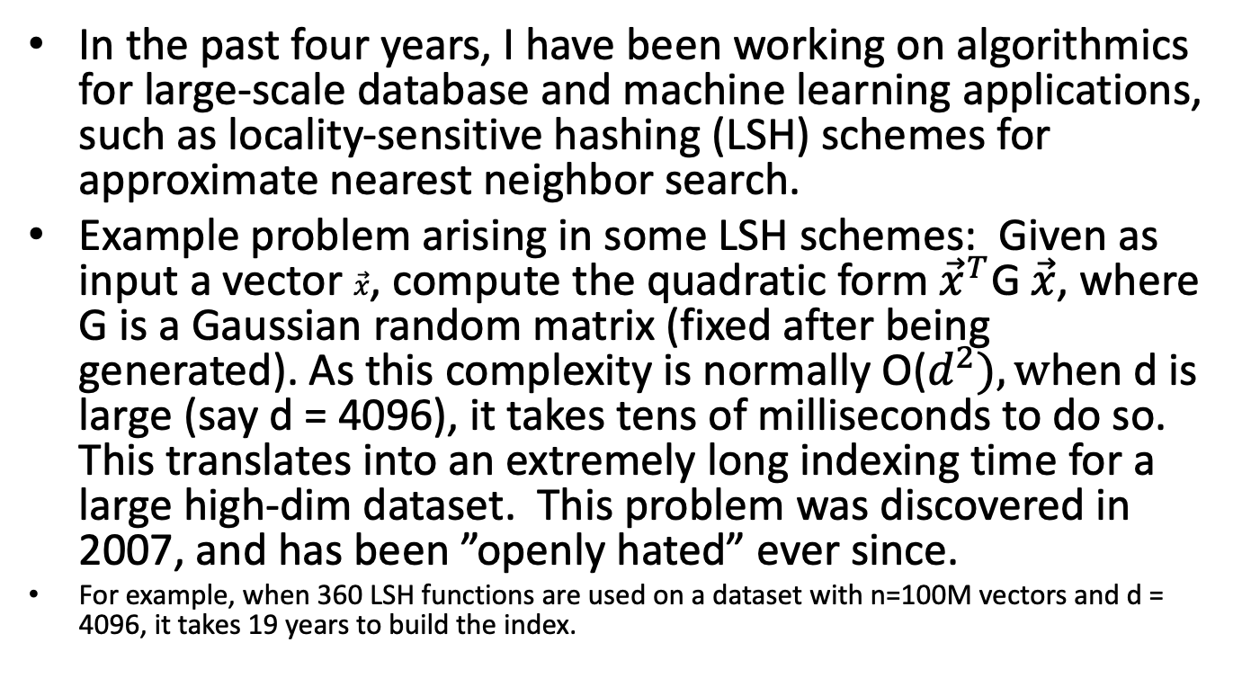
Branch into Big Data algorithmics
In the past four years, I have been working on algorithmics for large-scale database and machine learning applications, such as locality-sensitive hashing (LSH) schemes for approximate nearest neighbor search.
Example problem arising in some LSH schemes: Given as input a vector $\vec{x}$, compute the quadratic form ${\vec{x}}^{T}$G $\vec{x}$, where G is a Gaussian random matrix (fixed after being generated). As this complexity is normally O($d^{2}), w$hen d is large (say d = 4096), it takes tens of milliseconds to do so. This translates into an extremely long indexing time for a large high-dim dataset. This problem was discovered in 2007, and has been ”openly hated” ever since.
For example, when 360 LSH functions are used on a dataset with n=100M vectors and d = 4096, it takes 19 years to build the index.

Slide 27
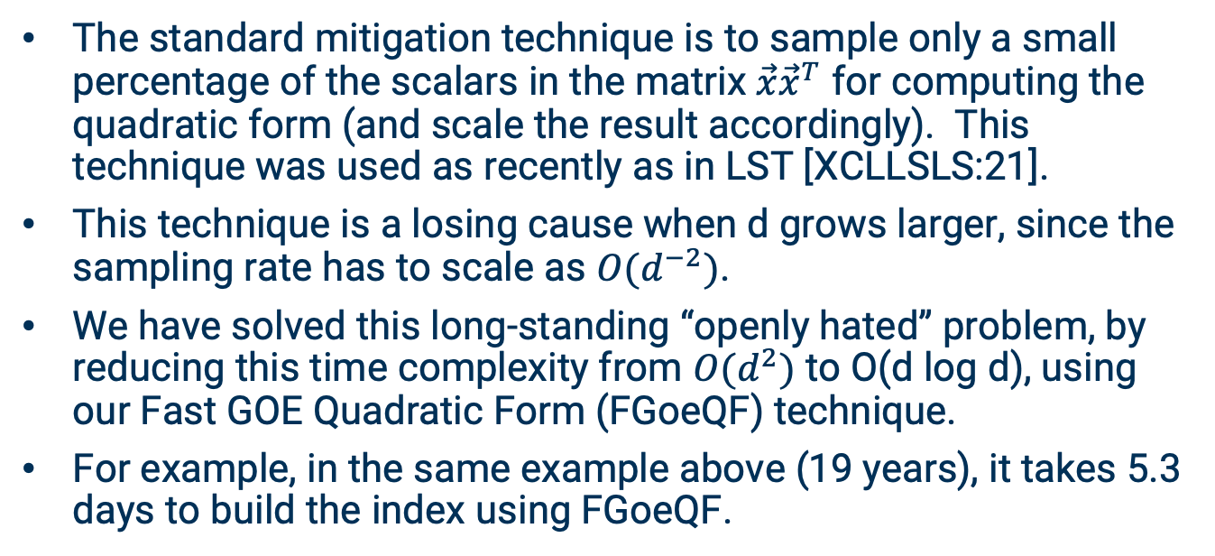
An example Big Data algorithmics problem
The standard mitigation technique is to sample only a small percentage of the scalars in the matrix $\vec{x}{\vec{x}}^{T}$ for computing the quadratic form (and scale the result accordingly). This technique was used as recently as in LST [XCLLSLS:21].
This technique is a losing cause when d grows larger, since the sampling rate has to scale as ${O(d}^{−2})$.
We have solved this long-standing “openly hated” problem, by reducing this time complexity from ${O(d}^{2})$ to O(d log d), using our Fast GOE Quadratic Form (FGoeQF) technique.
For example, in the same example above (19 years), it takes 5.3 days to build the index using FGoeQF.

Slide 28
DATA SYSTEMS AND ANALYTICS
(PROMOTIONAL MATERIAL)

Slide 29
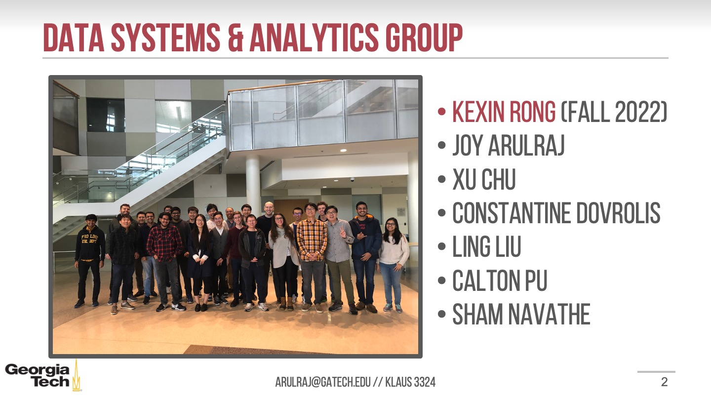
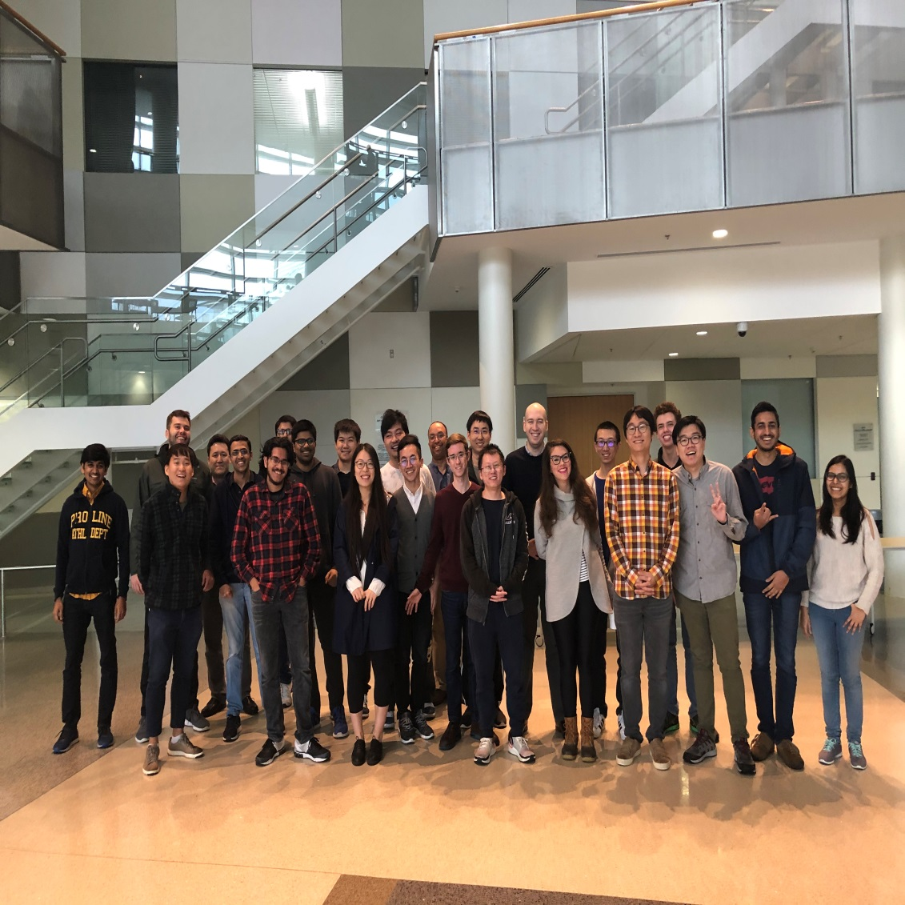
DATA SYSTEMS & ANALYTICS GROUP
KEXIN RONG (FALL 2022)
JOY ARULRAJ
XU CHU
CONSTANTINE DOVROLIS
LING LIU
CALTON PU
SHAM NAVATHE

Slide 30
Database Courses: Fall 2024
CS 6400 Database Systems Concepts and Design (Kexin Rong)
CS 6422 Database System Implementation (Joy Arulraj)
CS 6220 Big Data Systems and Analytics (Ling Liu)
( CS 6235 Real Time Systems by Calton Pu. He teaches CS 6365 Enterprise Computing in Spring)

Slide 31
QUESTIONS?

