Slide 1


BRICK: A Novel Exact Active Statistics Counter Architecture
Nan Hua¹, Bill Lin², Jun (Jim) Xu¹, Haiquan (Chuck) Zhao¹
¹Georgia Institute of Technology
²University of California, San Diego
*Supported in part by CNS-0519745, CNS-0626979, CNS-0716423,
CAREER Award ANI-0238315, and a gift from CISCO

Slide 2
Main Takeaways …
We need exact “active” counters
  Be able to update and lookup counters at wirespeed
Millions of full-size counters too expensive in SRAM
We can store millions of counters in SRAM with an efficient “variable-length” counter data structure

Slide 3
Motivation
Routers need to maintain large arrays of per-flow statistics counters at wirespeed
  Needed for various network measurement, router management, traffic engineering, and data streaming applications
  Millions of counters are needed for per-flow measurements
  Large counters needed (e.g. 64 bits) for worst-case counts during a measurement epoch
  At 40 Gb/s, just 8 ns for updates and lookups

Slide 4
Passive vs. Active Counters
Passive counters:
  For collection of traffic statistics that are analyzed “offline”, counters just need to be updated at wirespeed, but full counter values generally do not need to be read frequently (say not until the end of a measurement epoch)
Active counters:
  However, a number of applications require active counters, in which values may need to be read as frequently as they are incremented, typically on a per packet basis
  e.g. in many data streaming applications, on each packet arrival, values need to be read from some counters to decide on actions that need to be taken

Slide 5
Previous Approaches
Naïve “brute-force” SRAM approach
  Too expensive: e.g. 2 million flows x 64-bits = 128 Mbits = 16 MB of SRAM
Exact passive counters
  Hybrid SRAM-DRAM architectures (Shah’02, Ramabhadran’03, Roeder’04, Zhao’06)
  Interleaved DRAM architectures (Lin and Xu, 08)
  Counter braids (Lu et al, 08)
  Passive only: Counter lookups require many packet cycles
Approximate counters
  Large errors possible: e.g. well over 100% error

Slide 6
Our Approach
Main observations
  The total number of increments during a measurement epoch is bounded by M cycles (e.g. M = 16 million cycles)
  Therefore, the sum of all N counters is also bounded by M (e.g. N = 1 million counters)
  Although worst-case count can be M, the average count is much smaller (e.g. M/N = 16, then average counter size should be just log 16 = 4 bits)
N
C_{i} ≤ M
Σ
i=1

Slide 7
Our Approach (cont’d)
To exploit the fact that most counters will be small, we propose a novel “Variable-Length Counter” representation called BRICK, which stands for Bucketized Rank-Indexed Counters
Only dynamically increase counter size as necessary
The result is an exact counter data structure that is small enough for SRAM storage, enabling both active and passive applications

Slide 8
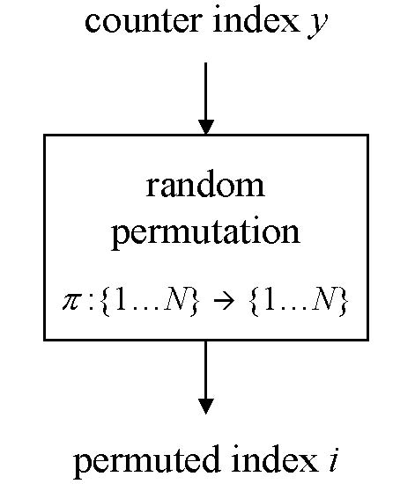
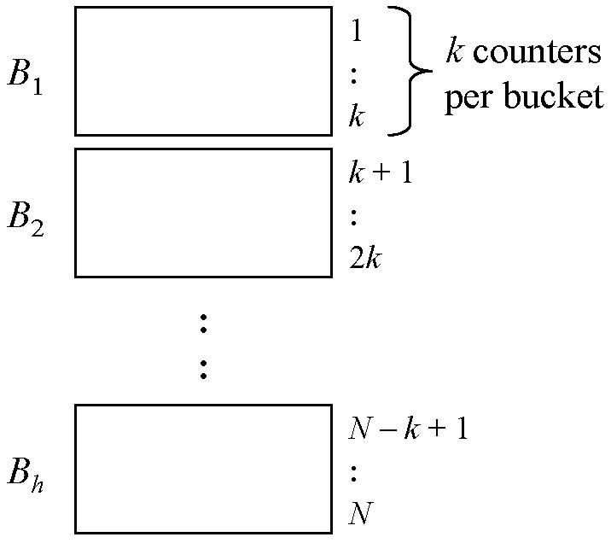
Basic Idea
Randomly bundle counters into buckets
Statistically, the sum of counter sizes per bucket should be similar

Slide 9
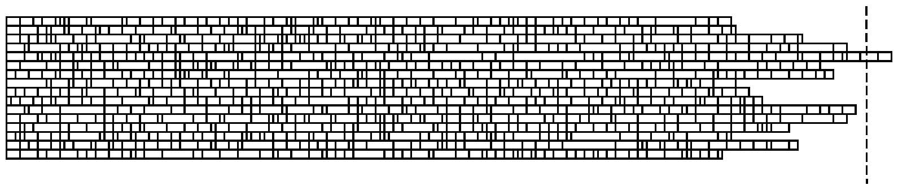
BRICK Wall Analogy
Each row corresponds to a bucket
Buckets should be statically sized to ensure a very low probability of overflow
Then provide a small amount of extra storage to handle overflow cases

Slide 10
A Key Challenge and Our Approach
The idea of variable-length data structures is not new, but expensive memory pointers are typically used to “chain” together different segments of a data structure
In the case of counters, these pointers are as or even more expensive than the counters themselves!
Our key idea is a novel indexing method called Rank Indexing

Slide 11
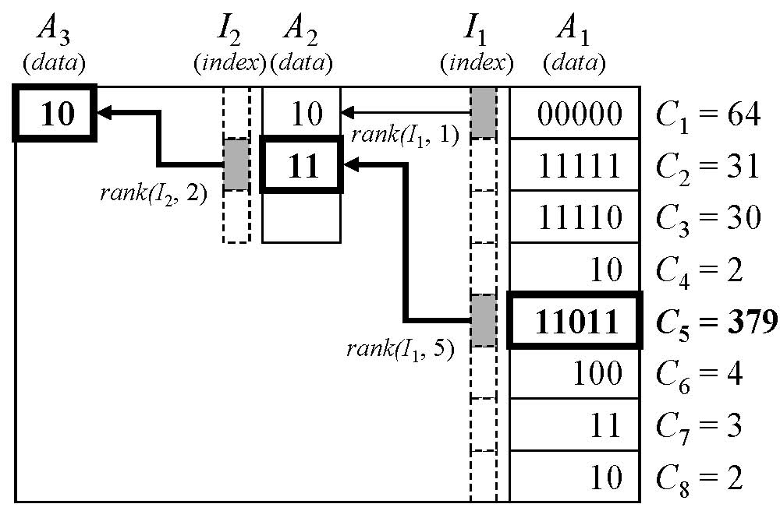
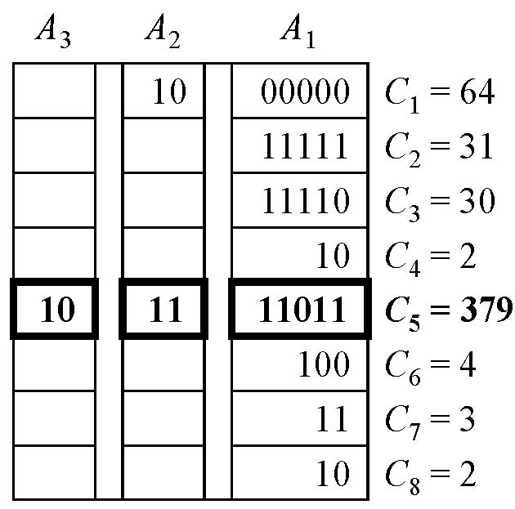
Rank Indexing
How rank indexing works?
  The location of the linked element is calculated by the “rank” operation, rank(I, b), which returns the number of bits set in bitmap I at or before position b
  No need for explicit pointer storage!
Bitmaps
rank(I₁, 5) = 2
(it’s 2nd bit set in I₁)

Slide 12
Rank Indexing
Key observation: The rank operator can be efficiently implemented in modern 64-bit x86 processors
Specifically, both Intel and AMD x86 processors provide a popcount instruction that returns the number of 1’s in a 64-bit word
The rank operator can be implemented in just 2 instructions using a bitwise-AND instruction and the popcount instruction!

Slide 13
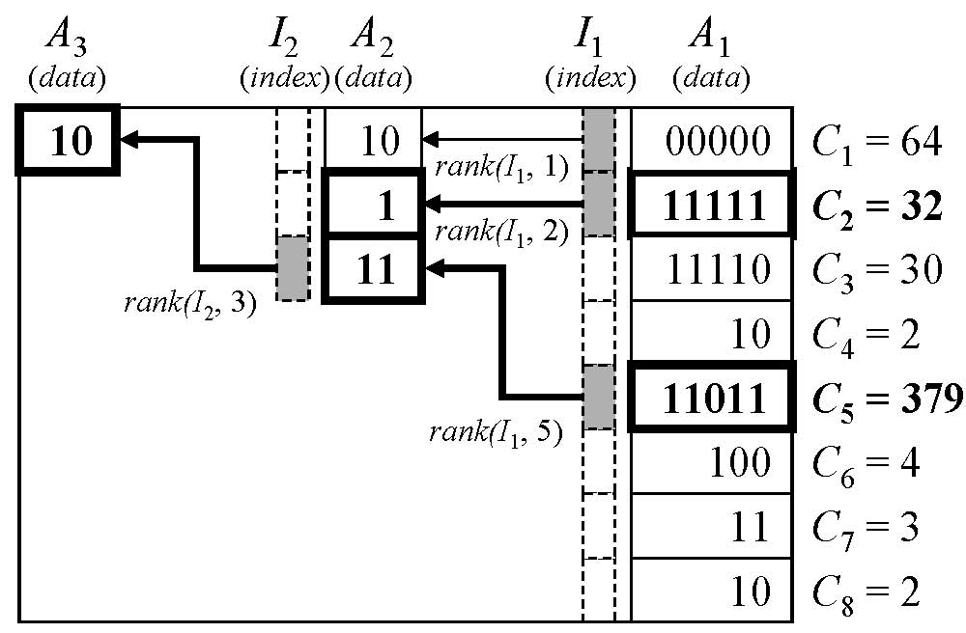
Dynamic Sizing
Suppose we increment C₂, which requires dynamic expansion into A₂
The update is performed by performing a variable shift operation in A₂ , which is also efficiently implemented with x86 hardware instructions
00000
rank(I₁, 5) = 2
(it was 2nd bit set in I₁)
rank(I₁, 5) = 3
(it’s now 3rd bit set in I₁)

Slide 14
Finding a Good Configuration
We need to decide on the following for a good configuration
  k : the number of counters in each bucket
  p : the number of sub-arrays in each bucket A₁ … A_{p}
  k₁ … k_{p} : the number of entries in each sub-array (k₁ = k)
  w₁ … w_{p} : the bit-width of each sub-array
We purposely choose k = 64 so that the largest index bitmap is 64-bits for the rank operation
We purposely choose w_{i} and k_{i} so that w_{i} * k_{i} ≤ 64 bits so that shift can be implemented as a 64-bit bitmap operation

Slide 15
Finding a Good Configuration (cont’d)
Given a configuration, we can decide on the probability of bucket overflow P_{f} using a binomial distribution tail bound analysis

Slide 16
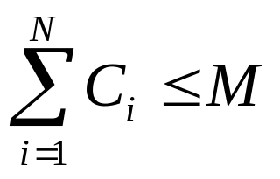
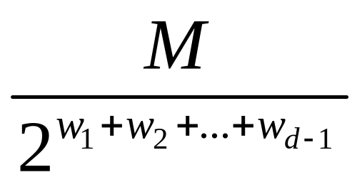
Tail Bound
Due to the total count constraint
at most (defined as m_{d} )
counters would be expanded into the d^{th} sub-array
Translated into the language of “balls and bins”:
  Throwing m_{d} balls into N bins
  The capacity of each bin is only k_{d}
  Bound the probability that more than J_{d} bins have more than k_{d} balls
The paper provides the math details to handle correlations

Slide 17
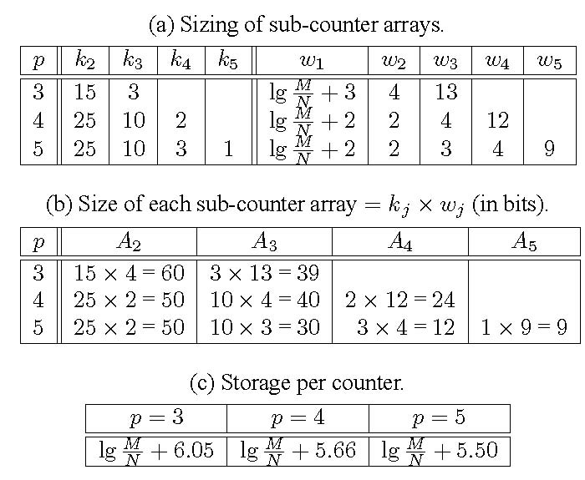
Numerical Results
Sub-counter array sizing and per-counter storage for k = 64 and P_{f} = 10⁻¹⁰

Slide 18
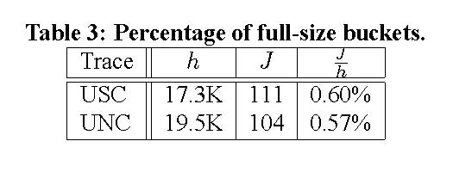
Simulation of Real Traces
USC (18.9 million packets, 1.1 million flows) and UNC traces (32.6 million packets, 1.24 million flows)
Percentage of full-size buckets

Slide 19
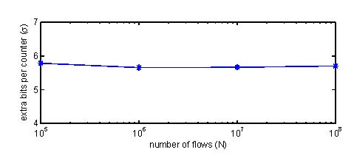
Trends

Slide 20
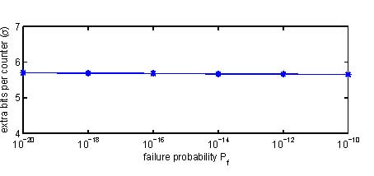
Trends

Slide 21
Concluding Remarks
Proposed an efficient variable-length counter data structure called BRICK that can implement exact statistics counters
Avoids explicit pointer storage by means of a novel rank indexing method
Bucketization enables statistical multiplexing

Slide 22
Thank You

Slide 23
Backup

Slide 24
Tail Bound
Due to the total count constraint
at most (defined as m_{d} )
counters would be expanded into the d^{th} sub-array
Translated into the language of “balls and bins”:
  Throwing m_{d} balls into N bins
  The capacity of each bin is only k_{d}
  Bound the probability that more than J_{d} bins have more than k_{d} balls

Slide 25
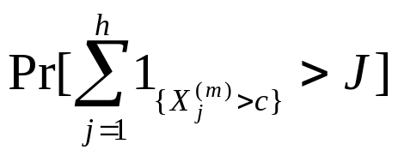
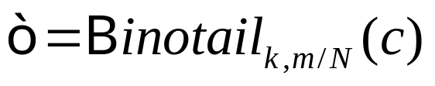
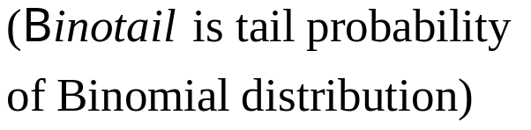
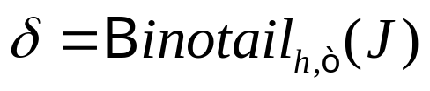
Tail Bound (cont’d)
Random Variable X_{i}^{(m)} denotes the number of balls thrown into the i^{th} bin, when there comes m balls in total
The failure probability is
(J is the number of full-size buckets pre-allocated)
We could “estimate” the failure probability this way:
  The overflow probability from one bin is
  Then the total failure probability would be
  This calculation is not strict since Random Variable X_{i}^{(m)}s are correlated under the constraint (although weakly)

Slide 26
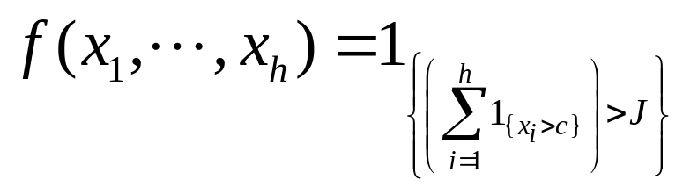
Tail Bound (cont’d)
How to “de-correlate” the weakly correlated X_{i}^{(m)} ?
Construct Random Variables Y_{i}^{(m)} , i=1….h, which is i.i.d random variables with Binomial distribution (k,m/N) .
it could be proved that:
where f is an nonnegative and increasing function.
Then, we could use the following increasing indicator function to get the bound

Slide 27
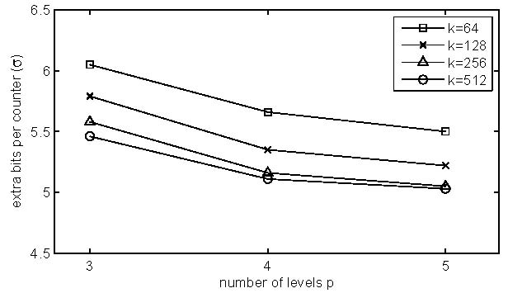
Effects of Larger Buckets
Bucket size k = 64 works well, amenable to 64-bit processor instructions

