Slide 1

CT322
Robotics and Automation
4-DOF Articulated
Robotic Arm
UNIVERSITY OF DODOMA
College of Informatics and Virtual Education
Dept. of Computer Science & Engineering
Group Assignment Report — CAD Assembly Inspection, Kinematic Structure,
and Motion Simulation Preparation
S/N | GROUP MEMBER | REG. NUMBER
1 | Jim Job | T23-03-11228
2 | Nerusigwe Patrick | T23-03-17871
3 | Nasania Msengi | T23-03-00262
4 | Stephen Samwel | T23-03-01246

Slide 2
01 · INTRODUCTION
Bridging CAD Design and Robot Kinematics
Robotics education increasingly relies on CAD models to bridge theoretical kinematics with physical robot structure.
This assignment required inspecting a provided SolidWorks robot assembly, interpreting it as a functional robotics system, and preparing a motion demonstration in MATLAB / Simulink / Simscape Multibody.
This report documents assembly inspection, structural classification, joint analysis, motion planning, simulation preparation, and a discussion of the robot's applications and limitations.
Inspect
1
Assembly & mates
2
Classify
DOF & joint types
3
Plan
Motion & workspace
4
Simulate
MATLAB / Simulink
CT322 · Robotics and Automation · 4-DOF Articulated Robotic Arm
2

Slide 3
02 · SELECTED ROBOT
4-DOF Articulated
Robotic Arm
ITEM | DETAIL
Selected ZIP file | 4-dof-robotic-arm-10_snapshot.zip
Assembly folder | 4-dof-robotic-arm-10.snapshot.2
Robot type | 4-DOF articulated arm, cutting-tool end-effector
Group number | 4
with cutting-tool end-effector
Group Number 4
CT322 · Robotics and Automation · 4-DOF Articulated Robotic Arm
3

Slide 4
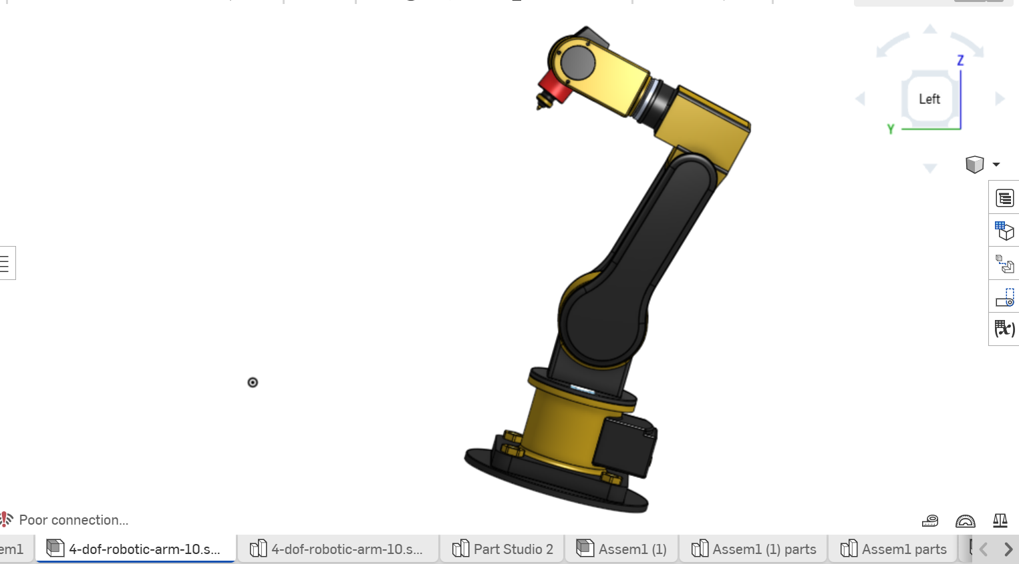
03 · CAD ASSEMBLY INSPECTION
Assembly Structure & Key Components
Part | Function
Base | Fixed foundation; anchors robot to world frame
Revolver (waist) | Rotates arm horizontally about vertical axis
Link C22 (upper arm) | Provides main lift/reach from the shoulder
Link C33 (forearm) | Extends/folds forearm relative to upper arm
Combiner (wrist) | Combines forearm motion with tool orientation
Cutter (end-effector) | Performs the cutting/trimming action
Files in Assembly Folder
Assem1.SLDASM · Base · Revolver · Link C22 · Link C33 Conne. · Link C33 · Combiner · Tool Holder · Cutter
CT322 · Robotics and Automation · 4-DOF Articulated Robotic Arm
4

Slide 5
04 · ROBOT TYPE & DOF
Classification: Articulated 4-Axis Serial Manipulator
Item | Description
Robot type | Articulated robotic arm (4-axis serial manipulator)
Main application | Cutting, trimming, or pointing tasks via fixed cutting-tool end-effector
Classification reason | Serial chain of four moving connections: Base→Revolver (waist), Revolver→Link C22 (shoulder), Link C22→Link C33 via connector (elbow), Link C33→Combiner→Tool Holder (wrist) — matching the articulated-arm naming rather than a Cartesian/cylindrical layout
4
DEGREES OF
FREEDOM
Waist · Shoulder
Elbow · Wrist
Revolute joints only — no prismatic (sliding) joints in the chain.
CT322 · Robotics and Automation · 4-DOF Articulated Robotic Arm
5

Slide 6
05 · LINK & JOINT IDENTIFICATION
Four Revolute Joints in Series
A link is a rigid part of the robot; a joint is a connection allowing relative motion between two links.
Joint | Connected Parts | Type | Motion | Axis / Direction
J1 | Base → Revolver | Revolute | Waist — rotates whole arm horizontally | About vertical axis
J2 | Revolver → Link C22 | Revolute | Shoulder — raises/lowers upper arm | About horizontal shoulder axis
J3 | Link C22 → Link C33 (via connector) | Revolute | Elbow — folds/extends forearm | Parallel to shoulder axis
J4 | Link C33 → Tool Holder (via Combiner) | Revolute | Wrist — orients cutting tool | Perpendicular / along tool axis
CT322 · Robotics and Automation · 4-DOF Articulated Robotic Arm
6

Slide 7
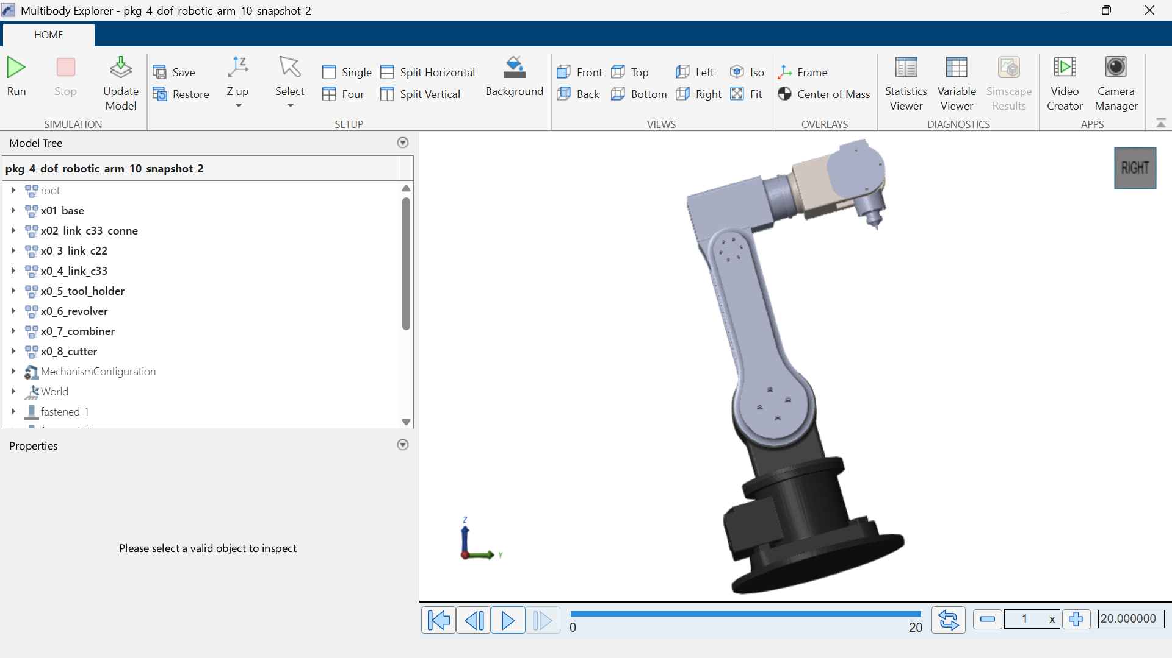
06 · MOTION REFERENCE POINTS
From Home Position to Cutting Position
The robot begins at home with all four joints at zero. The waist (J1) rotates toward the target, the shoulder and elbow (J2, J3) extend to bring the Cutter above the target material, and the wrist (J4) orients the tool to the correct cutting angle before the cutting action.
Point | Robot Condition
Home position | All joints at 0°, arm at rest
Target position | Cutter positioned above target
Cutting position | Wrist lowered/oriented, cutter engaged
Final position | Arm withdraws, returns toward home
CT322 · Robotics and Automation · 4-DOF Articulated Robotic Arm
7

Slide 8
07 · MOTION SEQUENCE
Six-Step Motion Cycle
1
Start from home
2
Rotate waist toward target
3
Extend shoulder & elbow
All joints
Joint 1 / Revolver
Joint 2 / Joint 3
Robot begins from rest
Robot turns toward the material
Cutter moves into working area
4
Orient wrist
5
Engage cutter
6
Withdraw and return
Joint 4 / Combiner-Tool Holder
End-effector
All joints
Cutter reaches material at correct angle
Cutting action performed on target
Robot completes the task
CT322 · Robotics and Automation · 4-DOF Articulated Robotic Arm
8

Slide 9
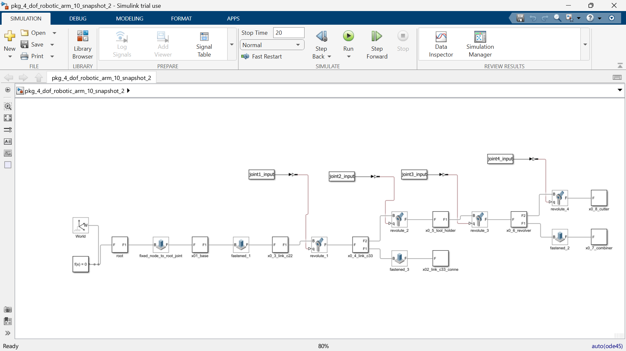
08 · SIMULATION PREPARATION
MATLAB / Simulink Multibody Setup
The CAD assembly was imported into Simscape Multibody, translating SolidWorks mates into simulation joint blocks for motion analysis.
CT322 · Robotics and Automation · 4-DOF Articulated Robotic Arm
9

Slide 10
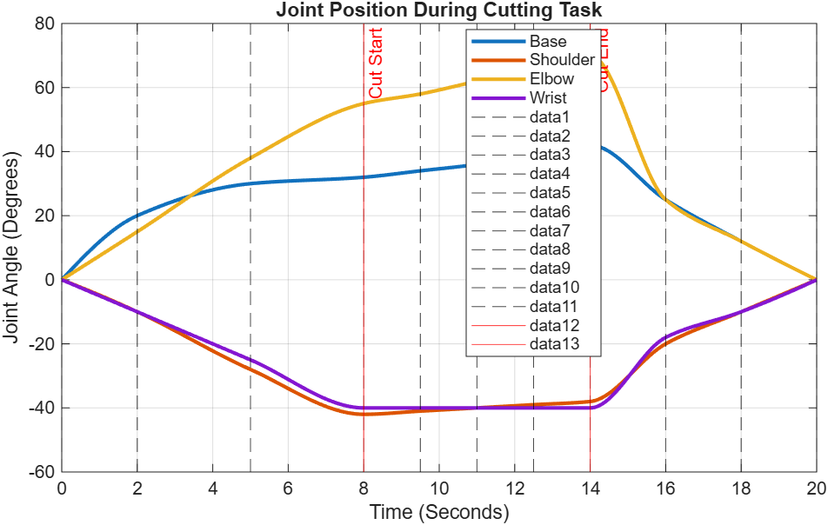
09 · MOTION DEMONSTRATION
Home → Cutting Position → Home in 2 Seconds
Time | J1 Waist | J2 Shoulder | J3 Elbow | J4 Wrist | End-Effector
0.0s | 0° | 0° | 0° | 0° | Home / Retracted
0.5s | 20° | 15° | -10° | 5° | Moving to target
1.0s | 35° | 25° | -20° | 10° | Cutting — engaged
1.5s | 20° | 15° | -10° | 5° | Withdrawing
2.0s | 0° | 0° | 0° | 0° | Home / Stop
During the 2-second motion, the robot moves from home toward the target, engages the Cutter at the 1.0 s mark, then withdraws back to home by 2.0 s.
CT322 · Robotics and Automation · 4-DOF Articulated Robotic Arm
10

Slide 11
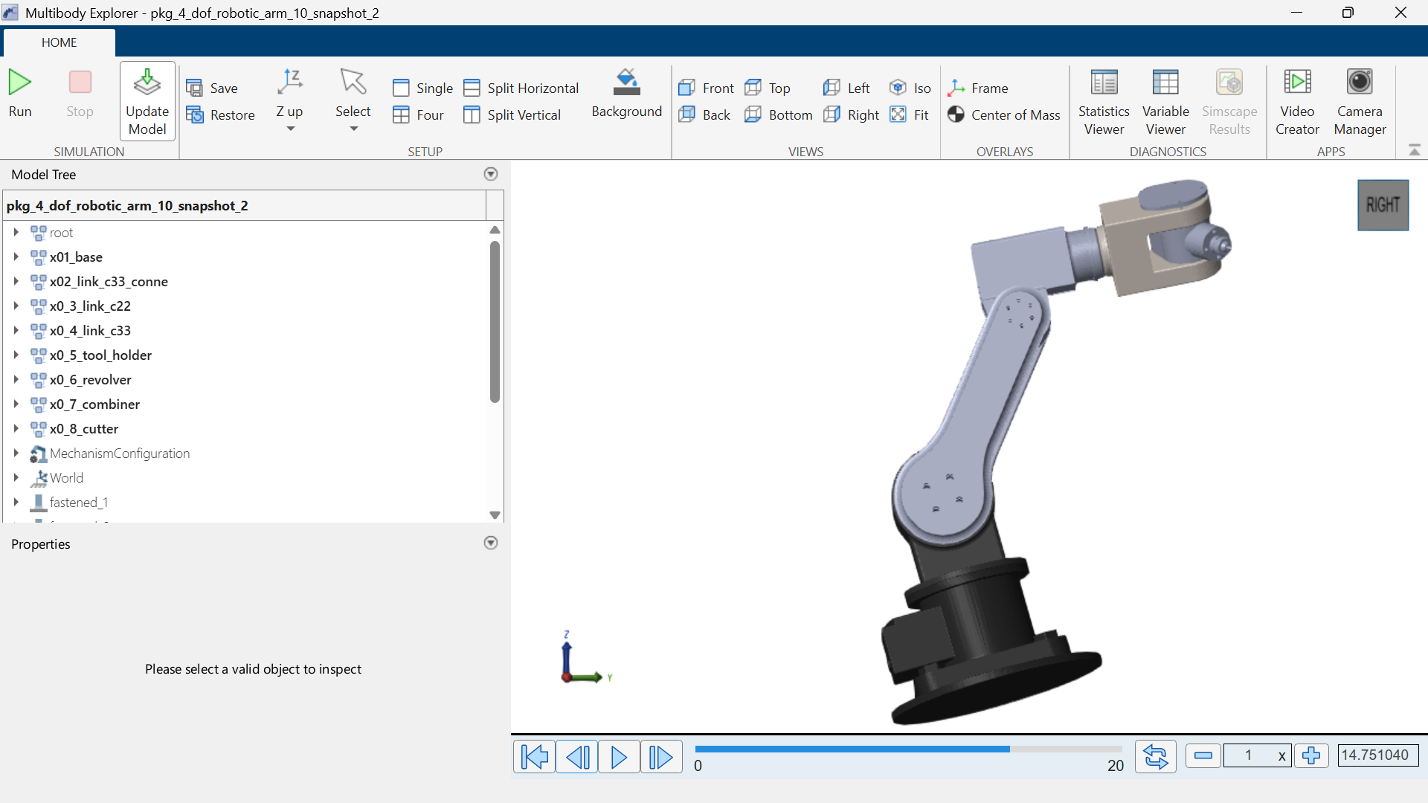
10 · WORKSPACE & REACHABILITY
Fan-Shaped Reachable Envelope
By sweeping Joints 1-4 through their range in SolidWorks and cross-checking in Simulink, the reachable envelope of the Cutter forms a fan-shaped/toroidal region centred on the base.
Bounded by the combined lengths of Link C22 and Link C33 and by joint limits.
Positions directly above the base (minimum reach) and beyond full extension are not reachable.
Limitations observed: reduced accuracy near full extension, wrist joint-limit restrictions, potential self-collision at extreme waist rotation.
Well suited to cutting/trimming tasks within mid-range reach — not suitable for targets very close to the base or beyond maximum arm extension.
CT322 · Robotics and Automation · 4-DOF Articulated Robotic Arm
11

Slide 12
11 · APPLICATIONS & LIMITATIONS
Where It Fits — and Where It Doesn't
APPLICATIONS
LIMITATIONS
Automated cutting/trimming stations
Light material processing
Precision pointing/marking tasks
Educational robotics demonstrations
Limited reach beyond combined Link C22 + Link C33 length
Payload/cutting-force capacity not specified — assumed light-duty
Only 4 DOF vs. full 3D orientation control of a 6-axis arm
Risk of self-collision/singularities near full extension
Connector & wrist mates needed manual correction in Simscape import
No actuator/motor specs — limits torque/speed analysis
CT322 · Robotics and Automation · 4-DOF Articulated Robotic Arm
12

Slide 13
12 · CONCLUSION
From CAD Geometry to Motion Simulation
This assignment demonstrated how a downloaded SolidWorks CAD assembly — the 4-dof-robotic-arm-10 model — can be interpreted as a functional robotics system: identifying the Base, Revolver, links, connector, Combiner, Tool Holder, and Cutter end-effector, and classifying the robot as a 4-DOF articulated arm.
The group mapped the mechanical structure to a joint table, defined practical motion reference points around a cutting task, and outlined a MATLAB/Simscape Multibody import approach to demonstrate a target-and-cut motion within the required 2-second window.
Challenges anticipated in the Simulink import process (particularly the connector and wrist combiner parts) reinforced the practical gap between an ideal CAD model and a simulation-ready robot — strengthening the group's understanding of robot classification, kinematic chains, and the CAD-to-simulation workflow.
CT322 · Robotics and Automation · 4-DOF Articulated Robotic Arm
13

Slide 14
13 · REFERENCES
References
Course robotics lecture notes, CT 322, University of Dodoma, 2026
1
SolidWorks Help Documentation: Assembly mates and motion study
2
MathWorks Documentation: Simscape Multibody, importing CAD assemblies (mathworks.com)
3
MathWorks Documentation: Simulink Multibody joint blocks (mathworks.com)
4
CT322 · Robotics and Automation · 4-DOF Articulated Robotic Arm
14

