Slide 1
ATmega32 USART Serial Data Monitoring System

Slide 2
Introduction
The USART-Based Serial Data Monitoring System is an embedded system developed using the ATmega32 microcontroller to demonstrate reliable serial communication with a computer.
The system monitors three push button switches, transmits their status through USART, receives commands from a serial terminal, and controls LEDs to indicate system operation.

Slide 3
Project Objectives
• Configure USART
• Monitor switches
• Receive commands
• Control LEDs
• Design PCB

Slide 4
System Requirements
Firmware, KiCad schematic, PCB, Gerber files, SimulIDE simulation, documentation and GitHub repository.

Slide 5
Hardware Components
ATmega32
3 Push Buttons
2 LEDs
8 MHz Crystal
Capacitors
Resistors
USB-Serial Interface

Slide 6
ATmega32 Pin Mapping
Function | ATmega32 Pin | Port Bit | Direction | Connected To | Description
Switch 1 (SW1) | PA0 | PORTA.0 | INPUT | Push Button → GND | Digital input, active LOW with pull-up
Switch 2 (SW2) | PA1 | PORTA.1 | INPUT | Push Button → GND | Digital input, active LOW with pull-up
Switch 3 (SW3) | PA2 | PORTA.2 | INPUT | Push Button → GND | Digital input, active LOW with pull-up
LED Status | PB1 | PORTB.1 | OUTPUT | R1(330Ω) → LED1 → GND | ON when any switch is pressed
LED Command | PB2 | PORTB.2 | OUTPUT | R2(330Ω) → LED2 → GND | ON when valid command received
USART RX | PD0 | PORTD.0 | INPUT | USB-Serial TX pin | Receive data from computer
USART TX | PD1 | PORTD.1 | OUTPUT | USB-Serial RX pin | Transmit data to computer
Reset | RESET | RESET | INPUT | R3(10KΩ)→VCC, Button→GND | Active LOW system reset
Power | VCC | VCC | POWER | +5V Supply | Main power supply 5V DC
Ground | GND | GND | POWER | Common Ground | System ground reference
Analog Power | AVCC | AVCC | POWER | +5V Supply | Analog section power supply
Crystal 1 | XTAL1 | XTAL1 | INPUT | 8MHz Crystal + 22pF Cap | Clock input pin
Crystal 2 | XTAL2 | XTAL2 | OUTPUT | 8MHz Crystal + 22pF Cap | Clock output pin

Slide 7
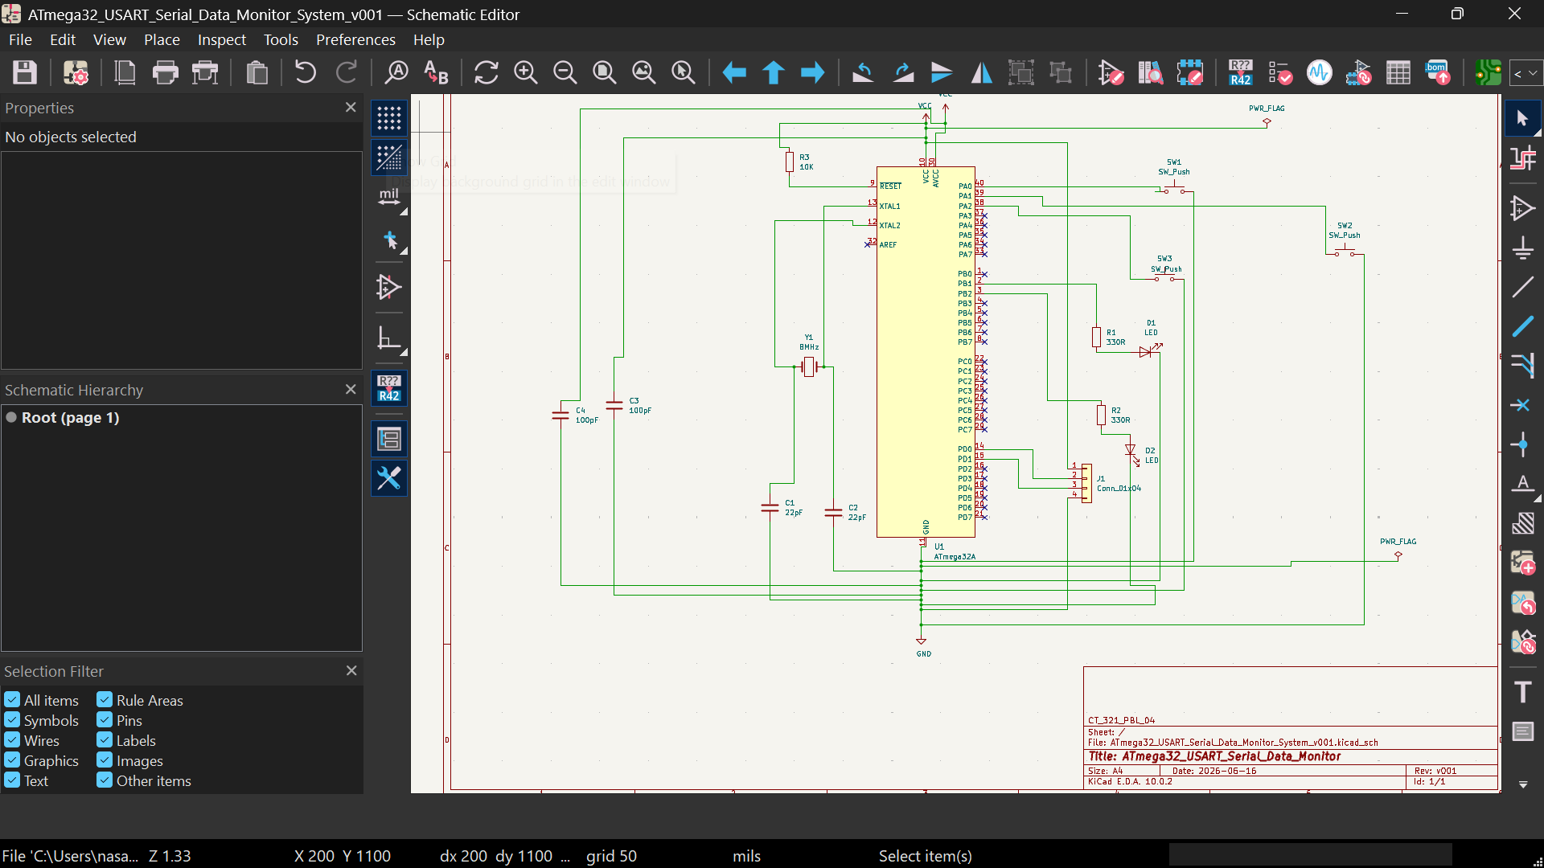
KiCad Schematic Design

Slide 8
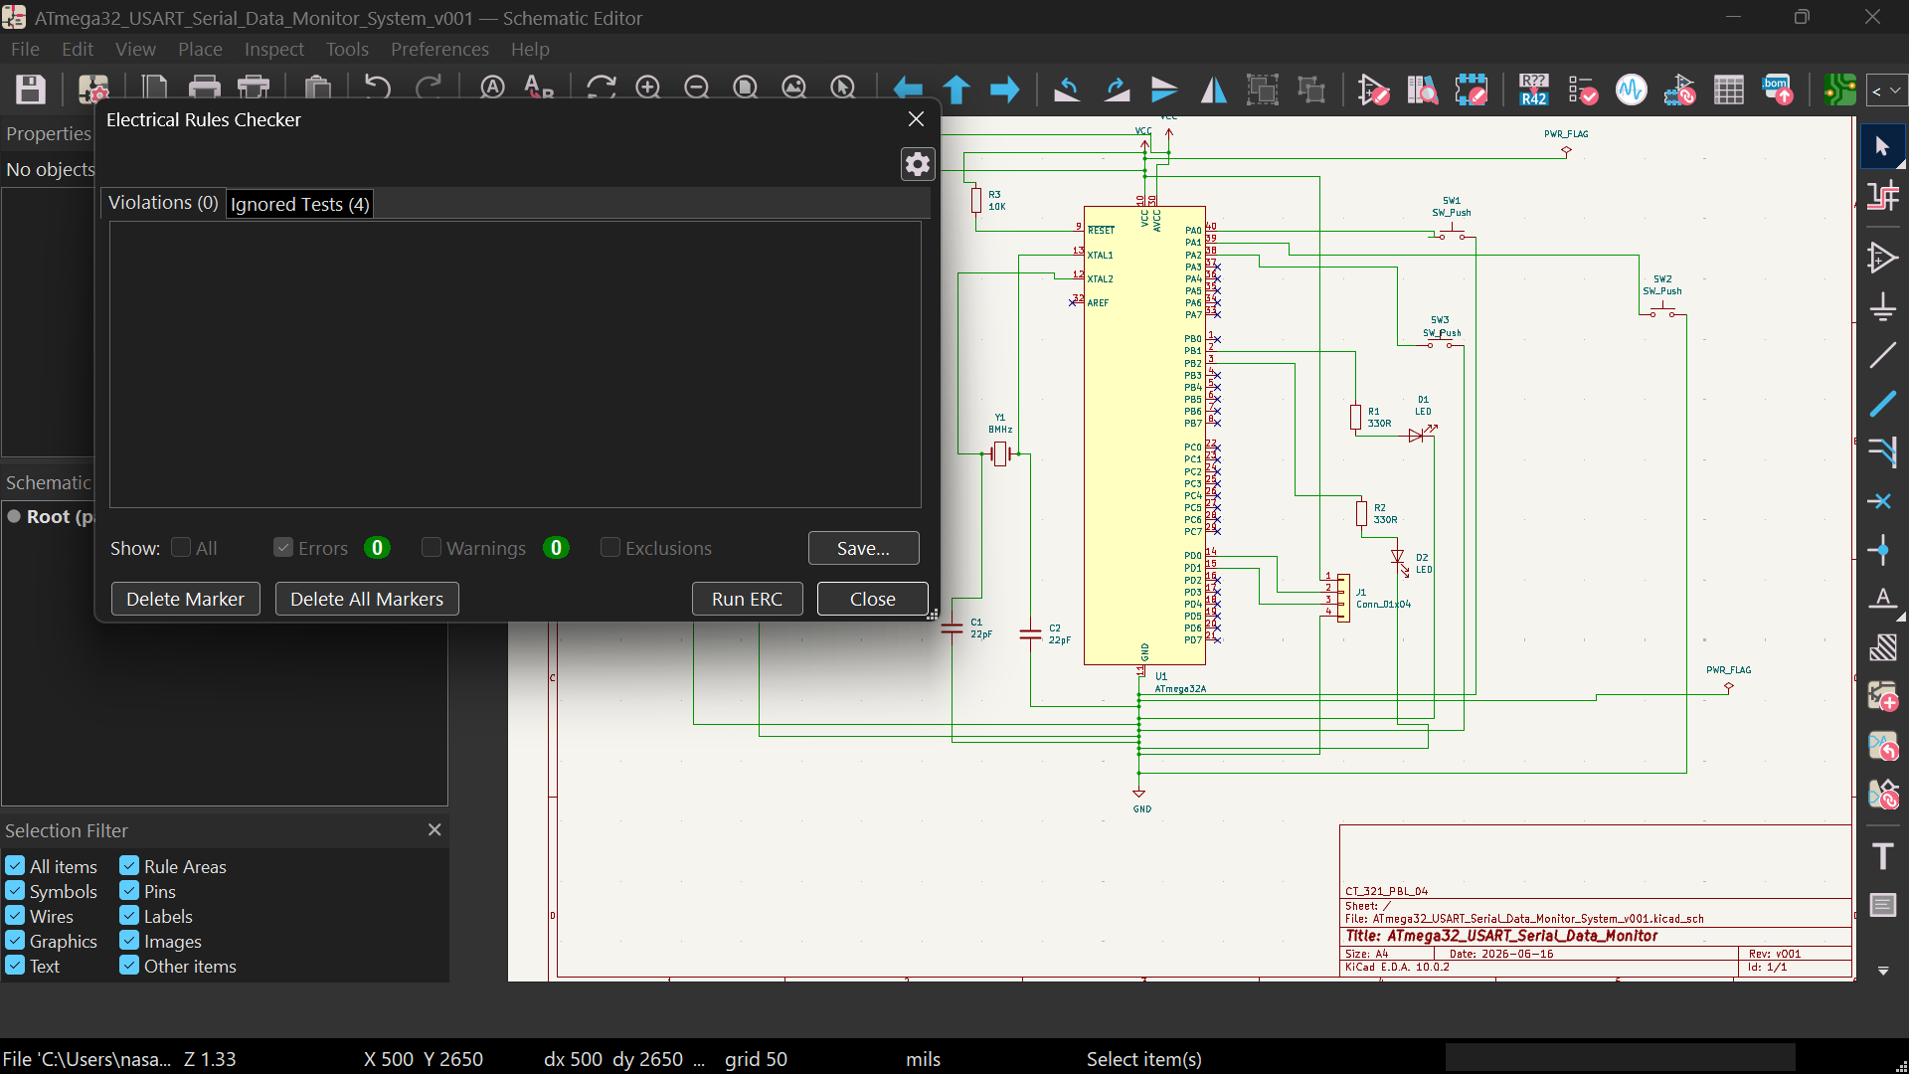
KiCad ERC Results

Slide 9
Firmware Architecture
Modules:
GPIO
USART
Commands
Main
LED Control

Slide 10
USART Configuration
Clock: 8 MHz
Baud: 9600
Frame: 8N1
TX/RX enabled

Slide 11
Command Processing
Supported commands:
STATUS
HELLO
Unknown command - INVALID COMMAND

Slide 12
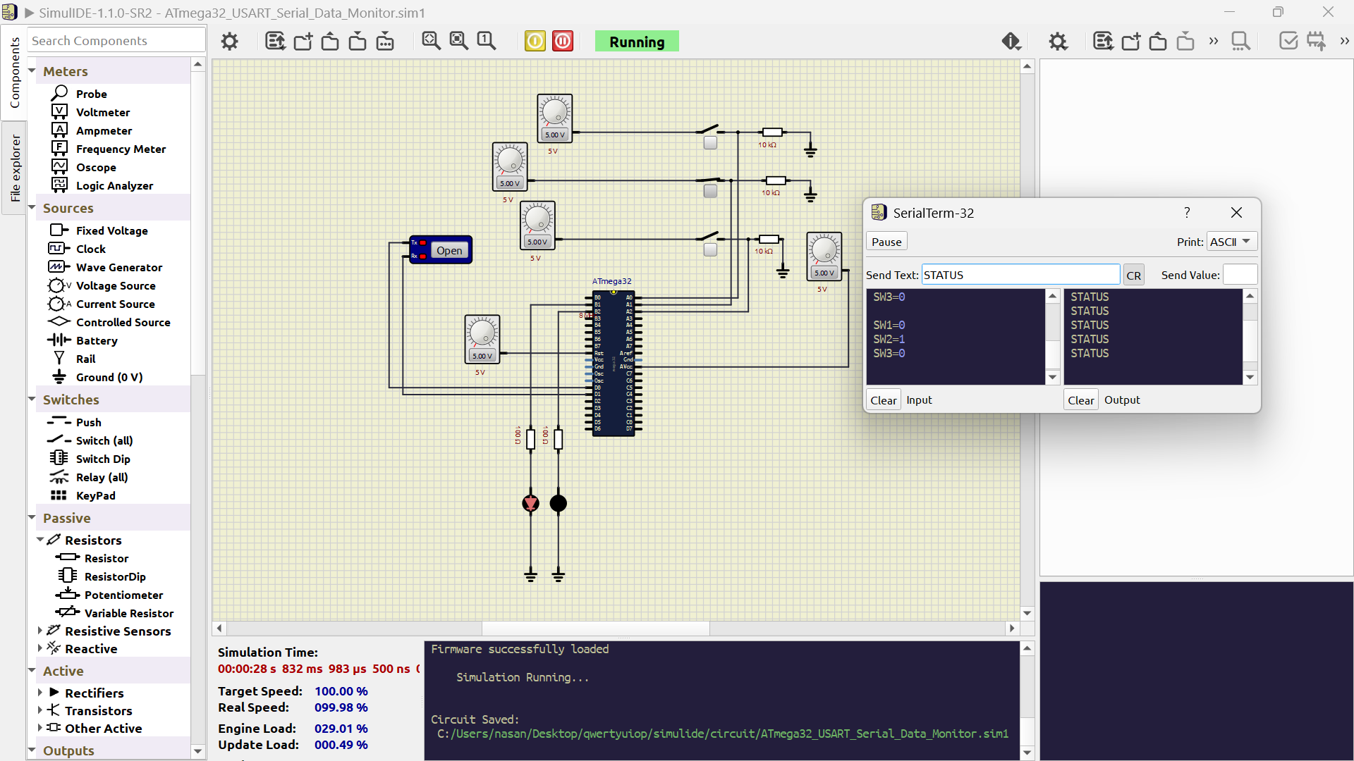
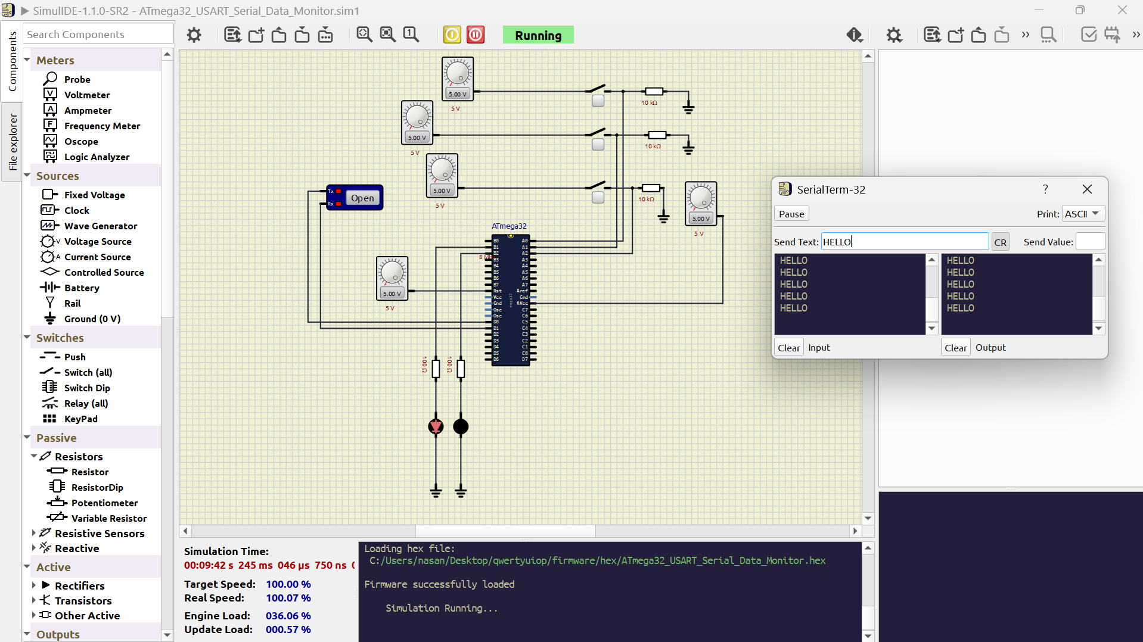
Simulation Results

Slide 13
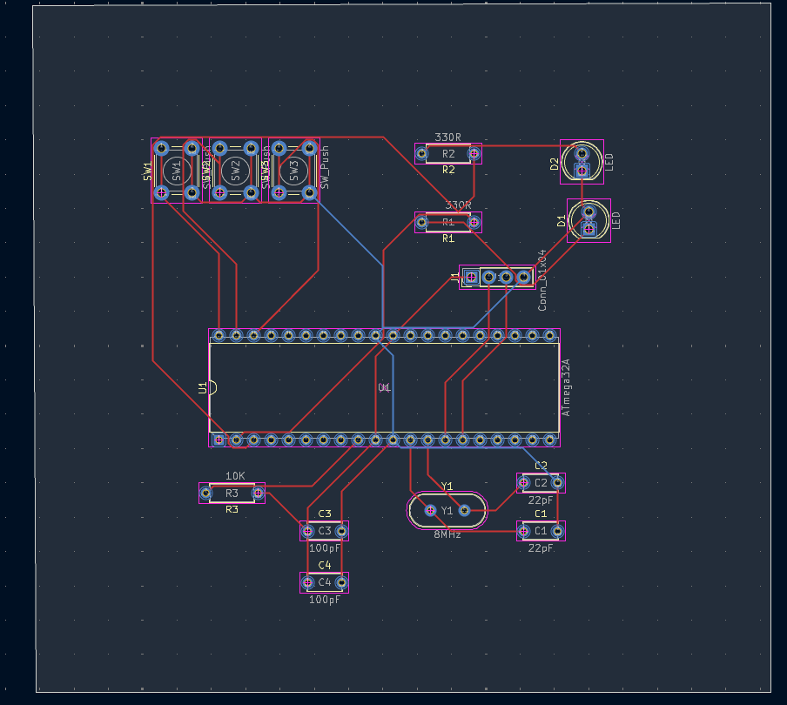
PCB Layout Design

Slide 14
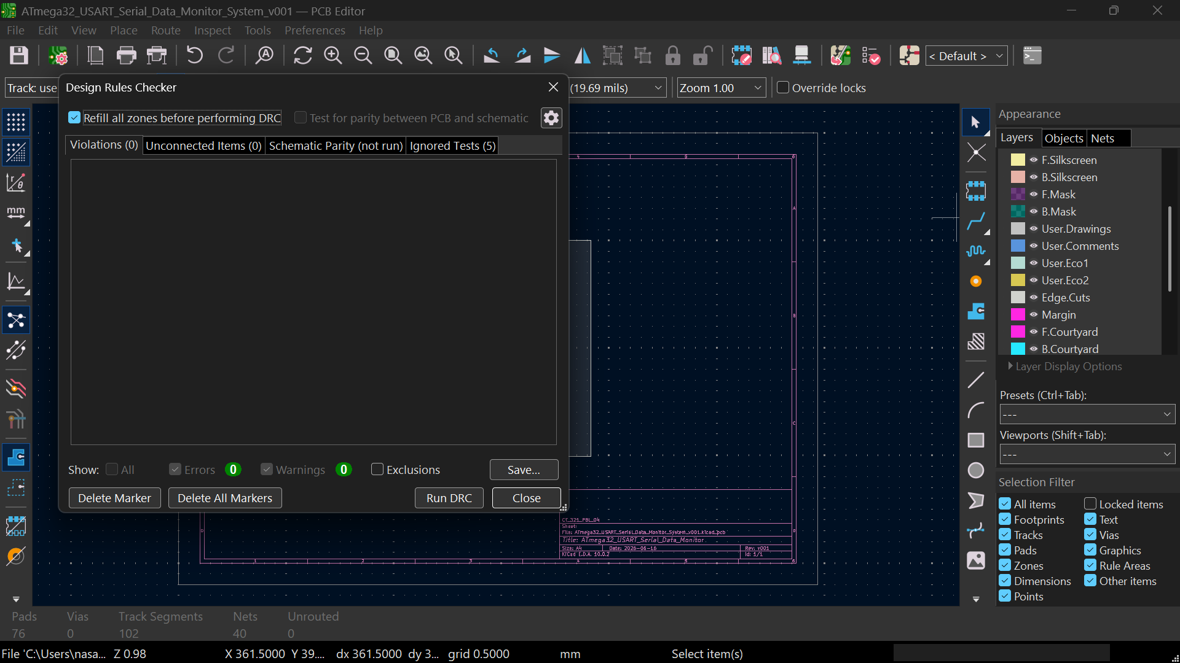
PCB DRC Results

Slide 15
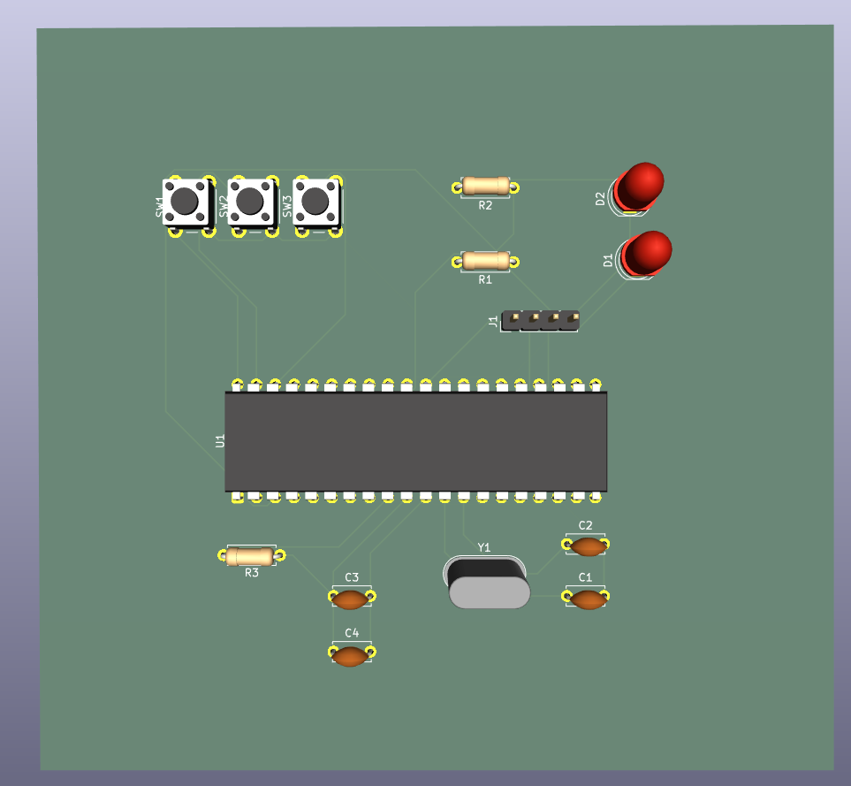
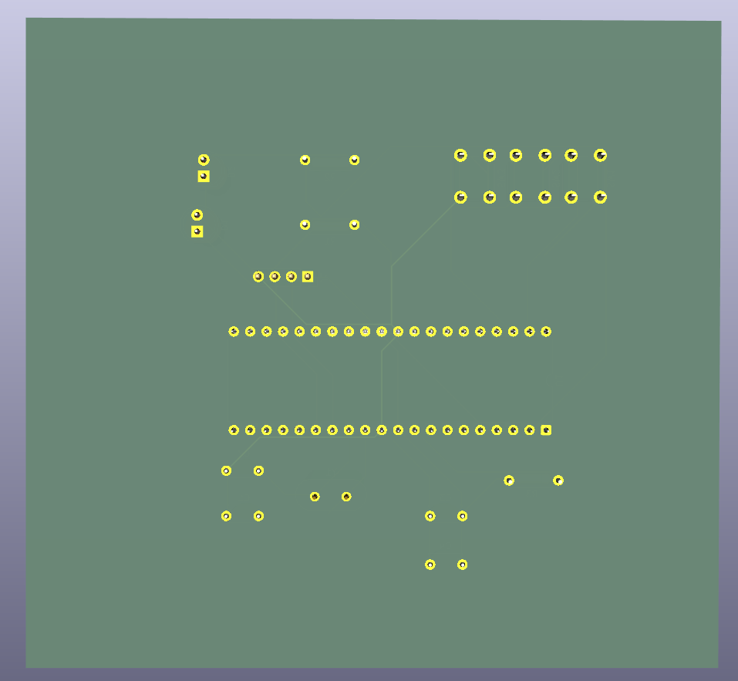
PCB Verification

Slide 16
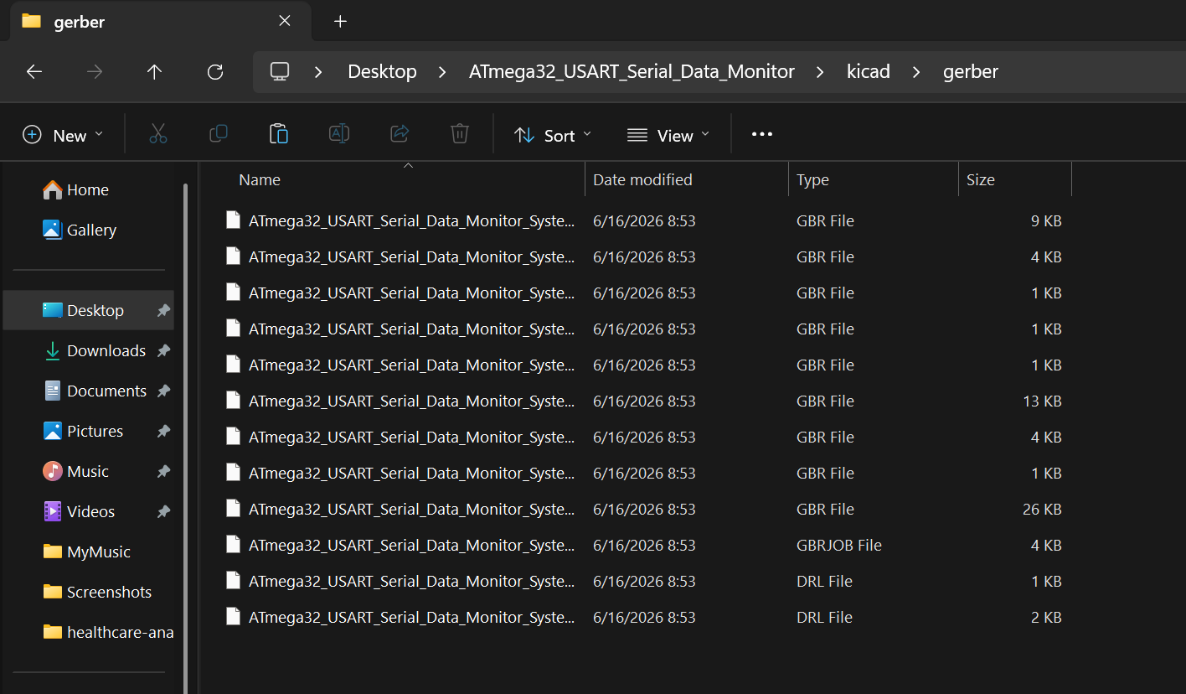
Gerber Generation

