Slide 1

Make Shopping Smarter & Friendlier
By Divija Hasteer , Adam Lee , Anitez Gautam, Neil Chulani, Richard Yoshioka

Slide 2

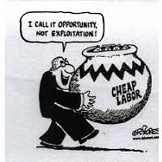

Our Purpose
We want to make shopping smarter and more efficient ,because of the amount of time that it takes to do this task in today’s fast paced world. We also want to raise awareness of the exploitation of labor in third world countries.There are many popular brands in the world that everybody loves but what people often don’t see is what goes on behind the scenes.

