Slide 1
Investigating the Neural Mechanisms Underlying Concurrent Regulation of Cognitive Stability and Flexibility
Notes:
Thank you all for coming today ☺
Today, I’ll be talking about an fMRI study and an intracranial EEG study both looking at how the brain simultaneously regulates cognitive stability and flexibility.

Slide 2
Outline
What are cognitive stability and flexibility?
Notes:
First, I’ll define what I mean by stability and flexibility
->
Next, I’ll go through a task that we’ve been using to manipulate how stable and flexible people are
->
And then I’ll go through what we’ve found so far and plan to do next in an fMRI study
->
Then I’ll go through what we’ve found and plan to do next in an intracranial EEG study
->
And finally, I’ll end with some conclusions that seem to be emerging from our results.
Go through this quickly, click through.
we study how stability and flexibility are simultaneously regulated in an fMRI study and also in an iEEG study

Slide 3
Outline
What are cognitive stability and flexibility?
Task to manipulate demands on stability and flexibility
Notes:
First, I’ll define what I mean by stability and flexibility
->
Next, I’ll go through a task that we’ve been using to manipulate how stable and flexible people are
->
And then I’ll go through what we’ve found so far and plan to do next in an fMRI study
->
Then I’ll go through what we’ve found and plan to do next in an intracranial EEG study
->
And finally, I’ll end with some conclusions that seem to be emerging from our results.
Go through this quickly, click through.
we study how stability and flexibility are simultaneously regulated in an fMRI study and also in an iEEG study

Slide 4
Outline
What are cognitive stability and flexibility?
Task to manipulate demands on stability and flexibility
fMRI Results + Future Work
Notes:
First, I’ll define what I mean by stability and flexibility
->
Next, I’ll go through a task that we’ve been using to manipulate how stable and flexible people are
->
And then I’ll go through what we’ve found so far and plan to do next in an fMRI study
->
Then I’ll go through what we’ve found and plan to do next in an intracranial EEG study
->
And finally, I’ll end with some conclusions that seem to be emerging from our results.
Go through this quickly, click through.
we study how stability and flexibility are simultaneously regulated in an fMRI study and also in an iEEG study

Slide 5
Outline
What are cognitive stability and flexibility?
Task to manipulate demands on stability and flexibility
fMRI Results + Future Work
iEEG Results + Future Work
Notes:
First, I’ll define what I mean by stability and flexibility
->
Next, I’ll go through a task that we’ve been using to manipulate how stable and flexible people are
->
And then I’ll go through what we’ve found so far and plan to do next in an fMRI study
->
Then I’ll go through what we’ve found and plan to do next in an intracranial EEG study
->
And finally, I’ll end with some conclusions that seem to be emerging from our results.
Go through this quickly, click through.
we study how stability and flexibility are simultaneously regulated in an fMRI study and also in an iEEG study

Slide 6
Outline
What are cognitive stability and flexibility?
Task to manipulate demands on stability and flexibility
fMRI Results + Future Work
iEEG Results + Future Work
Conclusions
Notes:
First, I’ll define what I mean by stability and flexibility
->
Next, I’ll go through a task that we’ve been using to manipulate how stable and flexible people are
->
And then I’ll go through what we’ve found so far and plan to do next in an fMRI study
->
Then I’ll go through what we’ve found and plan to do next in an intracranial EEG study
->
And finally, I’ll end with some conclusions that seem to be emerging from our results.
Go through this quickly, click through.
we study how stability and flexibility are simultaneously regulated in an fMRI study and also in an iEEG study

Slide 7
Cognitive stability – ability to stably maintain current goals (conflict control)
Notes:
Cognitive stability is our ability to stably maintain our current goals, protecting them from interference from conflicting goals.
->
As an example, imagine that you’re writing a review paper and your phone buzzes – you can use cognitive stability, our ability to maintain our goals and stay on task, to keep focusing on writing the paper and ignore the distracting notification.

Slide 8


Cognitive stability – ability to stably maintain current goals (conflict control)
Notes:
Cognitive stability is our ability to stably maintain our current goals, protecting them from interference from conflicting goals.
->
As an example, imagine that you’re writing a review paper and your phone buzzes – you can use cognitive stability, our ability to maintain our goals and stay on task, to keep focusing on writing the paper and ignore the distracting notification.

Slide 9
Cognitive flexibility – ability to switch between different goals (task switching)
Notes:
Cognitive flexibility is our ability to switch between different goals (task switching)
->
Going back to our paper writing example – if you’re expecting an e-mail from your thesis advisor with edits, you might want to employ cognitive flexibility to switch from writing your review paper to checking your phone notification.

Slide 10

Cognitive flexibility – ability to switch between different goals (task switching)
Notes:
Cognitive flexibility is our ability to switch between different goals (task switching)
->
Going back to our paper writing example – if you’re expecting an e-mail from your thesis advisor with edits, you might want to employ cognitive flexibility to switch from writing your review paper to checking your phone notification.
->

Slide 11


Cognitive flexibility – ability to switch between different goals (task switching)
Rewrite all of it
Notes:
Cognitive flexibility is our ability to switch between different goals (task switching)
->
Going back to our paper writing example – if you’re expecting an e-mail from your thesis advisor with edits, you might want to employ cognitive flexibility to switch from writing your review paper to checking your phone notification.
->

Slide 12
Motivation
Others’ 1D View
More Stable
More Flexible
Notes:
Stability and flexibility have been manipulated and studied separately, but haven’t really been studied together in the same experiment. This is partly because other researchers assume that stability and flexibility are opposite ends of a single dimension, such that becoming more stable comes at the cost of becoming less flexible, and vice versa. This view assumes that as you get more stable at writing your paper, you become less flexible at switching to checking your phone.
->
However, recent behavioral studies from our lab show that this assumption is probably wrong, and that stability and flexibility are likely independent processes. So this new, 2-dimensional view from our lab theorizes that becoming more stable does not affect how flexible you are. Going back to our example, this view assumes that becoming more stable at writing your paper does does not affect how flexible you are at switching to checking a phone notification.
->
We set out to test which of these two views is supported by how the brain regulates these processes, in two studies where we manipulate stability and flexibility demands simultaneously – one using fMRI and another using intracranial EEG.
->
In line with previous behavioral studies from our lab and our 2D view, we hypothesize that the brain will adapt to stability and flexibility demands independently.
->
Finally, this is important because understanding how stability and flexibility are regulated in the brain may lead to more targeted treatments towards many clinical disorders in which these abilities are impaired, such as ADHD and schizophrenia.
Stability and flexibility have been studied separately, but haven’t really haven’t been studied together in the same experiment partly because the general assumption is that stability and flexibility are two poles of the same continuum, such that increased stability comes at the cost of decreased flexibility, and vice versa. But this assumption hasn’t been directly tested before, and, in particular, we don’t know exactly how these processes are regulated concurrently in the brain. Based on prior behavioral studies from the Egner Lab, we hypothesize that stability and flexibility are actually independent processes, and thus how stable and flexible people are will vary independently as the demands on these processes change. So we set out to test this hypothesis in an fMRI study and an intracranial EEG study.
That’s the goal of this project ☺
Imagine you are a campus squirrel, digging through trash to get
hawk
I need to say something about how people typically think that these things are one-dimensional, where as you become more stable, you become less flexible. But that’s not necessarily the case.
better examples - one example for both (just put pic of the phone call or something, make it funny though. Specificity is funny.) Or have one example for each.
so what? nod to significance - clinical conditions
don't be too funny
pics for 1d vs 2d
operationalize of constructs good
Click through this with a bunch of slides and show one bullet point at a time

Slide 13
Motivation
Others’ 1D View
More Stable
More Flexible
Our 2D View
More Stable
More Flexible
Notes:
Stability and flexibility have been manipulated and studied separately, but haven’t really been studied together in the same experiment. This is partly because other researchers assume that stability and flexibility are opposite ends of a single dimension, such that becoming more stable comes at the cost of becoming less flexible, and vice versa. This view assumes that as you get more stable at writing your paper, you become less flexible at switching to checking your phone.
->
However, recent behavioral studies from our lab show that this assumption is probably wrong, and that stability and flexibility are likely independent processes. So this new, 2-dimensional view from our lab theorizes that becoming more stable does not affect how flexible you are. Going back to our example, this view assumes that becoming more stable at writing your paper does does not affect how flexible you are at switching to checking a phone notification.
->
We set out to test which of these two views is supported by how the brain regulates these processes, in two studies where we manipulate stability and flexibility demands simultaneously – one using fMRI and another using intracranial EEG.
->
In line with previous behavioral studies from our lab and our 2D view, we hypothesize that the brain will adapt to stability and flexibility demands independently.
->
Finally, this is important because understanding how stability and flexibility are regulated in the brain may lead to more targeted treatments towards many clinical disorders in which these abilities are impaired, such as ADHD and schizophrenia.
Stability and flexibility have been studied separately, but haven’t really haven’t been studied together in the same experiment partly because the general assumption is that stability and flexibility are two poles of the same continuum, such that increased stability comes at the cost of decreased flexibility, and vice versa. But this assumption hasn’t been directly tested before, and, in particular, we don’t know exactly how these processes are regulated concurrently in the brain. Based on prior behavioral studies from the Egner Lab, we hypothesize that stability and flexibility are actually independent processes, and thus how stable and flexible people are will vary independently as the demands on these processes change. So we set out to test this hypothesis in an fMRI study and an intracranial EEG study.
That’s the goal of this project ☺
Imagine you are a campus squirrel, digging through trash to get
hawk
I need to say something about how people typically think that these things are one-dimensional, where as you become more stable, you become less flexible. But that’s not necessarily the case.
better examples - one example for both (just put pic of the phone call or something, make it funny though. Specificity is funny.) Or have one example for each.
so what? nod to significance - clinical conditions
don't be too funny
pics for 1d vs 2d
operationalize of constructs good
Click through this with a bunch of slides and show one bullet point at a time

Slide 14
Motivation
Others’ 1D View
More Stable
More Flexible
How does the brain regulate stability and flexibility concurrently?
Our 2D View
More Stable
More Flexible
Notes:
Stability and flexibility have been manipulated and studied separately, but haven’t really been studied together in the same experiment. This is partly because other researchers assume that stability and flexibility are opposite ends of a single dimension, such that becoming more stable comes at the cost of becoming less flexible, and vice versa. This view assumes that as you get more stable at writing your paper, you become less flexible at switching to checking your phone.
->
However, recent behavioral studies from our lab show that this assumption is probably wrong, and that stability and flexibility are likely independent processes. So this new, 2-dimensional view from our lab theorizes that becoming more stable does not affect how flexible you are. Going back to our example, this view assumes that becoming more stable at writing your paper does does not affect how flexible you are at switching to checking a phone notification.
->
We set out to test which of these two views is supported by how the brain regulates these processes, in two studies where we manipulate stability and flexibility demands simultaneously – one using fMRI and another using intracranial EEG.
->
In line with previous behavioral studies from our lab and our 2D view, we hypothesize that the brain will adapt to stability and flexibility demands independently.
->
Finally, this is important because understanding how stability and flexibility are regulated in the brain may lead to more targeted treatments towards many clinical disorders in which these abilities are impaired, such as ADHD and schizophrenia.
Stability and flexibility have been studied separately, but haven’t really haven’t been studied together in the same experiment partly because the general assumption is that stability and flexibility are two poles of the same continuum, such that increased stability comes at the cost of decreased flexibility, and vice versa. But this assumption hasn’t been directly tested before, and, in particular, we don’t know exactly how these processes are regulated concurrently in the brain. Based on prior behavioral studies from the Egner Lab, we hypothesize that stability and flexibility are actually independent processes, and thus how stable and flexible people are will vary independently as the demands on these processes change. So we set out to test this hypothesis in an fMRI study and an intracranial EEG study.
That’s the goal of this project ☺
Imagine you are a campus squirrel, digging through trash to get
hawk
I need to say something about how people typically think that these things are one-dimensional, where as you become more stable, you become less flexible. But that’s not necessarily the case.
better examples - one example for both (just put pic of the phone call or something, make it funny though. Specificity is funny.) Or have one example for each.
so what? nod to significance - clinical conditions
don't be too funny
pics for 1d vs 2d
operationalize of constructs good
Click through this with a bunch of slides and show one bullet point at a time

Slide 15
Motivation
Others’ 1D View
More Stable
More Flexible
How does the brain regulate stability and flexibility concurrently?
Hypothesis: The brain adapts to stability and flexibility demands independently
Our 2D View
More Stable
More Flexible
Notes:
Stability and flexibility have been manipulated and studied separately, but haven’t really been studied together in the same experiment. This is partly because other researchers assume that stability and flexibility are opposite ends of a single dimension, such that becoming more stable comes at the cost of becoming less flexible, and vice versa. This view assumes that as you get more stable at writing your paper, you become less flexible at switching to checking your phone.
->
However, recent behavioral studies from our lab show that this assumption is probably wrong, and that stability and flexibility are likely independent processes. So this new, 2-dimensional view from our lab theorizes that becoming more stable does not affect how flexible you are. Going back to our example, this view assumes that becoming more stable at writing your paper does does not affect how flexible you are at switching to checking a phone notification.
->
We set out to test which of these two views is supported by how the brain regulates these processes, in two studies where we manipulate stability and flexibility demands simultaneously – one using fMRI and another using intracranial EEG.
->
In line with previous behavioral studies from our lab and our 2D view, we hypothesize that the brain will adapt to stability and flexibility demands independently.
->
Finally, this is important because understanding how stability and flexibility are regulated in the brain may lead to more targeted treatments towards many clinical disorders in which these abilities are impaired, such as ADHD and schizophrenia.
Stability and flexibility have been studied separately, but haven’t really haven’t been studied together in the same experiment partly because the general assumption is that stability and flexibility are two poles of the same continuum, such that increased stability comes at the cost of decreased flexibility, and vice versa. But this assumption hasn’t been directly tested before, and, in particular, we don’t know exactly how these processes are regulated concurrently in the brain. Based on prior behavioral studies from the Egner Lab, we hypothesize that stability and flexibility are actually independent processes, and thus how stable and flexible people are will vary independently as the demands on these processes change. So we set out to test this hypothesis in an fMRI study and an intracranial EEG study.
That’s the goal of this project ☺
Imagine you are a campus squirrel, digging through trash to get
hawk
I need to say something about how people typically think that these things are one-dimensional, where as you become more stable, you become less flexible. But that’s not necessarily the case.
better examples - one example for both (just put pic of the phone call or something, make it funny though. Specificity is funny.) Or have one example for each.
so what? nod to significance - clinical conditions
don't be too funny
pics for 1d vs 2d
operationalize of constructs good
Click through this with a bunch of slides and show one bullet point at a time

Slide 16
Motivation
Others’ 1D View
More Stable
More Flexible
How does the brain regulate stability and flexibility concurrently?
Hypothesis: The brain adapts to stability and flexibility demands independently
Both processes impaired in various clinical disorders
Our 2D View
More Stable
More Flexible
Notes:
Stability and flexibility have been manipulated and studied separately, but haven’t really been studied together in the same experiment. This is partly because other researchers assume that stability and flexibility are opposite ends of a single dimension, such that becoming more stable comes at the cost of becoming less flexible, and vice versa. This view assumes that as you get more stable at writing your paper, you become less flexible at switching to checking your phone.
->
However, recent behavioral studies from our lab show that this assumption is probably wrong, and that stability and flexibility are likely independent processes. So this new, 2-dimensional view from our lab theorizes that becoming more stable does not affect how flexible you are. Going back to our example, this view assumes that becoming more stable at writing your paper does does not affect how flexible you are at switching to checking a phone notification.
->
We set out to test which of these two views is supported by how the brain regulates these processes, in two studies where we manipulate stability and flexibility demands simultaneously – one using fMRI and another using intracranial EEG.
->
In line with previous behavioral studies from our lab and our 2D view, we hypothesize that the brain will adapt to stability and flexibility demands independently.
->
Finally, this is important because understanding how stability and flexibility are regulated in the brain may lead to more targeted treatments towards many clinical disorders in which these abilities are impaired, such as ADHD and schizophrenia.
Stability and flexibility have been studied separately, but haven’t really haven’t been studied together in the same experiment partly because the general assumption is that stability and flexibility are two poles of the same continuum, such that increased stability comes at the cost of decreased flexibility, and vice versa. But this assumption hasn’t been directly tested before, and, in particular, we don’t know exactly how these processes are regulated concurrently in the brain. Based on prior behavioral studies from the Egner Lab, we hypothesize that stability and flexibility are actually independent processes, and thus how stable and flexible people are will vary independently as the demands on these processes change. So we set out to test this hypothesis in an fMRI study and an intracranial EEG study.
That’s the goal of this project ☺
Imagine you are a campus squirrel, digging through trash to get
hawk
I need to say something about how people typically think that these things are one-dimensional, where as you become more stable, you become less flexible. But that’s not necessarily the case.
better examples - one example for both (just put pic of the phone call or something, make it funny though. Specificity is funny.) Or have one example for each.
so what? nod to significance - clinical conditions
don't be too funny
pics for 1d vs 2d
operationalize of constructs good
Click through this with a bunch of slides and show one bullet point at a time

Slide 17

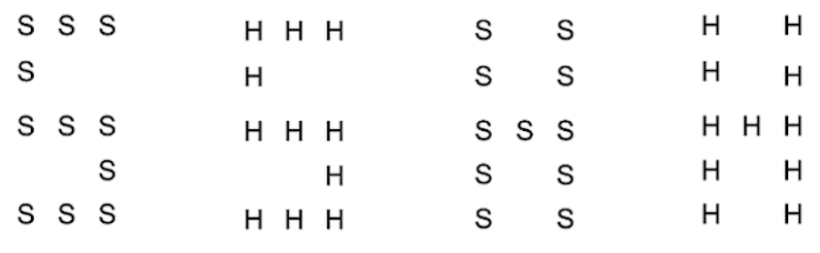
Our task measures both stability and flexibility
Blue Frame:
Big Letter
Red Frame: Small Letter
Notes:
So now for a task that lets us answer these questions. For the sake of time, I’ll skip the fMRI task and just go through the intracranial EEG task paradigm, though the fMRI and iEEG tasks are very conceptually similar. In the intracranial EEG task, participants perform a Navon Letter task in which they either categorize the identity of a big letter, or the identity of the small letters that make up the big letter, according to the color of a frame around the overall stimulus.
->
We can probe stability by comparing their performance on congruent trials where the big and small letters match, against incongruent trials where the big and small letters don’t match, thus introducing response conflict. The slower they are on incongruent trials relative to congruent trials, the less stable they are. We call the size of this reaction time difference the congruency effect.
->
Conversely, we can probe how flexible people are by comparing their performance on trials that repeat the same task as the last trial (last trial big, this trial big) compared to trials that switch the task from the last trial (last trial big, this trial small). The slower they are on task switch trials relative to task repeat trials, the less flexible they are. We call the size of this reaction time difference the switch cost.
note - stability for congruency effects, flexibility by switch costs
note task cue
navon letter task
walk through - lots of stuff
inc, con - incongruent congruent,
RT is reaction time
repeat switch - task switch, task repeat
put red frame and blue frame on left before the trial panels
track what people are looking at
Yeah let’s do more of a slow reveal here

Slide 18
Our task measures both stability and flexibility
Congruency Effect = RT_{inc} – RT_{con}
congruent
incongruent
incongruent
congruent
Blue Frame:
Big Letter
Red Frame: Small Letter
Notes:
So now for a task that lets us answer these questions. For the sake of time, I’ll skip the fMRI task and just go through the intracranial EEG task paradigm, though the fMRI and iEEG tasks are very conceptually similar. In the intracranial EEG task, participants perform a Navon Letter task in which they either categorize the identity of a big letter, or the identity of the small letters that make up the big letter, according to the color of a frame around the overall stimulus.
->
We can probe stability by comparing their performance on congruent trials where the big and small letters match, against incongruent trials where the big and small letters don’t match, thus introducing response conflict. The slower they are on incongruent trials relative to congruent trials, the less stable they are. We call the size of this reaction time difference the congruency effect.
->
Conversely, we can probe how flexible people are by comparing their performance on trials that repeat the same task as the last trial (last trial big, this trial big) compared to trials that switch the task from the last trial (last trial big, this trial small). The slower they are on task switch trials relative to task repeat trials, the less flexible they are. We call the size of this reaction time difference the switch cost.
note - stability for congruency effects, flexibility by switch costs
note task cue
navon letter task
walk through - lots of stuff
inc, con - incongruent congruent,
RT is reaction time
repeat switch - task switch, task repeat
put red frame and blue frame on left before the trial panels
track what people are looking at
Yeah let’s do more of a slow reveal here

Slide 19
Our task measures both stability and flexibility
Congruency Effect = RT_{inc} – RT_{con}
Switch Cost = RT_{switch} – RT_{repeat}
congruent
incongruent
incongruent
congruent
Repeat
Switch
Blue Frame:
Big Letter
S S S
S S S
S S S
S S S
S S S
H H H
H
H H H
HH H
H H H
H H H
H
H H H
HH H
H H H
…
Red Frame: Small Letter
Notes:
So now for a task that lets us answer these questions. For the sake of time, I’ll skip the fMRI task and just go through the intracranial EEG task paradigm, though the fMRI and iEEG tasks are very conceptually similar. In the intracranial EEG task, participants perform a Navon Letter task in which they either categorize the identity of a big letter, or the identity of the small letters that make up the big letter, according to the color of a frame around the overall stimulus.
->
We can probe stability by comparing their performance on congruent trials where the big and small letters match, against incongruent trials where the big and small letters don’t match, thus introducing response conflict. The slower they are on incongruent trials relative to congruent trials, the less stable they are. We call the size of this reaction time difference the congruency effect.
->
Conversely, we can probe how flexible people are by comparing their performance on trials that repeat the same task as the last trial (last trial big, this trial big) compared to trials that switch the task from the last trial (last trial big, this trial small). The slower they are on task switch trials relative to task repeat trials, the less flexible they are. We call the size of this reaction time difference the switch cost.
note - stability for congruency effects, flexibility by switch costs
note task cue
navon letter task
walk through - lots of stuff
inc, con - incongruent congruent,
RT is reaction time
repeat switch - task switch, task repeat
put red frame and blue frame on left before the trial panels
track what people are looking at
Yeah let’s do more of a slow reveal here

Slide 20
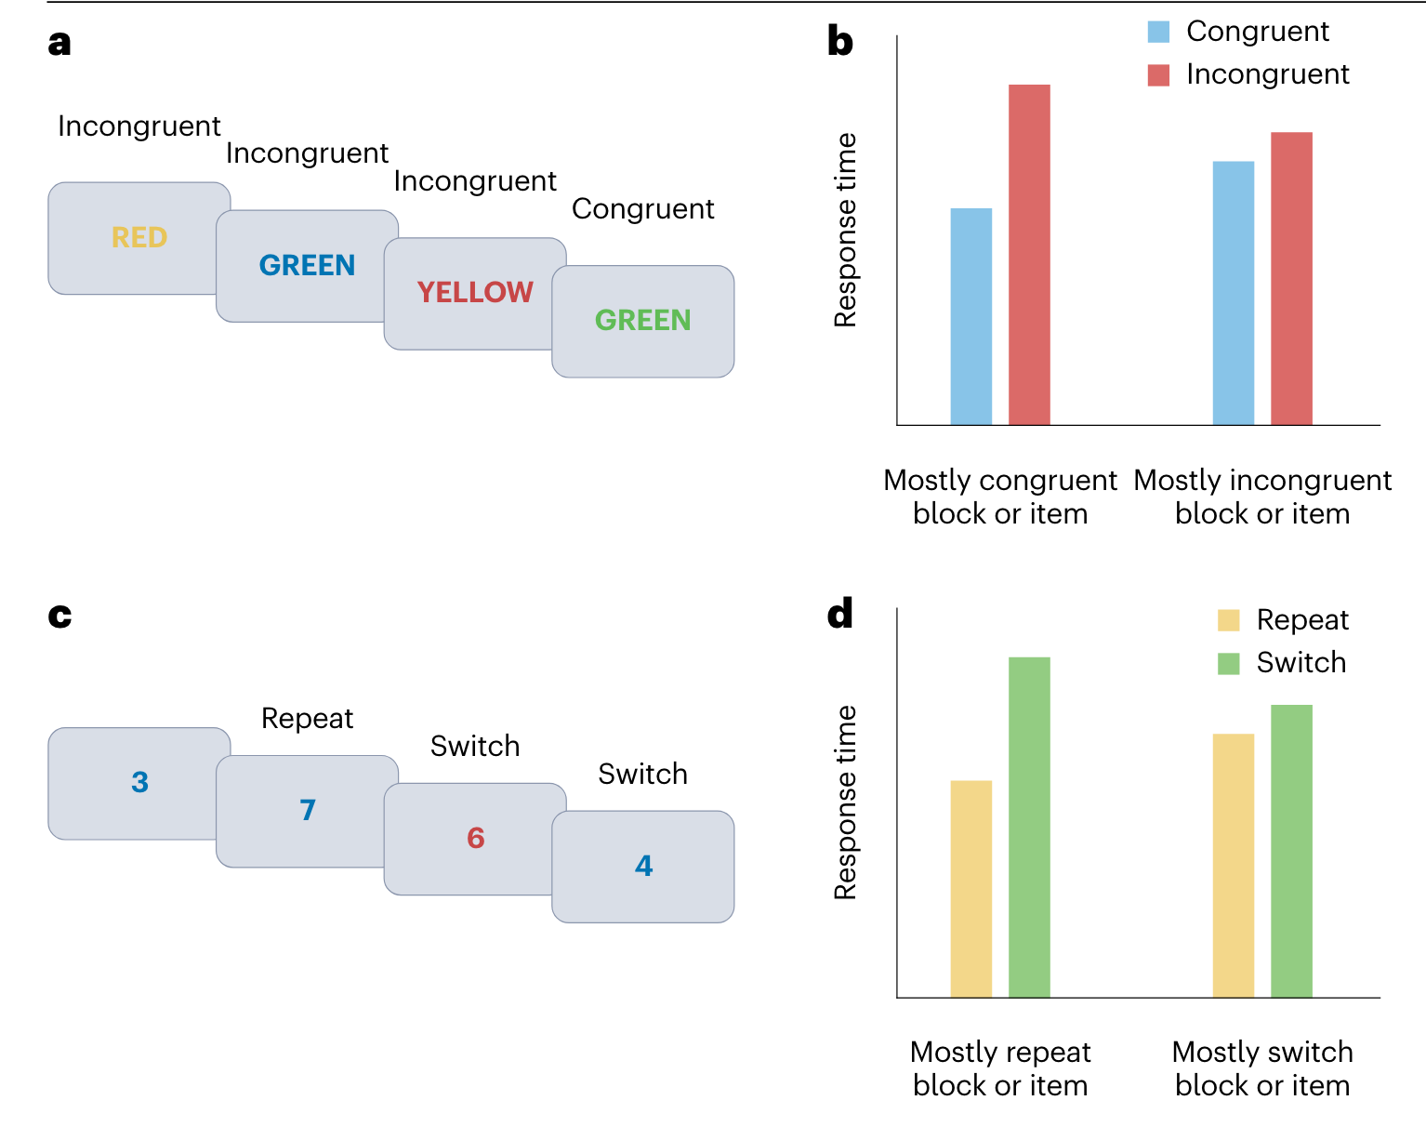
Egner, 2023
Con. Effect (RT_{inc} – Rt_{con})
Con. Effect
Switch Cost (RT_{switch} – RT_{repeat})
Switch Cost
Egner, 2023
Notes:
So now that we’re able to measure how stable and flexible people actually are on each trial, we also want to manipulate demands on stability and flexibility. To manipulate demands on stability, we manipulate the proportion of incongruent trials across different blocks, expecting them to become more stable in blocks with more incongruent trials, thus lowering their congruency effect in these blocks.
->
Under our 2D view of stability and flexibility as independent dimensions, this increase in stability will not affect how flexible they are, and thus have no effect on switch costs, but under the 1D view, this increase in stability will result in a decrease in flexibility, and thus increased switch costs.
->
We manipulate demands on flexibility by manipulating the proportion of task switch trials, expecting them to become more flexible in blocks with more task switch trials, thus lowering their switch costs.
->
Under our 2D view, this increase in flexibility will not affect how stable they are, and thus have no effect on congruency effects, but under the 1D view, this increase in flexibility will result in a decrease in stability, and thus increased congruency effects.
However, we also see that the switch cost is larger in mostly repeat blocks/items compared to mostly switch blocks/items.
This suggests that flexibility is also dynamically regulated, and we increase our flexibility when there’s a lot of switch trials that require more flexibility (this is like when we are switching between reading and checking our phone a lot in the café, so we expect to switch tasks and are more ready to do so) and become less flexible when there’s a lot of repeat trials that require less flexibility (this is like when our phone doesn’t buzz a lot in the cafe, so we just keep reading.)
Hmm oh I actually really like the way I went through this. Just go through it the same way but using my fMRI data.

Slide 21
Hypothesis (2D view): ↑incongruent proportion ↓congruency effect
Alternative hypothesis (1D view): ↑incongruent proportion ↓congruency effect ↑switch cost
Egner, 2023
Con. Effect (RT_{inc} – Rt_{con})
Con. Effect
Switch Cost (RT_{switch} – RT_{repeat})
Switch Cost
Notes:
So now that we’re able to measure how stable and flexible people actually are on each trial, we also want to manipulate demands on stability and flexibility. To manipulate demands on stability, we manipulate the proportion of incongruent trials across different blocks, expecting them to become more stable in blocks with more incongruent trials, thus lowering their congruency effect in these blocks.
->
Under our 2D view of stability and flexibility as independent dimensions, this increase in stability will not affect how flexible they are, and thus have no effect on switch costs, but under the 1D view, this increase in stability will result in a decrease in flexibility, and thus increased switch costs.
->
We manipulate demands on flexibility by manipulating the proportion of task switch trials, expecting them to become more flexible in blocks with more task switch trials, thus lowering their switch costs.
->
Under our 2D view, this increase in flexibility will not affect how stable they are, and thus have no effect on congruency effects, but under the 1D view, this increase in flexibility will result in a decrease in stability, and thus increased congruency effects.
However, we also see that the switch cost is larger in mostly repeat blocks/items compared to mostly switch blocks/items.
This suggests that flexibility is also dynamically regulated, and we increase our flexibility when there’s a lot of switch trials that require more flexibility (this is like when we are switching between reading and checking our phone a lot in the café, so we expect to switch tasks and are more ready to do so) and become less flexible when there’s a lot of repeat trials that require less flexibility (this is like when our phone doesn’t buzz a lot in the cafe, so we just keep reading.)
Hmm oh I actually really like the way I went through this. Just go through it the same way but using my fMRI data.

Slide 22
Hypothesis (2D view): ↑incongruent proportion ↓congruency effect
Alternative hypothesis (1D view): ↑incongruent proportion ↓congruency effect ↑switch cost
Egner, 2023
Con. Effect (RT_{inc} – Rt_{con})
Con. Effect
Switch Cost (RT_{switch} – RT_{repeat})
Switch Cost
Notes:
So now that we’re able to measure how stable and flexible people actually are on each trial, we also want to manipulate demands on stability and flexibility. To manipulate demands on stability, we manipulate the proportion of incongruent trials across different blocks, expecting them to become more stable in blocks with more incongruent trials, thus lowering their congruency effect in these blocks.
->
Under our 2D view of stability and flexibility as independent dimensions, this increase in stability will not affect how flexible they are, and thus have no effect on switch costs, but under the 1D view, this increase in stability will result in a decrease in flexibility, and thus increased switch costs.
->
We manipulate demands on flexibility by manipulating the proportion of task switch trials, expecting them to become more flexible in blocks with more task switch trials, thus lowering their switch costs.
->
Under our 2D view, this increase in flexibility will not affect how stable they are, and thus have no effect on congruency effects, but under the 1D view, this increase in flexibility will result in a decrease in stability, and thus increased congruency effects.
However, we also see that the switch cost is larger in mostly repeat blocks/items compared to mostly switch blocks/items.
This suggests that flexibility is also dynamically regulated, and we increase our flexibility when there’s a lot of switch trials that require more flexibility (this is like when we are switching between reading and checking our phone a lot in the café, so we expect to switch tasks and are more ready to do so) and become less flexible when there’s a lot of repeat trials that require less flexibility (this is like when our phone doesn’t buzz a lot in the cafe, so we just keep reading.)
Hmm oh I actually really like the way I went through this. Just go through it the same way but using my fMRI data.

Slide 23
Hypothesis (2D view): ↑incongruent proportion ↓congruency effect
Alternative hypothesis (1D view): ↑incongruent proportion ↓congruency effect ↑switch cost
Egner, 2023
Con. Effect (RT_{inc} – Rt_{con})
Con. Effect
Hypothesis (2D view): ↑task switch proportion ↓switch cost
Alternative hypothesis (1D view): ↑task switch proportion ↓switch cost ↑congruency effect
Switch Cost (RT_{switch} – RT_{repeat})
Switch Cost
Notes:
So now that we’re able to measure how stable and flexible people actually are on each trial, we also want to manipulate demands on stability and flexibility. To manipulate demands on stability, we manipulate the proportion of incongruent trials across different blocks, expecting them to become more stable in blocks with more incongruent trials, thus lowering their congruency effect in these blocks.
->
Under our 2D view of stability and flexibility as independent dimensions, this increase in stability will not affect how flexible they are, and thus have no effect on switch costs, but under the 1D view, this increase in stability will result in a decrease in flexibility, and thus increased switch costs.
->
We manipulate demands on flexibility by manipulating the proportion of task switch trials, expecting them to become more flexible in blocks with more task switch trials, thus lowering their switch costs.
->
Under our 2D view, this increase in flexibility will not affect how stable they are, and thus have no effect on congruency effects, but under the 1D view, this increase in flexibility will result in a decrease in stability, and thus increased congruency effects.
However, we also see that the switch cost is larger in mostly repeat blocks/items compared to mostly switch blocks/items.
This suggests that flexibility is also dynamically regulated, and we increase our flexibility when there’s a lot of switch trials that require more flexibility (this is like when we are switching between reading and checking our phone a lot in the café, so we expect to switch tasks and are more ready to do so) and become less flexible when there’s a lot of repeat trials that require less flexibility (this is like when our phone doesn’t buzz a lot in the cafe, so we just keep reading.)
Hmm oh I actually really like the way I went through this. Just go through it the same way but using my fMRI data.

Slide 24
Our block types orthogonally vary demands on stability and flexibility
Stable and inflexible
Stable and flexible
75%
Incongruent Prop.
Unstable and inflexible
Unstable and flexible
More stable
25%
25%
75%
Task Switch Prop.
More Flexible
Notes:
So, under our 2D view, people will adjust how stable and flexible they are independently of each other. We test if this is the case by orthogonally varying the incongruent proportion and task switch proportion across four block types.
->
We expect people to become more stable in blocks with more incongruent trials, with no effect on how flexible they are.
->
We also expect people to become more flexible in blocks with more task switch trials, with no effect on how stable they are.
We now orthogonally vary demands on stability and flexibility across four block types, by orthogonally varying the incongruent and switch proportions. This lets us answer our question of whether people and their brains adapt to stability and flexibility demands independently or not. We hypothesize that they do adapt to these demands independently. This would mean that the incongruent proportion will affect the size of the congruency effect but not the size of the switch cost, thus showing that demands on stability affect how stable people are, but not how flexible they are. Likewise, we expect that the switch proportion affects the size of the switch cost but not the congruency effect, thus showing that demands on flexibility affect how flexible people are, but not how stable they are.
Stick this in somewhere else when I talk about the brain - And this would all be mirrored in brain regions sensitive to stability and/or flexibility, such that regions mediating stability will adjust their activity based on changing stability demands due to the incongruent proportion and regions mediating flexibility will adjust their activity based on changing flexibility demands due to the switch proportion.
make this clear!
block a,b,c,d not super clear, suggests these are different things
show 75/25 - colors instead
put switch cost and congruency effect definitions back on here.
tie into switching and focus - fake data would be good with the bar graphs, say direction of prop effects (switch cost up in mostly repeat blocks)
switch cost up arrow, congruency effect up arrow
don't need to say brain hypotheses here yet - what about the brain?
I think just slowly reveal my fMRI results piece by piece alongside this hypothesis slide. Instead of showing Tobias’s fake data, why not show my real data? And this would save me time too.
Importantly, in our task design, we have four blocks in which we independently vary the demands on stability and flexibility by orthogonally varying the incongruent and task switch proportions in each block. This lets us check if people independently adapt how stable and flexible they are, or if they adapt these abilities together. Hypothesis here is that the switch prop only affects the difference between switch and repeat, and incongruent prop only affects the difference between incongruent and congruent. Thus, people adapt these abilities independently, not together.
If they ask - We do four runs of fmri data, and have two blocks in each, so we have 8 blocks total, with two blocks of each block type. 128 trials per run, so 64 trials per block. Blocks are randomly ordered. A and C never in the same run, B and D never in the same run.
In the ieeg participants, it’s 112 trials per block type. And each block type shows up in one block. Four blocks total.

Slide 25
Our block types orthogonally vary demands on stability and flexibility
Stable and inflexible
Stable and flexible
75%
Incongruent Prop.
Unstable and inflexible
Unstable and flexible
More stable
25%
25%
75%
Task Switch Prop.
More Flexible
Notes:
So, under our 2D view, people will adjust how stable and flexible they are independently of each other. We test if this is the case by orthogonally varying the incongruent proportion and task switch proportion across four block types.
->
We expect people to become more stable in blocks with more incongruent trials, with no effect on how flexible they are.
->
We also expect people to become more flexible in blocks with more task switch trials, with no effect on how stable they are.
We now orthogonally vary demands on stability and flexibility across four block types, by orthogonally varying the incongruent and switch proportions. This lets us answer our question of whether people and their brains adapt to stability and flexibility demands independently or not. We hypothesize that they do adapt to these demands independently. This would mean that the incongruent proportion will affect the size of the congruency effect but not the size of the switch cost, thus showing that demands on stability affect how stable people are, but not how flexible they are. Likewise, we expect that the switch proportion affects the size of the switch cost but not the congruency effect, thus showing that demands on flexibility affect how flexible people are, but not how stable they are.
Stick this in somewhere else when I talk about the brain - And this would all be mirrored in brain regions sensitive to stability and/or flexibility, such that regions mediating stability will adjust their activity based on changing stability demands due to the incongruent proportion and regions mediating flexibility will adjust their activity based on changing flexibility demands due to the switch proportion.
make this clear!
block a,b,c,d not super clear, suggests these are different things
show 75/25 - colors instead
put switch cost and congruency effect definitions back on here.
tie into switching and focus - fake data would be good with the bar graphs, say direction of prop effects (switch cost up in mostly repeat blocks)
switch cost up arrow, congruency effect up arrow
don't need to say brain hypotheses here yet - what about the brain?
I think just slowly reveal my fMRI results piece by piece alongside this hypothesis slide. Instead of showing Tobias’s fake data, why not show my real data? And this would save me time too.
Importantly, in our task design, we have four blocks in which we independently vary the demands on stability and flexibility by orthogonally varying the incongruent and task switch proportions in each block. This lets us check if people independently adapt how stable and flexible they are, or if they adapt these abilities together. Hypothesis here is that the switch prop only affects the difference between switch and repeat, and incongruent prop only affects the difference between incongruent and congruent. Thus, people adapt these abilities independently, not together.
If they ask - We do four runs of fmri data, and have two blocks in each, so we have 8 blocks total, with two blocks of each block type. 128 trials per run, so 64 trials per block. Blocks are randomly ordered. A and C never in the same run, B and D never in the same run.
In the ieeg participants, it’s 112 trials per block type. And each block type shows up in one block. Four blocks total.

Slide 26
Our block types orthogonally vary demands on stability and flexibility
Stable and inflexible
Stable and flexible
75%
Incongruent Prop.
Unstable and inflexible
Unstable and flexible
More stable
25%
25%
75%
Task Switch Prop.
More Flexible
Notes:
So, under our 2D view, people will adjust how stable and flexible they are independently of each other. We test if this is the case by orthogonally varying the incongruent proportion and task switch proportion across four block types.
->
We expect people to become more stable in blocks with more incongruent trials, with no effect on how flexible they are.
->
We also expect people to become more flexible in blocks with more task switch trials, with no effect on how stable they are.
We now orthogonally vary demands on stability and flexibility across four block types, by orthogonally varying the incongruent and switch proportions. This lets us answer our question of whether people and their brains adapt to stability and flexibility demands independently or not. We hypothesize that they do adapt to these demands independently. This would mean that the incongruent proportion will affect the size of the congruency effect but not the size of the switch cost, thus showing that demands on stability affect how stable people are, but not how flexible they are. Likewise, we expect that the switch proportion affects the size of the switch cost but not the congruency effect, thus showing that demands on flexibility affect how flexible people are, but not how stable they are.
Stick this in somewhere else when I talk about the brain - And this would all be mirrored in brain regions sensitive to stability and/or flexibility, such that regions mediating stability will adjust their activity based on changing stability demands due to the incongruent proportion and regions mediating flexibility will adjust their activity based on changing flexibility demands due to the switch proportion.
make this clear!
block a,b,c,d not super clear, suggests these are different things
show 75/25 - colors instead
put switch cost and congruency effect definitions back on here.
tie into switching and focus - fake data would be good with the bar graphs, say direction of prop effects (switch cost up in mostly repeat blocks)
switch cost up arrow, congruency effect up arrow
don't need to say brain hypotheses here yet - what about the brain?
I think just slowly reveal my fMRI results piece by piece alongside this hypothesis slide. Instead of showing Tobias’s fake data, why not show my real data? And this would save me time too.
Importantly, in our task design, we have four blocks in which we independently vary the demands on stability and flexibility by orthogonally varying the incongruent and task switch proportions in each block. This lets us check if people independently adapt how stable and flexible they are, or if they adapt these abilities together. Hypothesis here is that the switch prop only affects the difference between switch and repeat, and incongruent prop only affects the difference between incongruent and congruent. Thus, people adapt these abilities independently, not together.
If they ask - We do four runs of fmri data, and have two blocks in each, so we have 8 blocks total, with two blocks of each block type. 128 trials per run, so 64 trials per block. Blocks are randomly ordered. A and C never in the same run, B and D never in the same run.
In the ieeg participants, it’s 112 trials per block type. And each block type shows up in one block. Four blocks total.

Slide 27
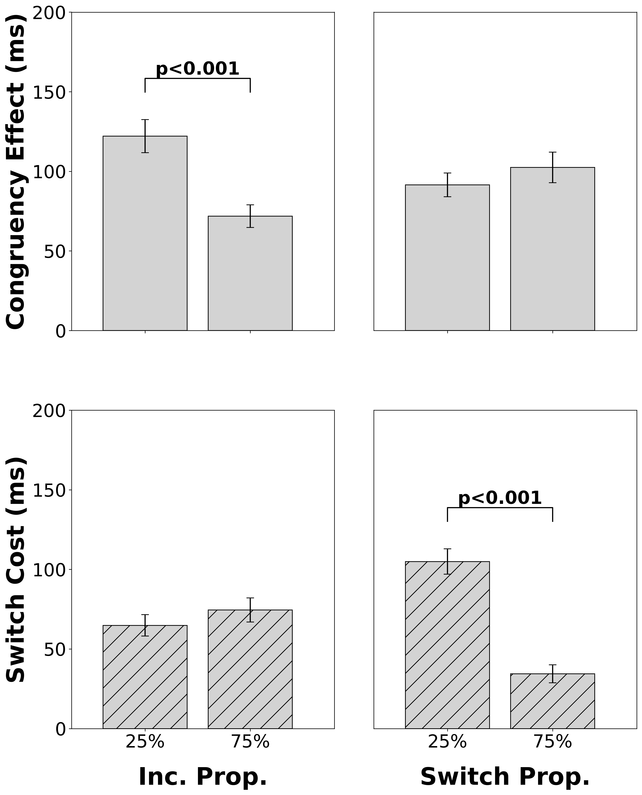
fMRI (N=45)
Switch Cost = RT_{switch} – RT_{repeat}
Congruency Effect = RT_{inc} – RT_{con}
Hypothesis (2D view): ↑incongruent proportion ↓congruency effect
Alternative hypothesis (1D view): ↑incongruent proportion ↓congruency effect ↑switch cost
Notes:
Our fMRI behavioral results support our 2D view over the alternative 1D view.
->
When our participants encounter more incongruent trials in a block, their congruency effect decreases, indicating they become more stable as demands on stability increase.
->
However, encountering more incongruent trials in a block does not significantly affect their switch cost, indicating that how flexible they are is not affected by demands on stability.
->
When they encounter more task switch trials in a block, their switch cost decreases, indicating they become more flexible as demands on flexibility increase.
->
However, encountering more task switch trials in a block does not significantly affect their congruency effect, indicating that how stable they are is not affected by demands on flexibility. Therefore, people seem to independently adjust how stable and flexible they are in response to changing environmental demands.
only affect the size of the congruency effect and not the switch cost, and demands on flexibility via varying the switch proportion only affect the size of the switch cost and not the congruency effect. Specifically, as people encounter more incongruent trials in a block, they become more stable, thus decreasing the size of their congruency effect. And as people encounter more task switch trials in a block, they become more flexible, thus decreasing the size of their switch cost. Thus, people seem to independently adapt how stable and flexible they are.
highlight alternative hypotheses - if you get more flexible, you are less stable and vice versa. Increased switch cost would mean decreased congruency effect. Nice replication of previous papers.
UPDATE THIS FIGURE. NEED TO ADAPT THE IEEG BEHAVIORAL CODE TO GET THE NEW RESULTS LIKE FMRI.
And similarly, we are still collecting intracranial EEG data but these preliminary behavioral results also show the same trends as our fmri data.

Slide 28
fMRI (N=45)
Switch Cost = RT_{switch} – RT_{repeat}
Congruency Effect = RT_{inc} – RT_{con}
Hypothesis (2D view): ↑incongruent proportion ↓congruency effect
Alternative hypothesis (1D view): ↑incongruent proportion ↓congruency effect ↑switch cost
Notes:
Our fMRI behavioral results support our 2D view over the alternative 1D view.
->
When our participants encounter more incongruent trials in a block, their congruency effect decreases, indicating they become more stable as demands on stability increase.
->
However, encountering more incongruent trials in a block does not significantly affect their switch cost, indicating that how flexible they are is not affected by demands on stability.
->
When they encounter more task switch trials in a block, their switch cost decreases, indicating they become more flexible as demands on flexibility increase.
->
However, encountering more task switch trials in a block does not significantly affect their congruency effect, indicating that how stable they are is not affected by demands on flexibility. Therefore, people seem to independently adjust how stable and flexible they are in response to changing environmental demands.
only affect the size of the congruency effect and not the switch cost, and demands on flexibility via varying the switch proportion only affect the size of the switch cost and not the congruency effect. Specifically, as people encounter more incongruent trials in a block, they become more stable, thus decreasing the size of their congruency effect. And as people encounter more task switch trials in a block, they become more flexible, thus decreasing the size of their switch cost. Thus, people seem to independently adapt how stable and flexible they are.
highlight alternative hypotheses - if you get more flexible, you are less stable and vice versa. Increased switch cost would mean decreased congruency effect. Nice replication of previous papers.
UPDATE THIS FIGURE. NEED TO ADAPT THE IEEG BEHAVIORAL CODE TO GET THE NEW RESULTS LIKE FMRI.
And similarly, we are still collecting intracranial EEG data but these preliminary behavioral results also show the same trends as our fmri data.

Slide 29
fMRI (N=45)
Switch Cost = RT_{switch} – RT_{repeat}
Congruency Effect = RT_{inc} – RT_{con}
Hypothesis (2D view): ↑incongruent proportion ↓congruency effect
Alternative hypothesis (1D view): ↑incongruent proportion ↓congruency effect ↑switch cost
Notes:
Our fMRI behavioral results support our 2D view over the alternative 1D view.
->
When our participants encounter more incongruent trials in a block, their congruency effect decreases, indicating they become more stable as demands on stability increase.
->
However, encountering more incongruent trials in a block does not significantly affect their switch cost, indicating that how flexible they are is not affected by demands on stability.
->
When they encounter more task switch trials in a block, their switch cost decreases, indicating they become more flexible as demands on flexibility increase.
->
However, encountering more task switch trials in a block does not significantly affect their congruency effect, indicating that how stable they are is not affected by demands on flexibility. Therefore, people seem to independently adjust how stable and flexible they are in response to changing environmental demands.
only affect the size of the congruency effect and not the switch cost, and demands on flexibility via varying the switch proportion only affect the size of the switch cost and not the congruency effect. Specifically, as people encounter more incongruent trials in a block, they become more stable, thus decreasing the size of their congruency effect. And as people encounter more task switch trials in a block, they become more flexible, thus decreasing the size of their switch cost. Thus, people seem to independently adapt how stable and flexible they are.
highlight alternative hypotheses - if you get more flexible, you are less stable and vice versa. Increased switch cost would mean decreased congruency effect. Nice replication of previous papers.
UPDATE THIS FIGURE. NEED TO ADAPT THE IEEG BEHAVIORAL CODE TO GET THE NEW RESULTS LIKE FMRI.
And similarly, we are still collecting intracranial EEG data but these preliminary behavioral results also show the same trends as our fmri data.

Slide 30
fMRI (N=45)
Switch Cost = RT_{switch} – RT_{repeat}
Congruency Effect = RT_{inc} – RT_{con}
Hypothesis (2D view): ↑task switch proportion ↓switch cost
Alternative hypothesis (1D view): ↑task switch proportion ↓switch cost ↑congruency effect
Notes:
Our fMRI behavioral results support our 2D view over the alternative 1D view.
->
When our participants encounter more incongruent trials in a block, their congruency effect decreases, indicating they become more stable as demands on stability increase.
->
However, encountering more incongruent trials in a block does not significantly affect their switch cost, indicating that how flexible they are is not affected by demands on stability.
->
When they encounter more task switch trials in a block, their switch cost decreases, indicating they become more flexible as demands on flexibility increase.
->
However, encountering more task switch trials in a block does not significantly affect their congruency effect, indicating that how stable they are is not affected by demands on flexibility. Therefore, people seem to independently adjust how stable and flexible they are in response to changing environmental demands.
only affect the size of the congruency effect and not the switch cost, and demands on flexibility via varying the switch proportion only affect the size of the switch cost and not the congruency effect. Specifically, as people encounter more incongruent trials in a block, they become more stable, thus decreasing the size of their congruency effect. And as people encounter more task switch trials in a block, they become more flexible, thus decreasing the size of their switch cost. Thus, people seem to independently adapt how stable and flexible they are.
highlight alternative hypotheses - if you get more flexible, you are less stable and vice versa. Increased switch cost would mean decreased congruency effect. Nice replication of previous papers.
UPDATE THIS FIGURE. NEED TO ADAPT THE IEEG BEHAVIORAL CODE TO GET THE NEW RESULTS LIKE FMRI.
And similarly, we are still collecting intracranial EEG data but these preliminary behavioral results also show the same trends as our fmri data.

Slide 31
fMRI (N=45)
Switch Cost = RT_{switch} – RT_{repeat}
Congruency Effect = RT_{inc} – RT_{con}
Hypothesis (2D view): ↑task switch proportion ↓switch cost
Alternative hypothesis (1D view): ↑task switch proportion ↓switch cost ↑congruency effect
Notes:
Our fMRI behavioral results support our 2D view over the alternative 1D view.
->
When our participants encounter more incongruent trials in a block, their congruency effect decreases, indicating they become more stable as demands on stability increase.
->
However, encountering more incongruent trials in a block does not significantly affect their switch cost, indicating that how flexible they are is not affected by demands on stability.
->
When they encounter more task switch trials in a block, their switch cost decreases, indicating they become more flexible as demands on flexibility increase.
->
However, encountering more task switch trials in a block does not significantly affect their congruency effect, indicating that how stable they are is not affected by demands on flexibility. Therefore, people seem to independently adjust how stable and flexible they are in response to changing environmental demands.
only affect the size of the congruency effect and not the switch cost, and demands on flexibility via varying the switch proportion only affect the size of the switch cost and not the congruency effect. Specifically, as people encounter more incongruent trials in a block, they become more stable, thus decreasing the size of their congruency effect. And as people encounter more task switch trials in a block, they become more flexible, thus decreasing the size of their switch cost. Thus, people seem to independently adapt how stable and flexible they are.
highlight alternative hypotheses - if you get more flexible, you are less stable and vice versa. Increased switch cost would mean decreased congruency effect. Nice replication of previous papers.
UPDATE THIS FIGURE. NEED TO ADAPT THE IEEG BEHAVIORAL CODE TO GET THE NEW RESULTS LIKE FMRI.
And similarly, we are still collecting intracranial EEG data but these preliminary behavioral results also show the same trends as our fmri data.

Slide 32
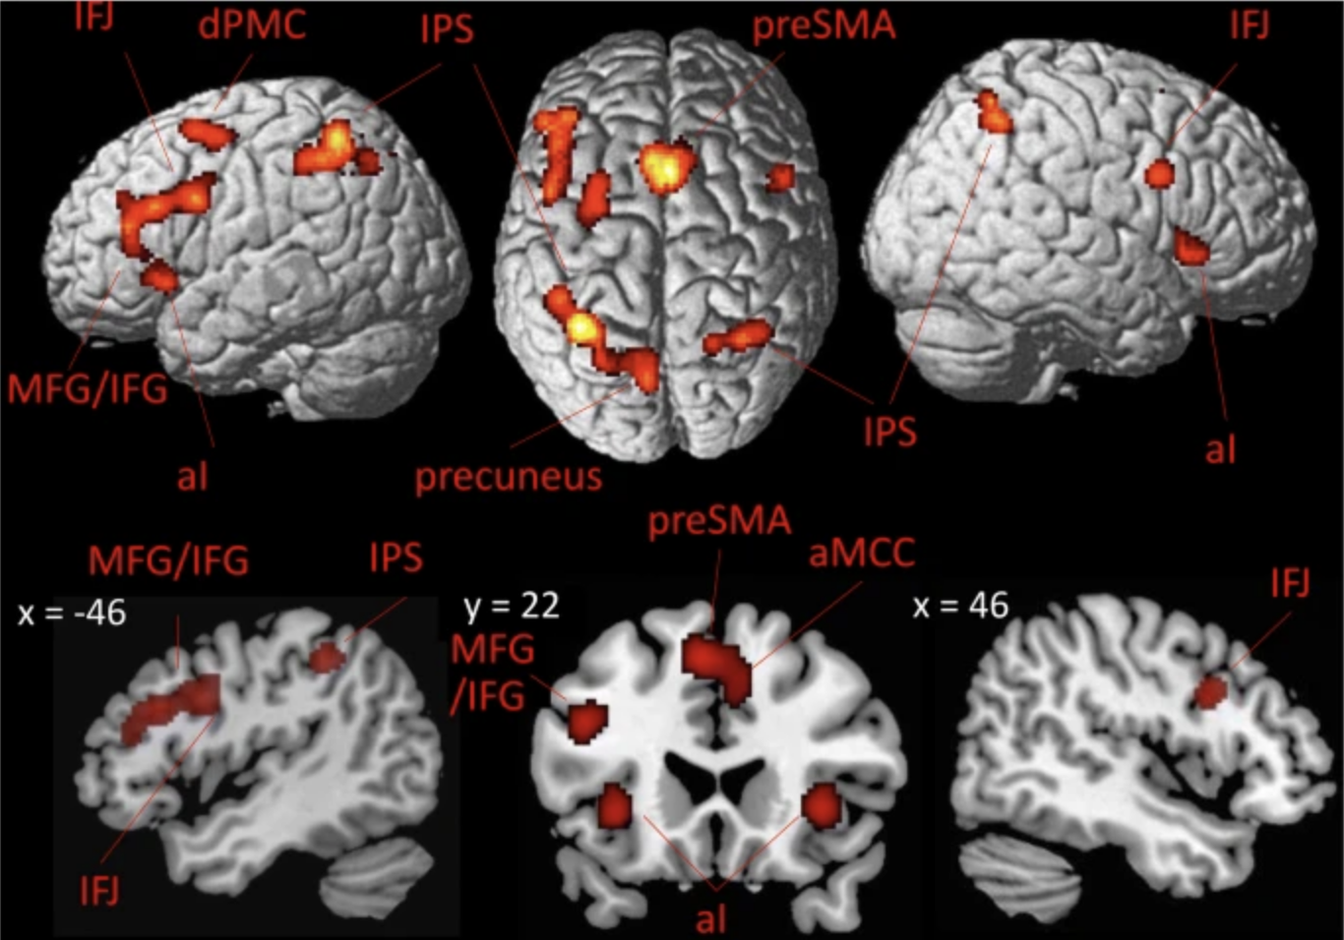
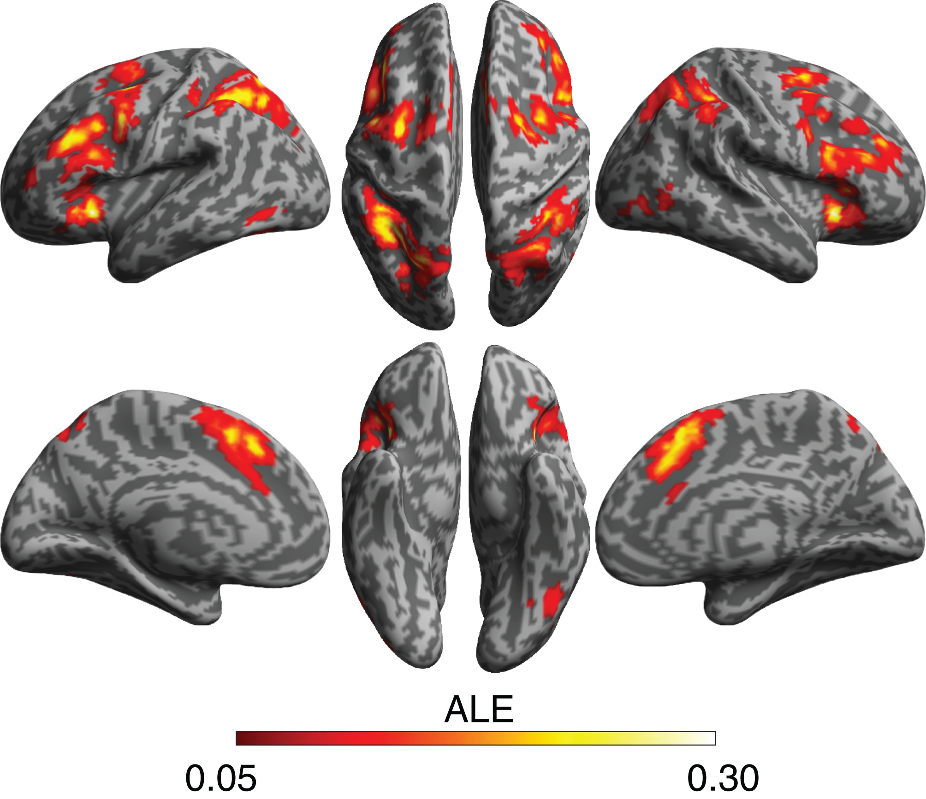
Do stability and flexibility have shared or distinct neural substrates?
Meta-analysis of flexibility studies
Meta-analysis of stability studies
Worringer et al, 2019
Wu et al, 2019
Notes:
Now that we’ve shown behavioral results in favor of our 2D view of stability and flexibility, let’s now look at the brain to see if stability and flexibility have shared or distinct neural substrates. Meta-analyses of studies in which people only manipulated flexibility show largely the same frontoparietal activation as meta-analyses of studies in which people only manipulated stability, suggesting they have shared neural substrates. However, our previous behavioral studies show that stability and flexibility are adapted independently, which may suggest that they would have distinct neural substrates. Thus, we need to manipulate both stability and flexibility in the same fMRI experiment to truly determine if they have shared or distinct neural substrates.
Another question that we want to answer is if stability and flexibility have shared or distinct neural substrates. This is because meta-analyses of studies in which people only manipulated flexibility show largely the same frontoparietal activation as meta-analyses of studies in which people only manipulated stability. So this would suggest they have shared neural substrates. However, our previous behavioral studies show that stability and flexibility are adapted independently, which may suggest that they would have distinct neural substrates.
Thus, we need to manipulate both stability and flexibility in the same task to truly determine if they have shared or distinct neural substrates.
Stability and flexibility have been manipulated and studied separately, but haven’t really been studied together in the same experiment partly because the general assumption is that stability and flexibility are two poles of the same continuum, such that increased stability comes at the cost of decreased flexibility, and vice versa. This view would assume that as you get more stable at reading your book, you become less flexible at switching to a phone call. However, recent behavioral studies from the Egner Lab show that this assumption is probably wrong, and that stability and flexibility are likely independent processes. So this new view from the Egner Lab theorizes that becoming more stable and locked in on reading your book does not necessarily affect how flexible you are at switching to answering a phone call.
But this assumption of stability and flexibility being opposite modes of the same process or
hasn’t been directly tested before using neural data, and we don’t know exactly how these processes are regulated concurrently in the brain. Based on prior behavioral studies from the Egner Lab, we hypothesize that stability and flexibility are actually independent processes, and thus how stable and flexible people are will vary independently as the demands on these processes change. So we set out to test this hypothesis.
outline slide
also maybe do task first before this
Ah yes put this down after the task

Slide 33
fMRI regions mediating flexibility (N=45)
Switch Cost = Z_{switch} – Z_{repeat}
Notes:
In our fMRI study, we found significant clusters that were sensitive to flexibility demands. This was done by first making a neural measure of the switch cost, as the difference in activity between switch and repeat trials.
->
We then found clusters whose neural switch costs significantly decreased when people encountered more task switches in a block, reflecting an adaptation in activity due to changing demands on flexibility. These clusters were roughly located in ventrolateral, dorsolateral, and medial prefrontal cortex.
->
We then probed these flexibility-mediating clusters to see if they also mediated stability, and if they did, did they do so independently in line with our 2D view, or if they did so dependently, in line with others’ 1D view. To do this, we first defined a neural measure of the congruency effect, as the difference in activity between incongruent trials and congruent trials.
->
Using our neural measures of the switch cost and congruency effect, we then looked to see if these flexibility-mediating clusters were also sensitive to changing stability demands, and if they independently regulated their activity based on stability and flexibility demands, essentially looking to replicate our behavioral results but using neural activity as our measure instead of RT. We found that the two clusters in lateral prefrontal cortex were also sensitive to stability demands, but independently adjusted their activity due to stability and flexibility demands, such that increased incongruent proportion decreased the size of the congruency effect, but not the switch cost, and increased switch proportion decreased the size of the switch cost, but not the congruency effect. This mirrors our behavioral results, and suggests that stability and flexibility both rely on lateral PFC, but may be independently regulated here.
->
Finally, the cluster in medial frontal cortex was selectively sensitive to flexibility demands, such that the switch proportion affected the switch cost but not congruency effect, and the incongruent proportion did not significantly affect the switch cost or congruency effect. Taken together, our results suggest that stability and flexibility rely on both shared and distinct neural substrates, and additionally support our hypothesis that the brain independently adapts to demands on stability and flexibility.
switch proportion
put things in as i explain them
color code legend for ROIs
use words to show how we got here
mfc vs lpfc
milk the point of these regions showing these things uniquely but no interaction
Need to rerun this with labels of Zinc – Zcon and Zswitch – Zrepeat Z(inc-con) and Z(switch- repeat)
And behavior can be RT (inc-con) and RT (switch – repeat)
Okay this needs to be prettier. Can expand these figures to be bigger I think. Instead of stacking them, maybe have them all in a row.
We identified brain regions mediating cognitive flexibility (via the Listwide Proportion Switch Effect) and probed their response to concurrent stability demands
ACC uniquely sensitive to flexibility demands, while vlPFC and dlPFC show sensitivity to both stability and flexibility demands
vlPFC/dlPFC results confirm overlapping neural substrates for stability and flexibility but show independent regulation of these processes
Absence of cross-domain effects suggests independence in how stability and flexibility are regulated neurally, mirroring behavior
Our findings suggest cognitive stability and flexibility rely on partially dissociable neural pathways, with ACC specifically supporting flexibility while vlPFC and dlPFC seem to support both control processes.
This functional specialization could help explain how the brain manages concurrent demands on task focus and task switching.

Slide 34
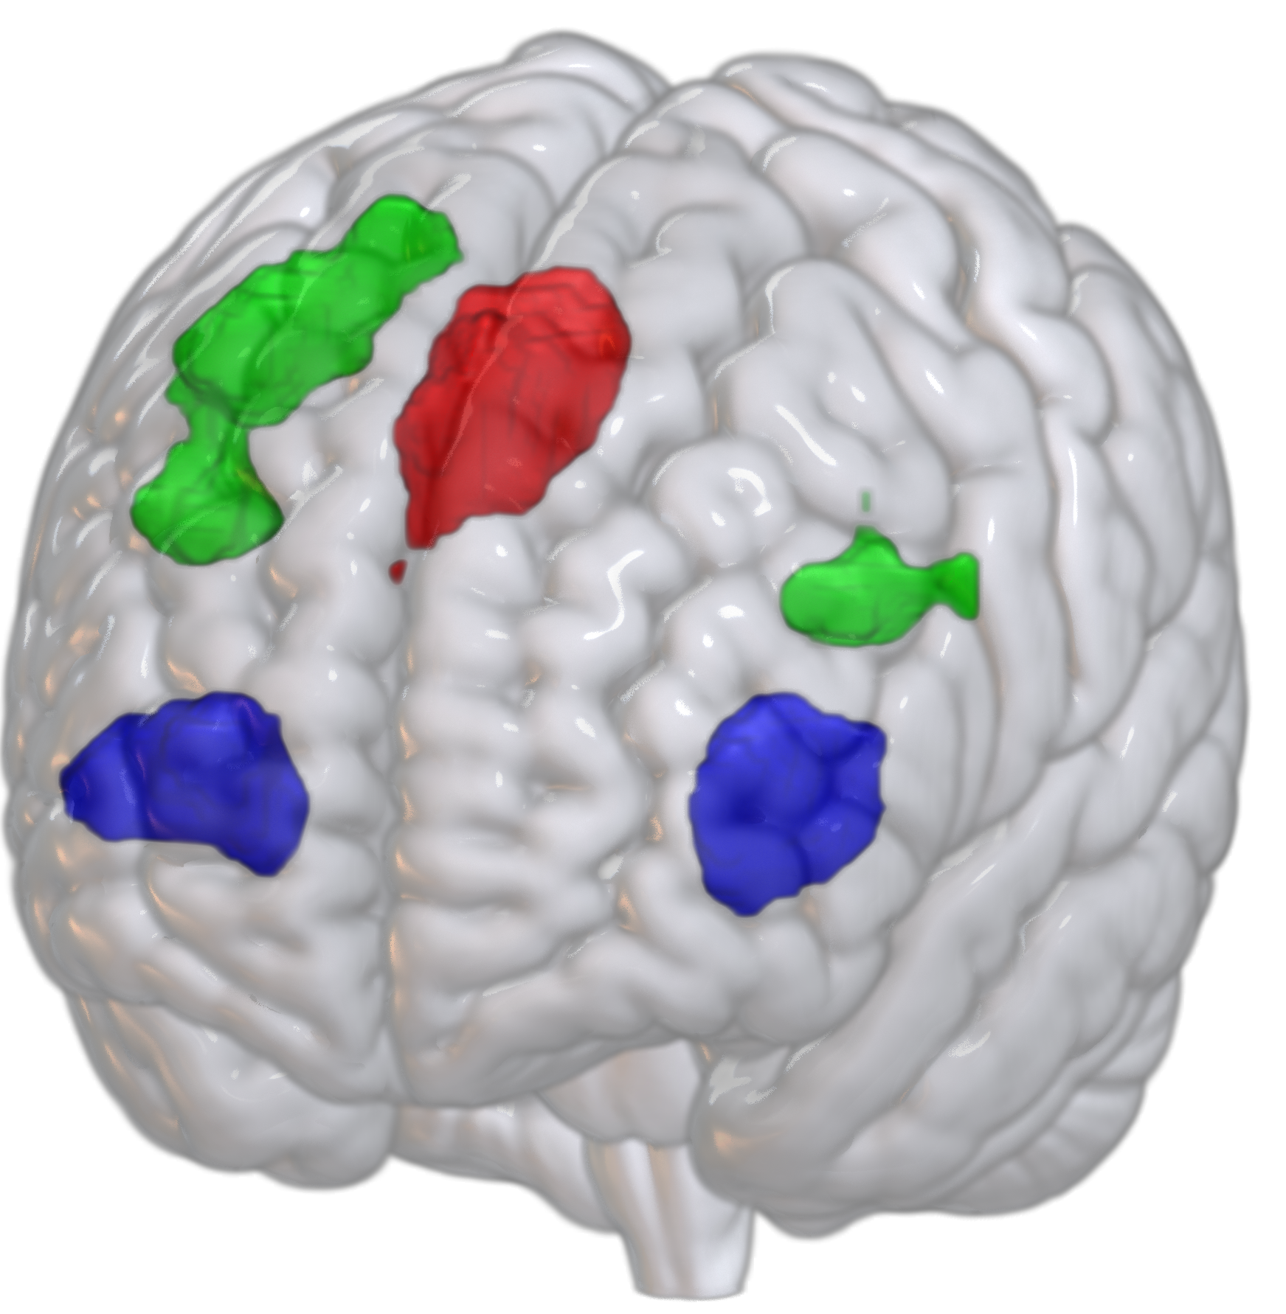
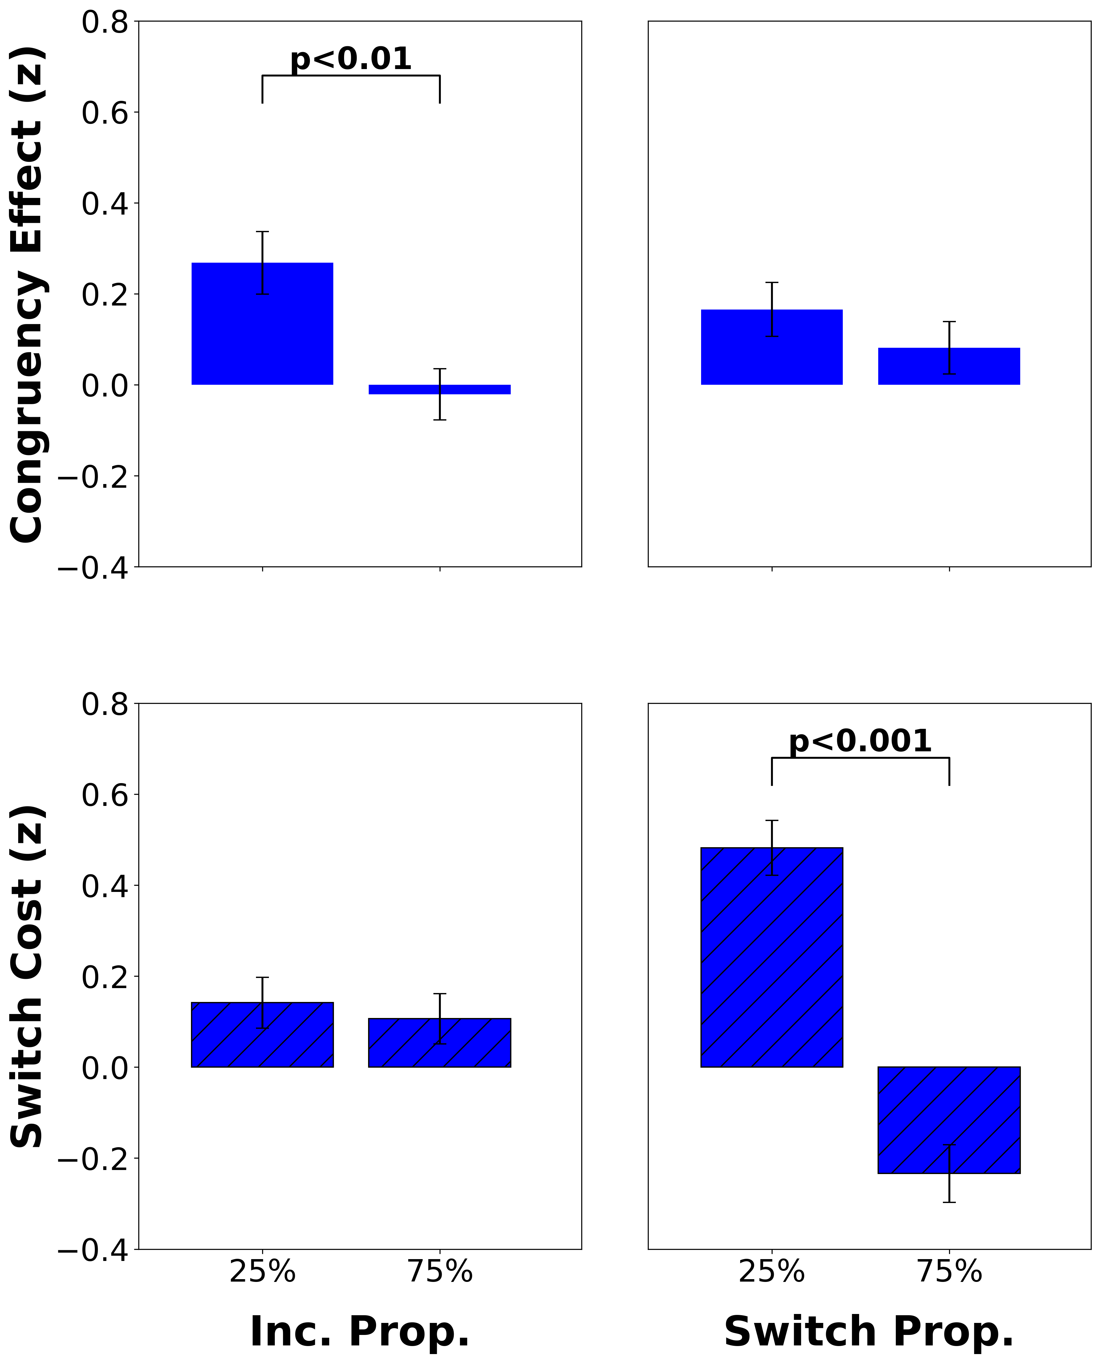
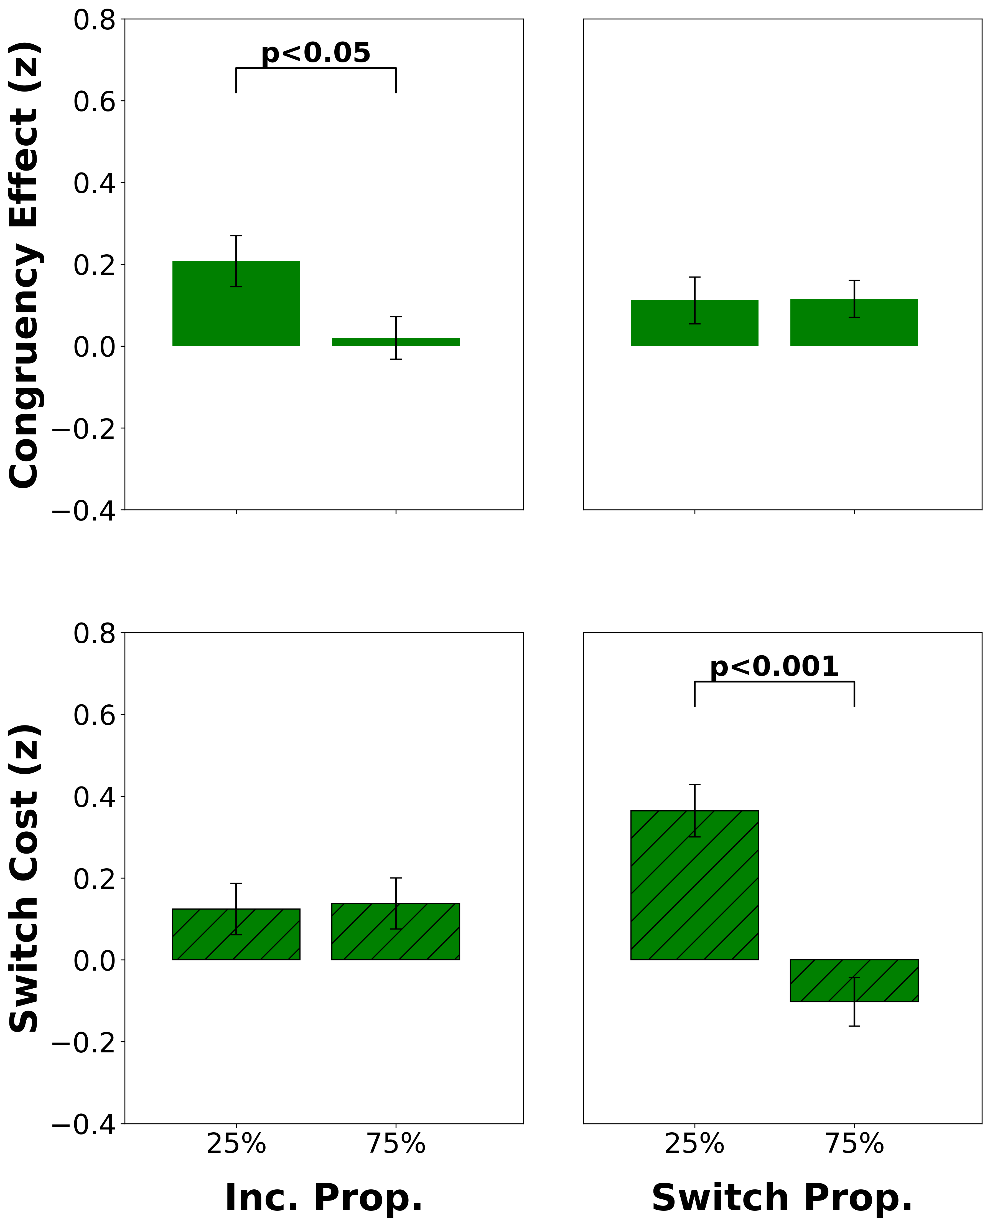
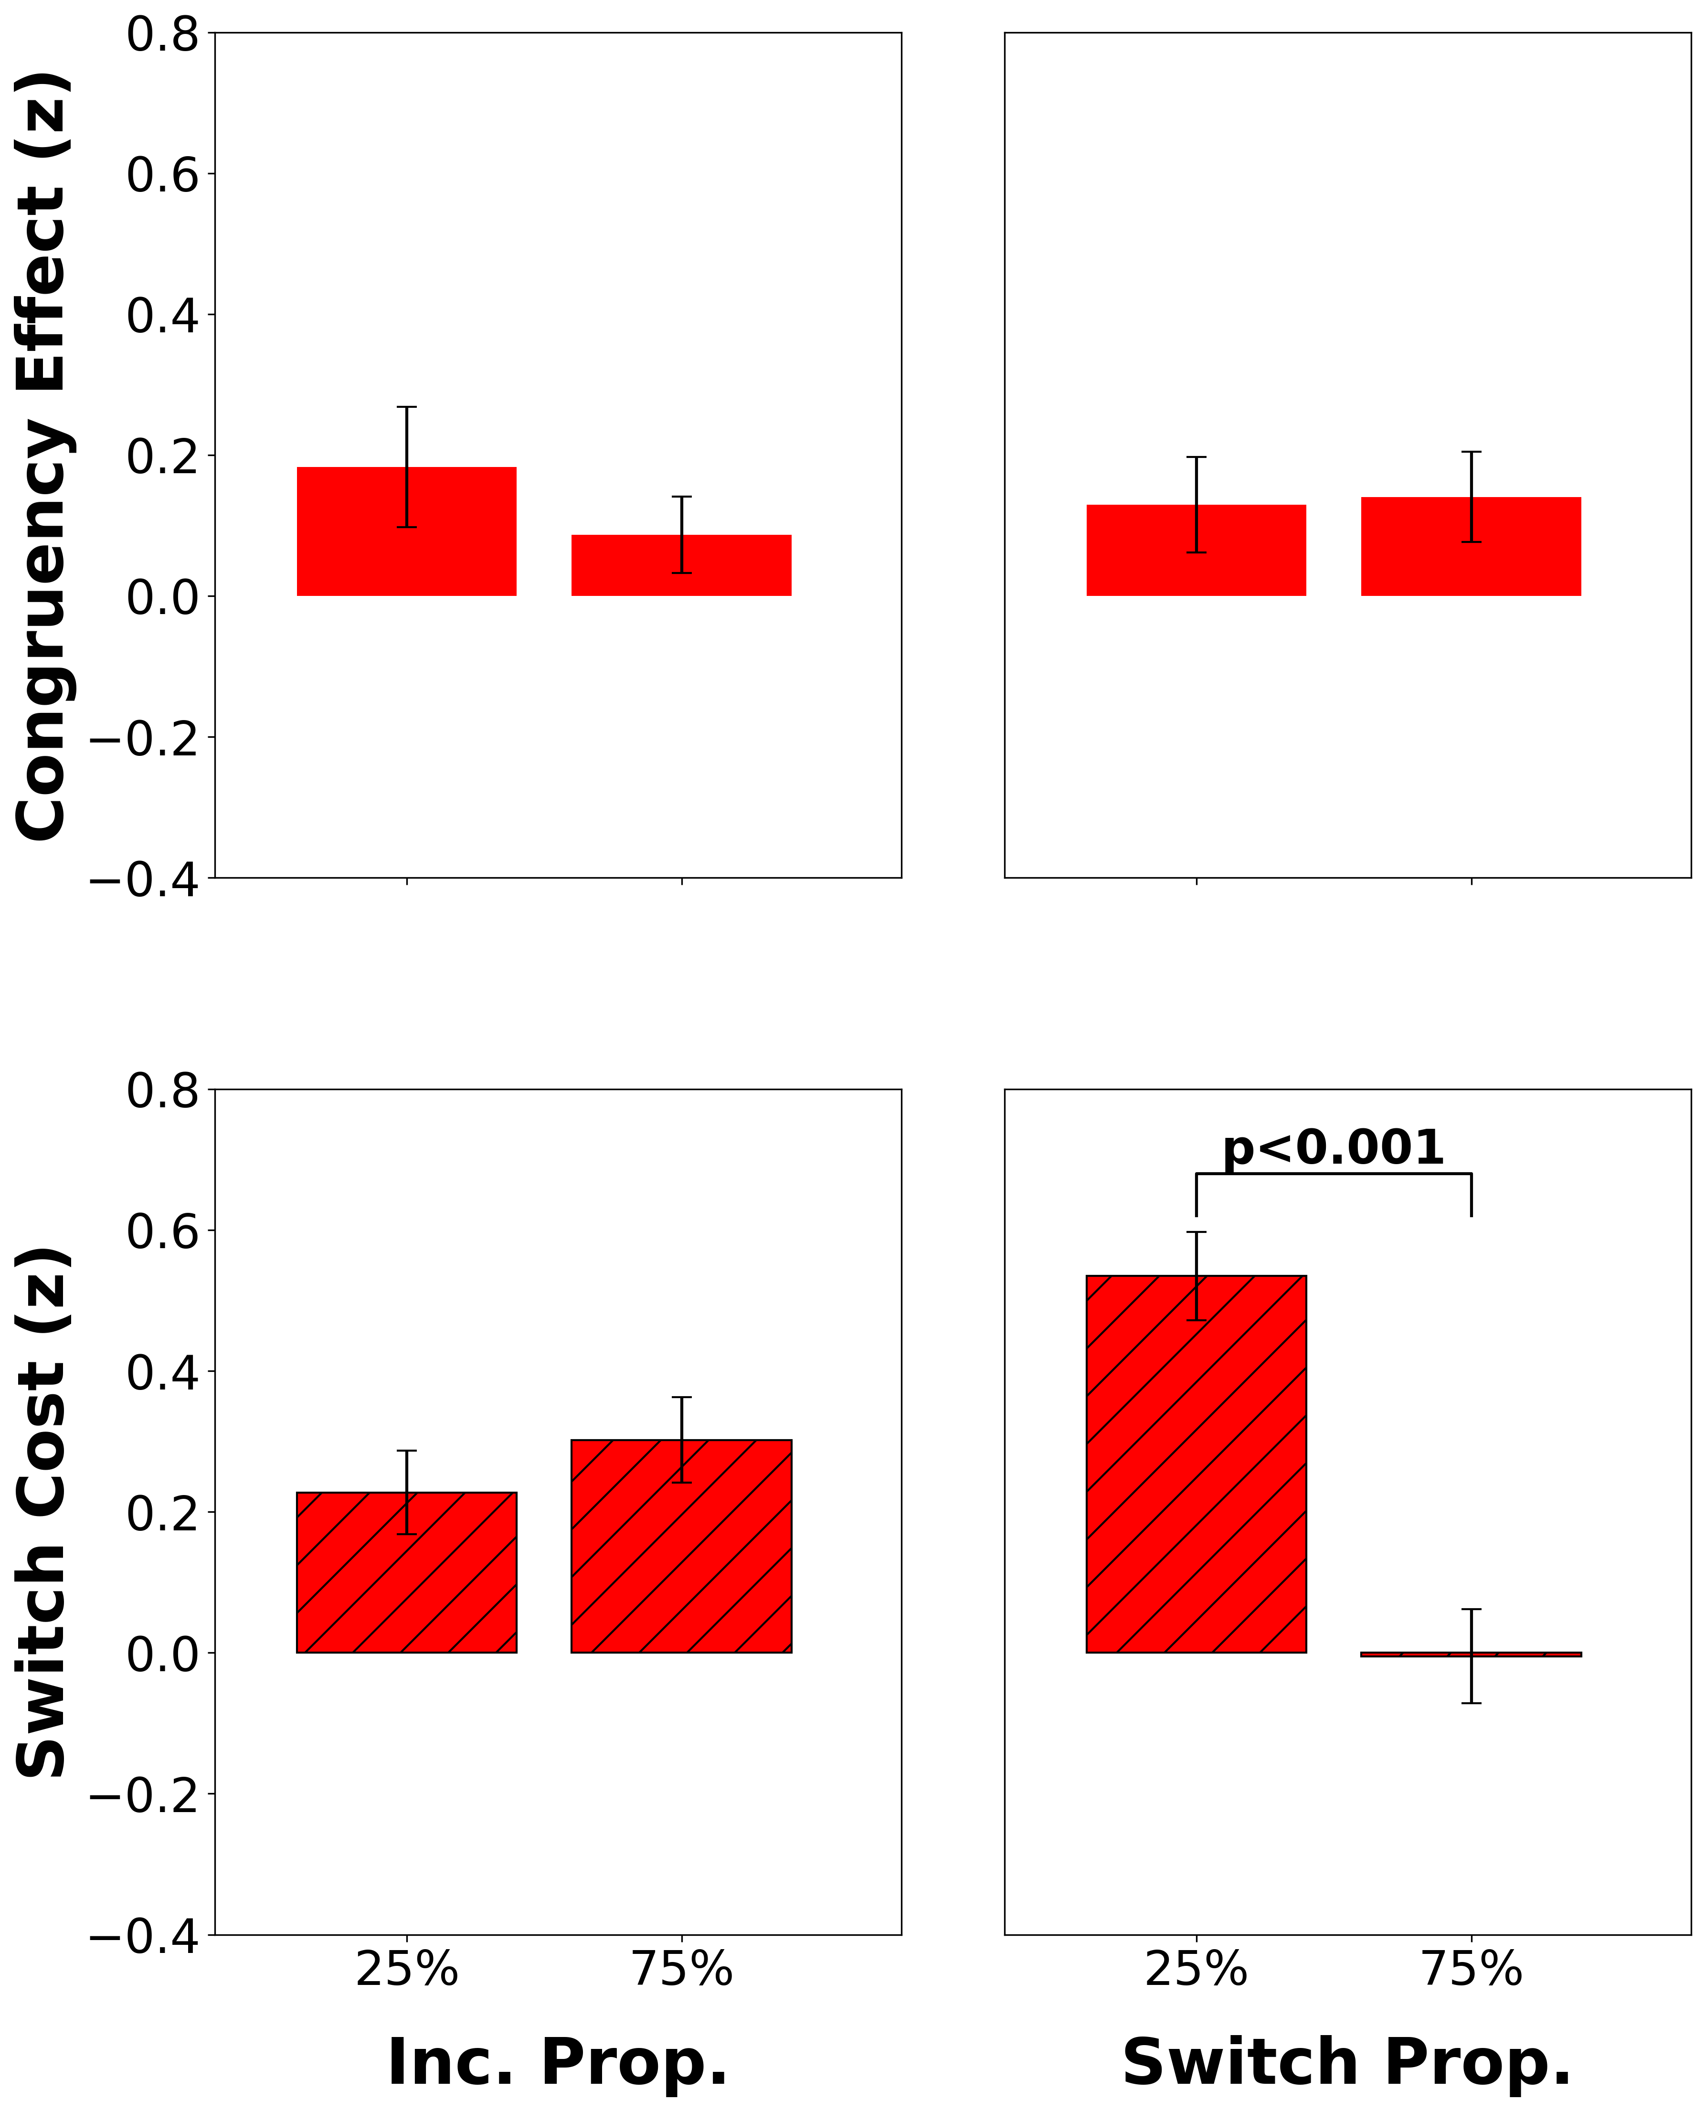
fMRI regions mediating flexibility (N=45)
↑task switch proportion ↓switch cost
Significant clusters in ~vlPFC, ~dlPFC, ~MFC
Switch Cost = Z_{switch} – Z_{repeat}
vlPFC
dlPFC
MFC
Notes:
In our fMRI study, we found significant clusters that were sensitive to flexibility demands. This was done by first making a neural measure of the switch cost, as the difference in activity between switch and repeat trials.
->
We then found clusters whose neural switch costs significantly decreased when people encountered more task switches in a block, reflecting an adaptation in activity due to changing demands on flexibility. These clusters were roughly located in ventrolateral, dorsolateral, and medial prefrontal cortex.
->
We then probed these flexibility-mediating clusters to see if they also mediated stability, and if they did, did they do so independently in line with our 2D view, or if they did so dependently, in line with others’ 1D view. To do this, we first defined a neural measure of the congruency effect, as the difference in activity between incongruent trials and congruent trials.
->
Using our neural measures of the switch cost and congruency effect, we then looked to see if these flexibility-mediating clusters were also sensitive to changing stability demands, and if they independently regulated their activity based on stability and flexibility demands, essentially looking to replicate our behavioral results but using neural activity as our measure instead of RT. We found that the two clusters in lateral prefrontal cortex were also sensitive to stability demands, but independently adjusted their activity due to stability and flexibility demands, such that increased incongruent proportion decreased the size of the congruency effect, but not the switch cost, and increased switch proportion decreased the size of the switch cost, but not the congruency effect. This mirrors our behavioral results, and suggests that stability and flexibility both rely on lateral PFC, but may be independently regulated here.
->
Finally, the cluster in medial frontal cortex was selectively sensitive to flexibility demands, such that the switch proportion affected the switch cost but not congruency effect, and the incongruent proportion did not significantly affect the switch cost or congruency effect. Taken together, our results suggest that stability and flexibility rely on both shared and distinct neural substrates, and additionally support our hypothesis that the brain independently adapts to demands on stability and flexibility.
switch proportion
put things in as i explain them
color code legend for ROIs
use words to show how we got here
mfc vs lpfc
milk the point of these regions showing these things uniquely but no interaction
Need to rerun this with labels of Zinc – Zcon and Zswitch – Zrepeat Z(inc-con) and Z(switch- repeat)
And behavior can be RT (inc-con) and RT (switch – repeat)
Okay this needs to be prettier. Can expand these figures to be bigger I think. Instead of stacking them, maybe have them all in a row.
We identified brain regions mediating cognitive flexibility (via the Listwide Proportion Switch Effect) and probed their response to concurrent stability demands
ACC uniquely sensitive to flexibility demands, while vlPFC and dlPFC show sensitivity to both stability and flexibility demands
vlPFC/dlPFC results confirm overlapping neural substrates for stability and flexibility but show independent regulation of these processes
Absence of cross-domain effects suggests independence in how stability and flexibility are regulated neurally, mirroring behavior
Our findings suggest cognitive stability and flexibility rely on partially dissociable neural pathways, with ACC specifically supporting flexibility while vlPFC and dlPFC seem to support both control processes.
This functional specialization could help explain how the brain manages concurrent demands on task focus and task switching.

Slide 35
fMRI regions mediating flexibility (N=45)
↑task switch proportion ↓switch cost
Significant clusters in ~vlPFC, ~dlPFC, ~MFC
Switch Cost = Z_{switch} – Z_{repeat}
Congruency Effect = Z_{inc} – Z_{con}
vlPFC
dlPFC
MFC
Notes:
In our fMRI study, we found significant clusters that were sensitive to flexibility demands. This was done by first making a neural measure of the switch cost, as the difference in activity between switch and repeat trials.
->
We then found clusters whose neural switch costs significantly decreased when people encountered more task switches in a block, reflecting an adaptation in activity due to changing demands on flexibility. These clusters were roughly located in ventrolateral, dorsolateral, and medial prefrontal cortex.
->
We then probed these flexibility-mediating clusters to see if they also mediated stability, and if they did, did they do so independently in line with our 2D view, or if they did so dependently, in line with others’ 1D view. To do this, we first defined a neural measure of the congruency effect, as the difference in activity between incongruent trials and congruent trials.
->
Using our neural measures of the switch cost and congruency effect, we then looked to see if these flexibility-mediating clusters were also sensitive to changing stability demands, and if they independently regulated their activity based on stability and flexibility demands, essentially looking to replicate our behavioral results but using neural activity as our measure instead of RT. We found that the two clusters in lateral prefrontal cortex were also sensitive to stability demands, but independently adjusted their activity due to stability and flexibility demands, such that increased incongruent proportion decreased the size of the congruency effect, but not the switch cost, and increased switch proportion decreased the size of the switch cost, but not the congruency effect. This mirrors our behavioral results, and suggests that stability and flexibility both rely on lateral PFC, but may be independently regulated here.
->
Finally, the cluster in medial frontal cortex was selectively sensitive to flexibility demands, such that the switch proportion affected the switch cost but not congruency effect, and the incongruent proportion did not significantly affect the switch cost or congruency effect. Taken together, our results suggest that stability and flexibility rely on both shared and distinct neural substrates, and additionally support our hypothesis that the brain independently adapts to demands on stability and flexibility.
switch proportion
put things in as i explain them
color code legend for ROIs
use words to show how we got here
mfc vs lpfc
milk the point of these regions showing these things uniquely but no interaction
Need to rerun this with labels of Zinc – Zcon and Zswitch – Zrepeat Z(inc-con) and Z(switch- repeat)
And behavior can be RT (inc-con) and RT (switch – repeat)
Okay this needs to be prettier. Can expand these figures to be bigger I think. Instead of stacking them, maybe have them all in a row.
We identified brain regions mediating cognitive flexibility (via the Listwide Proportion Switch Effect) and probed their response to concurrent stability demands
ACC uniquely sensitive to flexibility demands, while vlPFC and dlPFC show sensitivity to both stability and flexibility demands
vlPFC/dlPFC results confirm overlapping neural substrates for stability and flexibility but show independent regulation of these processes
Absence of cross-domain effects suggests independence in how stability and flexibility are regulated neurally, mirroring behavior
Our findings suggest cognitive stability and flexibility rely on partially dissociable neural pathways, with ACC specifically supporting flexibility while vlPFC and dlPFC seem to support both control processes.
This functional specialization could help explain how the brain manages concurrent demands on task focus and task switching.

Slide 36
fMRI regions mediating flexibility (N=45)
↑task switch proportion ↓switch cost
Significant clusters in ~vlPFC, ~dlPFC, ~MFC
Switch Cost = Z_{switch} – Z_{repeat}
Congruency Effect = Z_{inc} – Z_{con}
Independent regulation of stability and flexibility in vlPFC
Independent regulation of stability and flexibility in dlPFC
MFC
Notes:
In our fMRI study, we found significant clusters that were sensitive to flexibility demands. This was done by first making a neural measure of the switch cost, as the difference in activity between switch and repeat trials.
->
We then found clusters whose neural switch costs significantly decreased when people encountered more task switches in a block, reflecting an adaptation in activity due to changing demands on flexibility. These clusters were roughly located in ventrolateral, dorsolateral, and medial prefrontal cortex.
->
We then probed these flexibility-mediating clusters to see if they also mediated stability, and if they did, did they do so independently in line with our 2D view, or if they did so dependently, in line with others’ 1D view. To do this, we first defined a neural measure of the congruency effect, as the difference in activity between incongruent trials and congruent trials.
->
Using our neural measures of the switch cost and congruency effect, we then looked to see if these flexibility-mediating clusters were also sensitive to changing stability demands, and if they independently regulated their activity based on stability and flexibility demands, essentially looking to replicate our behavioral results but using neural activity as our measure instead of RT. We found that the two clusters in lateral prefrontal cortex were also sensitive to stability demands, but independently adjusted their activity due to stability and flexibility demands, such that increased incongruent proportion decreased the size of the congruency effect, but not the switch cost, and increased switch proportion decreased the size of the switch cost, but not the congruency effect. This mirrors our behavioral results, and suggests that stability and flexibility both rely on lateral PFC, but may be independently regulated here.
->
Finally, the cluster in medial frontal cortex was selectively sensitive to flexibility demands, such that the switch proportion affected the switch cost but not congruency effect, and the incongruent proportion did not significantly affect the switch cost or congruency effect. Taken together, our results suggest that stability and flexibility rely on both shared and distinct neural substrates, and additionally support our hypothesis that the brain independently adapts to demands on stability and flexibility.
switch proportion
put things in as i explain them
color code legend for ROIs
use words to show how we got here
mfc vs lpfc
milk the point of these regions showing these things uniquely but no interaction
Need to rerun this with labels of Zinc – Zcon and Zswitch – Zrepeat Z(inc-con) and Z(switch- repeat)
And behavior can be RT (inc-con) and RT (switch – repeat)
Okay this needs to be prettier. Can expand these figures to be bigger I think. Instead of stacking them, maybe have them all in a row.
We identified brain regions mediating cognitive flexibility (via the Listwide Proportion Switch Effect) and probed their response to concurrent stability demands
ACC uniquely sensitive to flexibility demands, while vlPFC and dlPFC show sensitivity to both stability and flexibility demands
vlPFC/dlPFC results confirm overlapping neural substrates for stability and flexibility but show independent regulation of these processes
Absence of cross-domain effects suggests independence in how stability and flexibility are regulated neurally, mirroring behavior
Our findings suggest cognitive stability and flexibility rely on partially dissociable neural pathways, with ACC specifically supporting flexibility while vlPFC and dlPFC seem to support both control processes.
This functional specialization could help explain how the brain manages concurrent demands on task focus and task switching.

Slide 37
fMRI regions mediating flexibility (N=45)
↑task switch proportion ↓switch cost
Significant clusters in ~vlPFC, ~dlPFC, ~MFC
Switch Cost = Z_{switch} – Z_{repeat}
Congruency Effect = Z_{inc} – Z_{con}
Independent regulation of stability and flexibility in vlPFC
Independent regulation of stability and flexibility in dlPFC
Regulation of flexibility in MFC
Notes:
In our fMRI study, we found significant clusters that were sensitive to flexibility demands. This was done by first making a neural measure of the switch cost, as the difference in activity between switch and repeat trials.
->
We then found clusters whose neural switch costs significantly decreased when people encountered more task switches in a block, reflecting an adaptation in activity due to changing demands on flexibility. These clusters were roughly located in ventrolateral, dorsolateral, and medial prefrontal cortex.
->
We then probed these flexibility-mediating clusters to see if they also mediated stability, and if they did, did they do so independently in line with our 2D view, or if they did so dependently, in line with others’ 1D view. To do this, we first defined a neural measure of the congruency effect, as the difference in activity between incongruent trials and congruent trials.
->
Using our neural measures of the switch cost and congruency effect, we then looked to see if these flexibility-mediating clusters were also sensitive to changing stability demands, and if they independently regulated their activity based on stability and flexibility demands, essentially looking to replicate our behavioral results but using neural activity as our measure instead of RT. We found that the two clusters in lateral prefrontal cortex were also sensitive to stability demands, but independently adjusted their activity due to stability and flexibility demands, such that increased incongruent proportion decreased the size of the congruency effect, but not the switch cost, and increased switch proportion decreased the size of the switch cost, but not the congruency effect. This mirrors our behavioral results, and suggests that stability and flexibility both rely on lateral PFC, but may be independently regulated here.
->
Finally, the cluster in medial frontal cortex was selectively sensitive to flexibility demands, such that increased switch proportion decreased the switch cost but not congruency effect, and the incongruent proportion did not significantly affect the switch cost or congruency effect. Taken together, our results suggest that stability and flexibility rely on both shared and distinct neural substrates, and additionally support our hypothesis that the brain independently adapts to demands on stability and flexibility.
switch proportion
put things in as i explain them
color code legend for ROIs
use words to show how we got here
mfc vs lpfc
milk the point of these regions showing these things uniquely but no interaction
Need to rerun this with labels of Zinc – Zcon and Zswitch – Zrepeat Z(inc-con) and Z(switch- repeat)
And behavior can be RT (inc-con) and RT (switch – repeat)
Okay this needs to be prettier. Can expand these figures to be bigger I think. Instead of stacking them, maybe have them all in a row.
We identified brain regions mediating cognitive flexibility (via the Listwide Proportion Switch Effect) and probed their response to concurrent stability demands
ACC uniquely sensitive to flexibility demands, while vlPFC and dlPFC show sensitivity to both stability and flexibility demands
vlPFC/dlPFC results confirm overlapping neural substrates for stability and flexibility but show independent regulation of these processes
Absence of cross-domain effects suggests independence in how stability and flexibility are regulated neurally, mirroring behavior
Our findings suggest cognitive stability and flexibility rely on partially dissociable neural pathways, with ACC specifically supporting flexibility while vlPFC and dlPFC seem to support both control processes.
This functional specialization could help explain how the brain manages concurrent demands on task focus and task switching.

Slide 38
fMRI Next Steps
Decoding (MVPA)
Notes:
To see if my results are also reflected in the pattern of activity across voxels rather than just the overall magnitude of activity, I’m currently working on decoding whether trials are congruent or incongruent, and if they’re task switch or task repeat, based on the pattern of activity across voxels in various regions. I can then see if the information underlying my decoding results generalizes between stability and flexibility, to further test if they are supported by shared or distinct neural substrates.
->
I’m also planning on linking my behavioral results with my neural results, for instance, checking if participants with higher behavioral switch costs may also have higher neural switch costs.
are look at if the information underlying my decoding results is shared between stability and flexibility, to further test if they are supported by shared or distinct neural substrates. I will also directly
Pretty pictures.
fMRI next steps with fMRI, iEEG next steps with iEEG. Explain more clearly is better. Clean this up, sell the future.
From cns 2025
Future work should investigate connectivity patterns between regions and brain-behavior correlations
Representational similarity analysis did not show significant multivariate patterns, potentially need alternative multivariate approaches (e.g., MVPA)
Future work should disentangle the concurrent regulation of stability and flexibility in vlPFC/dlPFC
From sfn 2024
We detected both congruency sensitive sites and switch type sensitive sites, and these sites were spatially interspersed.
There are both distinct and overlapping/interactive effects of stability and flexibility detectable at the level of mesoscale neural recordings in LPFC.
More demanding trial conditions (incongruent, switch) induced greater activity in LPFC electrodes sensitive to those conditions
Future analyses will investigate how stability and flexibility are regulated through block proportion manipulations
Future work will also investigate the temporal differences between conditions
No this sucks fix this.
So, there is a vast ocean of of neural analyses we could do next, but we’ve started by first creating general linear models with our fMRI data to find activation differences between our main effects, so incongruent vs. congruent trials, as well as switch vs. repeat trials. Then, we’ll also look at interaction effects, such as the differences between the switch costs in high and low switch proportion blocks, and the congruency effects in high and low congruency proportion blocks.
On the iEEG side, we’re currently looking at our iEEG data to determine the within-trial timing differences between our different conditions, such as when incongruent and congruent stimuli can be differentiated.
To compare across both methods, we’ll conduct representational similarity analyses in which we’ll make matrices of how dissimilar the activity caused by each of our trial types are.
Generalizability of decoders - (train on switch/repeat, test on incongruent/congruent)

Slide 39
fMRI Next Steps
Decoding (MVPA)
Brain-Behavior Correlations
Notes:
To see if my results are also reflected in the pattern of activity across voxels rather than just the overall magnitude of activity, I’m currently working on decoding whether trials are congruent or incongruent, and if they’re task switch or task repeat, based on the pattern of activity across voxels in various regions. I can then see if the information underlying my decoding results generalizes between stability and flexibility, to further test if they are supported by shared or distinct neural substrates.
->
I’m also planning on linking my behavioral results with my neural results, for instance, checking if participants with higher behavioral switch costs may also have higher neural switch costs.
are look at if the information underlying my decoding results is shared between stability and flexibility, to further test if they are supported by shared or distinct neural substrates. I will also directly
Pretty pictures.
fMRI next steps with fMRI, iEEG next steps with iEEG. Explain more clearly is better. Clean this up, sell the future.
From cns 2025
Future work should investigate connectivity patterns between regions and brain-behavior correlations
Representational similarity analysis did not show significant multivariate patterns, potentially need alternative multivariate approaches (e.g., MVPA)
Future work should disentangle the concurrent regulation of stability and flexibility in vlPFC/dlPFC
From sfn 2024
We detected both congruency sensitive sites and switch type sensitive sites, and these sites were spatially interspersed.
There are both distinct and overlapping/interactive effects of stability and flexibility detectable at the level of mesoscale neural recordings in LPFC.
More demanding trial conditions (incongruent, switch) induced greater activity in LPFC electrodes sensitive to those conditions
Future analyses will investigate how stability and flexibility are regulated through block proportion manipulations
Future work will also investigate the temporal differences between conditions
No this sucks fix this.
So, there is a vast ocean of of neural analyses we could do next, but we’ve started by first creating general linear models with our fMRI data to find activation differences between our main effects, so incongruent vs. congruent trials, as well as switch vs. repeat trials. Then, we’ll also look at interaction effects, such as the differences between the switch costs in high and low switch proportion blocks, and the congruency effects in high and low congruency proportion blocks.
On the iEEG side, we’re currently looking at our iEEG data to determine the within-trial timing differences between our different conditions, such as when incongruent and congruent stimuli can be differentiated.
To compare across both methods, we’ll conduct representational similarity analyses in which we’ll make matrices of how dissimilar the activity caused by each of our trial types are.
Generalizability of decoders - (train on switch/repeat, test on incongruent/congruent)

Slide 40
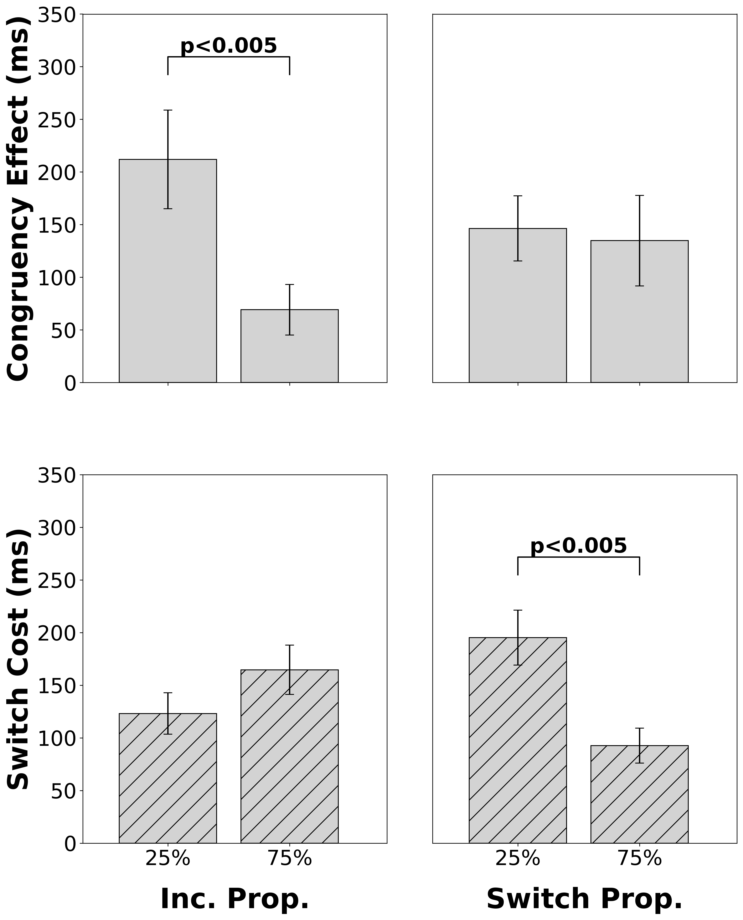
iEEG (N=14)
Switch Cost = RT_{switch} – RT_{repeat}
Congruency Effect = RT_{inc} – RT_{con}
Hypothesis: Incongruent proportion affects the size of congruency effect but not switch cost
Hypothesis: Switch proportion affects the size of switch cost but not congruency effect
Notes:
Now for our intracranial EEG study. So firstly, this data is from epilepsy patients who are unresponsive to medication, and thus have intracranially implanted electrodes for epilepsy monitoring. To check if we can generalize these results to healthy adults, we first replicated our behavioral results in our intracranial EEG patients.
Our behavioral results support our hypotheses. In our iEEG patients, demands on stability via varying the incongruent proportion only affect the size of the congruency effect and not the switch cost, and demands on flexibility via varying the switch proportion only affect the size of the switch cost and not the congruency effect. Thus, people seem to independently adapt how stable and flexible they are.
UPDATE THIS FIGURE. NEED TO ADAPT THE IEEG BEHAVIORAL CODE TO GET THE NEW RESULTS LIKE FMRI.
And similarly, we are still collecting intracranial EEG data but these preliminary behavioral results also show the same trends as our fmri data.

Slide 41
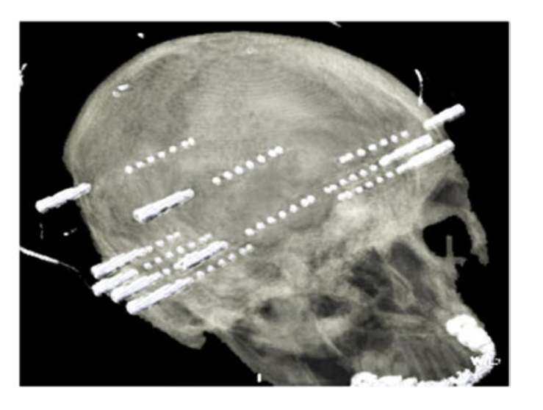
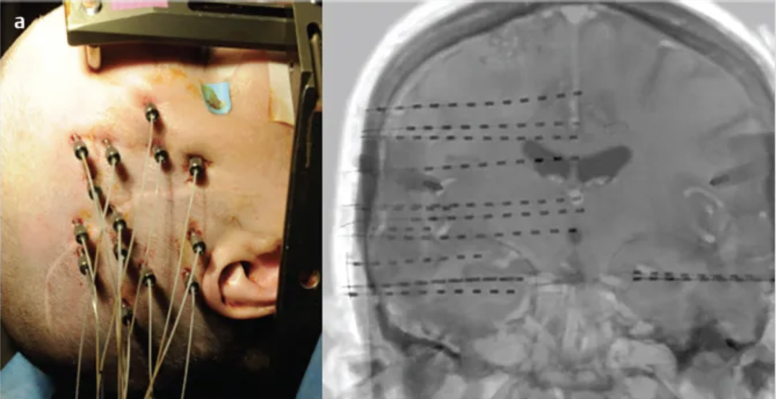
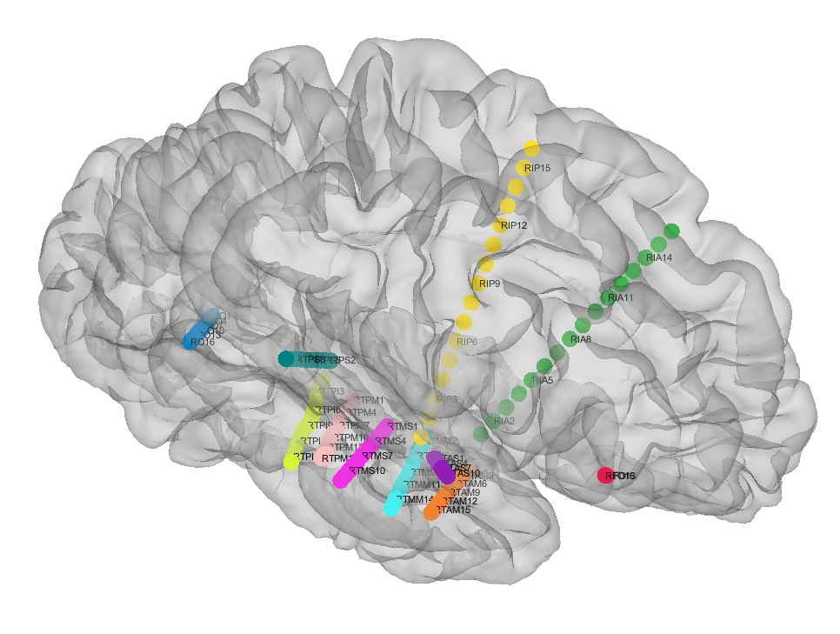
Stereo EEG provides better spatial/temporal resolution than fMRI
Parvizi and Kastner 2018
Maldonado-Naranjo et al., 2020
Notes:
In our patients, we record from stereo EEG electrodes that are directly inside the brain, providing increased signal quality and spatial resolution relative to our fMRI study. Additionally, this gives us a temporal resolution on the order of milliseconds, which allows us to ask questions about the timing of these processes that we can’t using fMRI.
For our intracranial analyses, we focus on the high gamma frequency band (70-150 Hz), which has been shown to reflect population level spiking activity. Here is an example electrode with a burst in high gamma power after stimulus onset.
-> This probably goes on the brain plot slide. Now, we’ve seen that the lateral prefrontal cortex supports both stability and flexibility from our fMRI study. Now we utilize the increased signal quality, and spatial and temporal resolution to look more precisely at lateral prefrontal cortex.
Now to zoom more closely into the lateral prefrontal cortex, we utilize intracranial EEG, which has increased signal quality, as well as spatial and temporal resolution, compared to fMRI. Here are some stereo EEG electrodes shown implanted inside the brain.
->
For our intracranial analyses, we focus on the high gamma frequency band (70-150 Hz), which has been shown to reflect population level spiking activity. Here is an example electrode with a burst in high gamma power after stimulus onset.
While we’ve learned a lot about cognitive stability and flexibility from these macroscale methods, both neuroimaging and scalp EEG have signal to noise ratio limitations, have low spatial and/or temporal resolution, and are limited in the conclusions they can draw about neuronal sources and oscillatory mechanisms. Thus, these methods leave lots of unanswered questions regarding how the brain implements and adjusts these processes. Human intracranial EEG thus offers an approach to resolve these issues, as it has high signal quality, high spatial and temporal resolution, and is done directly in human patients. This lets us study neural mechanisms that human macroscale methods and animal studies can’t directly address, such as oscillatory dynamics within and between brain regions. Therefore, for this presentation, I’ll focus on questions regarding how oscillatory mechanisms support these processes.
Here’s an example electrode showing HG power, which reflects
population level spiking activity.
High gamma (70-150 Hz) power extracted 0.5s before stimulus onset to 1s after⁵
To determine task-sensitive electrodes, cluster-thresholded permutation tests done at each time-point, comparing signal and pre-stimulus baseline
Baseline-normalized (z-scored) signals windowed from 0 to 0.5s, 0.5 to 1s. Significant differences between conditions determined using ANOVA.
LPFC defined based on Destrieux atlas⁶
^{use a figure with the scalp}
Now to zoom more closely into the lateral prefrontal cortex, we utilize intracranial EEG, which has increased signal quality, as well as spatial and temporal resolution, compared to fMRI. Here are some stereo EEG electrodes shown implanted inside the brain.
->
For our intracranial analyses, we focus on the high gamma frequency band (70-150 Hz), which has been shown to reflect population level spiking activity. Here is an example electrode with a burst in high gamma power after stimulus onset.
motivate this more - no temporal component. Nice to isolate spatial and temporal
fmri behavior, fmri results, then ieeg behavior, then ieeg results (mention these are patients where the medication for epilepsy doesn't work, why we have access to brain through epilepsy monitoring)
big up - replicate behavior so we can treat them the same way
separate behavior from fmri and ieeg
sell this more - sell what i have
While we’ve learned a lot about cognitive stability and flexibility from these macroscale methods, both neuroimaging and scalp EEG have signal to noise ratio limitations, have low spatial and/or temporal resolution, and are limited in the conclusions they can draw about neuronal sources and oscillatory mechanisms. Thus, these methods leave lots of unanswered questions regarding how the brain implements and adjusts these processes. Human intracranial EEG thus offers an approach to resolve these issues, as it has high signal quality, high spatial and temporal resolution, and is done directly in human patients. This lets us study neural mechanisms that human macroscale methods and animal studies can’t directly address, such as oscillatory dynamics within and between brain regions. Therefore, for this presentation, I’ll focus on questions regarding how oscillatory mechanisms support these processes.
Here’s an example electrode showing HG power, which reflects population level spiking activity.
High gamma (70-150 Hz) power extracted 0.5s before stimulus onset to 1s after⁵
To determine task-sensitive electrodes, cluster-thresholded permutation tests done at each time-point, comparing signal and pre-stimulus baseline
Baseline-normalized (z-scored) signals windowed from 0 to 0.5s, 0.5 to 1s. Significant differences between conditions determined using ANOVA.
LPFC defined based on Destrieux atlas⁶

Slide 42
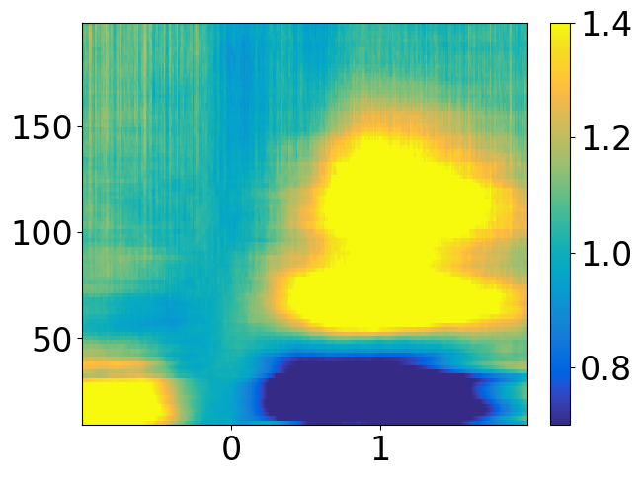
Stereo EEG and High Gamma Power
Log-Power (dB)
Frequency (Hz)
Time from Stimulus Onset (s)
Notes:
For our intracranial analyses, we focus on the high gamma frequency band, which is approximately from 70-150 Hz, and has been shown to reflect population level spiking activity. Here is an example electrode with a burst in high gamma power after stimulus onset.
Now to zoom more closely into the lateral prefrontal cortex, we utilize intracranial EEG, which has increased signal quality, as well as spatial and temporal resolution, compared to fMRI. Here are some stereo EEG electrodes shown implanted inside the brain.
->
For our intracranial analyses, we focus on the high gamma frequency band (70-150 Hz), which has been shown to reflect population level spiking activity. Here is an example electrode with a burst in high gamma power after stimulus onset.
motivate this more - no temporal component. Nice to isolate spatial and temporal
fmri behavior, fmri results, then ieeg behavior, then ieeg results (mention these are patients where the medication for epilepsy doesn't work, why we have access to brain through epilepsy monitoring)
big up - replicate behavior so we can treat them the same way
separate behavior from fmri and ieeg
sell this more - sell what i have
While we’ve learned a lot about cognitive stability and flexibility from these macroscale methods, both neuroimaging and scalp EEG have signal to noise ratio limitations, have low spatial and/or temporal resolution, and are limited in the conclusions they can draw about neuronal sources and oscillatory mechanisms. Thus, these methods leave lots of unanswered questions regarding how the brain implements and adjusts these processes. Human intracranial EEG thus offers an approach to resolve these issues, as it has high signal quality, high spatial and temporal resolution, and is done directly in human patients. This lets us study neural mechanisms that human macroscale methods and animal studies can’t directly address, such as oscillatory dynamics within and between brain regions. Therefore, for this presentation, I’ll focus on questions regarding how oscillatory mechanisms support these processes.
Here’s an example electrode showing HG power, which reflects population level spiking activity.
High gamma (70-150 Hz) power extracted 0.5s before stimulus onset to 1s after⁵
To determine task-sensitive electrodes, cluster-thresholded permutation tests done at each time-point, comparing signal and pre-stimulus baseline
Baseline-normalized (z-scored) signals windowed from 0 to 0.5s, 0.5 to 1s. Significant differences between conditions determined using ANOVA.
LPFC defined based on Destrieux atlas⁶

Slide 43
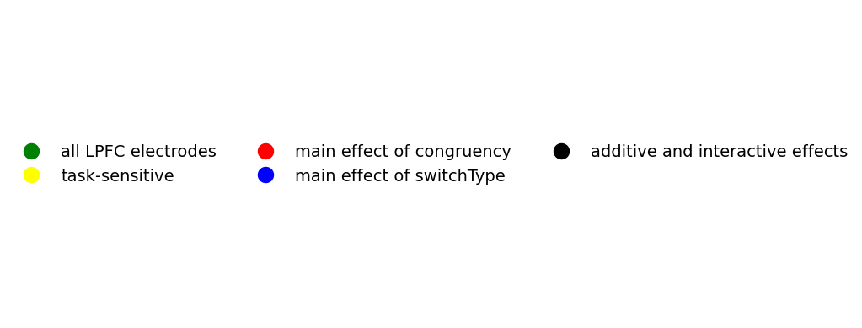
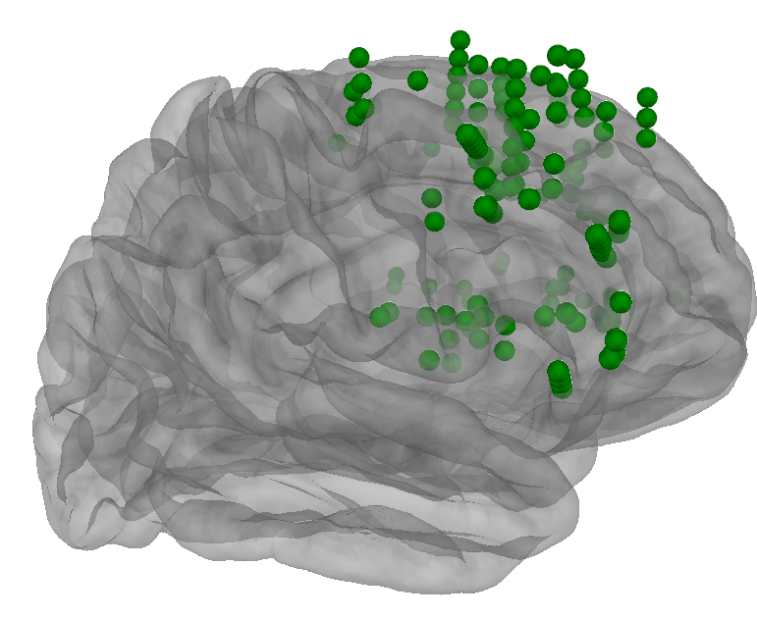
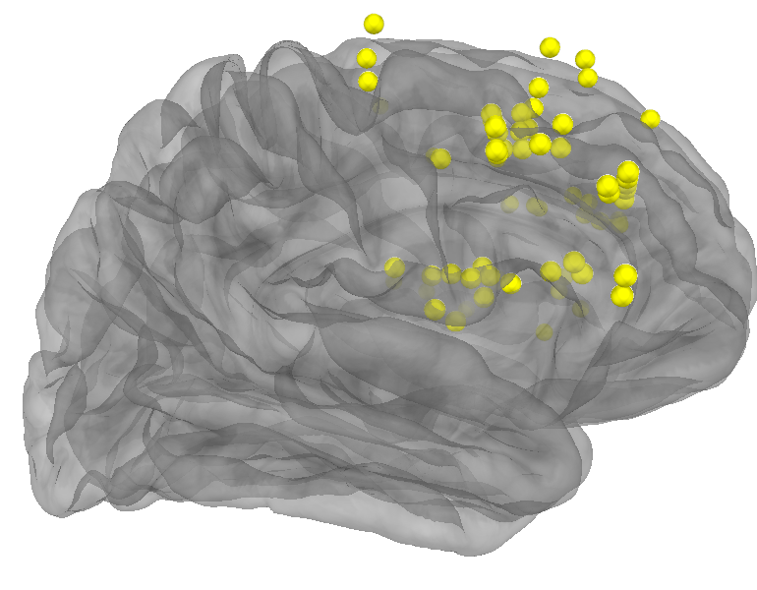
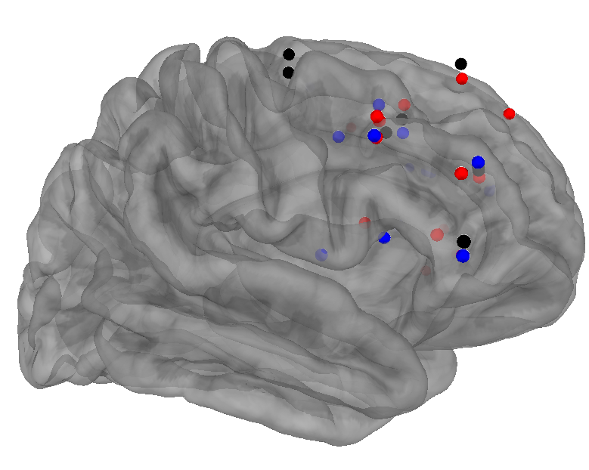
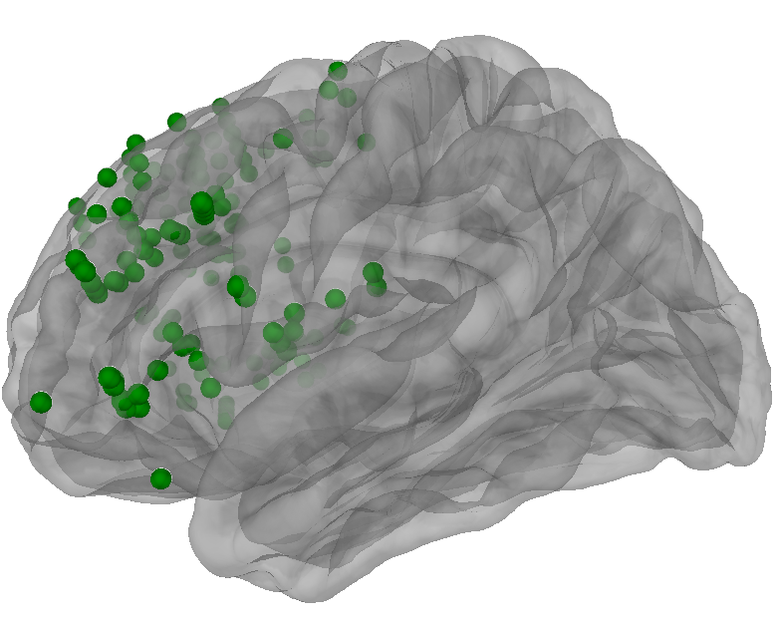
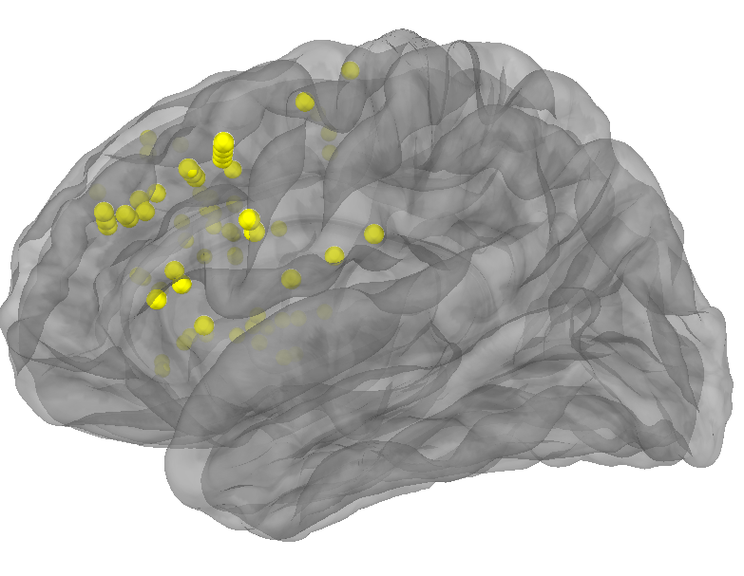
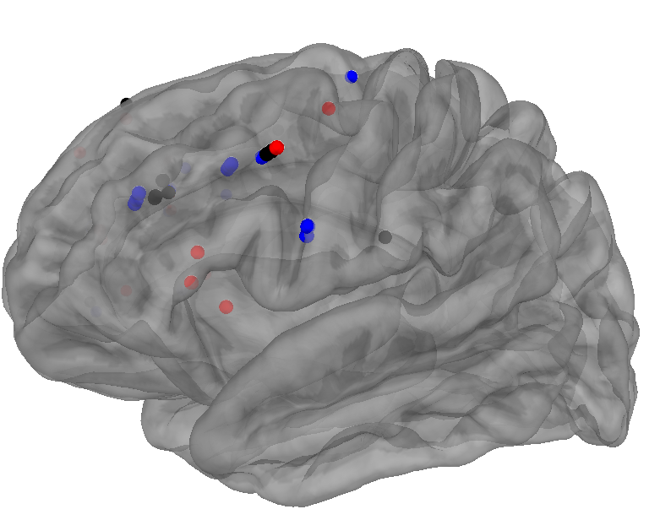
Notes:
In our fMRI study, we found the lateral prefrontal cortex to independently support both stability and flexibility, so we begin our intracranial EEG analyses by focusing on this region. First, we selected all of our LPFC electrodes.
->
Next, we further selected task-sensitive electrodes, who showed a significant increase in activity relative to a pre-stimulus baseline period during our task.
->
Next, from these task-sensitive electrodes, we found sites that were uniquely sensitive to stability or flexibility, such that stability-sensitive electrodes had differing high gamma activity for incongruent vs. congruent trials, while flexibility-sensitive electrodes had differing high gamma activity for task switch vs. task repeat trials. We also found electrodes who were sensitive to both stability and flexibility, with additive or interactive effects. Interestingly, there were sites uniquely sensitive to stability or flexibility, and sites sensitive to both, and all of these sites were interspersed among each other. This suggests that in lateral prefrontal cortex, there are shared and distinct neural substrates between stability and flexibility, with some neuronal populations selectively supporting one process while other populations support both, but there is not a strong spatial segregation between these different populations.
what do we do with this
green with green legend first, then yellow with yellow legend, then everyone else next
from this we find blank
High gamma (70-150 Hz) power extracted 0.5s before stimulus onset to 1s after⁵
To determine task-sensitive electrodes, cluster-thresholded permutation tests done at each time-point, comparing signal and pre-stimulus baseline
Baseline-normalized (z-scored) signals windowed from 0 to 0.5s, 0.5 to 1s. Significant differences between conditions determined using ANOVA.
LPFC defined based on Destrieux atlas⁶
73/164 LPFC electrodes were task-sensitive
48/73 task-sensitive LPFC electrodes showed effects of interest (congruency: N=15, switchType: N=18, additive or interactive: N=15)
Electrodes sensitive to different effects were spatially interspersed
We detected both congruency sensitive sites and switch type sensitive sites, and these sites were spatially interspersed.
There are both distinct and overlapping/interactive effects of stability and flexibility detectable at the level of mesoscale neural recordings in LPFC.
More demanding trial conditions (incongruent, switch) induced greater activity in LPFC electrodes sensitive to those conditions
Future analyses will investigate how stability and flexibility are regulated through block proportion manipulations
Future work will also investigate the temporal differences between conditions

Slide 44
Notes:
In our fMRI study, we found the lateral prefrontal cortex to independently support both stability and flexibility, so we begin our intracranial EEG analyses by focusing on this region. First, we selected all of our LPFC electrodes.
->
Next, we further selected task-sensitive electrodes, who showed a significant increase in activity relative to a pre-stimulus baseline period during our task.
->
Next, from these task-sensitive electrodes, we found sites that were uniquely sensitive to stability or flexibility, such that stability-sensitive electrodes had differing high gamma activity for incongruent vs. congruent trials, while flexibility-sensitive electrodes had differing high gamma activity for task switch vs. task repeat trials. We also found electrodes who were sensitive to both stability and flexibility, with additive or interactive effects. Interestingly, there were sites uniquely sensitive to stability or flexibility, and sites sensitive to both, and all of these sites were interspersed among each other. This suggests that in lateral prefrontal cortex, there are shared and distinct neural substrates between stability and flexibility, with some neuronal populations selectively supporting one process while other populations support both, but there is not a strong spatial segregation between these different populations.
what do we do with this
green with green legend first, then yellow with yellow legend, then everyone else next
from this we find blank
High gamma (70-150 Hz) power extracted 0.5s before stimulus onset to 1s after⁵
To determine task-sensitive electrodes, cluster-thresholded permutation tests done at each time-point, comparing signal and pre-stimulus baseline
Baseline-normalized (z-scored) signals windowed from 0 to 0.5s, 0.5 to 1s. Significant differences between conditions determined using ANOVA.
LPFC defined based on Destrieux atlas⁶
73/164 LPFC electrodes were task-sensitive
48/73 task-sensitive LPFC electrodes showed effects of interest (congruency: N=15, switchType: N=18, additive or interactive: N=15)
Electrodes sensitive to different effects were spatially interspersed
We detected both congruency sensitive sites and switch type sensitive sites, and these sites were spatially interspersed.
There are both distinct and overlapping/interactive effects of stability and flexibility detectable at the level of mesoscale neural recordings in LPFC.
More demanding trial conditions (incongruent, switch) induced greater activity in LPFC electrodes sensitive to those conditions
Future analyses will investigate how stability and flexibility are regulated through block proportion manipulations
Future work will also investigate the temporal differences between conditions

Slide 45
Only stability-sensitive
Only flexibility-sensitive
Notes:
In our fMRI study, we found the lateral prefrontal cortex to independently support both stability and flexibility, so we begin our intracranial EEG analyses by focusing on this region. First, we selected all of our LPFC electrodes.
->
Next, we further selected task-sensitive electrodes, who showed a significant increase in activity relative to a pre-stimulus baseline period during our task.
->
Next, from these task-sensitive electrodes, we found sites that were uniquely sensitive to stability or flexibility, such that stability-sensitive electrodes had differing high gamma activity for incongruent vs. congruent trials, while flexibility-sensitive electrodes had differing high gamma activity for task switch vs. task repeat trials. We also found electrodes who were sensitive to both stability and flexibility, with additive or interactive effects. Interestingly, there were sites uniquely sensitive to stability or flexibility, and sites sensitive to both, and all of these sites were interspersed among each other. This suggests that in lateral prefrontal cortex, there are shared and distinct neural substrates between stability and flexibility, with some neuronal populations selectively supporting one process while other populations support both, but there is not a strong spatial segregation between these different populations.
what do we do with this
green with green legend first, then yellow with yellow legend, then everyone else next
from this we find blank
High gamma (70-150 Hz) power extracted 0.5s before stimulus onset to 1s after⁵
To determine task-sensitive electrodes, cluster-thresholded permutation tests done at each time-point, comparing signal and pre-stimulus baseline
Baseline-normalized (z-scored) signals windowed from 0 to 0.5s, 0.5 to 1s. Significant differences between conditions determined using ANOVA.
LPFC defined based on Destrieux atlas⁶
73/164 LPFC electrodes were task-sensitive
48/73 task-sensitive LPFC electrodes showed effects of interest (congruency: N=15, switchType: N=18, additive or interactive: N=15)
Electrodes sensitive to different effects were spatially interspersed
We detected both congruency sensitive sites and switch type sensitive sites, and these sites were spatially interspersed.
There are both distinct and overlapping/interactive effects of stability and flexibility detectable at the level of mesoscale neural recordings in LPFC.
More demanding trial conditions (incongruent, switch) induced greater activity in LPFC electrodes sensitive to those conditions
Future analyses will investigate how stability and flexibility are regulated through block proportion manipulations
Future work will also investigate the temporal differences between conditions

Slide 46
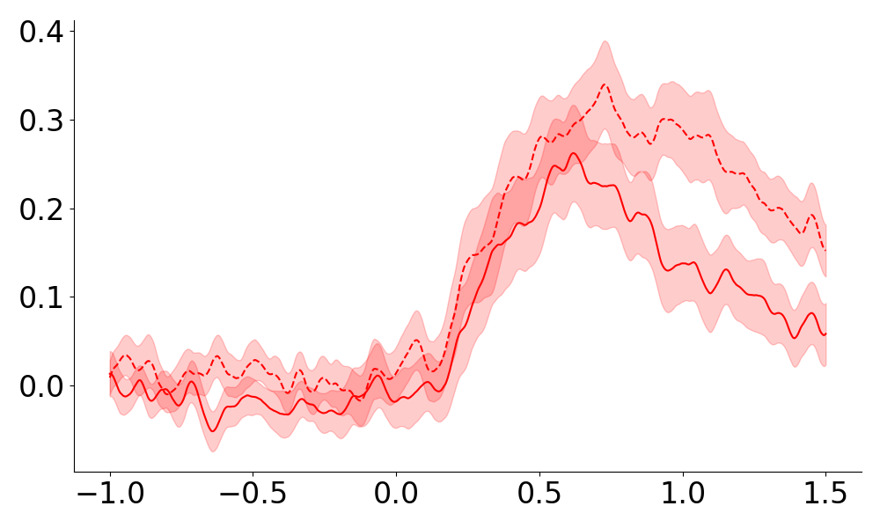
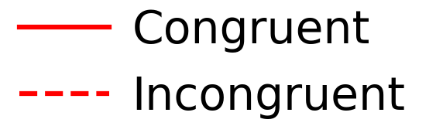
iEEG Average High Gamma Power (N=14)
Z-Score From Baseline
Only stability-sensitive
Only flexibility-sensitive
Notes:
We then looked at how the average high gamma power of our stability and flexibility sensitive LPFC electrodes varied over time. In the electrodes sensitive to stability, incongruent and congruent could be distinguished about half a second after stimulus onset,
->
and in the electrodes sensitive to flexibility, switch and repeat could similarly be distinguished about half a second after stimulus onset. Also, the more demanding trial conditions of incongruent and switch induced greater activity in LPFC electrodes sensitive to those conditions.
just say what i did here - avg hg neural response, see congruency effect at ~500 ms, and switch cost at roughly the same time. Ongoing work will do blah blah. Motivate with time, say time answer. Early analysis phase for both studies. Next, show what we want to do, here's a glimpse of data. Hopefully will work out cuz we can do visual decoding.
do fmri future directions too - right after or later? greg likes fmri with fmri, intracranial with intracranial
wrap up slide for task switching and congruency rehash it short and sweet at end
easier on the mind to keep separate
Rerun this legend code if I can find it…make it stack the three effects on top of each other.
Also yes I know this is just 14/18 subjects, my new subjects are in various stages of preprocessing and not sure if they’ll be ready by Friday..
Average trace plot for electrodes displaying a main effect of congruency (N=15)
Average trace plot for electrodes displaying a main effect of switch type (N=18)
We detected both congruency sensitive sites and switch type sensitive sites, and these sites were spatially interspersed.
There are both distinct and overlapping/interactive effects of stability and flexibility detectable at the level of mesoscale neural recordings in LPFC.
More demanding trial conditions (incongruent, switch) induced greater activity in LPFC electrodes sensitive to those conditions
Future analyses will investigate how stability and flexibility are regulated through block proportion manipulations
Future work will also investigate the temporal differences between conditions

Slide 47
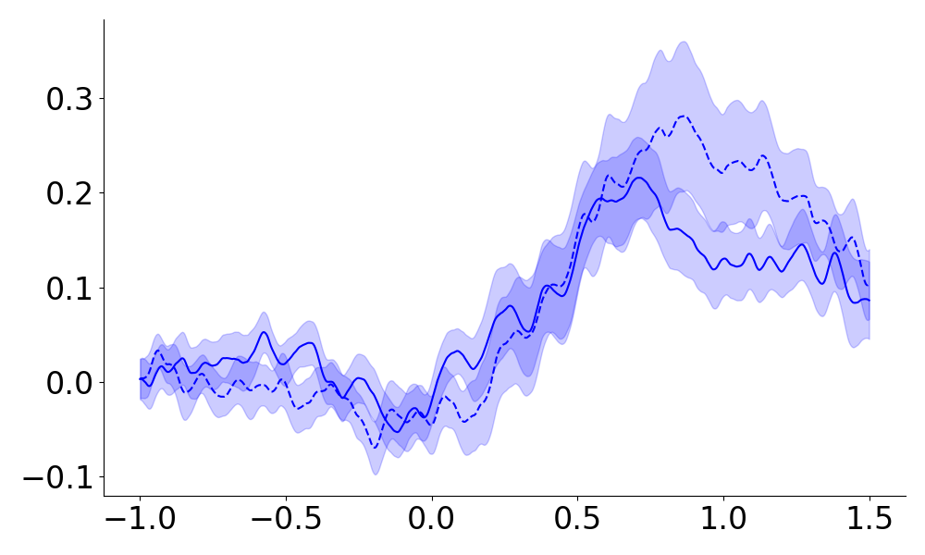
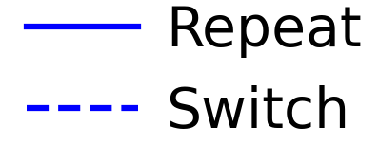
iEEG Average High Gamma Power (N=14)
Z-Score From Baseline
Z-Score From Baseline
Time From Stimulus Onset (s)
Notes:
We then looked at how the average high gamma power of our stability and flexibility sensitive LPFC electrodes varied over time. In the electrodes sensitive to stability, incongruent and congruent could be distinguished about half a second after stimulus onset,
->
and in the electrodes sensitive to flexibility, switch and repeat could similarly be distinguished about half a second after stimulus onset. Also, the more demanding trial conditions of incongruent and switch induced greater activity in LPFC electrodes sensitive to those conditions.
just say what i did here - avg hg neural response, see congruency effect at ~500 ms, and switch cost at roughly the same time. Ongoing work will do blah blah. Motivate with time, say time answer. Early analysis phase for both studies. Next, show what we want to do, here's a glimpse of data. Hopefully will work out cuz we can do visual decoding.
do fmri future directions too - right after or later? greg likes fmri with fmri, intracranial with intracranial
wrap up slide for task switching and congruency rehash it short and sweet at end
easier on the mind to keep separate
Rerun this legend code if I can find it…make it stack the three effects on top of each other.
Also yes I know this is just 14/18 subjects, my new subjects are in various stages of preprocessing and not sure if they’ll be ready by Friday..
Average trace plot for electrodes displaying a main effect of congruency (N=15)
Average trace plot for electrodes displaying a main effect of switch type (N=18)
We detected both congruency sensitive sites and switch type sensitive sites, and these sites were spatially interspersed.
There are both distinct and overlapping/interactive effects of stability and flexibility detectable at the level of mesoscale neural recordings in LPFC.
More demanding trial conditions (incongruent, switch) induced greater activity in LPFC electrodes sensitive to those conditions
Future analyses will investigate how stability and flexibility are regulated through block proportion manipulations
Future work will also investigate the temporal differences between conditions

Slide 48
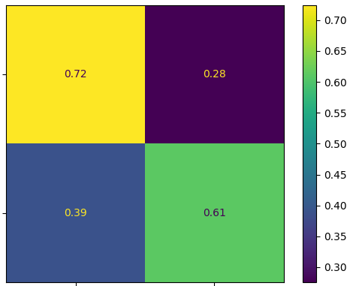
LPFC Decoding
Repeat
True Condition
Classification Proportion
Switch
Repeat
Switch
Predicted Condition
Notes:
I’ve also begun doing decoding analyses, to see if there could be activity pattern differences underlying my task conditions. To do this, I take the high gamma power from all of my task-sensitive lateral prefrontal electrodes during each trial, and separate the trials into a training set and a test set. Using the training trials, I train a decoding model to predict what condition each test trial is.
->
As an example, here I show that out of all of the test trials that are truly task repeat trials, my decoding model labels 72% of them as task repeat and 28% as task switch trials based on their lateral prefrontal activity patterns, without knowing what condition they were beforehand.
->
Out of all the test trials that are truly task switch trials, my model labels 61% of them as task switch trials and 39% of them as task repeat trials. Overall, I’m able to predict whether a single test trial is a task switch or a task repeat above the chance accuracy of 50%, and will next look at how this prediction accuracy changes throughout the trial.
PCA-LDA decoder from HG signals across all task-sensitive LPFC electrodes
PCA – 80% variance explained
2-way decoder (switch, repeat)
5 fold cross validation, 10 repeats
LPFC task-sensitive electrodes successfully decode switch type: mean decoding = 67.4%, chance = 50%
-1 to 1.5 seconds
what are we doing, what does it mean, explain this process more.
show an example of how this is working - just show one thing from decoding and show it well. Show this, not the visual decoding. Easier to focus on one of these. Too much to explain visual decoding. Slide to explain method. If visual decoding was in 90s then maybe but not good enough.
Explain confusion matrix, what does this mean. Remind people what chance decoding is.
Remind people I'm testing on single trials. Can tell whether it's repeat or switch based on a single trial. Hit this home.
Don't have time here. Big window. Model from all patients. More emphasis on analysis cuz not too many results. People don't really understand iEEG in the room - grab HG, feed into classifier, graphic of pipeline that goes into this.
does HG activity let us distinguish between these.

Slide 49
LPFC Decoding
Repeat
True Condition
Classification Proportion
Switch
Repeat
Switch
Predicted Condition
Notes:
I’ve also begun doing decoding analyses, to see if there could be activity pattern differences underlying my task conditions. To do this, I take the high gamma power from all of my task-sensitive lateral prefrontal electrodes during each trial, and separate the trials into a training set and a test set. Using the training trials, I train a decoding model to predict what condition each test trial is.
->
As an example, here I show that out of all of the test trials that are truly task repeat trials, my decoding model labels 72% of them as task repeat and 28% as task switch trials based on their lateral prefrontal activity patterns, without knowing what condition they were beforehand.
->
Out of all the test trials that are truly task switch trials, my model labels 61% of them as task switch trials and 39% of them as task repeat trials. Overall, I’m able to predict whether a single test trial is a task switch or a task repeat above the chance accuracy of 50%, and will next look at how this prediction accuracy changes throughout the trial.
PCA-LDA decoder from HG signals across all task-sensitive LPFC electrodes
PCA – 80% variance explained
2-way decoder (switch, repeat)
5 fold cross validation, 10 repeats
LPFC task-sensitive electrodes successfully decode switch type: mean decoding = 67.4%, chance = 50%
-1 to 1.5 seconds
what are we doing, what does it mean, explain this process more.
show an example of how this is working - just show one thing from decoding and show it well. Show this, not the visual decoding. Easier to focus on one of these. Too much to explain visual decoding. Slide to explain method. If visual decoding was in 90s then maybe but not good enough.
Explain confusion matrix, what does this mean. Remind people what chance decoding is.
Remind people I'm testing on single trials. Can tell whether it's repeat or switch based on a single trial. Hit this home.
Don't have time here. Big window. Model from all patients. More emphasis on analysis cuz not too many results. People don't really understand iEEG in the room - grab HG, feed into classifier, graphic of pipeline that goes into this.
does HG activity let us distinguish between these.

Slide 50
LPFC Decoding
Repeat
True Condition
Classification Proportion
Switch
Repeat
Switch
Predicted Condition
Notes:
I’ve also begun doing decoding analyses, to see if there could be activity pattern differences underlying my task conditions. To do this, I take the high gamma power from all of my task-sensitive lateral prefrontal electrodes during each trial, and separate the trials into a training set and a test set. Using the training trials, I train a decoding model to predict what condition each test trial is.
->
As an example, here I show that out of all of the test trials that are truly task repeat trials, my decoding model labels 72% of them as task repeat and 28% as task switch trials based on their lateral prefrontal activity patterns, without knowing what condition they were beforehand.
->
Out of all the test trials that are truly task switch trials, my model labels 61% of them as task switch trials and 39% of them as task repeat trials. Overall, I’m able to predict whether a single test trial is a task switch or a task repeat above the chance accuracy of 50%, and will next look at how this prediction accuracy changes throughout the trial.
PCA-LDA decoder from HG signals across all task-sensitive LPFC electrodes
PCA – 80% variance explained
2-way decoder (switch, repeat)
5 fold cross validation, 10 repeats
LPFC task-sensitive electrodes successfully decode switch type: mean decoding = 67.4%, chance = 50%
-1 to 1.5 seconds
what are we doing, what does it mean, explain this process more.
show an example of how this is working - just show one thing from decoding and show it well. Show this, not the visual decoding. Easier to focus on one of these. Too much to explain visual decoding. Slide to explain method. If visual decoding was in 90s then maybe but not good enough.
Explain confusion matrix, what does this mean. Remind people what chance decoding is.
Remind people I'm testing on single trials. Can tell whether it's repeat or switch based on a single trial. Hit this home.
Don't have time here. Big window. Model from all patients. More emphasis on analysis cuz not too many results. People don't really understand iEEG in the room - grab HG, feed into classifier, graphic of pipeline that goes into this.
does HG activity let us distinguish between these.

Slide 51
iEEG Next Steps
Generalizability of decoders
Notes:
The next things I will do are look at if the information underlying my decoding results is shared between stability and flexibility, to further test if they are supported by shared or distinct neural substrates.
->
I will also replicate my behavioral and fMRI analyses in my intracranial EEG data, testing our hypothesis that the brain independently adapts to demands on stability and flexibility.
->
And I’ll also more robustly compare the timing of stability and flexibility adaptations. So far I’ve been looking at if stability and flexibility have shared or distinct spatial substrates, but this will let me see if they have similar or distinct temporal substrates too.
additionally support our hypothesis that the brain independently adapts to demands on stability and flexibility.
Pretty pictures.
fMRI next steps with fMRI, iEEG next steps with iEEG. Explain more clearly is better. Clean this up, sell the future.
From cns 2025
Future work should investigate connectivity patterns between regions and brain-behavior correlations
Representational similarity analysis did not show significant multivariate patterns, potentially need alternative multivariate approaches (e.g., MVPA)
Future work should disentangle the concurrent regulation of stability and flexibility in vlPFC/dlPFC
From sfn 2024
We detected both congruency sensitive sites and switch type sensitive sites, and these sites were spatially interspersed.
There are both distinct and overlapping/interactive effects of stability and flexibility detectable at the level of mesoscale neural recordings in LPFC.
More demanding trial conditions (incongruent, switch) induced greater activity in LPFC electrodes sensitive to those conditions
Future analyses will investigate how stability and flexibility are regulated through block proportion manipulations
Future work will also investigate the temporal differences between conditions
No this sucks fix this.
So, there is a vast ocean of of neural analyses we could do next, but we’ve started by first creating general linear models with our fMRI data to find activation differences between our main effects, so incongruent vs. congruent trials, as well as switch vs. repeat trials. Then, we’ll also look at interaction effects, such as the differences between the switch costs in high and low switch proportion blocks, and the congruency effects in high and low congruency proportion blocks.
On the iEEG side, we’re currently looking at our iEEG data to determine the within-trial timing differences between our different conditions, such as when incongruent and congruent stimuli can be differentiated.
To compare across both methods, we’ll conduct representational similarity analyses in which we’ll make matrices of how dissimilar the activity caused by each of our trial types are.
Generalizability of decoders - (train on switch/repeat, test on incongruent/congruent)

Slide 52
iEEG Next Steps
Generalizability of decoders
Compare proportion effects in iEEG
Notes:
The next things I will do are look at if the information underlying my decoding results is shared between stability and flexibility, to further test if they are supported by shared or distinct neural substrates.
->
I will also replicate my behavioral and fMRI analyses in my intracranial EEG data, testing our hypothesis that the brain independently adapts to demands on stability and flexibility.
->
And I’ll also more robustly compare the timing of stability and flexibility adaptations. So far I’ve been looking at if stability and flexibility have shared or distinct spatial substrates, but this will let me see if they have similar or distinct temporal substrates too.
additionally support our hypothesis that the brain independently adapts to demands on stability and flexibility.
Pretty pictures.
fMRI next steps with fMRI, iEEG next steps with iEEG. Explain more clearly is better. Clean this up, sell the future.
From cns 2025
Future work should investigate connectivity patterns between regions and brain-behavior correlations
Representational similarity analysis did not show significant multivariate patterns, potentially need alternative multivariate approaches (e.g., MVPA)
Future work should disentangle the concurrent regulation of stability and flexibility in vlPFC/dlPFC
From sfn 2024
We detected both congruency sensitive sites and switch type sensitive sites, and these sites were spatially interspersed.
There are both distinct and overlapping/interactive effects of stability and flexibility detectable at the level of mesoscale neural recordings in LPFC.
More demanding trial conditions (incongruent, switch) induced greater activity in LPFC electrodes sensitive to those conditions
Future analyses will investigate how stability and flexibility are regulated through block proportion manipulations
Future work will also investigate the temporal differences between conditions
No this sucks fix this.
So, there is a vast ocean of of neural analyses we could do next, but we’ve started by first creating general linear models with our fMRI data to find activation differences between our main effects, so incongruent vs. congruent trials, as well as switch vs. repeat trials. Then, we’ll also look at interaction effects, such as the differences between the switch costs in high and low switch proportion blocks, and the congruency effects in high and low congruency proportion blocks.
On the iEEG side, we’re currently looking at our iEEG data to determine the within-trial timing differences between our different conditions, such as when incongruent and congruent stimuli can be differentiated.
To compare across both methods, we’ll conduct representational similarity analyses in which we’ll make matrices of how dissimilar the activity caused by each of our trial types are.
Generalizability of decoders - (train on switch/repeat, test on incongruent/congruent)

Slide 53
iEEG Next Steps
Generalizability of decoders
Compare proportion effects in iEEG
Timing of mental processes in iEEG
Notes:
The next things I will do are look at if the information underlying my decoding results is shared between stability and flexibility, to further test if they are supported by shared or distinct neural substrates.
->
I will also replicate my behavioral and fMRI analyses in my intracranial EEG data, testing our hypothesis that the brain independently adapts to demands on stability and flexibility.
->
And I’ll also more robustly compare the timing of stability and flexibility adaptations. So far I’ve been looking at if stability and flexibility have shared or distinct spatial substrates, but this will let me see if they have similar or distinct temporal substrates too.
additionally support our hypothesis that the brain independently adapts to demands on stability and flexibility.
Pretty pictures.
fMRI next steps with fMRI, iEEG next steps with iEEG. Explain more clearly is better. Clean this up, sell the future.
From cns 2025
Future work should investigate connectivity patterns between regions and brain-behavior correlations
Representational similarity analysis did not show significant multivariate patterns, potentially need alternative multivariate approaches (e.g., MVPA)
Future work should disentangle the concurrent regulation of stability and flexibility in vlPFC/dlPFC
From sfn 2024
We detected both congruency sensitive sites and switch type sensitive sites, and these sites were spatially interspersed.
There are both distinct and overlapping/interactive effects of stability and flexibility detectable at the level of mesoscale neural recordings in LPFC.
More demanding trial conditions (incongruent, switch) induced greater activity in LPFC electrodes sensitive to those conditions
Future analyses will investigate how stability and flexibility are regulated through block proportion manipulations
Future work will also investigate the temporal differences between conditions
No this sucks fix this.
So, there is a vast ocean of of neural analyses we could do next, but we’ve started by first creating general linear models with our fMRI data to find activation differences between our main effects, so incongruent vs. congruent trials, as well as switch vs. repeat trials. Then, we’ll also look at interaction effects, such as the differences between the switch costs in high and low switch proportion blocks, and the congruency effects in high and low congruency proportion blocks.
On the iEEG side, we’re currently looking at our iEEG data to determine the within-trial timing differences between our different conditions, such as when incongruent and congruent stimuli can be differentiated.
To compare across both methods, we’ll conduct representational similarity analyses in which we’ll make matrices of how dissimilar the activity caused by each of our trial types are.
Generalizability of decoders - (train on switch/repeat, test on incongruent/congruent)

Slide 54
Conclusion
Stability and flexibility rely on overlapping neural substrates but may be independently regulated
Notes:
So preliminarily, we see that the lateral prefrontal cortex seems to mediate both stability and flexibility, but it does so independently, while the medial frontal cortex seems to uniquely mediate flexibility. There are no cross-domain effects, suggesting that stability and flexibility are independently regulated in the brain, mirroring our behavioral results and supporting our hypothesis. Additionally, they seem to have both a shared neural substrate in the lateral prefrontal cortex, and perhaps distinct substrates in the medial frontal cortex.
->
Interestingly, when we use the high spatial resolution of iEEG to look more closely at the LPFC, we see that some sites are uniquely sensitive to one process, while others are sensitive to both. There may be some neuronal populations that uniquely mediate one process, while other neuronal populations mediate both in a multiplexed manner.
->
And finally, there’s still a lot of work I have to do ☺
talk more about fmri blobs
Ugh this sucks fix this!!! 4/30
From cns 2025
ACC uniquely sensitive to flexibility demands, while vlPFC and dlPFC show sensitivity to both stability and flexibility demands
vlPFC/dlPFC results confirm overlapping neural substrates for stability and flexibility but show independent regulation of these processes
Absence of cross-domain effects suggests independence in how stability and flexibility are regulated neurally, mirroring behavior
Our findings suggest cognitive stability and flexibility rely on partially dissociable neural pathways, with ACC specifically supporting flexibility while vlPFC and dlPFC seem to support both control processes.
This functional specialization could help explain how the brain manages concurrent demands on task focus and task switching.
From sfn 2024
We detected both congruency sensitive sites and switch type sensitive sites, and these sites were spatially interspersed.
There are both distinct and overlapping/interactive effects of stability and flexibility detectable at the level of mesoscale neural recordings in LPFC.
More demanding trial conditions (incongruent, switch) induced greater activity in LPFC electrodes sensitive to those conditions
Future analyses will investigate how stability and flexibility are regulated through block proportion manipulations
Future work will also investigate the temporal differences between conditions
In conclusion, we’ve made a task design in which we can measure stability and flexibility at the same time, and our preliminary behavioral results match the literature. We’re still collecting data, with the goal of determining how the brain concurrently regulates stability and flexibility.

Slide 55
Conclusion
Stability and flexibility rely on overlapping neural substrates but may be independently regulated
Congruency and switch type sensitive sites are interspersed in LPFC, with some sites sensitive to one process and others to both
Notes:
So preliminarily, we see that the lateral prefrontal cortex seems to mediate both stability and flexibility, but it does so independently, while the medial frontal cortex seems to uniquely mediate flexibility. There are no cross-domain effects, suggesting that stability and flexibility are independently regulated in the brain, mirroring our behavioral results and supporting our hypothesis. Additionally, they seem to have both a shared neural substrate in the lateral prefrontal cortex, and perhaps distinct substrates in the medial frontal cortex.
->
Interestingly, when we use the high spatial resolution of iEEG to look more closely at the LPFC, we see that some sites are uniquely sensitive to one process, while others are sensitive to both. There may be some neuronal populations that uniquely mediate one process, while other neuronal populations mediate both in a multiplexed manner.
->
And finally, there’s still a lot of work I have to do ☺
talk more about fmri blobs
Ugh this sucks fix this!!! 4/30
From cns 2025
ACC uniquely sensitive to flexibility demands, while vlPFC and dlPFC show sensitivity to both stability and flexibility demands
vlPFC/dlPFC results confirm overlapping neural substrates for stability and flexibility but show independent regulation of these processes
Absence of cross-domain effects suggests independence in how stability and flexibility are regulated neurally, mirroring behavior
Our findings suggest cognitive stability and flexibility rely on partially dissociable neural pathways, with ACC specifically supporting flexibility while vlPFC and dlPFC seem to support both control processes.
This functional specialization could help explain how the brain manages concurrent demands on task focus and task switching.
From sfn 2024
We detected both congruency sensitive sites and switch type sensitive sites, and these sites were spatially interspersed.
There are both distinct and overlapping/interactive effects of stability and flexibility detectable at the level of mesoscale neural recordings in LPFC.
More demanding trial conditions (incongruent, switch) induced greater activity in LPFC electrodes sensitive to those conditions
Future analyses will investigate how stability and flexibility are regulated through block proportion manipulations
Future work will also investigate the temporal differences between conditions
In conclusion, we’ve made a task design in which we can measure stability and flexibility at the same time, and our preliminary behavioral results match the literature. We’re still collecting data, with the goal of determining how the brain concurrently regulates stability and flexibility.

Slide 56
Conclusion
Stability and flexibility rely on overlapping neural substrates but may be independently regulated
Congruency and switch type sensitive sites are interspersed in LPFC, with some sites sensitive to one process and others to both
More later!
Notes:
So preliminarily, we see that the lateral prefrontal cortex seems to mediate both stability and flexibility, but it does so independently, while the medial frontal cortex seems to uniquely mediate flexibility. There are no cross-domain effects, suggesting that stability and flexibility are independently regulated in the brain, mirroring our behavioral results and supporting our hypothesis. Additionally, they seem to have both a shared neural substrate in the lateral prefrontal cortex, and perhaps distinct substrates in the medial frontal cortex.
->
Interestingly, when we use the high spatial resolution of iEEG to look more closely at the LPFC, we see that some sites are uniquely sensitive to one process, while others are sensitive to both. There may be some neuronal populations that uniquely mediate one process, while other neuronal populations mediate both in a multiplexed manner.
->
And finally, there’s still a lot of work I have to do ☺
talk more about fmri blobs
Ugh this sucks fix this!!! 4/30
From cns 2025
ACC uniquely sensitive to flexibility demands, while vlPFC and dlPFC show sensitivity to both stability and flexibility demands
vlPFC/dlPFC results confirm overlapping neural substrates for stability and flexibility but show independent regulation of these processes
Absence of cross-domain effects suggests independence in how stability and flexibility are regulated neurally, mirroring behavior
Our findings suggest cognitive stability and flexibility rely on partially dissociable neural pathways, with ACC specifically supporting flexibility while vlPFC and dlPFC seem to support both control processes.
This functional specialization could help explain how the brain manages concurrent demands on task focus and task switching.
From sfn 2024
We detected both congruency sensitive sites and switch type sensitive sites, and these sites were spatially interspersed.
There are both distinct and overlapping/interactive effects of stability and flexibility detectable at the level of mesoscale neural recordings in LPFC.
More demanding trial conditions (incongruent, switch) induced greater activity in LPFC electrodes sensitive to those conditions
Future analyses will investigate how stability and flexibility are regulated through block proportion manipulations
Future work will also investigate the temporal differences between conditions
In conclusion, we’ve made a task design in which we can measure stability and flexibility at the same time, and our preliminary behavioral results match the literature. We’re still collecting data, with the goal of determining how the brain concurrently regulates stability and flexibility.

Slide 57





Thanks to my advisors and labmates for their support!
Notes:
So thanks for listening, and thanks to my advisors and labmates for both being wonderful people and for helping me with every aspect of these studies.

Slide 58
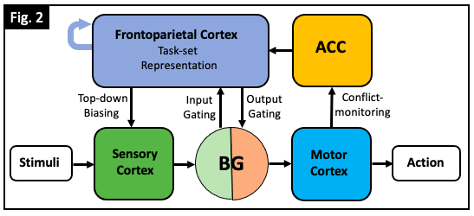
Notes:
Should I even talk about this..??? Kinda long..

Slide 59
Egner, 2023
Notes:
Thus, we’ve shown that we can measure cognitive stability and flexibility using the congruency effect and the switch cost. We’ve also shown that both stability and flexibility are dynamically regulated through the listwide proportion congruent effect and the listwide proportion switch effect. But how does our brain adjust its levels of cognitive stability and flexibility? And what neural differences exist between states in which we are highly focused and/or flexible, and states in which we aren’t?

Slide 60
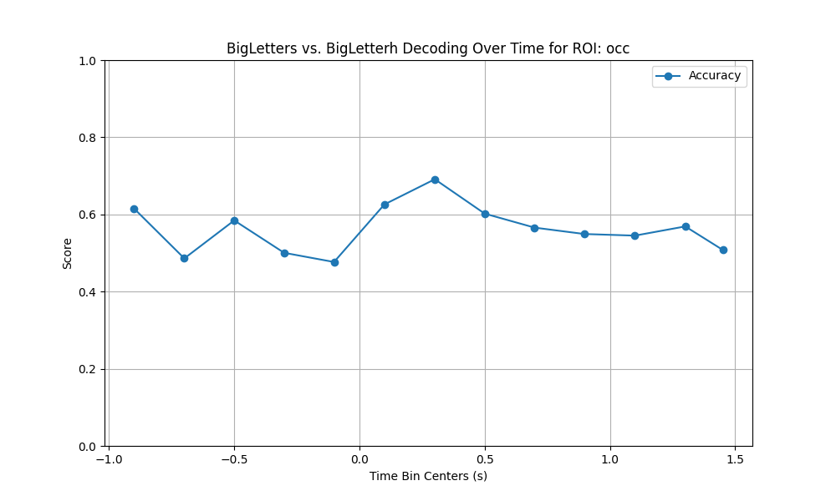
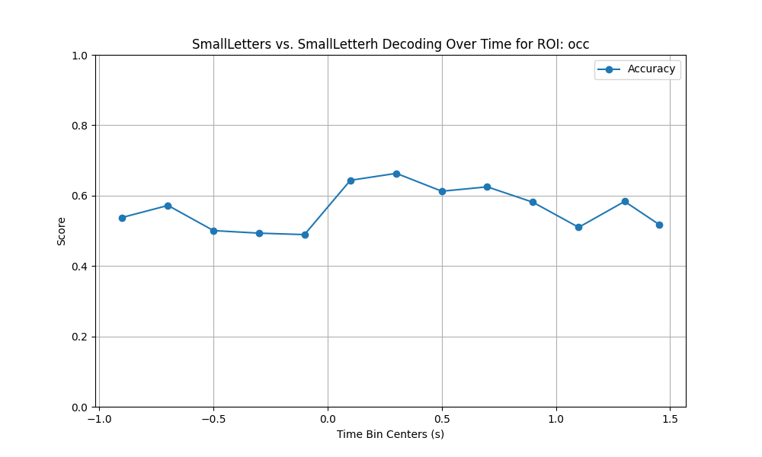
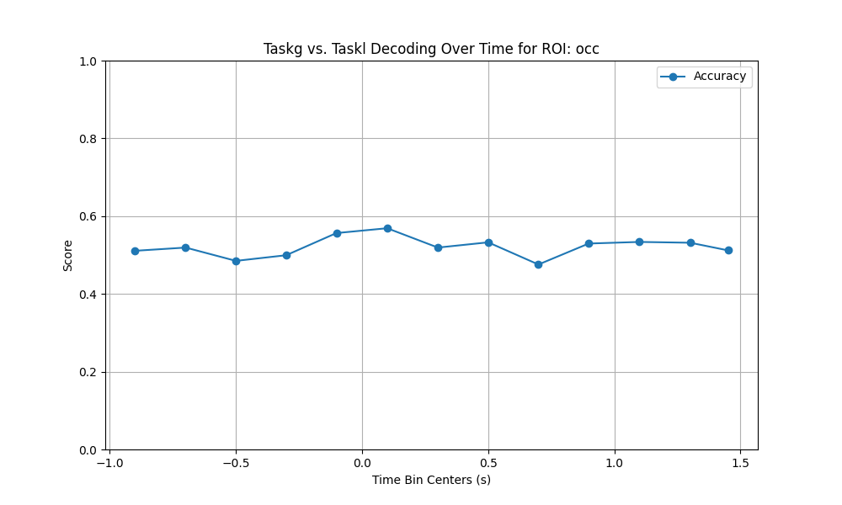
Occ visual decoding over time (200 ms bins, dots at bin centers)

Slide 61
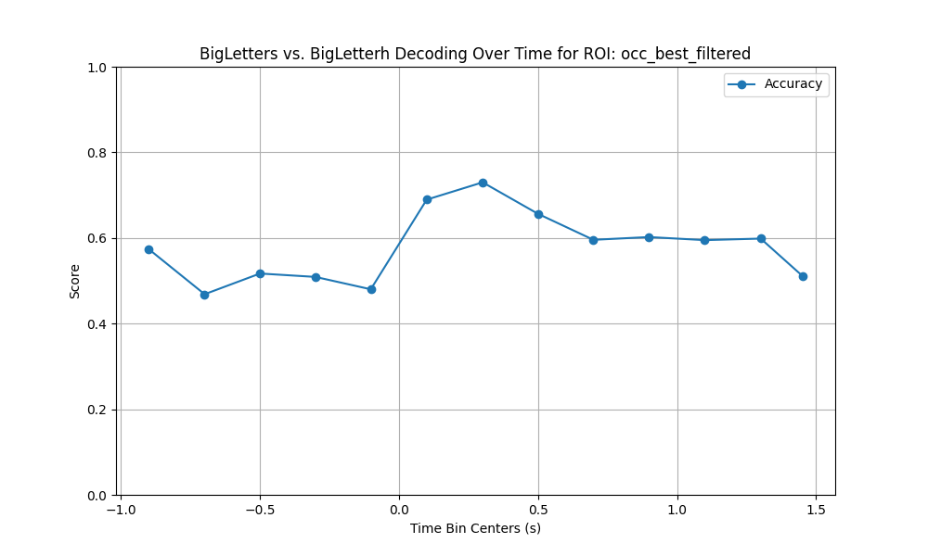
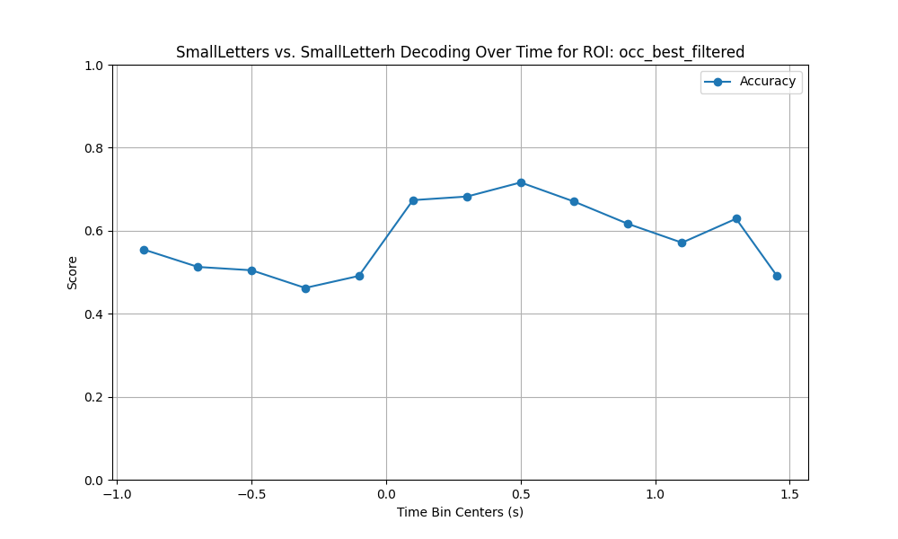
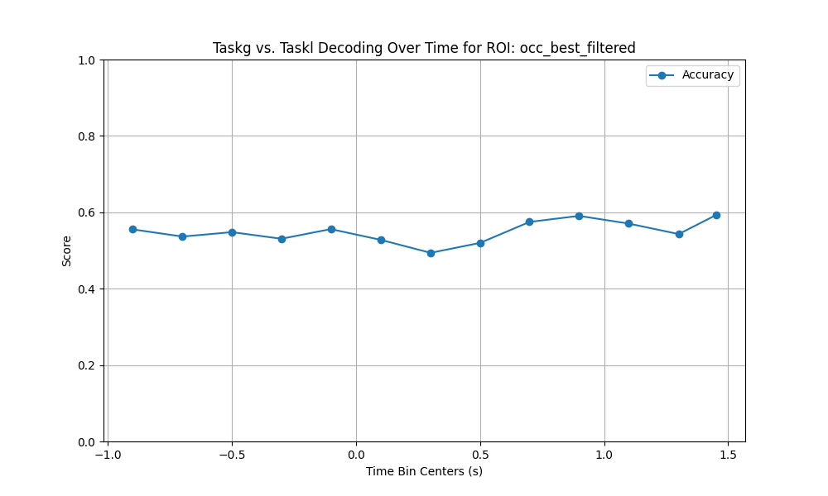
Occ best filtered visual decoding over time

Slide 62
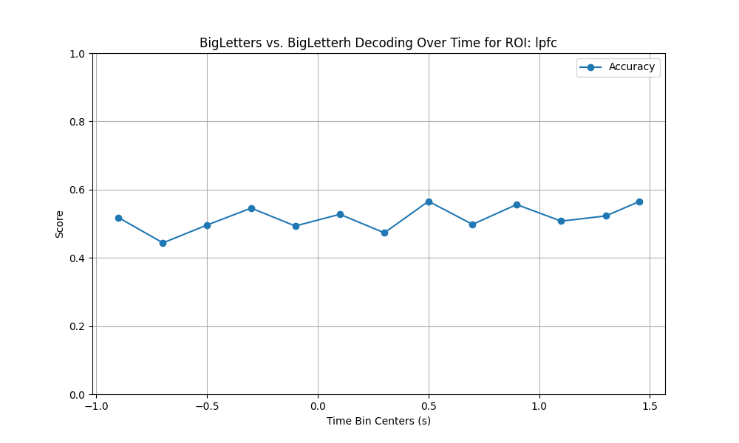
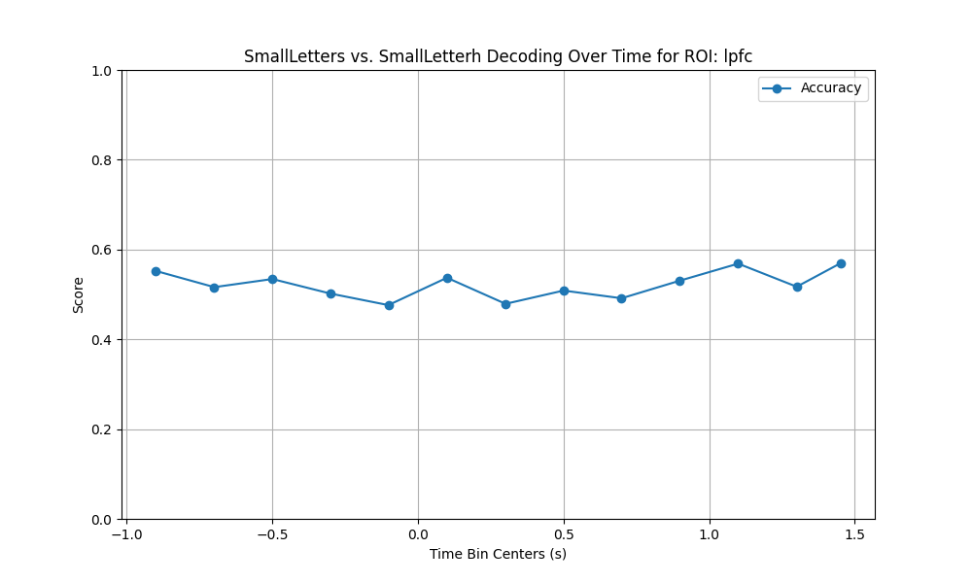
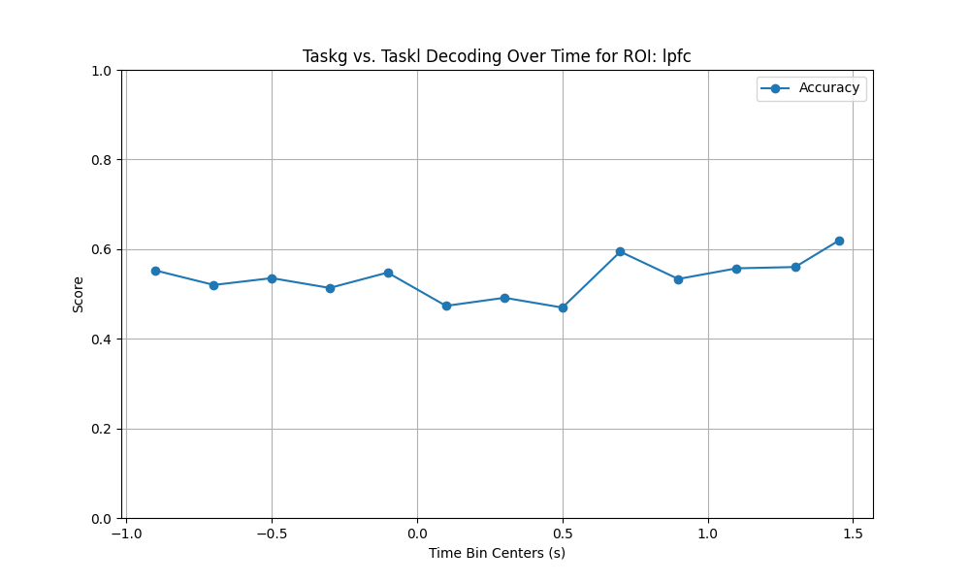
lpfc visual decoding over time

Slide 63
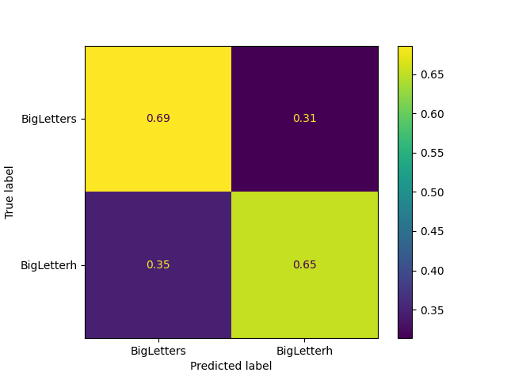
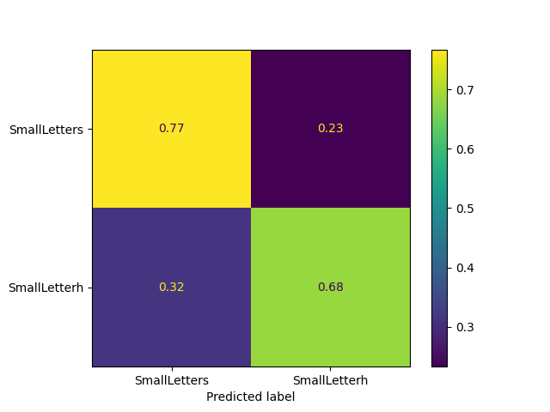
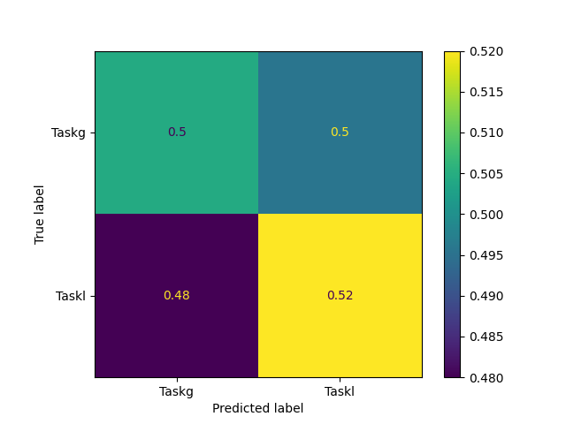
Occ visual decoding. 51 channels x 641 timepoints. This is using randomly chosen minimum number of good trials across decoding classes
big letter decoding. 51 channels x 641 timepoints. 96 big letter s, 110 big letter h
5 splits, 10 repeats
small letter decoding. 51 channels x 641 timepoints. 105 small letter s, 101 small letter h
5 splits, 10 repeats
Task decoding. 51 channels x 641 timepoints. 116 task g, 90 task l
5 splits, 10 repeats
Notes:
We have also begun doing multivariate decoding analyses, to see if there are activity-silent differences between stability and flexibility.
PCA-LDA decoder from HG signals across all task-sensitive LPFC electrodes
PCA – 80% variance explained
2-way decoder (switch, repeat)
5 fold cross validation, 10 repeats
LPFC task-sensitive electrodes successfully decode switch type: mean decoding = 67.4%, chance = 50%

Slide 64
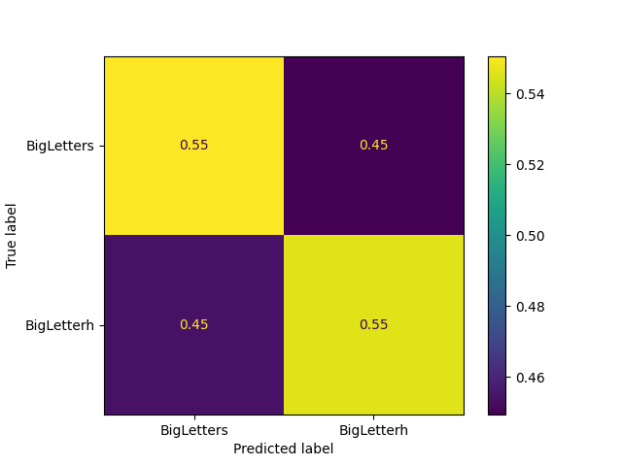
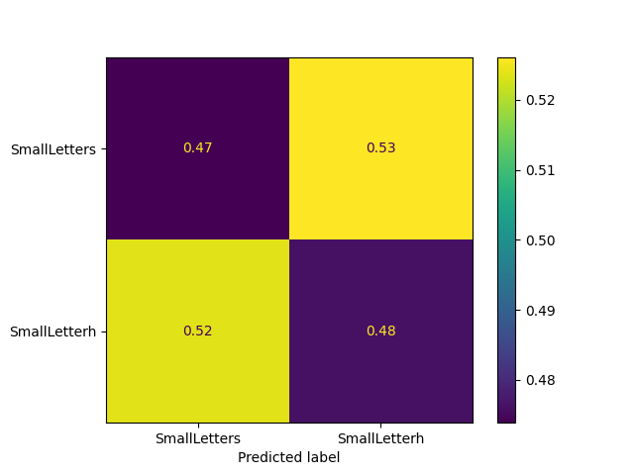
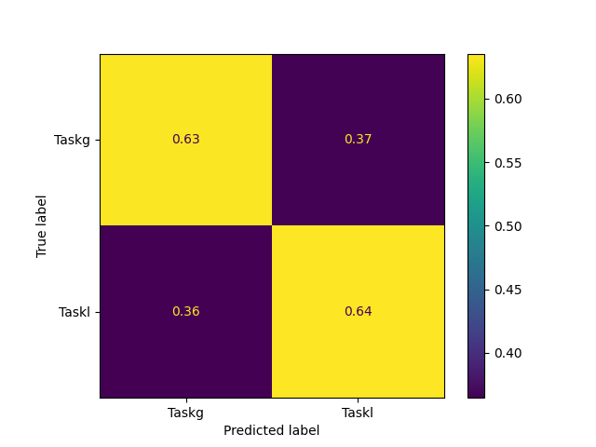
lpfc visual decoding. 59 channels x 641 timepoints. This is using randomly chosen minimum number of good trials across decoding classes
big letter decoding. 59 channels x 641 timepoints. 83 big letter s, 100 big letter h. 5 splits, 10 repeats
small letter decoding. 59 channels x 641 timepoints. 88 small letter s, 95 small letter h. 5 splits, 10 repeats
Task decoding. 59 channels x 641 timepoints. 104 task g, 79 task l. 5 splits, 10 repeats

Slide 65
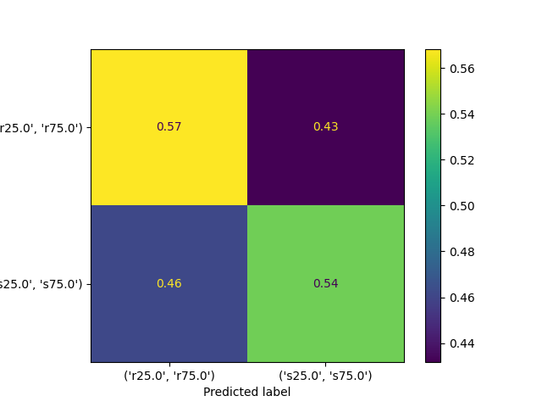

Occ cognitive control decoding. 51 channels x 641 timepoints. This is using randomly chosen minimum number of good trials across decoding classes
Switch type decoding. 51 channels x 641 timepoints. 106 repeat, 98 switch trials. 5 splits, 10 repeats
Congruency decoding. 51 channels x 641 timepoints. 120 congruent, 84 incongruent trials. 5 splits, 10 repeats

Slide 66
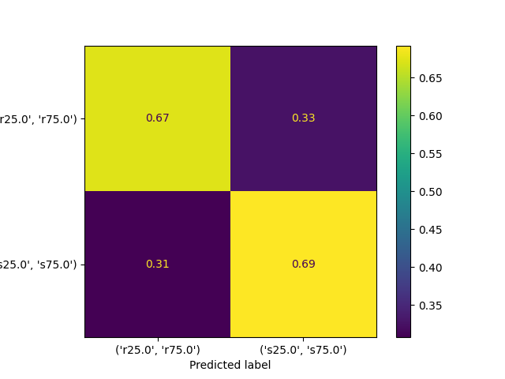
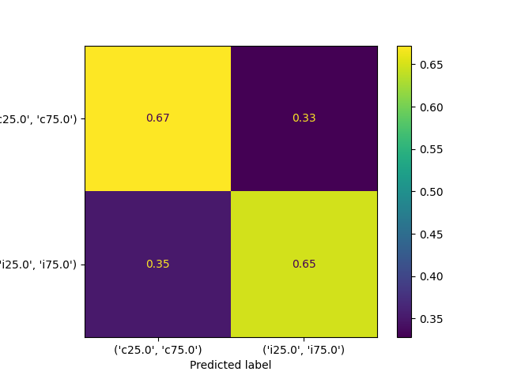
lpfc cognitive control decoding. 59 channels x 641 timepoints. This is using randomly chosen minimum number of good trials across decoding classes
Switch type decoding. 59 channels x 641 timepoints. 111 repeat, 92 switch trials. 5 splits, 10 repeats
Congruency decoding. 59 channels x 641 timepoints. 131 congruent, 72 incongruent trials. 5 splits, 10 repeats
Notes:
We have also begun doing multivariate decoding analyses, to see if there are activity-silent differences between stability and flexibility.

Slide 67
Egner, 2023
a
Incongruent
Incongruent
Con.
Effect
(RT_{inc} – RT_{con})
Con. Effect
Incongruent
Con. Effect
4
Congruent
2
9
1
c
Repeat
Switch Cost
Switch Cost
Switch
Switch Cost
4
Switch Cost
Switch
2
9
1
Notes:
People use the response time difference between incongruent and congruent trials to quantify stability. They call this difference the congruency effect.
The congruency effect acts as an inverse measure of cognitive stability because as it gets larger, it indicates that people are getting more distracted by the incongruent trials and are thus in a less stable state.

Slide 68
Egner, 2023
a
Incongruent
Incongruent
Con. Effect
Incongruent
Con. Effect
4
Congruent
2
9
1
c
Repeat
Switch Cost
Switch Cost
Switch
Switch Cost
4
Switch Cost
Switch
2
9
1
Notes:
However, people have also observed that the congruency effect is larger in mostly congruent blocks/items compared to mostly incongruent blocks/items.
This suggests that cognitive stability is dynamically regulated, and that we increase our stability when there’s a lot of incongruent trials that require more stability, and we become less stable when there’s a lot of congruent trials that require less stability,.
More incongruent more stability - like increasing our ability to focus when the café gets noisier,
More congruent less stability - which is like decreasing our ability to focus when the café gets quieter

Slide 69
Egner, 2023
a
Incongruent
Incongruent
Con. Effect
Incongruent
Con. Effect
4
Congruent
2
9
1
c
Repeat
Switch Cost
Switch
Cost
(RT_{switch} – RT_{repeat})
4
Switch
Switch Cost
Switch
2
9
1
Notes:
Okay so we have a way to measure stability , but what about flexibility?
Task switch trials are when the task switches from that of the previous trial, such as from odd/even to greater than or less than 5. Task repeat trials are when the task remains the same as that of the previous trial. We expect people to be slower on task switch trials relative to task repeat. To measure flexibility, we will use the response time difference between task switch and task repeat trials. We will call this difference the switch cost. The switch cost acts as an inverse measure of cognitive flexibility because as it gets larger, it indicates that people are less ready to switch, and are thus in a less flexible state.

Slide 70
Egner, 2023
a
Incongruent
Incongruent
Con. Effect
Incongruent
Con. Effect
4
Congruent
2
9
1
c
Repeat
Switch Cost
4
Switch
Switch Cost
Switch
2
9
1
Notes:
However, we also see that the switch cost is larger in mostly repeat blocks/items compared to mostly switch blocks/items.
This suggests that flexibility is also dynamically regulated, and we increase our flexibility when there’s a lot of switch trials that require more flexibility (this is like when we are switching between reading and checking our phone a lot in the café, so we expect to switch tasks and are more ready to do so) and become less flexible when there’s a lot of repeat trials that require less flexibility (this is like when our phone doesn’t buzz a lot in the cafe, so we just keep reading.)
Hmm oh I actually really like the way I went through this. Just go through it the same way but using my fMRI data.

