Slide 1

Streaming Trade Processing with FlinkSQL
Jim Zucker
24-Jun-2024
jim@streamingfintech.com

Slide 2

Agenda
Review Requirements
Setup Flink/Kafka/Grafana in Aiven
Publish orders to Kafka
Filtering capabilities of Flink
Setup Monitoring input and output
Questions

Slide 3
Background
Based on our last meeting Aiven is already being used for Postgres, Grafana, OpenSearch, Caching
Purpose of this demo is to to explore the capabilities of FlinkSQL to route orders over Kafka in real time to different downstream consumers of the trading system.
In our example today we want split orders based on account naming convention of the firm
flow* to systems processing flow trading
struct* to systems processing structured trading

Slide 4


Example Systems we will build today
If Account like flow%
Topic: flow_orders
Key: UUID
Value: Book, Quantity,
Ticker, Execution Time
Trading System
FlinkSQL
Topic: orders
Key: UUID
Value: Book, Quantity,
Ticker, Execution Time
If Account like struct%
Topic: structured_orders
Key: UUID
Value: Book, Quantity,
Ticker, Execution Time

Slide 5
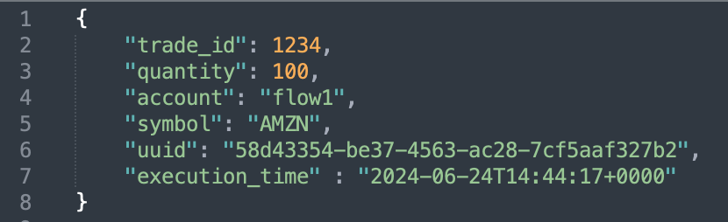
Example Order

Slide 6
Infrastructure
Built on Aiven

Slide 7
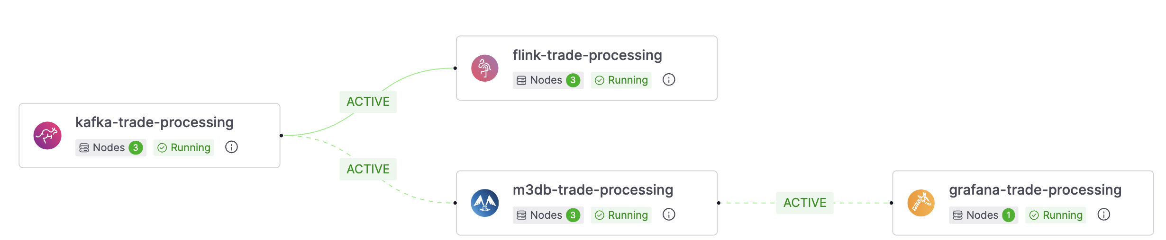
Infrastructure
Message Bus
Kafka
FlinkSQL
filter orders and route trades to different downstream consumers
Monitoring
m3db(Prometheus)
Grafana

Slide 8
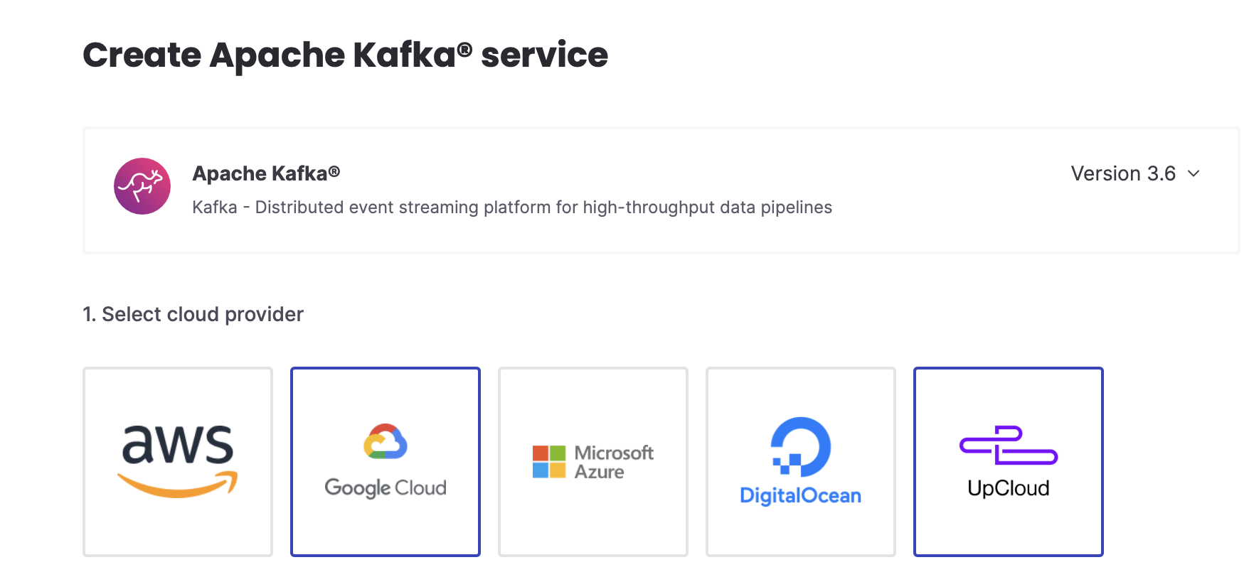
Each service create in minutes on any cloud

Slide 9
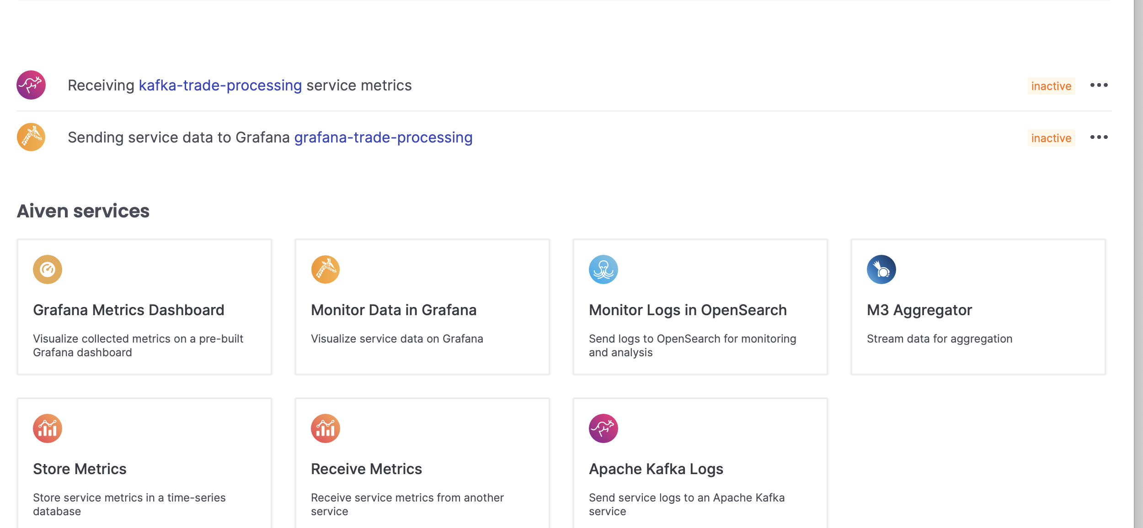
Integrate services easily

Slide 10
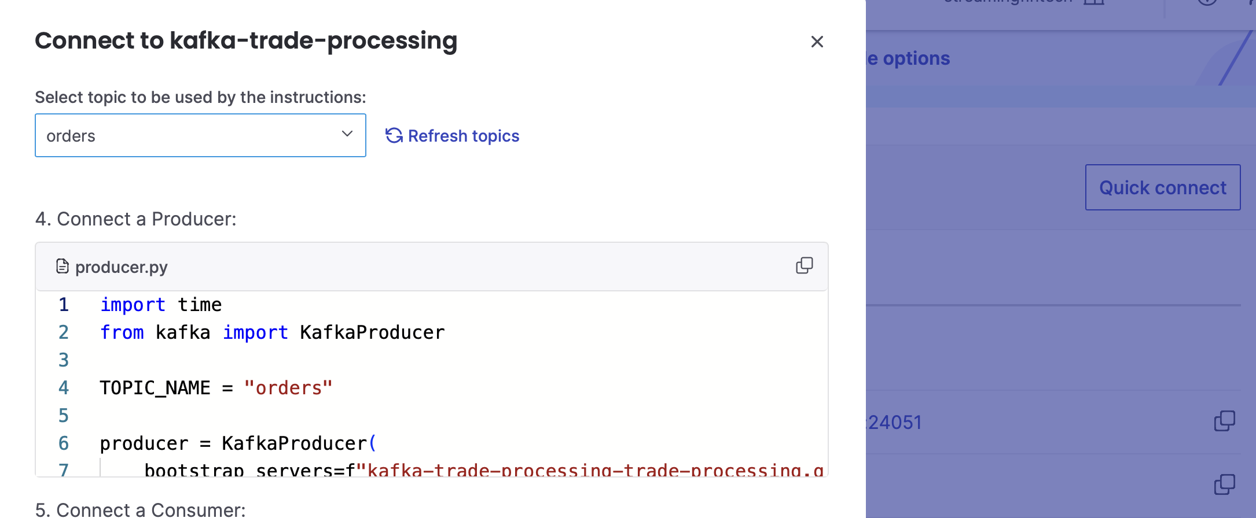
Create a mock order generator
Using ‘Quick’ Connect we can get a sample ‘producer’ python script and modify it to generate our orders

Slide 11
Demo

Slide 12
Demo
1. Create Topics
2. Create Mock Oder Generator in Python
Even Trade IDs account will be ‘flow<id>’
Odd Trade Ids account will be ‘struct<id>’
3. Create a flink SQL application
4. Setup a Grafana dashboard
Split orders to two topics one for flow orders and one for structured orders
Monitor records processed/consumed on kafka
Source: orders
Sink(Destination): flow_orders, struct_orders

Slide 13
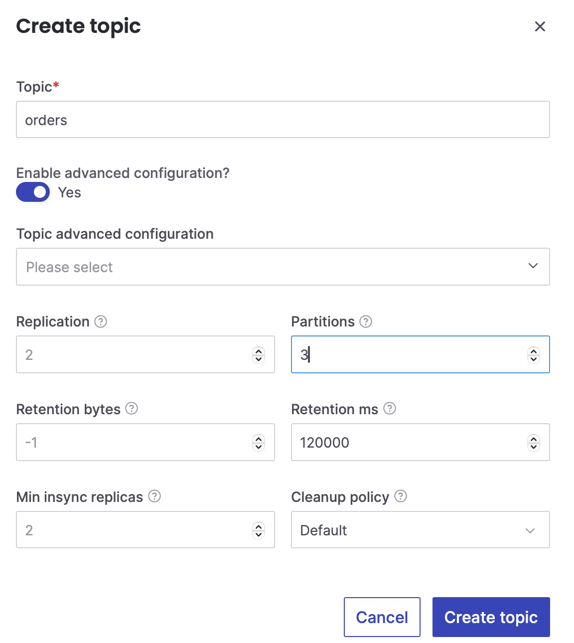
Create Topics
Set parallelism to 3
Set retention to a 3 minutes on topics so we can re-run demo from scratch

Slide 14
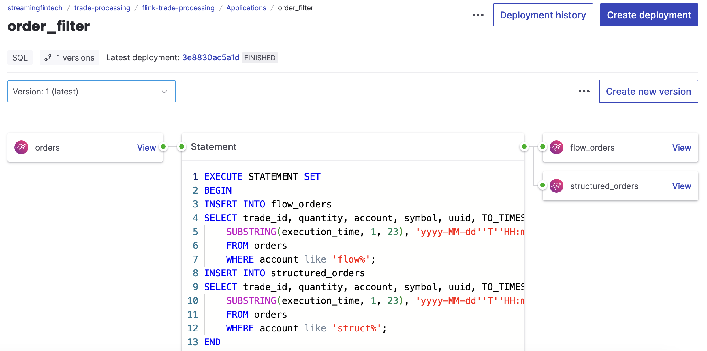
Flink Application

Slide 15
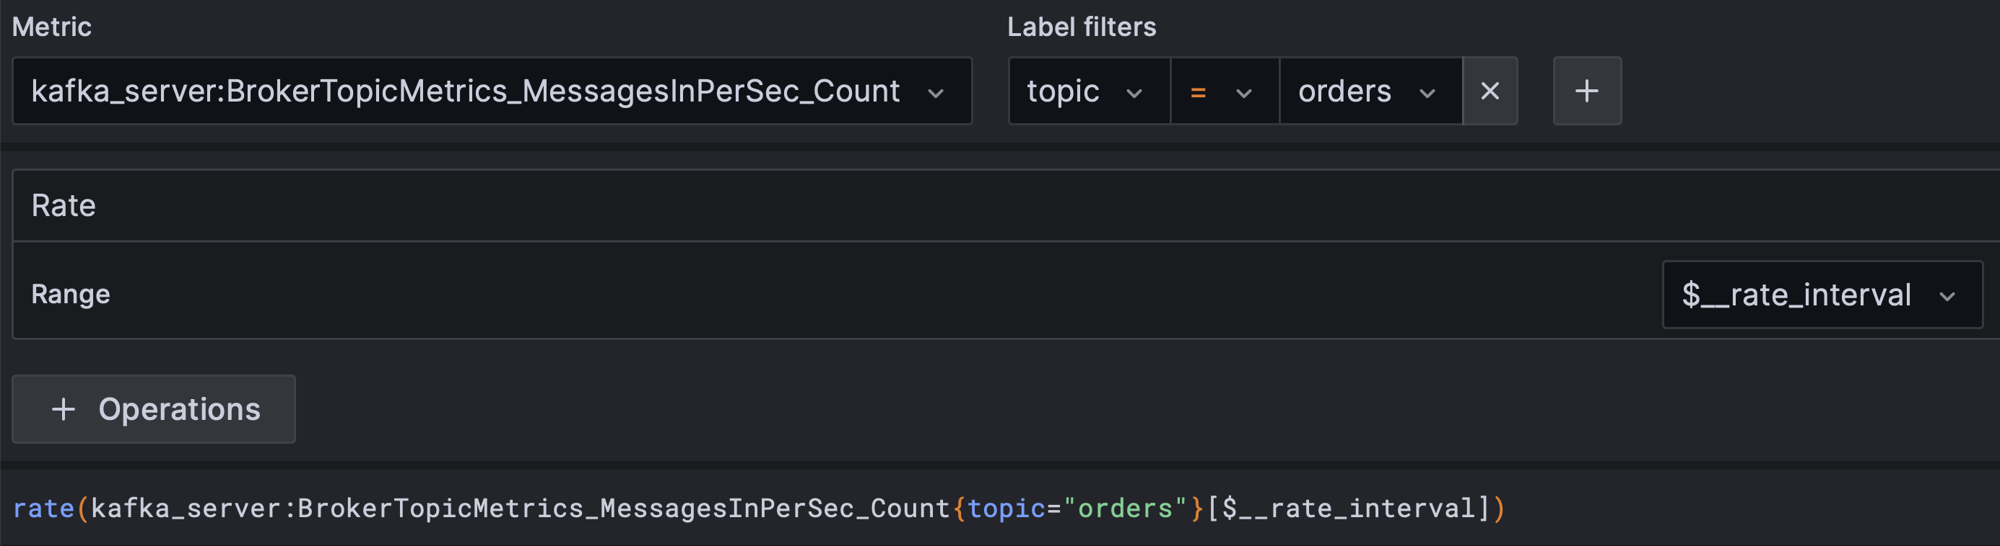
Configure Grafana to track records procesed
We use ‘rate’ on the records inserted into each topic to monitor producer and consumers

Slide 16
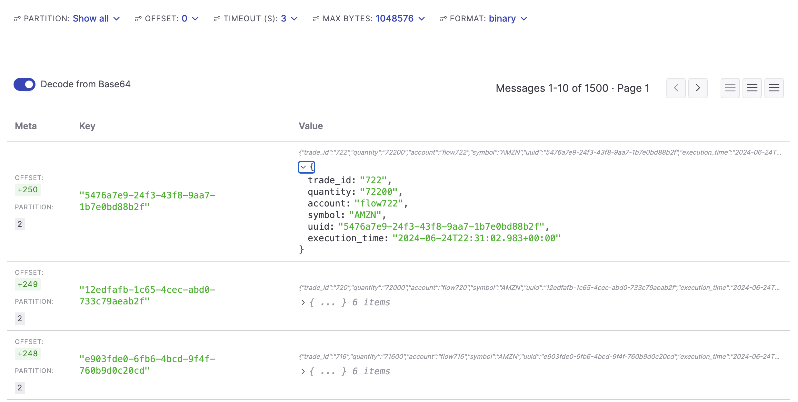
Orders Generated in Kafka Viewer

Slide 17
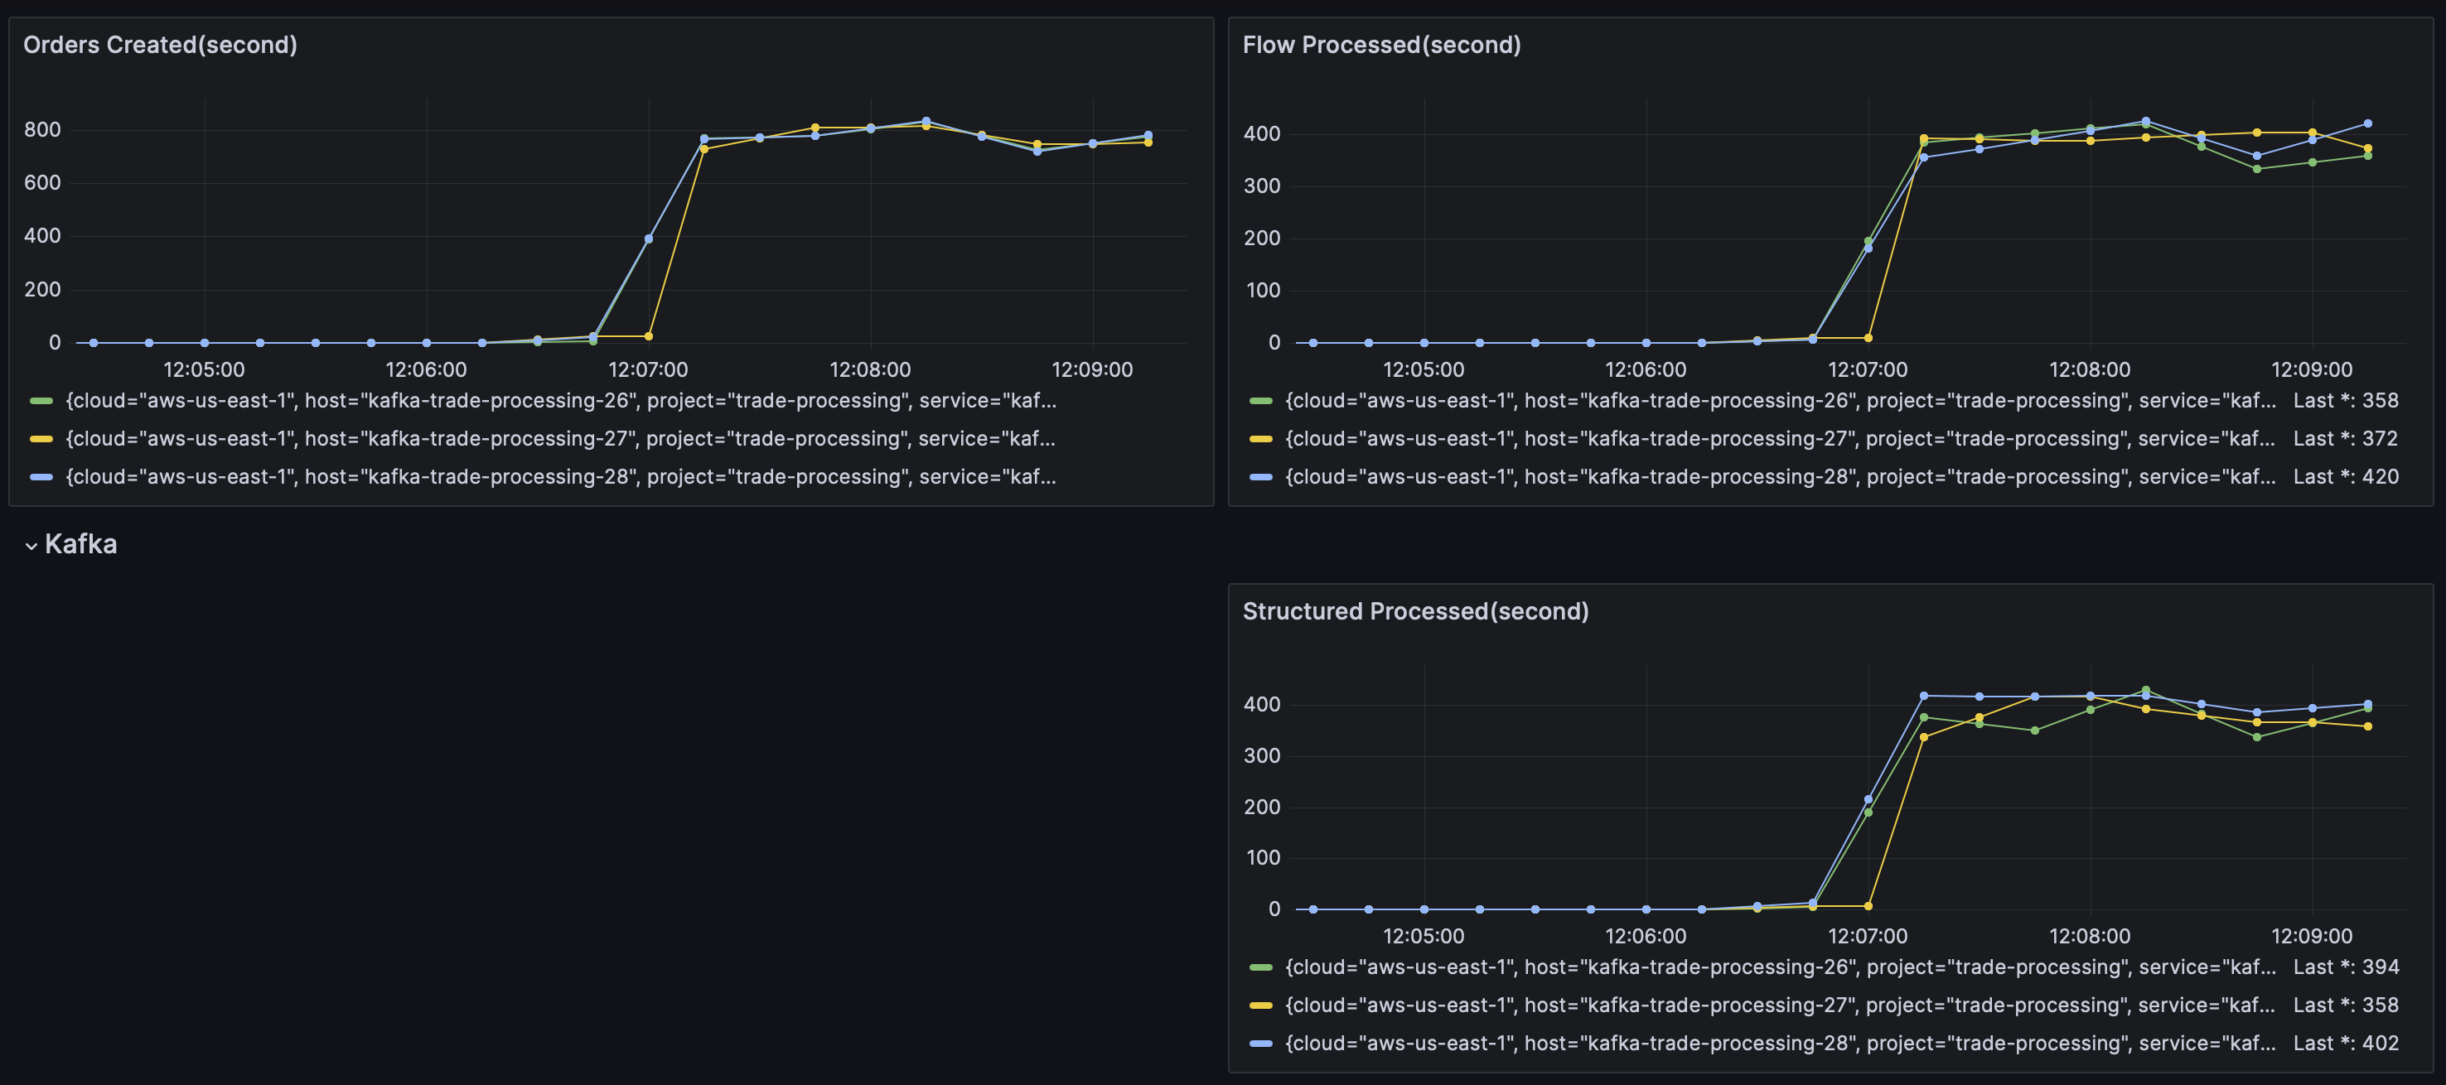
Run Application
The three lines on each graph represents the parallel processing we configured for 3
(left graph) Producer of orders generated at ~800/second
(right graphs) Consumers of flow & structured accounts are keeping up at ~400/second each

Slide 18

Questions?

