Slide 1




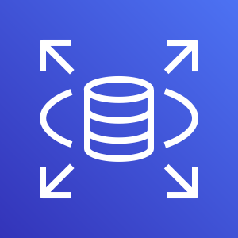


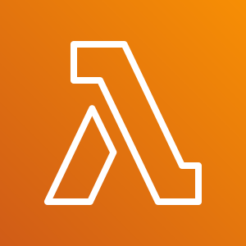



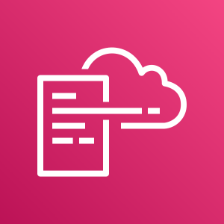
AWS Cloud
VPC
AWS Step Functions workflow
Private subnet
Stop RDS
RDS-EVENT-0154
Fail
Amazon RDS
Event
Amazon Simple Notification Service
AWS Lambda
IAM Role
Retry
Succeed
IAM Role
IAM Role
AWS Lambda
AWS 7 Day Auto Start
Amazon CloudWatch
AWS CloudFormation

