Slide 1
Real-Time Positions & Market Value
A streaming trading pipeline on Apache Flink — demo project results
Executive briefing · August 2026
Built in one day with Claude Code · github.com/jimzucker/flink-fable5

Slide 2
The ask
From Requirements.txt — a production-shaped proof, not a toy
• Consume block trades and ticking prices from Kafka; produce live positions and market values by account and by ticker
• Runs on a laptop and deploys to AWS — same application, configuration-only differences
• Scales linearly with CPU; scaling controlled by configuration, never a rebuild
• Handles duplicates; results deterministic, complete, reproducible — and explainable to the team
• Proven under load: 1,000 orders/sec, and extreme price values, without performance impact

Slide 3
What we built
Deterministic streaming pipeline — every number exact, every operator measured
Dedup
trade-id, state+TTL
Positions
by account+ticker / ticker
Kafka
trades
prices
4 output
streams
(Kafka)
Exact prices
long cents, no floats
Market value
position × latest price
Observability: Prometheus + Grafana, 12 panels
records/sec, KB/sec, duplicates, backpressure — per operator
• Apache Flink 1.20 (Java 17) — industry-standard stream processing; RocksDB state, checkpointing
• All money math exact (long cents + BigDecimal): correct at any price magnitude, by construction
• Every behavior is a config knob — rates, parallelism, dedup TTL: zero rebuilds to change anything

Slide 4
How it was delivered
Eight phases — each ended in something reviewable and running
1. Design
Plan + architecture,
reviewed first
2. Skeleton
End-to-end on
laptop, day one
3. Full calcs
All 4 outputs +
dashboard, live
4. Correctness
18 tests + indep.
validation, green
5. AWS IaC
Terraform validated,
ready to apply
6. Load tests
Both perf cases
passed, measured
7. Review find
Price-storm flaw:
proven, fixed, verified
8. AWS proof
Deployed, all tests
green, ladder measured
• Nothing advanced unverified: every phase closed with the system running and measured
• Full audit trail in git: one squash commit per phase, tagged Phase-2 … Phase-6, branches preserved
• Phase 7 was unplanned: a human review comment predicted the price-storm bottleneck — proven, fixed and re-verified the same day
• The seven engineering prompts that drove the build are recorded in the repo (prompts/)

Slide 5
How we know the numbers are right
Three independent layers of proof
• 18 unit tests against the real operators — including a golden dataset with hand-computed expected results
– Duplicate-injection proven: first occurrence wins; replays absorbed silently
– Extreme-price test: 999,999 shares × $10 trillion — exact to the last digit, no overflow
• Independent validation: a script re-derives every output from the raw input topics and compares exactly
– Live run: 20,210 trades, 959 duplicates dropped, all 50 positions and every market value exact to the penny — 6/6 checks PASS
• Completeness invariant holds: per-account positions always sum to the ticker position
• Deterministic: same inputs → identical outputs, proven by test; generator fully seeded

Slide 6
Load test results — both required cases pass
Config-only changes; the application was never rebuilt
 | Baseline (10/sec) | Case 1: 1,000 orders/sec | Case 2: $10 trillion price
Throughput | 10/sec | sustained 1,000/sec | sustained 1,000/sec
CPU (busiest task) | 0.9% | 5.2% | 4.9%
Backpressure / lag | none | none | none
Latency (p50) | 100 ms | 96 ms — unchanged | 118 ms — within noise
Verdict | reference | PASS | PASS — math exact to 19 digits
• 100× the order rate moved latency not at all — the pipeline runs at ~5% capacity at 1,000/sec (~14× headroom)
• Price magnitude is data, not work: the extreme-price case cannot slow the order path by design
• Review-driven Case 3: 10,000 price ticks/sec saturated the naive design; conflated re-valuation (config: 250 ms) gives 240x less work, zero backpressure, flat order latency

Slide 7
Scaling is linear — and configuration-only
Measured on AWS under sustained overload (Managed Flink KPUs)
• Each doubling of parallelism ~doubles throughput — one Terraform variable, zero job restarts
• Capacity model: ~12k msgs/sec per KPU (~$0.12/hr each)
• The 110k msgs/sec stress load = a ~P=10 dial setting
• Next 3-5x identified: binary serialization (Avro) instead of JSON — before buying more KPUs
• Laptop result matched: P=1->2 exactly 2.0x

Slide 8
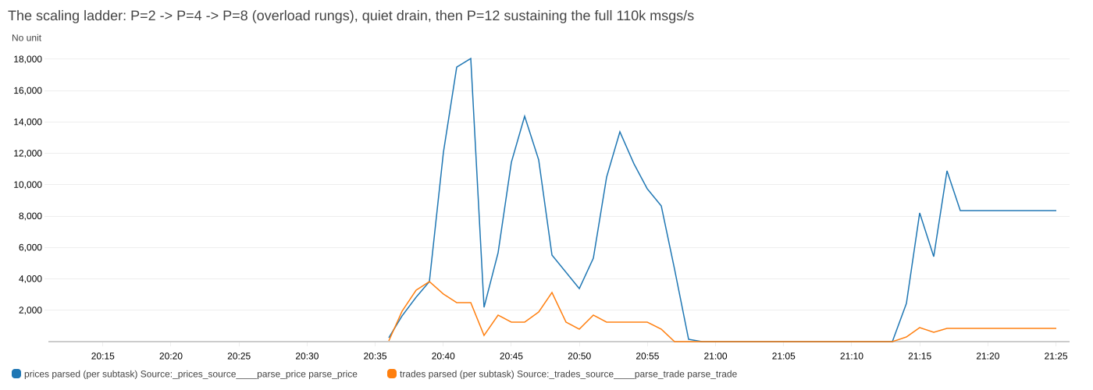
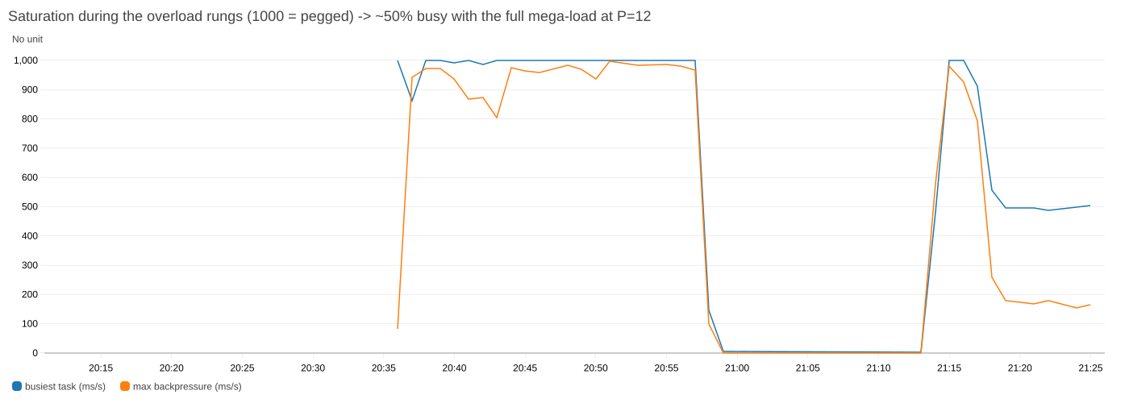
The ladder, as measured
CloudWatch, per-subtask throughput and saturation — AWS, Managed Flink

Slide 9
DataStream API vs Flink SQL — the measured scoreboard
The axis is the API, not the vendor: SQL was run on BOTH clouds and behaved the same on each
 | AWS (Managed Flink + MSK) | Confluent Cloud (Flink SQL)
Correctness - 5 independent checks | All pass, exact to the cent | All pass, exact to the cent
Throughput - DataStream (Java) | 146,300 rec/sec | not offered - SQL only
Throughput - the same SQL | 76,956 rec/sec | 39,400 - 90,600 rec/sec
Run-to-run variance | ~25% - gaps below that are noise | ~25%
Scaling | bounded by the workload: 10 tickers cap parallelism at 10 | pool allowed 20 CFU drew a measured max of 10
Cost (known) | $1.84/hr - 64% of it Kafka, not Flink | compute measured; cluster charge not captured
Partitions | billed: $0.0015/partition-hr | free
Code to build it | ~2,000 lines of Java | ~200 lines of SQL
Rate-limit an output | one connector option | NOT EXPRESSIBLE
Bad query shapes | silent - found by reading a plan | named in the console with a doc link
• Java is ~2x faster than SQL on identical hardware, load and logic - that gap is real and outside the noise
• SQL runs the SAME on both clouds - same speed, same failure to scale. The API is the variable; the vendor is not
• Both APIs scale. DataStream converts compute better - 2.27x vs 1.70x for 2x parallelism - and the gap widens with scale
• The deciding factor was not speed: do not update a screen faster than a human can read is one option on AWS SQL and has no construct in Confluent SQL

Slide 10
Most of the first numbers were wrong
Five published conclusions did not survive re-measurement
What I published | What was actually happening | Corrected
SQL is 124x slower | One SQL statement per Java operator - every stage hopped through Kafka | 1.8s, not 26.7s
SQL is 2.69x slower | That run consumed 119k rec/sec and wrote NOTHING for an hour - status green | ~2x, output verified
Confluent does not scale | 6-bucket tables capped the source at 6 readers - my rig, not the platform | ceiling was mine
Confluent scales 1.5x | Compared runs with different backlog sizes; ramp-up favours the larger | no scaling at all
Every throughput number | Math.min(requested, 30) capped the test data at 30 symbols, not 3,000 | re-measured at 3,000
• Root cause of the worst one: I checked on every test that records went IN. I never checked that records came OUT
• A pipeline that reads fast and writes nothing scores beautifully on a throughput metric
• I published 'it does not scale', corrected it, then corrected the correction - and the ORIGINAL answer was right
• Benchmarks mostly measure the person running them

Slide 11
Fast only counts if the numbers are correct
Days of throughput figures, and the correctness suite had never once run
• Six independent checks recompute every position and market value from the RAW topics with exact decimal arithmetic
• Market values asserted against the FINAL RAW price using OUR OWN recomputed position - so a wrong position cannot cancel a wrong price
• To make failures legible: every trade 1 share, every symbol its own fixed price. A position is then a count you can verify by eye
• It FAILED - 615 market values wrong. They were each priced at a slightly older tick of the RIGHT symbol
• Rather than wave it away as known semantics, the checker proves it: the implied price must fall inside the range that symbol actually traded at. All 615 did
• Result: zero wrong answers, plus a 6% staleness characteristic now described honestly instead of hidden behind a green tick

Slide 12
What happens on IPO day
One symbol takes 90% of the tape - measured at the producer
Feed | Record key | Ingest | Per-symbol ordering
Uniform | symbol | 873,333/sec | kept
90% one ticker | symbol | 293,333/sec (-66%) | kept
90% one ticker | salted | 764,444/sec (-12%) | LOST
90% one ticker | adaptive | 788,888/sec (-10%) | kept for quiet names
• A hot listing costs two thirds of ingest BEFORE the stream processor sees a record: every producer queues behind the one broker owning that symbol's partition
• Adding producers makes it worse - they contend for the same leader. No downstream tuning can touch this
• Fix: spread at the KEY, which is upstream of every ceiling. Salt only the hot names so quiet symbols keep ordering and compaction
• Keying fixes INGEST only. Surviving an IPO needs both: spread at the key AND conflate before the narrow stage

Slide 13
Flink SQL did not scale on either cloud
Same load, same market, one variable: the compute knob doubled
 | Knob doubled | Throughput gained | Cost
DataStream (Java) | parallelism | converts extra hardware into throughput | linear
SQL on AWS | parallelism 20 -> 40 | 6,106 -> 10,363 rec/s = 1.70x | +15% total cost
SQL on Confluent | pool cap 10 -> 20 | 0% - platform kept drawing 10 units | n/a
• DataStream 2.27x vs SQL 1.70x. Both scale; DataStream converts compute better and the gap WIDENS: 2.05x faster at P=20, 2.74x at P=40
• Earlier 1.17x was a metric artifact - CloudWatch reports PER-SUBTASK, dividing by the variable under test. Retracted; re-measured on fixed backlogs
• Extra workers only help if the work can be split - a stock's numbers must be added up in one place, so the new workers idle
• The Java advantage is not mainly SPEED, it is that Java converts extra hardware into throughput and this SQL does not
• Speed you can live with. Not being able to grow is a different problem - and invisible if you only test at one size

Slide 14
Path to production — AWS ready today
Full infrastructure-as-code, validated; one command to deploy
• Terraform stack complete: MSK Serverless (Kafka) + Amazon Managed Service for Apache Flink + generator on Fargate + CloudWatch dashboard
• The exact same application jar runs on AWS — every environment difference is configuration
• Security by default: private VPC, IAM auth to Kafka, least-privilege roles
• Operations runbook: deploy, in-place code update, config-only rescale, teardown
• Demo cost ≈ $1/hour while running; destroyed when not in use
• Status: DEPLOYED and load-tested on AWS — all cases green, scaling ladder measured, then torn down cleanly

Slide 15
What it took to build
AI-assisted engineering with review gates
1 day + epilogue
requirements to a
two-cloud proof
9 prompts
drove all nine
phases of work
≈ $515
metered AI compute
(flat-rate in practice)
26 finds
7 bugs, 1 design flaw,
18 deploy/cleanup gotchas
• Quality came from the process: plan first, review each outcome, make the system prove itself
• Bugs caught included the kind that bite in production: dependency clashes, silent metric mismatches, replay semantics
• Every prompt, decision, and result is recorded in the repository — fully auditable

Slide 16
Recommendations & next steps
• Recommend AWS Managed Flink for this product: it is faster, cheaper at equal work, and the only one of the two that can satisfy the output-cadence requirement (CR-1)
• Volume and stability proven on both, same method: AWS 757k msgs/sec peak, 28 min at 232,705/sec with deviation of 30; Confluent 386k peak single-statement
• Team walkthrough: live dashboard + 'explain the numbers' script are ready (docs/PERF_RESULTS.md)
• Candidate hardening for production: schema registry, DLQ for malformed records, autoscaling policy, CI pipeline
• Adopt the delivery pattern (phased outcomes + self-verification) for the next AI-assisted build
Repo: github.com/jimzucker/flink-fable5 · All results reproducible: make test · make validate · perf scripts

