Slide 1
FINAL PROJECT
Positions and Market Value from Block Trades
A streaming pipeline that aggregates block trades two ways, joins prices, and publishes market value — with exactly-once delivery.
Runtime | Apache Flink 1.20 · Java 17
Transport | Apache Kafka 3.9 (KRaft)
Delivery | exactly-once, verified by killing a task manager
Observability | Prometheus · Grafana
Runs on | one laptop, `docker compose up` — and on AWS unchanged
The live demo is the deliverable. These slides are the handout and the backup.
Notes:
Open with the running stack already built but idle. The most persuasive moment is graphs going from flat to flowing while people watch.

Slide 2
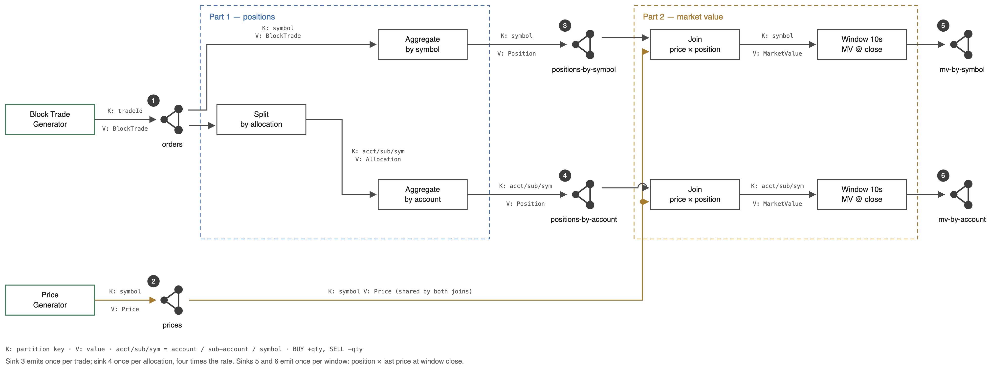
THE DESIGN
Six numbered elements, end to end
Every edge carries its partition key and value.
Notes:
Numbered left to right, in the order the demo talks through them. Point at 1 and 2 as the inputs, 3-6 as the outputs to verify.

Slide 3
THE PROBLEM
One order becomes four allocations
▸ A block trade is one order split across several accounts. A trade of 400 shares allocated to 4 accounts becomes 4 allocations of 100.
▸ Publish positions two ways, in parallel. By symbol, and by account / sub-account / symbol.
▸ Then join prices to those positions and publish market value the same two ways, once per key per window.
That split is the whole reason the two aggregations differ. The account side sees four records for every one the symbol side sees, so sink 4 updates four times as often as sink 3 — while the quantities still reconcile, because the four allocations sum to the block. It is the first thing anyone notices on the dashboard and the first thing to have an answer ready for.
Notes:
Sink 4 updates 4x as often as sink 3. Quantities reconcile — the four accounts sum to the block. The update counts differ by design.

Slide 4
EXPECTED OUTPUT
What the numbers should be, before we run anything
Input | Rate
Trades | 10 / sec
Prices | 1 000 / sec
Symbols | 4 unique
Accounts | 4 unique
Allocations per trade | 4 (one per account)
# | Sink | Rate in the demo | Keys
3 | positions-by-symbol | 10 / sec | 4
4 | positions-by-account | 40 / sec | 16
5 | mv-by-symbol | 4 per 10 s | 4
6 | mv-by-account | 16 per 10 s | 16
Set for the demo: window 10 s checkpoint interval 1 s partitions 4
Committing to these numbers before the run is what makes the demo a verification rather than a tour. scripts/verify-topics.sh checks every one of them against the real topics, at these settings, on every push.
Notes:
Say the numbers out loud BEFORE starting the generators. Then the dashboard either matches or it does not.

Slide 5
LIVE
Start the generators, then switch to Grafana
docker compose -f docker/compose.yml up -d --build → ./scripts/start-generators.sh
Notes:
The generators come up idle on purpose, so the dashboard is visibly empty until you start them. A stack that is already busy when it appears gives the moment away.

Slide 6
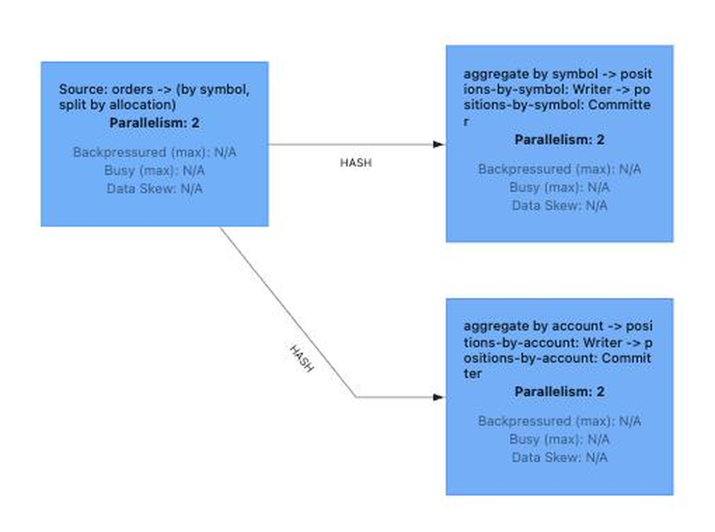
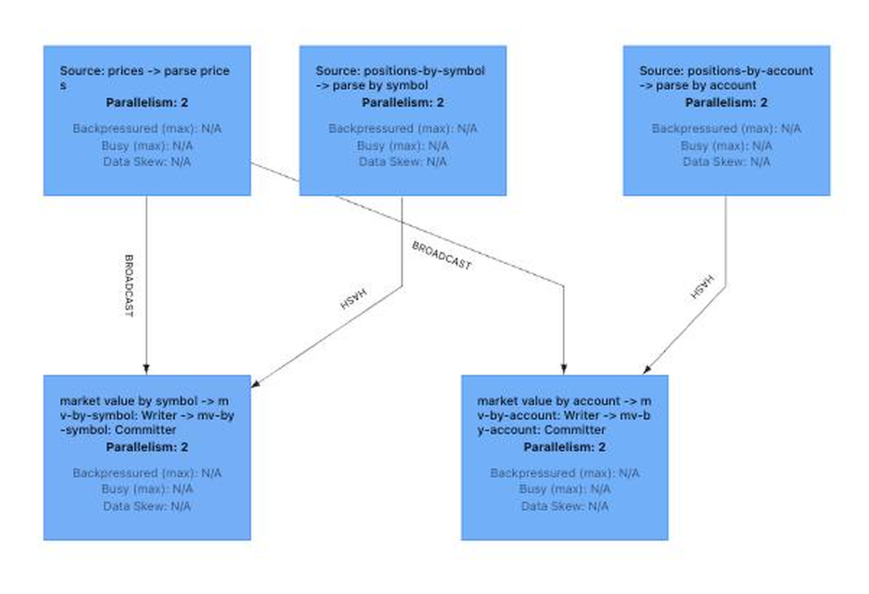
THE RUNNING PIPELINE
What Flink shows: two jobs, six operators
Part 1 — positions
Part 2 — market value
orders → split by allocation → two keyed aggregates, each with its own sink
prices broadcast to both joins; positions read back from topics 3 and 4
Part 2 reads sinks 3 and 4 back out of Kafka rather than taking the streams in-process, so it consumes exactly what any other consumer would — which is why Flink draws two graphs and not one.
Notes:
Two jobs because Part 2 consumes the published position topics rather than an in-process stream. Either part can be restarted or rescaled without the other, and Part 2 validates the topics that are themselves deliverables. Use this slide if the Flink UI is not reachable.

Slide 7
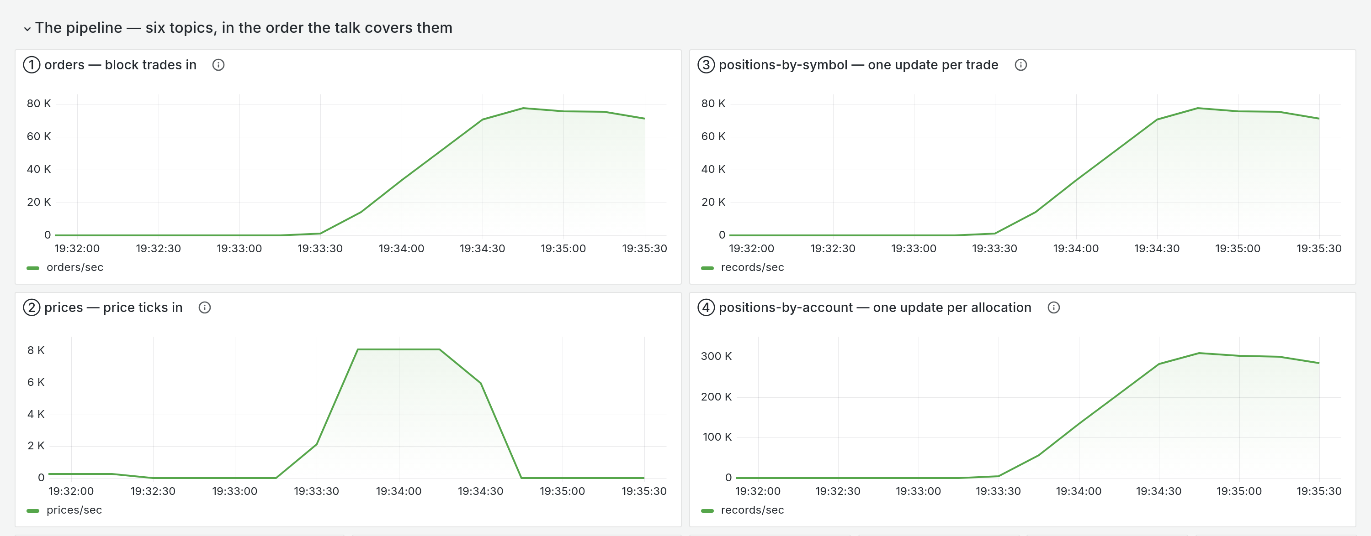
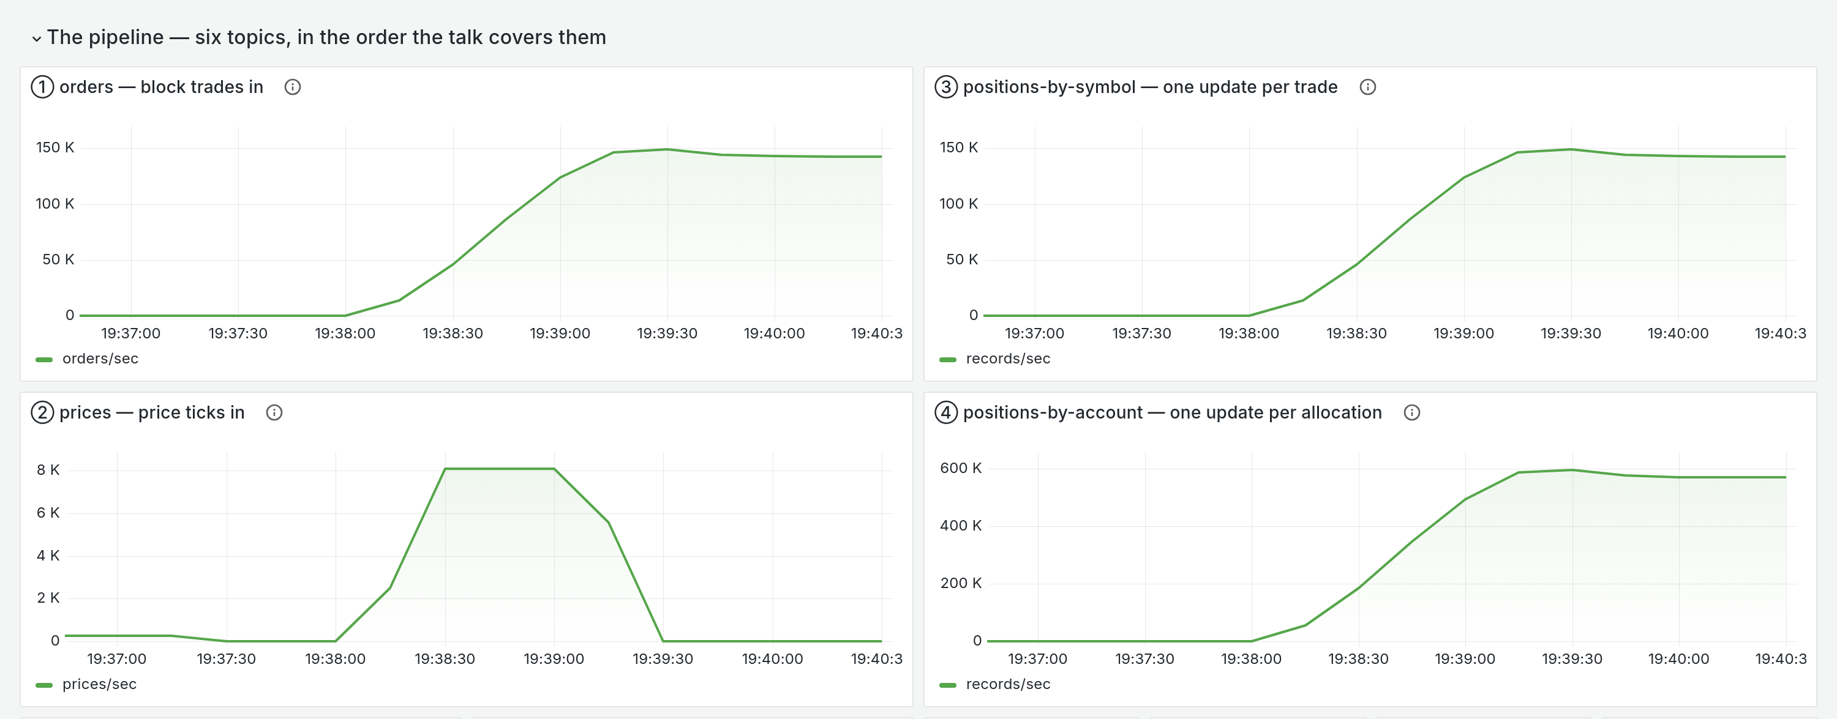
WHAT IT LOOKED LIKE
The same pipeline at two units, then four
2 units 73,397 orders/sec
4 units 146,063 orders/sec
Same panels, same axes, twice the units. Orders in and positions-by-account both roughly double; the account side runs at four times the order rate throughout, because every trade splits across four accounts.
Each image is the dashboard rendered over that case's own measurement window, so the plateau in the middle is the number the next slides quote — not a picture taken at a convenient moment.
Notes:
Rendered from the real measurement windows of the same run the next two slides quote -- 8 partitions, 5s checkpoint, 50M queued orders. If the live demo will not start, this slide and the Flink graph slide are the demo.

Slide 8
SCALING
Double the units, double the throughput
units | orders/sec | vs previous | Flink cores | broker cores | back-pressure
2 | 73 397 | — | 1.99 of 2 | 0.39 | 26.5%
4 | 146 063 | 1.99× | 3.89 of 4 | 0.78 | 47.3%
50,000,000 queued orders drained with the producer stopped, 8 partitions and a 5 s checkpoint interval held constant across both cases — so nothing varies but the units. These are the harness's settings, not the demo's.
A unit is one core and one degree of parallelism, bought together — which is exactly what a KPU is in Managed Service for Apache Flink. Two columns turn this from an assertion into a measurement. Flink used every core it was given, 1.99 of 2 and 3.89 of 4, so a unit bought is a unit worked. And the broker never passed 0.78 of a core while Flink was saturated, so Flink was unambiguously the constrained component — which is the precondition for showing that anything scales at all.
Notes:
You can only show that something scales when it is the thing that is constrained. Step 10 got this wrong — it varied parallelism while Flink already had every core it could use, and the answer came back flat.

Slide 9
SCALING
Two units, then four — against a perfect 2x
perfect 2x = 146,794
146,063
▸ A unit is one core and one degree of parallelism, bought together. That is what a KPU is in Managed Service for Apache Flink.
▸ Flink used every core it was given — 1.99 of 2, then 3.89 of 4. A unit bought is a unit worked.
▸ The broker never passed 0.78 of a core. Flink was the constrained component, and you can only show that something scales when it is the thing that is constrained.
73,397
1.99x
orders / sec
2 units
1.99 of 2 cores used
4 units
3.89 of 4 cores used
Eight partitions and a 5 s checkpoint were held constant across both cases, and the backlog was drained with the producer stopped, so nothing varied but the units. The dashed line is exactly twice the two-unit result; the four-unit bar reaches 99.5% of it.
Notes:
The dashed line is exactly 2x the first bar. The whole claim is whether the second bar reaches it -- 146,063 against 146,794, which is 99.5%. Step 10 got this wrong by varying parallelism while Flink already had every core it could use, and the answer came back flat.

Slide 10
EXPLAIN IT
Every number on the screen has an answer
▸ Why does sink 4 update four times as often as sink 3? Every block trade splits across four accounts. The quantities reconcile; the counts differ by design.
▸ Why do the market value sinks look like steps? They emit once per key per window, not continuously.
▸ Why is there one aborted checkpoint? At startup the first checkpoint triggers before every task is running. Harmless, and the panel says so.
The requirement is to be able to explain any number on the dashboard, and if a question cannot be answered, to change the logging until it can. The aborted-checkpoint panel is an example of that going the other way first: it originally implied the guarantee was being retried, which would have raised a false alarm mid-demo.
Notes:
If you cannot answer something, say so and take it as an action item to change the logging. That is the instruction in the requirements, and it beats an explanation invented on the spot.

Slide 11
LOAD
Both required cases pass
 | orders/s asked | prices/s | orders through | allocations | order p50
baseline | 10 | 1 000 | 8/s | 33/s | 519 ms
case 1 | 1 000 | 1 000 | 816/s | 3 269/s | 522 ms
case 2 | 10 | 20 000 | 8/s | 33/s | 513 ms
Case 1 raised throughput a hundredfold and order latency did not move — the requirement allows latency to rise, and it did not need to. Case 2 raised the price rate twentyfold and latency was again unchanged, which settles the question left open when prices were made a broadcast: the concern was that every price would pass through the threads doing order work, and at twenty times the rate it does not.
Notes:
Case 2 is the one that settles the broadcast-prices question.

