Slide 1

Final Project Requirements and Best Practices
Flink Training

Slide 2
Agenda
Final Demo Assignment Schedule
Streaming Development Lifecycle
Standard Principals
Final Project Problem Statement
Best Practices for
Pipeline Design
Verifying Calculations/Results
Grafana Dashboards
Demo

Slide 3
Final Demo Assignment and Schedule
Duration: Final should be completed within 8 days of completing Module 6
Review Video’s and training material
Background Business Problem
Flink Training Final Presentation - Portfolio Object Model and terms.mp4
Flink Training - Final Project - Object Model
Flink Training - Capital Markets Terms
Example Final Presentation.ppt
Meet with instructor iteratively as each deliverable in complete
Pipeline Design
Part 1 of pipeline running locally (Positions)
Part 2 of pipeline running locally (MarketValue)
Demo numbers and calculations are correct with small volumes using Grafana metrics
Demo running on locally using docker to have run locally with Kafka and Flink.
Demo running on AWS
Demo latency for orders is low using logging
Demo application can scale and latency not increase if order rate and or price rate increase
Prepare final Demo
Request instructor to setup Final Demo

Slide 4
Streaming Development Life Cycle
When we code a Flink pipeline we follow this development lifecycle
Create a pipeline design and review with team
Create a working application end to end and demo to team
Application should run local or on AWS
Demo should be on AWS with Grafana metrics to explain behavior
Validate calculation are correct with simple inputs, verify completeness, reproducibility of results.
Application behavior must be deterministic
You must be able to explain the numbers and demo to team
Verify application performs as expected with higher volumes
Case 1: Changing Speed of Order to say 1000/sec should not impact performance (latency will increase)
Case 2: Change price to very high # should not impact performance or latency of orders (ie 1000/sec)
1) Design
2) Build End to End with metrics
3) Validate Calculations/Results
4) Tune for Performance (Volume + Latency)

Slide 5
Standard Principals
Application must have a deterministic behavior
We all know things are random in the real world, but we must first prove our application is correct
Using random input where you don’t have deterministic output is impossible to demo and give confidence
You control the inputs and outputs, for the first demo show everyone the sunny path works!
Reproducibility
You should always be able to reproduce your results, if not something is wrong
don’t try to explain it away and argue with the team about it
fix your demo or explain the numbers are approximate and why when you set expectations
Traceability
You have to be able to explain the numbers, use logging liberally. If asked a question your not ready to answer, be honest, take it as an action item to change the logging to prove it is correct.
Latency
Its always important to measure latency end to end in streaming to show our application can scale efficiently.

Slide 6
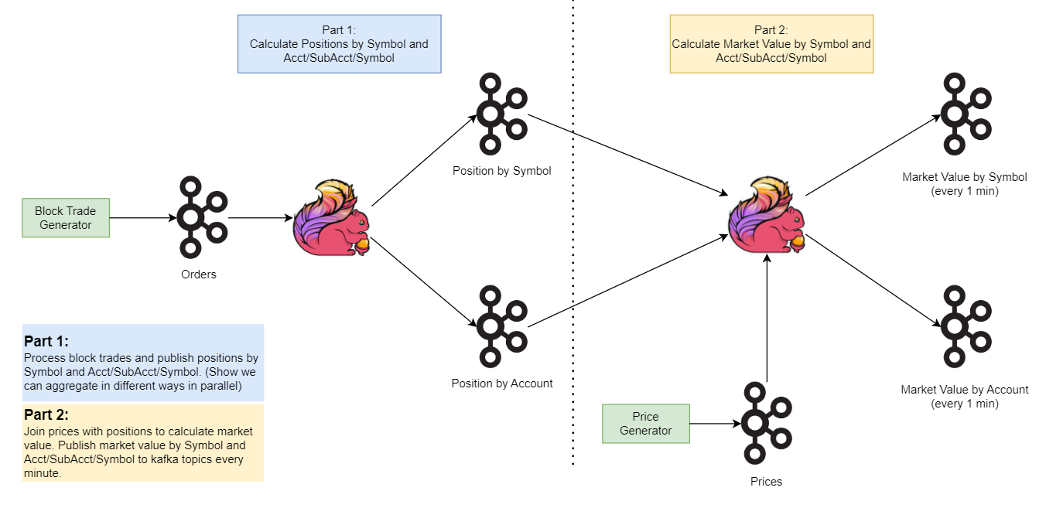
Final Project Problem Statement

Slide 7
Best Practices

Slide 8
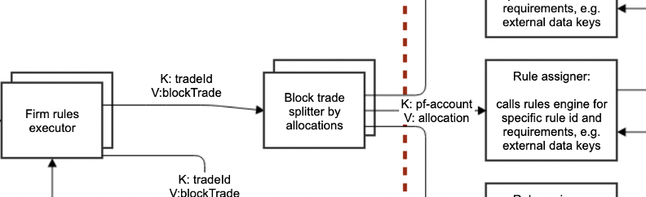


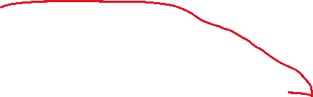


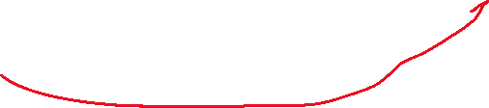
Best Practice Pipeline Design
Highlight, Keys, Values
sources and sinks
Between operators
Use colors sparingly, too many colors are hard to read
Number your diagram left to right like we read in the order you are going to talk about it
Use Kafka Icons for Kafka source/sinks
Boxes should explain operations like
Split
Aggregate
Join
1
2
3

Slide 9
Best Practice Verifying Calculations/Results
Use simple number like 4 or 10
Explain the numbers/Calcs
Tie back to the steps on the Design
Set expectations for demo output
Parameter | Input | Expected Output
Trades | 10/sec | 10 order /sec
Symbols | 4 unique | Sink 3 - 10 updates/sec & 4 unique keys Sink 5 – 4 unique keys (update 1x per minute do to window req in specs)
Accounts | 4 unique | Sink 4 – (10*4 allocations) = 40/sec (4account x 4 Symbols) == 16 Unique keys Sink 6 - 16 Unique keys (emitted 1x per minute)
Allocations | 4 unique

Slide 10
Best Practices Grafana
Show sources on left and sinks on the right like we read
Use Simple numbers so it is clear the results are what is expected
Always demo live, don’t bore us with slides! The slides are there for a handout.
Source
Sink
Latency

Slide 11
Best Practices for Demo
Go through your deck (ask if there are any questions before you proceed to the next)
problem statement
Pipeline design
Example of expected inputs/outputs
DEMO LIVE (The slides are in the deck for backup)
Have tabs open with everything pre-run so you can jump around and have it ready incase the live demo run fails (or people are impatient)
Launch your test and then switch to Grafana and explain what they see
Always go left to right
Don’t jump around
Explain inputs and outputs that match the example you walked people through

