Slide 1
FINAL PROJECT
Positions and Market Value from Block Trades
A streaming pipeline that aggregates block trades two ways, joins prices, and publishes market value — with exactly-once delivery.
Runtime | Apache Flink 1.20 · Java 17
Transport | Apache Kafka 3.9 (KRaft)
Delivery | exactly-once, verified by killing a task manager
Observability | Prometheus · Grafana
Runs on | one laptop, `docker compose up` — and on AWS unchanged
The live demo is the deliverable. These slides are the handout and the backup.
Notes:
Open with the running stack already built but idle. The most persuasive moment is graphs going from flat to flowing while people watch.

Slide 2
THE PROBLEM
One order becomes four allocations
▸ A block trade is one order split across several accounts. A trade of 400 shares allocated to 4 accounts becomes 4 allocations of 100.
▸ Publish positions two ways, in parallel. By symbol, and by account / sub-account / symbol.
▸ Then join prices to those positions and publish market value the same two ways, once per key per window.
That split is the whole reason the two aggregations differ. The account side sees four records for every one the symbol side sees, so sink 4 updates four times as often as sink 3 — while the quantities still reconcile, because the four allocations sum to the block. It is the first thing anyone notices on the dashboard and the first thing to have an answer ready for.
Notes:
Sink 4 updates 4x as often as sink 3. Quantities reconcile — the four accounts sum to the block. The update counts differ by design.

Slide 3
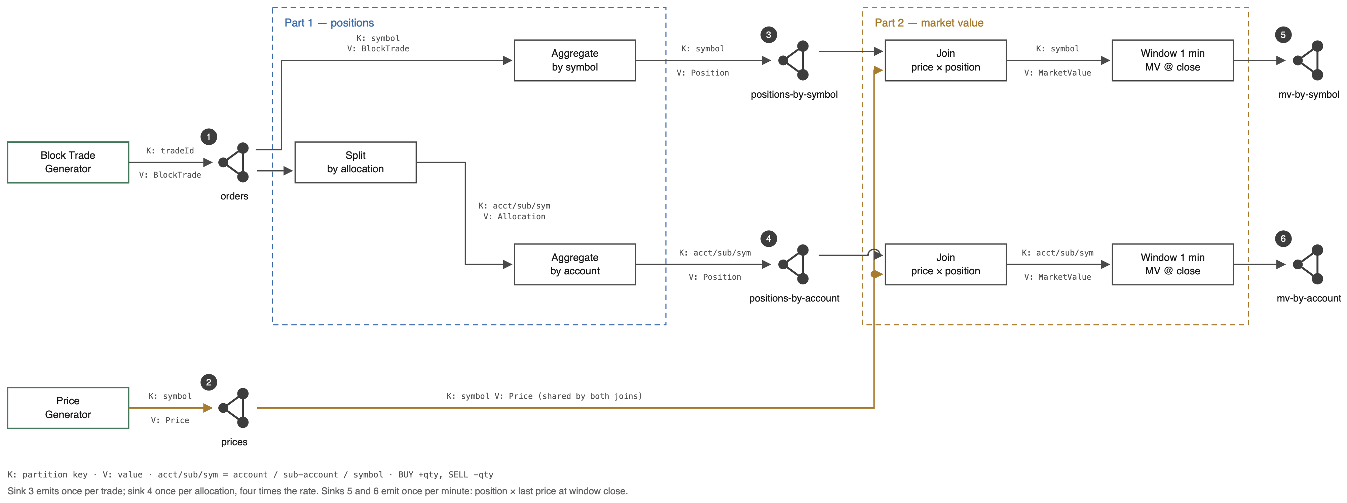
THE DESIGN
Six numbered elements, end to end
Every edge carries its partition key and value. The diagram states the specified one-minute window; the demo overrides it to ten seconds, and the calculation is identical either way.
Notes:
Numbered left to right, in the order the demo talks through them. Point at 1 and 2 as the inputs, 3-6 as the outputs to verify. If anyone reads '1 min' off the diagram, that is the specification -- the demo runs a 10s window.

Slide 4
EXPECTED OUTPUT
What the numbers should be, before we run anything
Input / setting | Demo value
Trades | 10 / sec
Prices | 1 000 / sec
Symbols | 4 unique
Accounts | 4 unique
Allocations per trade | 4 (one per account)
Window | 10 s (spec: 1 min)
Checkpoint interval | 1 s
# | Sink | Rate in the demo | Keys
3 | positions-by-symbol | 10 / sec | 4
4 | positions-by-account | 40 / sec | 16
5 | mv-by-symbol | 4 per 10 s | 4
6 | mv-by-account | 16 per 10 s | 16
The window is 10 s for the demo so the market value sinks say something without a minute of waiting — the job defaults to the specified minute, and the calculation is identical either way. Committing to these numbers before the run is what makes the demo a verification rather than a tour; scripts/verify-topics.sh checks every one of them against the real topics, on every push.
Notes:
Say the numbers out loud BEFORE starting the generators. Then the dashboard either matches or it does not. If asked why the window is 10s and not a minute: only for the demo, so the sinks say something without a minute of waiting. The job defaults to the specified minute and the verification runs against both.

Slide 5
LIVE
Start the generators, then switch to Grafana
docker compose -f docker/compose.yml up -d --build → ./scripts/start-generators.sh
Notes:
The generators come up idle on purpose, so the dashboard is visibly empty until you start them. A stack that is already busy when it appears gives the moment away.

Slide 6
EXPLAIN IT
Every number on the screen has an answer
▸ Why does sink 4 update four times as often as sink 3? Every block trade splits across four accounts. The quantities reconcile; the counts differ by design.
▸ Why do the market value sinks look like steps? They emit once per key per window, not continuously.
▸ Why is there one aborted checkpoint? At startup the first checkpoint triggers before every task is running. Harmless, and the panel says so.
The requirement is to be able to explain any number on the dashboard, and if a question cannot be answered, to change the logging until it can. The aborted-checkpoint panel is an example of that going the other way first: it originally implied the guarantee was being retried, which would have raised a false alarm mid-demo.
Notes:
If you cannot answer something, say so and take it as an action item to change the logging. That is the instruction in the requirements, and it beats an explanation invented on the spot.

Slide 7
CORRECTNESS UNDER FAILURE
A replayed record is a wrong number, not a duplicate
▸ A position is a running sum. At-least-once would silently corrupt it — and a wrong number is harder to spot than a missing one.
▸ EXACTLY_ONCE, one transactional id prefix per sink. Every reader in the verification path uses read_committed.
▸ Proved by breaking it. scripts/chaos-exactly-once.sh kills a task manager mid-run; the job recovers from checkpoint and the totals still reconcile.
Exactly-once is a claim about what happens when something fails, so without a failure the setting is untested and at-least-once looks identical. That is why the proof is a chaos script rather than a configuration screenshot. It also has a visible cost, which the next slide is about.
Notes:
The cost of this guarantee is the latency on the next slide. Don't let anyone read the 518ms as slowness — it is the commit interval, and it is a dial.

Slide 8
LATENCY
Two numbers, and they are not the same
 | p50 | max
What the pipeline takes | 59 ms | 110 ms (p99)
What a consumer waits for | 518 ms | 1 025 ms
Checkpoint interval | p50 | max
5 s | 2 488 ms | 4 988 ms
1 s (the default) | 518 ms | 1 025 ms
The gap is the guarantee, not the work. Under exactly-once nothing is readable until the checkpoint that produced it commits, so a consumer waits a roughly uniform interval on top of the processing time. Cut the interval by five and the latency falls by five, with the maximum landing inside one interval each time — which is what a uniform wait for the next commit looks like, and the strongest evidence that the delay is the guarantee rather than the pipeline. A checkpoint itself takes about 13 ms.
Notes:
Market value latency is measured from the window close, not the trade — the window is the specification, not a delay to account for.

Slide 9
LOAD
Both required cases pass
 | orders/s asked | prices/s | orders through | allocations | order p50
baseline | 10 | 1 000 | 8/s | 33/s | 519 ms
case 1 | 1 000 | 1 000 | 816/s | 3 269/s | 522 ms
case 2 | 10 | 20 000 | 8/s | 33/s | 513 ms
Case 1 raised throughput a hundredfold and order latency did not move — the requirement allows latency to rise, and it did not need to. Case 2 raised the price rate twentyfold and latency was again unchanged, which settles the question left open when prices were made a broadcast: the concern was that every price would pass through the threads doing order work, and at twenty times the rate it does not.
Notes:
Case 2 is the one that settles the broadcast-prices question.

Slide 10
SCALING
Double the units, double the throughput
units | orders/sec | vs previous | Flink cores | broker cores | back-pressure
2 | 65 721 | — | 2.00 of 2 | 0.25 | 28.5%
4 | 129 056 | 1.96× | 3.94 of 4 | 0.39 | 51.6%
A unit is one core and one degree of parallelism, bought together — which is exactly what a KPU is in Managed Service for Apache Flink. Two columns turn this from an assertion into a measurement. Flink used every core it was given, 2.00 of 2 and 3.94 of 4, so a unit bought is a unit worked. And the broker stayed under half a core, so Flink was unambiguously the constrained component — which is the precondition for showing that anything scales at all. Eight partitions were held constant across both cases, so nothing varied but the units.
Notes:
You can only show that something scales when it is the thing that is constrained. Step 10 got this wrong — it varied parallelism while Flink already had every core it could use, and the answer came back flat.

Slide 11
BACKUP — THE WHOLE CURVE
Where it stops, and why the broker looks idle
units | orders/sec | vs previous | Flink cores | broker cores | back-pressure
1 | 30 505 | — | 1.00 of 1 | 0.10 | 24.1%
2 | 65 721 | 2.15× | 2.00 of 2 | 0.25 | 28.5%
4 | 129 056 | 1.96× | 3.94 of 4 | 0.39 | 51.6%
8 | 151 969 | 1.18× | 4.98 of 8 | 0.48 | 72.7%
The broker is at 0.48 cores while being the thing in the way. It has run out of write throughput, not CPU: 151 969 orders/sec is 759 845 records/sec, against the ~750 000 one broker accepts — because each order becomes five records.
A broker that looks asleep can still be the ceiling, and the only way to tell is to have both CPU figures beside the throughput. "The broker is full" would have been the wrong way to say it — it implies a busy broker, and the two cases are only distinguishable from this table.
Notes:
Only show this if asked where it stops. The demo pair is 2 and 4.

Slide 12
BACKUP — SAME SCRIPT, BIGGER KAFKA
Is that Flink's ceiling, or the laptop's?
 | laptop | AWS
4 → 8 units | 1.18× | 1.73×
Flink cores at 8 units | 4.98 of 8 | 7.99 of 8
broker cores at 8 units | 0.48 | 0.62
The laptop's. The same script, unchanged, against a two-broker MSK cluster. With the broker no longer in the way, Flink uses everything it is given and the flattening disappears. Nothing about the job changed.
Stated honestly: that run was a confirmation, not a second demo. Its step ratios rise rather than decay, which is backwards and is not yet explained, and its two highest points were measured once each. The laptop numbers are the ones to stand behind.
Notes:
Do not volunteer this. It is an answer to one question, not a slide in the flow.

Slide 13
BACKUP — HOW IT WAS BUILT
Thirteen steps, each reviewed before the next
▸ One branch per step, squash-merged. Linear history, one commit and one tag per step, branches kept so the working history stays inspectable.
▸ CI on every push. Build and unit tests, shellcheck, a cold-start run of the whole stack, and a job that verifies the expected numbers against real topics.
▸ Everything is scripted. The demo, the chaos test, the latency measurement, the scaling run — and this deck.
The scaling harness refuses to report a number it cannot stand behind: it checks that the CPU limit was applied to the container, that a job is actually running, that the backlog outlasted the measurement window, and that no previous run still owns the cluster. Every one of those was a real failure during the scaling work, and each had produced a confident wrong answer.
Notes:
The journal records what drove each step, what was decided, and what its review changed. docs/reviews/ has the exchanges verbatim.

