Slide 1
Introduce myself
Name :Wang Ruijun
Nationality:China

Slide 2

4
9
6
7
0
4
1
8
7
6
0
1
2
4
4
6
0
1
4
7
5
5
1
4
2
8
9
My name is WANGRUIJUN
I’m from HENAN CHINA
I’m 19 years old.
Maybe I am a shy person .
But I will very happy if you want to be my friend.

Slide 3
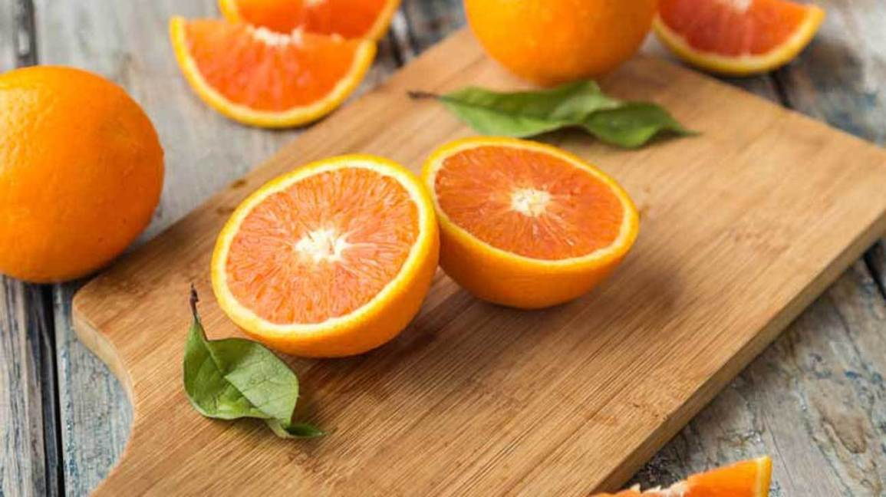


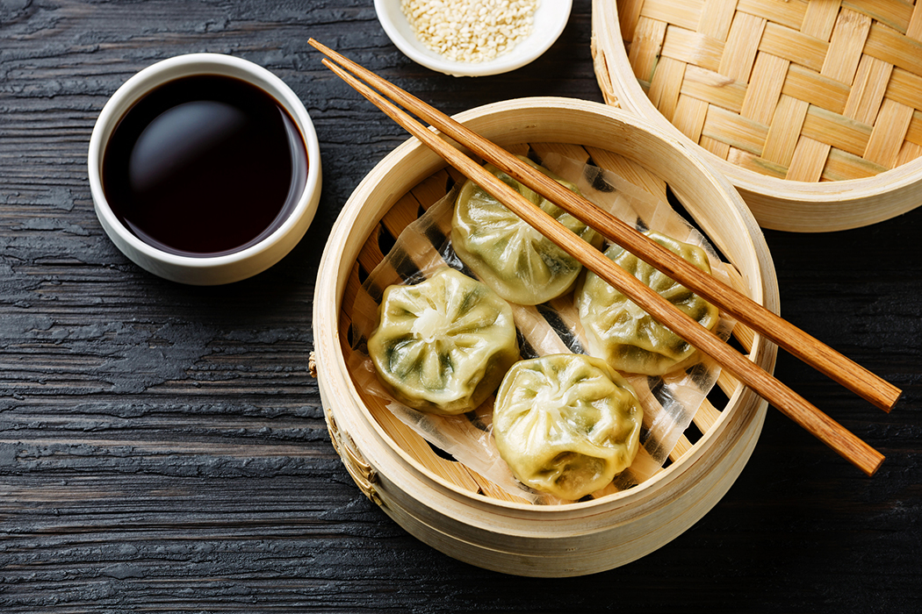
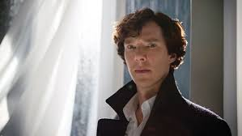
My favorite
Color : Blue
Food : All the Chinese food
Fruit : orange, durian.
Singer : Jay zhou.
Book : Ender’s game.
Actor : Benedict Cumberbatch

Slide 4
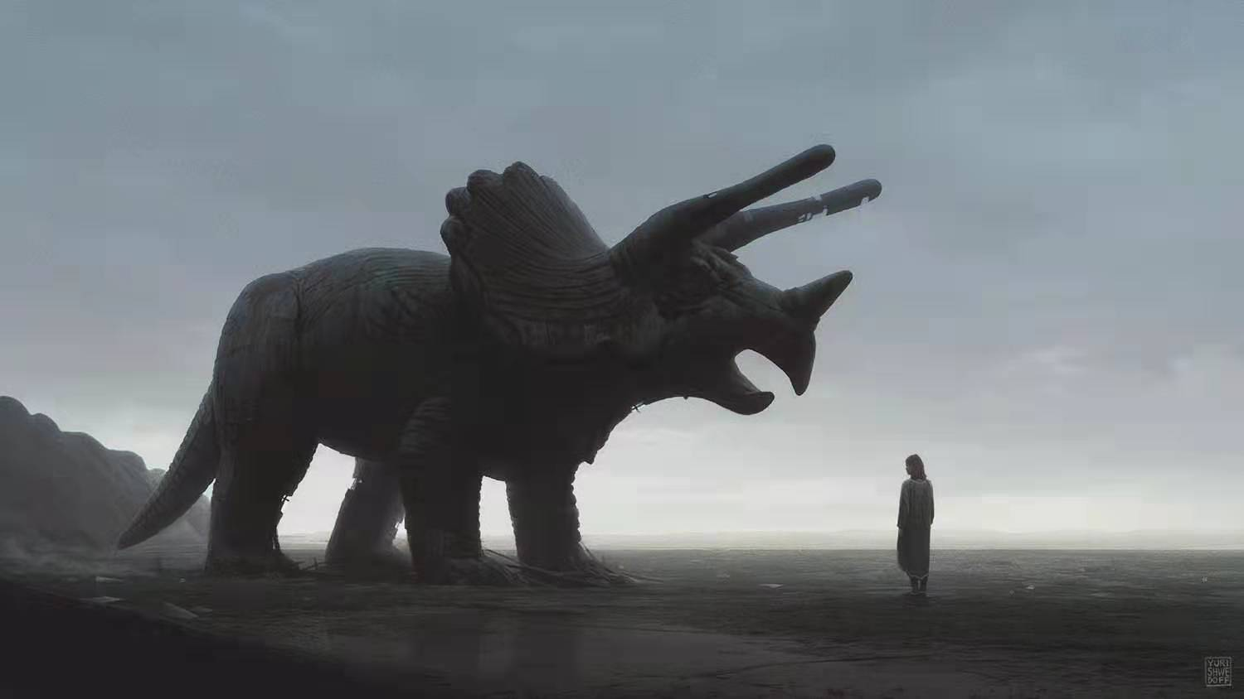
4
0
6
0
1
9
0
8
0
6
0
0
VERY HAPPY TO MEET YOU HERE IN
2
9
07
0
2
1
1
0
1
4
2

