Slide 1

End2End speech to text
Karel Veselý
BISSIT 2021, Brno

Slide 2
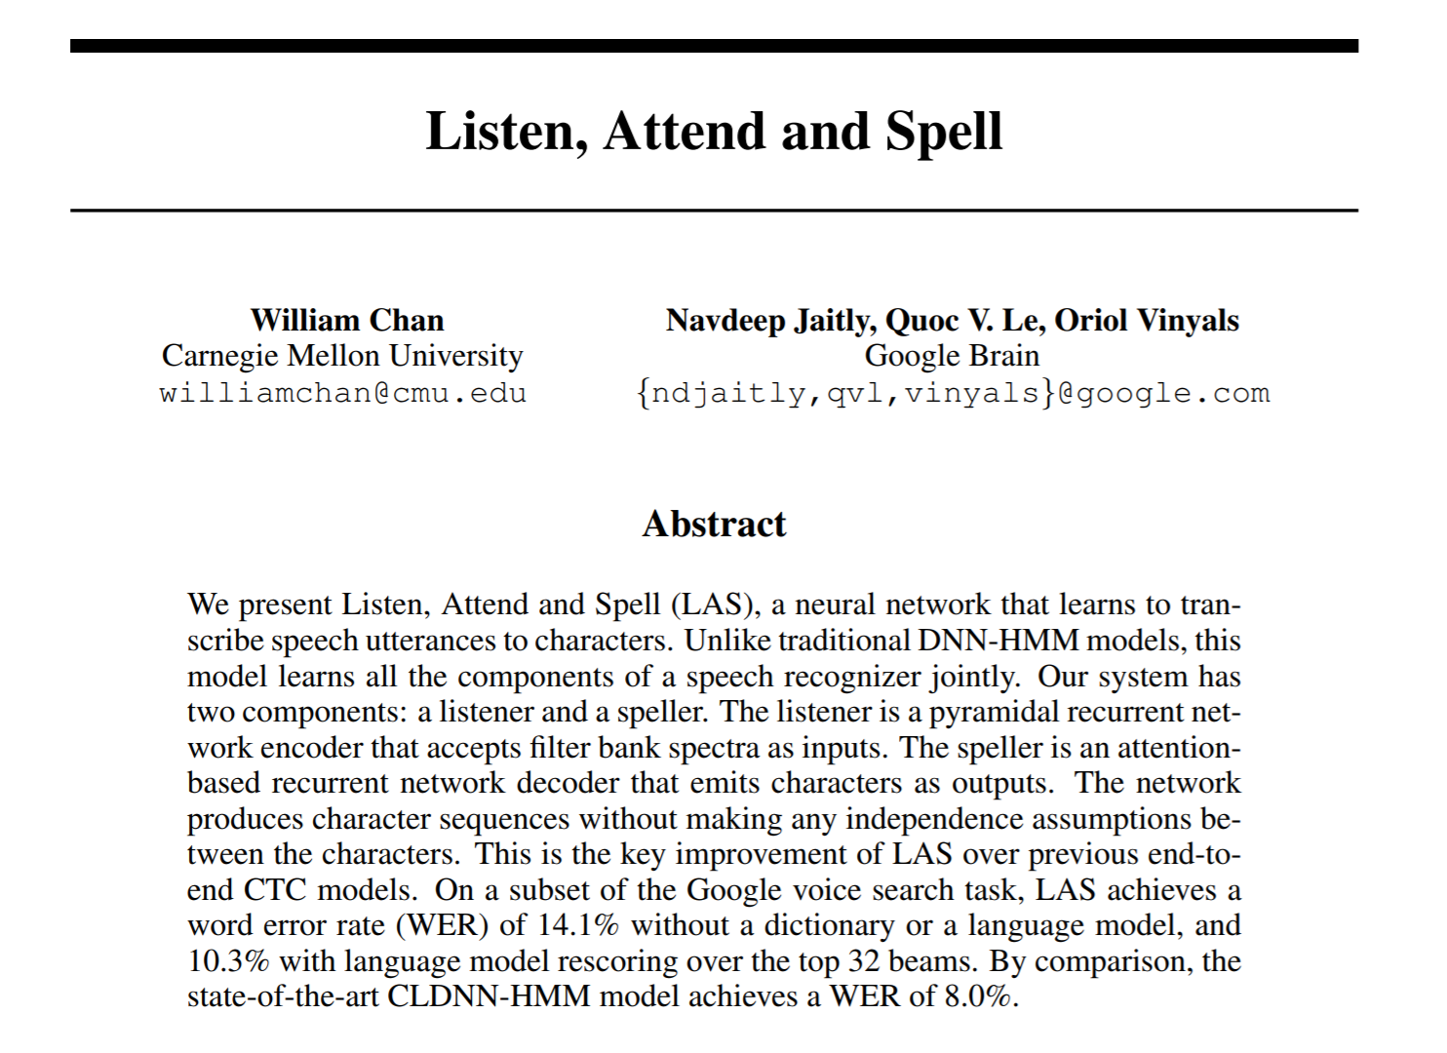
End2End system
End2End = everything in one model (acoustics, pronunciation, language)
Article summary:
Not as good performance as the best HMM recognizer (14% vs. 8%),
Simpler concept than HMM,
That was 2015, now the gap is closed already …
https://arxiv.org/pdf/1508.01211.pdf

Slide 3
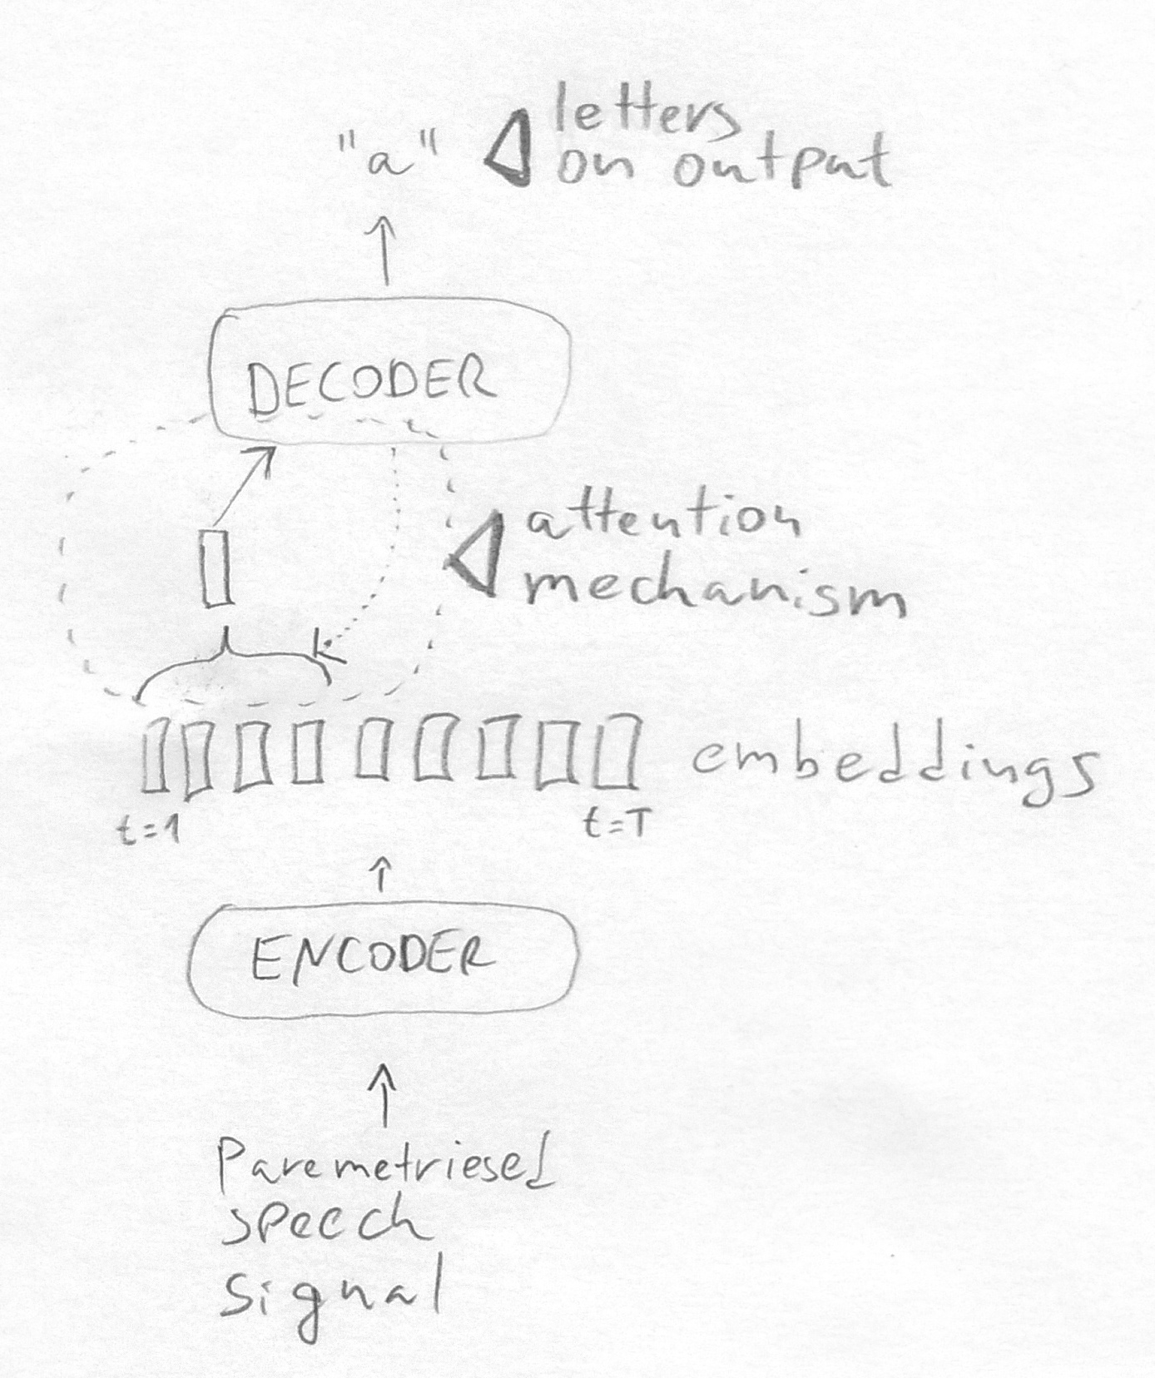
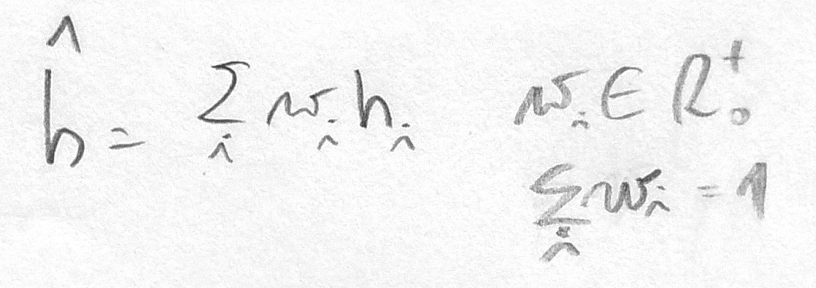
End2End system
Spell
Attend
Listen

Slide 4
End2End system
Output example: “#beg i # l i k e # b r n o #end”
Encoder, decoder : neural network (BLSTM)
Decoder has an inner state:
previous output symbol,
previous hidden layer values,
The time-steps have various lengths

Slide 5
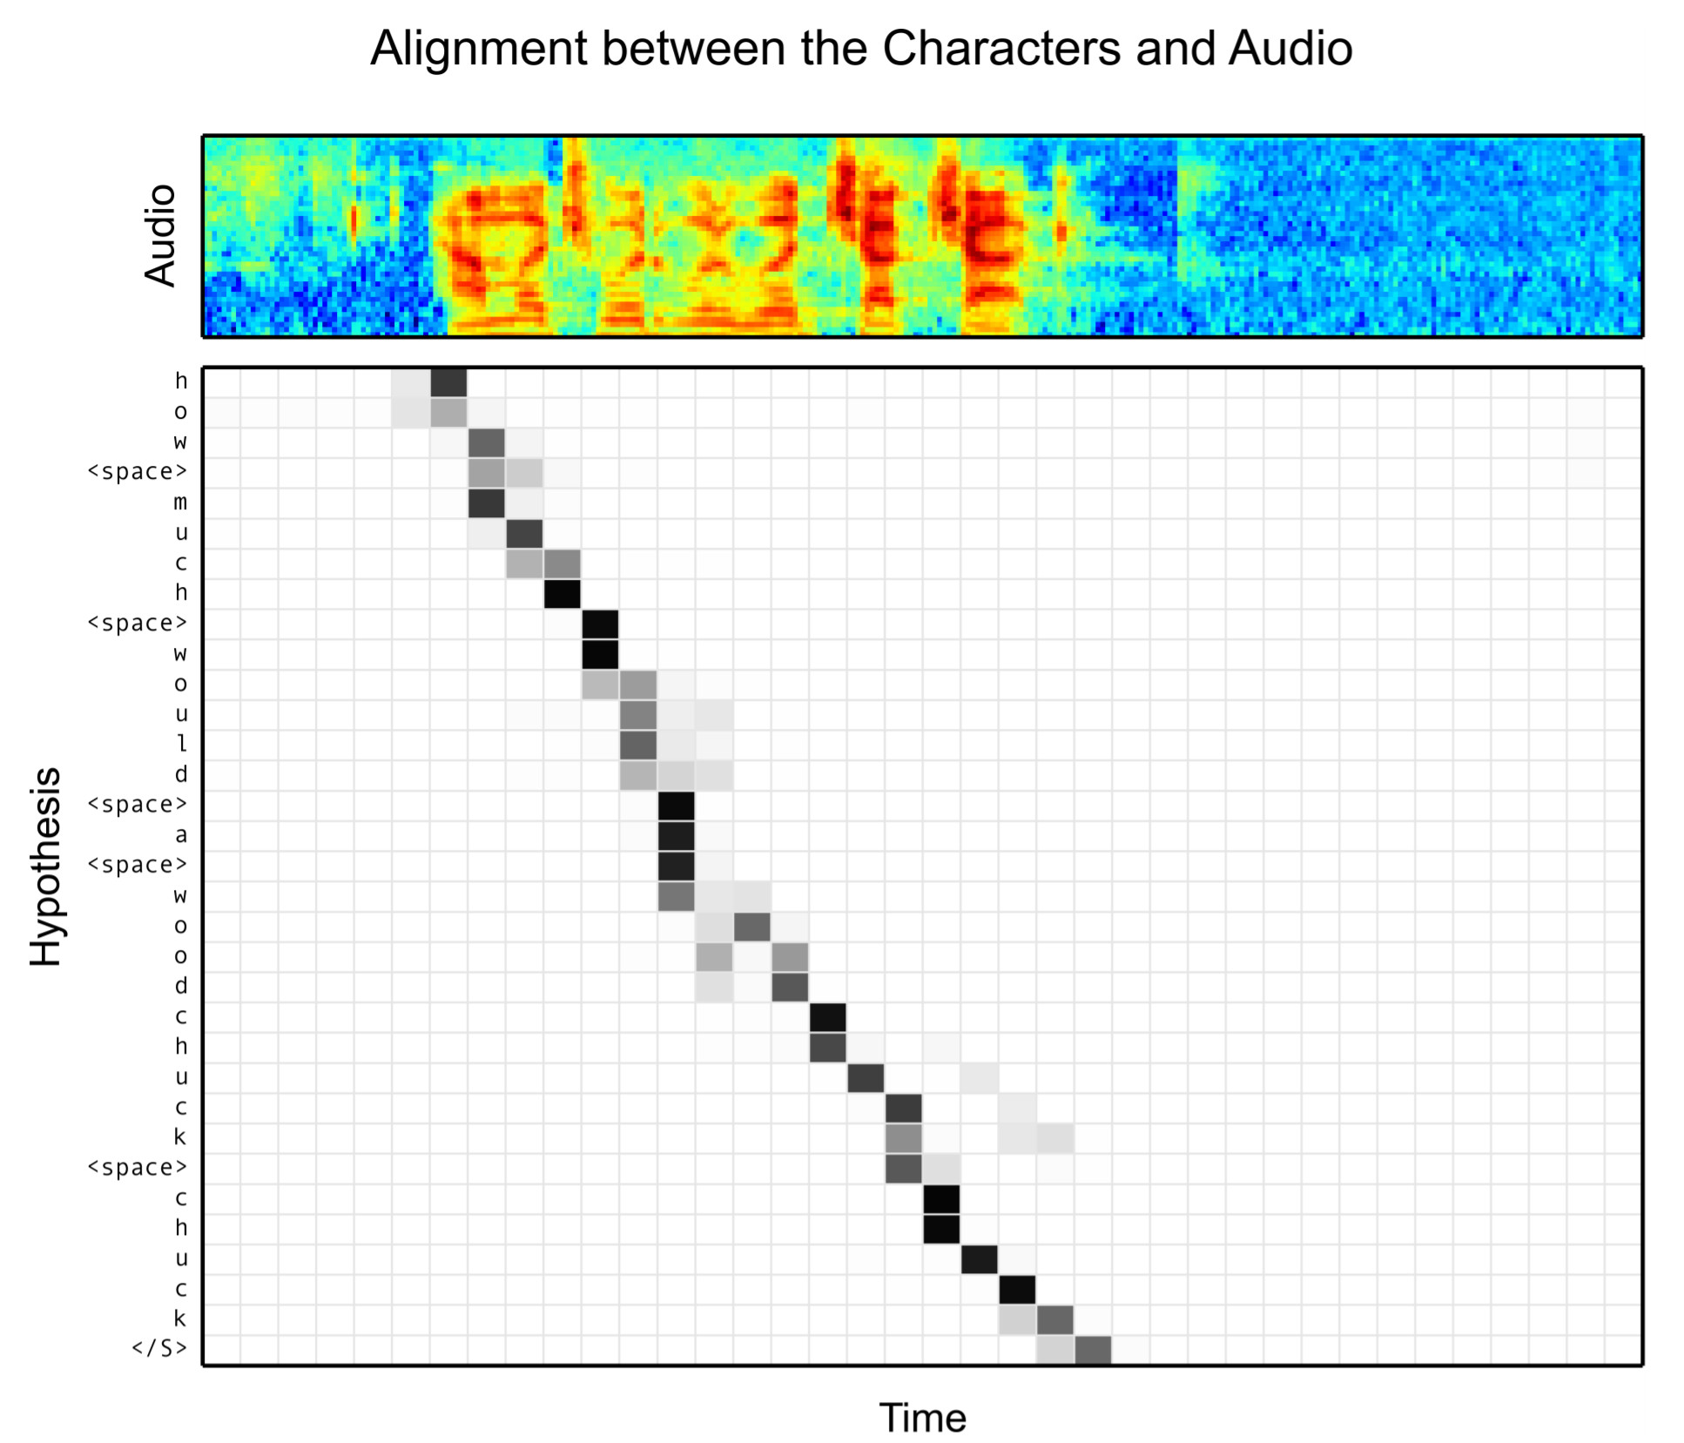
End2End system

Slide 6
End2End system
For training we need:
Speech signal,
“Correct” output symbols,
Training paradigm:
Change the model parameters so that the probability of “correct” output symbols is maximized
The model produces posterior prob. distribution : P(s|x)

Slide 7
End2End system
Some reading on End2End models:
Google uses RNN-T without attention mechanism: https://ai.googleblog.com/2019/03/an-all-neural-on-device-speech.html
good for “on-device” recognition (needs less memory than HMM recognizer)
can be used on continuous stream of audio, attention can’t,
Recent generation of End2End models:
Transformer: https://ieeexplore.ieee.org/stamp/stamp.jsp?tp=&arnumber=8462506
Conformer: https://www.isca-speech.org/archive/Interspeech_2020/pdfs/3015.pdf
Toolkits:
EspNet https://github.com/espnet/espnet
Espresso https://github.com/freewym/espresso/blob/master/examples/asr_librispeech/run.sh
WeNet https://github.com/wenet-e2e/wenet
Flashlight ASR https://github.com/flashlight/flashlight/tree/master/flashlight/app/asr

Slide 8
What do did you learn from this part?
…

