Slide 1
The _Layout.cshtml file in the Views/Shared folder
<!DOCTYPE html>
…
<body>
@RenderBody() -> here come other pages
</body>
</html>
A _ViewStart.cshtml file that sets the default layout
@{
Layout = "_Layout";
}
A _ViewImports.cshtml file that enables all ASP.NET Core MVC tag helpers
@addTagHelper *, Microsoft.AspNetCore.Mvc.TagHelpers

Slide 2
Two ways to code a link
Use HTML to hard code the URL in the href attribute
<a href="/Product/List/Guitars">View guitars</a>
Use ASP.NET tag helpers to generate the URL
<a asp-controller="Product" asp-action="List"
asp-route-id="Guitars">View guitars</a>
The URL for both links
/Product/List/Guitars
A link that specifies a route parameter that doesn’t exist
<a asp-controller="Product" asp-action="List"
asp-route-page="1" asp-route-sort_by="price">
Products - Page 1</a>
The URL that’s generated
/Product/List?page=1&sort_by=price

Slide 3
More tag helpers for generating URLs
asp-area
asp-fragment
asp-protocol
asp-host
How to code a link to an area
<a asp-area="Admin" asp-controller="Product"
asp-action="List">Admin - Product Manager</a>
The URL that’s generated
/Admin/Product/List
How to code an HTML placeholder
<h2 id="Fender">Fender Guitars</h2>
How to code a URL that jumps to an HTML placeholder on the same page
<a asp-fragment="Fender">View Fender Guitars</a>
The URL that’s generated
/#Fender

Slide 4
How to code an absolute URL
<a asp-protocol="https"
asp-host="murach.com"
asp-controller="Shop"
asp-action="Details"
asp-route-id="html5-and-css3"
asp-fragment="reviews">Murach's HTML5 and CSS3 - Reviews</a>
The URL that’s generated
https://www.murach.com/Shop/Details/html5-and-css3#reviews

Slide 5
Razor expressions that format the numbers
Expression Result
@ViewBag.Price.ToString("C") $12,345.67
@ViewBag.Price.ToString("C1") $12,345.7
@ViewBag.Price.ToString("C0") $12,346
@ViewBag.Price.ToString("N") 12,345.67
@ViewBag.Price.ToString("N1") 12,345.7
@ViewBag.Price.ToString("N0") 12,346
@ViewBag.DiscountPercent.ToString("P") 4.50%
@ViewBag.DiscountPercent.ToString("P1") 4.5%
@ViewBag.DiscountPercent.ToString("P0") 5%

Slide 6
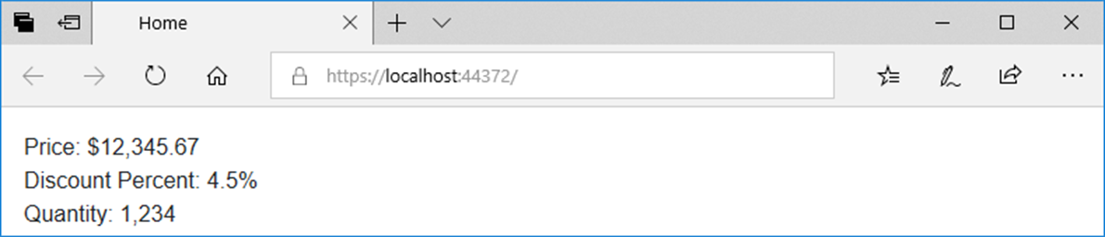
Code in a view that displays the numbers
<div>Price: @ViewBag.Price.ToString("C")</div>
<div>Discount Percent: @ViewBag.DiscountPercent.ToString("P1")</div>
<div>Quantity: @ViewBag.Quantity.ToString("N0")</div>
The view displayed in a browser

Slide 7
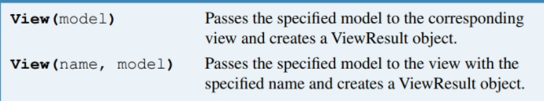
A method that a controller can use to pass a model to a view
View(model)
View(name, model)
The Product/Details() action method that passes a model to a view
public IActionResult Details(int id) {
Product product = context.Products.Find(id);
return View(product);
}
A Product/Add() action method that passes a model to the specified view
[HttpGet]
public IActionResult Add() {
return View("Update", new Product());
}

Slide 8
A _ViewImports file that imports the Models namespace for all views
A directive for displaying model properties in a view
@model
A property for displaying model properties in a view
@Model
@addTagHelper *, Microsoft.AspNetCore.Mvc.TagHelpers
@using GuitarShop.Models
The code for the Product/Details view
@model Product
@{
ViewBag.Title = "Product Details";
}
<h1>Product Details</h1>
<div>ID: @Model.ProductID</div>
<div>Name: @Model.Name</div>
<div>Category: @Model.Category.Name</div>
<div>Price: @Model.Price.ToString("C2")</div>
<a asp-controller="Home" asp-action="Index">Home</a>

Slide 9
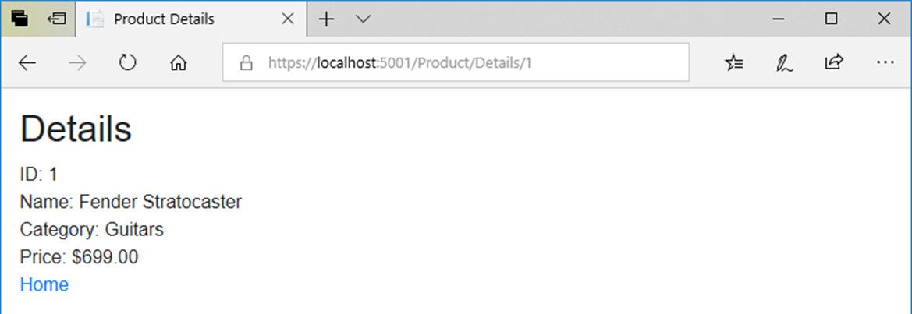
The view with model properties in a browser

Slide 10
A tag helper for binding HTML elements to model properties
asp-for
A view with asp-for tag helpers (part 1)
@model Product
@{
ViewBag.Title = "Update Product";
}
<h1>Update Product</h1>
<form asp-action="Update" method="post">
<div class="form-group">
<label asp-for="Name"></label>
<input asp-for="Name" class="form-control">
</div>
<div class="form-group">
<label asp-for="Price"></label>
<input asp-for="Price" class="form-control">
</div>

Slide 11
A view with asp-for tag helpers (part 2)
<input type="hidden" asp-for="ProductID" />
<input type="hidden" asp-for="Category.Name" />
<button asp-action="Update" type="submit"
class="btn btn-primary">Update
</button>
<a asp-action="List" class="btn btn-primary">
Cancel</a>
</form>

Slide 12
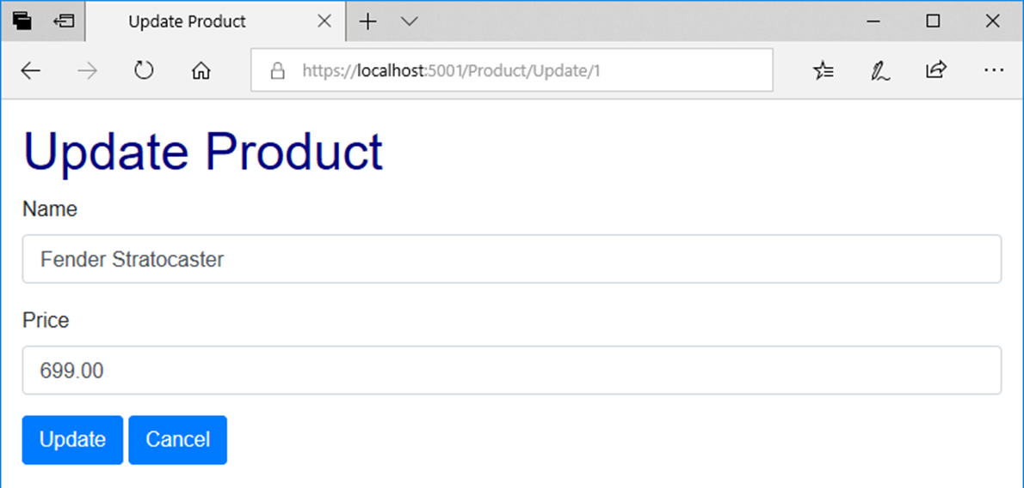
The view with bound properties in a browser

Slide 13
The HTML that’s generated for the Price <label> and <input> elements
<label for="Price">Price</label>
<input class="form-control" type="text"
id="Price" name="Price" value="699.00">

Slide 14
A tag helper for adding options to a <select> element
asp-items
The constructor of the SelectList class
SelectList(list, value, text, selectedValue)

Slide 15
An Update action method that creates the model and passes it to the view
public IActionResult Update(int id)
{
ViewBag.Categories = context.Categories.ToList();
Product product = context.Products.Find(id);
return View(product);
}

Slide 16
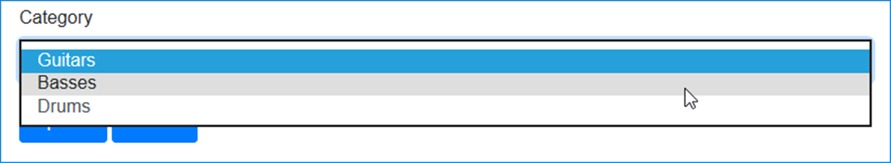
The code that binds items to a <select> element
<div class="form-group">
<label asp-for="CategoryID">Category</label>
<select asp-for="CategoryID"
asp-items="@(new SelectList(ViewBag.Categories,
"CategoryID", "Name",
Model.CategoryID.ToString()))"
class="form-control"></select>
</div>
The <select> element and its label displayed in a browser

Slide 17
HTML that’s generated for the <select> element
<select class="form-control" id="Category_CategoryID"
name="Category.CategoryID">
<option selected="selected" value="1">
Guitars</option>
<option value="2">Basses</option>
<option value="3">Drums</option>
</select>

Slide 18
A List action method that creates the model and passes it to the view
public IActionResult List(string id = "All")
{
ViewBag.Categories = context.Categories.ToList();
ViewBag.SelectedCategory = id;
List<Product> products = context.Products
.Where(p => p.Category.Name == id).ToList();
return View(products);
}

Slide 19
The code for the view (part 1)
@model List<Product>
@{
ViewBag.Title = "Product List";
}
<h1>Product List</h1>
@if (ViewBag.Categories != null)
{
foreach (Category c in ViewBag.Categories)
{
<a asp-controller="Product" asp-action="List"
asp-route-id="@c.Name">@c.Name</a>
<text> | </text>
}
}
<a asp-controller="Product" asp-action="List"
asp-route-id="All">All</a>
<hr />

Slide 20
The code for the view (part 2)
@if (@ViewBag.SelectedCategory == "All")
{
<h2>All Products</h2>
}
else
{
<h2>@ViewBag.SelectedCategory</h2>
}
<table class="table table-bordered table-striped">
<thead>
<tr>
<th>Name</th>
<th>Price</th>
<th></th>
<th></th>
</tr>
</thead>

Slide 21
The code for the view (part 3)
<tbody>
@foreach (var product in @Model)
{
<tr>
<td>@product.Name</td>
<td>@product.Price.ToString("C")</td>
<td>
<a asp-controller="Product"
asp-action="Details"
asp-route-id="@product.ProductID">
View</a>
</td>
<td>
<a asp-controller="Product"
asp-action="Update"
asp-route-id="@product.ProductID">
Update</a>
</td>
</tr>
}
</tbody>
</table>

Slide 22
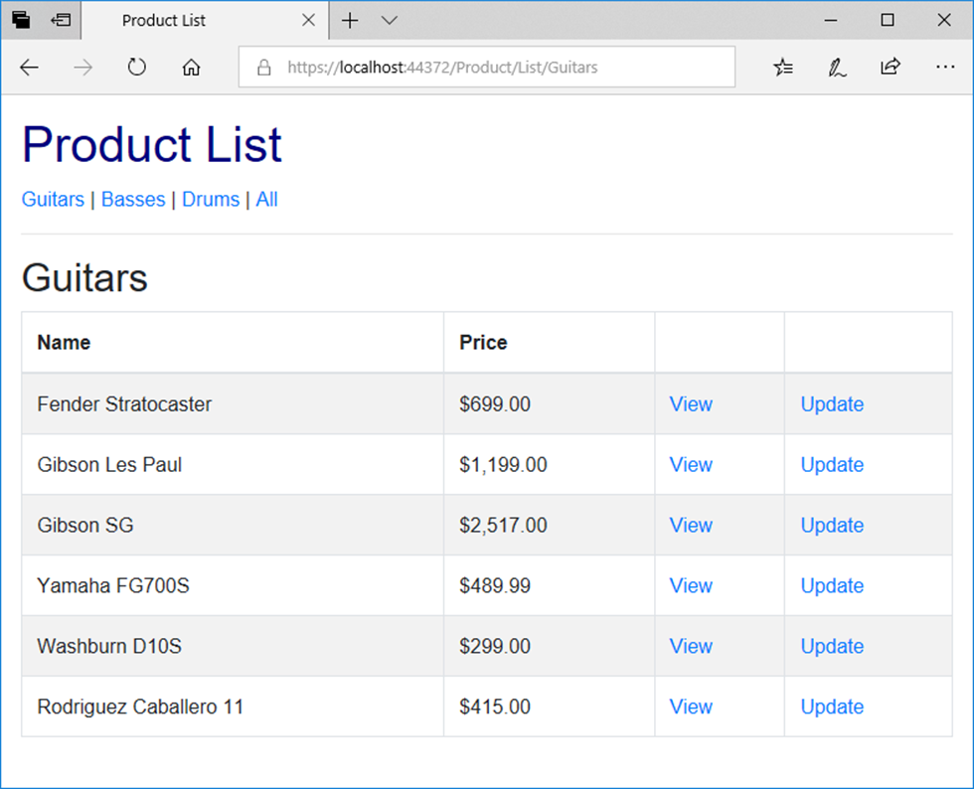
The Product objects view in a browser

Slide 23
The Views/Shared/_MainLayout.cshtml file (part 1)
<!DOCTYPE html>
<html>
<head>
<title>@ViewBag.Title</title>
<link rel="stylesheet" href="~/lib/bootstrap/css/bootstrap.min.css" />
<link rel="stylesheet" href="~/css/custom.css" />
</head>
<body>
<header>
<a asp-controller="Home" asp-action="Index">
Home</a> |
<a asp-controller="Product" asp-action="List">
Products</a> |
<a asp-controller="Home" asp-action="About">
About</a>
<hr />
</header>

Slide 24
The Views/Shared/_MainLayout.cshtml file (part 2)
@RenderBody()
<footer>
<hr />
<p>&copy; @DateTime.Now.Year - Guitar Shop</p>
</footer>
</body>
</html>

Slide 25
The code for a _ViewStart.cshtml file that sets the default layout
@{
Layout = "_Layout";
}
The code for a Home/Index view that explicitly specifies a layout
@{
Layout = "_MainLayout";
ViewBag.Title = "Home";
}
<p>Welcome to the Guitar Shop website!</p>

Slide 26
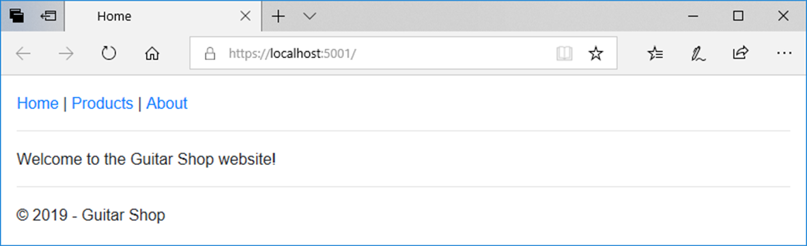
The Home page

Slide 27
The _Layout file
<!DOCTYPE html>
<html>
<head>
<title>@ViewBag.Title</title>
<link rel="stylesheet"
href="~/lib/bootstrap/css/bootstrap.min.css" />
<link rel="stylesheet" href="~/css/custom.css" />
</head>
<body>
@RenderBody()
</body>
</html>

Slide 28
The _MainLayout file
@{
Layout = "_Layout";
}
<header>
<a asp-controller="Home" asp-action="Index">Home</a> |
<a asp-controller="Product" asp-action="List"
asp-route-id="All">Products</a> |
<a asp-controller="Home" asp-action="About">About</a>
<hr />
</header>
@RenderBody()
<footer>
<hr />
<p>&copy; @DateTime.Now.Year - Guitar Shop</p>
</footer>

Slide 29
The _ProductLayout file
@{
Layout = "_MainLayout";
}
<h1>Product Manager</h1>
@if (ViewBag.Categories != null)
{
foreach (Category c in ViewBag.Categories)
{
<a asp-controller="Product" asp-action="List"
asp-route-id="@c.Name">@c.Name</a><text> | </text>
}
<a asp-controller="Product" asp-action="List"
asp-route-id="All">All</a>
}
<hr />
@RenderBody()

Slide 30
The code for a view that uses the _ProductLayout view
@model List<Product>
@{
Layout = "_ProductLayout";
ViewBag.Title = "Product List";
}
@if (@ViewBag.SelectedCategory == "All")
{
<h2>All Products</h2>
}
else
{
<h2>@ViewBag.SelectedCategory</h2>
}
<!-- The code for the <table> element -->

Slide 31
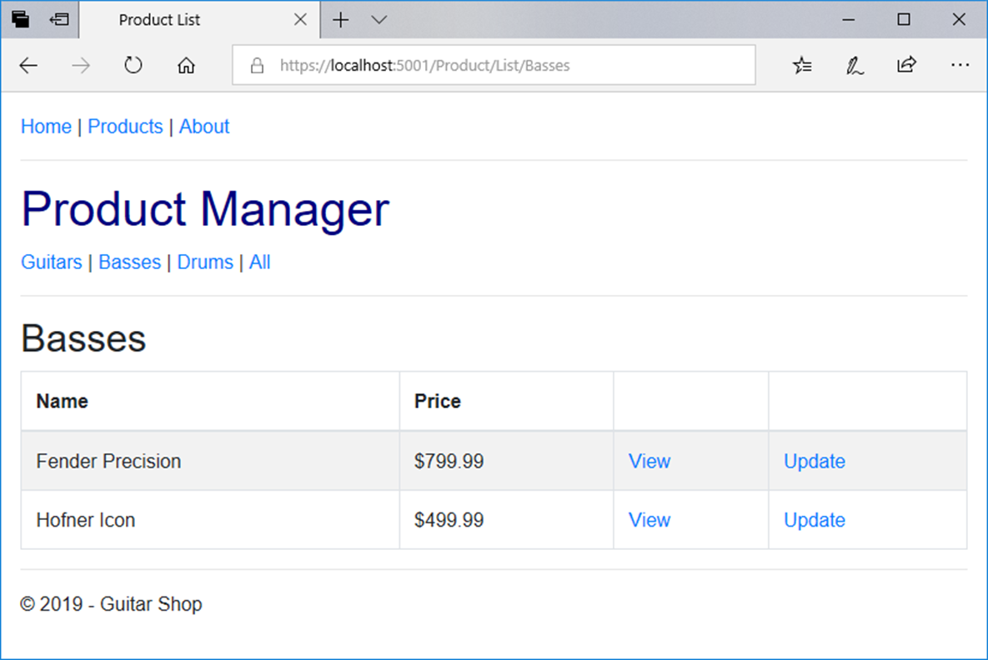
The view with nested layouts in a browser

Slide 32
A _MainLayout file that uses view context (part 1)
@{
Layout = "_Layout";
string controller =
ViewContext.RouteData.Values["controller"].ToString();
string action =
ViewContext.RouteData.Values["action"].ToString();
}
<nav class="navbar navbar-dark bg-primary fixed-top">
<a class="navbar-brand" href="/">My Guitar Shop</a>
<div class="navbar-nav">
<a class="nav-link
@(controller == "Home" && action == "Index" ?
"active" : "")"
asp-controller="Home" asp-action="Index">Home</a>
<a class="nav-link
@(controller == "Product" ? "active" : "")"
asp-controller="Product" asp-action="List">
Products</a>
<a class="nav-link
@(controller == "Home" && action == "About" ?
"active" : "")"
asp-controller="Home" asp-action="About">About</a>
</div>
</nav>

Slide 33
A _MainLayout file that uses view context (part 2)
@RenderBody()
<footer>
<hr />
<p>&copy; @DateTime.Now.Year - Guitar Shop</p>
</footer>

Slide 34
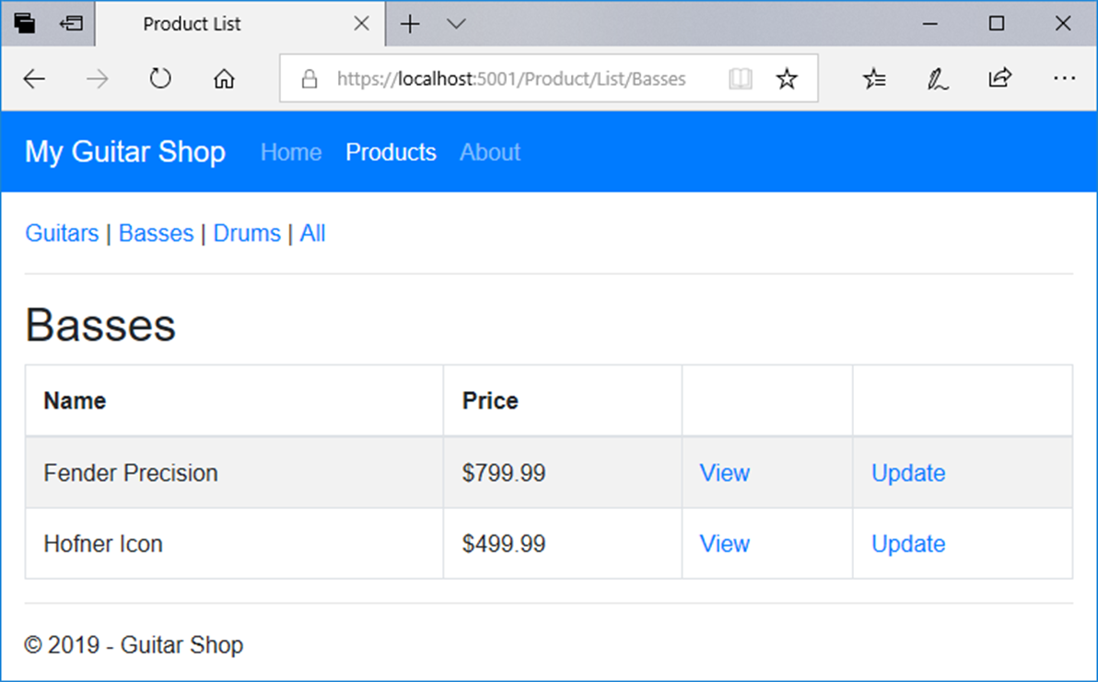
A view that uses this layout

Slide 35
Code in a view file that specifies a section
@model Product
@{
ViewBag.Title = "Update Product";
}
@section scripts {
<script src="~/lib/jquery-validate/jquery.validate.min.js">
</script>
<script src="~/lib/jquery-validation-unobtrusive/
jquery.validate.unobtrusive.min.js">
</script>
}
<h2>Update</h2>
// the HTML elements for the rest of the view body go here

Slide 36
A method that can insert content from a section into a layout
RenderSection(name, isRequired)
A layout file that specifies an optional section
<!DOCTYPE html>
<html>
<head>
<title>@ViewBag.Title</title>
<link rel="stylesheet"
href="~/lib/bootstrap/css/bootstrap.min.css" />
<link rel="stylesheet" href="~/css/custom.css" />
<script src="~/lib/jquery/jquery.min.js"></script>
<script src="~/lib/popper.js/popper.min.js"></script>
<script src="~/lib/bootstrap/js/bootstrap.min.js"></script>
@RenderSection("scripts", false)
</head>
<body>
@RenderBody()
</body>
</html>

Slide 37
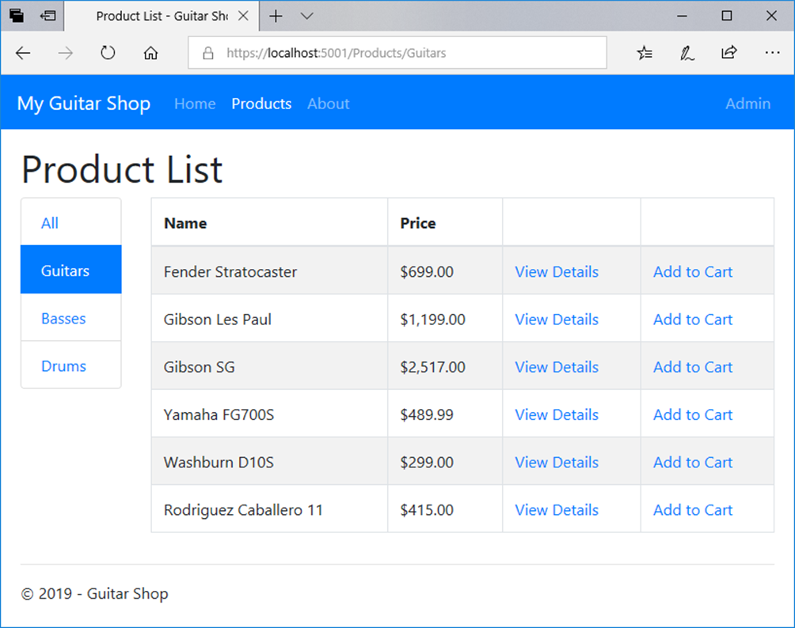
The Product List page for customers

Slide 38
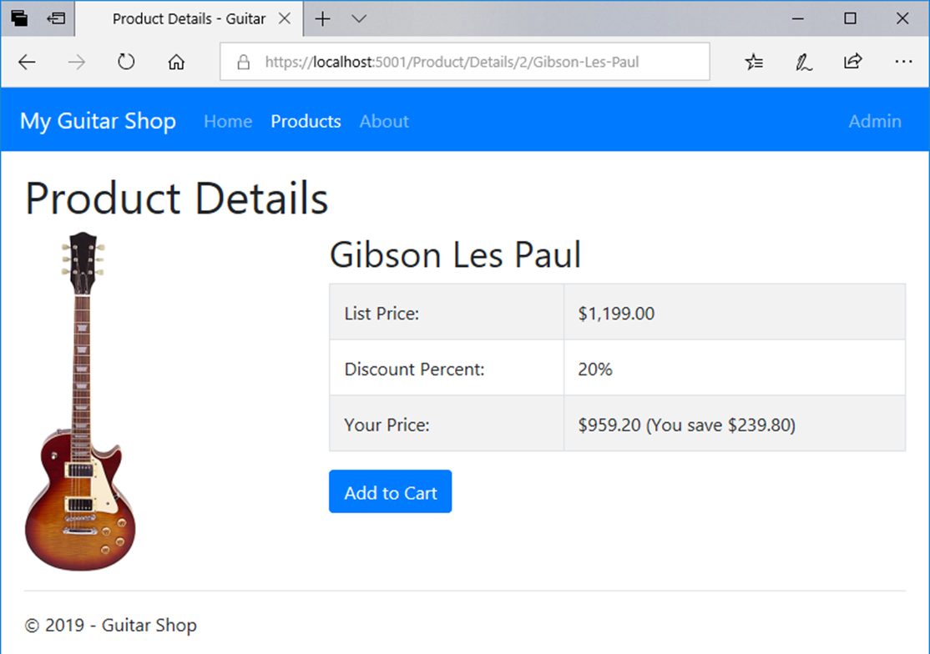
The Product Details page

Slide 39
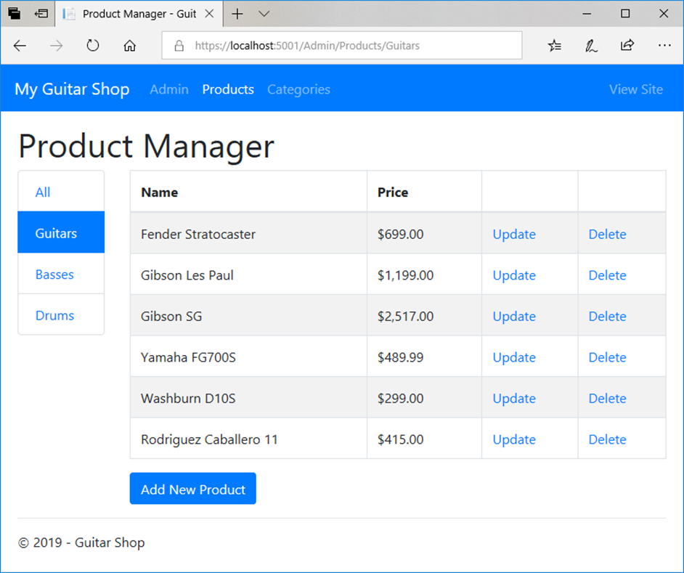
The Product Manager page for administrators

Slide 40
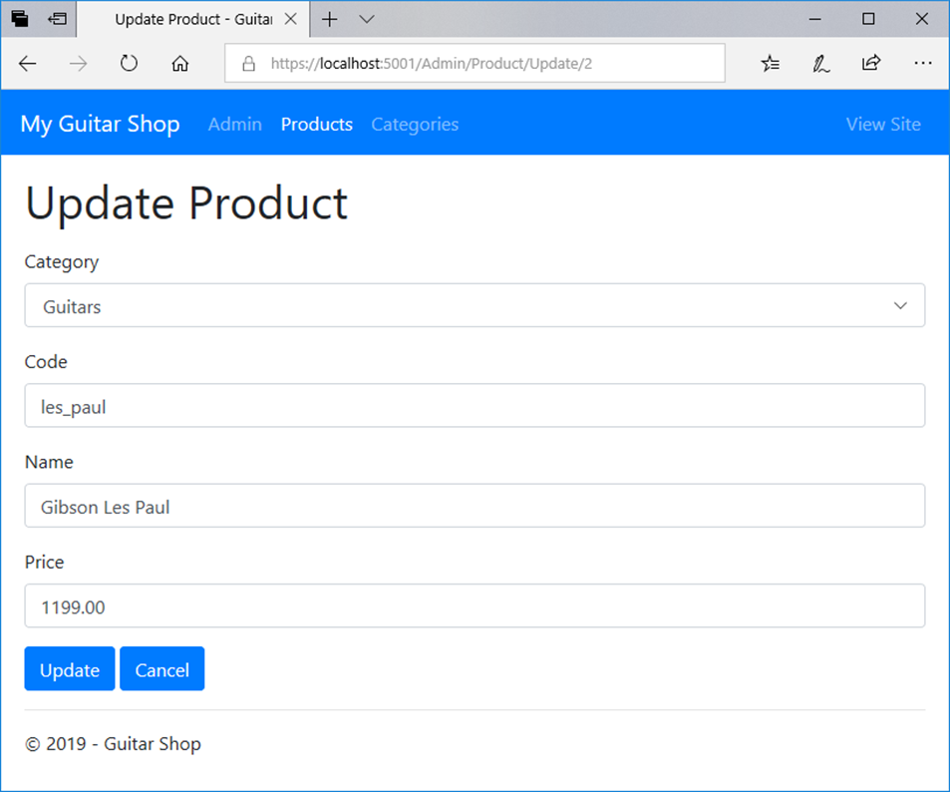
The Update Product page

Slide 41
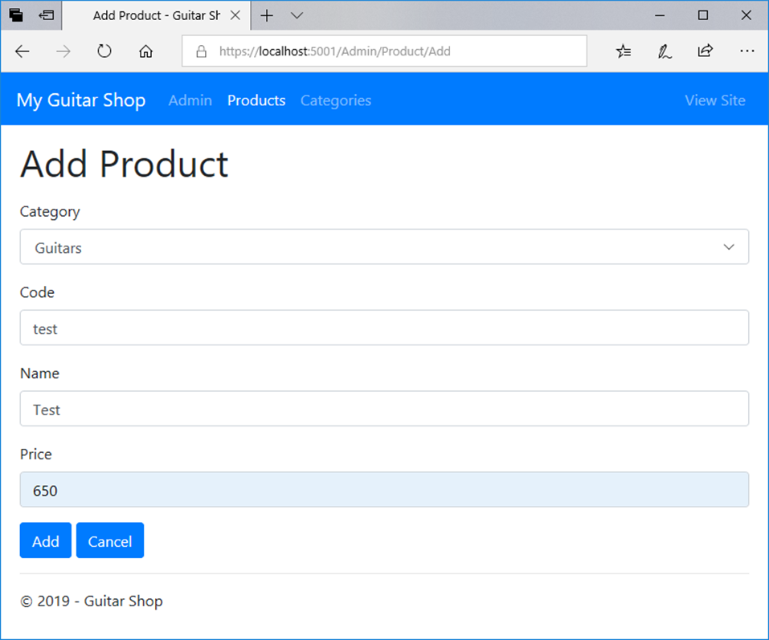
The Add Product page

Slide 42
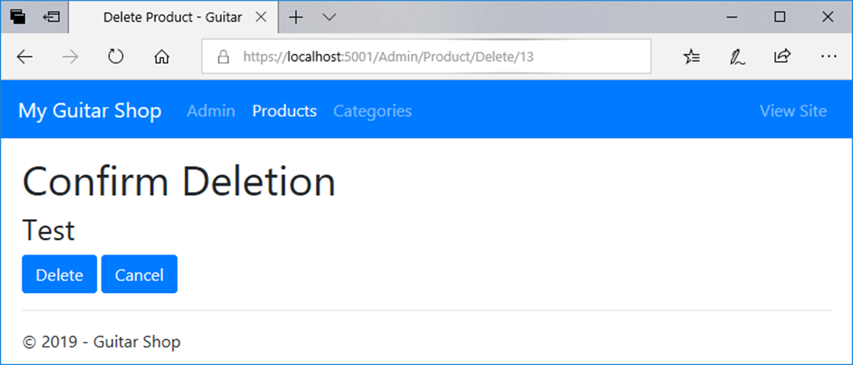
The Delete Product page

