Slide 1
The _Layout.cshtml file in the Views/Shared folder
<!DOCTYPE html>
…
<body>
@RenderBody() -> here come other pages
</body>
</html>
A _ViewStart.cshtml file that sets the default layout
@{
Layout = "_Layout";
}
A _ViewImports.cshtml file that enables all ASP.NET Core MVC tag helpers
@addTagHelper *, Microsoft.AspNetCore.Mvc.TagHelpers

Slide 2
Two ways to code a link
Use HTML to hard code the URL in the href attribute
<a href="/Product/List/Guitars">View guitars</a>
Use ASP.NET tag helpers to generate the URL
<a asp-controller="Product" asp-action="List"
asp-route-id="Guitars">View guitars</a>
The URL for both links
/Product/List/Guitars
A link that specifies a route parameter that doesn’t exist
<a asp-controller="Product" asp-action="List"
asp-route-page="1" asp-route-sort_by="price">
Products - Page 1</a>
The URL that’s generated
/Product/List?page=1&sort_by=price

Slide 3
More tag helpers for generating URLs
asp-area
asp-fragment
asp-protocol
asp-host
How to code a link to an area
<a asp-area="Admin" asp-controller="Product"
asp-action="List">Admin - Product Manager</a>
The URL that’s generated
/Admin/Product/List
How to code an HTML placeholder
<h2 id="Fender">Fender Guitars</h2>
How to code a URL that jumps to an HTML placeholder on the same page
<a asp-fragment="Fender">View Fender Guitars</a>
The URL that’s generated
/#Fender

Slide 4
How to code an absolute URL
<a asp-protocol="https"
asp-host="murach.com"
asp-controller="Shop"
asp-action="Details"
asp-route-id="html5-and-css3"
asp-fragment="reviews">Murach's HTML5 and CSS3 - Reviews</a>
The URL that’s generated
https://www.murach.com/Shop/Details/html5-and-css3#reviews

Slide 5
Razor expressions that format the numbers
Expression Result
@ViewBag.Price.ToString("C") $12,345.67
@ViewBag.Price.ToString("C1") $12,345.7
@ViewBag.Price.ToString("C0") $12,346
@ViewBag.Price.ToString("N") 12,345.67
@ViewBag.Price.ToString("N1") 12,345.7
@ViewBag.Price.ToString("N0") 12,346
@ViewBag.DiscountPercent.ToString("P") 4.50%
@ViewBag.DiscountPercent.ToString("P1") 4.5%
@ViewBag.DiscountPercent.ToString("P0") 5%

Slide 6
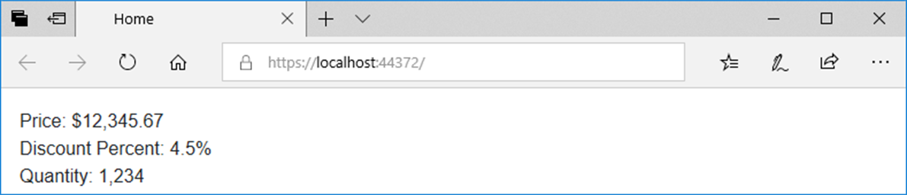
Code in a view that displays the numbers
<div>Price: @ViewBag.Price.ToString("C")</div>
<div>Discount Percent: @ViewBag.DiscountPercent.ToString("P1")</div>
<div>Quantity: @ViewBag.Quantity.ToString("N0")</div>
The view displayed in a browser

Slide 7
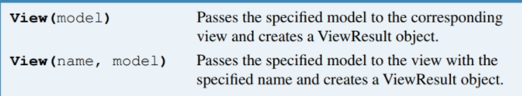
A method that a controller can use to pass a model to a view
View(model)
View(name, model)
The Product/Details() action method that passes a model to a view
public IActionResult Details(int id) {
Product product = context.Products.Find(id);
return View(product);
}
A Product/Add() action method that passes a model to the specified view
[HttpGet]
public IActionResult Add() {
return View("Update", new Product());
}

Slide 8
A _ViewImports file that imports the Models namespace for all views
A directive for displaying model properties in a view
@model -> binds the specified model to the view
A property for displaying model properties in a view
@Model
@addTagHelper *, Microsoft.AspNetCore.Mvc.TagHelpers
@using GuitarShop.Models
The code for the Product/Details view
@model Product
@{
ViewBag.Title = "Product Details";
}
<h1>Product Details</h1>
<div>ID: @Model.ProductID</div>
<div>Name: @Model.Name</div>
<div>Category: @Model.Category.Name</div>
<div>Price: @Model.Price.ToString("C2")</div>
<a asp-controller="Home" asp-action="Index">Home</a>

Slide 9

@model
Then use either @Model or asp-for to use properties of a model

Slide 10
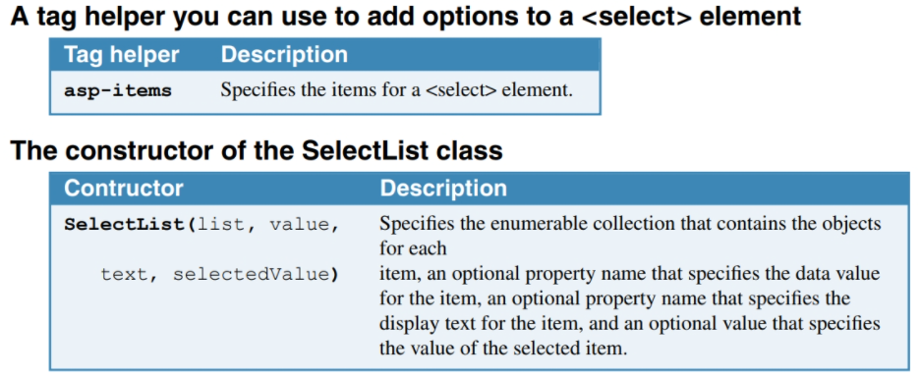

Slide 11
An Update action method that creates the model and passes it to the view
public IActionResult Update(int id)
{
ViewBag.Categories = context.Categories.ToList();
Product product = context.Products.Find(id);
return View(product);
}

Slide 12
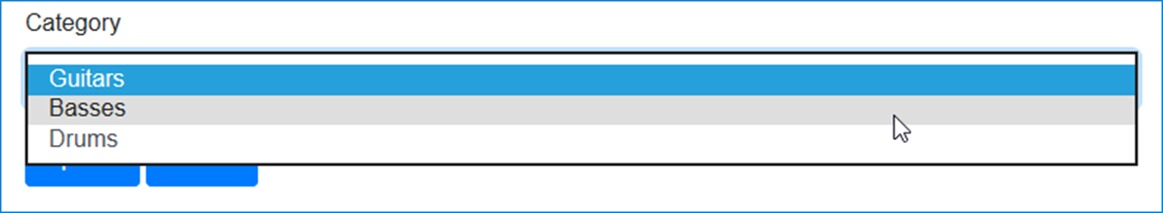
The code that binds items to a <select> element
<div class="form-group">
<label asp-for="CategoryID">Category</label>
<select asp-for="CategoryID"
asp-items="@(new SelectList(ViewBag.Categories,
"CategoryID", "Name",
Model.CategoryID.ToString()))"
class="form-control"></select>
</div>
The <select> element and its label displayed in a browser

Slide 13
A List action method that creates the model and passes it to the view
public IActionResult List(string id = "All")
{
ViewBag.Categories = context.Categories.ToList();
ViewBag.SelectedCategory = id;
List<Product> products = context.Products
.Where(p => p.Category.Name == id).ToList();
return View(products);
}

Slide 14
The code for the view (part 1)
@model List<Product>
@{
ViewBag.Title = "Product List";
}
<h1>Product List</h1>
@if (ViewBag.Categories != null)
{
foreach (Category c in ViewBag.Categories)
{
<a asp-controller="Product" asp-action="List"
asp-route-id="@c.Name">@c.Name</a>
<text> | </text>
}
}
<a asp-controller="Product" asp-action="List"
asp-route-id="All">All</a>
<hr />

Slide 15
The code for the view (part 2)
@if (@ViewBag.SelectedCategory == "All")
{
<h2>All Products</h2>
}
else
{
<h2>@ViewBag.SelectedCategory</h2>
}
<table class="table table-bordered table-striped">
<thead>
<tr>
<th>Name</th>
<th>Price</th>
<th></th>
<th></th>
</tr>
</thead>

Slide 16
The code for the view (part 3)
<tbody>
@foreach (var product in @Model)
{
<tr>
<td>@product.Name</td>
<td>@product.Price.ToString("C")</td>
<td>
<a asp-controller="Product"
asp-action="Details"
asp-route-id="@product.ProductID">
View</a>
</td>
<td>
<a asp-controller="Product"
asp-action="Update"
asp-route-id="@product.ProductID">
Update</a>
</td>
</tr>
}
</tbody>
</table>

Slide 17
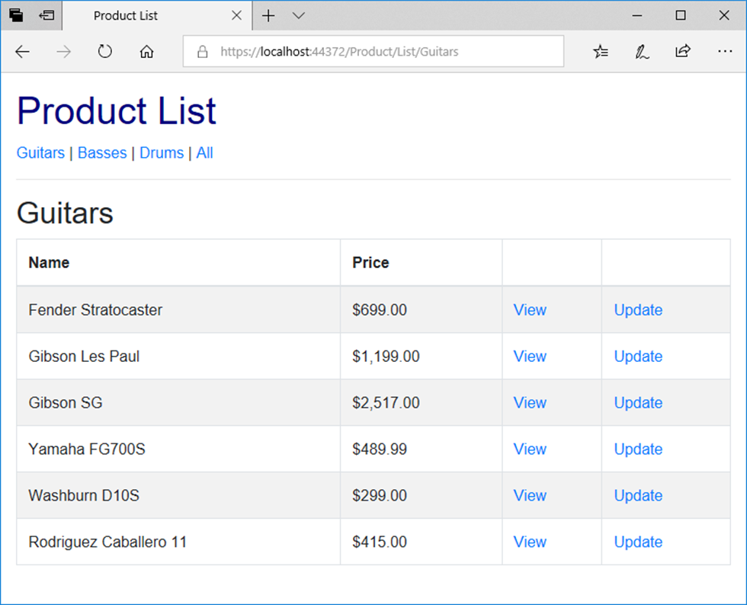
The Product objects view in a browser

Slide 18
The Views/Shared/_MainLayout.cshtml file (part 1)
<!DOCTYPE html>
<html>
<head>
<title>@ViewBag.Title</title>
<link rel="stylesheet" href="~/lib/bootstrap/css/bootstrap.min.css" />
<link rel="stylesheet" href="~/css/custom.css" />
</head>
<body>
<header>
<a asp-controller="Home" asp-action="Index">
Home</a> |
<a asp-controller="Product" asp-action="List">
Products</a> |
<a asp-controller="Home" asp-action="About">
About</a>
<hr />
</header>

Slide 19
The Views/Shared/_MainLayout.cshtml file (part 2)
@RenderBody()
<footer>
<hr />
<p>&copy; @DateTime.Now.Year - Guitar Shop</p>
</footer>
</body>
</html>

Slide 20
The code for a _ViewStart.cshtml file that sets the default layout
@{
Layout = "_Layout";
}
The code for a Home/Index view that explicitly specifies a layout
@{
Layout = "_MainLayout";
ViewBag.Title = "Home";
}
<p>Welcome to the Guitar Shop website!</p>

Slide 21
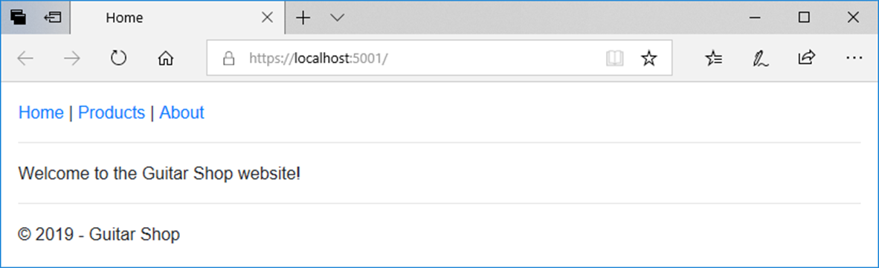
The Home page

Slide 22
The _Layout file
<!DOCTYPE html>
<html>
<head>
<title>@ViewBag.Title</title>
<link rel="stylesheet"
href="~/lib/bootstrap/css/bootstrap.min.css" />
<link rel="stylesheet" href="~/css/custom.css" />
</head>
<body>
@RenderBody()
</body>
</html>

Slide 23
The _MainLayout file
@{
Layout = "_Layout";
}
<header>
<a asp-controller="Home" asp-action="Index">Home</a> |
<a asp-controller="Product" asp-action="List"
asp-route-id="All">Products</a> |
<a asp-controller="Home" asp-action="About">About</a>
<hr />
</header>
@RenderBody()
<footer>
<hr />
<p>&copy; @DateTime.Now.Year - Guitar Shop</p>
</footer>

Slide 24
The _ProductLayout file
@{
Layout = "_MainLayout";
}
<h1>Product Manager</h1>
@if (ViewBag.Categories != null)
{
foreach (Category c in ViewBag.Categories)
{
<a asp-controller="Product" asp-action="List"
asp-route-id="@c.Name">@c.Name</a><text> | </text>
}
<a asp-controller="Product" asp-action="List"
asp-route-id="All">All</a>
}
<hr />
@RenderBody()

Slide 25
The code for a view that uses the _ProductLayout view
@model List<Product>
@{
Layout = "_ProductLayout";
ViewBag.Title = "Product List";
}
@if (@ViewBag.SelectedCategory == "All")
{
<h2>All Products</h2>
}
else
{
<h2>@ViewBag.SelectedCategory</h2>
}
<!-- The code for the <table> element -->

Slide 26
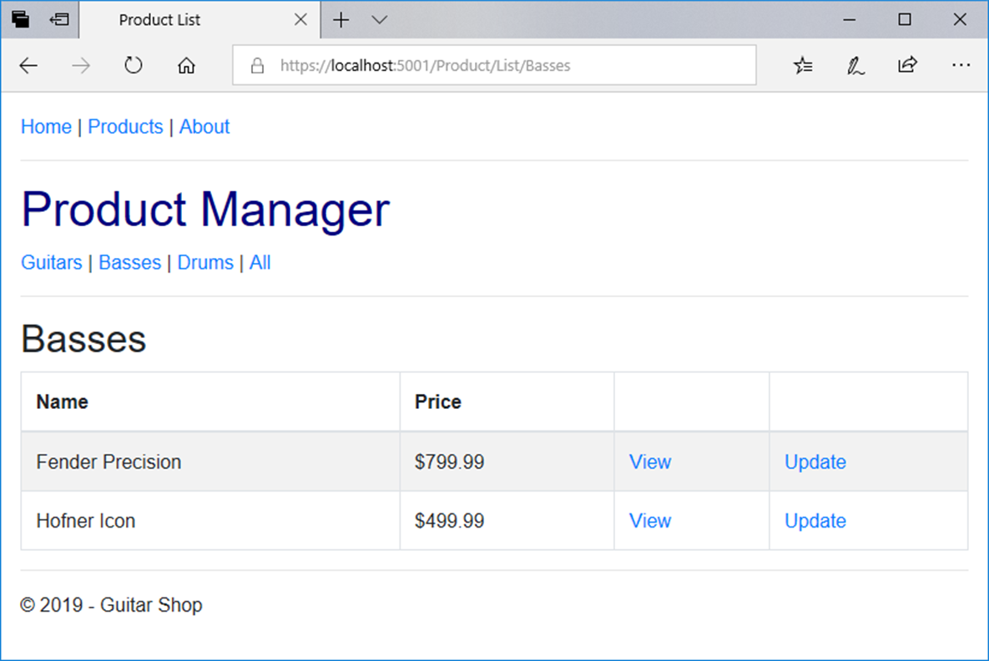
The view with nested layouts in a browser

Slide 27
A _MainLayout file that uses view context (part 1)
@{
Layout = "_Layout";
string controller =
ViewContext.RouteData.Values["controller"].ToString();
string action =
ViewContext.RouteData.Values["action"].ToString();
}
<nav class="navbar navbar-dark bg-primary fixed-top">
<a class="navbar-brand" href="/">My Guitar Shop</a>
<div class="navbar-nav">
<a class="nav-link
@(controller == "Home" && action == "Index" ?
"active" : "")"
asp-controller="Home" asp-action="Index">Home</a>
<a class="nav-link
@(controller == "Product" ? "active" : "")"
asp-controller="Product" asp-action="List">
Products</a>
<a class="nav-link
@(controller == "Home" && action == "About" ?
"active" : "")"
asp-controller="Home" asp-action="About">About</a>
</div>
</nav>

Slide 28
A _MainLayout file that uses view context (part 2)
@RenderBody()
<footer>
<hr />
<p>&copy; @DateTime.Now.Year - Guitar Shop</p>
</footer>

Slide 29
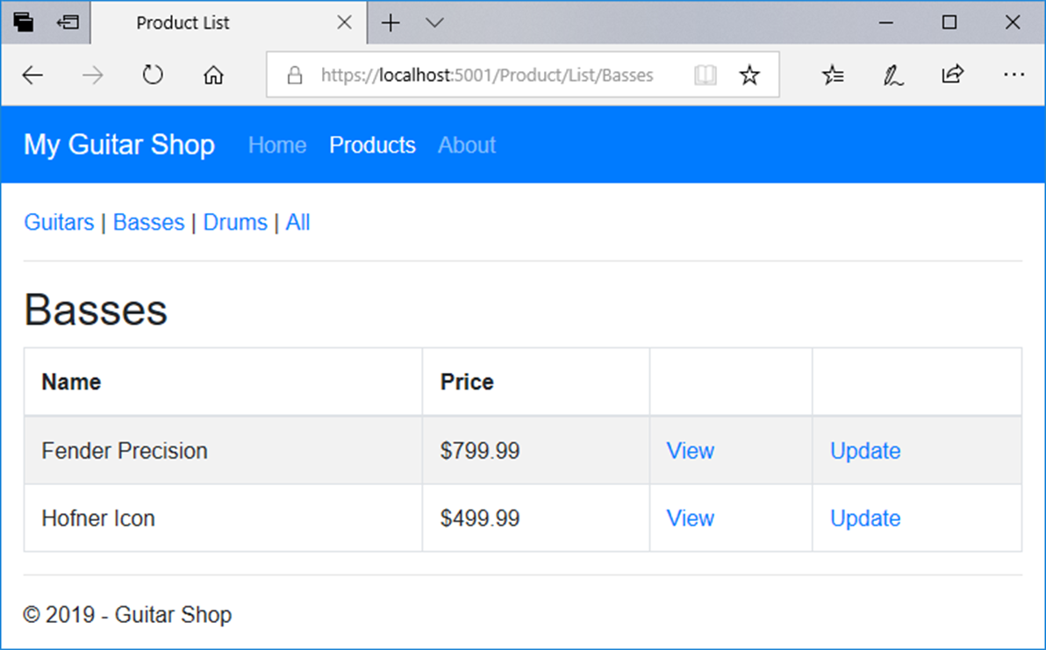
A view that uses this layout

Slide 30
Code in a view file that specifies a section
@model Product
@{
ViewBag.Title = "Update Product";
}
@section scripts {
<script src="~/lib/jquery-validate/jquery.validate.min.js">
</script>
<script src="~/lib/jquery-validation-unobtrusive/
jquery.validate.unobtrusive.min.js">
</script>
}
<h2>Update</h2>
// the HTML elements for the rest of the view body go here

Slide 31
A method that can insert content from a section into a layout
RenderSection(name, isRequired)
A layout file that specifies an optional section
<!DOCTYPE html>
<html>
<head>
<title>@ViewBag.Title</title>
<link rel="stylesheet"
href="~/lib/bootstrap/css/bootstrap.min.css" />
<link rel="stylesheet" href="~/css/custom.css" />
<script src="~/lib/jquery/jquery.min.js"></script>
<script src="~/lib/popper.js/popper.min.js"></script>
<script src="~/lib/bootstrap/js/bootstrap.min.js"></script>
@RenderSection("scripts", false)
</head>
<body>
@RenderBody()
</body>
</html>

Slide 32
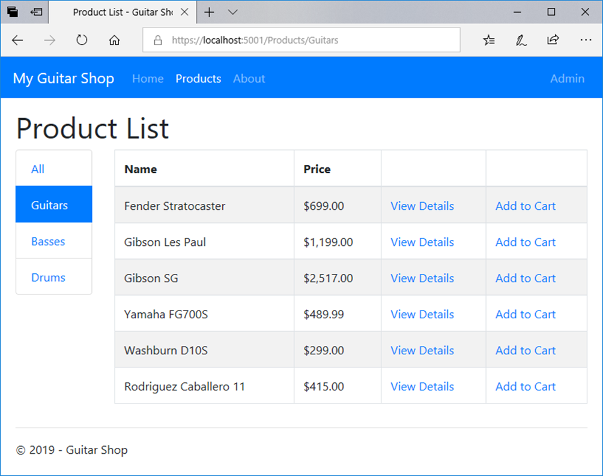
The Product List page for customers

Slide 33
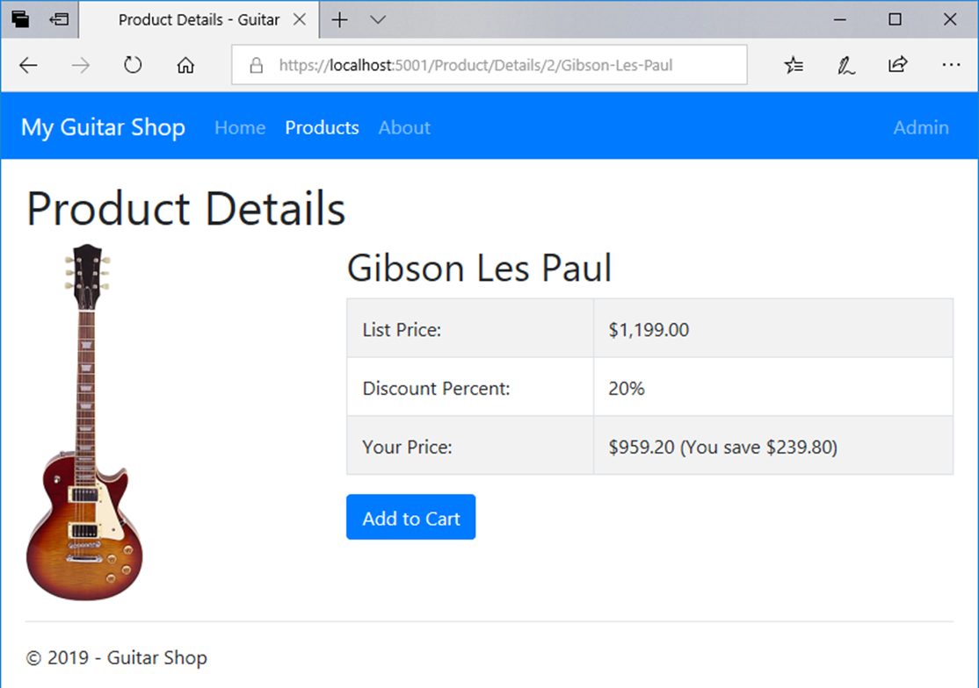
The Product Details page

Slide 34
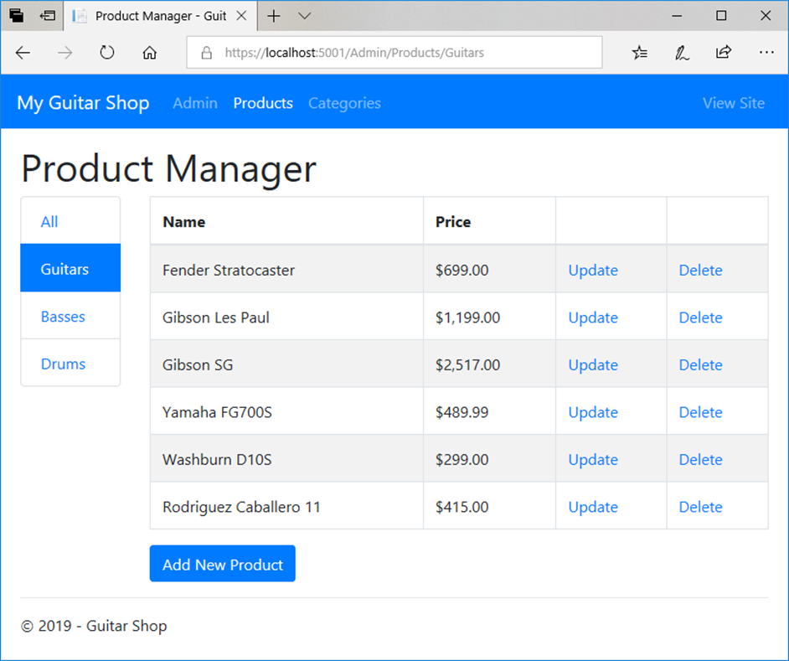
The Product Manager page for administrators

Slide 35
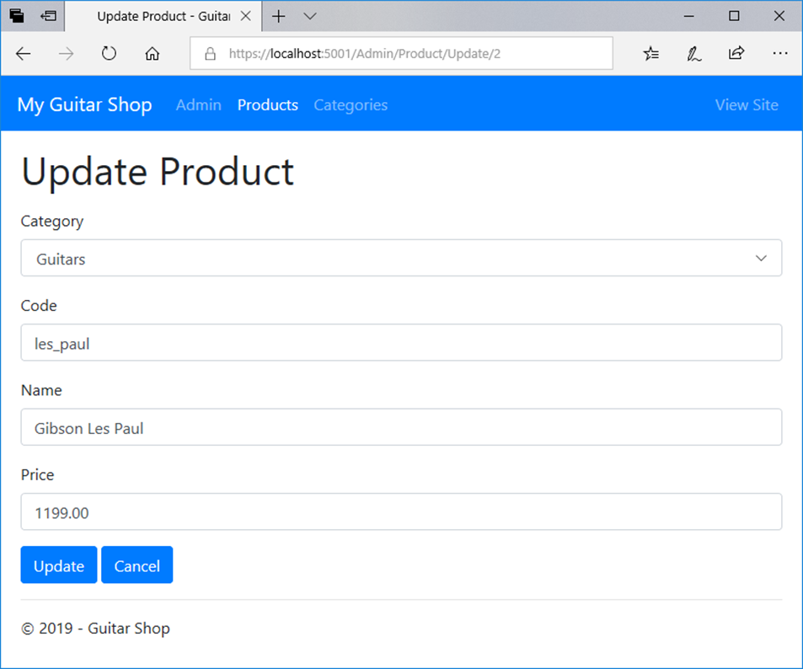
The Update Product page

Slide 36
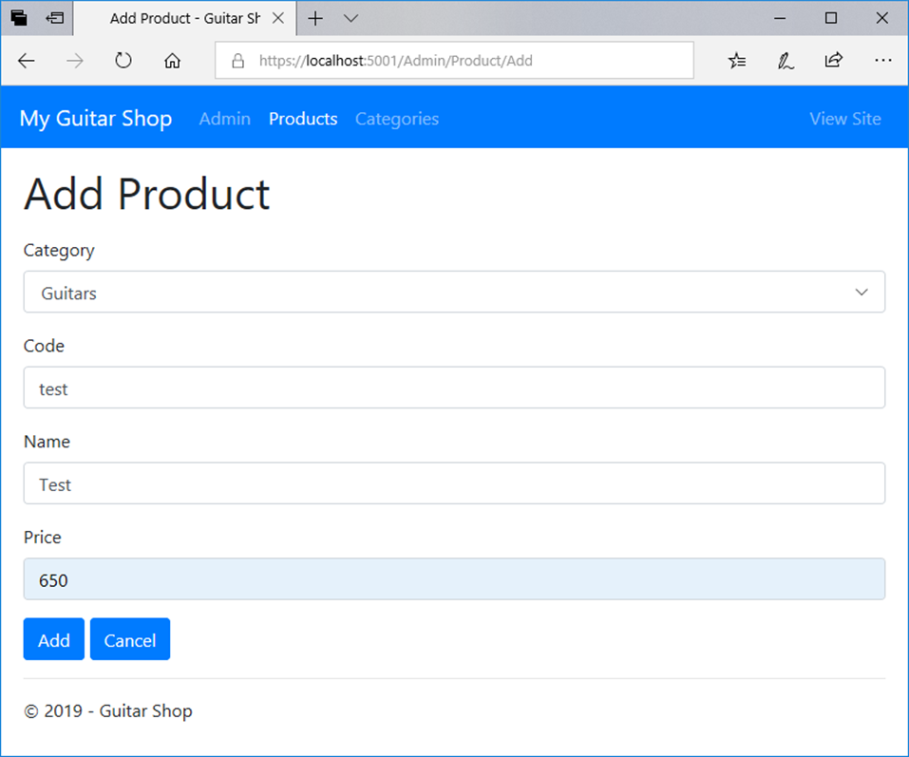
The Add Product page

Slide 37
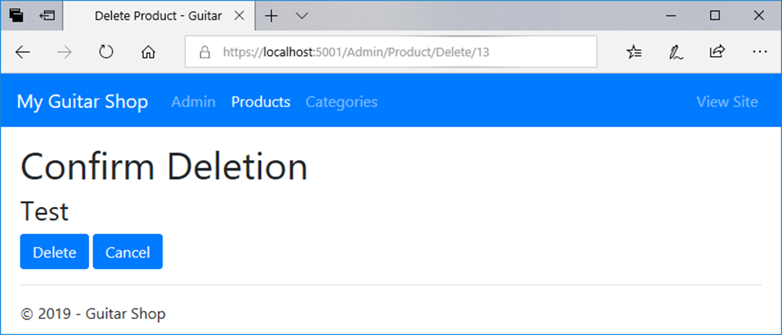
The Delete Product page

