Slide 1
By default, controllers and their action methods are used to create URLs and it starts with an upper case
-> to change it to lower case -> go to Startup.cs and add
public void ConfigureServices(IServiceCollection services)
{
services.AddControllersWithViews();
services.AddRouting(options =>
{
options.LowercaseUrls = true; // lower case
options.AppendTrailingSlash = true; // trailing slash
});
}

Slide 2

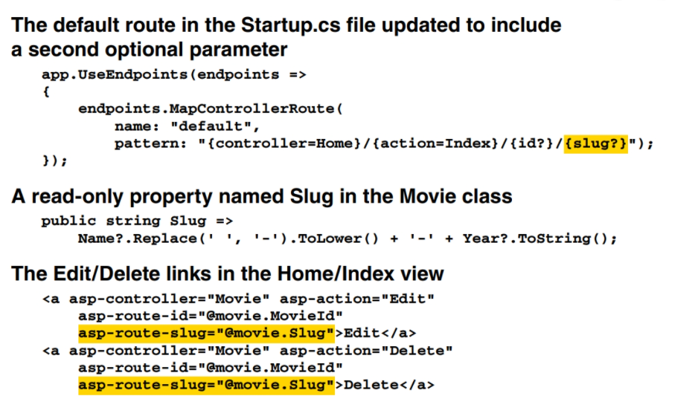
Slug

Slide 3
The methods for adding the MVC service
Method Available with
AddControllersWithViews() ASP.NET Core 2.2 and later
AddMvc() Versions prior to ASP.NET.Core 2.2
Two methods for enabling and configuring routing
UseRouting()
UseEndpoints(endpoints)

Slide 4
Methods that configure the default route (part 1)
// Use this method to add services to the project.
public void ConfigureServices(IServiceCollection services) {
services.AddControllersWithViews(); // add MVC services
// add other services here
}
// Use this method to configure the HTTP request pipeline.
public void Configure(IApplicationBuilder app,
IWebHostEnvironment env) {
app.UseDeveloperExceptionPage();
app.UseHttpsRedirection();
app.UseStaticFiles();
app.UseRouting(); // mark where routing decisions are made
// configure middleware that runs after routing decisions
// have been made
app.UseEndpoints(endpoints => // map the endpoints
{
endpoints.MapControllerRoute(
name: "default",
pattern: "{controller=Home}/{action=Index}/{id?}");
});
// configure other middleware here
}

Slide 5
Another way to map a controller to the default route
endpoints.MapDefaultControllerRoute();

Slide 6
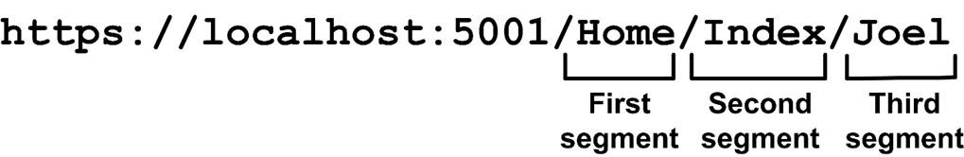
The pattern for the default route
A URL that has three segments
{controller=Home}/{action=Index}/{id?}
How the default route works
The first segment specifies the controller. Since the pattern sets the Home controller as the default controller, this segment is optional.
The second segment specifies the action method within the controller. Since the pattern sets the Index() method as the default action, this segment is optional.
The third segment specifies an argument for the id parameter of the action method. The pattern uses a question mark (?) to specify that this segment is optional.

Slide 7
Request URL mappings for the default route
Request URL Controller Action Id
http://localhost Home Index null
http://localhost/Home Home Index null
http://localhost/Home/Index Home Index null
http://localhost/Home/About Home About null
http://localhost/Product Product Index null
http://localhost/Product/List Product List null
http://localhost/Product/List/Guitars Product List Guitars
http://localhost/Product/Detail Product Detail 0
http://localhost/Product/Detail/3 Product Detail 3

Slide 8
A method that a controller can use to return plain text to the browser
Content(string)
The Home controller
using Microsoft.AspNetCore.Mvc;
namespace GuitarShop.Controllers
{
public class HomeController : Controller
{
public IActionResult Index()
{
return Content("Home controller, Index action");
}
public IActionResult About()
{
return Content("Home controller, About action");
}
}
}

Slide 9
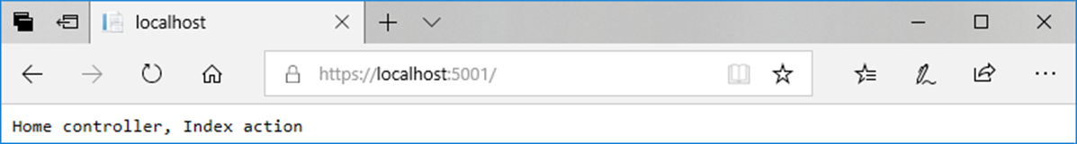
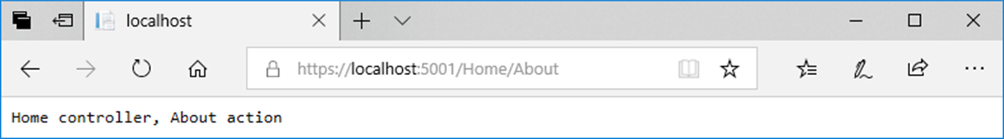
A browser after requesting the default page
A browser after requesting the Home/About page

Slide 10
The Product controller
using Microsoft.AspNetCore.Mvc;
namespace GuitarShop.Controllers
{
public class ProductController : Controller
{
public IActionResult List(string id = "All")
{
return Content("Product controller, List action, id: "
+ id);
}
public IActionResult Detail(int id)
{
return Content("Product controller, Detail action, id: "
+ id);
}
}
}

Slide 11
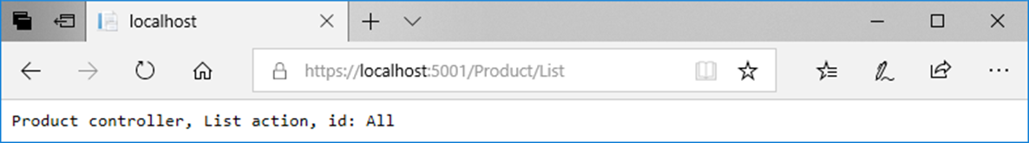
A browser after requesting the Product/List action with no id segment

Slide 12
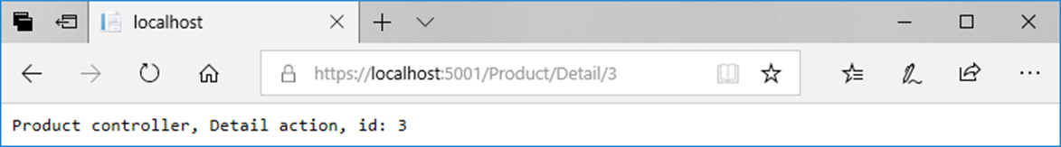
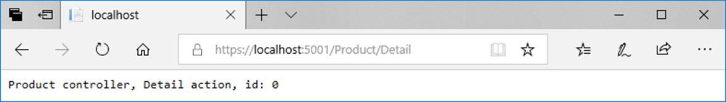
A browser after requesting the Product/Detail action with an id segment
A browser after requesting the Product/Detail action with no id segment

Slide 13
A pattern that mixes static and dynamic data for a segment
{controller}/{action}/{cat}/Page{num} // 4 segments
Example URLs with static and dynamic data
Request URL Controller Action Parameters
/Product/List/All/Page1 Product List cat=All, num=1
/Product/List/All/Page2 Product List cat=All, num=2

Slide 14
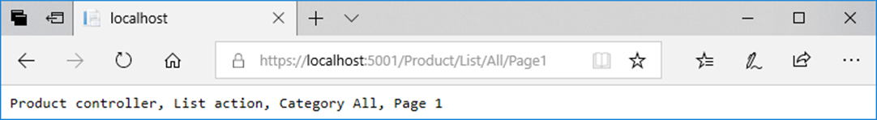
The List() method of the Product controller with static and dynamic data
public IActionResult List(string cat, int num)
{
return Content("Product controller, List action, " +
"Category " + cat + ", Page " + num);
}
A URL that requests the Product/List action for page 1 of all categories

Slide 15
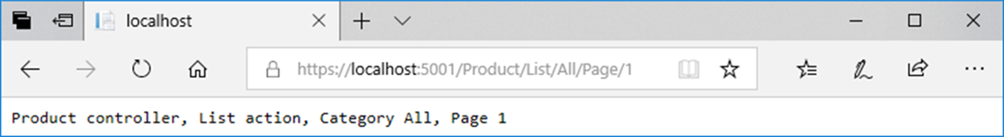
A pattern with one completely static segment
{controller}/{action}/{cat}/Page/{num} // 5 segments
Example URLs with a completely static segment
Request URL Controller Action Parameters
/Product/List/All/Page/1 Product List cat=All, num=1
/Product/List/All/Page/2 Product List cat=All, num=2
A URL that requests the Product/List action for page 1 of all categories

Slide 16
Three routing patterns mapped to controllers
app.UseEndpoints(endpoints =>
{
// most specific route – 5 required segments
endpoints.MapControllerRoute(
name: "paging_and_sorting",
pattern: "{controller}/{action}/{id}/page{page}/sort-by-{sortby}");
// specific route – 4 required segments
endpoints.MapControllerRoute(
name: "paging",
pattern: "{controller}/{action}/{id}/page{page}");
// least specific route – 0 required segments
endpoints.MapControllerRoute(
name: "default",
pattern: "{controller=Home}/{action=Index}/{id?}");
});

Slide 17
The List() method of the Product controller with multiple routing patterns
public IActionResult List(string id = "All",
int page = 1, string sortby = "Price")
{
return Content("id=" + id + ", page=" + page +
", sortby=" + sortby);
}

Slide 18
URLs that use the default route
Request URL Controller/Action Parameters
/ Home/Index id=null
/Home/About Home/About id=null
/Product/Detail/4 Product/Detail id=4
/Product/List/Guitars Product/List id=Guitars

Slide 19
URLs that uses the paging route
Request URL Parameters
/Product/List/All/Page3 id=All, page=3
/Product/List/Guitars/Page2 id=Guitars, page=2
/Product/List/Guitars/Pg2 Not found because "Pg" doesn't match static "Page".

Slide 20
URLs that use the paging_and_sorting route
Request URL Parameters
/Product/List/Guitars/Page2/Sort-By-Name id=Guitars, page=2, sortby=Name
/Product/List/Guitars/Page2/By-Name Not found because "By-" doesn't match "Sort-By-".

Slide 21
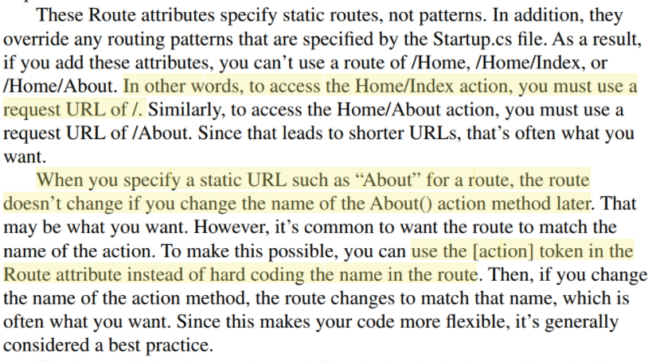

Slide 22
The Home controller with attribute routing for both actions
public class HomeController : Controller
{
[Route("/")]
public IActionResult Index()
{
return Content("Home controller, Index action");
}
[Route("About")]
public IActionResult About()
{
return Content("Home controller, About action");
}
}

Slide 23
Request URL mappings that use attribute routing
Request URL Maps to
/ the Home/Index action
/About the Home/About action
Two default routes that are overridden by the attribute routing
/Home/Index
/Home/About

Slide 24
Two tokens for inserting variable data into a route
[controller]
[action]
A more flexible way to code the attribute for the Home/About action
[Route("[action]")]

Slide 25
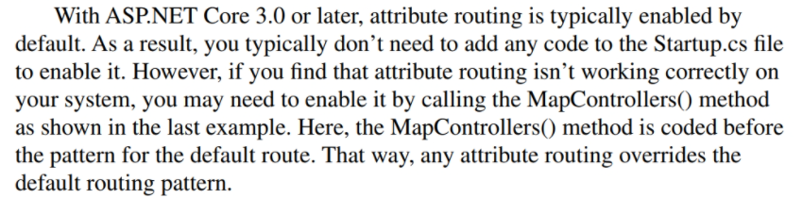
How to map all controllers that use attribute routing
app.UseEndpoints(endpoints =>
{
// map controllers that use attribute routing -
// often not necessary
endpoints.MapControllers();
// map pattern for default route
endpoints.MapControllerRoute(
name: "default",
pattern: "{controller=Home}/{action=Index}/{id?}");
});

Slide 26
The Product controller with attribute routing that specifies segments
public class ProductController : Controller
{
[Route("Products/{cat?}")]
public IActionResult List(string cat = "All")
{
return Content("Product controller, List action, Category: "
+ cat);
}
[Route("Product/{id}")]
public IActionResult Detail(int id)
{
return Content("Product controller, Detail action, ID: "
+ id);
}
[NonAction]
public string GetSlug(string name)
{
return name.Replace(' ', '-').ToLower();
}
}

Slide 27
Request URL mappings with attribute routing that specifies segments
Request URL Description
/Products Maps to the Product/List action and uses the default parameter value of “All”.
/Products/Guitars Maps to the Product/List action and passes an argument of “Guitars”.
/Product/3 Maps to the Product/Detail action and supplies a valid int argument of 3.
/Product This URL is not found. It does not map to the Product/Detail action because it does not supply the required id segment.

Slide 28
Two default routes that are overridden by the attribute routing with segments
/Product/List
/Product/Detail
A more flexible way to code the attribute for the Product/List action
[Route("[controller]s/{cat?}")]
A more flexible way to code the attribute for the Product/Detail action
[Route("[controller]/{id}")]

Slide 29
The code for the Product controller
[Route("Retail/[controller]/[action]/{id?}")]
public class ProductController : Controller
{
public IActionResult List(string id = "All")
{
return Content("Product controller, List action, Category: "
+ id);
}
public IActionResult Detail(int id)
{
return Content("Product controller, Detail action, ID: "
+ id);
}
}

Slide 30
Request URL mappings with attribute routing for all actions of a controller
Request URL Description
/Retail/Product/List Maps to the Product/List action and uses the default parameter value of “All”.
/Retail/Product/List/Guitars Maps to the Product/List action and passes an argument of “Guitars”.
/Retail/Product/Detail Maps to the Product/Detail action and uses the default int value of 0.
/Retail/Product/Detail/3 Maps to the Product/Detail action and passes a valid int argument of 3.

Slide 31
Two default routes that are overridden by the attribute routing
/Product/List
/Product/Detail

Slide 32
Best practices for URLs
Keep the URL as short as possible while still being descriptive and user-friendly.
Use keywords to describe the content of a page, not implementation details.
Make your URLs easy for humans to understand and type.
Use hyphens to separate words, not other characters, especially spaces.
Prefer names as identifiers over numbers.
Create an intuitive hierarchy.
Be consistent.
Avoid the use of query string parameters if possible.

Slide 33
A URL that identifies a product…
With a number
https://www.domain.com/product/1307
With a name
https://www.domain.com/product/fender-special-edition-standard-stratocaster
With a number and name (to keep it descriptive but short)
https://www.domain.com/product/1307/fender-special

Slide 34
Four URLs that use query strings to pass data (not recommended)
https://www.murach.com/p/List?
/p/List?catId=1
/p/List?catId=1&pg=1
/p/Detail?id=1307

Slide 35
Four URLs that follow best practices
https://www.murach.com/product/list
/product/list/guitars
/product/list/guitars/page-1
/product/detail/1307/fender-stratocaster

Slide 36
Four shorter URLs that follow best practices
https://www.murach.com/products
/products/guitars
/products/guitars/page-1
/product/1307/fender-stratocaster

Slide 37
The starting folders for an app with an Admin area (part 1)
GuitarShop
/Areas
/Admin
/Controllers
/HomeController.cs
/ProductController.cs
/Views
/Home
/Index.cshthml
/Product
/List.cshthml
/AddUpdate.cshthml
/Delete.cshthml
/Shared
/_AdminLayout.cshtml
_ViewImports.cshtml
_ViewStart.cshtml

Slide 38
The starting folders for an app with an Admin area (part 2)
/Controllers
/HomeController.cs
/ProductController.cs
/Models
/Product.cs
/Category.cs
/Views
/Home
/Index.cshthml
/About.cshthml
/Product
/List.cshthml
/Detail.cshthml
/Shared
/_Layout.cshtml
_ViewImports.cshtml
_ViewStart.cshtml
Program.cs
Startup.cs

Slide 39
A route that works with an area
app.UseEndpoints(endpoints =>
{
endpoints.MapAreaControllerRoute(
name: "admin",
areaName: "Admin",
pattern: "Admin/{controller=Home}/{action=Index}/{id?}");
endpoints.MapControllerRoute(
name: "default",
pattern: "{controller=Home}/{action=Index}/{id?}");
});

Slide 40
The Home controller for the Admin area
namespace GuitarShop.Areas.Admin.Controllers
{
[Area("Admin")]
public class HomeController : Controller
{
public IActionResult Index()
{
return View(); // maps to /Areas/Admin/Views/Home/
// Index.cshtml
}
}
}

Slide 41
A token you can use to insert the area into a route
[area]
The Product controller for the Admin area
namespace GuitarShop.Areas.Admin.Controllers
{
[Area("Admin")]
public class ProductController : Controller
{
[Route("[area]/[controller]s/{id?}")]
public IActionResult List(string id = "All") {...};
public IActionResult Add() {...};
public IActionResult Update(int id) {...};
public IActionResult Delete(int id) {...};
}
}

Slide 42
Request URL mappings associated with areas
Request URL Description
/Admin/Products Maps to the Product/List action and uses the default parameter value of “All”.
/Admin/Products/Guitars Maps to the Product/List action and passes an argument of “Guitars”.
/Admin/Product/Add Maps to the Product/Add action.
/Admin/Product/Update/3 Maps to the Product/Detail action and passes an id argument of 3.

