Slide 2
An if statement that adds a Bootstrap CSS class if true
<a asp-controller="Product" asp-action="List"
asp-route-id="All"
class="list-group-item
@if (ViewBag.SelectedCategoryName == "All") {
<text>active</text>
}">
All
</a>

Slide 3
A conditional expression that adds a Bootstrap CSS class if true
<a asp-controller="Product" asp-action="List" asp-route-id="All"
class="list-group-item
@(ViewBag.SelectedCategoryName == "All" ? "active" : "")">
All
</a>

Slide 4
The _Layout.cshtml file in the Views/Shared folder
<!DOCTYPE html>
…
<body>
@RenderBody() -> here come other pages
</body>
</html>
A _ViewStart.cshtml file that sets the default layout
@{
Layout = "_Layout";
}
A _ViewImports.cshtml file that enables all ASP.NET Core MVC tag helpers
@addTagHelper *, Microsoft.AspNetCore.Mvc.TagHelpers

Slide 5
Two ways to code a link
Use HTML to hard code the URL in the href attribute
<a href="/Product/List/Guitars">View guitars</a>
Use ASP.NET tag helpers to generate the URL
<a asp-controller="Product" asp-action="List"
asp-route-id="Guitars">View guitars</a>
The URL for both links
/Product/List/Guitars
A link that specifies a route parameter that doesn’t exist
<a asp-controller="Product" asp-action="List"
asp-route-page="1" asp-route-sort_by="price">
Products - Page 1</a>
The URL that’s generated
/Product/List?page=1&sort_by=price

Slide 6
The Home/Index view
@{
ViewBag.Title = "Home";
}
<h1>Home</h1>
<div class="list-group">
<a asp-controller="Product" asp-action="List">
View all products</a>
<a asp-controller="Product" asp-action="List"
asp-route-id="Guitars">View guitars</a>
<a asp-controller="Product" asp-action="Details"
asp-route-id="Fender-Stratocaster">
View Fender Stratocaster</a>
</div>

Slide 7
The Product/List view
@{
ViewBag.Title = "Product List";
}
<h1>Product List</h1>
<div class="list-group">
<p>Category: @ViewBag.Category</p>
<a asp-action="Details"
asp-route-id="Fender-Stratocaster">
View Fender Stratocaster</a>
<a asp-controller="Home" asp-action="Index">Home</a>
</div>

Slide 8
The Product/Details view
@{
ViewBag.Title = "Product Details";
}
<h1>Product Details</h1>
<div class="list-group">
<p>Slug: @ViewBag.ProductSlug</p>
<a asp-controller="Home" asp-action="Index">Home</a>
</div>

Slide 9
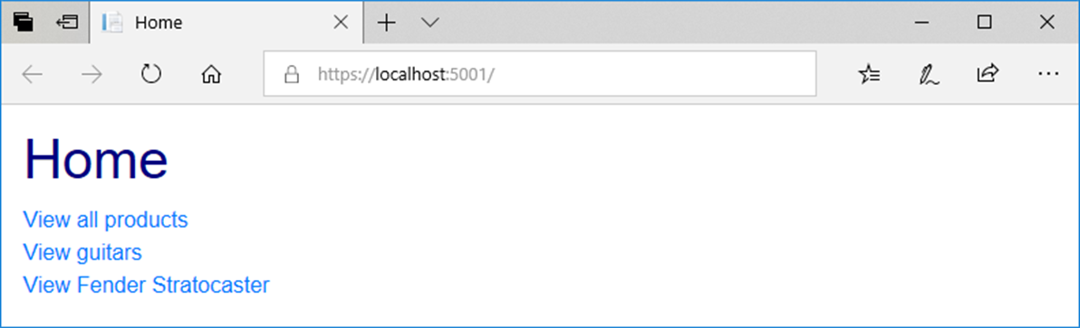
A browser displaying the Home page

Slide 10
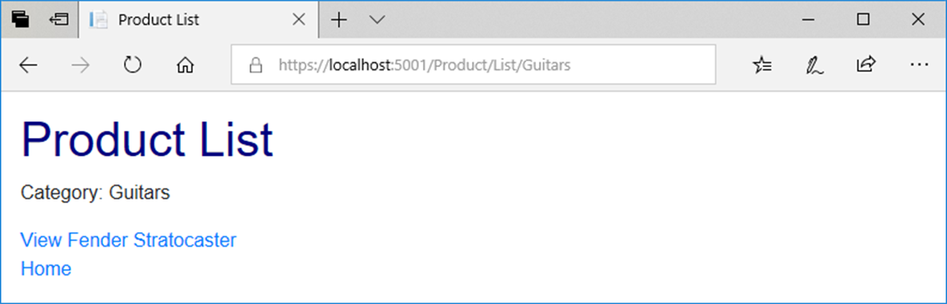
A browser after clicking the View Guitars link

Slide 11
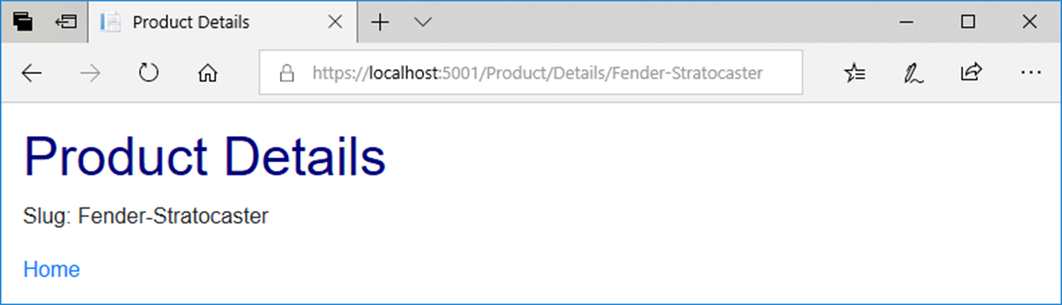
A browser after requesting the View Fender Stratocaster link

Slide 12
More tag helpers for generating URLs
asp-area
asp-fragment
asp-protocol
asp-host

Slide 13
How to code a link to an area
<a asp-area="Admin" asp-controller="Product"
asp-action="List">Admin - Product Manager</a>
The URL that’s generated
/Admin/Product/List

Slide 14
How to code an HTML placeholder
<h2 id="Fender">Fender Guitars</h2>
How to code a URL that jumps to an HTML placeholder on the same page
<a asp-fragment="Fender">View Fender Guitars</a>
The URL that’s generated
/#Fender

Slide 15
How to code an absolute URL
<a asp-protocol="https"
asp-host="murach.com"
asp-controller="Shop"
asp-action="Details"
asp-route-id="html5-and-css3"
asp-fragment="reviews">Murach's HTML5 and CSS3 - Reviews</a>
The URL that’s generated
https://www.murach.com/Shop/Details/html5-and-css3#reviews

Slide 16
Format specifiers you can use to format numbers
Specifier Name
C Currency
N Number
P Percent

Slide 17
Code that stores numbers in the ViewBag
ViewBag.Price = 12345.67;
ViewBag.DiscountPercent = .045;
ViewBag.Quantity = 1234;

Slide 18
Razor expressions that format the numbers
Expression Result
@ViewBag.Price.ToString("C") $12,345.67
@ViewBag.Price.ToString("C1") $12,345.7
@ViewBag.Price.ToString("C0") $12,346
@ViewBag.Price.ToString("N") 12,345.67
@ViewBag.Price.ToString("N1") 12,345.7
@ViewBag.Price.ToString("N0") 12,346
@ViewBag.DiscountPercent.ToString("P") 4.50%
@ViewBag.DiscountPercent.ToString("P1") 4.5%
@ViewBag.DiscountPercent.ToString("P0") 5%

Slide 19
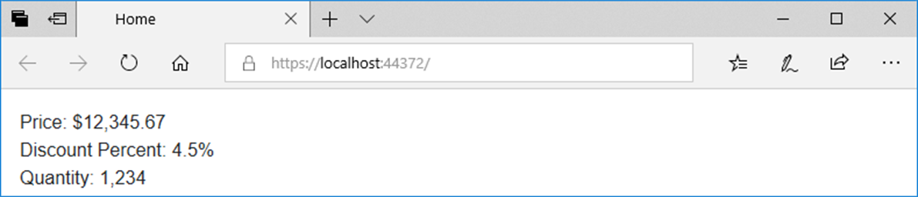
Code in a view that displays the numbers
<div>Price: @ViewBag.Price.ToString("C")</div>
<div>Discount Percent: @ViewBag.DiscountPercent.ToString("P1")</div>
<div>Quantity: @ViewBag.Quantity.ToString("N0")</div>
The view displayed in a browser

Slide 20
The Product model
namespace GuitarShop.Models
{
public class Product
{
public int ProductID { get; set; }
public Category Category { get; set; }
public string Name { get; set; }
public decimal Price { get; set; }
public string Slug => Name.Replace(' ', '-');
}
}

Slide 21
The Category model
namespace GuitarShop.Models
{
public class Category
{
public int CategoryID { get; set; }
public string Name { get; set; }
}
}

Slide 22
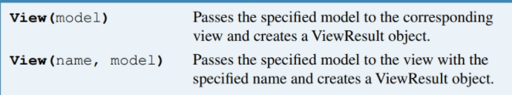
A method that a controller can use to pass a model to a view
View(model)
View(name, model)
The Product/Details() action method that passes a model to a view
public IActionResult Details(int id) {
Product product = context.Products.Find(id);
return View(product);
}
A Product/Add() action method that passes a model to the specified view
[HttpGet]
public IActionResult Add() {
return View("Update", new Product());
}

Slide 23
A directive for displaying model properties in a view
@model
A property for displaying model properties in a view
@Model

Slide 24
A _ViewImports file that imports the Models namespace for all views
@addTagHelper *, Microsoft.AspNetCore.Mvc.TagHelpers
@using GuitarShop.Models
The code for the Product/Details view
@model Product
@{
ViewBag.Title = "Product Details";
}
<h1>Product Details</h1>
<div>ID: @Model.ProductID</div>
<div>Name: @Model.Name</div>
<div>Category: @Model.Category.Name</div>
<div>Price: @Model.Price.ToString("C2")</div>
<a asp-controller="Home" asp-action="Index">Home</a>

Slide 25
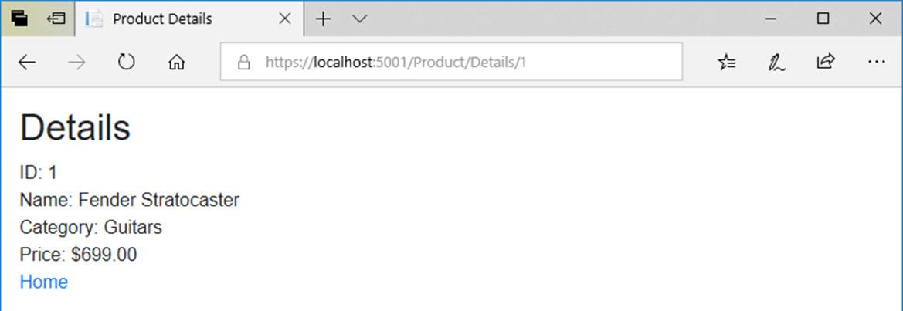
The view with model properties in a browser

Slide 26
A tag helper for binding HTML elements to model properties
asp-for
A view with asp-for tag helpers (part 1)
@model Product
@{
ViewBag.Title = "Update Product";
}
<h1>Update Product</h1>
<form asp-action="Update" method="post">
<div class="form-group">
<label asp-for="Name"></label>
<input asp-for="Name" class="form-control">
</div>
<div class="form-group">
<label asp-for="Price"></label>
<input asp-for="Price" class="form-control">
</div>

Slide 27
A view with asp-for tag helpers (part 2)
<input type="hidden" asp-for="ProductID" />
<input type="hidden" asp-for="Category.Name" />
<button asp-action="Update" type="submit"
class="btn btn-primary">Update
</button>
<a asp-action="List" class="btn btn-primary">
Cancel</a>
</form>

Slide 28
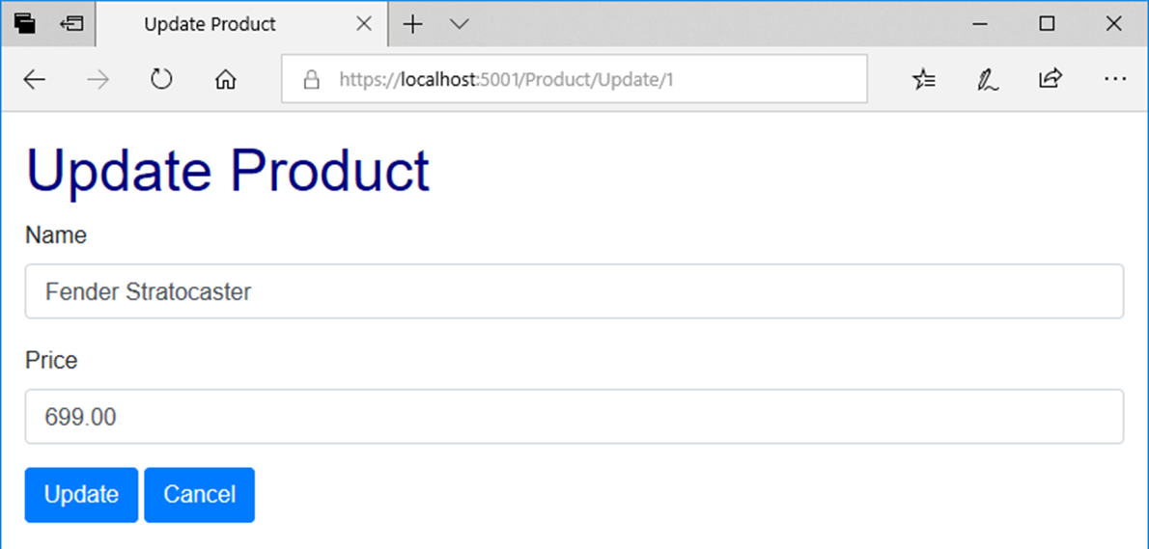
The view with bound properties in a browser

Slide 29
The HTML that’s generated for the Price <label> and <input> elements
<label for="Price">Price</label>
<input class="form-control" type="text"
id="Price" name="Price" value="699.00">

Slide 30
A tag helper for adding options to a <select> element
asp-items
The constructor of the SelectList class
SelectList(list, value, text, selectedValue)

Slide 31
An Update action method that creates the model and passes it to the view
public IActionResult Update(int id)
{
ViewBag.Categories = context.Categories.ToList();
Product product = context.Products.Find(id);
return View(product);
}

Slide 32
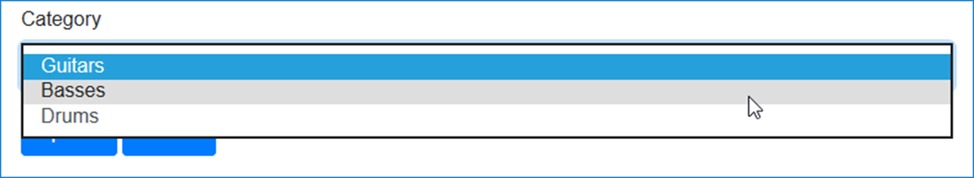
The code that binds items to a <select> element
<div class="form-group">
<label asp-for="CategoryID">Category</label>
<select asp-for="CategoryID"
asp-items="@(new SelectList(ViewBag.Categories,
"CategoryID", "Name",
Model.CategoryID.ToString()))"
class="form-control"></select>
</div>
The <select> element and its label displayed in a browser

Slide 33
HTML that’s generated for the <select> element
<select class="form-control" id="Category_CategoryID"
name="Category.CategoryID">
<option selected="selected" value="1">
Guitars</option>
<option value="2">Basses</option>
<option value="3">Drums</option>
</select>

Slide 34
A List action method that creates the model and passes it to the view
public IActionResult List(string id = "All")
{
ViewBag.Categories = context.Categories.ToList();
ViewBag.SelectedCategory = id;
List<Product> products = context.Products
.Where(p => p.Category.Name == id).ToList();
return View(products);
}

Slide 35
The code for the view (part 1)
@model List<Product>
@{
ViewBag.Title = "Product List";
}
<h1>Product List</h1>
@if (ViewBag.Categories != null)
{
foreach (Category c in ViewBag.Categories)
{
<a asp-controller="Product" asp-action="List"
asp-route-id="@c.Name">@c.Name</a>
<text> | </text>
}
}
<a asp-controller="Product" asp-action="List"
asp-route-id="All">All</a>
<hr />

Slide 36
The code for the view (part 2)
@if (@ViewBag.SelectedCategory == "All")
{
<h2>All Products</h2>
}
else
{
<h2>@ViewBag.SelectedCategory</h2>
}
<table class="table table-bordered table-striped">
<thead>
<tr>
<th>Name</th>
<th>Price</th>
<th></th>
<th></th>
</tr>
</thead>

Slide 37
The code for the view (part 3)
<tbody>
@foreach (var product in @Model)
{
<tr>
<td>@product.Name</td>
<td>@product.Price.ToString("C")</td>
<td>
<a asp-controller="Product"
asp-action="Details"
asp-route-id="@product.ProductID">
View</a>
</td>
<td>
<a asp-controller="Product"
asp-action="Update"
asp-route-id="@product.ProductID">
Update</a>
</td>
</tr>
}
</tbody>
</table>

Slide 38
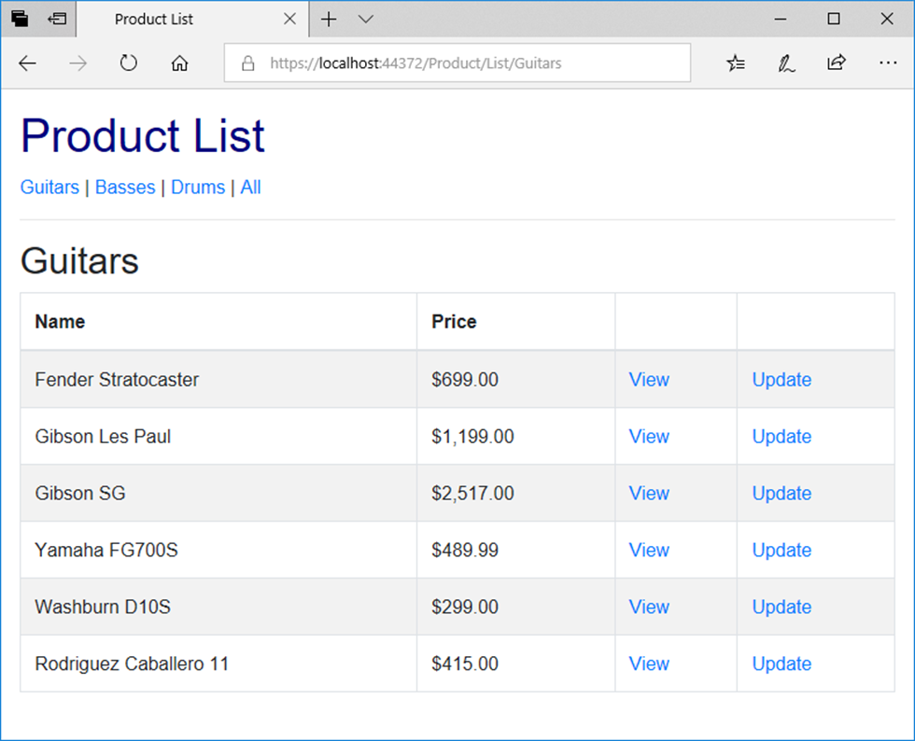
The Product objects view in a browser

Slide 39
The Views/Shared/_MainLayout.cshtml file (part 1)
<!DOCTYPE html>
<html>
<head>
<title>@ViewBag.Title</title>
<link rel="stylesheet" href="~/lib/bootstrap/css/bootstrap.min.css" />
<link rel="stylesheet" href="~/css/custom.css" />
</head>
<body>
<header>
<a asp-controller="Home" asp-action="Index">
Home</a> |
<a asp-controller="Product" asp-action="List">
Products</a> |
<a asp-controller="Home" asp-action="About">
About</a>
<hr />
</header>

Slide 40
The Views/Shared/_MainLayout.cshtml file (part 2)
@RenderBody()
<footer>
<hr />
<p>&copy; @DateTime.Now.Year - Guitar Shop</p>
</footer>
</body>
</html>

Slide 41
The code for a _ViewStart.cshtml file that sets the default layout
@{
Layout = "_Layout";
}
The code for a Home/Index view that explicitly specifies a layout
@{
Layout = "_MainLayout";
ViewBag.Title = "Home";
}
<p>Welcome to the Guitar Shop website!</p>

Slide 42
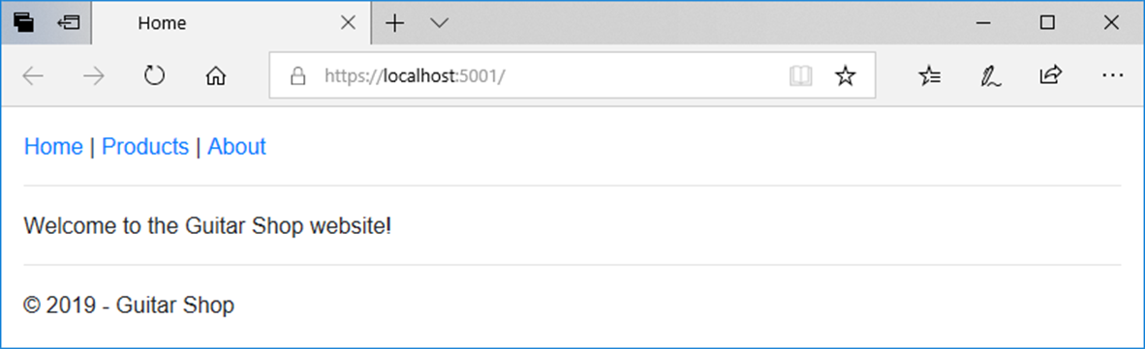
The Home page

Slide 43
The _Layout file
<!DOCTYPE html>
<html>
<head>
<title>@ViewBag.Title</title>
<link rel="stylesheet"
href="~/lib/bootstrap/css/bootstrap.min.css" />
<link rel="stylesheet" href="~/css/custom.css" />
</head>
<body>
@RenderBody()
</body>
</html>

Slide 44
The _MainLayout file
@{
Layout = "_Layout";
}
<header>
<a asp-controller="Home" asp-action="Index">Home</a> |
<a asp-controller="Product" asp-action="List"
asp-route-id="All">Products</a> |
<a asp-controller="Home" asp-action="About">About</a>
<hr />
</header>
@RenderBody()
<footer>
<hr />
<p>&copy; @DateTime.Now.Year - Guitar Shop</p>
</footer>

Slide 45
The _ProductLayout file
@{
Layout = "_MainLayout";
}
<h1>Product Manager</h1>
@if (ViewBag.Categories != null)
{
foreach (Category c in ViewBag.Categories)
{
<a asp-controller="Product" asp-action="List"
asp-route-id="@c.Name">@c.Name</a><text> | </text>
}
<a asp-controller="Product" asp-action="List"
asp-route-id="All">All</a>
}
<hr />
@RenderBody()

Slide 46
The code for a view that uses the _ProductLayout view
@model List<Product>
@{
Layout = "_ProductLayout";
ViewBag.Title = "Product List";
}
@if (@ViewBag.SelectedCategory == "All")
{
<h2>All Products</h2>
}
else
{
<h2>@ViewBag.SelectedCategory</h2>
}
<!-- The code for the <table> element -->

Slide 47
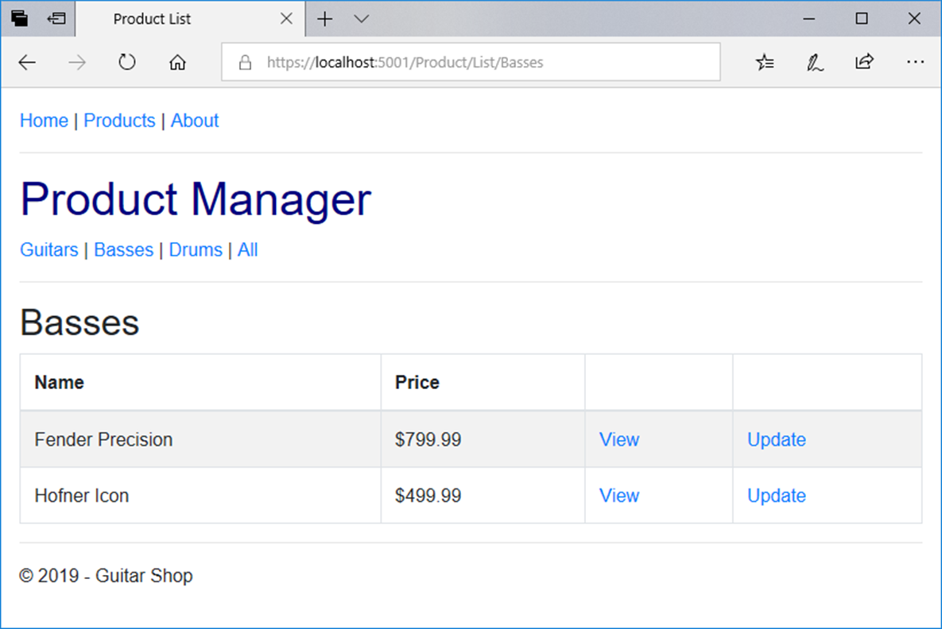
The view with nested layouts in a browser

Slide 48
A _MainLayout file that uses view context (part 1)
@{
Layout = "_Layout";
string controller =
ViewContext.RouteData.Values["controller"].ToString();
string action =
ViewContext.RouteData.Values["action"].ToString();
}
<nav class="navbar navbar-dark bg-primary fixed-top">
<a class="navbar-brand" href="/">My Guitar Shop</a>
<div class="navbar-nav">
<a class="nav-link
@(controller == "Home" && action == "Index" ?
"active" : "")"
asp-controller="Home" asp-action="Index">Home</a>
<a class="nav-link
@(controller == "Product" ? "active" : "")"
asp-controller="Product" asp-action="List">
Products</a>
<a class="nav-link
@(controller == "Home" && action == "About" ?
"active" : "")"
asp-controller="Home" asp-action="About">About</a>
</div>
</nav>

Slide 49
A _MainLayout file that uses view context (part 2)
@RenderBody()
<footer>
<hr />
<p>&copy; @DateTime.Now.Year - Guitar Shop</p>
</footer>

Slide 50
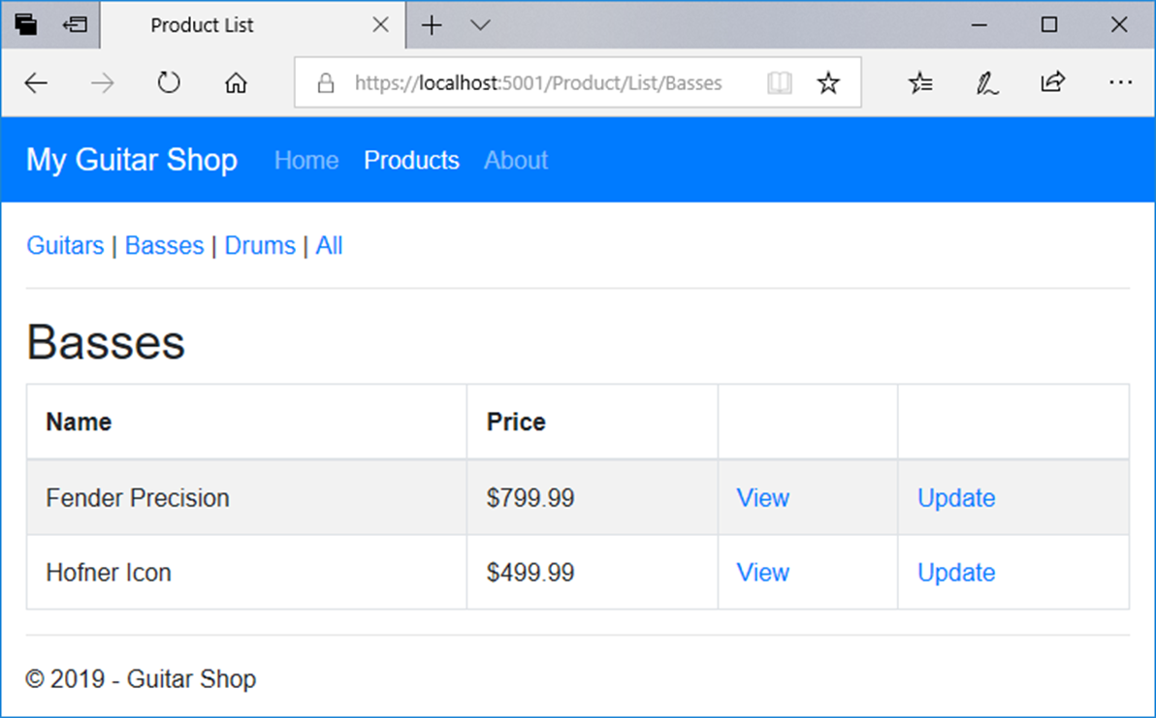
A view that uses this layout

Slide 51
Code in a view file that specifies a section
@model Product
@{
ViewBag.Title = "Update Product";
}
@section scripts {
<script src="~/lib/jquery-validate/jquery.validate.min.js">
</script>
<script src="~/lib/jquery-validation-unobtrusive/
jquery.validate.unobtrusive.min.js">
</script>
}
<h2>Update</h2>
// the HTML elements for the rest of the view body go here

Slide 52
A method that can insert content from a section into a layout
RenderSection(name, isRequired)
A layout file that specifies an optional section
<!DOCTYPE html>
<html>
<head>
<title>@ViewBag.Title</title>
<link rel="stylesheet"
href="~/lib/bootstrap/css/bootstrap.min.css" />
<link rel="stylesheet" href="~/css/custom.css" />
<script src="~/lib/jquery/jquery.min.js"></script>
<script src="~/lib/popper.js/popper.min.js"></script>
<script src="~/lib/bootstrap/js/bootstrap.min.js"></script>
@RenderSection("scripts", false)
</head>
<body>
@RenderBody()
</body>
</html>

Slide 53
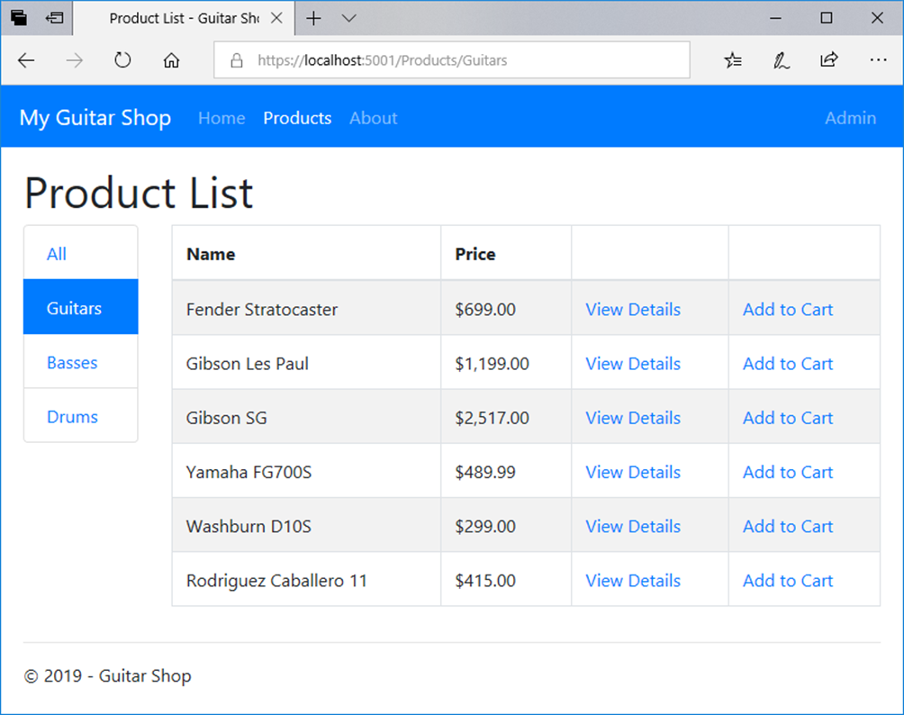
The Product List page for customers

Slide 54
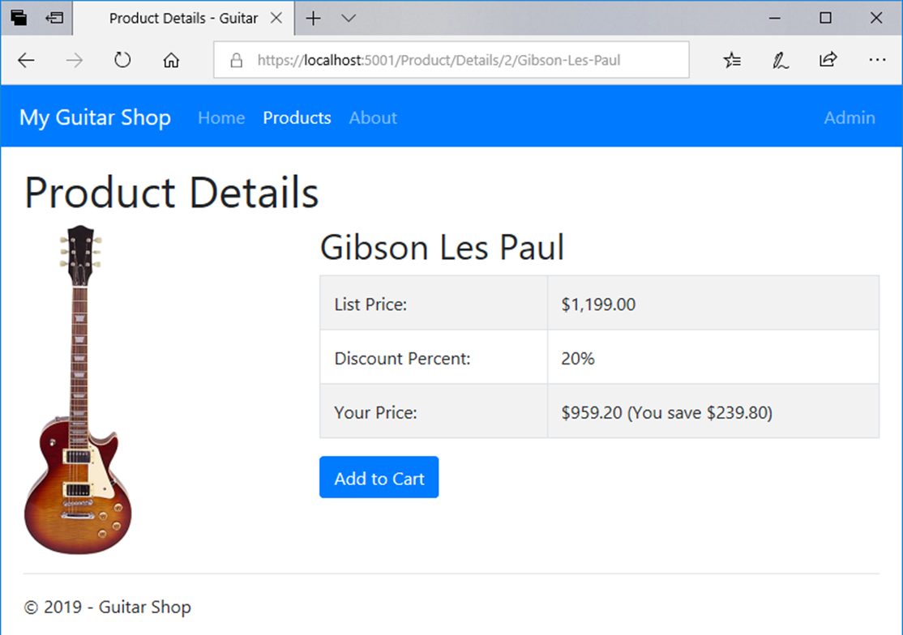
The Product Details page

Slide 55
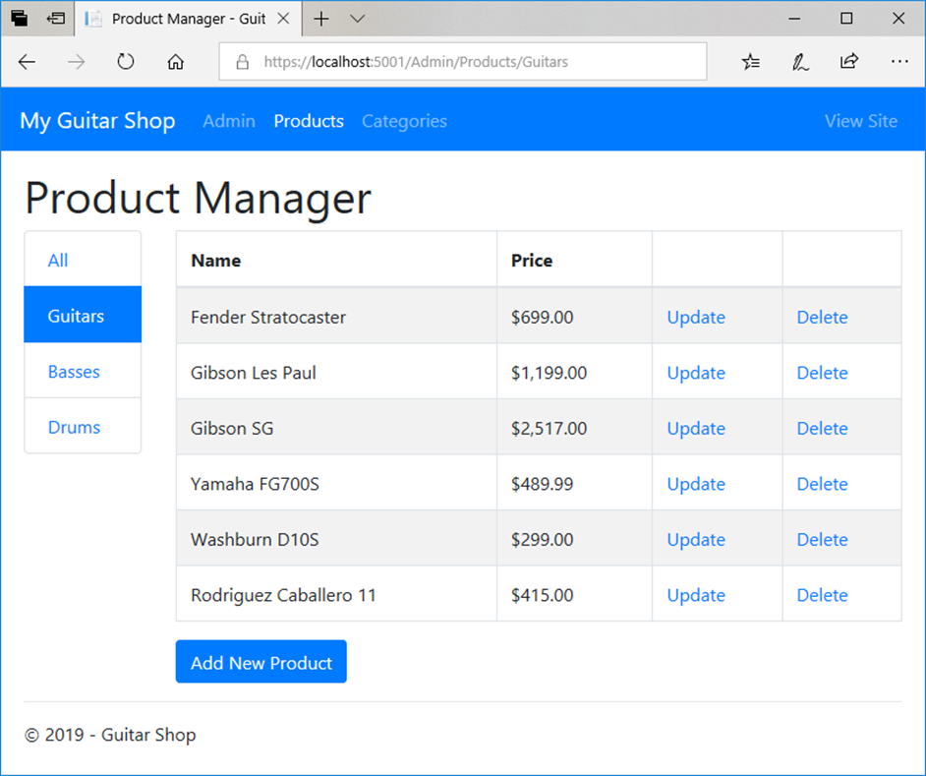
The Product Manager page for administrators

Slide 56
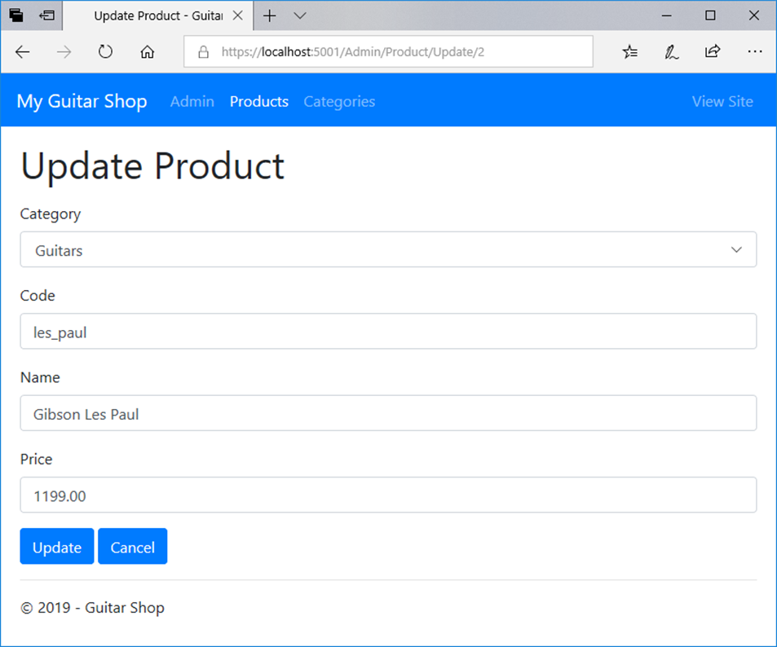
The Update Product page

Slide 57
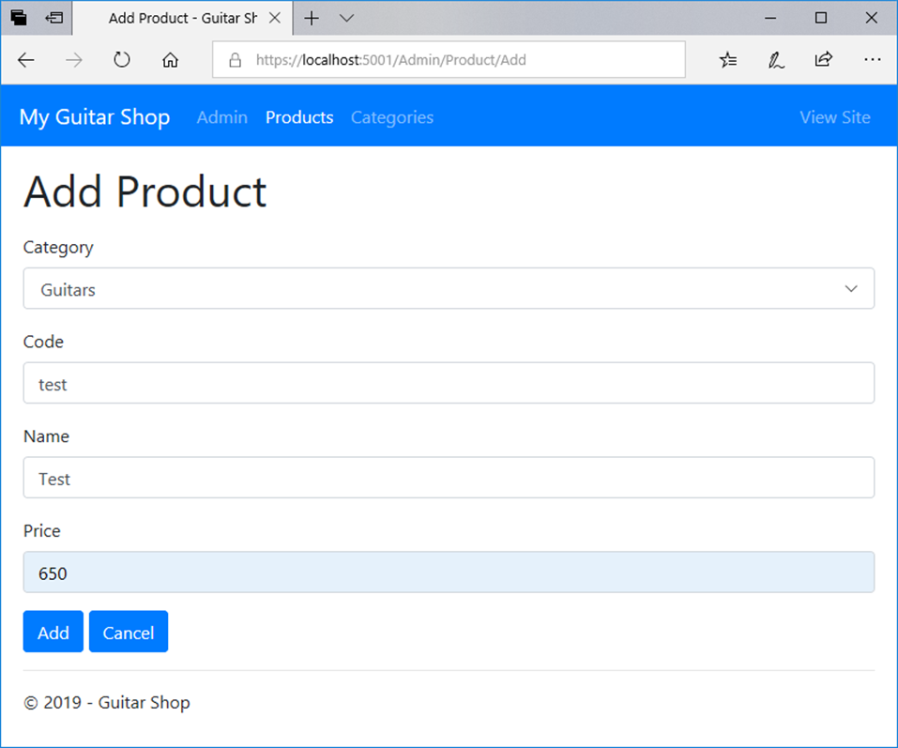
The Add Product page

Slide 58
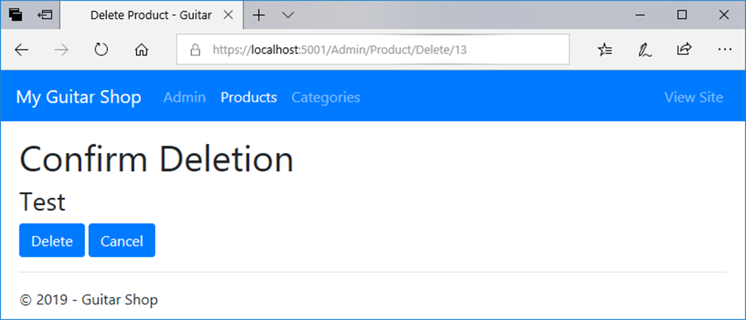
The Delete Product page

