Slide 1
CRITICAL APPROACHES TO ADVERTISING

Slide 2
Advertising and “commercial” advertising

Slide 3


Slide 4
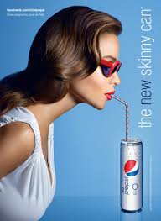

Slide 5
WHY STUDY ADVERTISING? WHAT DO ADS “DO”?
ADVERTISING:
CULTURAL TEXT/PHENOMENON
MEDIATES THE RELATIONSHIP BETWEEN MATERIAL/ECONOMIC RELATIONS/THINGS
(I.E. GOODS, OBJECTS, ETC) AND CULTURE

Slide 6


Slide 7
HOW? BY PRODUCING SYMBOLIC MEANINGS THAT CREATE A RELATIONSHIP BETWEEN THE “THING”, “OBJECT” (BEING MARKETED) AND PEOPLE (THEIR NEEDS, DESIRES, FEARS, ANXIETIES ETC)
ADVERTISING –NEEDS TO BE UNDERSTAND AS THUS AS A SYMBOLIC SYSTEM AS WELL (WORKS THROUGH IMAGES, METAPHORS ETC)

Slide 8


Slide 9
ADS OFTEN REFRAME OR RECODE PUBLIC MEANINGS ABOUT THINGS BY RE-ATTACHING THEM TO A CONSUMPTION LOGIC (THUS OFTEN CREATING SETS OF EQUIVALENCES)
THESE NEED TO BE STUDIED AND OFTEN EVEN CHALLENGED

Slide 10
IT HAS TO DO WITH MEANINGS, VALUES, IDEOLOGIES, AND COMMUNICATION AS MUCH AS IT HAS TO DO WITH “SELLING”, ECONOMIC RELATIONS, MARKET ETC

Slide 11
ADVERTISING GIVES “OBJECTS” “THINGS” A “SOCIAL LIFE”
(APPADURAI, ARJUN NOTION OF “SOCIAL LIFE OF THINGS”)

Slide 12
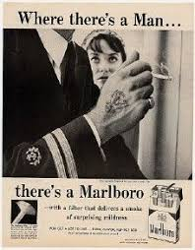

Slide 13


Slide 14
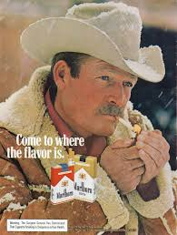

Slide 15
ADS ARE EVERYWHERE RESULTING IN THE COMMODIFICATION OF ALL ASPECTS OF OUR LIVES (INCLUDING INTIMATE AND VERY PERSONAL ASPECTS—E.G HEALTH, SEX, RELATIONSHIPS)

Slide 16


Slide 17


Slide 18
WHAT DOES “CRITICAL” MEAN IN CRITICAL APPROACHES TO ADVERTISING?
CRITICAL—EXAMINING OF INEQUALITIES AND SOCIAL POWER

Slide 19
APPLE FAMOUS 1984 AD
https://www.youtube.com/watch?v=VtvjbmoDx-I

