Slide 1


FitFlex
Arpita Gaonkar - 001447128
Janhavi Bhalerao - 001494855
Kumari Deepshikha - 001403302
Jinal Sapariya - 001448816

Slide 2

EXISTING DESIGN
Currently in the market there are too many different applications to track fitness, health, nutrition individually
Most of the applications provide either trial version or give access to one or two basic features. To use the app fully they have to take a monthly or yearly subscription

Slide 3
FLAWS IN EXISTING DESIGN
Users have to download too many apps to consistently keep track of different activity such as steps, health, water or any other health related factors.
Tier of memberships are confusing.
Users have to manually enter their goals for calorie intake, steps suitable for their body.

Slide 4
IMPROVEMENTS
One unified application
Intuitive error and informational messages.
Simple and improved user interface.
Consistent theme and common UI elements.
Strategic use of colors/contrast.
Collect reviews and feedback for continuous UX improvement.

Slide 5
IBM DESIGN THINKING
1: Understand
2:Explore
3:Prototype
4:Evaluate
It is important to maintain a Healthy & Fit lifestyle
There are no easy to use apps for tracking these factors
Users may face difficulty in exploring new healthy resources
Unified solution for fitness tracking
Providing feature of exploring new recipes, events explore, collecting user feedback
Personalised goals according to data collected from user
An application for tracking fitness factors
Discovering new events
Exploring new healthy lifestyle resources
Logging water, weight, etc
View past data, statistics
Weekly or monthly progress
Future scope of purchasing healthy food products

Slide 6
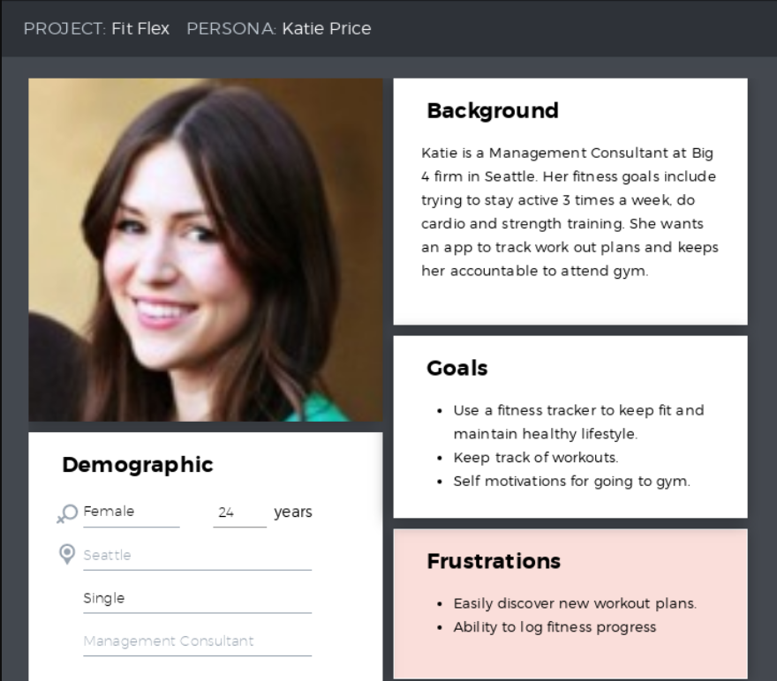
STRATEGY PLANE- Persona 1
Notes:
user and business need

Slide 7
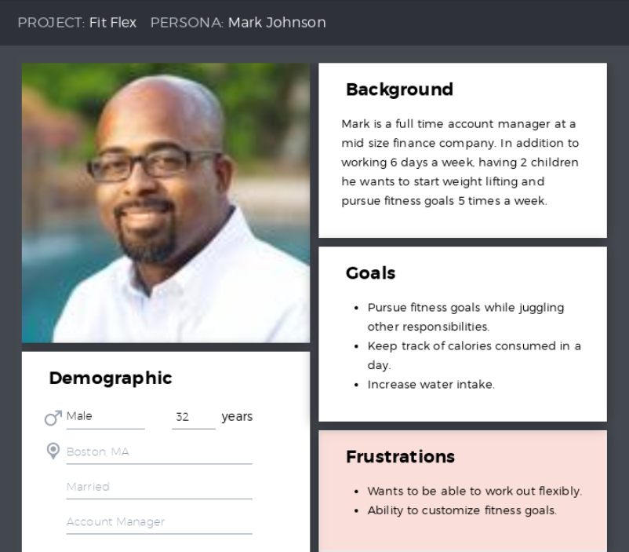
STRATEGY PLANE- Persona 2

Slide 8
SCOPE PLANE-
Functional Requirements
Customize solution catered to user by providing personal health information based on demographic
Ability to track their fitness, water and nutrition level
Able to set and update goals
Discover new recipes
Explore events happening around you
Able to get customer reviews
Daily, weekly and monthly analysis of their progress
Workout suggestions
User must be able to add demographic information

Slide 9
SCOPE PLANE-
Content Requirements
Demographic information of user must contain username, location, age, height, weight and purpose.
Home page should include the main features of the application.
There should be shortcuts in the home page for easy navigation.
The statistical analytics should be in a representative format.
Dashboard should contain dynamic overall performance details of the user.
Recipes displayed must include necessary details like ingredients
Each clickables on the current page must be self explanatory.

Slide 10
STRUCTURE PLANE-
Error Handling
By using informative onboarding technique we are educating the user about the app hence, reducing the error
Minimized the situation where user needs to type the information by extensively using checkbox, radio button etc
Used tool tip to make the user know the format of text to be entered
Providing setting page and profile page to edit the personal and account details
Adding detailed error message about something going wrong due to technical issue

Slide 11
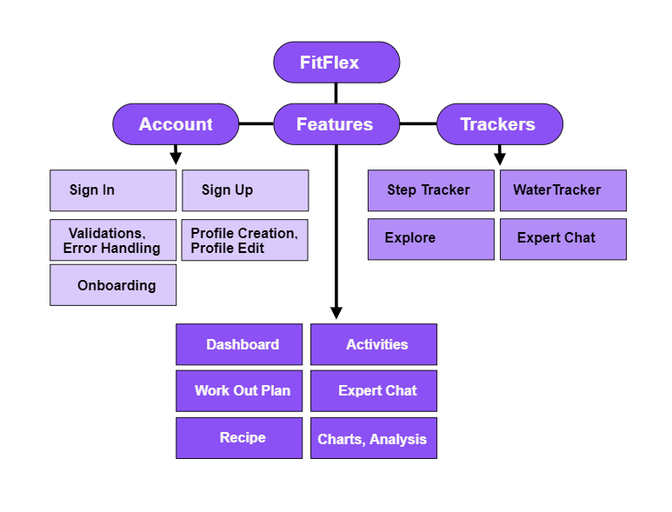
Information
Architecture

Slide 12






USER REQUIREMENTS
One place solution for tracking and maintaining their fitness, health, sleep etc.
Easy to understand and less complex application for staying fit
Getting customized recommendation for staying fit
No unnecessary notification
Able to use most of the features without paying for the app
Google Survey Forms

Slide 13
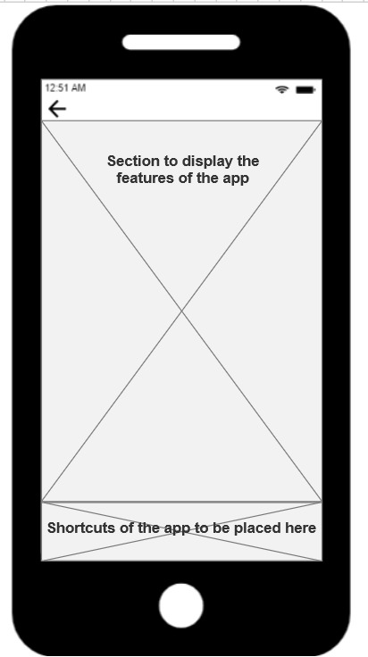
SURFACE PLANE
This is where the content meets users’ senses and it determines how does the product look!
Right Layout
Content formatting
Typography in relation to content consumption: font-sizes, line height, spacing
Style guides

Slide 14
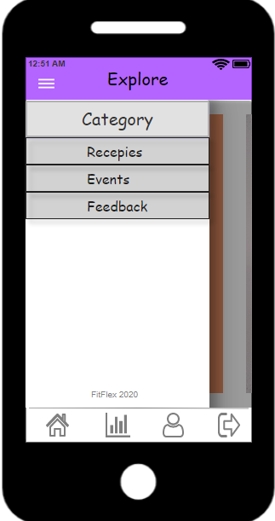
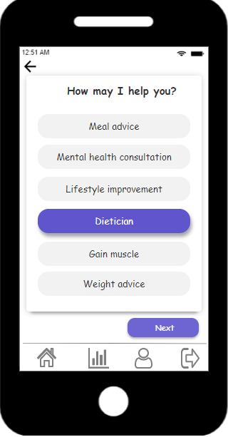

Google Material Design

Slide 15
STYLE GUIDE
We have selected purple and white colors.
Purple implies calmness which is essential in day to day life.
White is tied to positivity and is used for a minimalist design, due to simplicity.
White easily takes on the characteristics of purple due to its neutrality.
Font is Comic Sans.

Slide 16
SKELETON PLANE - Wireframes
https://app.moqups.com/08EmWTM9Xy/edit/page/ae419fcd8
https://app.axure.cloud/app/project/wg323o/overview

Slide 17
ONBOARDING
The app provides easy navigation to increase user experience
Showing the major features of app to user
When a new person sign ups he has the option of viewing/ skipping onboarding process which is in the slider form
User can see onboarding back again under help guide page along
Users will be greeted in app to increase customization
Notes:
slider explanation and interactive tour

Slide 18
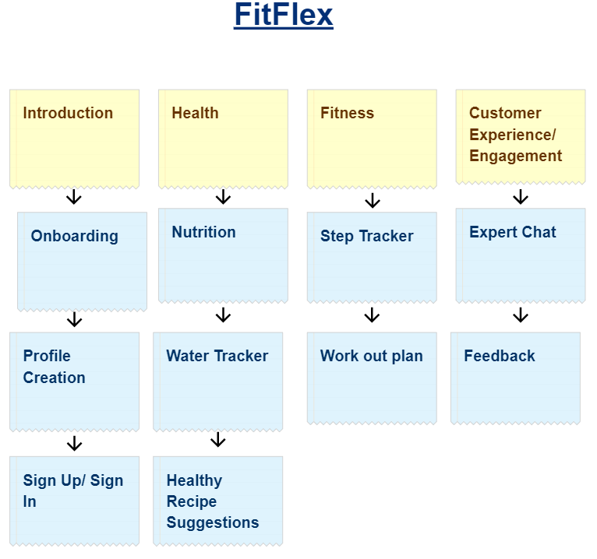
UX Research Methods - Card Sorting
It enabled us to assemble and categorize the apps information into a logical structure that will lead to navigation.
It helped in developing the site’s information architecture and made it more user centric.
This helped make sure that the site structure matches the way users think.

Slide 19
UX Research Methods - Personas
This method aimed at creating a representative user based on user interviews and available data.
Although the peculiar details of the persona may be fictional, the information used to form the user type isn’t.

Slide 20
UX Research Methods - Prototyping
An early model, sample, or release of a product built to inspect a concept or process, prototyping allowed us to explore ideas before implementation through creating a mock-up of the site.
https://app.moqups.com/08EmWTM9Xy/edit/page/ae419fcd8

Slide 21
UX Research Methods - Focus Groups
This method involved a moderated discussion with a selected group of users, whose participation offers insights into users’ ideas, desires, and attitudes.
It consisted of candidates who want to start a healthy lifestyle.
1. Akash
2. Neha
3. Anjali
4. Ishita
5. Archie
6. Shubhangi
It helped in understanding user perspective and gauge requirements.

Slide 22
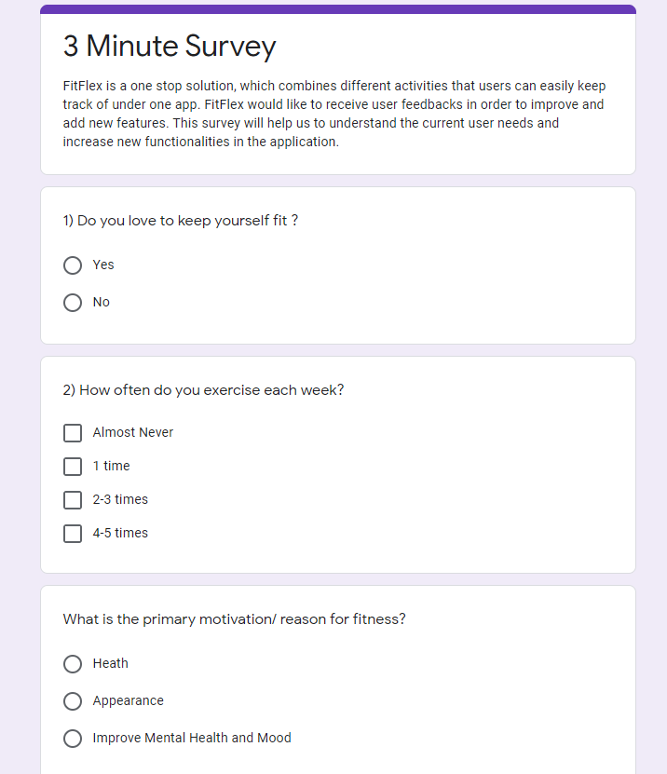
UX Research Methods - Surveys
Google Survey Forms
This method progresses by establishing a series of questions asked to different users of the application. Surveys help you know about the people who visit the site/app.

Slide 23
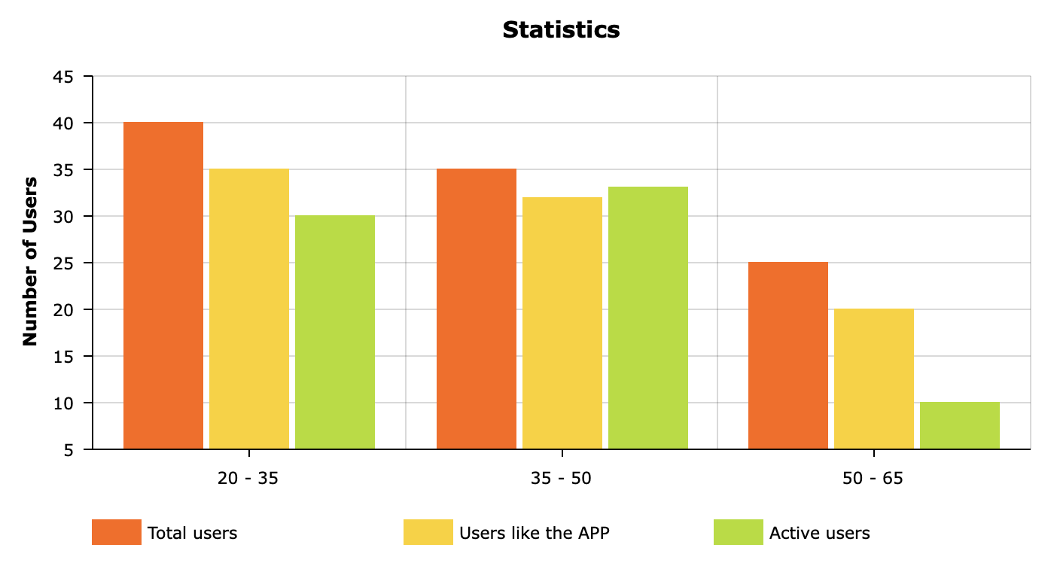
UX Research Methods - Surveys

Slide 24
Outcomes of UX Research Methods
Some of the outcomes generated through user research testify that enhancing the usability will:
1) Improve conversion rates
2) Improve sign-ups
3) Improve customer satisfaction
4) Improve trust in the brand
Moreover, the integration of UX research into the development procedure resulted in:
1) Reduce development time
2) Disclosed worthy insights about the audience
3) Offer an in-depth sight into users’ mental models, goals, and pain points.

Slide 25
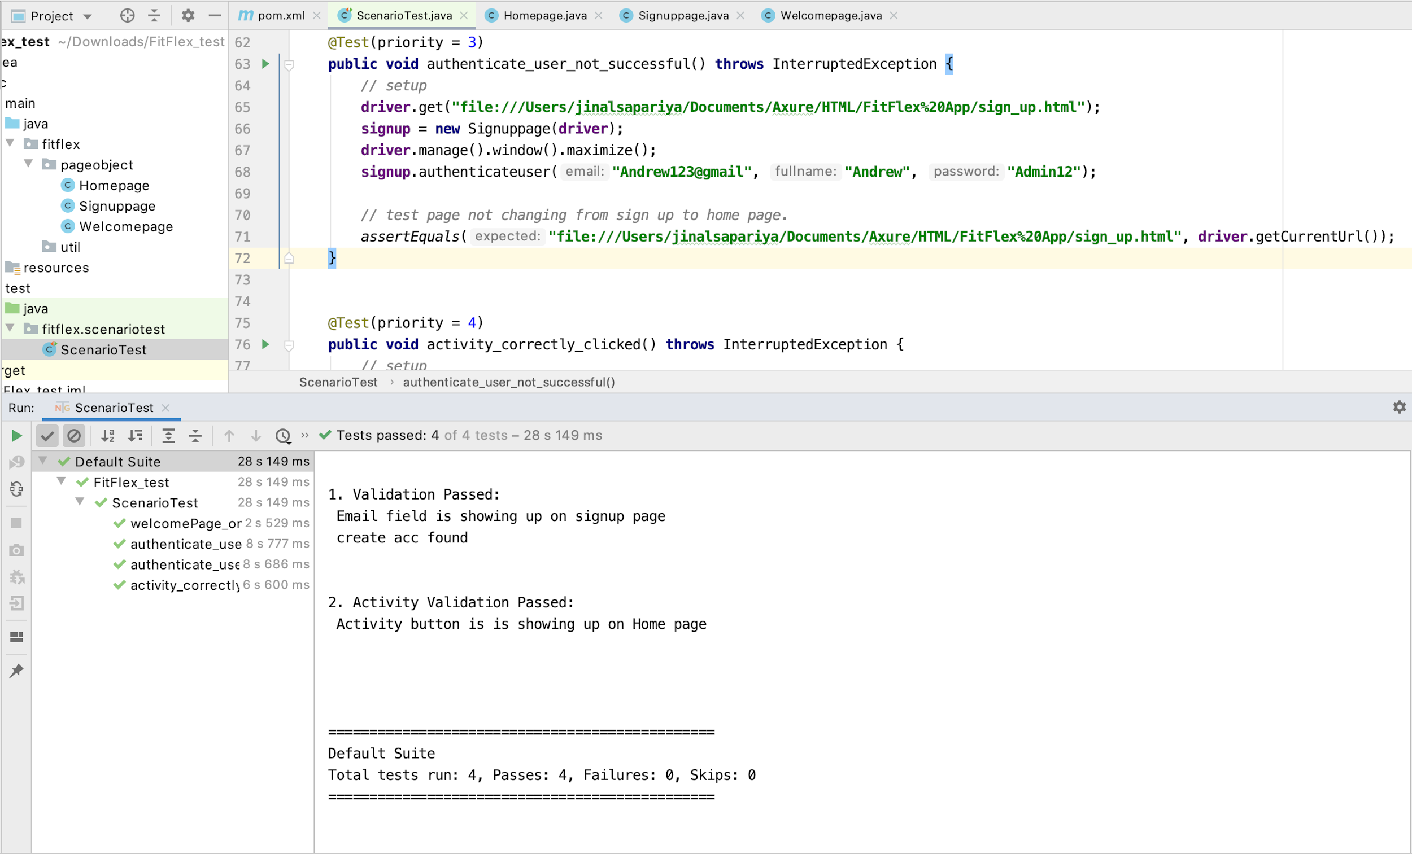
Testing
By using selenium tool the application was tested for its functionality and errors.
4 Test Cases were implemented

Slide 26
HUMAN FACTOR CONCEPTS
Taken into account below mentioned factors:
Things like borders, edges, color, and size can create powerful contrasts, and powerful contrast dominates attention.
Working memory has a limited capacity, limited duration, is highly volatile.

Slide 27
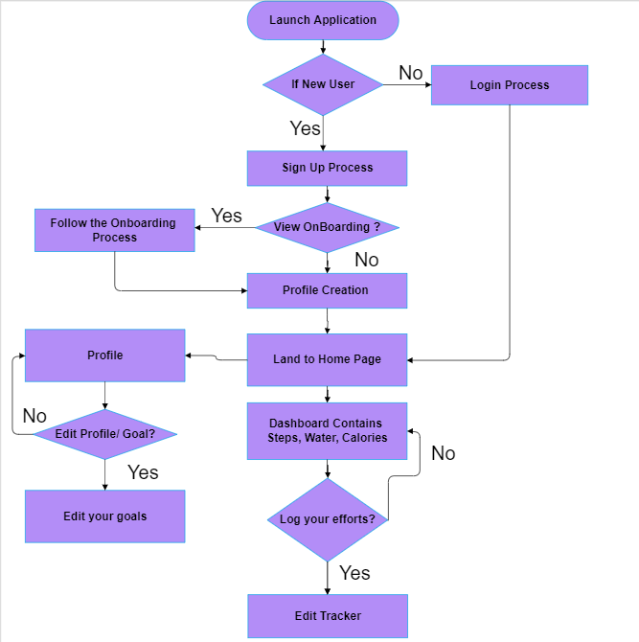
FLOWCHART

Slide 28
Thank you and stay fit !
TEAM:
Arpita Gaonkar - 001447128
Janhavi Bhalerao - 001494855
Kumari Deepshikha - 001403302
Jinal Sapariya - 001448816

