Slide 1
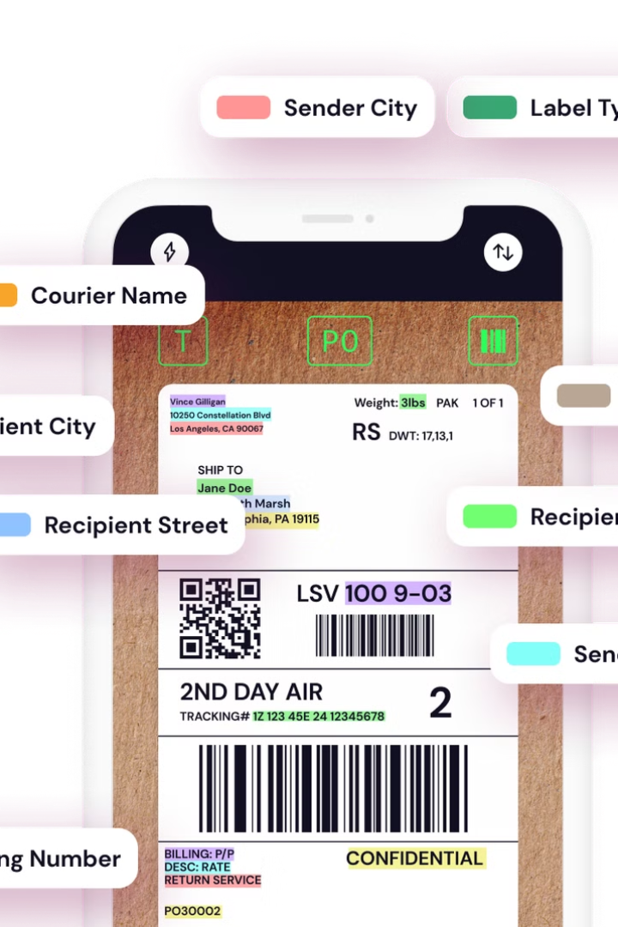
Label Extraction Using Deep Learning and OCR
This project explores a novel approach to extracting label information from images using deep learning and OCR technology. We'll delve into the intricate process, highlighting its applications in e-commerce and accessibility for the visually impaired.
Jinam Sancheti (BT21ECE074)
Anshul Patil (BT21ECE069)

Slide 2
Introduction: Problem Statement and Motivation
Label Extraction Challenge
Motivation
Extracting key information like weight, volume, and ingredients from product labels is a crucial but challenging task.
This technology has the potential to revolutionize e-commerce and create a more accessible world for the visually impaired by providing accurate product information.

Slide 3

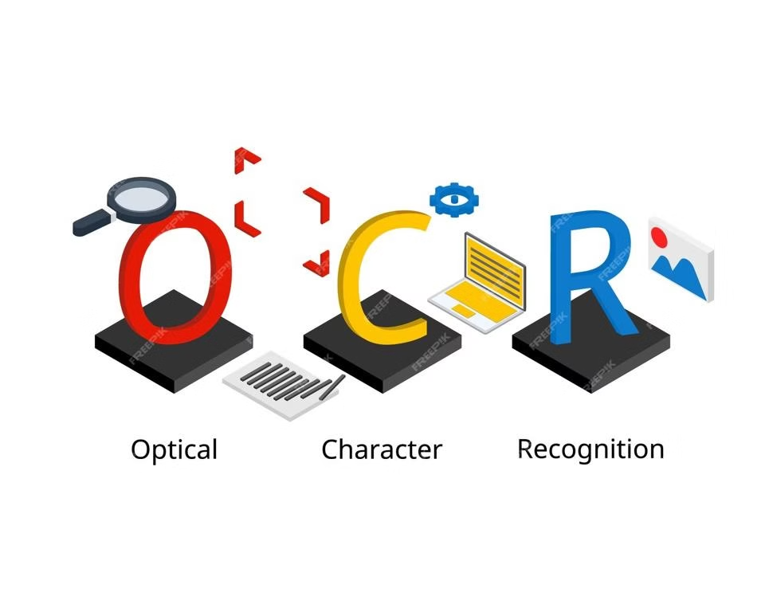
Overview of the Label Extraction Process
1
1. Image Acquisition
2
2. Preprocessing
The process begins with capturing images of product labels.
Images are cleaned and normalized to enhance the accuracy of text recognition.
3
3. Deep Learning Model
4
Post Processing
We used Paddle OCR to extract text from images. We have also developed our own OCR model using CNN, to compare the results.
OCR model returns all of the text written on an image. So it required a heavy amount of post-processing to extract the essential data from it.

Slide 4
Data Preprocessing: Cleaning and Normalization
Image Enhancement
Text Segmentation
Normalization
Techniques like noise reduction, contrast adjustment, and sharpening improve image quality.
Label text is separated from the background, ensuring accurate OCR recognition.
Images are resized and standardized to ensure consistency and optimize model performance.

Slide 5

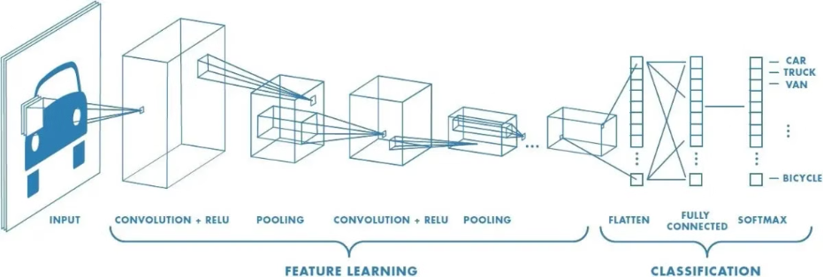



Deep Learning Model Architecture
Convolutional Neural Networks
Feature Extraction
Text Segmentation
CNNs are particularly well-suited for image recognition tasks.
CNNs learn to identify and extract relevant features from the image data.
The model effectively segments the label text from the surrounding background.

Slide 6

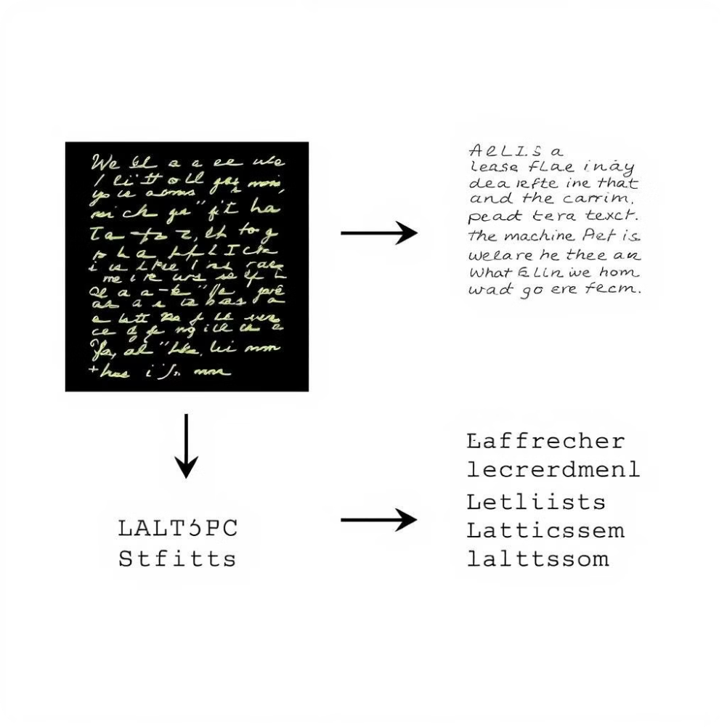
OCR Text Recognition
1
The extracted text is then processed by an Paddle OCR system.
2
Paddle OCR algorithms convert image pixels into machine-readable text.
3
This step ensures that the extracted text is accurate and reliable.

Slide 7

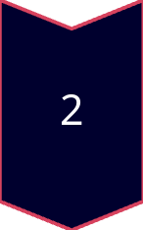
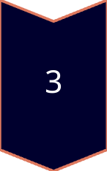
Post-Processing: Text Cutting, Unit Extraction, and Value Selection
Text Cutting
Extracted text is processed by removing spaces, convert to lower case, removing unwanted symbols, finding matches with units of entities.
Unit Extraction
Units of measurement like "grams," "ml," or "oz" are identified in the received output. Match units from input_list using the provided units_dict.
Value Selection
The corresponding numeric values associated with the units are selected.

Slide 8



Applications in E-Commerce and Accessibility for the Visually Impaired
E-Commerce
1
This technology allows online retailers to automatically extract product information from labels.
Accessibility
2
Provides accurate product information for visually impaired individuals through mobile apps or assistive devices.
Enhanced User Experience
3
Simplifies product search and selection, improving user experience for everyone.

Slide 9

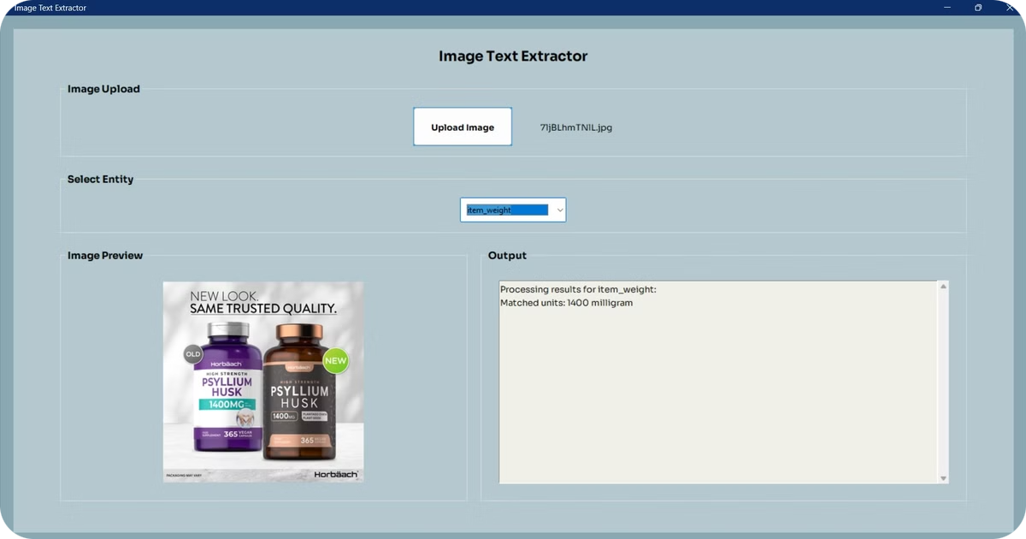
Evaluation and Performance Metrics
90%
95%
Accuracy
Precision
The percentage of correctly extracted labels.
The proportion of correctly identified labels among all labels extracted.

Slide 10
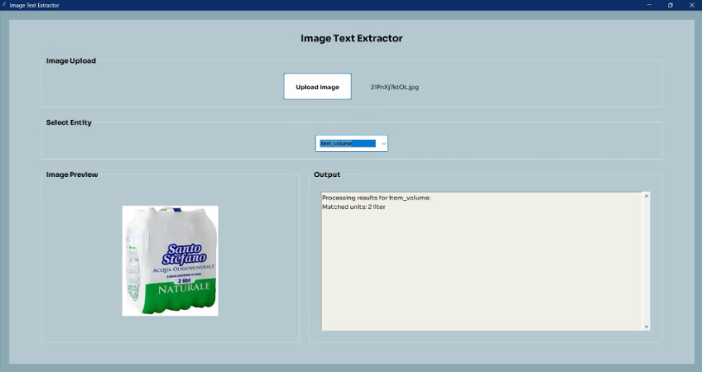
Output Image
As we can see here the model has correctly predicted 2 Liter, i.e. the volume of the item.

Slide 11
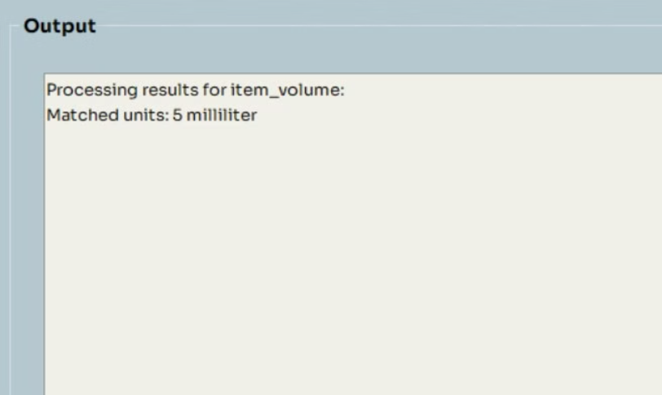
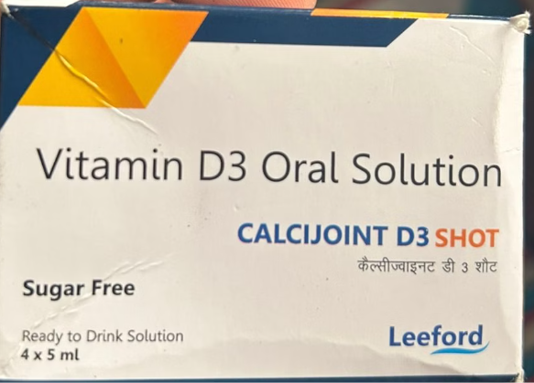

Slide 12
Challenges and Future Improvements
Handling Complex Labels
1
Improving the ability to handle labels with multiple languages, fonts, and layouts.
Contextual Understanding
2
Developing models that can understand the context of label information.
Real-Time Processing
3
Creating a system that can process labels in real-time for applications like mobile scanning.

