Slide 1

SentiArab-LEV
Arabic Sentiment Analysis Using Classical ML, CAMeL-BERT & GPT-4o-mini
Jinan Ghannam | Natural Language Processing | May 2026
100K Dataset
5 Models
3 Classes
Arabic NLP

Slide 2






OVERVIEW
Presentation Agenda
01
05
Problem & Motivation
Results & Evaluation
02
06
Dataset
Error Analysis
03
07
Pipeline & Methods
Conclusion & Future
04
Models

Slide 3
PROBLEM & MOTIVATION
Why Arabic Sentiment Analysis Is Hard
Morphological Richness
One Arabic root generates hundreds of inflected forms — a single verb can have 50+ conjugations.
Dialect Diversity
Our Goal
Levantine, Egyptian, Gulf, Moroccan dialects differ significantly from MSA — and from each other.
Build SentiArab-LEV
A complete pipeline combining classical ML, transformer fine-tuning, and LLM comparison for 3-class Arabic sentiment analysis on 100K real reviews.
Noisy Social Media
Spelling inconsistencies, emojis, code-switching, repeated characters, and abbreviations are common.
Limited NLP Resources
Arabic NLP tools and large labeled datasets lag significantly behind English equivalents.

Slide 4
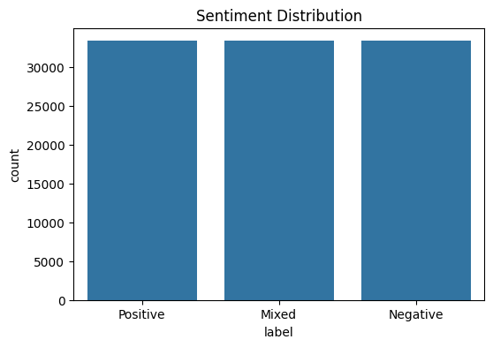
DATASET
100K Arabic Reviews — Perfectly Balanced
Custom Arabic user-generated review dataset with 3 sentiment classes from Kaggle by Ahmed Gamel Waly
99,999
80,000
20,000
Total Reviews
Training (80%)
Test Samples (20%)
Positive
per class
~33,333
Negative
per class
~33,333
Mixed
per class
~33,333

Slide 5

PIPELINE & METHODS
NLP Processing Pipeline
1
2
3
4
5
6
Normalize
Clean
Tokenize
Stem / Lem
POS + NER
TF-IDF
→
→
→
→
→
Alef/Ya unification
Tatweel & diacritics
removal
URLs, emojis,
punctuation, numbers
removed
Word & sentence
tokenization +
stopword removal
ISRI Stemmer
+ lemmatization
for root forms
Adjective tagging
+ entity flags
(CAMeL Tools)
Unigrams & bigrams
+ POS & NER
feature matrix
Why These Steps? Arabic morphology creates excessive vocabulary sparsity without normalization and stemming. POS tagging identifies sentiment-bearing adjectives and adverbs for weighted feature extraction. NER flags add contextual signals about brand/location mentions.

Slide 6
MODELS
Five Models Across Three Paradigms
Classical ML
Classical ML
Classical ML
Transformer
LLM
Naïve Bayes
Logistic Reg
SVM
CAMeL-BERT
GPT-4o-mini
Probabilistic baseline
Fast & lightweight
Assumes independence
Linear discriminative
Interpretable weights
Strong TF-IDF baseline
Max-margin classifier
High-dim sparse input
Best classical result
Arabic pre-trained
Contextual embeddings
Fine-tuned on 80K
Zero-shot prompting
100 sample evaluation
API cost constrained
TF-IDF + POS
TF-IDF + POS
TF-IDF + POS
50K fine-tune
150 samples

Slide 7
RESULTS & EVALUATION
Model Performance Summary
Accuracy and Macro F1 across all 5 models on 20,000 test samples
Model | Accuracy | Macro F1 | Test Samples | Paradigm
🥇 CAMeL-BERT | 69.91% | 0.70 | 10,000 | Transformer
GPT-5.5 | 58.67% | 0.59 | 150 * | LLM (zero-shot)
Logistic Regression | 54.6% | 0.55 | 20,000 | Classical ML
SVM | 54.3% | 0.54 | 20,000 | Classical ML
Naïve Bayes | 53.1% | 0.53 | 20,000 | Classical ML
* GPT-5.5 evaluated on 150-sample subset only due to API cost — not directly comparable to other models.

Slide 8
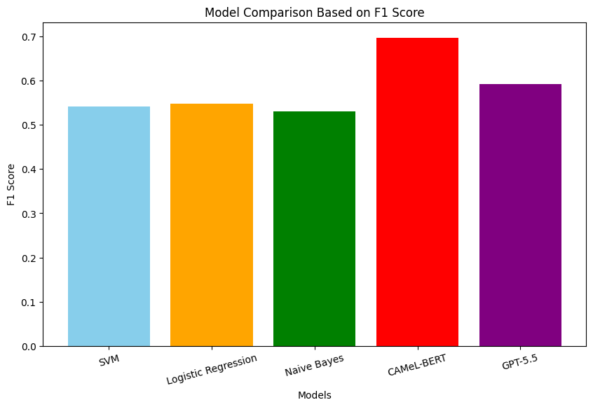
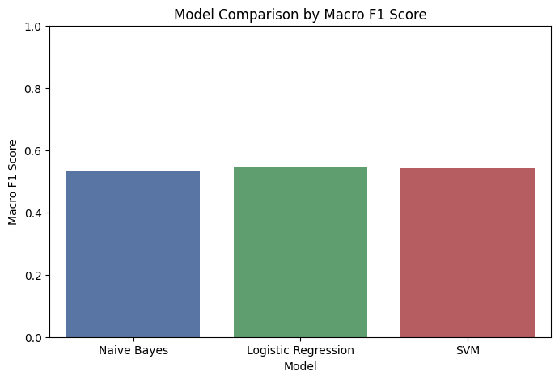
RESULTS & EVALUATION
F1 Score Comparison Across All Models
All 5 Models (F1)
Classical ML Only (Macro F1)

Slide 9
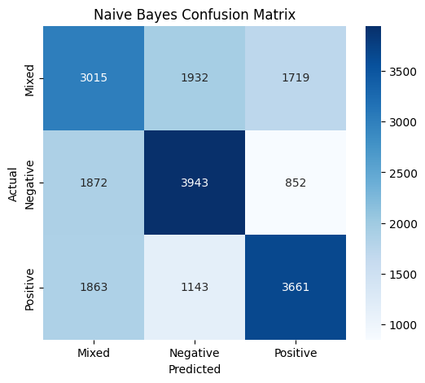
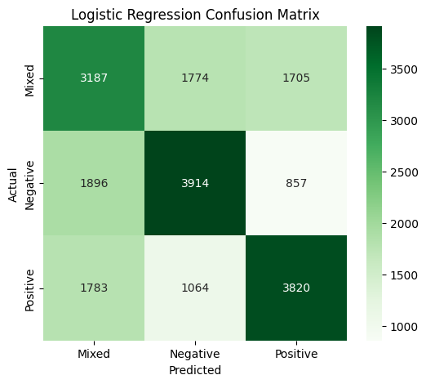
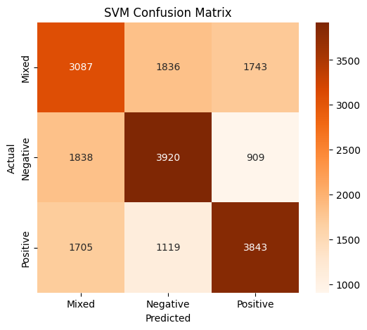
RESULTS & EVALUATION
Confusion Matrices — Classical ML Models
Naïve Bayes
Logistic Regression
SVM
Acc: 53.1%
F1: 0.53
Acc: 54.6%
F1: 0.55
Acc: 54.3%
F1: 0.54
Mixed class is the hardest to classify across all 3 models — recall ≈45-48%. Negative class has the highest recall (~59%).

Slide 10
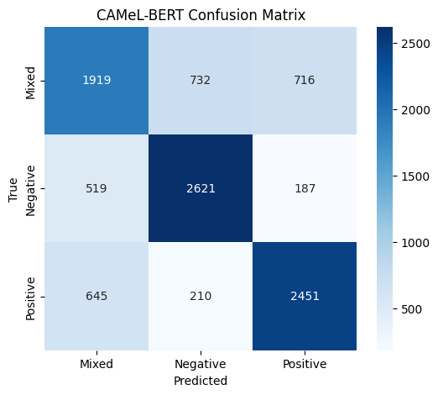
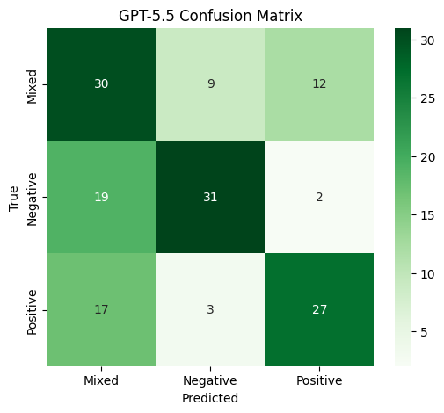
RESULTS & EVALUATION
Confusion Matrices — Transformer & LLM
CAMeL-BERT
GPT-4o-mini
Acc: 69.91%
F1: 0.70
Acc: 58.67%
n=150 only

Slide 11


RESULTS & EVALUATION
Key Findings & Discussion
Classical ML: competitive but outclassed
Logistic Regression (54.6%) edges out SVM (54.3%) and Naïve Bayes (53.1%). TF-IDF + POS features remain a solid baseline but fall short of transformer and LLM approaches.
CAMeL-BERT outperforms all models
CAMeL-BERT outperforms all models 69.91% accuracy — best across all five models. Fine-tuned on clean_text for 5 epochs on a 50K subset, CAMeL-BERT's contextual representations outperform classical TF-IDF approaches by ~15 percentage points.
GPT-5.5: promising but limited
strong zero-shot performance 58.67% accuracy on 150 samples using an Arabic-language prompt. Ranks second overall, outperforming all classical ML models without any task-specific training.
Mixed class is universally hard
All 5 models struggle most with Mixed sentiment. Recall 45-48% across classical models — genuinely ambiguous for both models and humans.

Slide 12
ERROR ANALYSIS
Why Do Models Make Mistakes?
Sarcasm & Irony
Short Reviews
Positive surface words hide negative intent. All models predicted Positive for sarcastic reviews.
Example: 'ممتاز كالعادة!' → classified Positive
2-3 token reviews lack sufficient context for all models. Higher misclassification rate than longer texts.
Dialect Ambiguity
Code-Switching
Same word = different sentiment across Levantine, Egyptian, Gulf dialects. No dialect labels in dataset.
Arabic + English within one review disrupts stemming and tokenization pipelines.
Mixed Reviews
Transformer Advantage
Starts positive, ends negative (or vice versa). TF-IDF averages the signals — no dominant class.
CAMeL-BERT and GPT-4o-mini handled dialectal ambiguity and long mixed reviews better than classical models — but neither resolved sarcasm.

Slide 13
CONCLUSION & FUTURE WORK
Limitations & Future Directions
Current Limitations
Future Directions
✕ GPU constraints limited CAMeL-BERT training epochs
→ Full CAMeL-BERT fine-tuning with adequate GPU
✕ GPT-5.5 tested on only 150 samples (not comparable)
→ AraBERT & XLM-RoBERTa comparison
✕ No dialect labels — cannot analyze dialect-level performance
→ Dialect identification as preprocessing step
✕ No sarcasm detection component
→ Arabic sarcasm detection module
✕ Arabic NLP tools lag English alternatives
→ Aspect-based sentiment analysis

Slide 14
Conclusion
SentiArab-LEV: What We Built & Learned
01
Classical ML + good Arabic features = competitive baseline (Logistic Regression: 54.6%, F1: 0.55)
02
Transformer models need sufficient compute — CAMeL-BERT underperformed due to GPU constraints, not model failure
03
LLMs (GPT-5.5) show zero-shot promise but introduce API cost and comparability challenges
04
Mixed sentiment class remains universally hard — sarcasm and dialect ambiguity are unsolved challenges
Thank you | Jinan | NLP Course — May 2026

