Slide 1
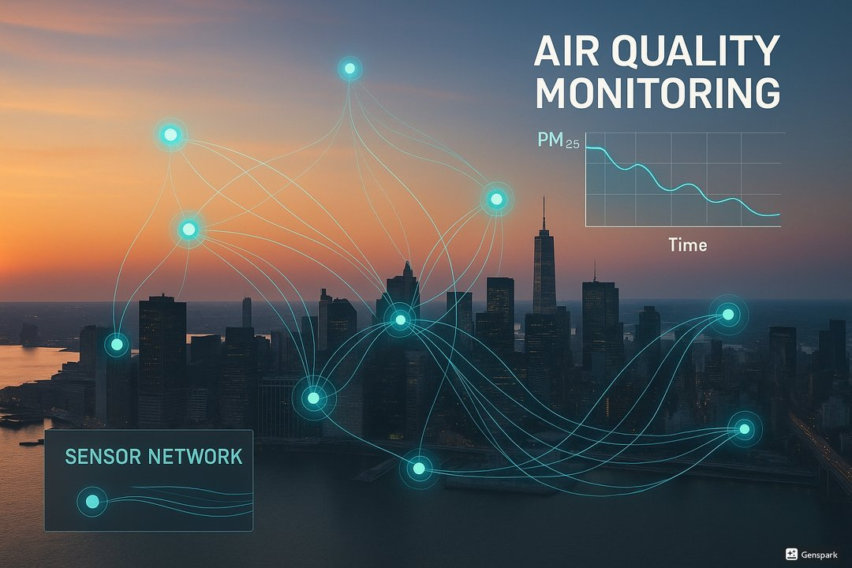
Smart City Air Quality Monitoring System
Real-Time Environmental Intelligence with Azure PostgreSQL & AI Streaming
Team: Justin · Sravani · Jinank

Slide 2
Why Care? The Urban Air Quality Crisis
99% of the world’s population breathes polluted air.
Over 7 million deaths annually linked to air pollution (WHO).
Rapid urbanization and traffic emissions demand smart monitoring solutions.

Slide 3
Our Solution: Smart AQMS Architecture
Azure PostgreSQL as the core real-time data store.
Data ingestion pipeline inserting hundreds of records per minute.
Streaming analytics, outlier detection, and ML inference modules.
Streamlit dashboard for live KPIs and geospatial visualization.

Slide 4
Relational Database Schema (Azure PostgreSQL)
Stations – master list of IoT monitoring stations.
Air_Quality – continuous sensor data feed.
Predictions – online ML outputs (AQI classes).
Alerts – anomaly detection and threshold-based warnings.
System_Metrics – pipeline throughput, latency, and accuracy tracking.

Slide 5
Streaming Pipeline Workflow
1. Sensor data simulated from multiple city zones.
2. Async COPY ingestion to Azure PostgreSQL for high throughput.
3. Hybrid outlier detection (Z-score + IsolationForest).
4. Online ML model (SGDClassifier) predicts AQI class per batch.
5. Dashboard auto-refreshes every 10 seconds with new metrics.

Slide 6
Live Dashboard: Real-Time Insights
Interactive KPI cards show PM2.5, CO₂, alerts, and total records.
Line charts visualize trends and latency in real-time.
Map view updates with color-coded AQI predictions across zones.
Seamlessly integrated with the streaming pipeline.

Slide 7
Implemented Outlier Detection Method
Hybrid statistical + machine learning approach.
Z-score thresholding for immediate detection of spikes.
IsolationForest model for adaptive anomaly identification.
Detected anomalies automatically logged into scaqms.alerts.

Slide 8
Machine Learning Component (Streaming AQI Model)
Online SGDClassifier trained incrementally per micro-batch.
Features: PM2.5, CO₂, temperature, humidity, wind speed.
Predicts AQI category: Good, Moderate, Unhealthy, Hazardous.
Model accuracy logged continuously in system_metrics.

Slide 9
Key Insights & Performance
Achieved ~1,800 rows/minute throughput with async COPY.
Ingestion latency under 50 milliseconds per batch.
Streaming model accuracy: 85–90% across continuous updates.
Adaptive anomaly detection enables proactive alerting.

Slide 10
Future Roadmap & Impact
Integrate River library for advanced online learning and drift detection.
Deploy containerized version on Azure App Service with dashboard CI/CD.
Extend coverage across multiple smart city zones.
Drive data-informed environmental policy decisions.

Slide 11
Thank You
Team: Justin · Sravani · Jinank
Smart AQMS – Real-Time Environmental Intelligence
Built with ❤️ using Python, Azure PostgreSQL, and Streamlit.

