Slide 1
AUTOMATION IN FIELD OF FARMING
Team Id : TG-000845
Problem Id : GIH009
Industry Type : Corporate
Team Leader : Shah Rahul
Contact : 160303105318@paruluniversity.ac.in

Slide 2
Abstract
Bringing automation in the field of farming by :
-> Controlling farming activites like irrigation, crop monitoring, etc using an android application.
-> Moreover, creating smart farm which guides the farmer about soil parameter like moisture, etc & having attributes of environment like temperature, humidity, wind speed, cloud weather,air pressure,etc which can helpful in future to predict the soil fertility to yield the crop production.

Slide 3
Problem
Huge amount of labour & hardwork for the development & the production of the crops.
During these whole proceedure they need to work very hard in the major farming activites like ploughing, seed sowing, fertilization, irrigation, crop monitoring,etc.
Doing these much hardwork, still farmers can't able to increase the yeild production of crops.

Slide 4
Solution
Automation & smart farming can might be the solution
With the help of moisture sensor, we can sense the moisture in the soil.
By the use of these water motor can be operable automatically with the help of android app.
By creating algorithm to predict which crop should be grown on the basis of location,temperature,moisture.
Creating convolutional neural network to predict the plant disease and do action according to the result to increase the yield production.

Slide 5
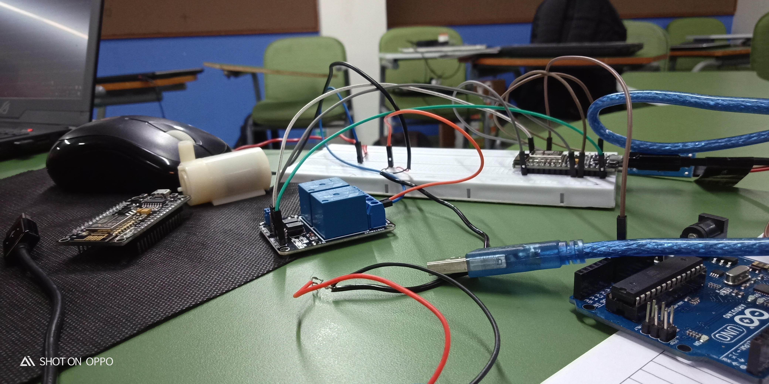
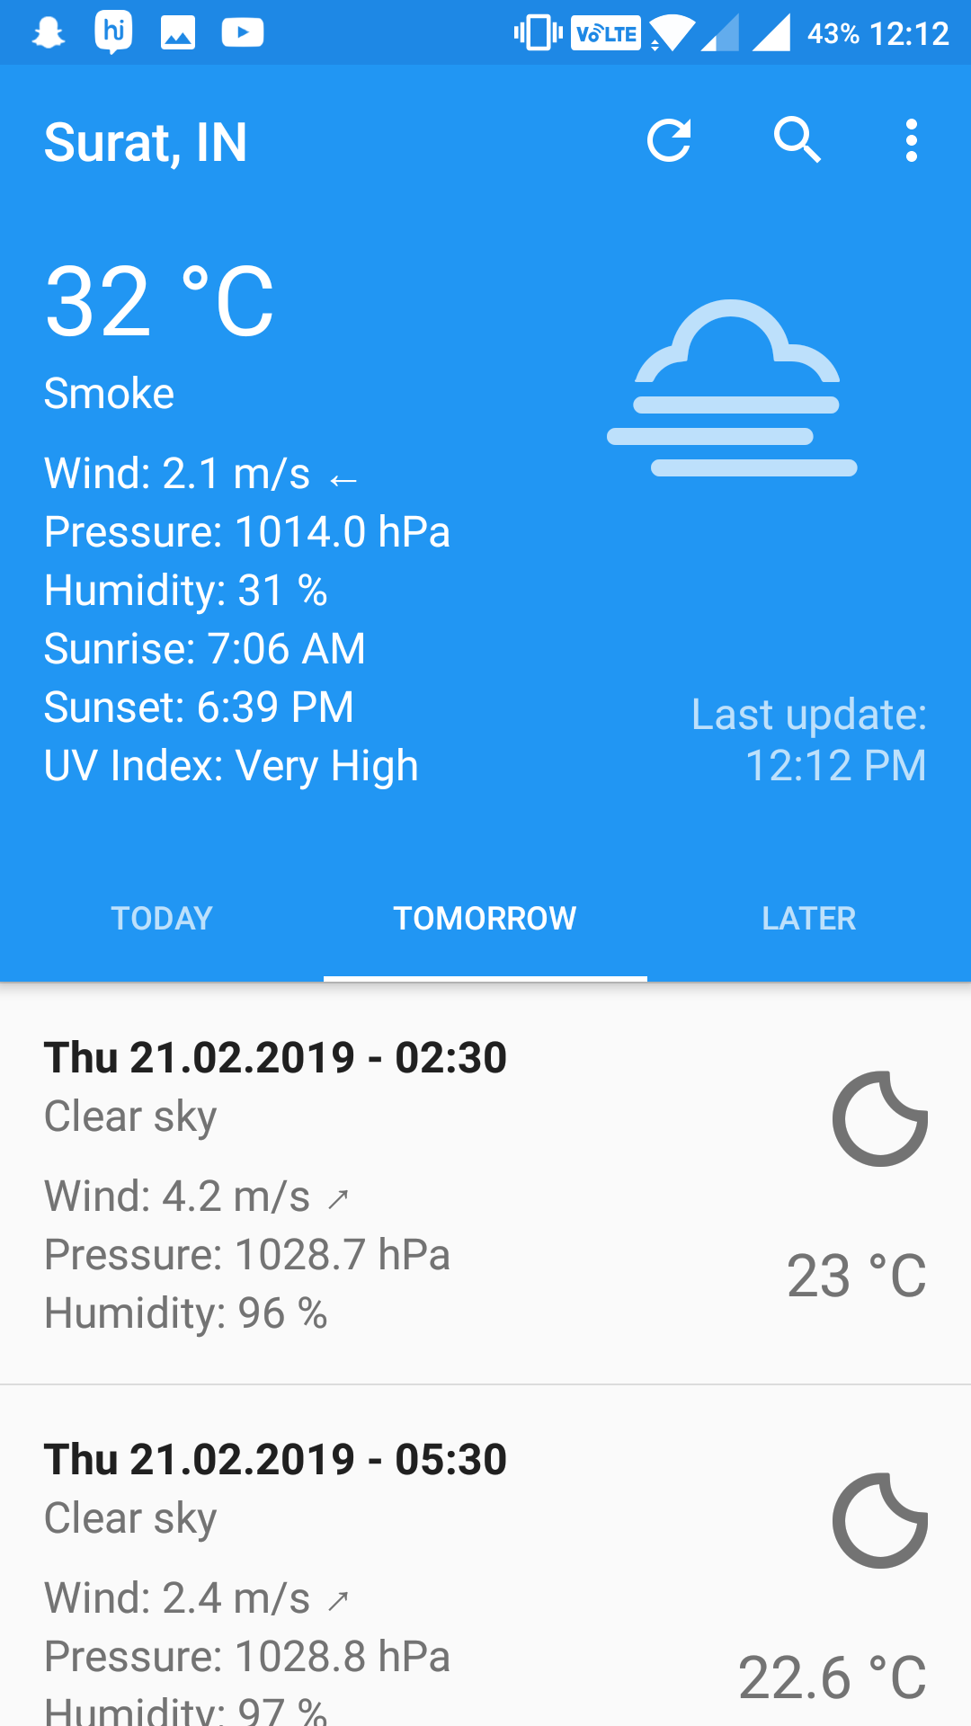

Slide 6
