Slide 1

Antibody Charge Variants: Characterization and Control Strategies
Jin Baisheng
Biological Applications Department
NanoMicro Technology Company
3/26/2026

Slide 2

Charge Heterogeneity is a Critical Quality Attribute (CQA)
Charge variants significantly impact antibody stability, biological activity, and pharmacokinetics.
Charge heterogeneity is a fundamental characteristic of monoclonal antibodies (mAbs) that must be rigorously controlled to ensure therapeutic efficacy and safety. Regulatory agencies, including the FDA and EMA, classify charge variants as Critical Quality Attributes (CQAs), requiring manufacturers to establish robust characterization and control strategies. These variants typically represent 5-30% of the total product and arise from various post-translational modifications (PTMs) during cell culture, purification, or storage.
Attribute
Impact on Product Quality
Altered charge distribution can lead to increased aggregation or fragmentation.
Stability
Modifications in the CDR regions may reduce antigen-binding affinity.
Activity
Changes in pI can significantly affect the serum half-life and clearance rates.
Pharmacokinetics
Certain variants may increase the risk of eliciting an immune response in patients.
Immunogenicity

Slide 3
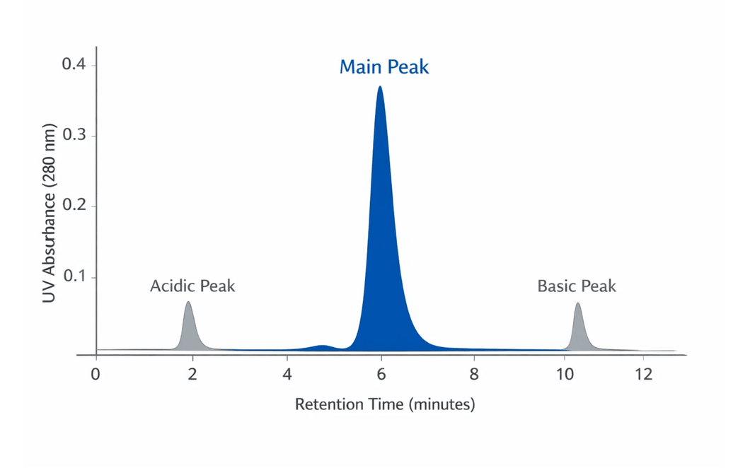
Defining Acidic and Basic Peaks in Chromatography
Charge variants are classified by their isoelectric point (pI) relative to the main isoform.
In ion-exchange chromatography, charge variants are identified by their elution position relative to the main antibody isoform. The isoelectric point (pI) determines the net charge of the molecule at a given pH, which in turn dictates its interaction with the stationary phase.
Variant Type
pI Relative to Main
CEX Elution Order
Acidic Peak
Lower
Earlier Eluting
Main Peak
Reference
Central Peak
Basic Peak
Higher
Later Eluting

Slide 4
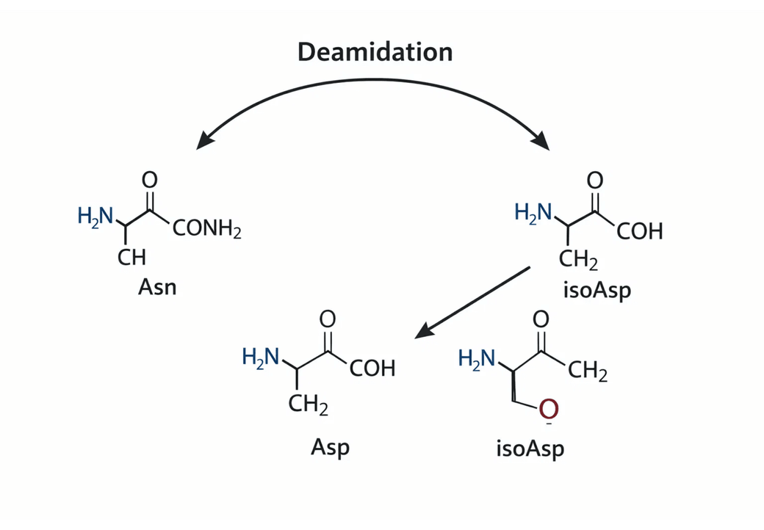
Deamidation and Sialylation Drive Acidic Variant Formation
Chemical and enzymatic modifications increase the negative charge density of the antibody.
The formation of acidic variants is primarily driven by modifications that increase the negative charge of the protein. Deamidation, the conversion of Asparagine (Asn) to Aspartic acid (Asp) or isoAspartic acid (isoAsp), is the most common contributor. This process is highly sensitive to environmental factors, particularly alkaline pH and elevated temperatures.
Additionally, the enzymatic addition of sialic acid residues to N-glycans introduces further negative charges, which can significantly influence the molecule's biological half-life and anti-inflammatory properties.
Deamidation Hotspots: Sequences such as Asn-Gly and Asn-Ser in the complementarity-determining regions (CDRs) are particularly susceptible to rapid deamidation.
Figure: Chemical pathway of Asparagine deamidation to Asp and isoAsp isoforms.

Slide 5
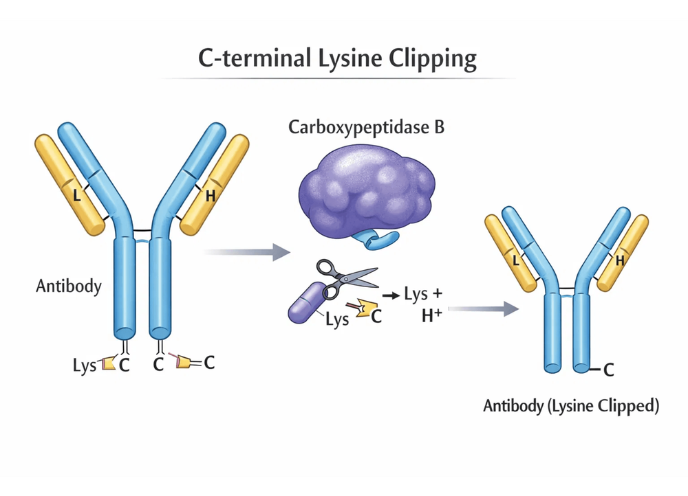
C-Terminal Lysine Clipping is the Primary Source of Basic Variants
The loss of positive charge through enzymatic cleavage creates basic heterogeneity.
Basic variants predominantly arise from the incomplete processing of C-terminal lysine residues. During cell culture, endogenous carboxypeptidases remove these positively charged residues from the heavy chains of the antibody. This results in a mixture of species with zero, one, or two C-terminal lysines, creating a characteristic "basic" profile in chromatographic assays.
Modification
Mechanism
Charge Effect
Lysine Clipping
Removal of C-terminal Lys by enzymes.
Loss of Positive Charge
Succinimide
Cyclization of Asp/Asn residues.
Altered Distribution
Glycation
Reaction with reducing sugars.
Potential Masking
Aggregation
Protein association/complexing.
Complex Profiles
Figure: Enzymatic removal of C-terminal Lysine by Carboxypeptidase B

Slide 6
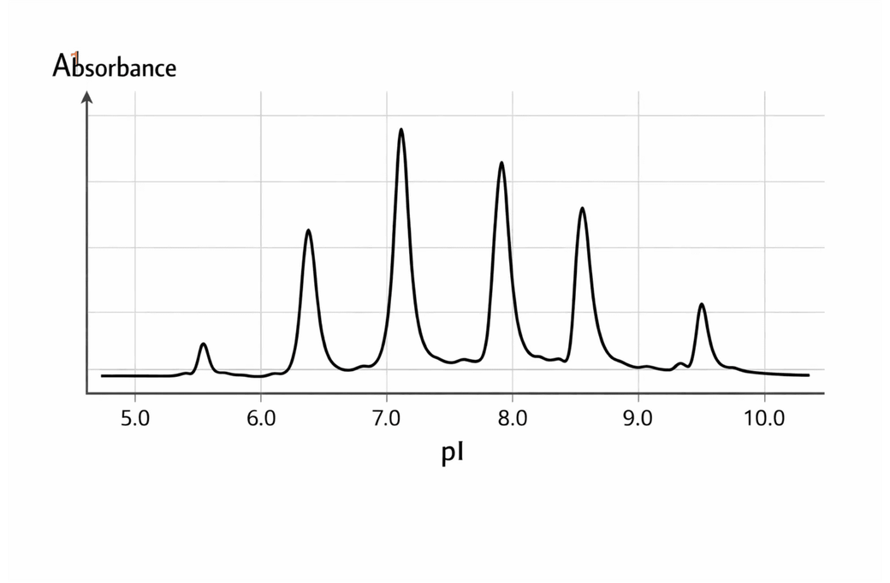
icIEF is the Gold Standard for Charge Variant Quantification
High-resolution electrophoretic methods provide precise pI-based profiling.
Imaged Capillary Isoelectric Focusing (icIEF) has emerged as the industry standard for the rapid and precise quantification of charge variants. By utilizing whole-column imaging, icIEF eliminates the need for a mobilization step, significantly improving precision and capturing the entire separation profile simultaneously.
Parameter
icIEF Performance Standard
Relative Standard Deviation (RSD) ≤ 2.0%
Precision
Resolves variants within 0.02-0.04 pH units
Resolution
R² ≥ 0.99 over the 5-40% variant range
Linearity
Recognized by ChP, USP, and EP standards
Compliance
Figure: Representative icIEF electropherogram showing pI-based separation.

Slide 7

Cation Exchange Chromatography (CEX) Enables Preparative Separation
CEX remains the most practical tool for both analytical monitoring and downstream purification.
Cation Exchange Chromatography (CEX) is the most widely utilized technique for both the analysis and purification of antibody charge variants. By leveraging the interaction between the positively charged protein and negatively charged resin, CEX can separate closely related species using either salt gradients or pH gradients.
Elution Method
Mechanism and Application
The standard approach for routine quality control. It utilizes a linear NaCl gradient to displace bound proteins based on their surface charge density.
Salt Gradient Elution
Provides superior resolution for complex variant profiles by leveraging the specific pI of each species. Ideal for characterization and high-purity fraction collection.
pH Gradient Elution
Online coupling with native mass spectrometry allows for the direct identification of chemical modifications associated with each chromatographic peak in real-time.
CEX-MS Integration
"Multi-attribute monitoring" via CEX-MS significantly accelerates the development of robust control strategies for therapeutic antibodies.

Slide 8
Regulatory Expectations and Quality Specifications
Specifications must be grounded in clinical experience and process capability (ICH Q6B).
Establishing appropriate specifications for charge variants is a critical component of the Quality by Design (QbD) framework. According to ICH Q6B guidelines, these limits should be based on the levels observed in clinical trial materials and the demonstrated capability of the manufacturing process. Routine monitoring is required to ensure that the charge profile remains within the established "design space" throughout the product's lifecycle.
Variant Category
Typical Release Specification
Stability Expectation
60% - 80%
Not to decrease by >10%
Main Peak
10% - 30%
Not to increase by >10%
Acidic Variants
5% - 15%
Not to increase by >5%
Basic Variants

Slide 9

Upstream and Downstream Process Control Limits
Tight control of environmental parameters minimizes the formation of charge variants.
Upstream Process Controls
Parameter
Control Range
Impact on Charge Variants
6.8 - 7.2
Critical for controlling deamidation rates of Asn residues.
Bioreactor pH
32 - 37°C
Directly affects degradation kinetics and PTM accumulation.
Temperature
Optimized Cysteine
Prevents disulfide bond disruption and acidic species formation.
Media Components
Downstream Process Controls
Parameter
Control Strategy
Impact on Charge Variants
2 - 8°C
Minimizes spontaneous chemical degradation during purification.
Processing Temp
Minimize Duration
Reduces the accumulation of variants in intermediate pools.
Residence Time
Optimized per Step
Ensures stability and consistent elution profiles across scales.
Buffer pH/Cond.

Slide 10
Fraction Collection is the Industry Standard for Variant Removal
Strategic "peak cutting" during CEX purification balances product purity and yield.
The most common industrial strategy for controlling charge variants is fraction collection (or "peak cutting") during the CEX polishing step. By discarding the early-eluting acidic fractions and late-eluting basic fractions, manufacturers can significantly enrich the main isoform. This process requires a careful balance between product purity and step yield, as aggressive cutting can lead to significant material loss.
Parameter
Optimization Strategy
Use UV threshold (>5% height) or slope-based detection for precision.
Triggering
Typically 10-20% loss for 50-80% variant removal efficiency.
Yield Loss
Validate cut points across the expected range of variant levels.
Robustness
Implement automated fractionators for manufacturing consistency.
Automation

Slide 11

Enzymatic and Multimodal Strategies Enhance Purity
Targeted enzymatic treatment and advanced resins provide alternative control pathways.
For products with high levels of basic variants, targeted enzymatic treatment offers a highly specific solution. Additionally, advanced chromatographic resins provide enhanced selectivity for difficult separations where traditional ion-exchange methods may reach their resolution limits.
Strategy
Mechanism and Efficiency
Enzymatically removes C-terminal lysine and arginine residues. Achieves
of basic variants, effectively converting them into the main isoform.
Carboxypeptidase B (CpB)
>95% removal efficiency
Combines ion exchange with hydrophobic interactions (HIC). Provides enhanced selectivity for variants with similar pI but different surface hydrophobicity.
Multimodal Chromatography
Frequently employed as a polishing step to specifically target and remove acidic species, host cell proteins, and viral contaminants.
Anion Exchange (AEX)
Advanced SMB (Simulated Moving Bed) systems can further improve productivity and variant removal efficiency in continuous manufacturing.

Slide 12
Implementation Roadmap for Charge Variant Control
A phased approach ensures robust process development and regulatory compliance.
A successful charge variant control strategy is implemented in three distinct phases, moving from initial molecular understanding to full-scale manufacturing validation. This structured approach ensures that the final control strategy is both scientifically sound and operationally robust.
Phase
Key Objectives and Deliverables
Develop and validate analytical methods (icIEF, CEX). Identify major variants via LC-MS/MS and establish baseline process capability.
Phase 1: Characterization
Optimize CEX parameters and fraction collection cut points. Conduct Design of Experiments (DoE) to establish process robustness and design space.
Phase 2: Development
Implement the control strategy at manufacturing scale. Validate fraction collection protocols and establish ongoing monitoring and trending programs.
Phase 3: Validation
Continuous improvement: Leverage lifecycle data to refine specifications and optimize purification yields.

Slide 13
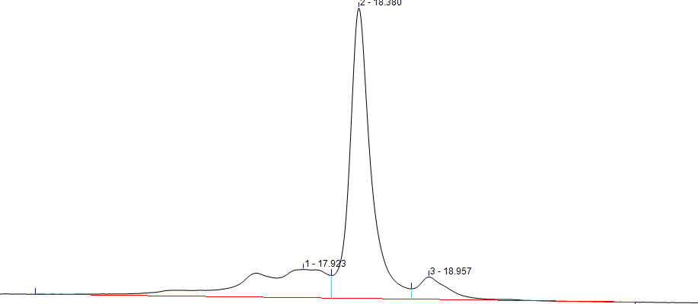
Case study 1: Finetuning the slope of elution step to removal Acid-Base Peak Separation
Effect of Concentration Gradient Slope on Separation of Acid-Base Peaks
Condition 1. Three-step slope K1=2 5CV, K2=0 3CV, K3=3.9 12CV
 | Acid peak % | Main peak% | Alkaline peak % | SEC%
load | 30 | 50 | 20 | 98.5
CEX Elu | 25 | 62 | 13 | 99.5
Acidic peak
On the NanoGel 50SP HP packing material, the acidic and basic peaks of an antibody were separated under Condition 2, achieving a final recovery rate above 70% with the acidic and basic peaks meeting the required specifications.
Condition 2. Three-step slope K1=0.6 8CV, K2=6 5CV, K3=1.25 8CV

Slide 14
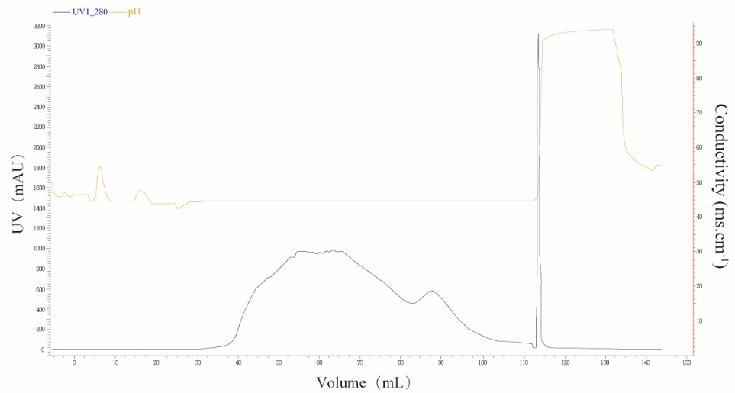
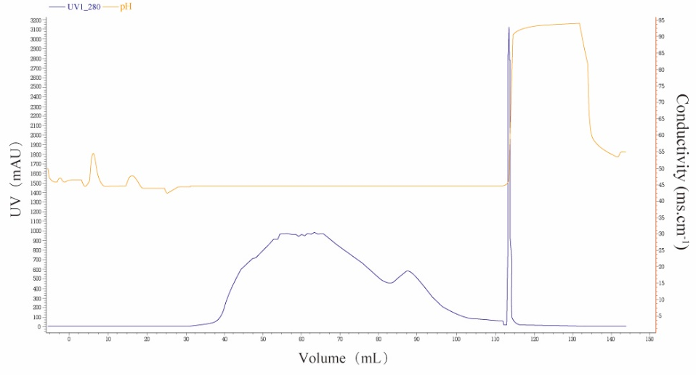
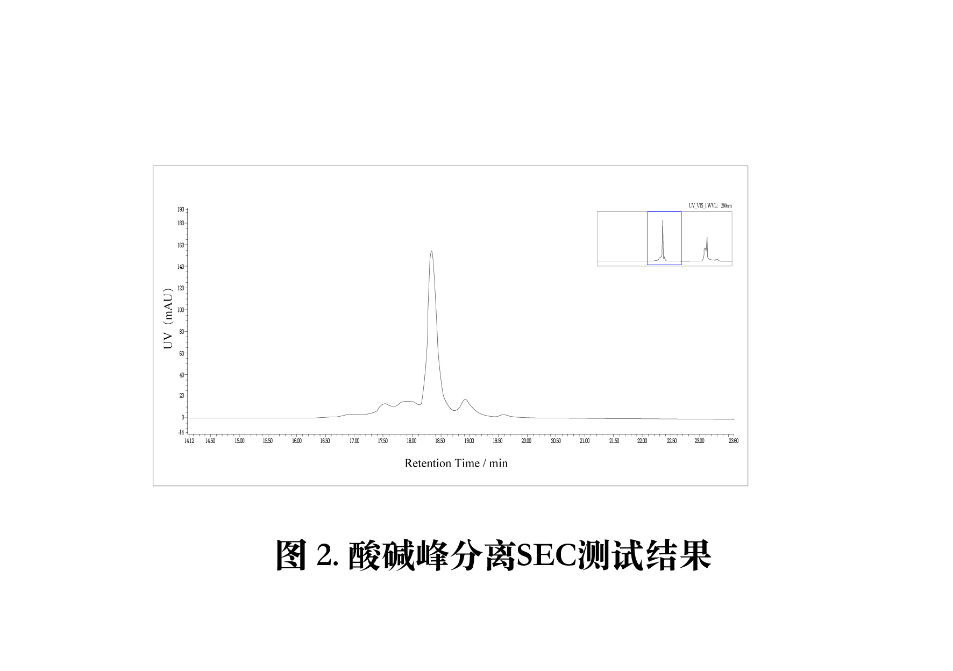
Case study 2：NanoGel 50SP HP—Removal of Acid-Base Isoforms
Yield: 70%
Main Peak
Collection Segment
499mAU-452mAU
Acid peak
Alkaline peak
NanoGelTM-50SP Cation Exchange Chromatography Salt Concentration Linear Gradient Elution
Collection segment results (analytical column BioCore WCX, i.d. 4.6 mm, column height 250mm)
Table 2. Comparison of Charge Heterogeneity Content, Purity, and HCP Residue of NanoGelTM-50SP Before and After Purification
Name | Before Purification | After Purification
Acid peak % | 21.25 | 18.34
Main peak% | 47.50 | 70.62
Alkaline peak % | 31.25 | 11.04
SEC Purity % | 98.21 | 99.64
HCP residual ppm | 85.82 | 20.18

Slide 15
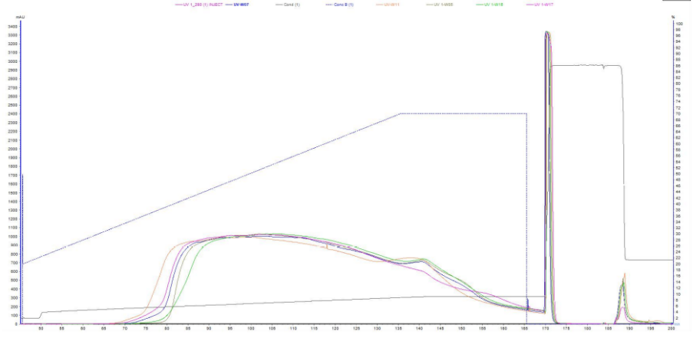
NanoGel 50SP HP—More Consistent Batch-to-Batch
Overlay Chromatograms of Cation Exchange Chromatography Batch Consistency Study
Brown: L08W05KC; Blue: L08W07KC; Yellow: L08W11KC; Green: L08W15KC; Red: L08W17KC
Serial Number | Batch Number | A(mS/cm) | B(mS/cm)
1 | L08W05KC | 6.38 | 10.06
2 | L08W07KC | 6.18 | 10.08
3 | L08W11KC | 5.9 | 9.86
4 | L08W15KC | 6.33 | 10.06
5 | L08W17KC | 6.01 | 10.08
Conclusion: The differences in recovery rates of five batches of NanoGel 50SP HP are due to different collection methods, while SEC all reached 98%, CEX without enzymatic digestion was around 55%, and CEX with enzymatic digestion was around 65%, indicating good batch-to-batch stability of this resin.
Critical Conductivity Data for Sample Elution

Slide 16
Thank you for watching

