Slide 1
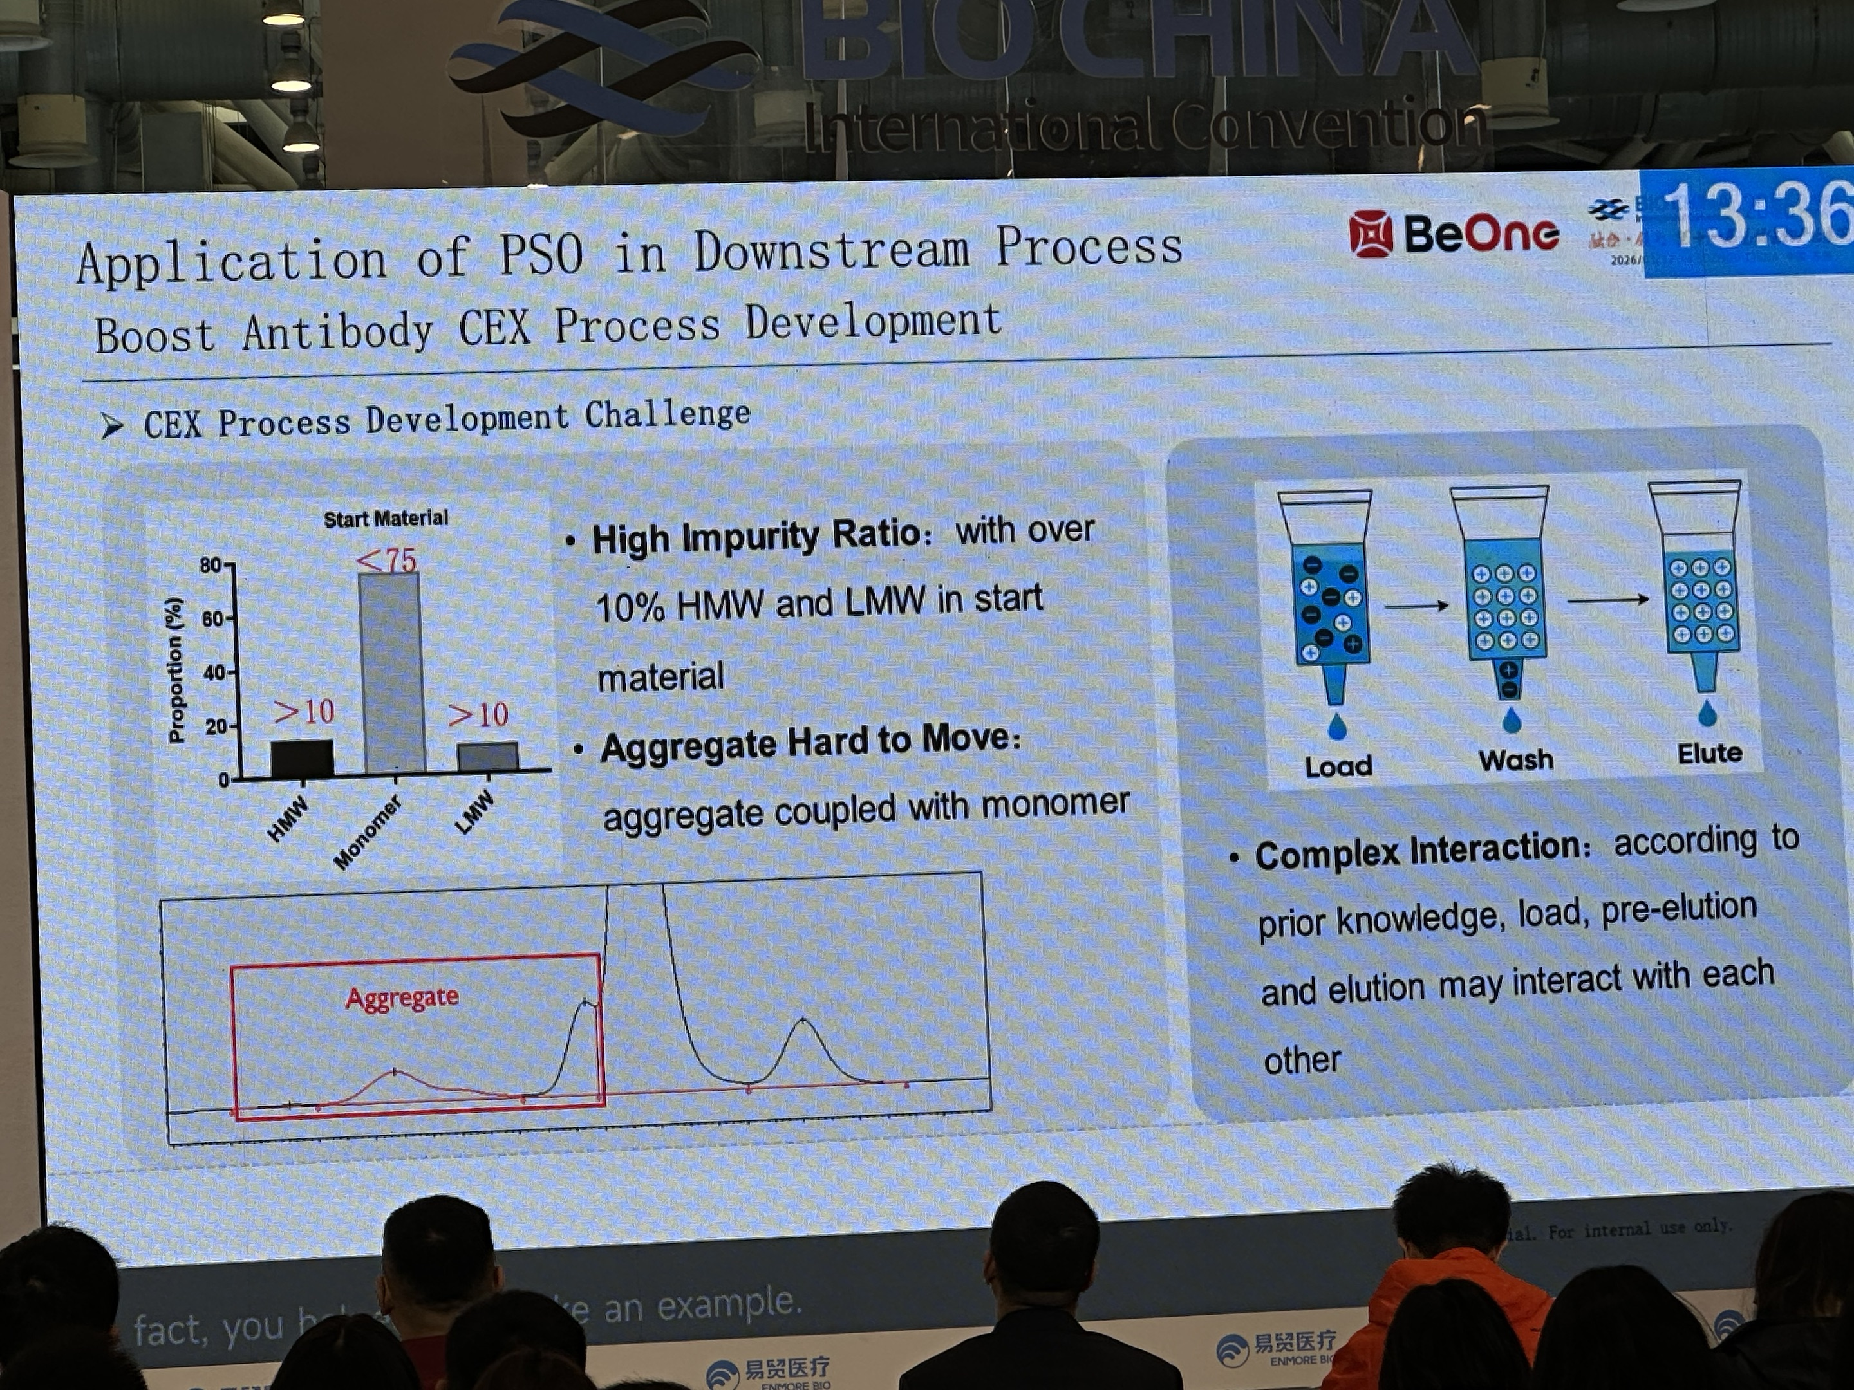
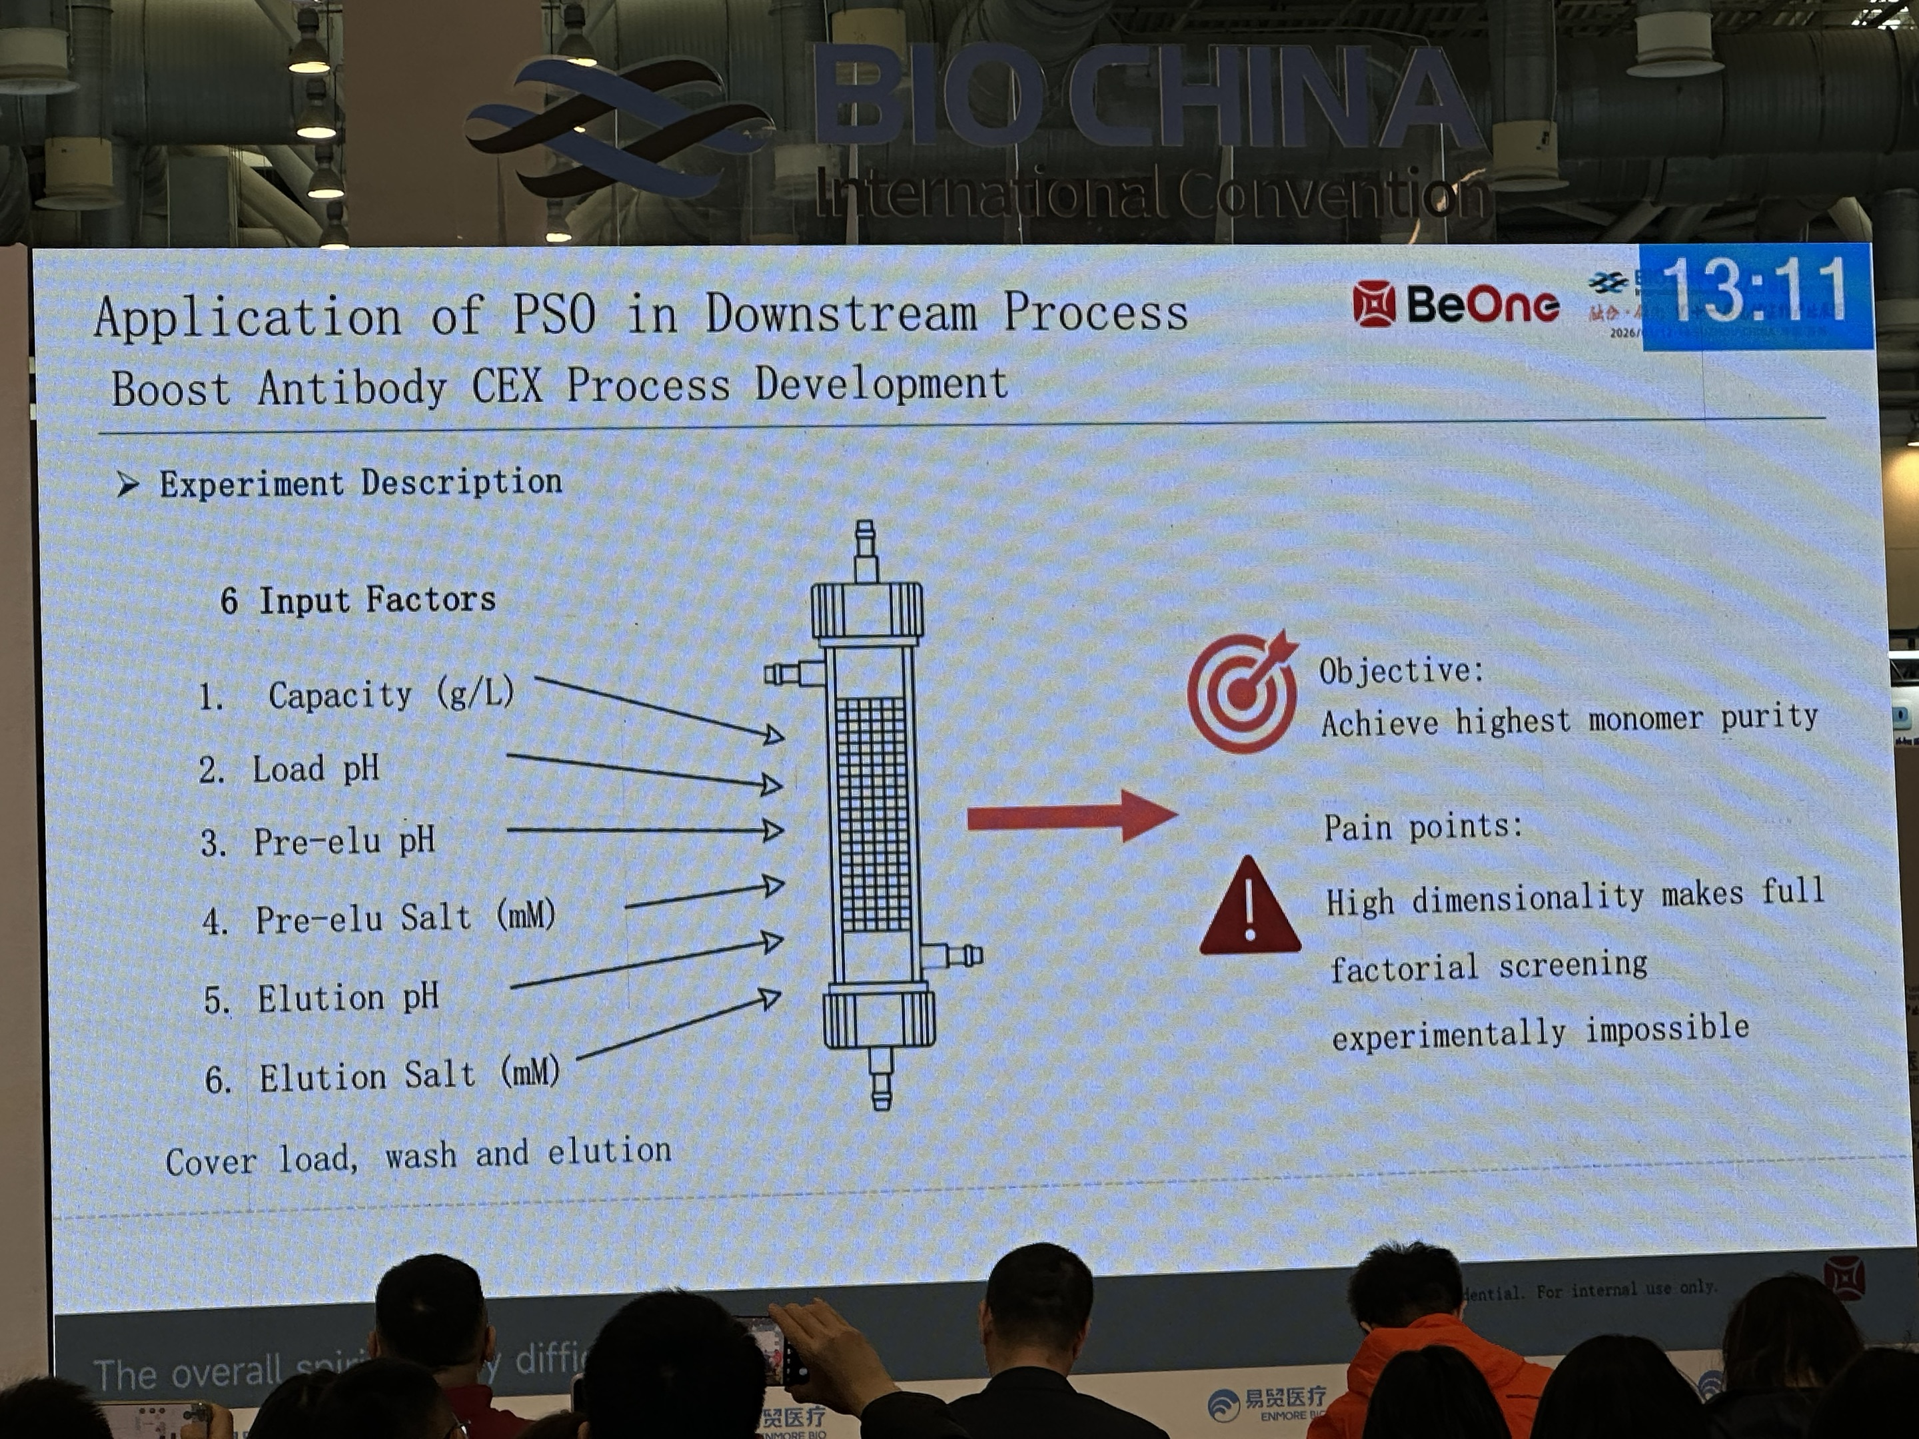
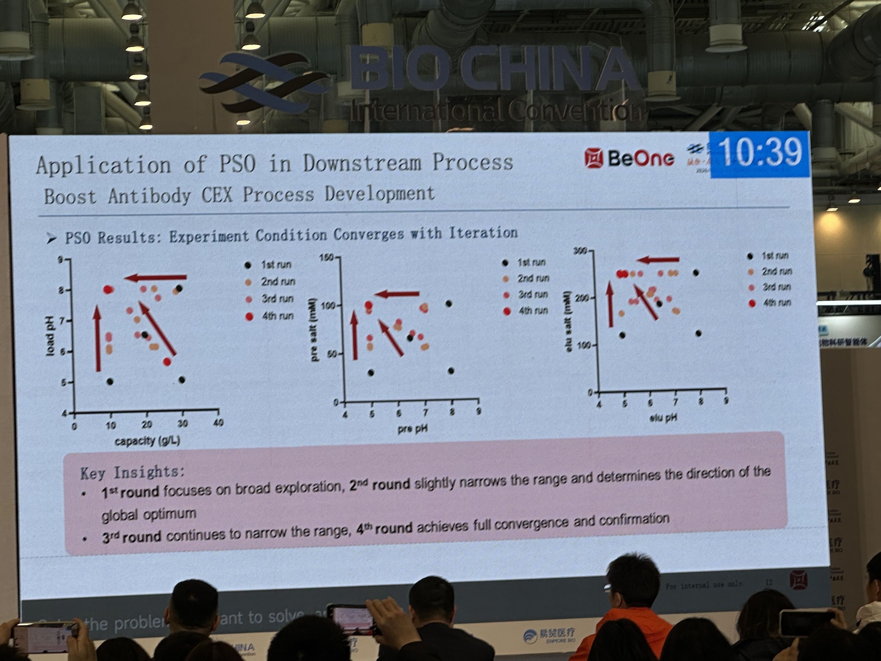
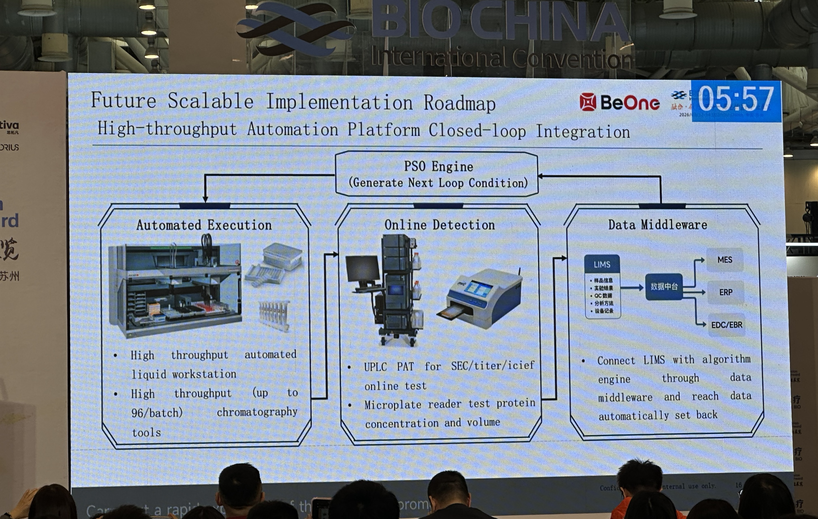
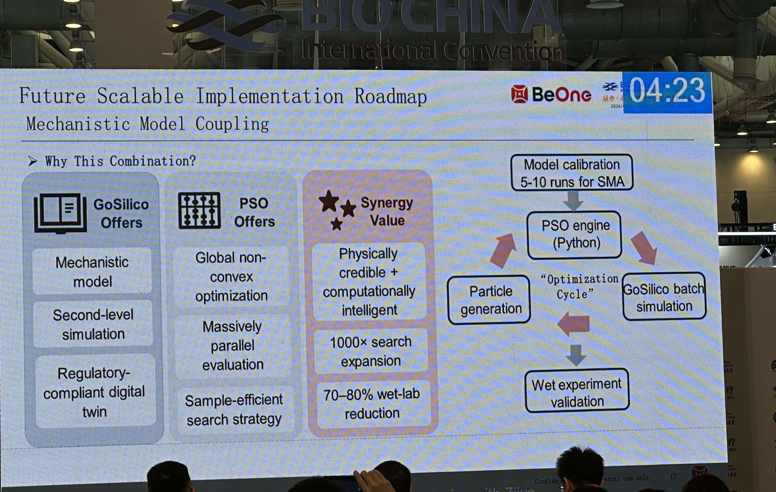
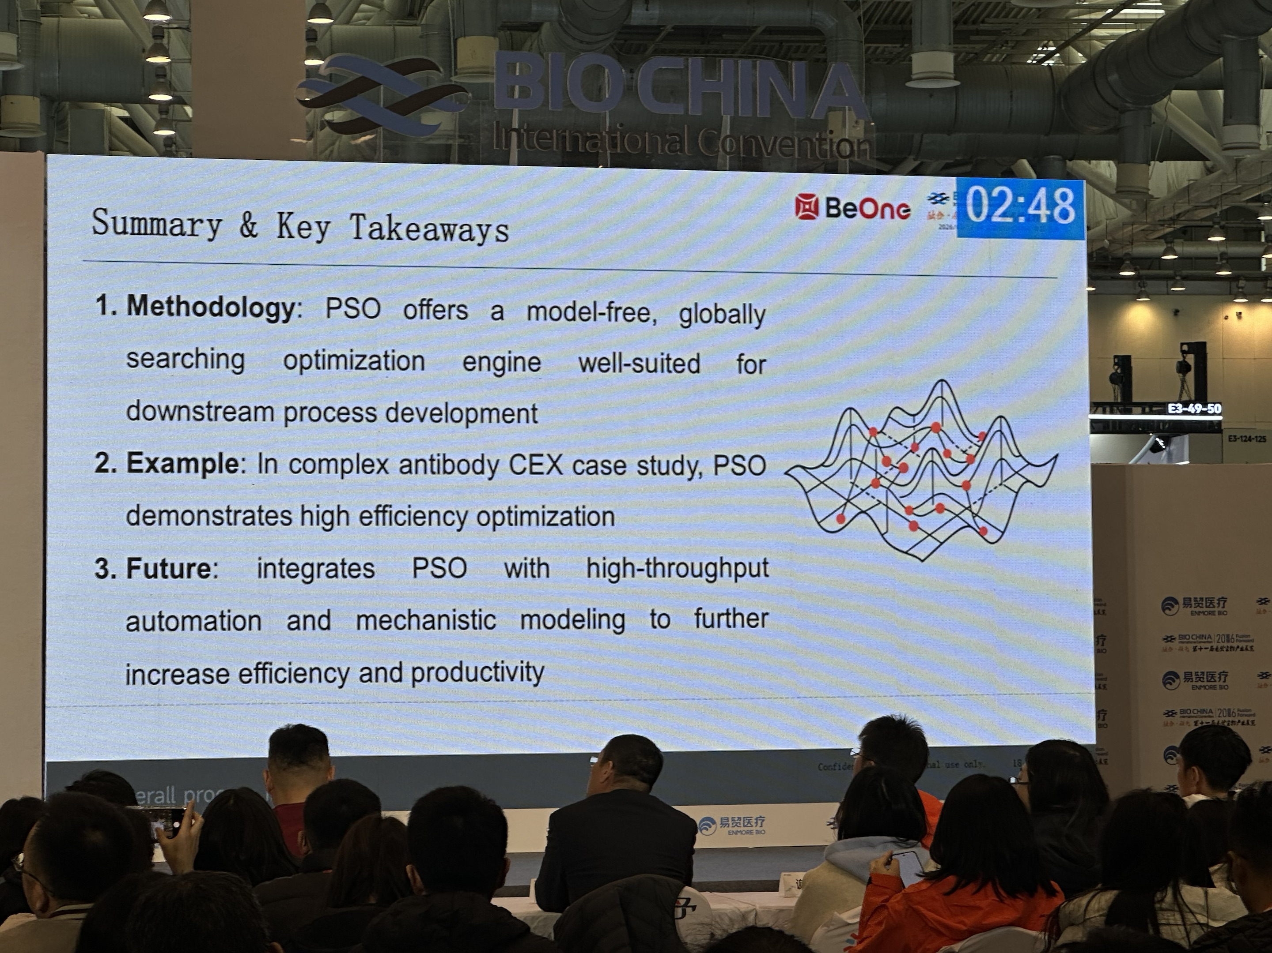
PSO 在单抗阳离子层析优化中的应用
Particle Swarm Optimization for mAb Cation Exchange Process Development
从上传会议照片重构案例，并扩展到“可执行”的 PSO 工艺优化方案：背景、原理、操作、对比、实施路径与展望
uploaded slide
uploaded slide
Rebuilt from the uploaded conference photos and extended into a practical implementation plan: background, mechanism, workflow, comparison, execution, and outlook.
uploaded slide
uploaded slide
案例重构 / Case reconstruction
真实流程 / Step-by-step plan
技术对比 / Comparison
双语表达 / Bilingual
一句话判断 / Key takeaway: 当实验响应是黑箱、变量耦合强、且可以并行做一批实验时，PSO 很适合用来快速锁定 CEX 的最佳操作区间。
uploaded slide
uploaded slide
Notes:
[Sources] - User-provided images from PSO技术.zip; cover collage uses uploaded conference slide photos. - Kennedy J, Eberhart R. Particle Swarm Optimization. Proc. ICNN 1995. https://www.cs.tufts.edu/comp/150GA/homeworks/hw3/_reading6%201995%20particle%20swarming.pdf - Freitas DB et al. Particle Swarm Optimisation: A Historical Review Up to the Current Developments. Entropy 2020. https://www.mdpi.com/1099-4300/22/3/362

Slide 2
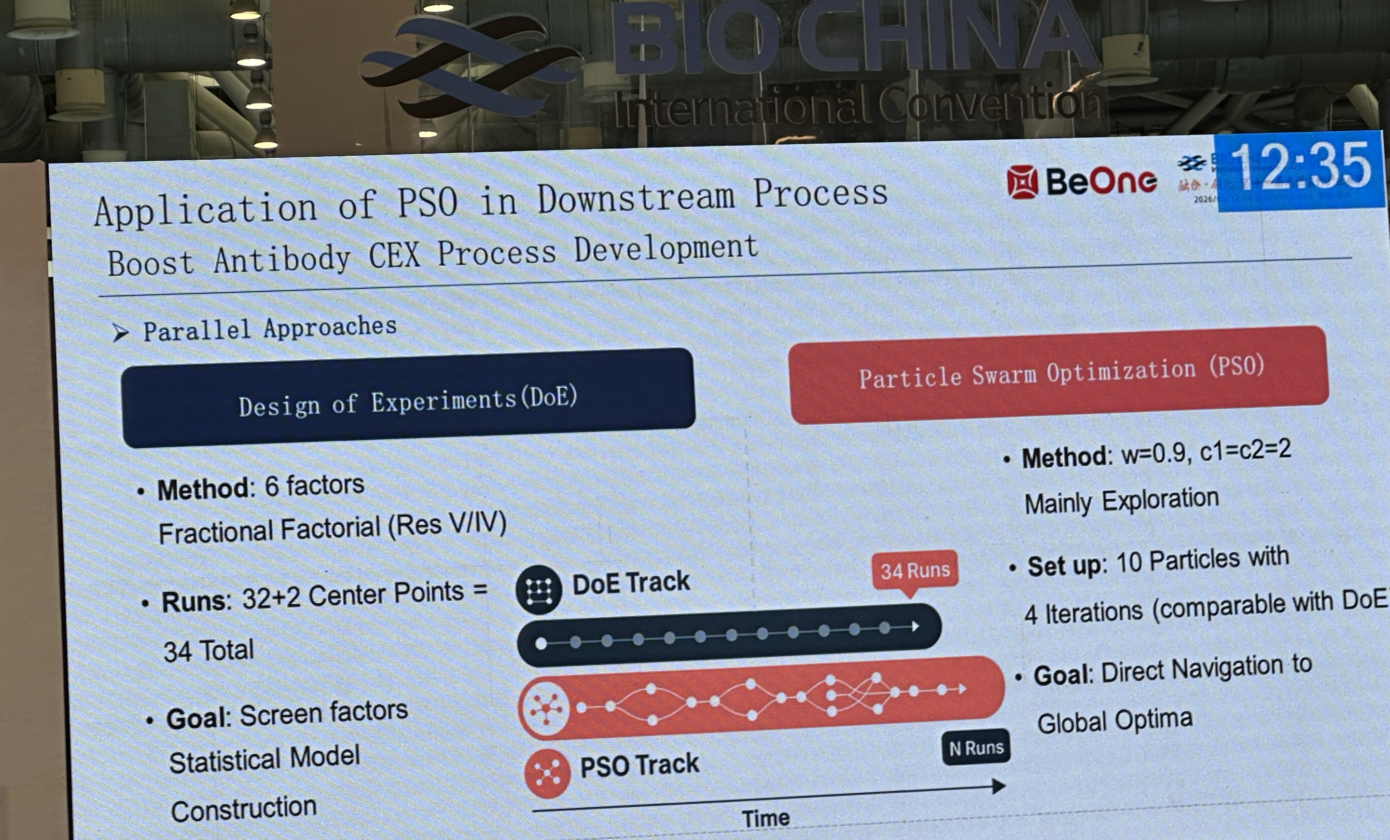
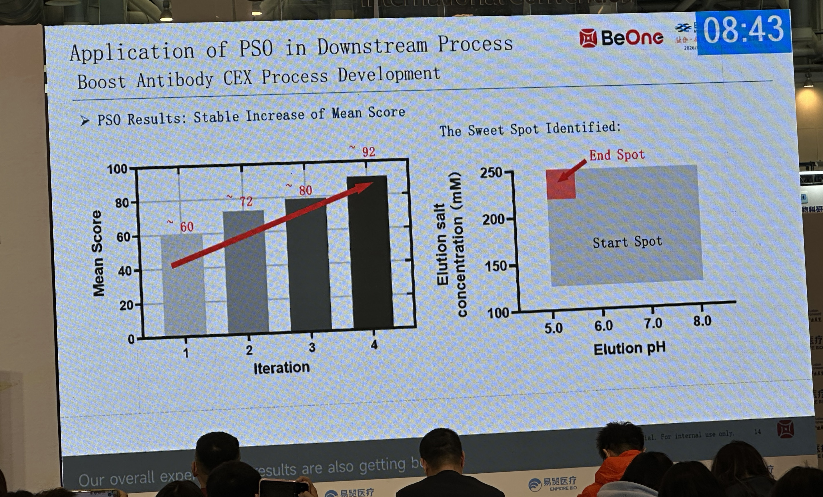
01. 从上传图片识别出的案例主线
会议主题聚焦“PSO in Downstream Process / Boost Antibody CEX Process Development”
What the uploaded images reveal
识别出的关键信息
会议原图证据带
Evidence strip from uploaded slides
Signals reconstructed from the photos
对象是抗体下游中的 CEX 开发，不是纯算法演示。
The case is about real CEX process development, not a purely algorithmic demo.
输入因子至少覆盖 load、pre-elution、elution 等多个阶段。
The input variables span load, pre-elution, and elution stages.
会中直接对比了 DOE/RSM 与 PSO 的实验投入和输出方式。
problem framing
input factors
DOE vs PSO
The slides explicitly compare DOE/RSM style workflows with PSO.
结论不是“PSO 替代一切”，而是“在黑箱优化中更快逼近高分区域”。
The message is not “PSO replaces everything”, but “PSO can reach high-performing regions faster in black-box optimization”.
identified model
convergence + score
future roadmap
案例展示了收敛、sweet spot、以及后续自动化/闭环优化展望。
图像复原后的结论 / Reconstructed narrative
The case shows convergence, sweet spots, and an outlook toward automated closed-loop optimization.
这组图片说明，报告人把 PSO 当作一种“实验决策引擎”：先定义变量与评分，再并行执行一批 CEX 实验，根据得分更新下一轮条件，直至找到高分操作窗口。
The presenter treats PSO as an experimental decision engine: define variables and a score, run a batch of CEX experiments in parallel, update the next-round conditions from the scores, and iterate until a high-performing operating window is found.
Notes:
[Sources] - User-provided conference slide photos from PSO技术.zip, especially *_367_178.jpg, *_369_178.jpg, *_370_178.jpg, *_373_178.jpg, *_375_178.jpg, *_379_178.jpg.

Slide 3

02. PSO 原理：一页看懂粒子群如何找最优
适合黑箱、非线性、强耦合、可并行实验的问题
PSO principles in one page
直觉版解释
PSO 为什么适合工艺优化
Plain-language intuition
每个粒子 = 一组实验条件，例如 pH、导电率、梯度终点。
pbest
gbest
不需要显式梯度或精确机理模型。
粒子记住自己历史最优 pbest，也参考群体最优 gbest。
当前粒子
Current
天然适配并行实验，一轮可以同时跑多组条件。
下一轮不是盲猜，而是在“惯性 + 个体经验 + 群体经验”下更新。
面对非凸、多峰、噪声响应时仍然实用。
群体在搜索空间中移动，逐轮朝更优区域聚拢
Particles move through the search space and gradually cluster near better regions.
适合先找操作窗口，再做确认与稳健性验证。
早期更偏探索，后期更偏收敛，因此适合快速缩小操作区。
Why PSO fits bioprocess work
Each particle is one candidate recipe, e.g., pH, conductivity, or gradient end-point.
常见更新式 / Standard update equations
No explicit gradients or perfect mechanistic model are required.
Each particle remembers its own best point (pbest) and the swarm best (gbest).
It naturally fits parallel experimentation.
The next move is not random guessing; it mixes inertia, self-experience, and social learning.
It remains useful for non-convex, multi-modal, and noisy responses.
The search starts broad and becomes more exploitative, which is ideal for shrinking an operating window quickly.
w = 惯性权重 inertia；c1/c2 = 学习因子 learning coefficients；r1/r2 = 随机数 random numbers
It is strong at finding a sweet spot before final verification.
Notes:
[Sources] - Kennedy J, Eberhart R. Particle Swarm Optimization. Proc. ICNN 1995. https://www.cs.tufts.edu/comp/150GA/homeworks/hw3/_reading6%201995%20particle%20swarming.pdf - turn4search1 Freitas et al. historical review of PSO developments. - turn6search1 Schutte et al. 2004 on parallel global optimization with PSO.

Slide 4
03. 为什么 PSO 特别适合层析优化
层析开发常同时面对非线性、约束、多目标与实验预算压力
Why PSO is a strong fit for chromatography
层析开发的真实痛点
PSO 在这里的价值
典型收敛轨迹（示意）
Illustrative convergence curve
What PSO contributes here
得分 Score
多个旋钮同时作用：pH、盐、电导率、梯度、载量、流速。
把工艺配方当成“粒子位置”
Treat a process recipe as a particle position
响应往往不是单峰，局部最好并不代表全局最好。
把实验得分当成“适应度”
Treat the lab score as fitness
指标彼此冲突：纯度、收率、HCP/HMW 去除、循环时间。
把高通量或并行小柱当成“群体实验平台”
Use mini-columns/HTPD as the swarm execution platform
一轮实验成本高，不能无限制地“扫格点”。
1
2
3
4
5
6
每一轮自动在探索和利用之间平衡
迭代 Iteration
Balance exploration and exploitation each round
Why chromatography is hard to optimize
操作窗口热图（示意）
Illustrative sweet-spot map
最终输出不是单点，而是一片可用窗口
Many knobs change at once: pH, salt, conductivity, gradient, load, flow rate.
Output not just one point, but a workable region
Conductivity ↑
The response is rarely unimodal; a local best is not necessarily global best.
best
Objectives conflict: purity, yield, HCP/HMW clearance, and cycle time.
一句话 / In one sentence: PSO 最擅长的是“快速缩小搜索空间”，尤其适合先找最佳操作区，再做小范围确认。
pH →
Each round is expensive, so exhaustive gridding is impractical.
Notes:
[Sources] - turn5view2 Baumann et al. review discussing heuristics, HTPD, and model-based/combinatorial development approaches for bioprocess DSP. - turn6search1 Schutte et al. PSO parallelization. - turn6search12 historical review highlighting simplicity and competence in complex search spaces.

Slide 5
04. 类似技术对比：DoE、RSM、BO、PSO 应该怎么选
不是“谁绝对更好”，而是“谁更适合当前实验形态”
Comparison with neighboring methods
方法 / Method
核心逻辑 / Core logic
优点 / Strengths
短板 / Limitations
更适合 / Best when
DoE
系统设计实验点
Structured experimental design
效应解释强，利于工艺表征
Strong factor interpretation
高维时点数快速增长
Runs grow quickly with dimension
做筛选、识别主效应
Screening and factor understanding
RSM
局部二次曲面拟合
Local quadratic response surface
局部优化、稳健性好
Good local optimization
需要较平滑且局部单峰
Works best for smooth local regions
已接近最优区
Near-optimum polishing
GA
交叉 + 变异 + 选择
Evolutionary recombination
离散/组合变量友好
Good for discrete/combinatorial spaces
参数较多，收敛解释弱
More hyperparameters
配方组合、离散选择
Recipe selection
BO
代理模型 + 采集函数
Surrogate + acquisition
实验最省、对昂贵实验友好
Data-efficient
常偏顺序式；对代理模型较敏感
Often sequential; surrogate-sensitive
实验特别昂贵、预算很小
Very expensive experiments
PSO
群体搜索 + 经验更新
Swarm search + memory
并行友好、实现直观、适合黑箱
Parallel, intuitive, black-box-ready
若约束复杂，需额外处理
Needs explicit constraint handling
可并行跑一批条件
Parallel lab batches
何时优先选 PSO
何时优先选 BO
最实用的组合
When to favor PSO
When to favor BO
Most practical hybrid
实验可并行、响应可能多峰、且你最关心“尽快找到好条件”。
每次实验极贵，轮次很少，希望每一个新点都尽量“值回票价”。
先用 DoE/预筛定范围，再用 PSO 收缩窗口，最后用确认实验或局部 RSM 做稳健性。
Choose PSO when experiments can run in parallel and you care about finding a good region quickly.
Choose BO when each experiment is extremely expensive and every new point must be highly informative.
A pragmatic path is DoE/scouting -> PSO windowing -> confirmation or local RSM for robustness.
Notes:
[Sources] - turn6search13 / turn6search6 Bayesian Optimization in Bioprocess Engineering review: BO as stochastic global black-box optimization balancing exploration and exploitation. - turn5view2 / turn3view5 review of HTPD, heuristics, mechanistic models, and response surface modeling in DSP. - Kennedy & Eberhart 1995; Freitas 2020 historical PSO review. - User-provided conference photos comparing DOE/RSM and PSO in a CEX case.

Slide 6
05. 把问题落到单抗 CEX：我们到底在优化什么
以下流程是面向“抛光或中间纯化”的真实开发模板
What exactly are we optimizing in mAb CEX?
单抗平台流程中的 CEX 位置
这次重点：pH、导电率、洗脱梯度
Where CEX sits in the platform process
Today's focus: pH, conductivity, elution gradient
如果只优化三个变量，也足够让 PSO 发挥价值。
Even a three-variable PSO can create real value.
Protein A 捕获
Capture
低 pH 病毒灭活
VI
过滤 / UFDF
Filtration
CEX 抛光
CEX polish
建议先固定树脂、柱高、流速、样品来源，再优化这三个主旋钮。
Fix resin, column geometry, flow, and feed source first, then optimize the three key knobs.
为什么 CEX 难：产品和杂质都带电，且 charge variants、聚集体、HCP、DNA、Protein A 残留可能对 pH/盐/梯度高度敏感。
Why CEX is hard: product and impurities are all charge-driven, and charge variants, aggregates, HCP, DNA, and leached Protein A can all respond strongly to pH, salt, and gradient shape.
一个可执行的示例设计空间（示意）
A realistic example design space (illustrative)
可优化变量示例
参数 / Parameter
建议起始范围 / Starting range
备注 / Notes
Candidate decision variables
变量 / Variable
常见角色 / Why it matters
平衡/装载 pH
Load pH
5.0 - 6.0
若 IgG1 pI 较高，可从 pI-0.5 到 pI-1.5 附近起步
Start around pI-0.5 to pI-1.5 for a basic mAb
装载/平衡 pH
Load / equilibration pH
决定产品净电荷和结合强度
Controls net charge and binding strength
装载导电率
Load cond.
2 - 8 mS/cm
太低可能过强结合，太高可能穿透
Too low = overbinding; too high = breakthrough
装载导电率
Load conductivity
影响结合选择性与穿透风险
Sets selectivity vs. breakthrough risk
梯度终点
Gradient end
25 - 60 mS/cm
也可改写为终点%B 或总盐浓度
Can also be expressed as end %B or salt
洗脱起点
Elution start
决定主峰何时开始移动
Determines when the main peak starts moving
梯度斜率或 CV
Gradient slope / CV
影响分辨率、收率、节拍
Trades off resolution, yield, and cycle time
梯度长度
Gradient length
10 - 30 CV
短梯度快，但可能牺牲分辨率
Shorter is faster but may reduce resolution
流速 / 载量
Flow / load
影响产能与峰展宽
Affects productivity and peak broadening
Notes:
[Sources] - turn5view1 platform process description showing Protein A followed by CEX and AEX polishing in common mAb processes. - turn5view0 heuristic rule of thumb: binding in CEX around 0.5 pH units below pI. - turn2search1 / turn2search5 hybrid pH-conductivity CEX gradient study for process-scale mAb purification. - turn2search0 Ishihara & Yamamoto 2005 on optimization of mAb purification by ion-exchange chromatography using linear gradient data.

Slide 7
06. 先定义评分函数：PSO 不是盲搜，而是按你的目标前进
目标清楚，PSO 才会朝着正确方向收敛
Define the score before you search
为什么先要评分函数
一个实用的示例评分函数
A practical example score
评分设计的经验法则
Rules of thumb
Why scoring comes first
PSO 只知道“哪个条件更好”，所以要把业务目标变成一个数。
先把所有指标归一化到 0-1
Normalize each response to 0-1
Y = 收率归一化；P = 单体纯度；CHCP / CHMW = 杂质清除能力；T = 周期时间；Penalty = 违反硬约束时的扣分
Y = normalized yield; P = monomer purity; CHCP / CHMW = impurity clearance scores; T = cycle time; Penalty = deduction for violated hard constraints.
先设硬阈值，再谈权重
如果只追求纯度，可能牺牲收率；如果只追求收率，可能放走杂质。
Set hard thresholds before weights
权重反映项目优先级，而不是数学美观
Weights should reflect project priorities
最稳妥的做法是“加权目标 + 约束惩罚”。
每轮都保存原始响应，不只保存总分
硬约束建议 / Suggested hard constraints
Keep raw responses, not only the score
主峰单体纯度 >= 98.0%
最后要看“窗口”而不是只看最优单点
Monomer purity >= 98.0%
Look for a robust region, not only the top point
PSO only knows which recipe is better, so business goals must be encoded as a score.
HCP <= 100 ppm
HCP <= 100 ppm
Purity-only scoring may sacrifice yield; yield-only scoring may leak impurities.
HMW <= 1.0%
HMW <= 1.0%
The most robust approach is weighted objectives plus constraint penalties.
柱压、流速、缓冲液能力不超设备边界
Stay within pressure, flow, and buffer limits
装载条件下不能出现明显穿透
No obvious breakthrough at load conditions
Notes:
[Sources] - Score structure in this slide is an implementation template authored for the user; it is not quoted as a universal industry standard. - turn3view4 deep-learning + multi-objective optimization paper on mAb downstream process outputs including CEX concentration, acidic/basic variants, and aggregates. - turn5view2 / turn3view5 for the multi-objective and combinatorial nature of DSP development.

Slide 8
07. 真实方案：PSO 用在某个单抗 CEX 的 step-by-step 流程
目标：快速找到 pH、导电率、洗脱梯度的最佳操作区间
Step-by-step implementation for one mAb CEX case
1
2
3
4
5
6
7
问题定义
预筛范围
变量编码
首轮群体
实验执行
更新迭代
确认放大
Define target
Scout ranges
Encode space
Initialize swarm
Run batch
Update swarm
Confirm
固定树脂/柱体积/样品来源，明确 CQAs、KPIs、硬约束
用 8-16 个条件快速摸清能结合、能洗脱、能分离的范围
把 pH、导电率、梯度参数映射到数值边界与约束
用 10-16 个粒子均匀铺开首轮实验
并行跑小柱 / 板式 / ÄKTA 方法，采集纯度、收率、HCP 等
计算 score，更新 pbest/gbest，生成下一轮条件
做 3-5 个确认点 + 1 个稳健性环，输出可放大的窗口
推荐的首轮设置
每轮必须采集什么
停止规则建议
Recommended first-round setup
What every round must measure
Suggested stop criteria
粒子数 10-16；迭代 4-6 轮；惯性 w 0.4-0.9 线性递减。
主峰单体纯度、收率、HCP、HMW、周期时间、压力、是否穿透。
连续两轮 gbest 提升 < 1-2%，且高分点区域开始聚拢。
Use 10-16 particles, 4-6 iterations, and linearly decrease inertia from 0.4-0.9.
At minimum: monomer purity, yield, HCP, HMW, cycle time, pressure, and breakthrough risk.
Stop when gbest improves by <1-2% for two rounds and high-score points cluster.
首轮尽量覆盖边界和中间，不要一开始就只围着“经验点”转。
记录完整洗脱曲线，后续可做机理分析或训练代理模型。
如果硬约束频繁被触发，先收窄边界，再继续 PSO。
Cover both edges and center in round 1; do not cluster only around a favorite recipe.
Record the full elution profile for later mechanistic analysis or surrogate modeling.
If hard constraints are frequently violated, shrink the search bounds before continuing.
Notes:
[Sources] - This slide is a practical implementation blueprint authored for the user based on the uploaded case and literature on PSO/HTPD/CEX. - turn2search2 and turn5view2 on high-throughput chromatography strategies and miniaturized downstream development. - turn6search1 on PSO parallelization; turn4search0 and turn4search1 for standard PSO mechanics.

Slide 9
08. 把流程做细：实验怎么排、PSO 怎么算、数据怎么回写
下面给的是一个“能在实验室里真正执行”的版本
Operational details: experiment plan, PSO settings, data return
A. 实验执行配置（示例）
B. PSO 参数（建议起点)
C. 数据回写逻辑
C. Data return loop
A. Example lab execution setup
项目 / Item
建议设置 / Suggested setting
particles = 12
12 个粒子与一块实验板/一轮小柱批次很匹配
生成条件
Generate
树脂 / Resin
同一批强阳离子树脂；柱床体积先固定
Keep one strong CEX resin lot; fix bed volume
iterations = 5
平台 / Platform
ÄKTA + 0.2-1.0 mL 小柱，或板式 HTPD
ÄKTA mini-columns or plate-based HTPD
通常 60 个实验以内即可得到较清楚的窗口
w = 0.85 → 0.45
更新粒子
Update
跑实验
Run
样品 / Feed
固定中间液来源与预处理，避免跨批波动
Keep feed source and pre-treatment constant
前大后小，先探索后收敛
c1 = 1.4, c2 = 1.6
每轮粒子数
12 个条件并行；每个条件至少 1 次注射
12 conditions in parallel; >=1 injection each
兼顾个体记忆与群体收敛
算得分
Score
分析 / Analytics
UV280 + SEC/HPLC + HCP + conductivity/pH trace
position clamp
超出边界就回弹或截断
seed + logbook
关键不是“跑算法”，而是把实验数据及时标准化并回写到下一轮。
The real enabler is not the code alone, but fast, standardized data return into the next iteration.
保存随机种子与每轮原始响应
Notes:
[Sources] - This slide is an implementation template authored for the user. - turn2search2 / turn5view2 for HTPD and miniaturized chromatography workflows. - turn4search0, turn4search1, turn6search1 for PSO basics and parallel execution logic.

Slide 10
09. 一个示例：PSO 如何把 CEX 操作区从“很宽”收缩到“可执行”
本页数据为示意模板，用来说明执行逻辑，不代表某一真实分子
Illustrative example of narrowing the operating window
示例项目设定
Illustrative project setup
示例窗口收缩 / Window contraction
操作窗口热图（示意）
Illustrative sweet-spot map
分子类型：IgG1 单抗，中和后进入 CEX。
变量
初始范围
迭代后建议窗口
pH
5.0 - 6.0
5.35 - 5.60
Conductivity ↑
固定树脂与流速，只优化 4 个变量：pH、装载导电率、梯度终点、梯度 CV。
best
目标：单体纯度 >=98%，HCP <100 ppm，同时尽量保收率。
Load cond.
2 - 8 mS/cm
3.5 - 5.0 mS/cm
Gradient end
25 - 60 mS/cm
38 - 48 mS/cm
pH →
实验预算：12 粒子 x 5 轮 = 60 次。
Budget: 12 particles x 5 iterations = 60 experiments.
Gradient length
10 - 30 CV
14 - 20 CV
指标 / Metric
初始好点
PSO 收敛后
典型收敛轨迹（示意）
Illustrative convergence curve
Monomer purity
97.3%
98.6%
得分 Score
解释 / Interpretation
Yield
86.5%
91.8%
PSO 的价值不是一下子给出“唯一真值”，而是把宽泛搜索区迅速收缩到几组高分附近，便于做确认、稳健性与放大。
The benefit is not a magical single truth, but a rapid contraction from a broad region to a few high-scoring neighborhoods ready for confirmation and scale-up.
HCP
145 ppm
72 ppm
1
2
3
4
5
6
Cycle time
28 min
21 min
迭代 Iteration
Notes:
[Sources] - All numerical values on this slide are illustrative author-created example values for a practical workflow; they are intentionally labeled illustrative and are not quoted from a specific publication. - Conceptual structure inspired by the uploaded conference slides showing convergence, score gains, and sweet-spot localization.

Slide 11
10. 找到最优点后，还要做什么：验证、稳健性、放大
真正可用的结果 = 最优点 + 稳健窗口 + 放大一致性
What to do after finding a best point
确认实验包
最常见的失败模式
实用建议 / Practical safeguards
Verification package
Common failure modes
取 PSO 最优点附近 3-5 个点，做重复注射确认结果一致性。
评分函数设计不对，把算法引到“假最优”。
每轮都保留原始层析图谱和分析原始表
样品批间波动太大，掩盖了真实趋势。
先小柱验证，再考虑放大到工艺柱
做一个小型 robustness ring：pH ±0.1，导电率 ±0.5 mS/cm，梯度 ±2 CV。
边界设得太宽或太窄，分别导致浪费或错失好点。
把不可操作区直接做成硬约束，不要让算法自己“悟”
把最优点与平台工艺或 DoE 最优点正面对照。
只看单点最优，不看窗口稳健性。
如果实验极贵，可考虑 PSO 与 BO 混合
A poor score definition can steer the algorithm to a fake optimum.
最终交付建议写成“操作区间”而不是单点配方
Take 3-5 points around the PSO best and repeat them to confirm reproducibility.
Feed batch variability can mask the true trend.
Keep raw chromatograms and analytics for every run
Run a small robustness ring: pH ±0.1, conductivity ±0.5 mS/cm, gradient ±2 CV.
Verify on mini-columns before moving to process columns
Bounds that are too wide waste runs; too narrow can miss the sweet spot.
Benchmark the PSO best against the platform recipe or a DoE optimum.
Encode non-operable regions as hard constraints
Focusing on a single point rather than a robust region is risky.
If runs are very expensive, consider PSO-BO hybrids
Report an operating window, not only one recipe
Notes:
[Sources] - Validation and robustness guidance in this slide is authored as practical implementation advice. - turn3view5 and turn5view2 review the need for process characterization and combinatorial approaches; turn1search2 describes experimental verification of optimization outputs with three runs in a modern mAb DSP study.

Slide 12
11. 展望：PSO 不是终点，而是自动化优化链条中的一环
未来更强的不是单一算法，而是“高通量 + PSO/BO + 机理/数据模型 + 自动化”
Outlook: PSO as part of a broader optimization stack
推荐路线图
PSO 未来怎么进化
对你当前项目的建议
Recommended future stack
自适应参数：惯性和学习因子随轮次自动变化。
如果现在有一批小柱和标准分析手段，可以先做“轻量版 PSO”。
高通量实验
HTPD
PSO/BO
optimizer
机理/代理模型
models
自动化回路
automation
多目标 PSO：直接给出 purity-yield-speed 的 Pareto 前沿。
先拿一个代表性单抗做示范，再扩到平台分子。
PSO + 代理模型：把历史数据变成更聪明的下一轮搜索。
把每轮原始数据沉淀下来，为下一步 BO/代理模型铺路。
解释 / Interpretation
How PSO may evolve
Recommended path for your project
未来最实际的路径不是“只上 AI”，而是先把实验自动化与数据结构化，再用 PSO 或 BO 做闭环决策，最终叠加机理模型、数字孪生或序列-工艺关联模型。
The most practical future path is not “AI only”, but automated experiments + structured data + closed-loop optimization via PSO or BO, followed by mechanistic, digital-twin, or sequence-to-process models.
Adaptive inertia and learning factors over time.
If you already have mini-columns and standard analytics, start with a lightweight PSO.
Multi-objective PSO with a purity-yield-speed Pareto front.
Pilot on one representative mAb before rolling out platform-wide.
PSO plus surrogate models to guide smarter next experiments.
Preserve every round of raw data to enable BO/surrogate modeling later.
Notes:
[Sources] - turn3view2 scoping review: need for integrative multimodal methods across unit operations in mAb process development. - turn6search13 / turn6search6 / turn2search3 on Bayesian optimization in bioprocess engineering. - turn3view4 deep-learning aided optimization in mAb DSP demonstrating real-time prediction + optimization.

Slide 13
12. 总结：如果明天就开做，最短路径是什么
把复杂问题拆成“定义边界 - 并行实验 - PSO 迭代 - 确认窗口”四步
Summary: the shortest practical path from tomorrow
01
先做 8-16 个 scouting 条件，确定 pH / 导电率 / 梯度的可行边界。
Run 8-16 scouting conditions to define feasible bounds for pH, conductivity, and gradient.
02
搭一个 12 粒子 x 5 轮的轻量版 PSO；每轮同步拿到 purity、yield、HCP、HMW、cycle time。
Launch a lightweight 12-particle x 5-iteration PSO and collect purity, yield, HCP, HMW, and cycle time every round.
03
把最优点周围做 3-5 个确认点，最终交付“稳健操作窗口”而不只是单点。
Confirm 3-5 points around the optimum and deliver a robust operating window, not just a single point.
04
后续再决定是否升级为 PSO + BO / 代理模型 / 自动化闭环。
Then decide whether to upgrade into a PSO+BO, surrogate-model, or automated closed-loop workflow.
结论 / Final message: 对于单抗 CEX 这类黑箱、多目标、可并行实验的问题，PSO 很适合作为“快速找最佳操作区间”的第一套实战工具。
Notes:
[Sources] - This summary synthesizes the uploaded case images and the literature sources cited throughout the deck.

