Slide 1
Details Make The Difference
Cathy Fang

Slide 2

5.Focus on details
5.Focus on details
5.Focus on details
5.Focus on details
5.Focus on details
5.Focus on details
5.Focus on details
5.Focus on details
Font Alignment

Slide 3


Slide 4
Picture Size

Slide 5
Details make the Difference

Slide 6



Dream
Reality
Secretary
Project management
organize documents
schedule daily meeting
record meeting minutes

Slide 7
organize documents
made a directory for all documents
uniform the name
schedule daily meeting
arrived the meeting room in advance
prepare things well
record meeting minutes
improve my writing ability
reflection
Details

Slide 8
Ability
Salary
Position

Slide 9
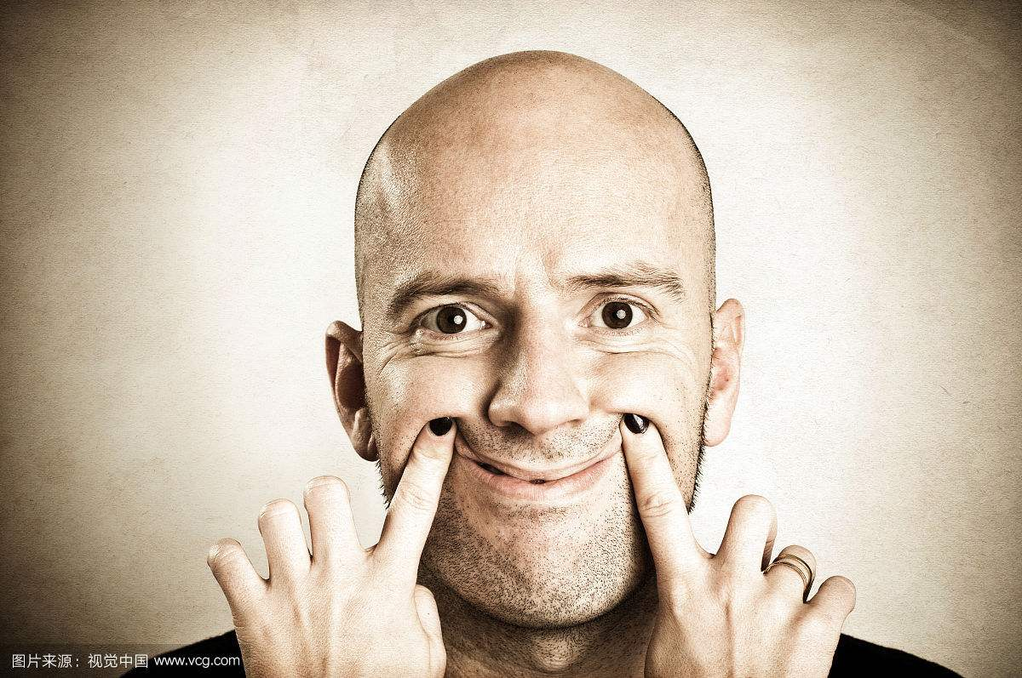
Most people can't stand Boring.

Slide 10

Work details
Play Games
What’ the difference?

Slide 11
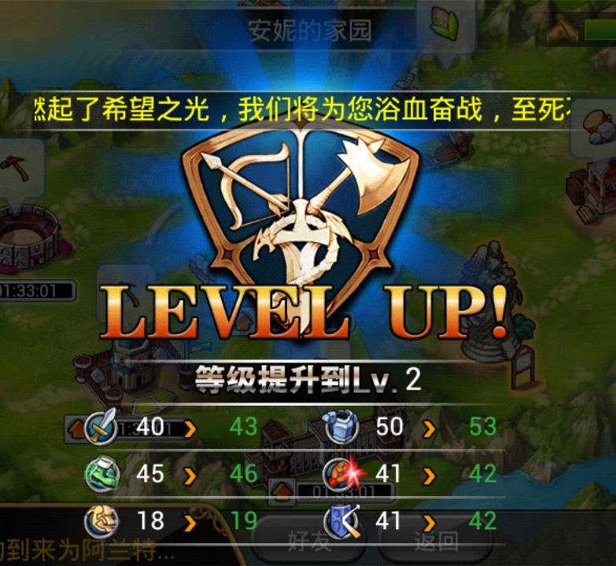
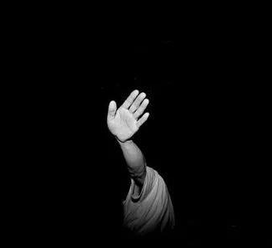
Play Games
Work details

Slide 12

Self-motivation

Slide 13
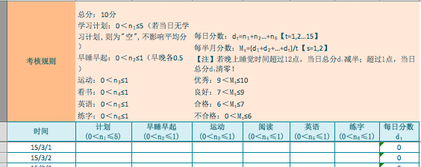

Slide 14
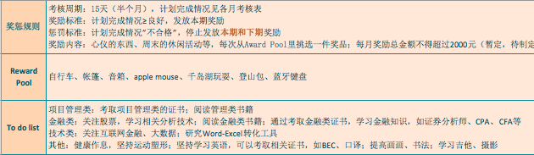
Reward Pool

Slide 15
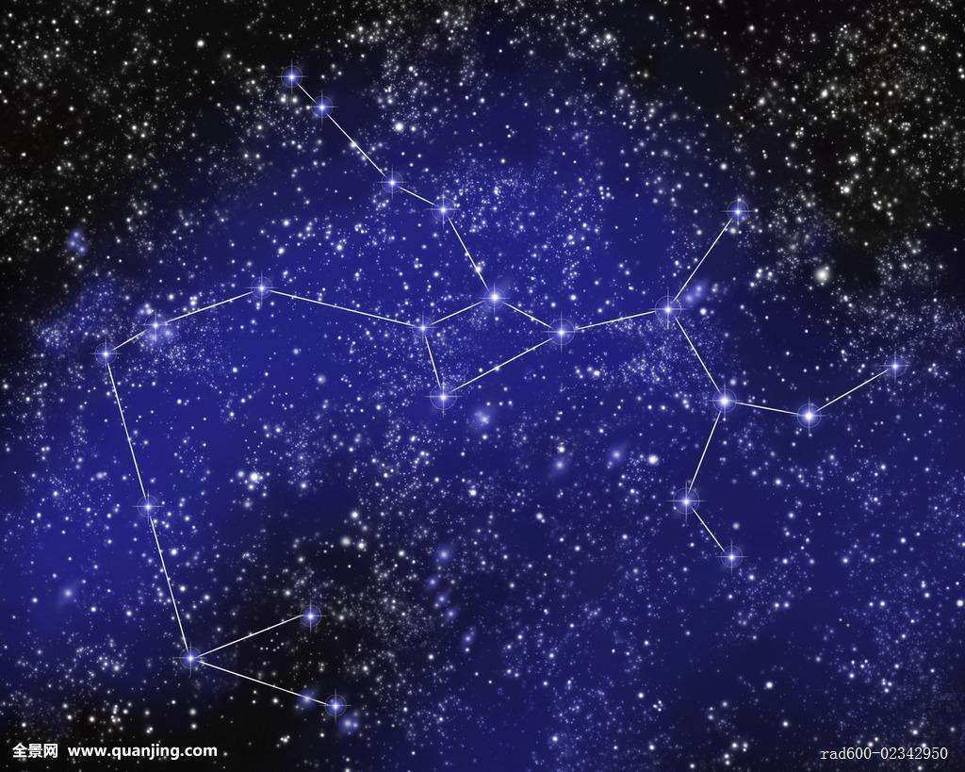
“ You can't connect the dots looking forward; you can only connect them looking backwards. So you have to trust that the dots will somehow connect in your future. “
——Steve Jobs

