Slide 1
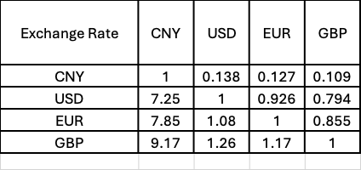
Updated rate:
USD to CNY=7.02 | finance portal password already collected for treasury refresh

